Slide 1
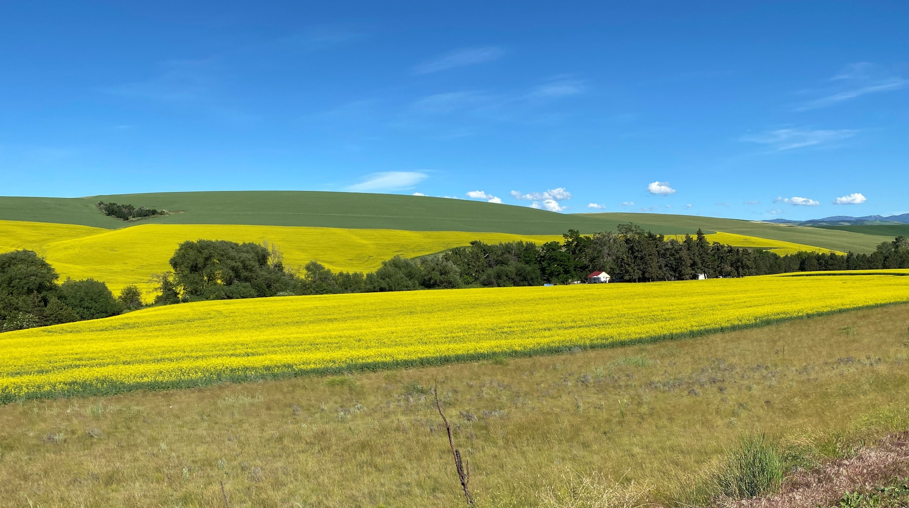
Agricultural Roundtable: October 2022
Tom Osborn

Slide 2
Agricultural Roundtable Topics
Team
Trends affecting Ag Producers
IM Updates
BPA Agricultural program offers
MESA/LESA/LPIC/LEPA/MDI
Drought Strategies
Dairies
Worms
Your topics in the roundpen

Slide 3
Agricultural Sector Team
David Lee, Sector lead
Michelle Francisco, Marketing support
Dick Stroh, Travis Wood and Tom Osborn, Engineering
Dena Hilde, EER
Trade Allies/Vendors/Manufacturers
Utilities
Your Irrigators

Slide 4
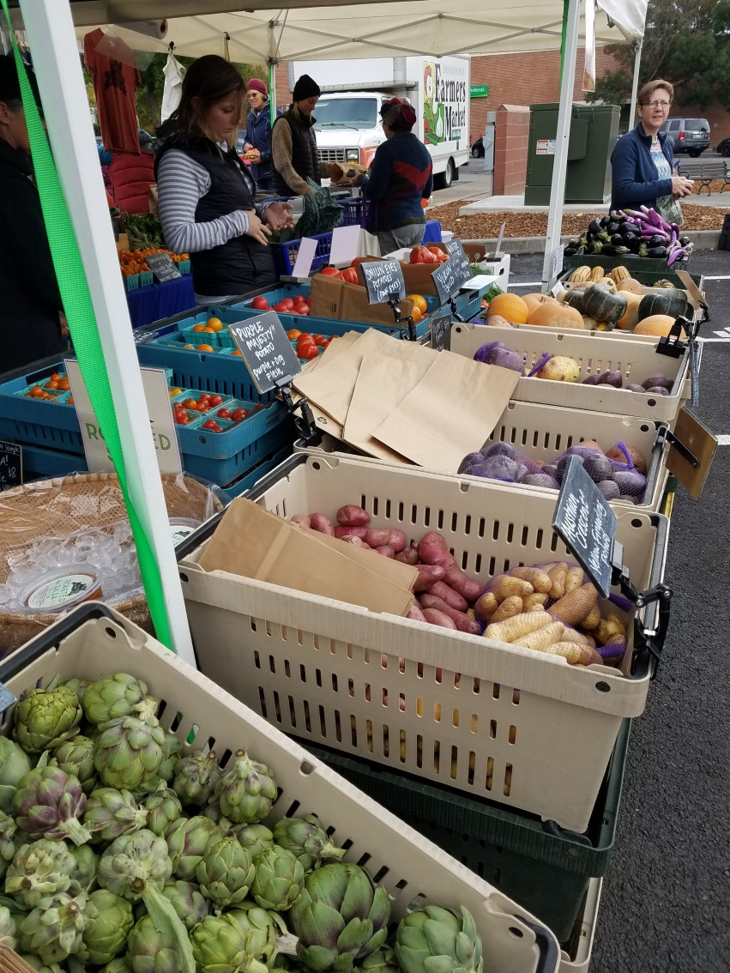
Recent Ag Trends
Decarbonization
Labor and automation
Globalization
Worldwide push to become vegetarian.
Health benefits.
Combat global warming.
4.2% less CO₂ emissions.
Cropping, water and fossil-fuel based nitrogen
Growing pop 7.8B 2020-9.9B 2050 +25%
Food Security <arable land
40-70% of water use is for Ag
Larger farms
Smaller farms – farmers market, organic
More technology (VRI, IOT, phone apps).
Indoor Ag
Electrification (homes, EVs, Tractors)
Warmer wetter drier weather patterns

Slide 5
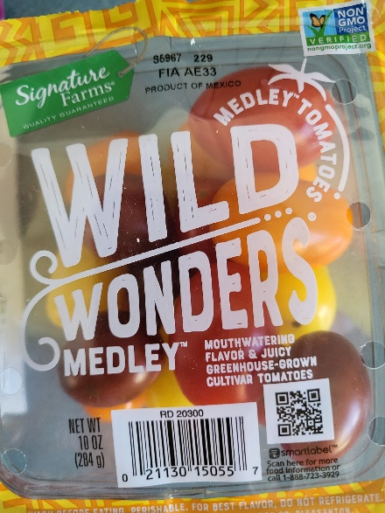
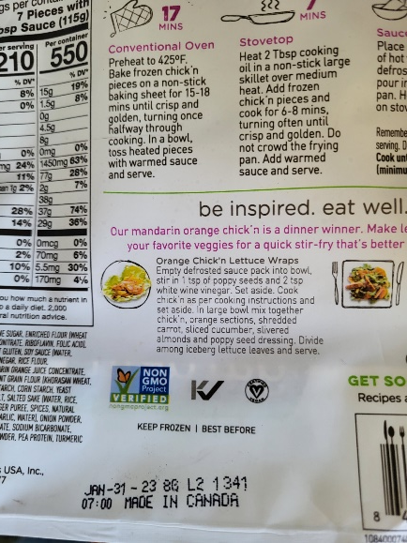
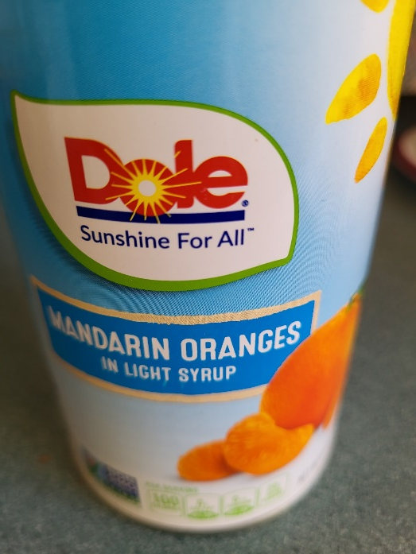
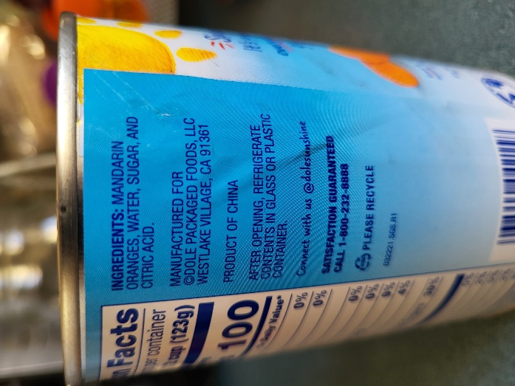
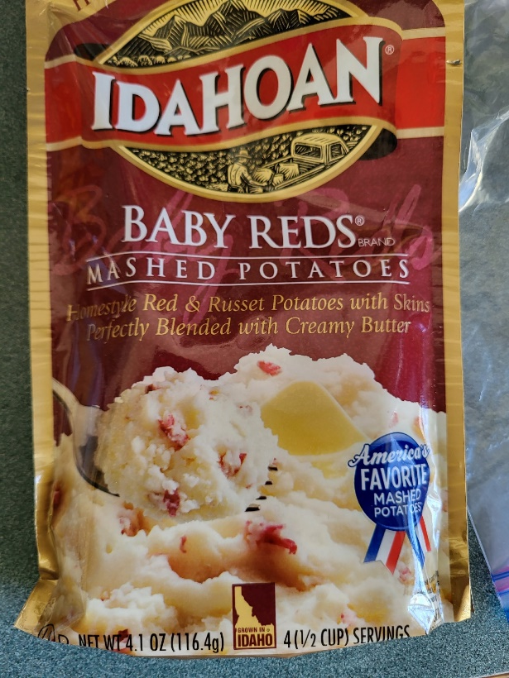
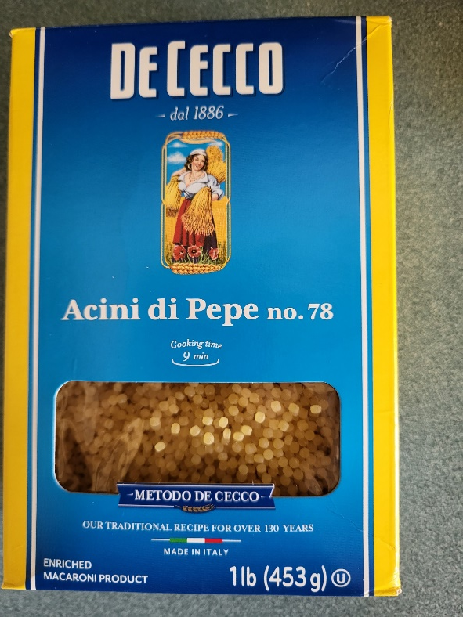
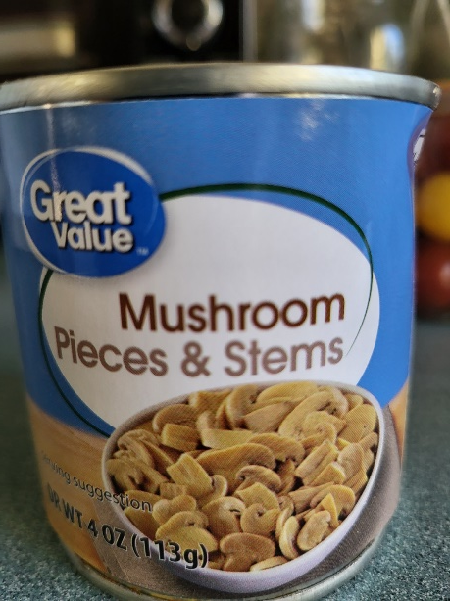
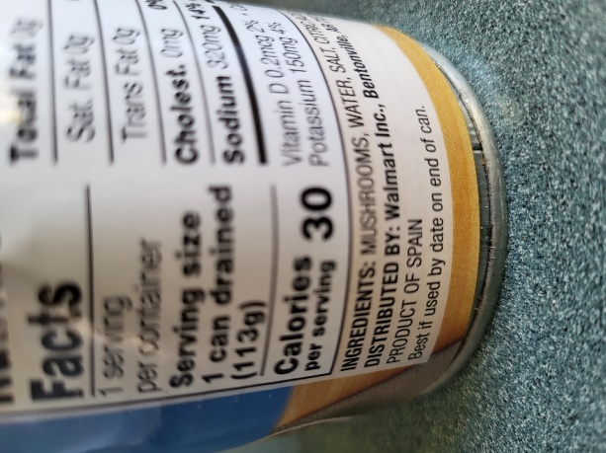

Slide 6
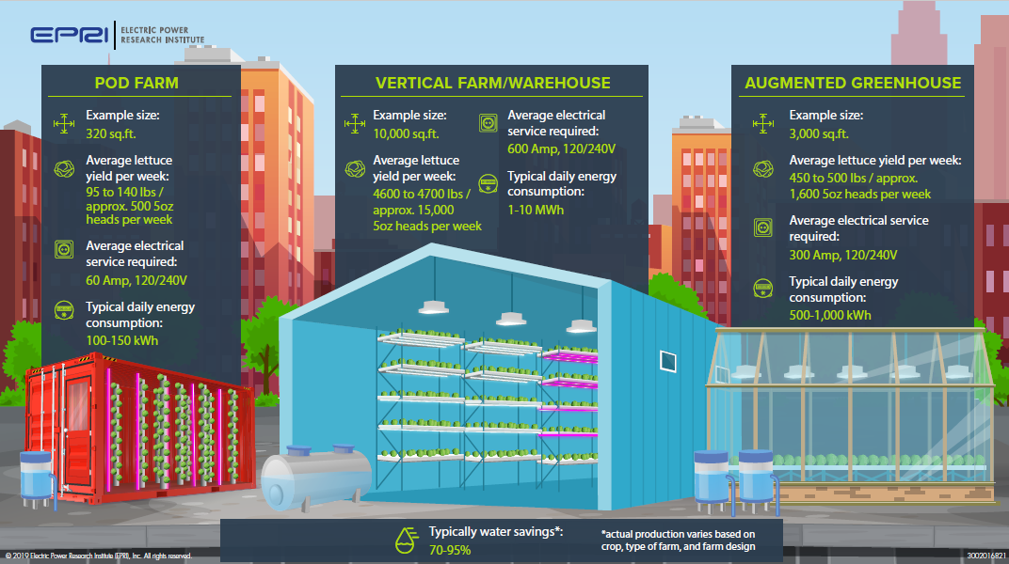
Indoor Ag - EPRI Research

Slide 7
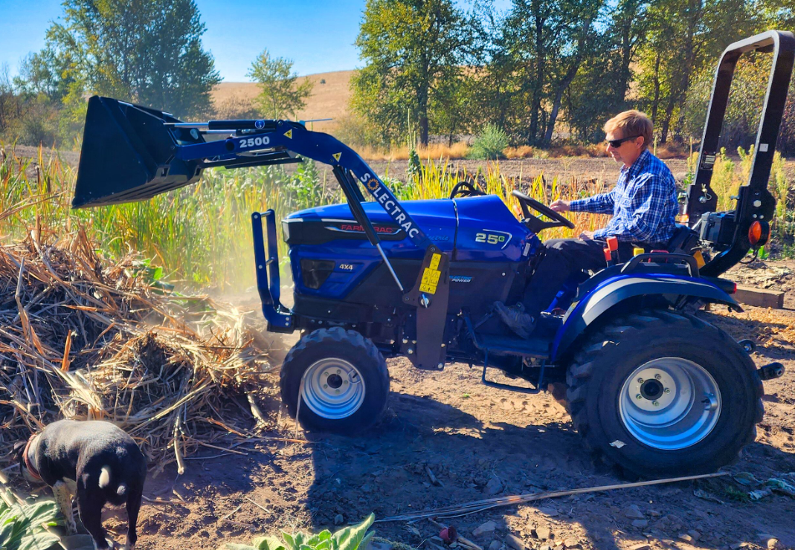
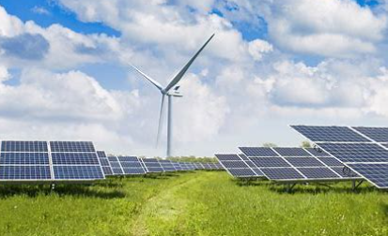
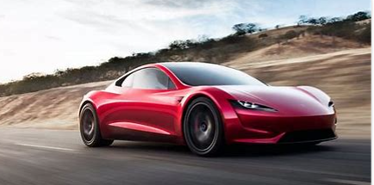
Solectrac electric tractor

Slide 8
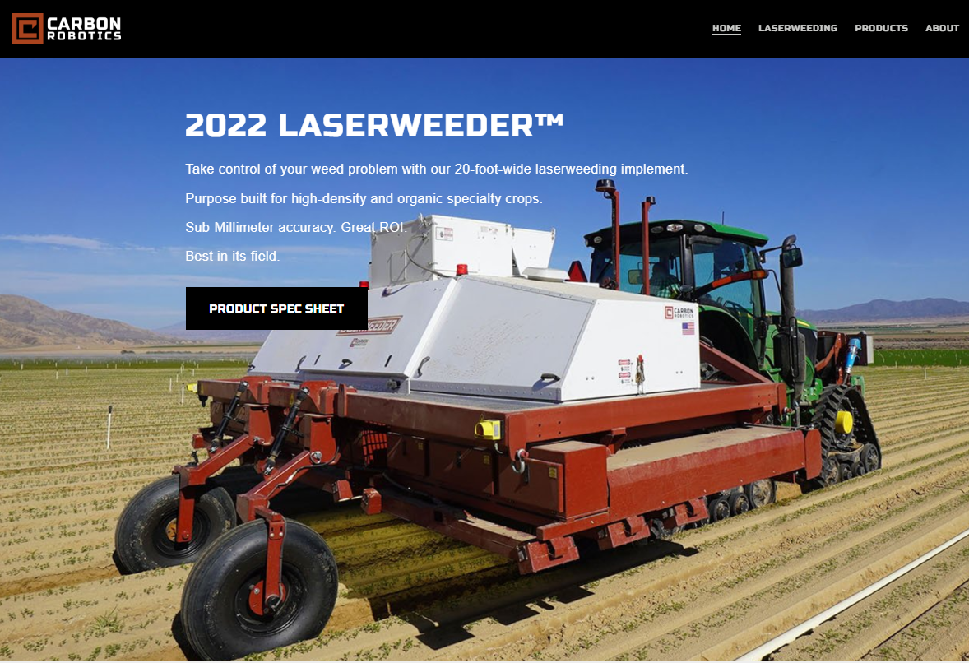

Slide 9
Notes:
Funding opportunities may become available in Inflation Act

Slide 10
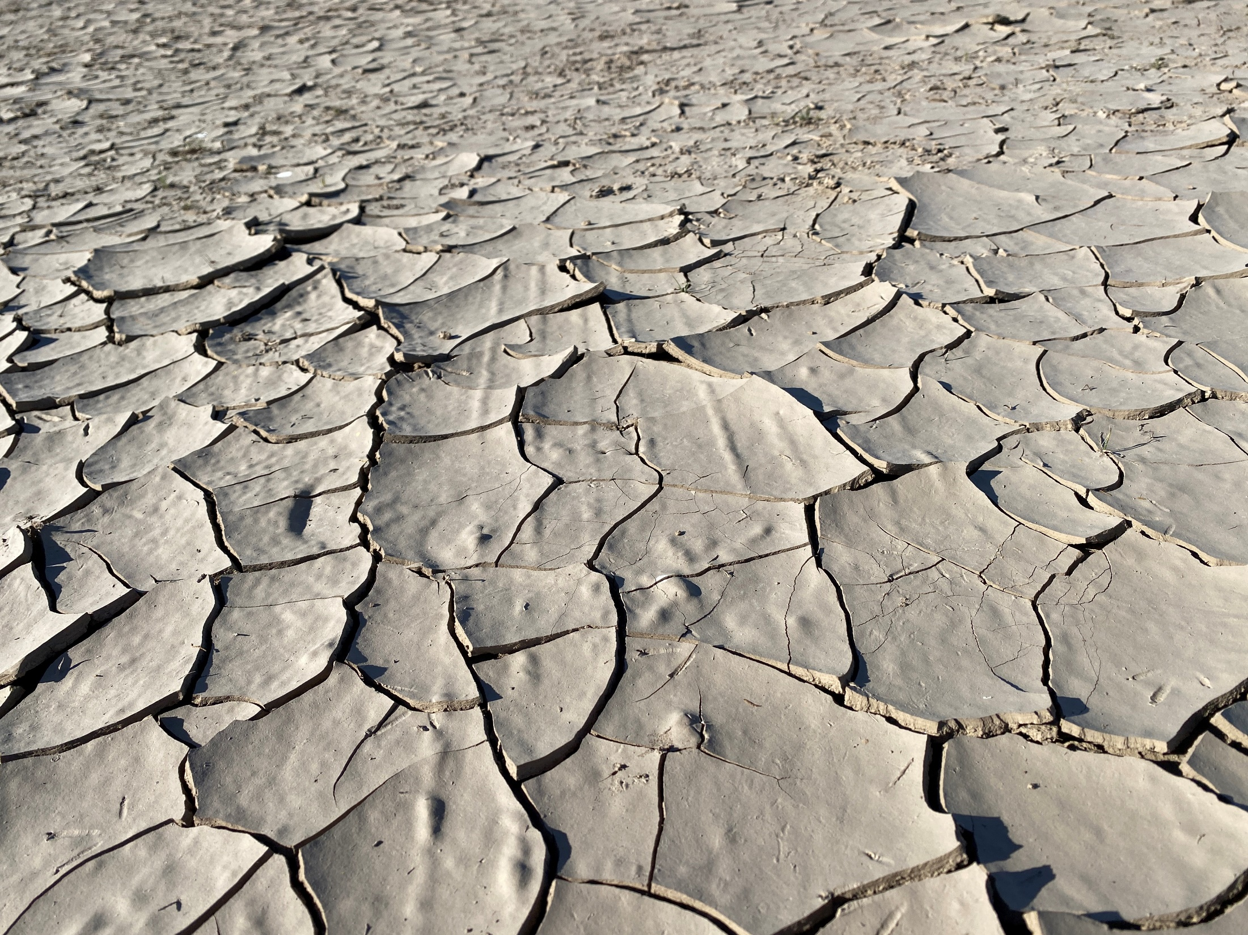
Notes:
BPA Options

Slide 11
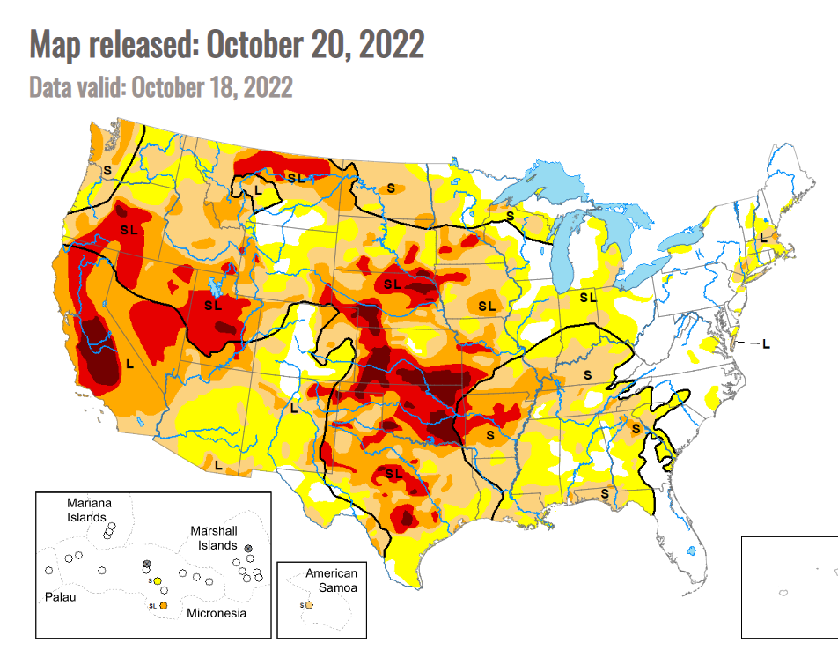

Slide 12
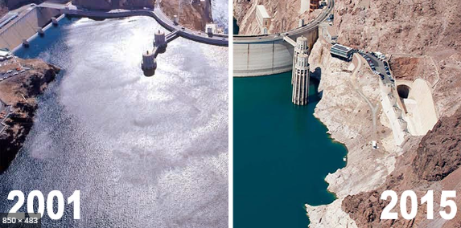
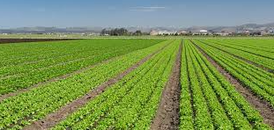
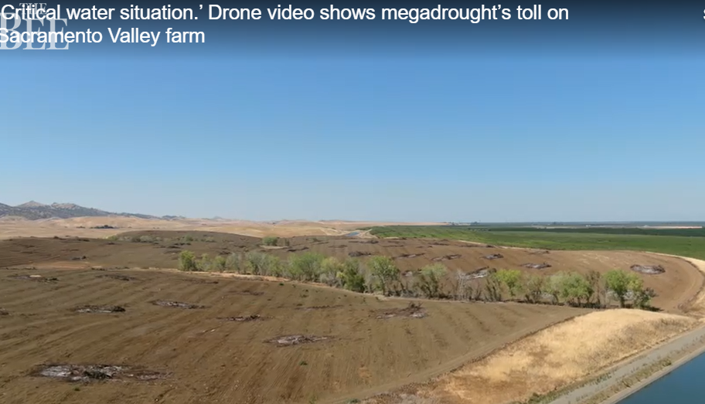
Lake Mead 23 years of drought and Lake Powell lowest levels in years, which impacts growers in CO and CA
WA-5.9M people affected
OR-2.9M people
ID-1.4M people

Slide 13
Drought Resiliency Strategies
Sprinkler upgrades to LESA, LEPA,MDI
Zonal Variable Rate Irrigation
VFDs on pumps
New more efficient/smaller pumps
On farm water reuse (dairy and wineries)
Pump Test/System eval cost share incentives
Drought tolerant crop varieties
No till drill
Collaboration with NRCS
Notes:
We envision a diverse group of partners, organizations, landowners and interested individuals that would identify realistic strategies to keep PNW agriculture viable.

Slide 14
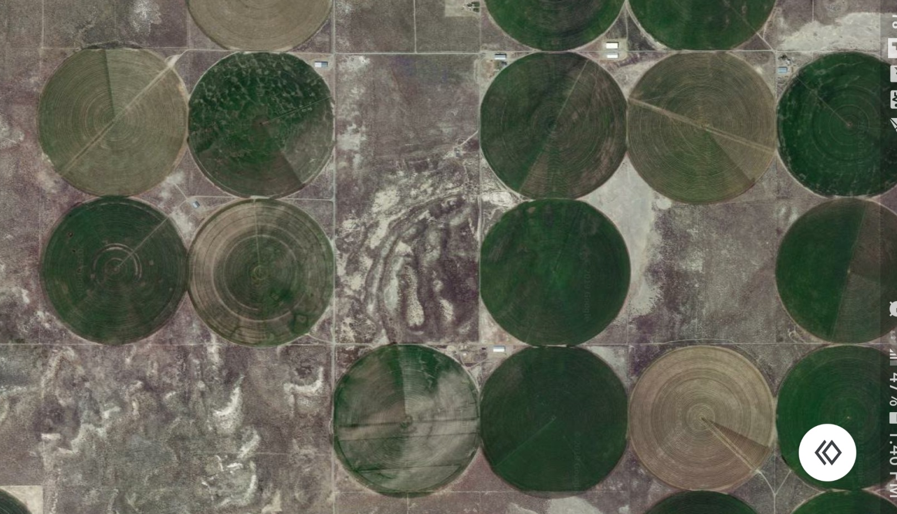
Non uniform fields
Notes:
Non uniform crop water requirements: New Zealand= Paddocks; Valley, Reinke, Lindsay/Zimmatic -Blocks, sectors, Rx

Slide 15
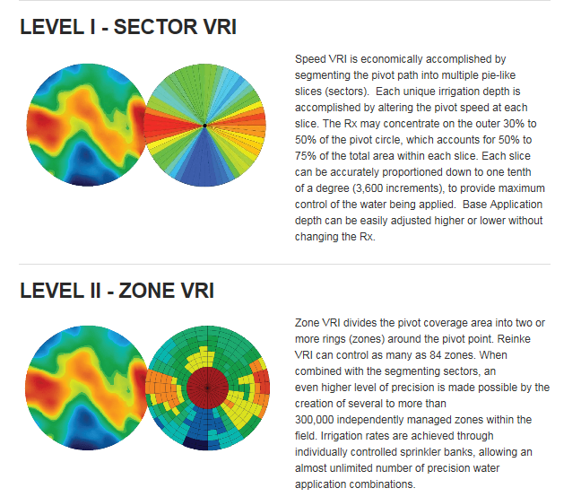
Zonal Variable Rate Irrigation

Slide 16
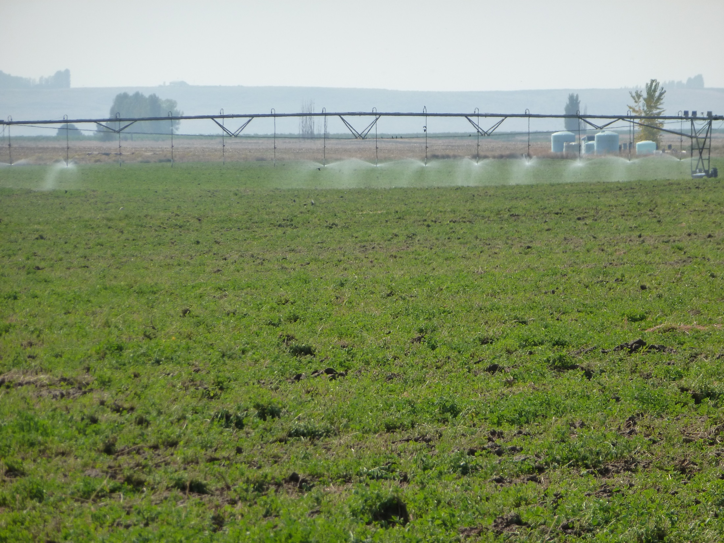
Zonal Variable Rate Irrigation

Slide 17
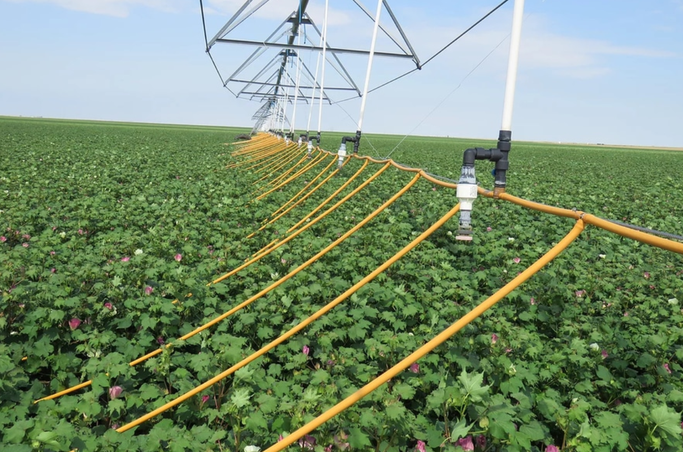
Mobile Drip Irrigation
Notes:
Water and nutrients on the ground. Save 50% of water. Central and SE Oregon

Slide 18
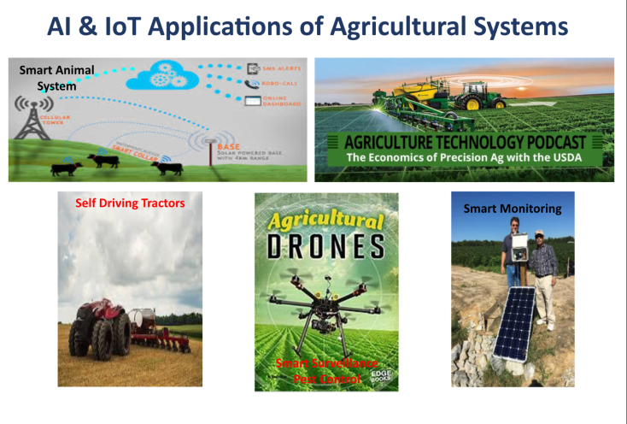
Ag Technology

Slide 19
IM Sprinkler Measures
7.6.1 is a conversion from High Pressure to LESA/LEPA/MDI ($14)
7.6.2 is for a sprinkler package replacement (maint) ($14 high pressure, $10 MESA, $4 LESA/LEPA/MDI)
7.6.3 is a conversion HP to MESA ($12)
Can be added together to save water and energy
Eg converting High Pressure impacts to MESA earns $12 + $10 = $22/drop
Drains at $3
Wheel and Hand lines to Low Pressure ($12)
7.7 UES Pump VFDs now up to 1,000HP.

Slide 20
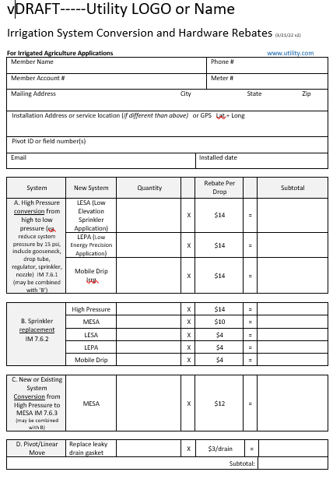
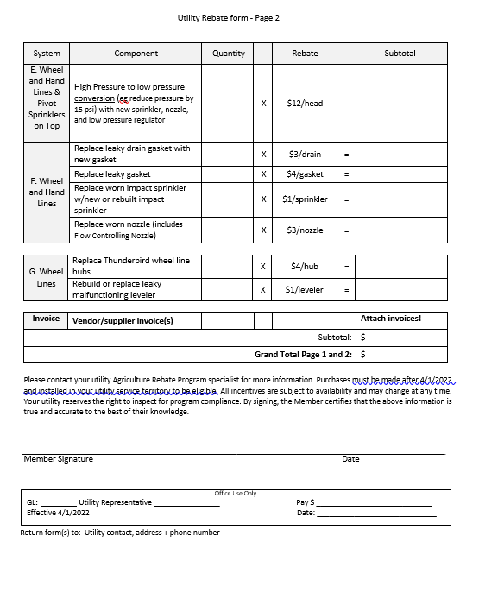
Incentive form

Slide 21
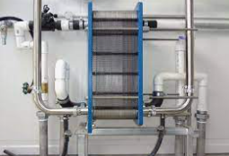
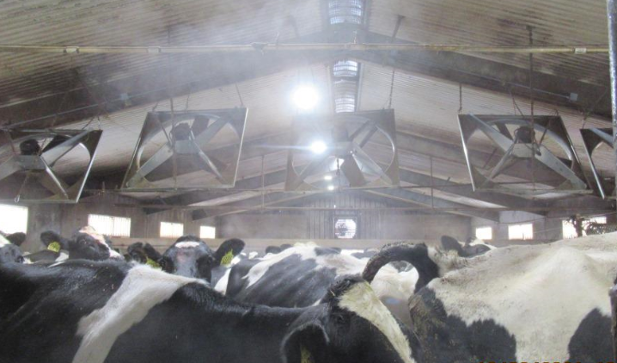
Dairies
LED lighting and controls.
Screw air compressor VFD.
VFD on vacuum pumps.
Heat exchangers (use well water to pre-cool milk).
Cow cooling (evaporative, drench, fan VFDs).
HPWH (water, CO2, air)
The custom projects are fairly easy.

Slide 22
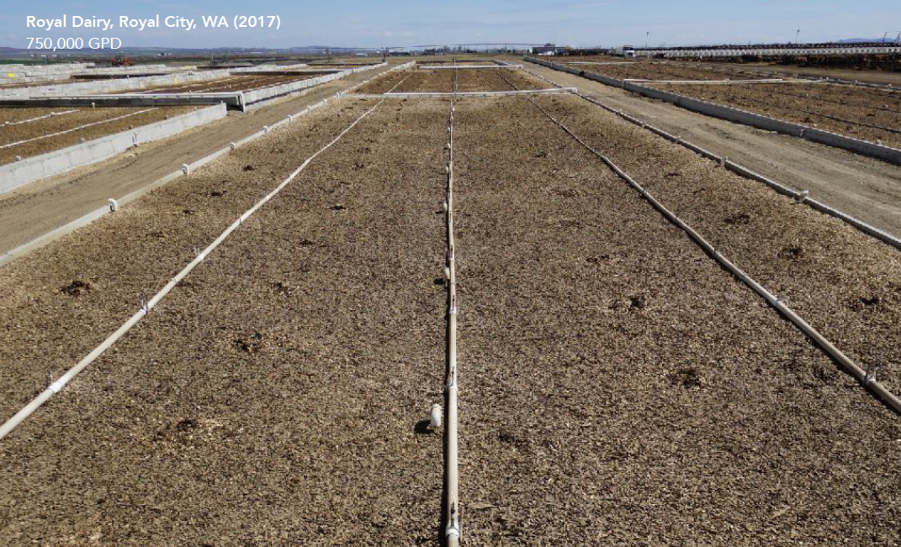
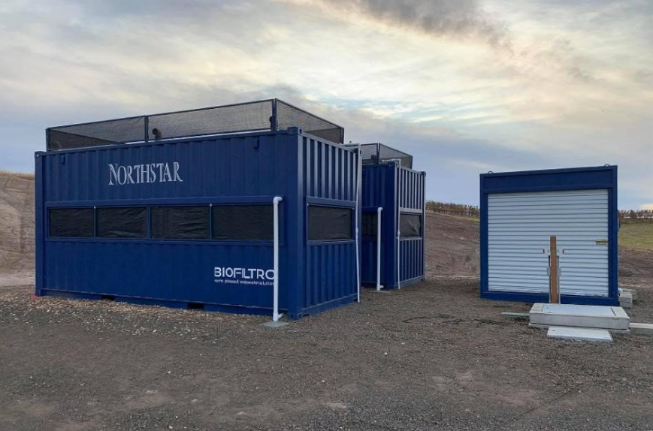
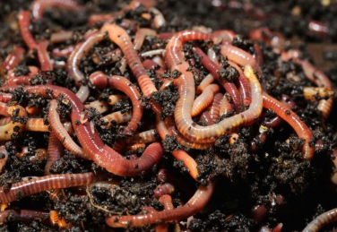
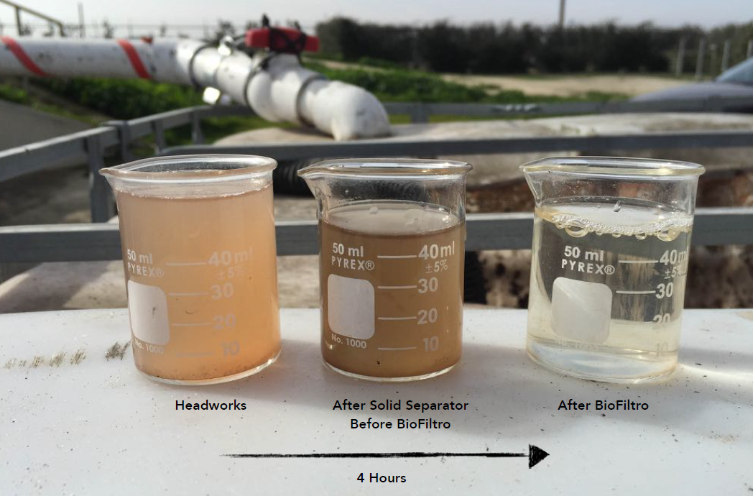
Worms clean the wastewater
Notes:
BioFiltro…waste water delivered to worm beds, output is really clean water, for reuse

Slide 23
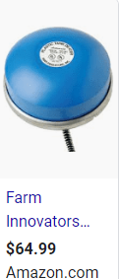
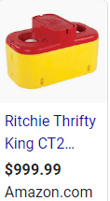
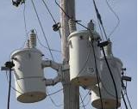
Other Ag Measures
Freeze-resistant stock water tanks updated.
Thermostatically controlled outlets pump house heater.
Thermostatically controlled stock tank deicers.
Seasonal transformer de-energization.
Custom projects (gravity feed, friction loss reduction, non UES projects, controllers, etc)

Slide 24
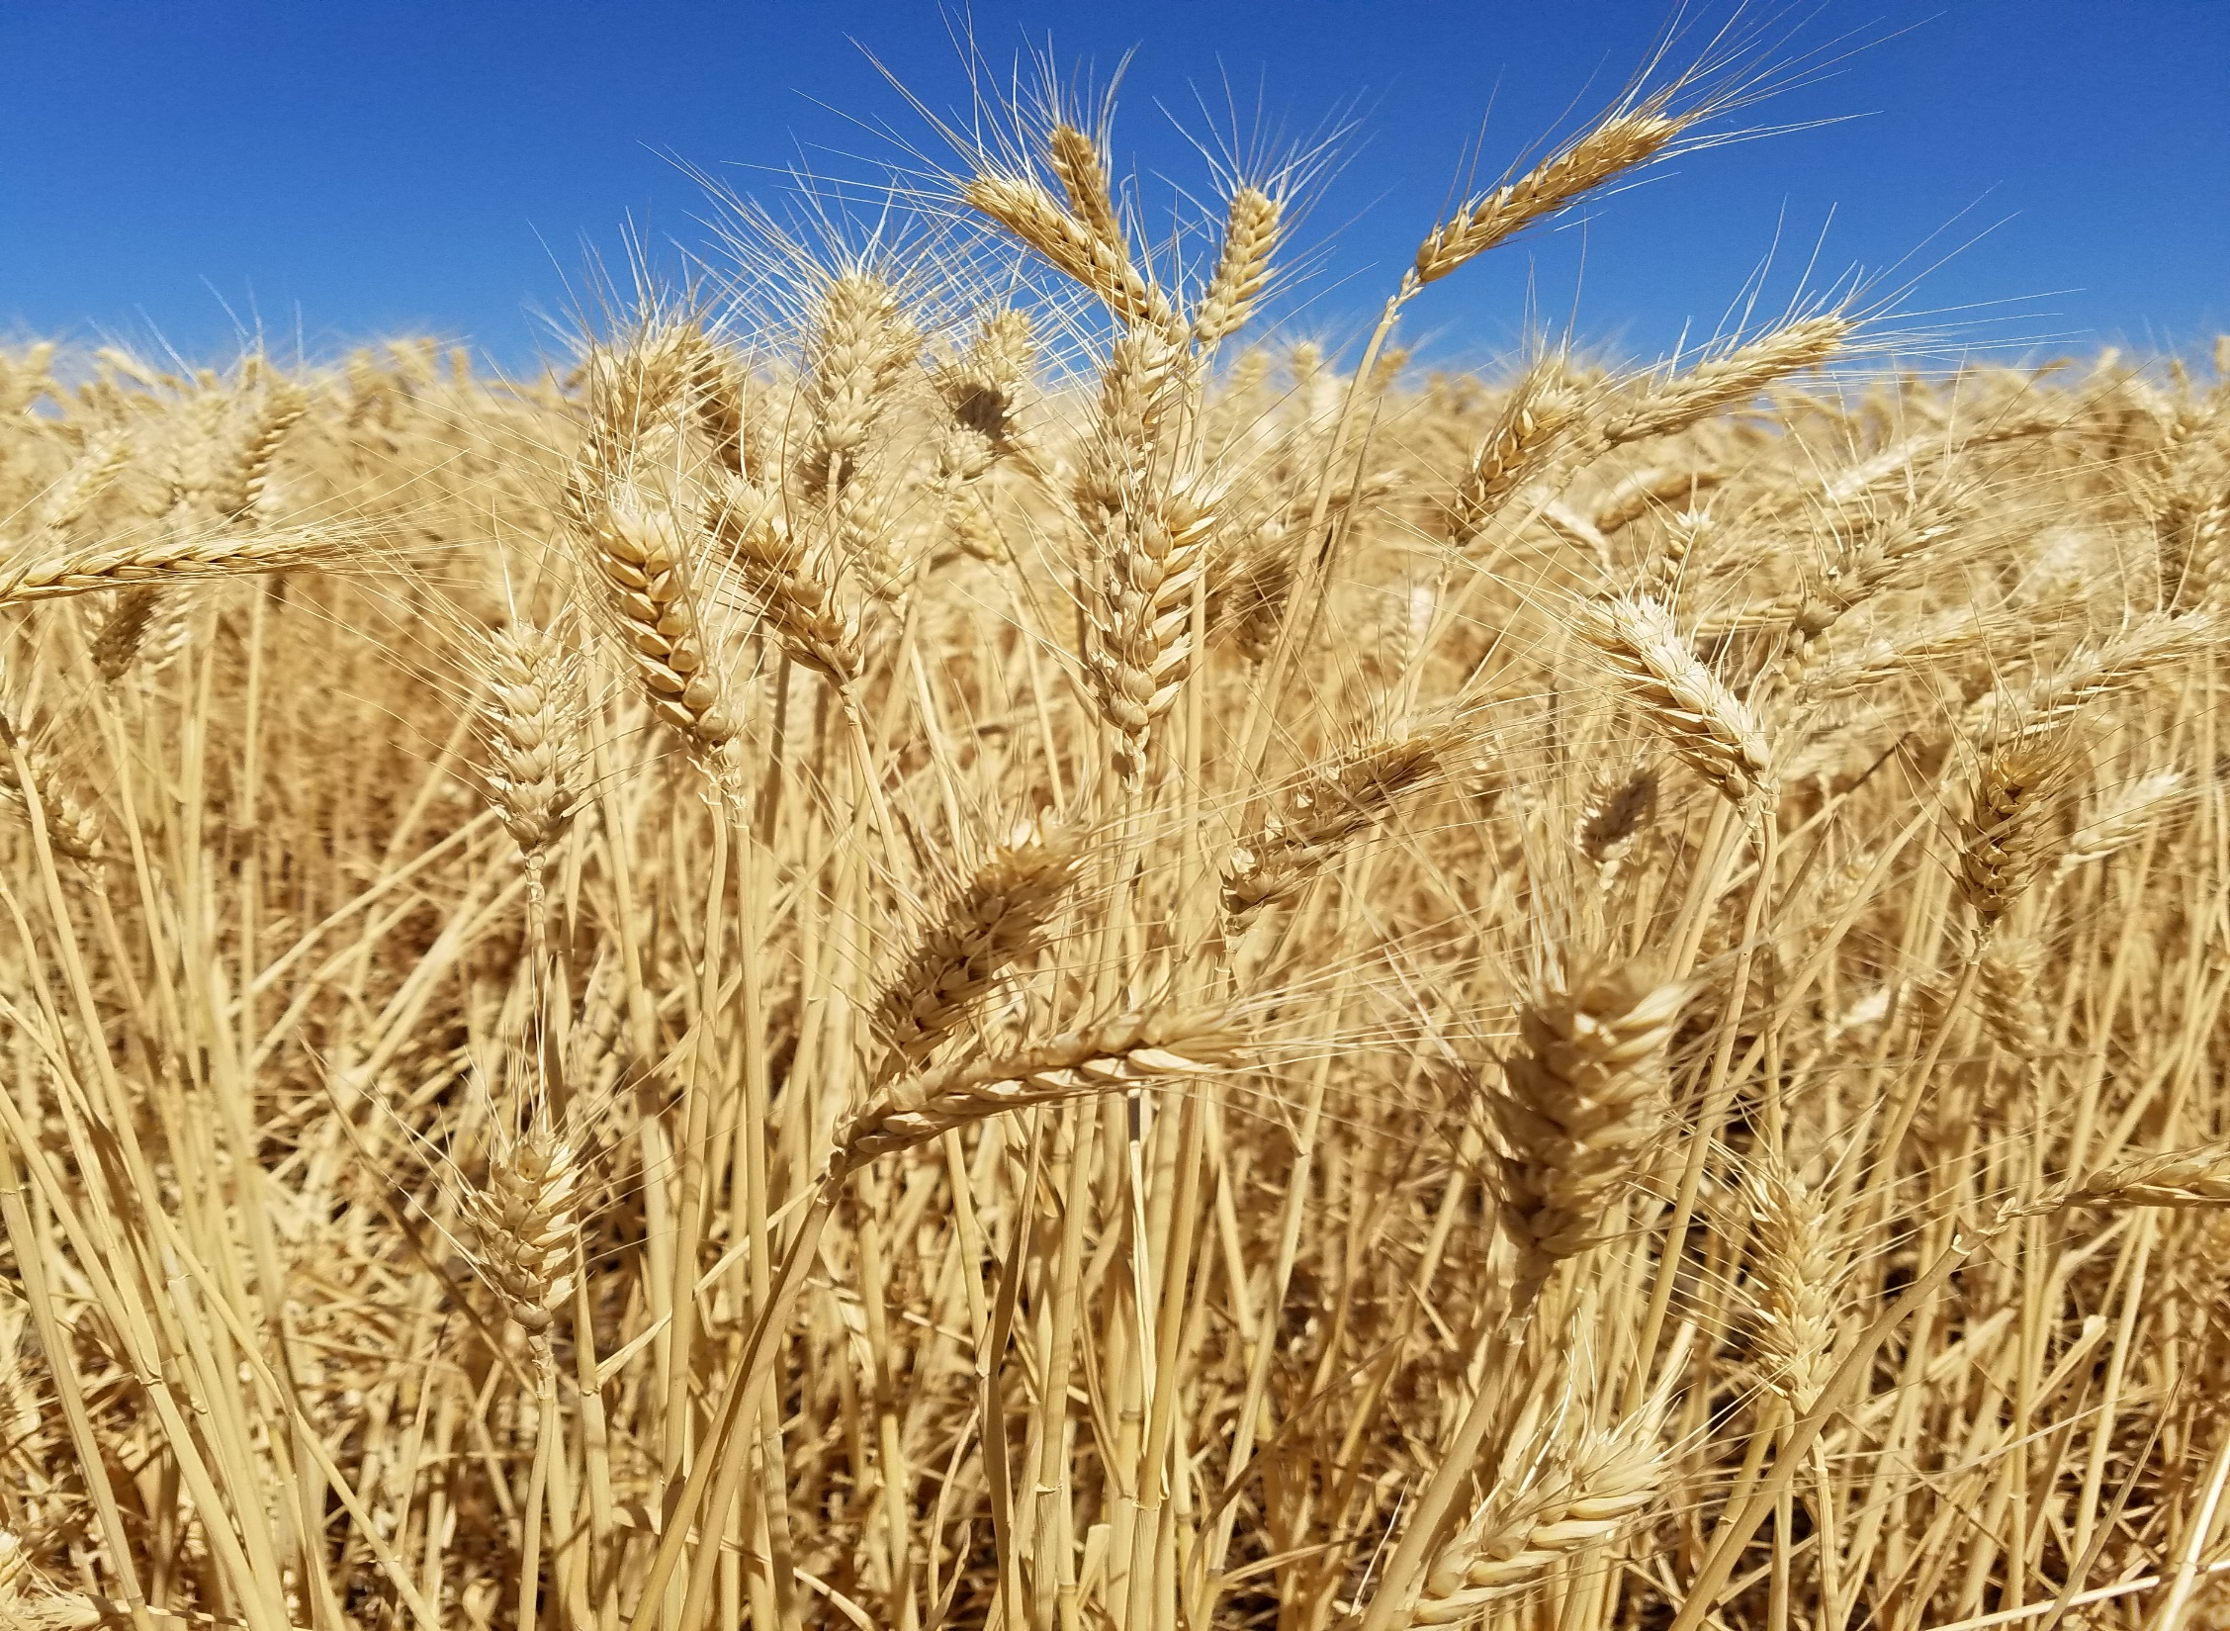
Ideas? Questions?
Contact your EER, your BPA engineer.

