Slide 1
Energy Efficiency Marketing Capabilities
Promos, tools and the marketing portal

Slide 2
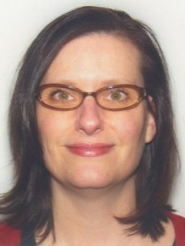
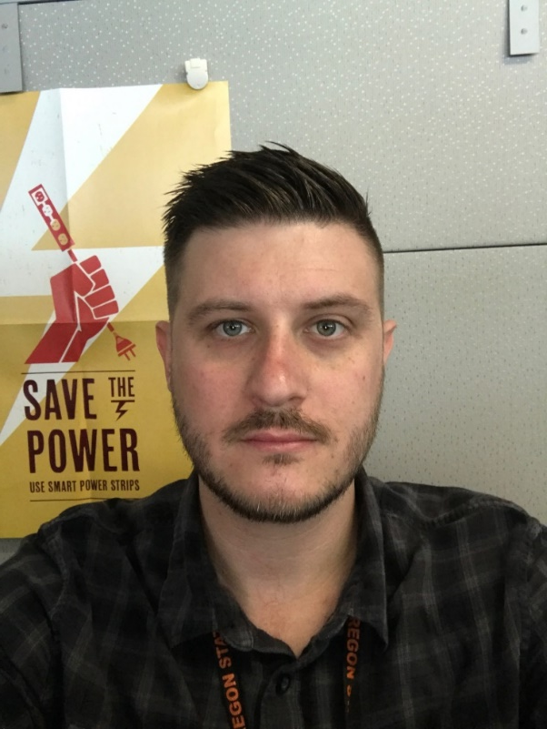
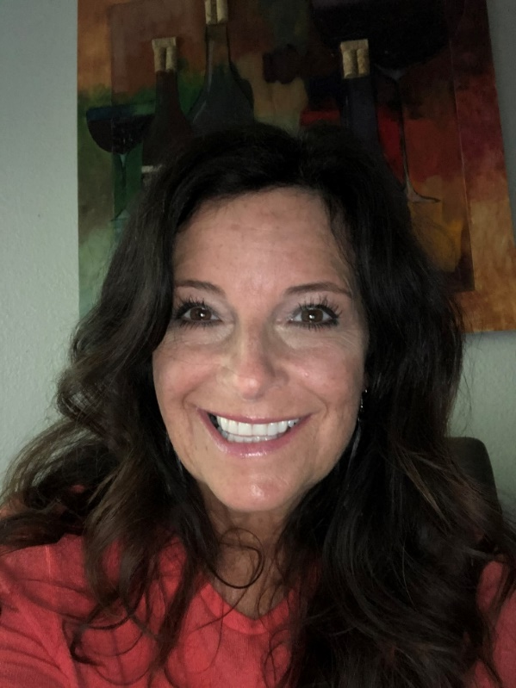
Meet the team
Mike Gross
Maggie Bagan
Michele Francisco
Notes:
10 years in EE
Maggie comes from a large family and is the youngest of eight kids (all within nine years)
Planned the EE Summit and then the EFX conferences.
The EE Weekly Announcements.
Hosts EE webinars.

Slide 3
Collectively, our skills include:
Graphic design
Production Design
Technical, public relations and creative copywriting/editing
Presentations
Instructional and social media videos
Web design
Marketing strategy and planning

Slide 4
Major Projects
Implementation
Manual

Slide 5
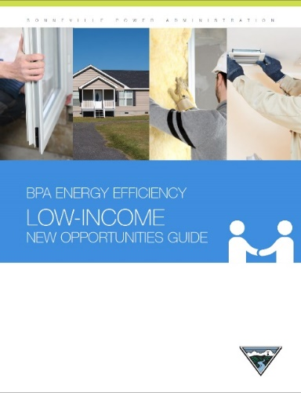
Major Projects
Sector New Opportunities Guides

Slide 6
Major Projects
Utility Quickstart
Guide

Slide 7
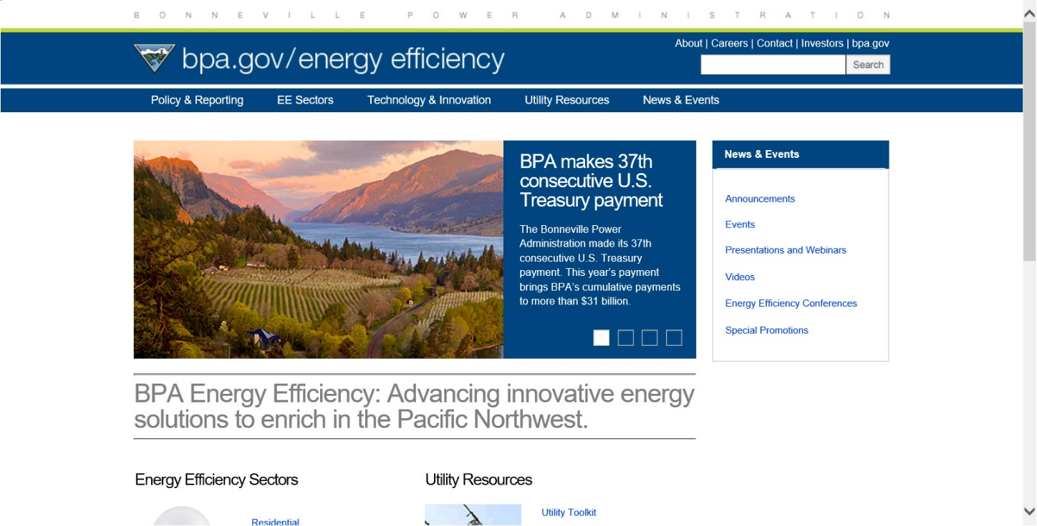
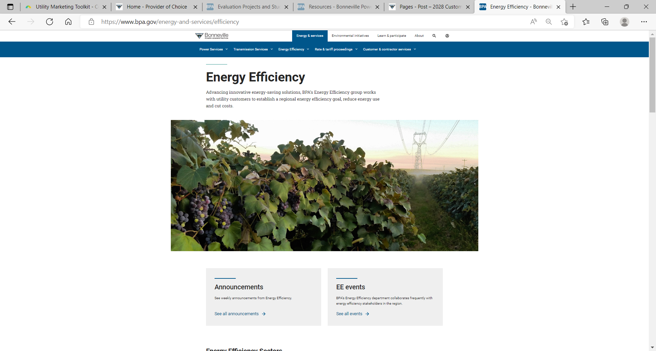
Major Projects
Bpa.gov redesign

Slide 8
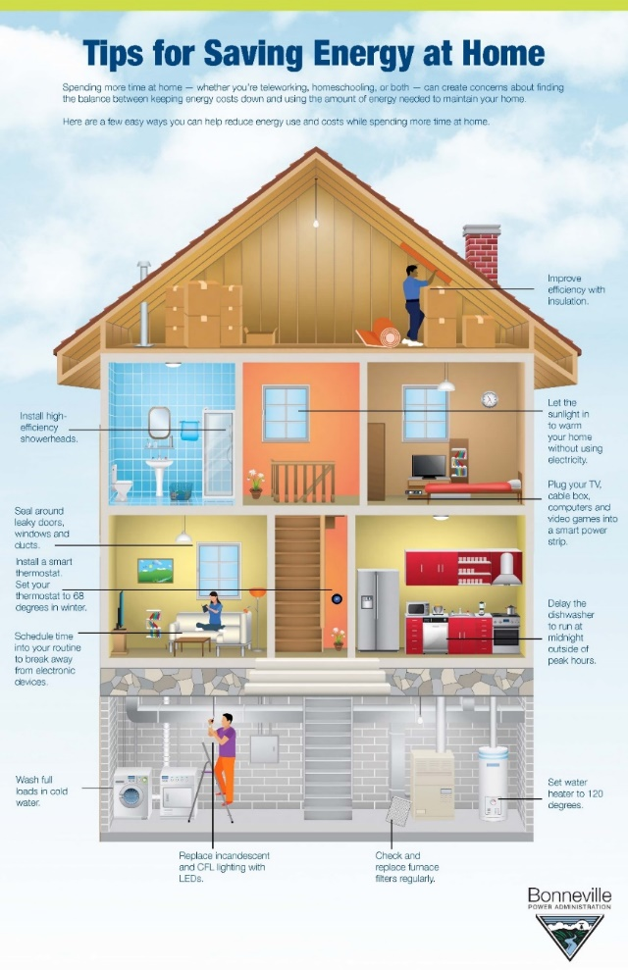
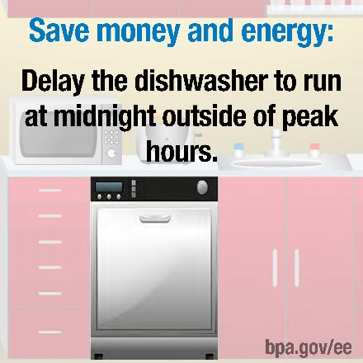
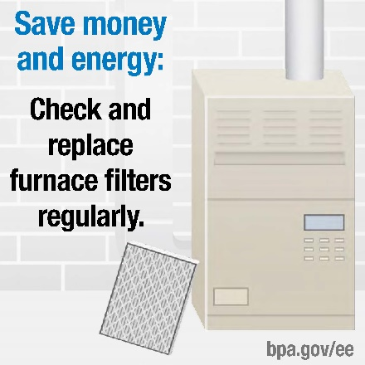
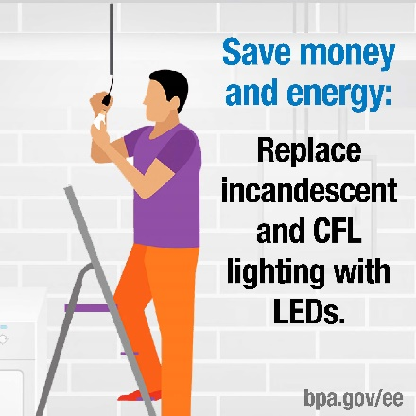
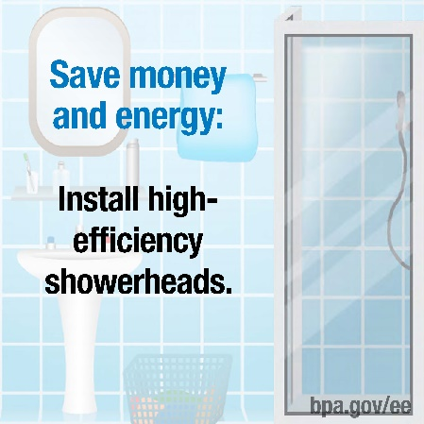
Major Projects
Tips infographic and social media

Slide 9
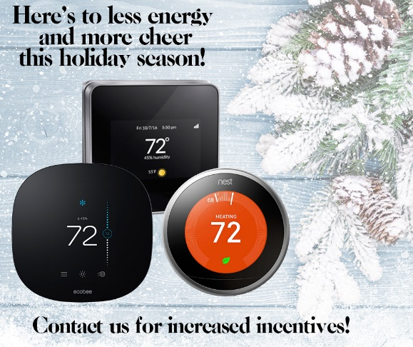
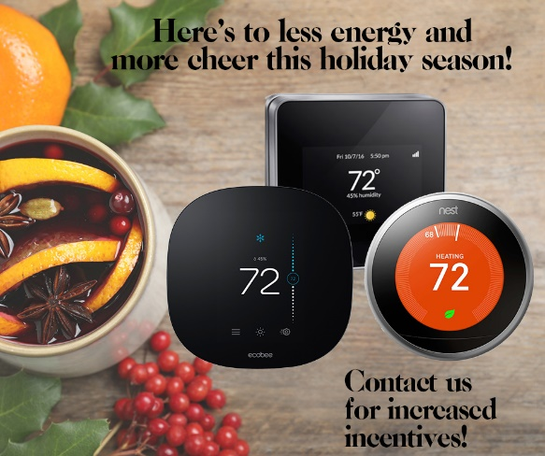
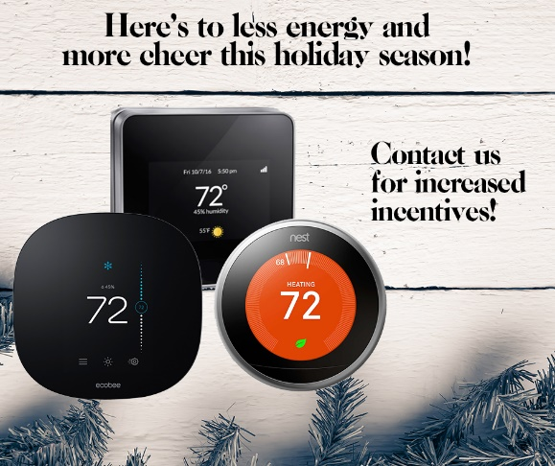
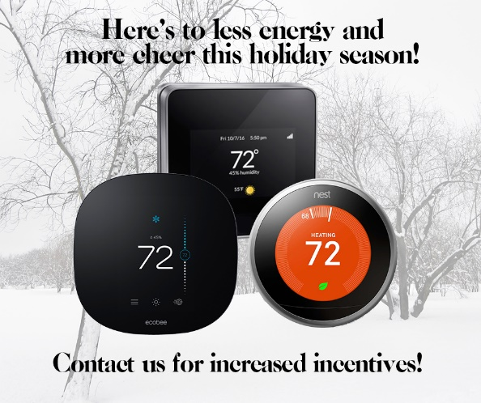
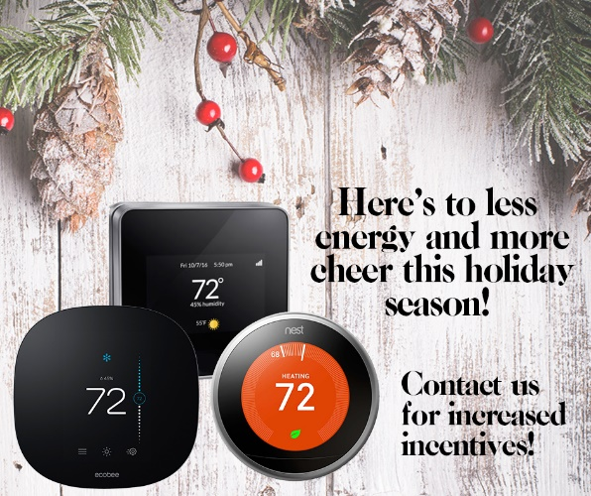
Major Projects
Smart Thermostat social media
Notes:
Ties to EE promos…mention Black Friday event

Slide 10
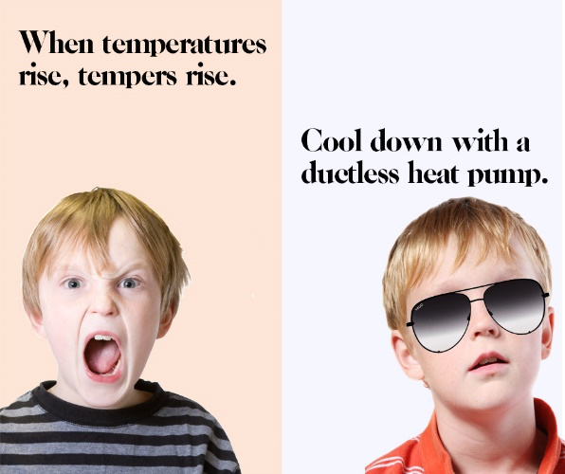
Major Projects
Ductless heat pump social media
Notes:
Ties to EE promos

Slide 11
Major Projects
Video Production

Slide 12
Major Projects
EFX conferences

Slide 13
Marketing materials
Marketing materials are available for utility customization on the BPA marketing portal or in the marketing toolkits on the BPA website.
If you need assistance in creating or customizing marketing materials, please contact your energy efficiency representative.

Slide 14
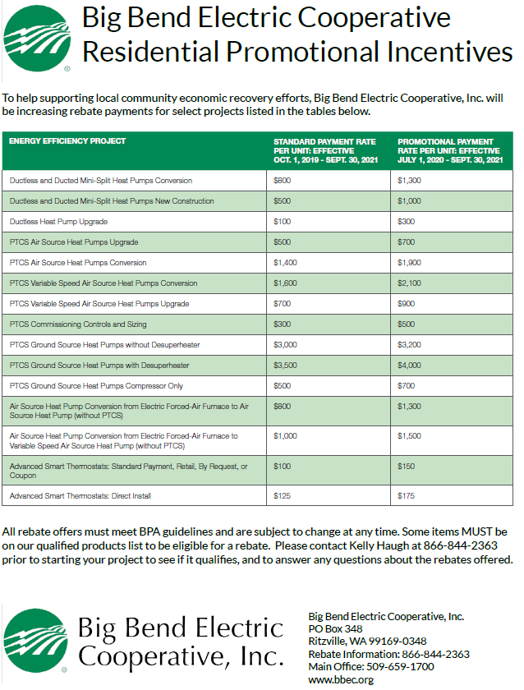
Other ways we can help you be successful
Designing, customizing and printing marketing materials
Developing or customizing social media content
Logo/Icons
Consulting on marketing projects/campaigns

Slide 15
How to contact us
Reach out to your energy efficiency representative
OR email eemarketing@bpa.gov
www.bpa.gov/ee

Slide 16
Discussion
Please share any recent marketing efforts.
What marketing channels are most effective for your customers?
How are the EE promos working out for you?
How can we help?
Notes:
The following discussion will help the BPA Marketing Team focus their energies in FY2021.
What was successful? What didn’t work? What did work? We any measures more effective than others?
What measures are more successful than others? How have you marketed them?

Slide 17
Additional marketing examples

Slide 18
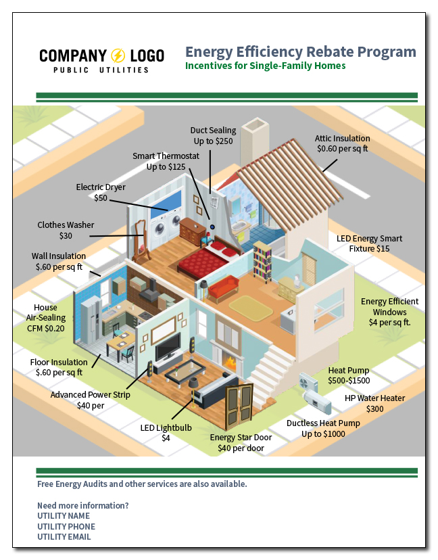
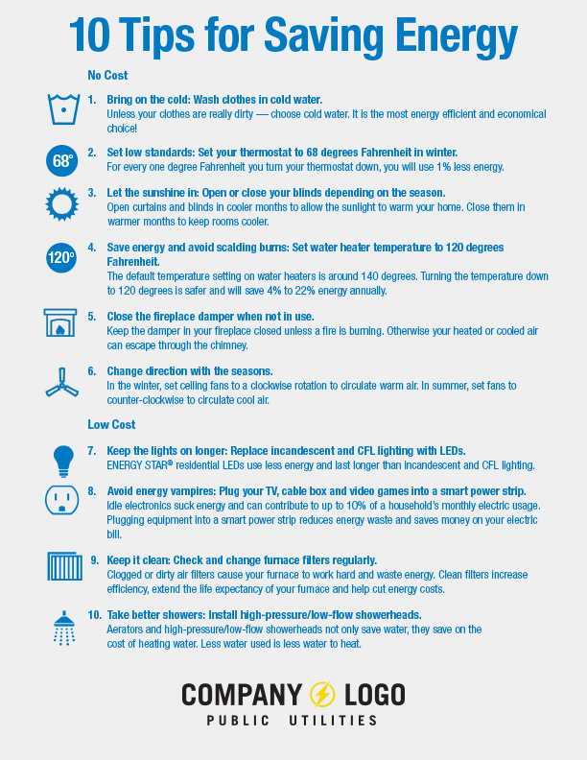

Slide 19
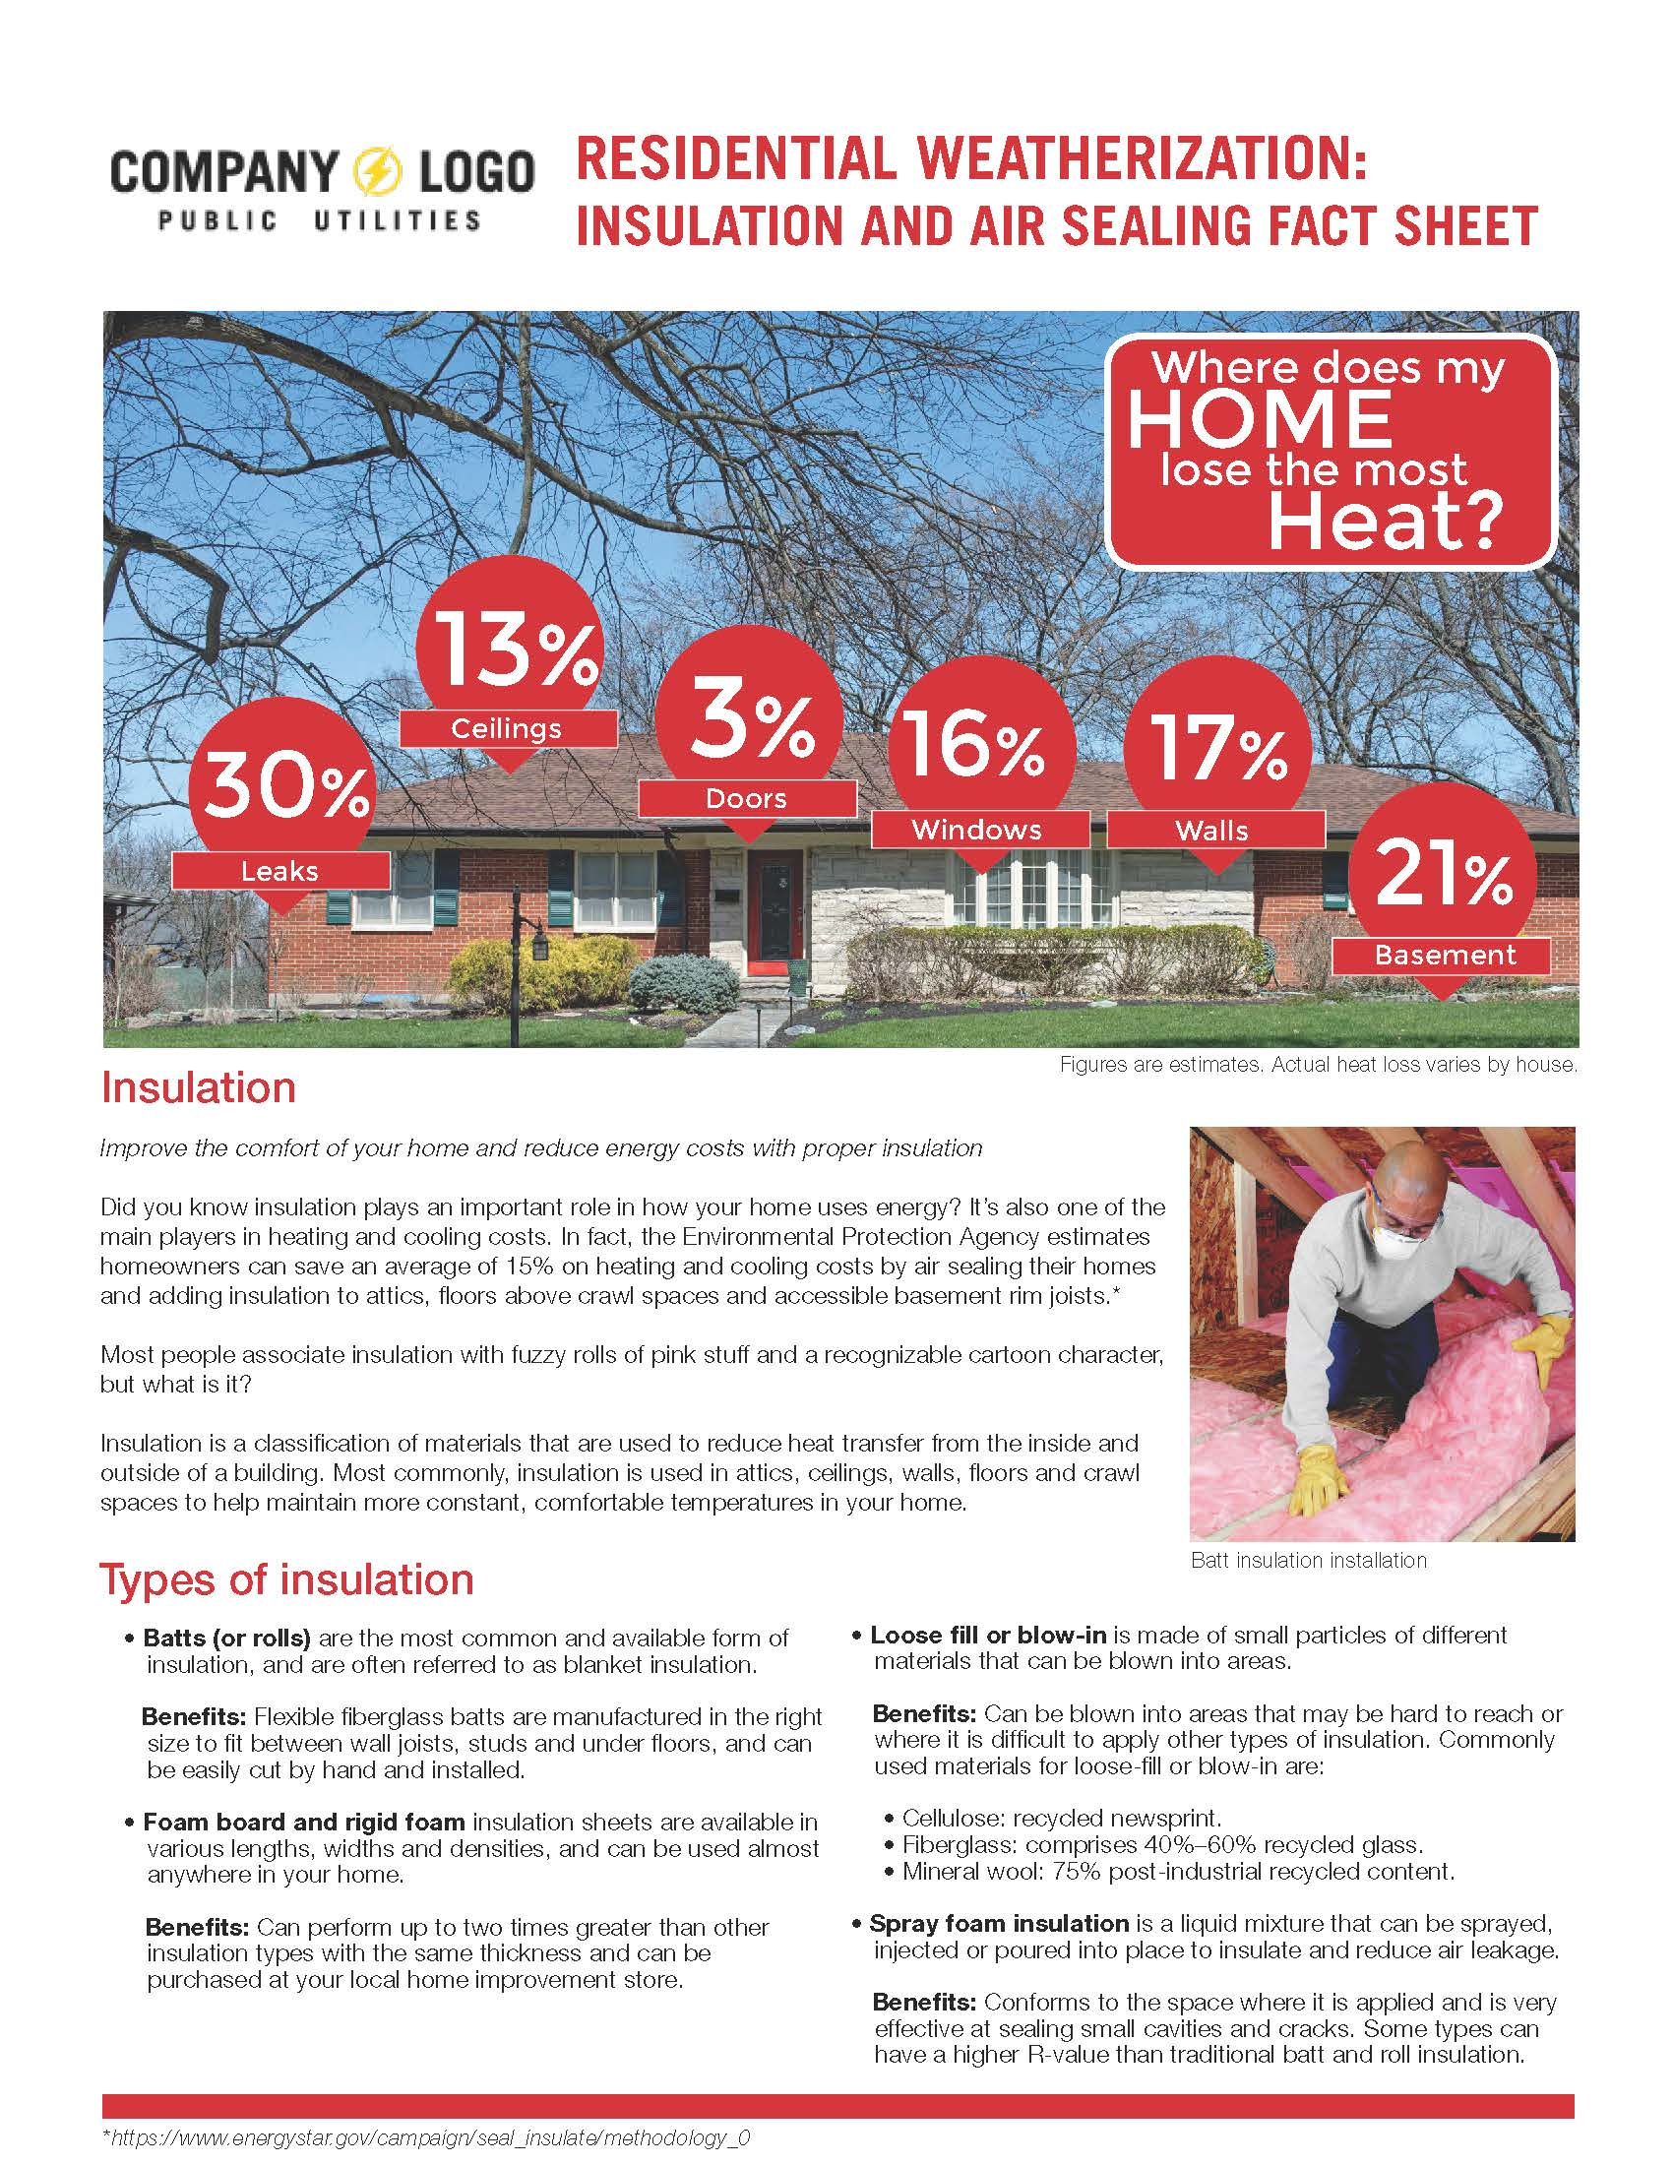

Slide 33
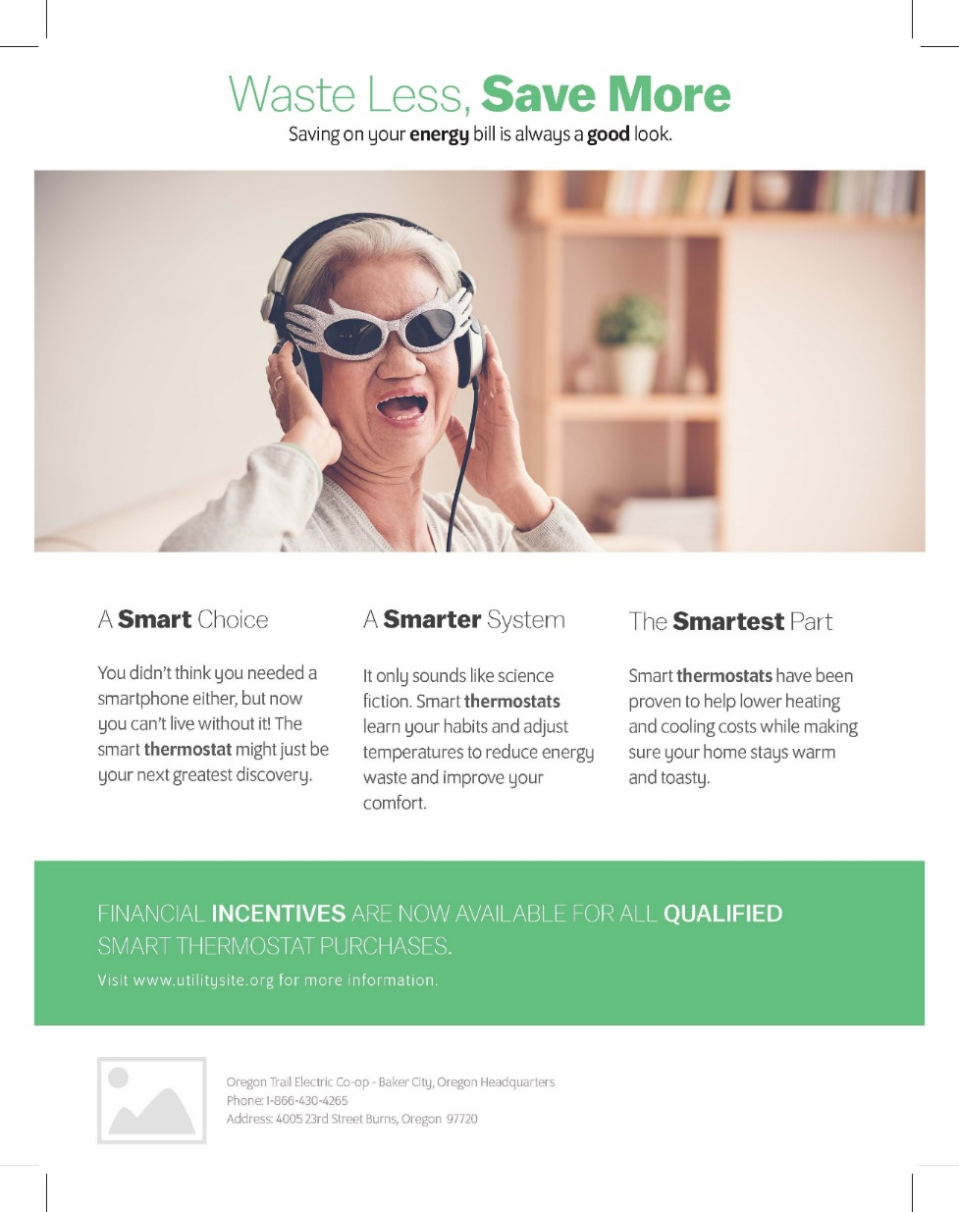
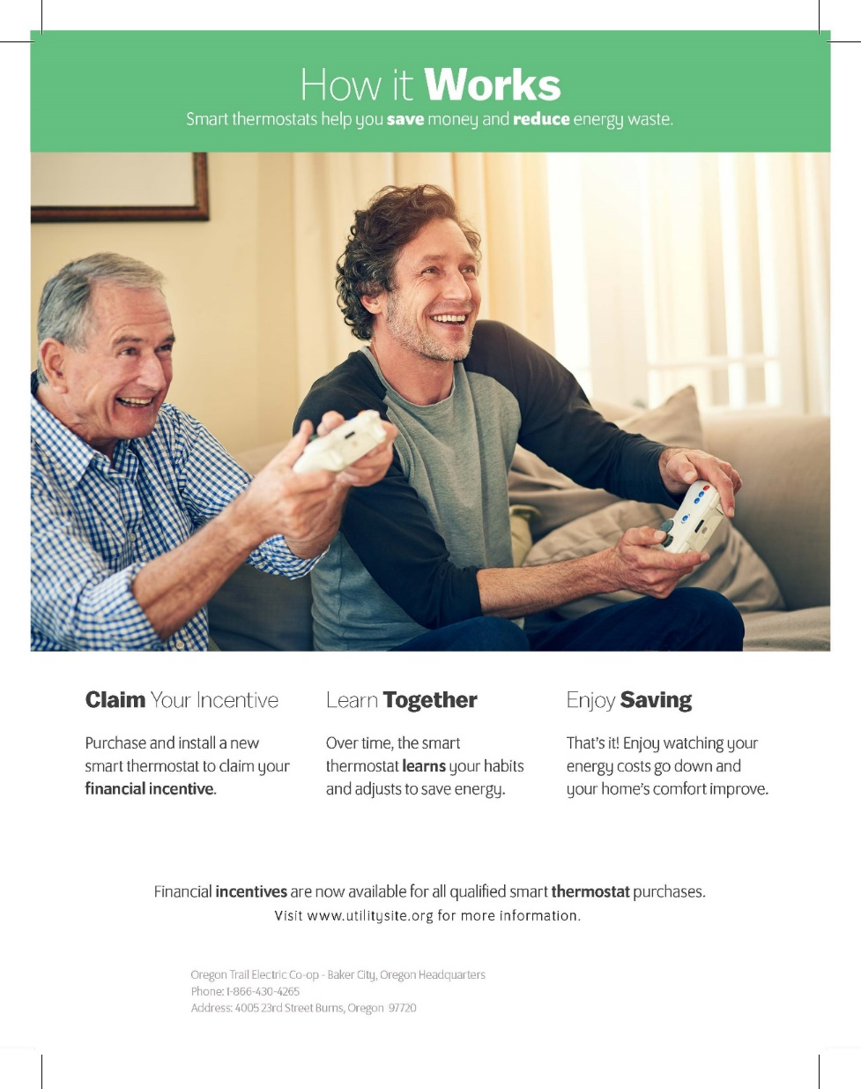

Slide 42
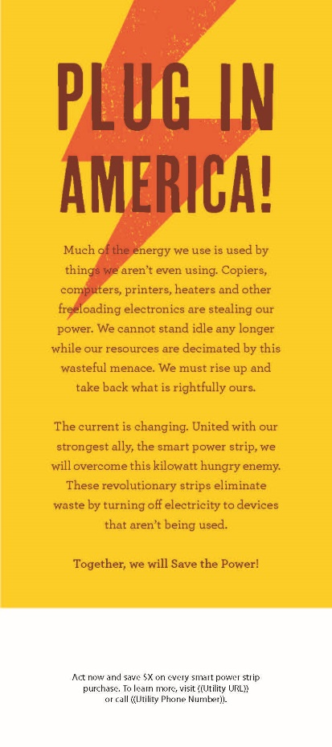

Slide 43
