Slide 1

Energy Efficiency

Slide 2
Welcome
Richard Génecé, Vice President of Energy Efficiency
2

Slide 3
What We Want to Accomplish Today
Create a shared understanding of BPA’s Energy Efficiency program
- then -
Identify topics for engagement
3

Slide 4
How we Got here & a look back at our accomplishments
Scott Wilson, Customer Account Executive
4

Slide 5
How We Got Here
NW Power Act
Regional Dialogue Policy
Post-2011 Design
5
Notes:
Regional Dialogue Policy:
“To meet its load obligations, BPA will pursue conservation equivalent to all cost-effective conservation in the service territories of those public utilities served by BPA and will accomplish this in partnership with public utilities at lowest cost to BPA.”
“BPA expects these goals to be met to a significant extent through programs initiated and funded by its public utility customers. BPA will supplement and facilitate utility initiatives.”
“BPA will recover the costs of achieving this conservation in Tier 1 rates.”
Post-2011 Design:
Cost of acquiring conservation will be collected in Tier One rates.
Conservation costs consist of two components:
regional infrastructure and program design; and,
acquisition incentives.
BPA will use the Council’s Plan as the basis for our EE target
BPA will budget for acquiring 75% of public power’s conservation target and plan on customers (on average) self-funding the remaining 25% of the target.
There is no specific mandate for any customer to provide self-funded savings.
BPA will not establish individual customer savings targets for conservation.
There will be only one contractual mechanism, the Energy Conservation Agreement (ECA), and one funding mechanism, the Energy Efficiency Incentive (EEI)
EEI will be allocated to customers on a Tier One Cost Allocator (TOCA) basis.

Slide 6
Nearly 5800 aMW from Utility Funded Programs and Codes and Standards
Source: Northwest Power and Conservation Council
6

Slide 7
Energy Efficiency’s mission and service to the region
Richard Génecé, Vice President of Energy Efficiency
7

Slide 8

Our Work Flows from Our Mission
“BPA will pursue conservation equivalent to all cost-effective conservation in the service territories of those public utilities served by BPA and will accomplish this in partnership with public utilities at the lowest cost to BPA.”
2007 Regional Dialogue Policy
Mission
Program Scale
Acquisition Strategy
Program Design
Funding Need
Incentives
8
Notes:
BPA’s EE Mission is more than just incentives. In fact incentives are the final piece of the process. BPA’s EE department helps the region build the decentralized energy efficiency power plant at scale, consistently across the region and with confidence in the resource.
This starts with the need to acquire a resource. As Scott mentioned earlier that was defined as all cost effective conservation. All of our work starts there.
From that acquisition need we determine the scale of our efforts needed to meet our targets
From that scale we work to establish our strategy for acquiring efficiency, what can be achieved through market transformation, what the market will produce on it’s own, and what needs to be achieved through utility programs.
Starting from this strategy we design programs to efficiently and effectively acquire efficiency in partnership with our customers
These programs require both infrastructure and incentives to work which require funding
It’s only when we get to this point do we establish the incentive need and thus how much money will be distrusted in the form of EEI

Slide 9
Energy Efficiency in Rates
From BP-16 Final Proposal
9

Slide 10

The Elephant in the Room
$
RATES IN
EEI
OUT
10
Notes:
The question that get’s asked most often is why do we put one dollar in and get less than a dollar out. That is one of the fundamental issues we are here to resolve, and I want to address it head on. Essentially the answer is we turn your $s into services beyond the Energy Efficiency Incentive that utilities use to provide value to their end users, and in doing so we best accomplish our mission.

Slide 11
BPA’s Value to the Region
Economies of Scale
Resource Reliability
Consistency of Programs
11
Notes:
As a regional entity, BPA is uniquely situated to support a regional efficiency acquisition effort
We create economies of scale that would otherwise be unachievable in individual service territories reducing cost for everyone.
We create the program consistency necessary for market actors to effectively implement efficiency programs across service territories.
And, we can centralize the rigorous before, during, and after implementation work to ensure the resource we are acquiring is reliable.
I’d like to provide a bit more detail on each of these functions and how we see our role in the region.

Slide 12
Creates Economies of Scale
12
Notes:
The first place I’d like to focus on is economies of scale
By centralizing cost and effort BPA can provide services for everyone at a lower cost to us all.
I think one of the best examples of this is our Energy Smart Industrial program. This provides the deep technical and engineering know how necessary to work with industrial customers to achieve large scale energy efficiency. It would simply be cost prohibitive for each utility to employ the resources necessary to achieve the same results
This doesn’t just apply to our programs. BPA also consolidates and streamlines regional and national work on energy efficiency emerging technology. BPA can have the specialized staff in place and engage with national and international research efforts necessary to ensure the pipeline is filled with new efficient technology.

Slide 13

Provides Consistent Programs
Installers
Manufacturers
Retailers
13
Notes:
The world is not constrained by utility service territory. Contractors work in multiple territories, business have multiple locations, and people travel to and from on a daily basis. By providing a consistent portfolio of energy efficiency programs across all of public power in the Northwest BPA helps to eliminate the market barriers that would come with a patchwork approach. It is our goal to provide the consistency and predictability where it is needed while still our utility customers the flexibility and local control to execute ee programs in the way that best serves their end use customers.
One excellent example of this consistency is the BPA lighting calculator. This is a tool that provides a consistent approach for lighting contractors to use across service territory that allows for an apples to apples approach to lighting across public power. But it allows utilities the flexibility necessary to control incentives and program components.
Our Simple Steps Smart Savings allows for a robust retail presence across the region that wouldn’t be possible if individual utilities attempted to work with chains like Home Depot or Fred Meyer to implement their programs.
BPA also provides a consistency in our approach to organizations’ like NEEA. BY centralizing the support for Market transformation we help public power speak with one voice to ensure we get the most out of the important work that they do.

Slide 14



Ensures the EE Resource is Reliable
Measure
Development
Resource Reliability
Evaluation
Implementation
Support
14
Notes:
And the final piece that often gets left out of the discussion is the work we do to ensure the resource we acquire is reliable. At it’s core our mission is one of resource acquisition, and just like you would do substantial due diligence before you bought a gas turbine, and regularly evaluate it performance you need to effectively plan and evaluate your efficiency acquisitions.
Broadly speaking you can think of our you can think of our reliability activities in three categories
Measure and program development that happens before installation
Implementation support that happens during,
and evaluation that happens after.
Measure development
As we develop measures and programs we recognize that there are many variables that can affect the reliability of the resource we acquire. Outcomes can vary dramatically and our level of confidence in the measures we are implementing is variable as well. We do the research necessary to develop a portfolio of measures that manage risk while making utility efforts easy and ensuring overall reliability.
Implementation support
Not everything can be predetermined as either a UES or a calculated measure. There are projects where the site, its equipment, processes and uses are unique and its interactions cannot be standardized nor predetermined. BPA works to develop measures to support widespread reproducible efficiency, but we also help our customers and their end users implement efficiency that is unique to specific locations. We want to actively pursue these opportunities because they are often extremely high yield, but they require substantially more rigor and oversight to ensure reliability
Evaluation
EE is by nature an intangible. You can’t measure it like water spinning a turbine– you can’t see what’s it’s doing right now on the SCADA system. It is a distributed asset embedded within our customers’ distribution systems. You have to prove a negative. Thus to address the real and meaningful concerns that skeptics bring forward it is incumbent upon us to prove reliability. This is after all not a customer service, this is a real and reliable resource and we need it to be unassailable. The evaluation we do after the fact proves the savings are a reliable and tangible resource we can count on, or demonstrates that we need to true up any of our savings to accurately state reflect the resource we are providing.
The circle closes by using lessons learned in implementation and evaluation to improve the measures we develop.

Slide 15
Setting our sights on the future
Allie Mace, Manager, Planning and Evaluation
15

Slide 16
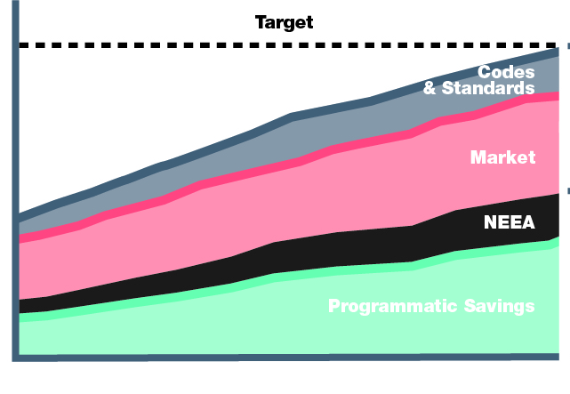


How can we Impact our Future
Council Sets
Regional Target
BPA Takes on
Public Power’s Share
BPA Determines the
Best Path To Achieve Savings
16
Notes:
Discuss the process by which BPA takes the council targets and arrives at programmatic targets. Focus on the fact that that is where we start our incentive budgeting process

Slide 17
Strive for the Council’s target
17

Slide 18

Change customer self-funding
18

Slide 19
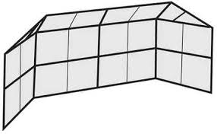
Define BPA’s Backstop Role
19

Slide 20
Find Program and Policy Efficiencies
20

Slide 21
Identifying topics for follow-on engagements
Matt Tidwell, Policy Specialist
21

Slide 22
What Comes Next
Follow Up Meeting
  Feb. 29 1:00-4:00
  Rates Hearing Room
Listening Sessions (Locations Tentative)
  March 7 Tacoma Power
  March 9 Montana Location TBD
  March 10 Benton PUD
  March 16 EWEB
  March 17 ICUA meeting in Boise
22

Slide 23
Financial Disclosure
This information has been made publicly available by BPA on February 10, 2016 and contains information not reported in BPA’s financial statements.

