Slide 1

Energy Efficient Block Heater
Brown Bag
BPA Energy Efficiency
4/15/14

Slide 2
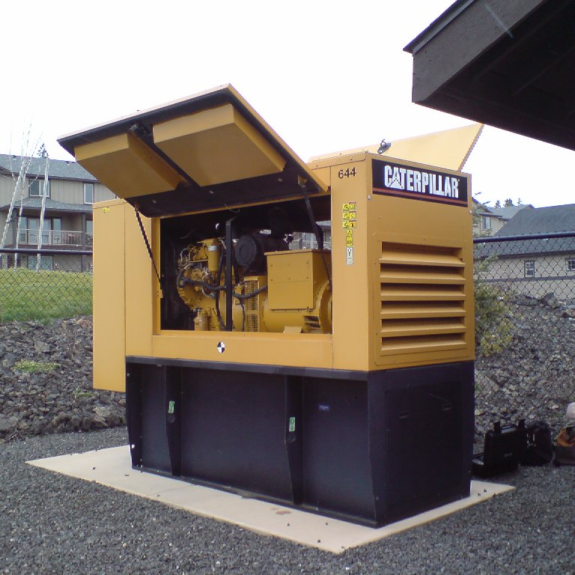
Back-Up Generators?
Generators provide back-up power for continuity of operation and life-safety

Slide 3

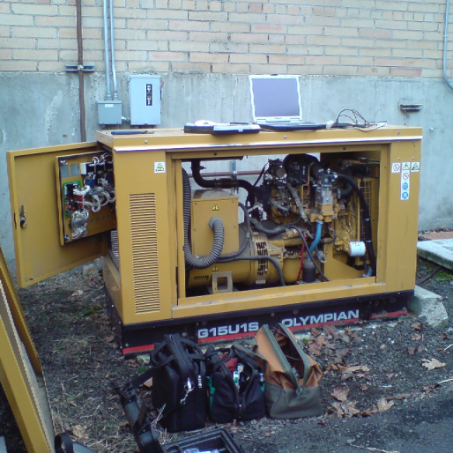
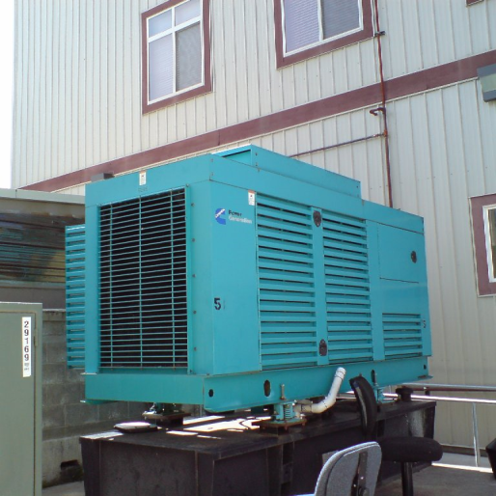
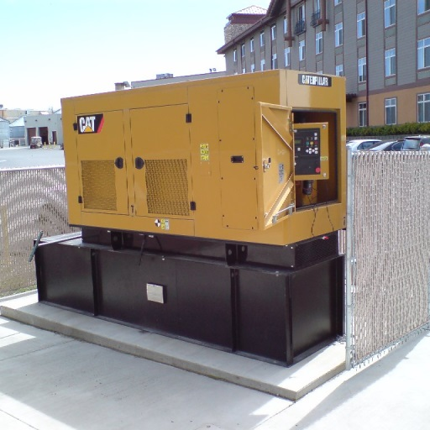
Who has generators?
Schools and Universities
Government and public buildings
Hospitals
Industrial facilities
Hospitality and lodging
Utilities

Slide 4
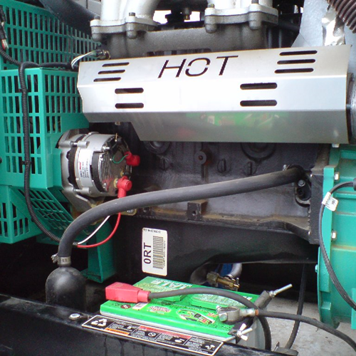
What’s the Big Deal?
Generators are kept at 110F for quick starting. So most generators use more electricity than they generate over their lifetime.

Slide 5
Where’s the Block Heater?

Slide 6

Generator Block Heater

Slide 7
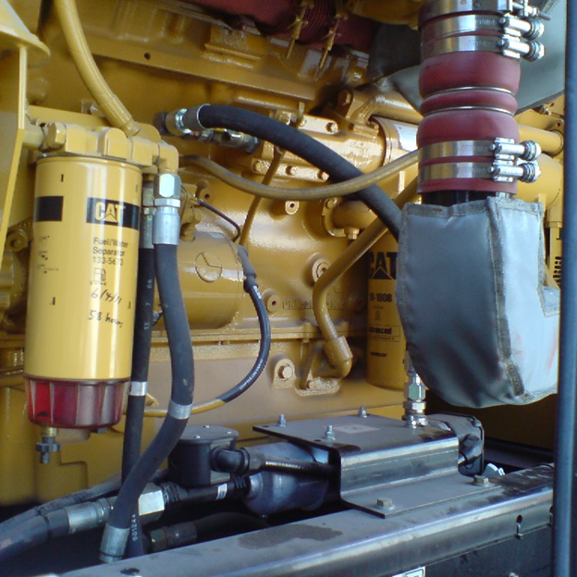
Where’s the Block Heater?

Slide 8
Generator Block Heater

Slide 9
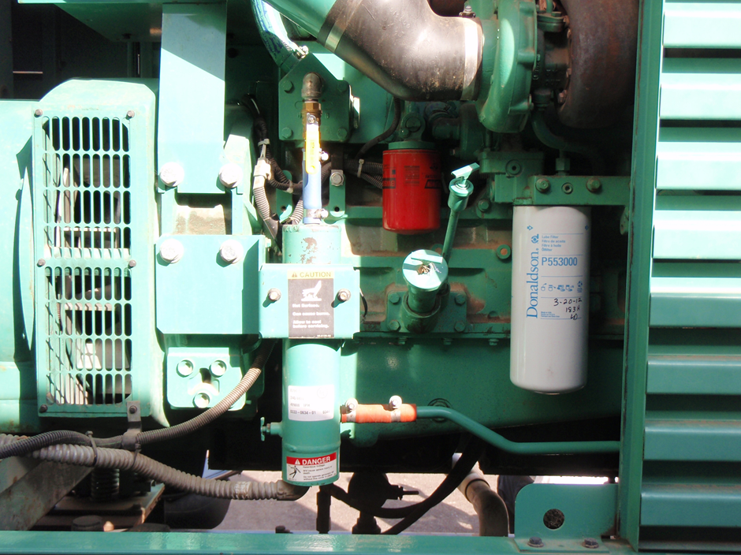
Where’s the Block Heater?

Slide 10
Generator Block Heater

Slide 11
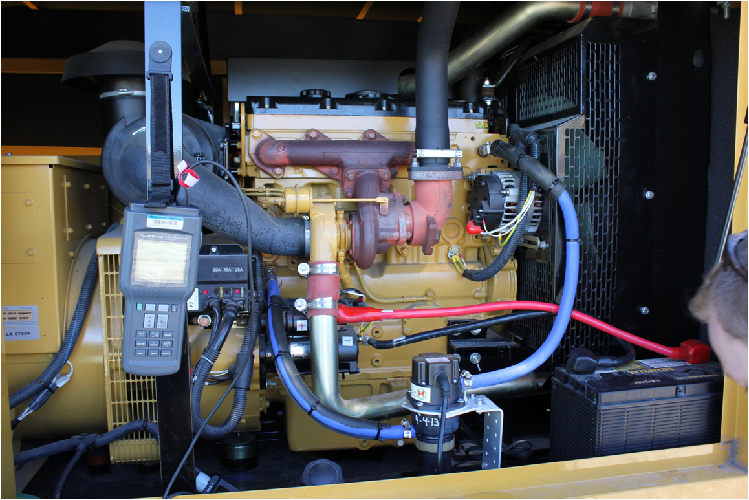
Energy Efficient Block Heater
This new pumped, block heater, installed per manufacturer recommendations, will save energy, while meeting the block heating requirements.

Slide 12
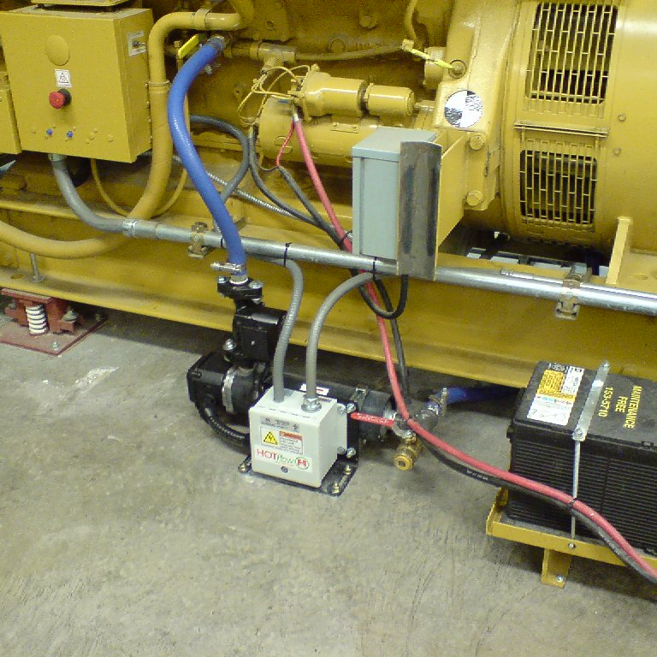
Energy Efficient Block Heater
This new pumped, block heater, installed per manufacturer recommendations, will save energy, while meeting the block heating requirements.

Slide 13
2012-2013 EE BH Pilot
    Understand the technology
      Identify primary variables affecting energy savings
      Refine energy saving estimates
      Ensure savings can be evaluated
    Develop a BPA Qualified measure

Slide 14
Variables Affecting Energy Use & Savings
  Heater size and number of heaters
  Location of site (ambient temperature range)
  Indoor or outdoor location
  Piping configuration
  For indoor locations –proximity to OSA damper
  Enclosure type (insulated, operable dampers, etc.)
  Engine block temperature setpoint
  Oil heater
  Percent of time that gen-set runs
  “Health” of existing heater
  Other

Slide 15
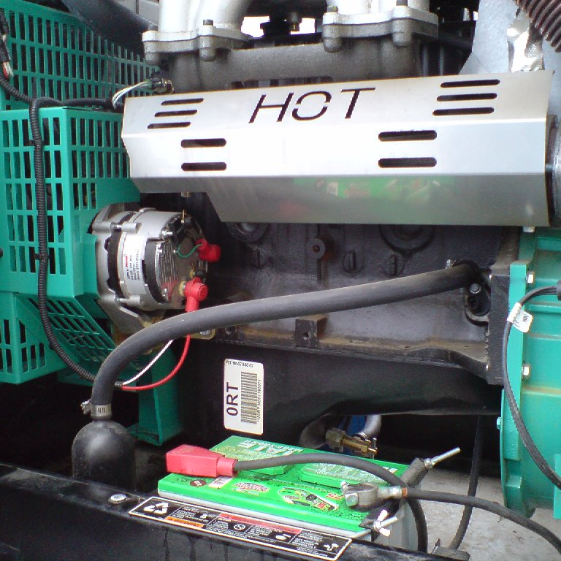
EE BH Pilot Retrofits
  City of Cheney – 9 retrofits
  Kootenai Electric Coop – 15 retrofits
  Ravalli Electric Coop – 3 retrofits
  Flathead Electric Coop – 26 retrofits
  Missoula Electric Coop -5 retrofits

Slide 16
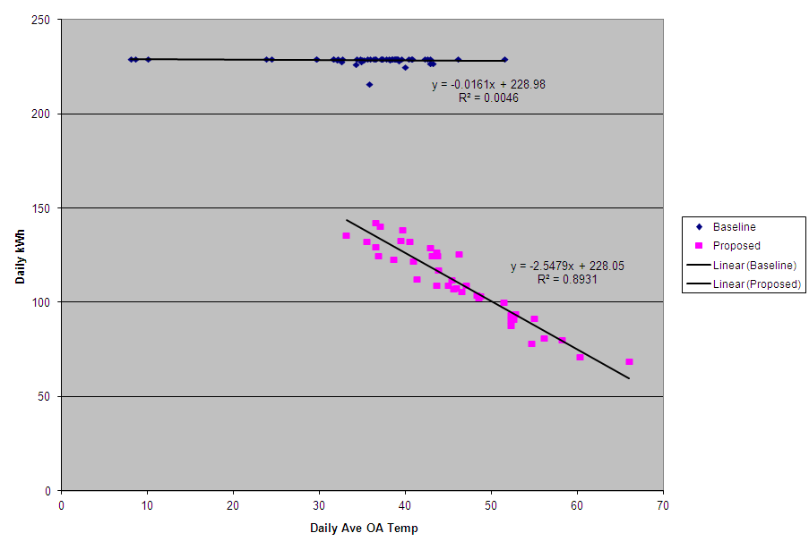
Case Study #1: 55% Energy Savings
  Large generator (1MW)
    Annual Energy Savings = 33,857kWh (55%)

Slide 17
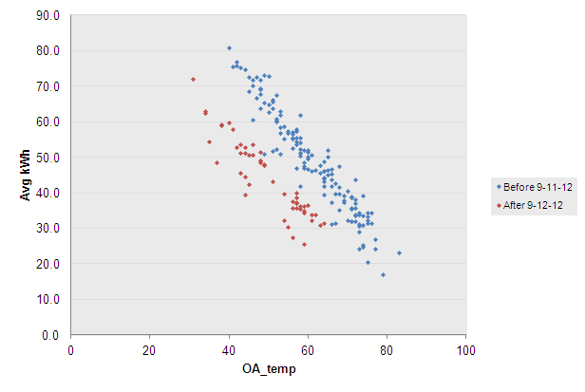
Case Study #2: 29% Energy Savings
  Data Center (900kW)
    Annual Energy Savings = 7,613kWh (29%)

Slide 18
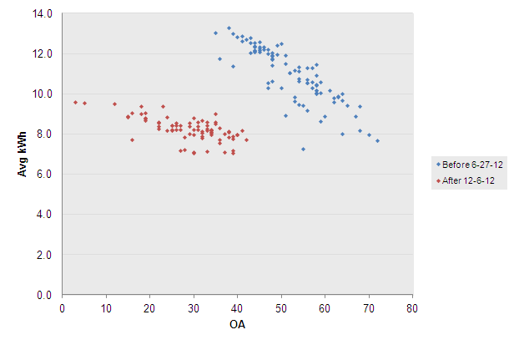
Case Study #3 : 36% Energy Savings
  WW Plant (15kW)
    Annual Energy Savings = 1,589kWh (36%)

Slide 19
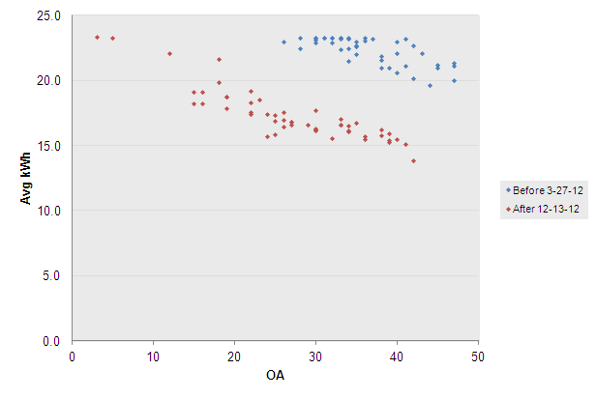
Case Study #4 a) 27% Energy Savings
  Water Plant (20kW): heater replacement only
    Annual Energy Savings = 2,037kWh (27%)

Slide 20
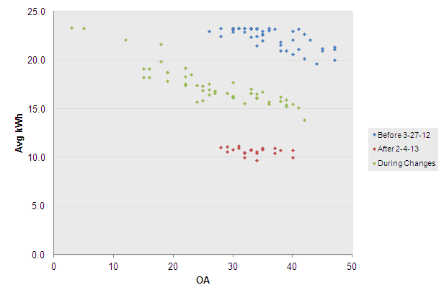
Case Study #4 b) 50% Energy Savings
  Water Plant (20kW): piping correction
    Total Energy Savings = 3,746kWh (50%)
    23% savings attributed to piping correction

Slide 21
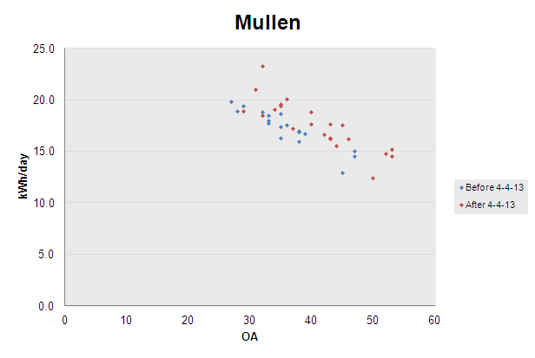
Case Study #5: -11% Energy Savings
  Lift Station(80kW)
    Total Energy Savings = -609kWh (-11%)

Slide 22
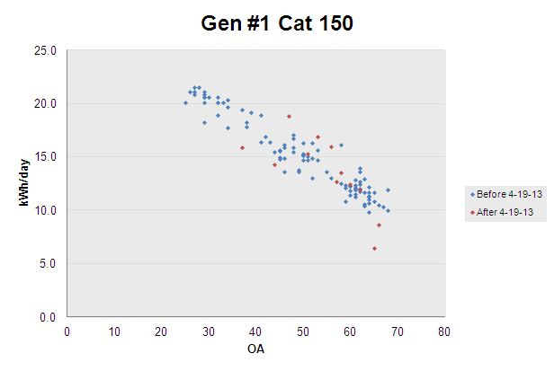
Case Study #6: -4% Energy Savings
  Lift Station(150kW)
    Total Energy Savings = -244kWh (-4%)

Slide 23
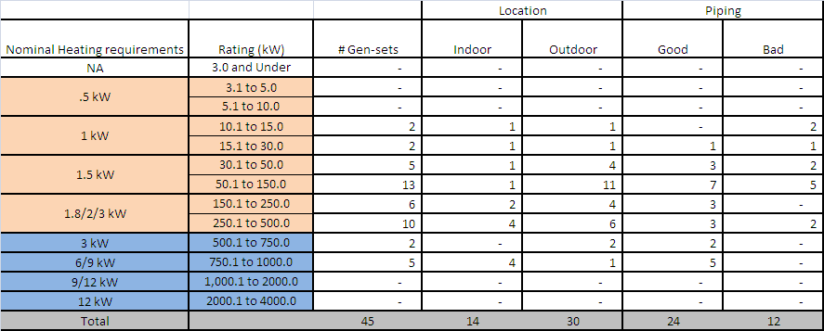
  EE BH Pilot Primary Variable Matrix
    Generator Size-Heater Size
    Climate Zone
    Location (indoor/outdoor)
    Piping Configuration

Slide 24
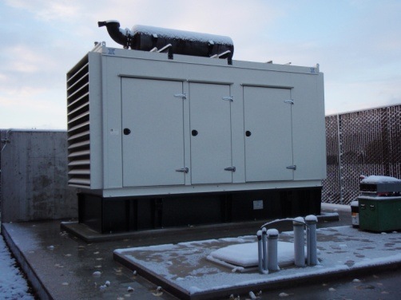
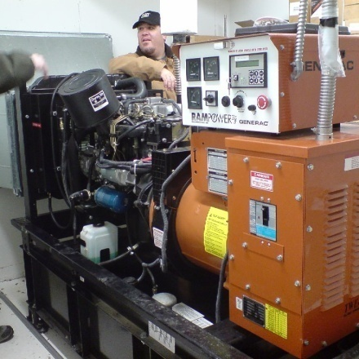
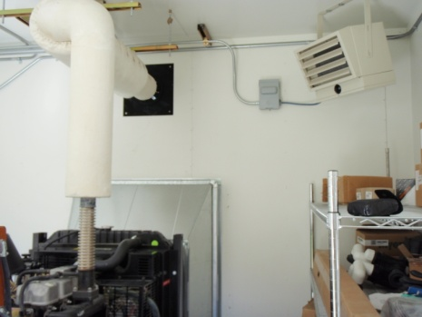

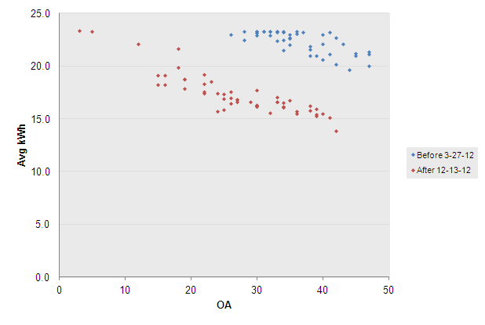
    EE BH Location (indoor/outdoor)
    Sensitivity Analysis

Slide 25
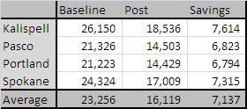
Climate Zone Sensitivity Analysis for Exterior Location
  Case Study #2 models projected to 3 other PNW cities

Slide 26
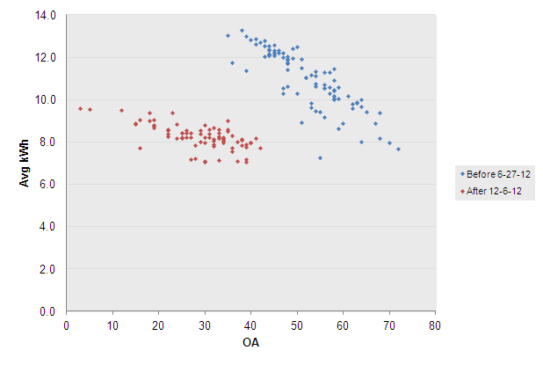
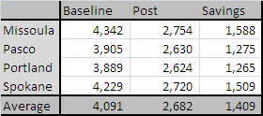
Climate Zone Sensitivity Analysis for Interior Location
  Case Study #3 models projected to 3 other PNW cities

Slide 27
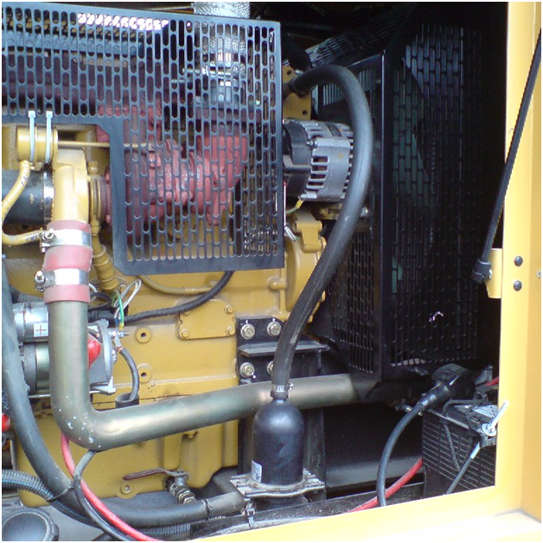
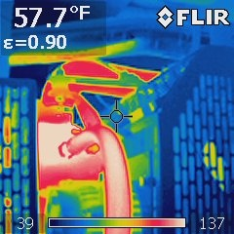
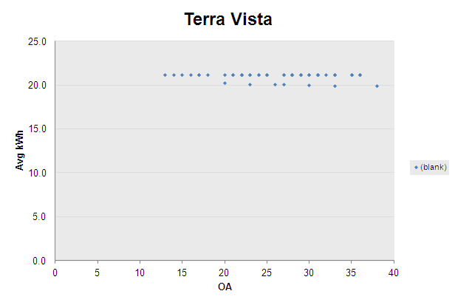
    Piping Configuration
    Sensitivity Analysis

Slide 28
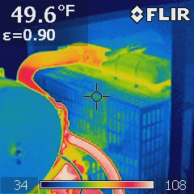
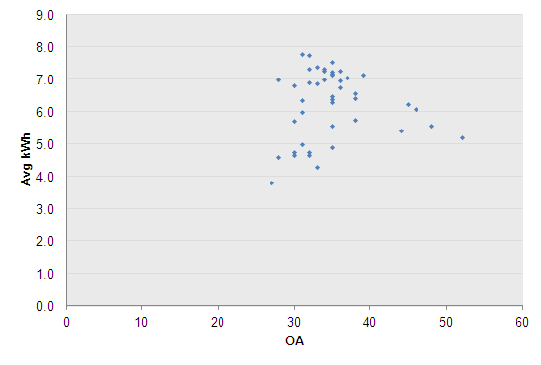
    TPS Heater Sensitivity Analysis
TPS Heater

Slide 29
Average Savings Showing the Effect of Piping Configuration
Heater Size | Good Piping | Bad Piping
1 kW |  | 1,003
 | (143) | 3,774
1.5 kW | (341) | 1,207
 | (626) | 2,459
1.8/2/3 kW | 1,827
 | (512)
3 kW | 8,704
6/9 kW | 11,374 | 33,858
Negative average savings for TPS heater baselines

Slide 30
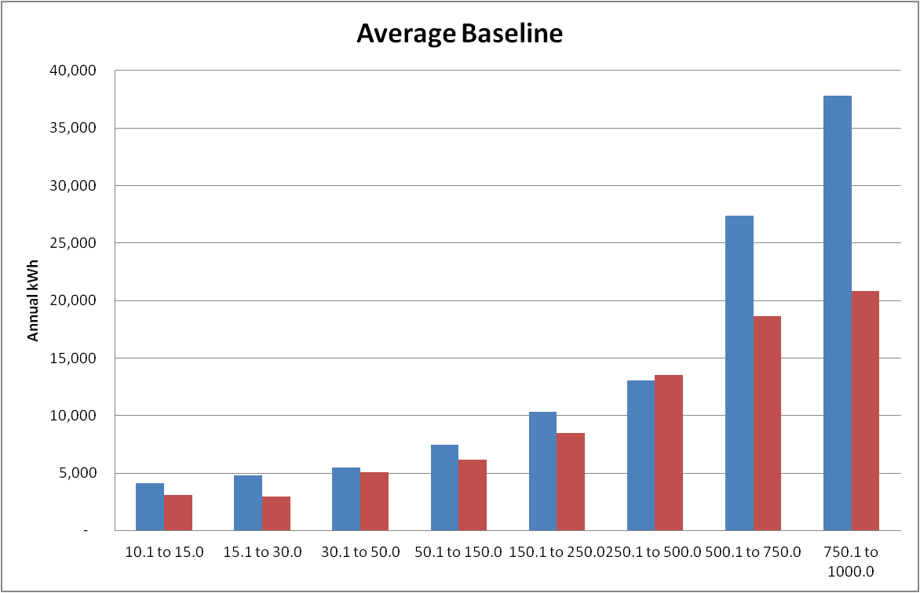
Average Energy Use by Generator Size
Baseline
Post

Slide 31
October 1st BPA Qualified measure is based on the Pilot results!

Slide 32
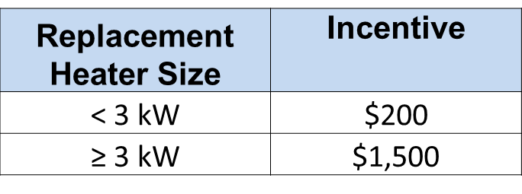
Energy Efficient Block Heater (EE BH)
BPA Qualified measure

Slide 33
EE BH Retrofit BPA Qualified Measure
Must replace a thermo-siphon, electric-resistance block heater
The generator must be stationary
Must be retrofit by a manufacturer-certified installer
Installer provides manufacturer checklist with:
    invoice,
    pre- & post- spot measurements (V, A, kW) and
    pre- & post- pictures

Slide 34
Typical EE Block Heater Installed Costs
Heater Size (kW) | Typical Installed Cost
1 | $1,200
1.5 | $1,350
2.5 | $1,500
3 | $2,660
6 | $2,770
9 | $3,300
12 | $3,950

Slide 35
Technician certification ensures correct piping configuration
    Heater return port should be high and towards the back of the engine
    Heater supply port should be low and towards the front of the engine
http://www.hotstart.com/home/products/hotflow/hotflow-certified-technicians/

Slide 36
Questions?
Rick Hodges
rshodges@bpa.gov

Slide 37

Commercial Marketing Toolkit
GBH materials are part of the new Commercial Marketing Toolkit
Download in Adobe InDesign format at: http://www.bpa.gov/energy/n/Commercial/Marketing_Toolkit/

Slide 38

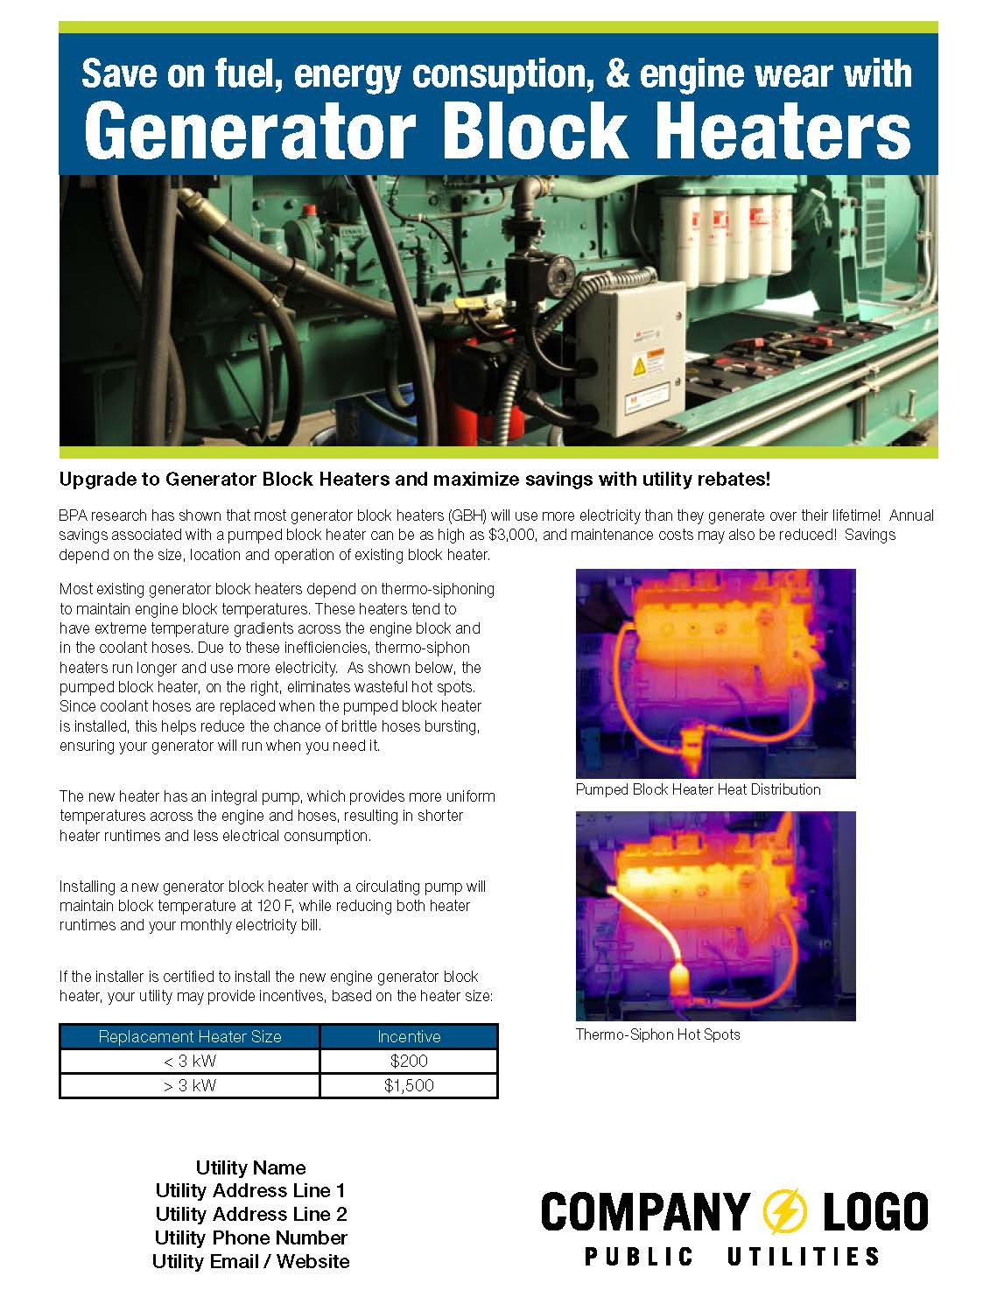
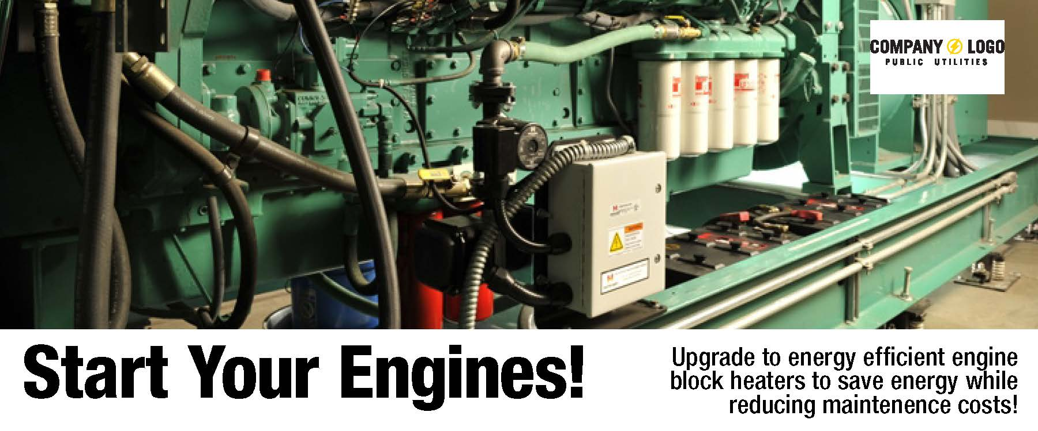
EGBH Promotional Materials
One page print promos
Bill Inserts
Trade Ally One Sheet communication

Slide 39



EGBH Promotional Materials
Customize with:
  Utility Logo
  Custom Colors
  Custom Text
EE Marketing Team can assist -contact your EER

