Slide 1
Central Water Heating Workgroup
July 7, 2020
Untapped Capacity: Load Shifting Central Water Heating Systems

Slide 2
Agenda
Capability of Central Water Heating Systems | Presenter Mark Frankel
NW Utility Pilot Project| Tom Hovde Snohomish PUD
CA Utility Perspective | Owen Howlett SMUD
CEC Programs and California Policy for HPWH| Gabe Taylor

Slide 3

Grid Integration for CHPWH
Mark Frankel
Director of Technology and Innovation
Ecotope

Slide 4

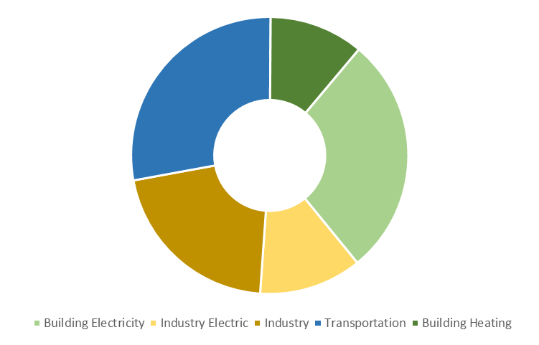
Grid and Decarbonization Context
Transportation 28%
Combustion 11%
Buildings 39%
Electricity 28%
Industry 33%
Notes:
2/3 of US electricity production is combustion-fired

Slide 5
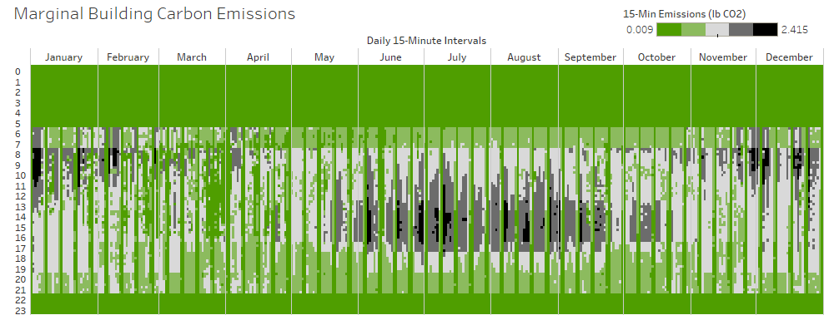
Grid Peaks Based on Time of Use
Winter
Spring
Summer
Fall
(Carbon as Proxy for Resource Adequacy)
Notes:
The additional carbon contributed by this building.

Slide 6
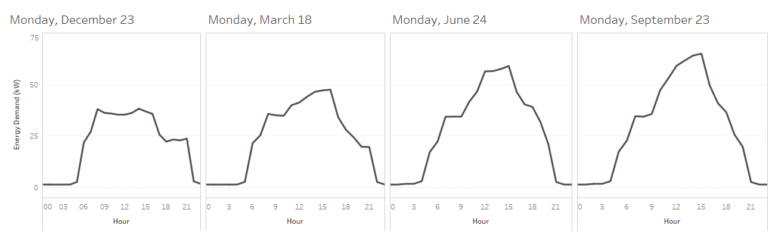
Building Energy Load Shape
Energy Demand (kW)
Reduce energy use in the
Winter mornings and Summer evenings
“The New Efficiency: When Matters”
Notes:
Seasonal load shape variation. The same building has different energy demands (load shapes) across different seasons.

Slide 7
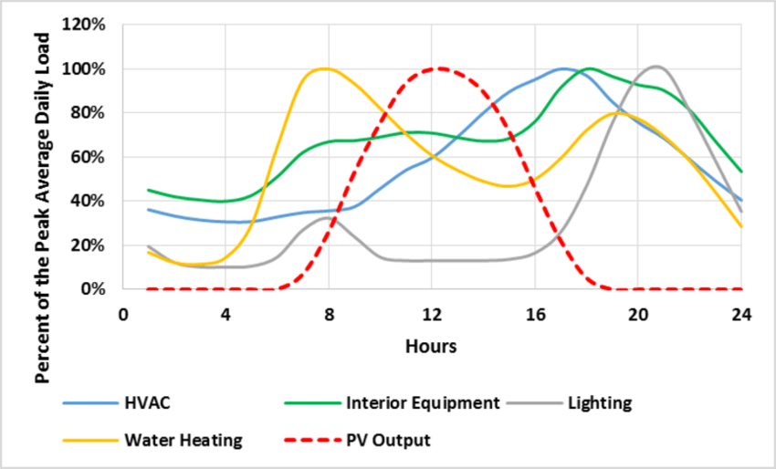
Residential Loads Peak at Different Times

Slide 8
Managing DHW Load Shape
Water Heating – Baseline
Water Heating – Load Shift

Slide 9
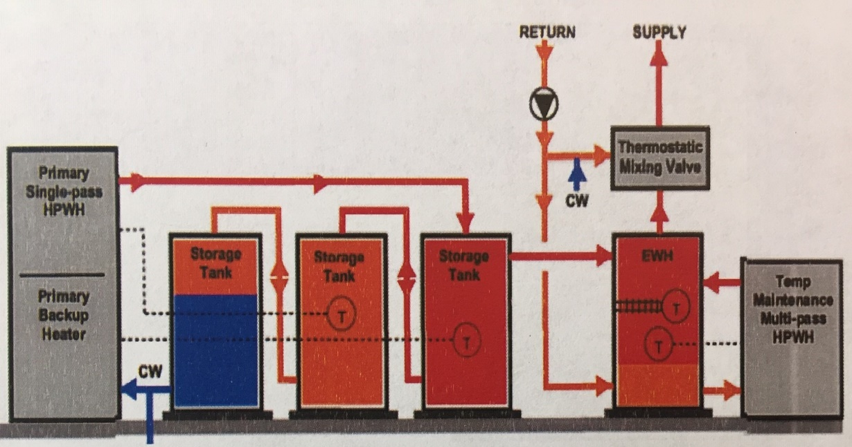
How Far Ahead Can We Plan for Grid Response?
Event (ADR)
3 Hour
6 Hour
Day Ahead

Slide 10
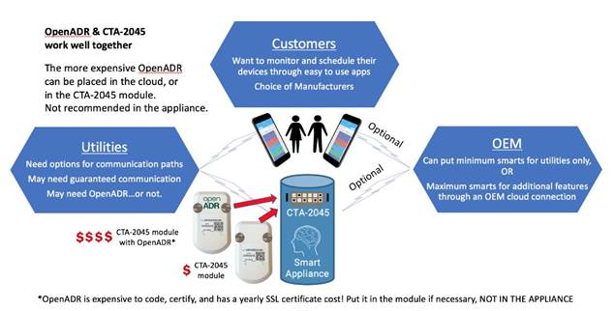
CTA-2045
Required in WA
Anticipated in OR
Negotiating in CA
Third Party Signal for Load Shed (or Add) that can be accepted or declined
May become gateway for other advanced control features

Slide 11
CHPWH Features Affecting Grid Response
HPWH designed for longer run times with lower capacity (70%)
Already incorporate/require large storage capacity (tank size)
Need to manage tank stratification to support HP efficiency (depending on configuration)
Temperature limited by refrigerant and configuration
Limited controls and sensors
Electric resistance back-up
Temperature maintenance system less flexible
Capacity (recovery)
Storage
Temperature
Controls
Temperature Maintenance

Slide 12
Tom Hovde- Snohomish PUD
Snohomish NW C&I Time of Day Pilot

Slide 13
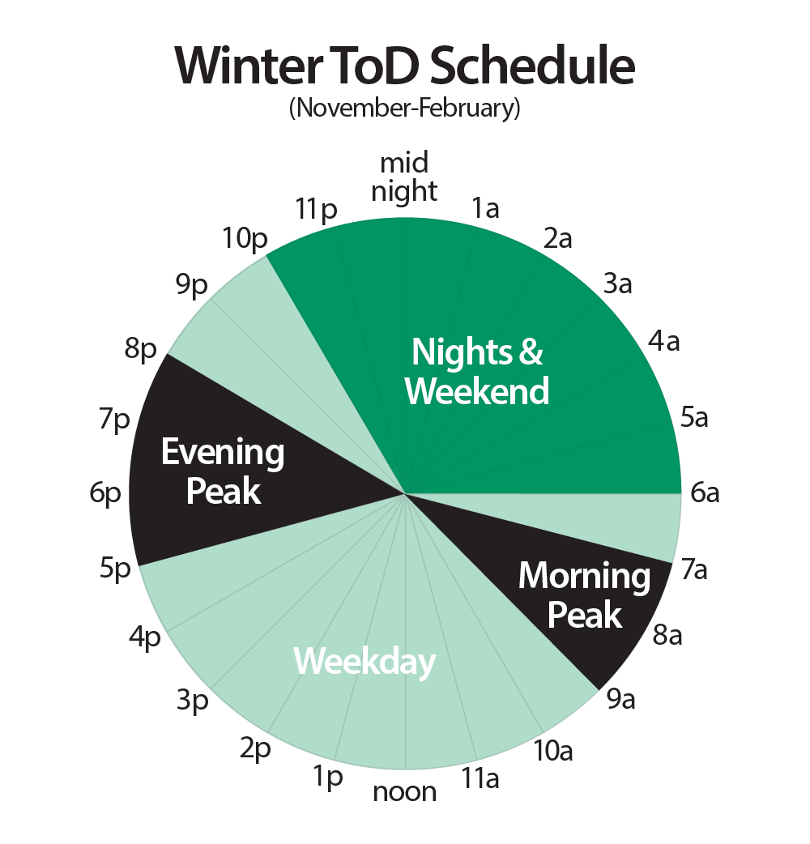
CI Time of Day Rate Pilot
Time of Day (TOD): different prices for
energy at different times of day
Basic structure: Nights and weekends discount
Peak periods morning and evening Nov – Feb
Facilitates Load Shifting behaviors from “Peak” to “Off-peak”
Supporting central HP DHW system via incentives/rates aligns w/peak load management and energy efficiency objectives

Slide 14

Snohomish County Public Utility District
Since 1946 –electric & water distribution
  Customers -360,000 electric - 20,000 water
  $650M revenue, @1000 employees,
  BPA’s largest customer, 12th largest US public utility
  PUD power supply is currently 98% carbon free, over 80% hydroelectric source
14

Slide 15
Why DER…Changing Market
Demand mgt key in Distributed Energy Resources (DER)
  Goal - meet load growth w/cost effective EE/renewables
  Participant in BPA Winter Peaking Demand Response Pilot 2015-17
  PUD Winter Peak Shifting Pilot 2018-20
  PUD Time of Day Rate Pilot 2020-23
Supporting central HP DHW systems via incentives/rates aligns w/peak load management and energy efficiency objectives
15

Slide 16
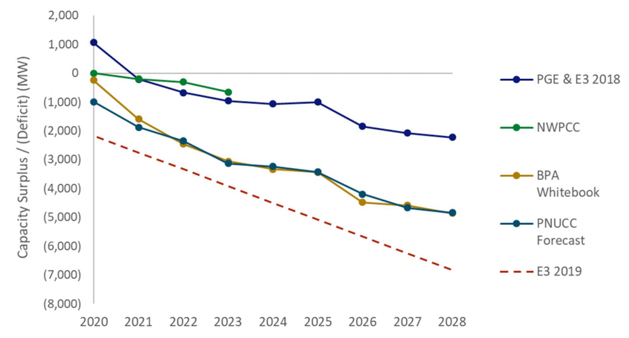
Why It’s Important
Region is expecting increasing likelihood of a capacity shortage as soon as next year
Retirements of multiple regional baseload generators (coal) are pending
Flood of new renewables generate lots of electricity but can’t be counted on in any given hour
NW Power Pool
16

Slide 17
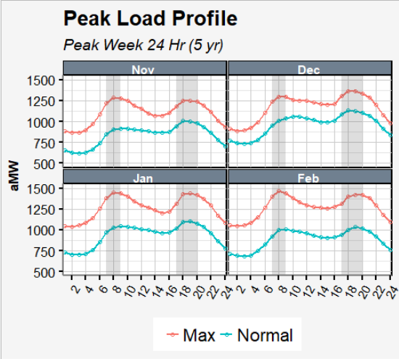
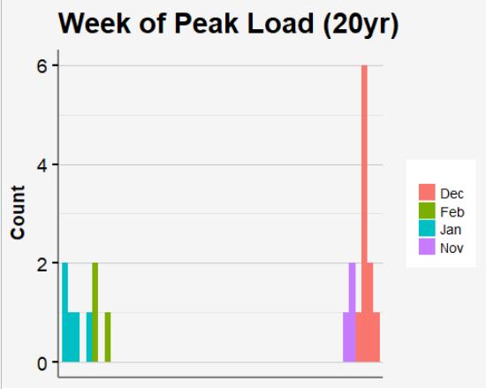
PUD System Peaks & TOD Design
District Perspective:
  District Peak Loads have occurred in Nov – Dec over the last 20 years.
  Peaks occur during specific hours of the day
  Peaking Costs (capacity costs) require generation and distribution assets for a very short duration, but are costly ($100K/MW-year for peaking capacity)
These 5 hours account for 55% of SnoPUD’s winter “peaking” energy needs
Exponential Costs
17

Slide 18
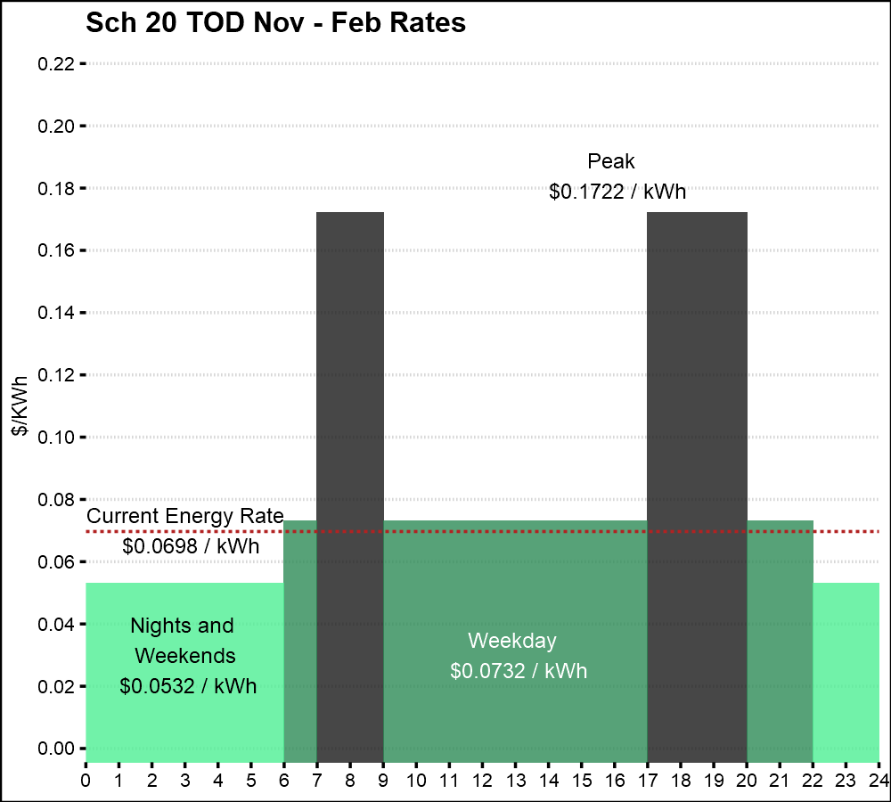
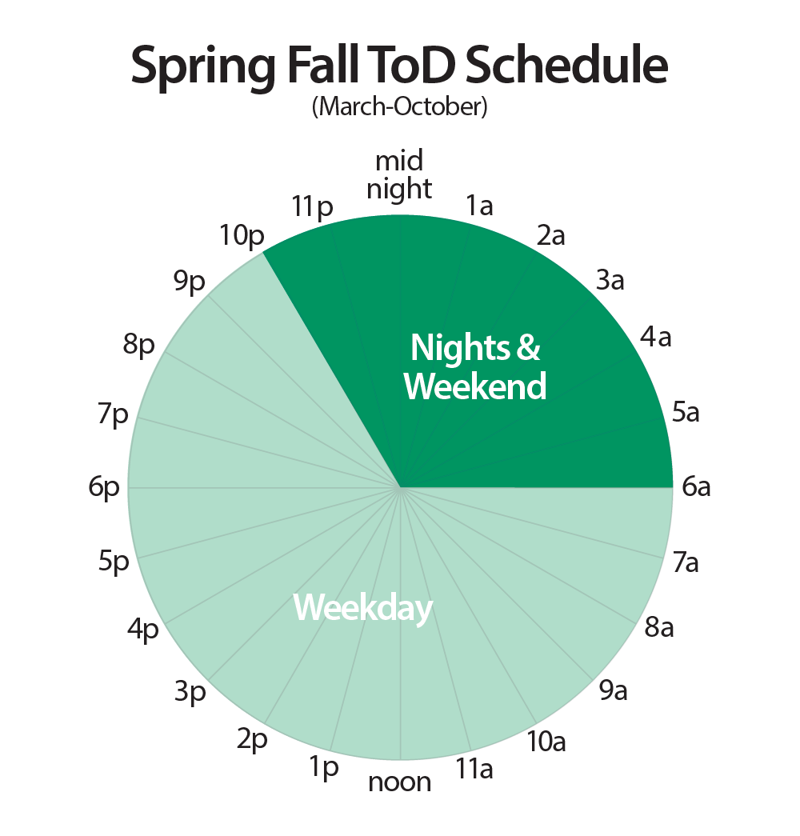
TOD Load Shifting Opportunities
TOD is an Energy Price Modifier to existing Rate Schedule (Sch20):
  Nights & Weekends: -$0.0166 (46% of hrs)
  Weekdays: +$0.0034 (49% of hours)
  Peaks: +$0.1024
  (5% of hours)
Revenue-neutral based on 2018 usage
Pre-heating & Post - heating
Pre-cooling & Post - cooling
Timers / control equipment
Machine / Motor / Pump Run Schedules
Automating Processes
Improving Energy Efficient Consumption Behaviors
Adjusting Employee Shifts
18

Slide 19
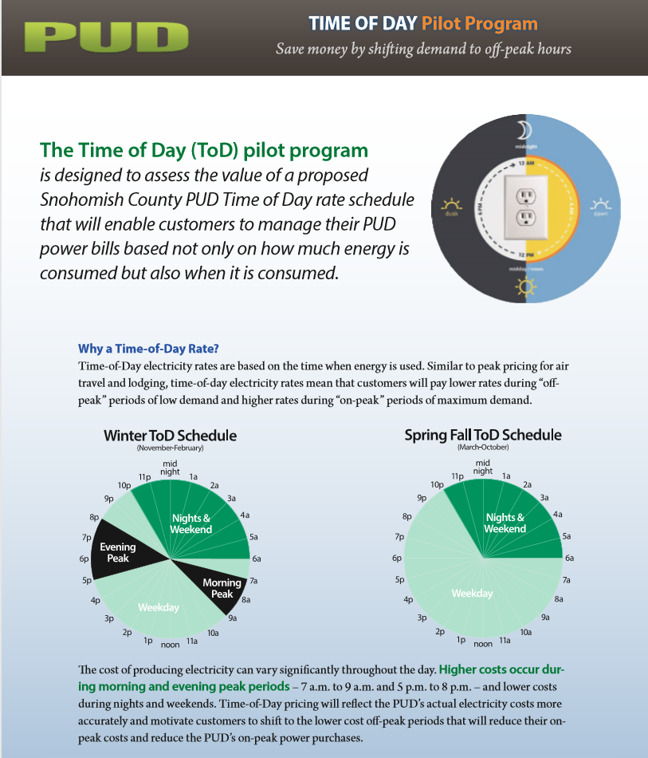

Slide 20
Program Structure
Pilot runs for 4 years - Jan 2020 – Dec 2023
Open to C&I Customers by invitation
Maximum 25 participants initially
Access to online detailed usage data via AEI
Opt-In and Rate Comparison options
One-time “mulligan” so that customers can try Opt-In at no risk
20

Slide 21
TOD Pilot Active Participants to Date:
King County Brightwater – Wastewater Treatment Plant (RC)
DaVinci – Indoor Agriculture (RC)
Everett Transit – Electric Bus Charging (RC)
Crane Eldec – Aerospace Mgr – (RC)
Synrad – Laser Mfgr – (RC)
Safran – Aerospace Mfgr – (RC now Opt- In)

Slide 22
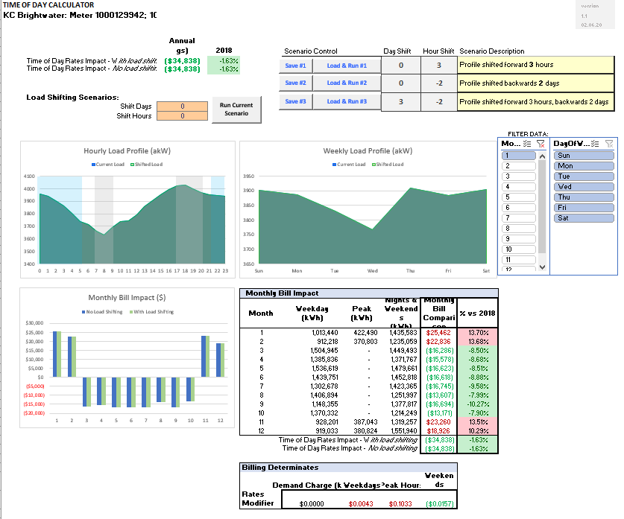

Slide 23
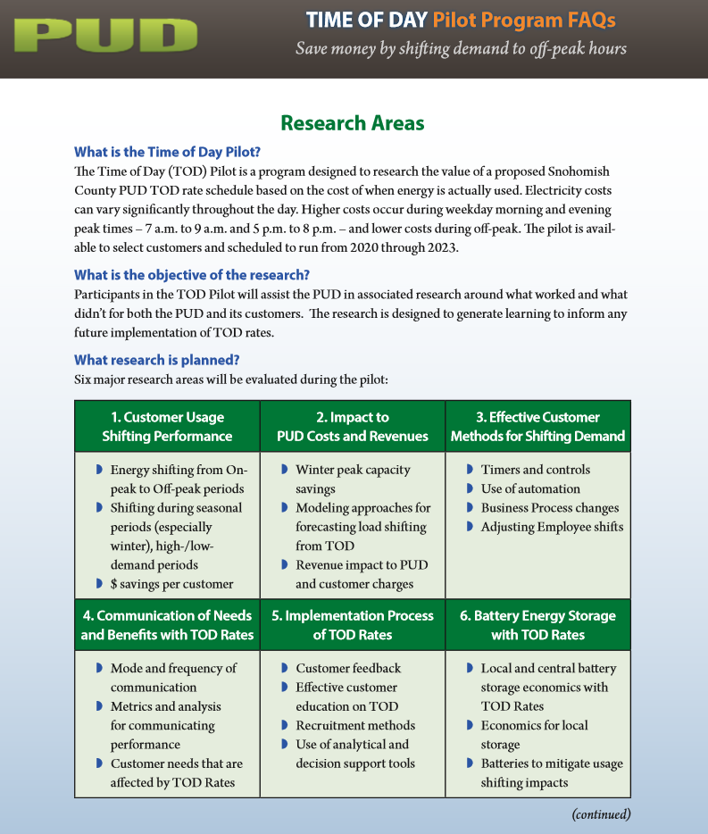

Slide 24

Questions?
tbhovde@snopud.com

Slide 25
Owen Howlett - SMUD
Owen.howlett@smud.org
c. (916) 233 9636

Slide 26
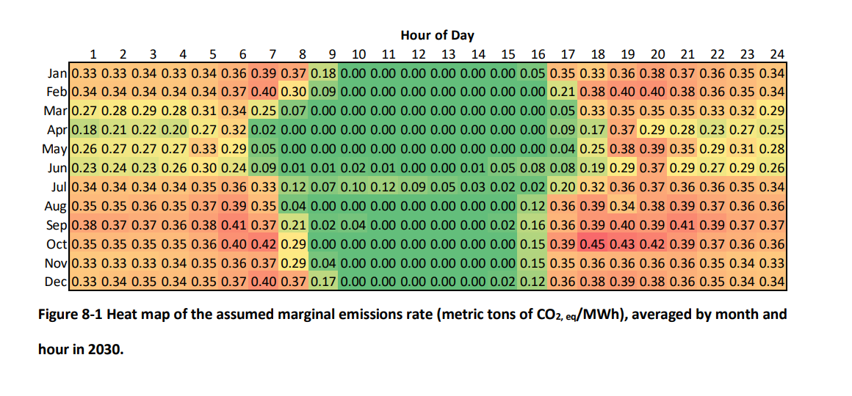
SMUD Drivers
  SMUD System
    Summer peaking utility eventually winter peak too
  Published TOU rates are an approximation to real time price of power and/or marginal GHGs, and are responsive to other issues such as NEM, so they are not necessarily a good approximation of any one thing.
  Published rate structures have to be simple enough to be memorable.
  Source: Energy and Environmental Economics (E3), 2019. Residential Building Electrification in California Consumer economics, greenhouse gases and grid impacts.

Slide 27
Central Water Heater Control Taxonomy
 | Load control signal | Value to utility / society | Value to customer | Implementation issues
Load controlled directly by the utility or third-party implementers | Real time prices and/or marginal GHG signal from the utility | $$$ if utility ignores comfort... $$ if it doesn't | Depends on how much the utility passes through... | Third-party control perhaps most likely, to minimize cost and direct complaints to utility Hard to implement before occupancy
Load controlled by the device itself using onboard logic | Pre-published time-of-use rates from the utility | $ | $$ | Less expensive to implement Load could be highly mismatched with GHGs, for intermittent utilities
See: Ecotope, 2018, Heat Pump Water Heater Electric Load Shifting: A Modeling Study

Slide 28
Policy Requirements
  Eventually, building code should require heat pump water heating in new and existing buildings except in cases when it's technically infeasible
    So we need data collection and research *now* to prepare for this, i.e., to find out when it's infeasible, and whether/how those hurdles can be overcome
    Many of those hurdles will be due to local building practices and local climate, but others may be universal, so coordinated research at the state and maybe national level would help

Slide 29
Manufacturer Guidance
See the AWHI report 2020! But we already know that we need....
  Provide clear signals
  Advocate for products with low GWP refrigerants
  Develop load shift calculators and design guidance based on the system size and capacity

Slide 30
Gabe Taylor- CEC
CEC Programs and California Policy for HPWH

Slide 31
Load Management Standards
Building Decarbonization Assessment
Updated Building Energy Standards (JA-13)
Optimization, not Demand Response
  Manufacturer Coordination with Utilities
  Grid Value

