Slide 1


2016
UES Impact Evaluation
Sampled
Utilities Kickoff
April 12, 2016

Slide 2


Welcome!
  Objectives
  Background
  Evaluation Measure Groups & Approaches
  Timeline
  Support
  Data Collection (Walk through Notification Template)

Slide 3
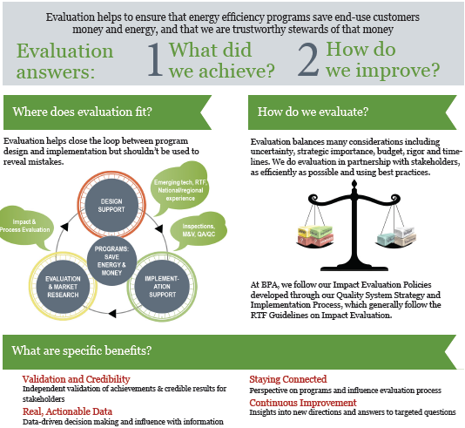

Full presentation and other evaluation docs:
www.bpa.gov/goto/evaluation
* Evaluation is covered in Section 3.3 of the Implementation Manual

Slide 4
Evaluation Objectives
Evaluate UES energy savings for consistency with the savings claimed
Provide strategic feedback to improve program operation and measures
And sometimes assess savings to inform RTF estimates
Full Evaluation Plan and detailed presentation can be found at: www.bpa.gov/goto/evaluation

Slide 5
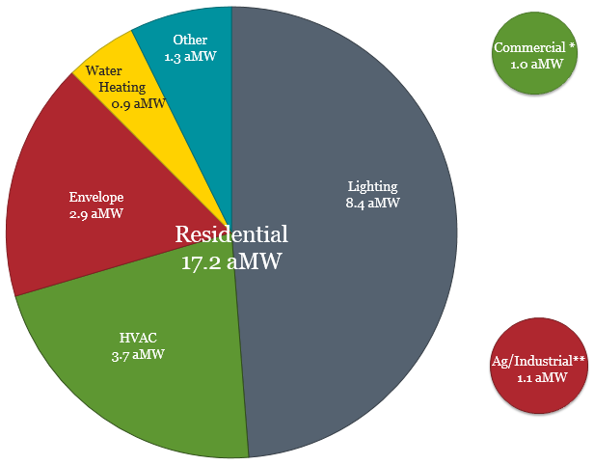


Where Are The Largest Savings?
FY2015 UES data
summarized from IS2 data pull
* Savings from Energy Smart Grocers deemed measures are not included in this summary.
** Ag/Industrial value does not include savings achieved through the Scientific Irrigation Scheduling measure.

Slide 6
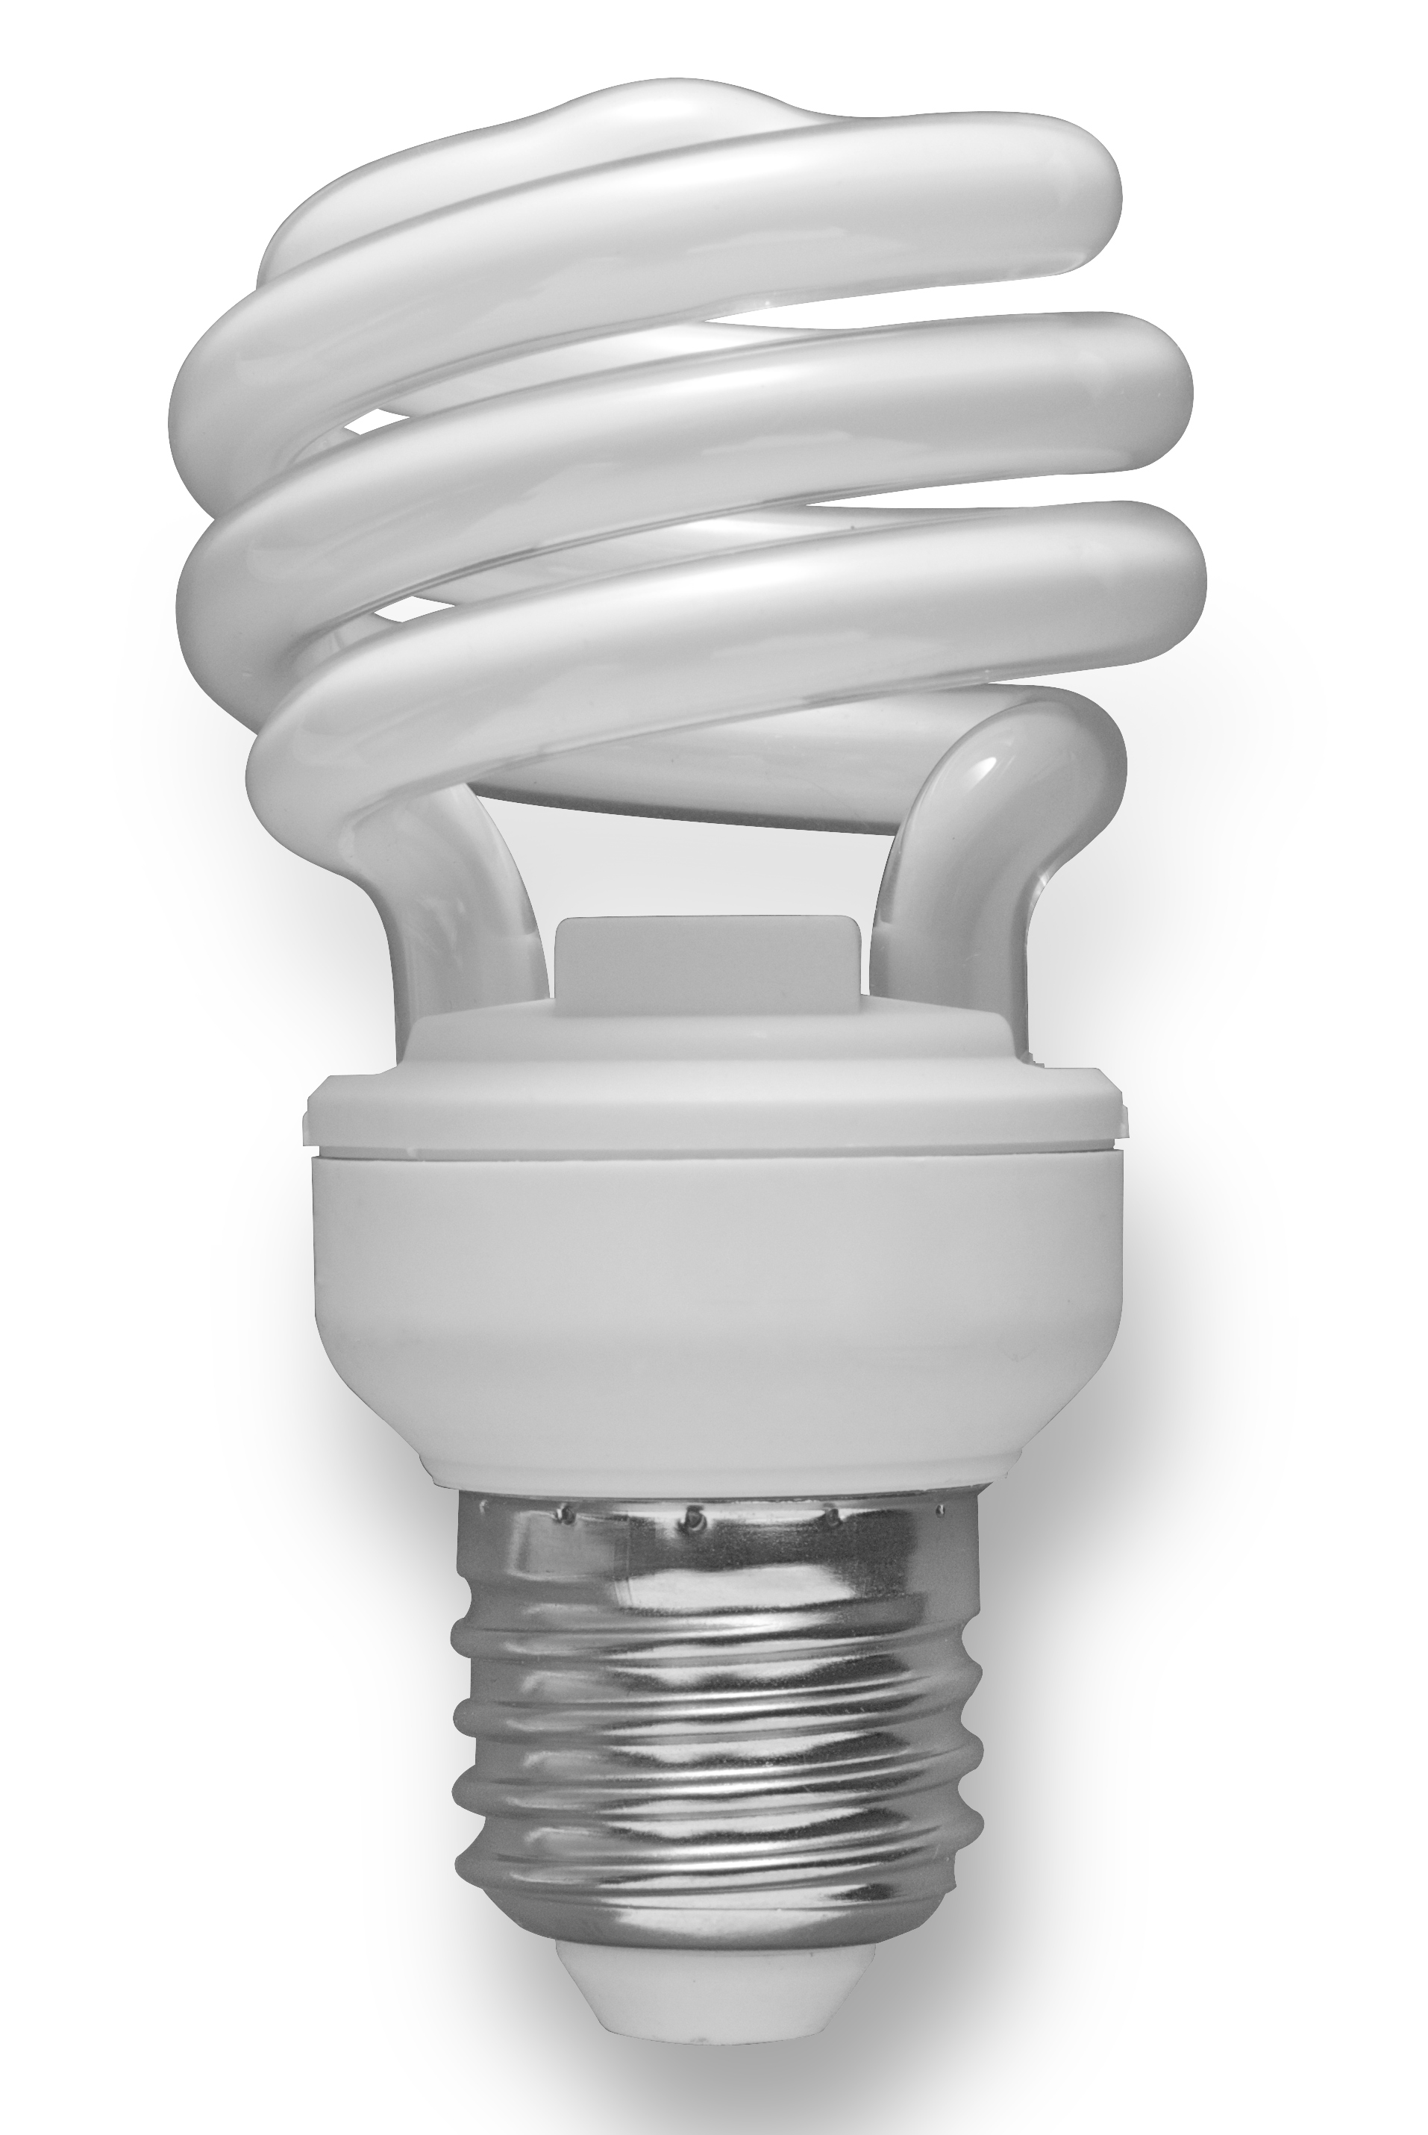

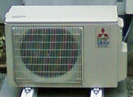
Residential Lighting
Residential Envelope
Residential
HVAC
Engineering Review
  Retail & By Request
  Customer Files
Billing Analysis
Envelope, Prescriptive Duct Sealing & DHP with FAF
  Billing data, if issues - customer files and phone surveys
Engineering
Review
HPs, CCS and Performance Duct Sealing
  PTCS QA/QC data

Slide 7

What Should We Consider When We Select the Evaluation Approach?
Contribution to Savings
Uncertainty In UES Savings Value
Strategic Importance
Measure Status

Slide 8
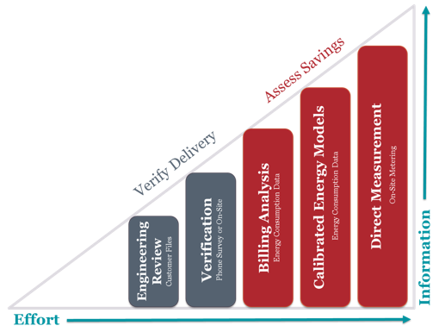
Evaluation Approaches
Notes:
We can always go up, but we can't always go down.

Slide 9
Residential Lighting
Measure Group | Approach | Data Source
 |  | 3rd Party Imp. | Utility
Retail |  | Simple Steps Program Data | Customer File*
By Request
Engineering Review
*Utilities to provide CLEAResult invoice numbers for sampled Simple Steps projects and IM-required data not available via third party implementers for other sampled projects
Use customer files/program data to verify delivery & pass through all UES value assumptions

Slide 10
What Will We Learn?
Verifies delivery in terms of:
  Quantity
  Measure specifications
  Measure applications
Passes through underlying
assumptions
  Other research is happening
  Storage assumptions may need
  future review
Information
Engineering Review
Effort
10

Slide 11
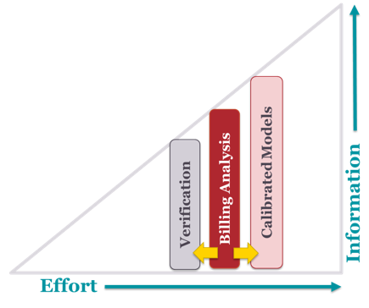
Utilities can Opt In! (HZ 2&3)
Billing Analysis
– Staged Approach
Billing analysis; minimize utility burden
Info from pilot analysis
If needed: more work to explain ‘why?’
Second stage:
Customer files for outliers
  baseline heating system
  home size
Phone surveys
  secondary heat
  changes in occupancy
SEEM model calibration
Effort
11

Slide 12
Residential Envelope
Measure Group | Approach | Data Source | Second Stage Outlier Analysis
 |  | Utility
Insulation |  | Energy Consumption Data* Customer File** | SEEM model calibration Phone surveys
Windows
Billing Analysis
*Evaluation targets census of billing data; sample where unfeasible
**Staged request.
Initial - evaluation would love any customer information that is easy for utilities to provide (project files, auditor data)
Stage two - evaluation may request a sub-sample of customer files for outlier projects

Slide 13
What Will We Learn?
Estimate savings directly for windows and insulation
  If enough sample, may see savings by HZs or measure
Opportunity to investigate why savings estimates may vary from RTF claimed savings
Calibrated Models
Billing Analysis
Information
Verification
Effort
13

Slide 14
Residential HVAC
Measure Group | Approach | Data Sources
 |  | 3rd Party Imp. | Utility
Prescriptive Duct Sealing |  |  | Energy Consumption Data* Customer Files**
Ductless Heat Pumps replacing Forced Air Furnaces
Heat Pumps, Commissioning, Controls & Sizing, Performance Duct Sealing |  | QA/QC Data
Billing Analysis
Engineering Review
*Evaluation targets census of billing data; sample where unfeasible
**Staged request similar to Envelope

Slide 15
What Will We Learn?
Heat Pumps, CC&S, Performance Duct Sealing
Verifies delivery in terms of:
Quantity, Measure specifications, Measure applications
  Passes through underlying assumptions
Envelope, Prescriptive Duct Sealing & DHP Replacing FAF
  Estimate savings directly
  Opportunity to investigate why savings
  may vary from RTF claimed savings
    Phase 2 outlier analysis
    might provide insights
Eng. Review
15

Slide 16
What about the Results?
Report Includes
Evaluated savings
Report Doesn’t Include
Utility-specific results**
Impact
Adjust historic savings in the Redbook
Realization Rates
Cost-effectiveness
Inform program design
Inform future measures
Recommendations
** If requested, BPA can provide utility with their results: project results for delivery verification and average savings and uncertainty for billing analysis models
16

Slide 17
Sampling
Utility savings for each measure group
Large Contributors (>5%)
Certainly sampled
Tiny Contributors (smallest savers up to 5%)
Excluded from sample
Medium Contributors
(2-5%) and Small Contributors (rest)
Random sample of these
Exclude if had FY2014 COTR oversight
17

Slide 18
Number of Utilities in each Stratum
Stratum | Insulation | Windows | Prescriptive Duct Sealing | DHP replacing FAF | Lighting - By Request | Lighting - Retail
Large Contributors | 4 | 2 | 5 | 6 | 4 | 4
Medium Contributors | 11 | 14 | 8 | 9 | 4 | 6
Small Contributors | 32 | 39 | 3 | 28 | 6 | 8
Tiny Contributors | 61 | 53 | 92 | 65 | 94 | 90
** PTCS Duct Sealing, HPs & CCS not listed because evaluation will use PTCS QA/QC

Slide 19
Sample Sizes
Measure Group* | Number of Utilities | Target Number of Projects
Retail | 7 | 75*
By Request | 6 | 65*
Insulation | 12 | ~2500**
Windows | 10 | ~1700**
Prescriptive Duct Sealing | 10 | ~500**
Ductless Heat Pumps replacing Forced Air Furnaces | 14 | ~800**
*Utilities to provide CLEAResult invoice numbers for sampled Simple Steps projects and IM-required data not available via third party implementers for other sampled projects
**Evaluation targets census of billing data; sample where unfeasible
19

Slide 20
Draft 2016 UES Evaluation Schedule
Domain | Data Collection | Analysis | Final Report
Res-Lighting | April – May | June – September | Late-September
Res-Envelope | April – May | June – September* | Mid-December
Res-HVAC | April – July | June – September* | Mid-December
* Decision on outlier analysis expected July-August
20

Slide 21
Data Collection Timeline
6 week data collection period
May 25th – Data due
Please let us know by May 11th if you need an extra week or two, but please keep in mind that we’re striving for a timely evaluation to ensure our findings and recommendations are relevant.
21

Slide 22
Data Security
Anonymize your data
Secure file transfer options
NDA with evaluation contractor
Contact Tolga Tutar, 360-828-4020 tolga.tutar@navigant.com, for data related questions.
22

Slide 23

Support
Office Hours
  Standing ‘office hours’ each Wednesday afternoon 1-2pm through May
  We’ll be online and on the phone to answer any questions*
One-on-One Support
  Anytime, contact:
    Lauren Gage - BPA project manager: lsmgage@bpa.gov
    Melissa Podeszwa – BPA Communications - mjpodeszwa@bpa.gov
    Tolga Tutar – Navigant data contact tolga.tutar@navigant.com
  Multiple data transfer modes offered (secure FTP, email, fax, mail, on-site support)
    * Dial in 866.227.0668 Code 539.468.4942 https://insidenci.webex.com/meet/jrivas

Slide 24
Data Collection Process
Review sampled projects
(on ‘Main Sample’ tab)
Provide required data directly in workbook
(e.g. Invoice #, Billing Data)
Prepare additional data
(e.g. non-Simple Step invoices)
Save and send all files by FTP or to Tolga.Tutar@Navigant.com
24

Slide 25
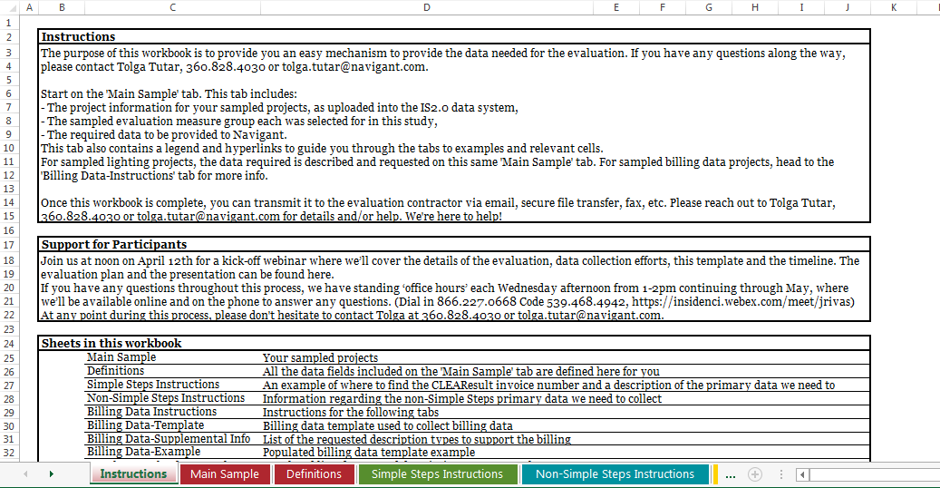
Data Collection
Detailed data request provided in excel workbook

Slide 26

Let’s Walk Through the Email Notification Data Collection Template!

Slide 27





Tracking Move Ins & Move Outs
What we DO want:
Billing data for the unique combination of the sampled end user and the house at which the measure was installed
What we DON’T want:
Billing data for the sampled site before or after the participating end user lived there
Billing data for the participating end user at a different house

Slide 28
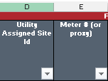
How Do You Track This?
We need bills for end user + location (where measure was installed)
  To filter for change in occupancy, we need field(s) that allow us to track both parameters
Please provide evaluation team any field(s) that can be of help
  Use columns D and E for this information (and document what fields from your CIS you used), or
  Evaluation team can reissue a data collection template with these fields, or
  You can add columns to data collection template to provide the necessary fields
  Not a one-sized fits all solution, we can work with you to customize this!

Slide 29
Duplicate Sampled Sites
Thanks for your close inspection of the template!
Duplicate line items in the current requested sample resulting from:
Invoice corrections
Site IDs with multiple measures installed within each measure group
Evaluation team will reissue the Sample Notification Workbooks
Let us know if you see any other issues &/or if there is anything helpful we can add!

