Slide 1
Evaluation Update and
Draft results of the
Site-Specific
Savings Portfolio
November 18, 2015
Prepared by: Lauren Gage, BPA and Michael Baker, SBW Consulting, Inc.
Prepared for: Regional Webinar

Slide 2
Why Evaluation?
What did we achieve?
Objectively, retrospectively documents and measures effects of a program in order to determine how well it has met its intended outcomes or goals.
How do we improve?
Accurate and reliable achievements
Transparency and accountability
Effectiveness of spending
Understand why effects occurred and identify ways to improve current and future programs
Constructive and strategic feedback
Understand, improve, get new measures
More to come!

Slide 3
Evaluation Update
Policies
QSSI Policies approved by Sponsors
Plans
2016 Strategy finalizing - UES evaluation focus
In Progress
Simple Steps
Billing analysis testing
Recent Results
Energy Management Pilot
Clark OPower Brownbag
Site-specific Evaluation
“Why Evaluation” brownbag
www.bpa.gov/goto/evaluation
Notes:
Remove for Oversample

Slide 4
Today’s Meeting
Design
Implement
Evaluate
Next:
Decide on recommendations
What else can we learn?
Today: Share draft results

Slide 5

BPA Evaluation Thoughts
Great Results
Confirms great work by utility and BPA staff
Good process, not perfect
Successes: transparency with utilities,
multi-functional team, lots of BPA review
Next steps important
Some areas of improvement
Improvement needed: duration, communication protocol tracking
BPA response to recommendations
How can we use it fully?
Study meets several needs
Huge Thanks!
Internal team
Utility staff
SBW/Cadmus team

Slide 6
Background
Site-Specific Evaluation

Slide 7
Evaluation Background
Site-Specific
Savings portfolio
Custom and calculator projects
Little recent evaluation
Timeline
Evaluation Plan : June–December 2013
Sample selection and contact (Feb – May 2014)
Data collection (June 2014 – June 2015)
Analysis and report preparation (July – August 2015)
Review and Finalize report (September 2015 – now)
~40% of BPA’s 2012-2013 achievements
All Sectors
Evaluation on non-res lighting in 2008
Evaluation of Energy Management Pilot in 2012
(new, separate evaluation forthcoming)
7

Slide 8
Objectives
Estimate first-year kWh savings for portfolio and 9 domains
Estimate the lifecycle cost-effectiveness
Identify opportunities for improving processes, M&V practices, evaluation
8

Slide 9
Domains
Option 1
Lighting
Non-lighting
Option 2
Lighting
Non-lighting
Commercial/Ag
Industrial
Commercial/Ag
Industrial
Commercial
Industrial
Commercial
Industrial
ESRP
Site-Specific Savings Portfolio
Notes:
Energy smart reserve projects

Slide 10
Sample Design
Sample represents ~28% of savings, but less than 3% of measures in population.
Utilities funded 1/3 of measures

Slide 11
More Evaluation Information
Response
Rate
Good response
from sample
(90%) acceptance
Little risk of non-
response bias
Supplemental
Data Collection
Majority of sites needed some data beyond program documentation
Phone surveys 93%, on-site 86%, metering 62%
Oversample
3 Utilities oversampled
Funded 31% of measures in study
Allows for separate estimates for their service areas

Slide 12
Estimating Site-Specific Savings – Guiding Principles
Treat all measures consistently. Small savers just as important as large savers in stratified random sample
Reuse available data. We re-used as much of the program-collected data as we determined to be reliable.
Focus on the key determinants and areas with greatest savings.

Slide 13

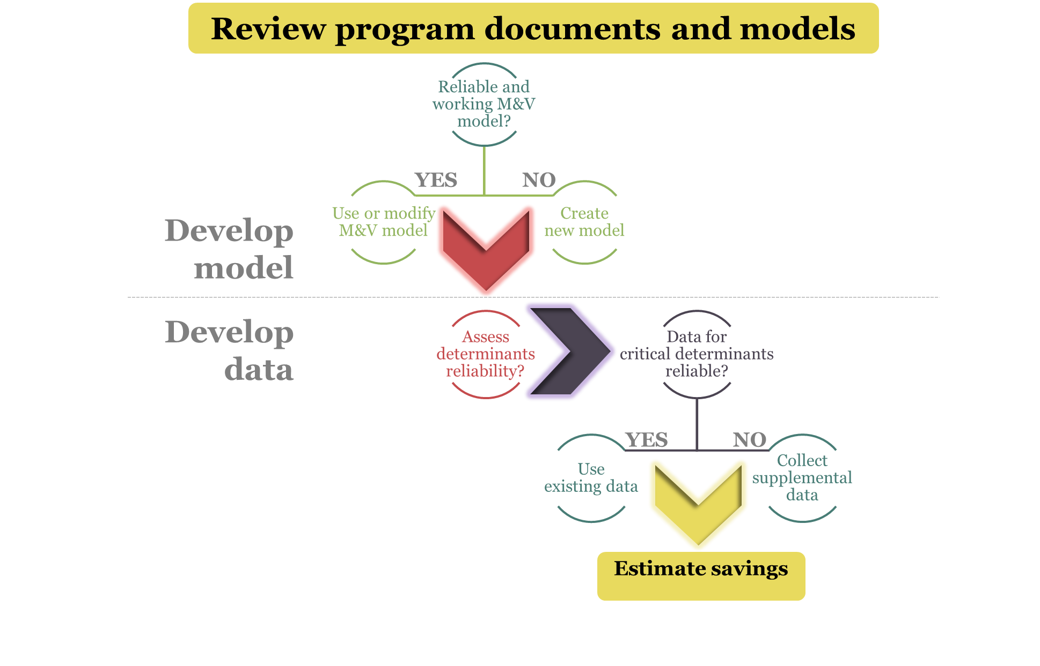
Process for
Estimating Measure Savings

Slide 14
Review by BPA and Utilities
BPA-Funded Measure Review
New Models
Oversample Utility Review
Some one-on-one discussions with utility staff
Site-specific results : BPA reviewed all Non-Lighting and sample of lighting
Utility review: Provided results, offered one-on-one discussions but not many occurred

Slide 15
What is a Realization Rate (RR)
Evaluation Savings
= Realization rate
Reported Savings
Realization rates greater than 1 mean that we found more savings than was reported
Realization rates less than 1 mean fewer savings were found

Slide 16
Findings
Site-Specific Evaluation

Slide 17
Overall Results
Evaluation savings for
the portfolio are nearly the same as the reported savings
  RR is 0.98
  Highs and lows tend to cancel out
  Combined Domains
  Measure: Lighting RR is 1.0 and Non-lighting RR is 1.03
  Sector: Both commercial and Industrial RRs are 0.98.
  Option: Option 1 RR is 0.98, Option 2 is 1.08

Slide 18
  Measure Realization Rates
Quite a bit of scatter by measure
Approximately 40% of portfolio has either high or low realization rate; essentially equal high and low

Slide 19
  Life-Cycle Cost-Effectiveness
All domains and portfolio are cost-effective (TRC 2.65)
Non-Electric Benefits increase TRC by 6%
(from 2.49 to 2.65)

Slide 20
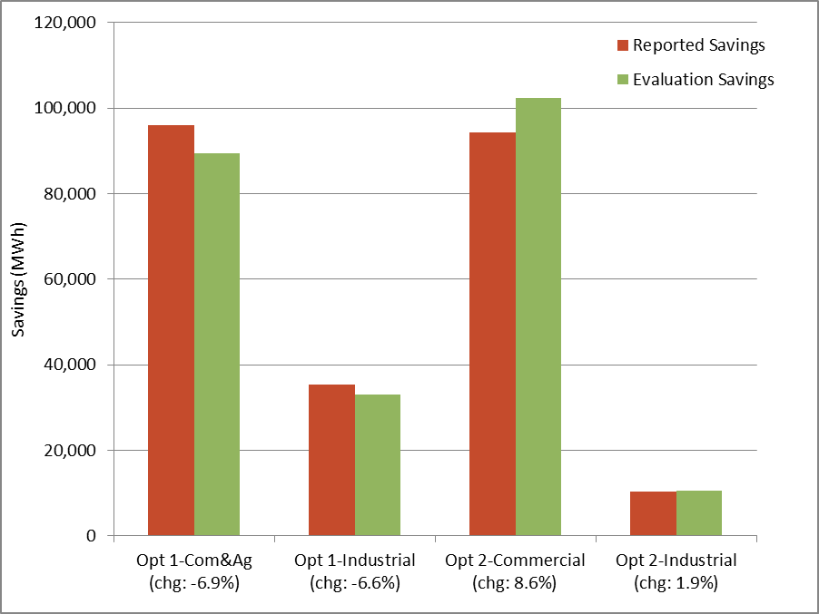
Lighting Savings
Overall, lighting RR is 1.0
  Offsetting factors between Option 1 and Option 2
  Option 1 RR is 0.93
  Option 2 Lighting RR is 1.08

Slide 21
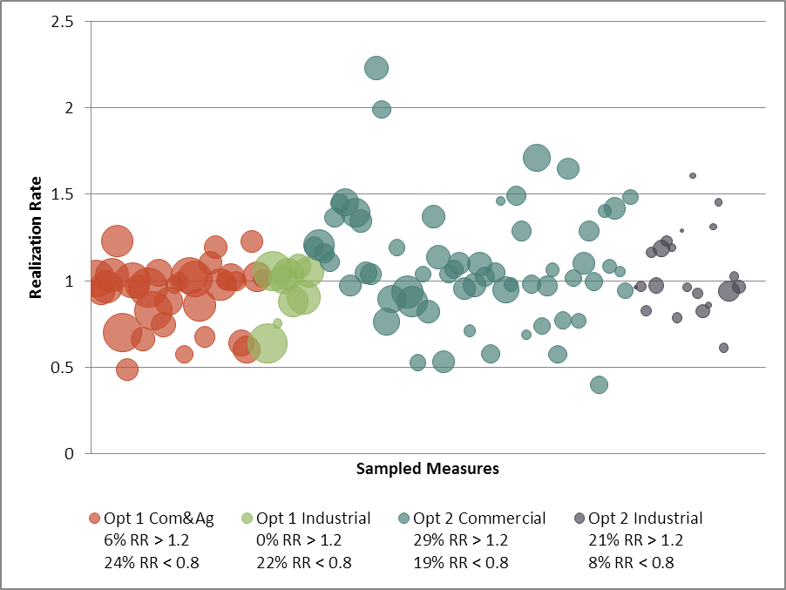
Lighting Realization Rates
Option 1
Mostly low RRs
Option 2
More scatter, more high RRs

Slide 22
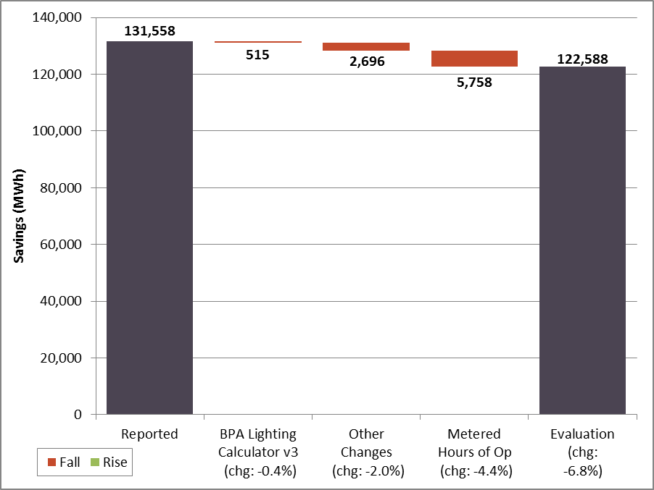
Option 1 Lighting
Evaluation found 6.8% less savings
  All factors less than 5% difference in savings:
  Metering found ~4% fewer hours of operation
  Other changes - HVAC system type and fixture type/count – reduced savings by ~2%

Slide 23
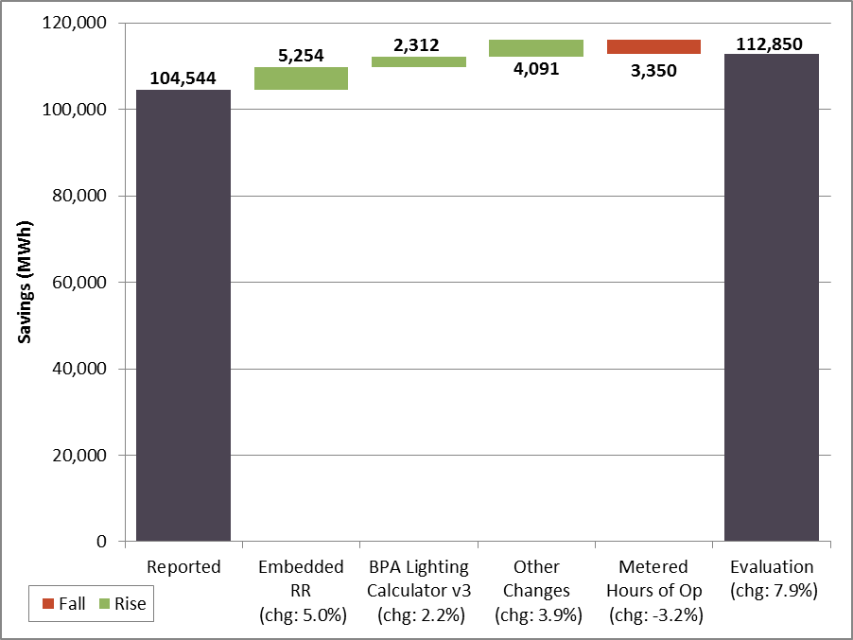
Option 2 Lighting
Evaluation found 7.9% more savings
Utility embedded largest factor (5% increase)
  Small other changes
  Metering found ~3% fewer hours of operation
  Change to BPA calculator increased savings by 2%

Slide 24
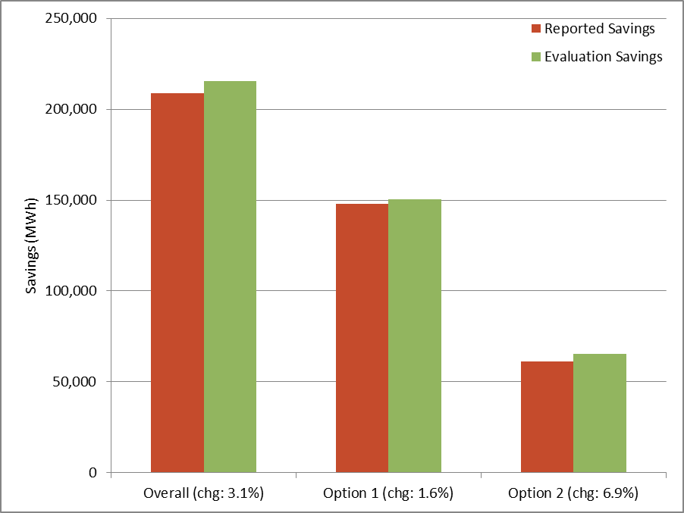
Non-Lighting Savings
Overall, Non-Lighting RR is 1.03
Evaluation found more savings for both Option 1 and Option 2
  Option 1 RR is 1.02
  Option 2 Lighting RR is 1.07

Slide 25
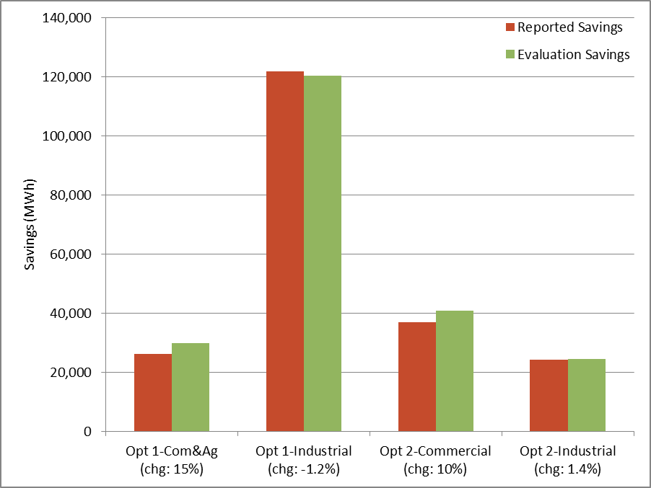
Non-Lighting Savings
Evaluation found 10%+ more savings for Opt 1 and 2 Commercial
Option 2 embedded RR : under-reporting of savings
  Commercial 7% Industrial 5%

Slide 26
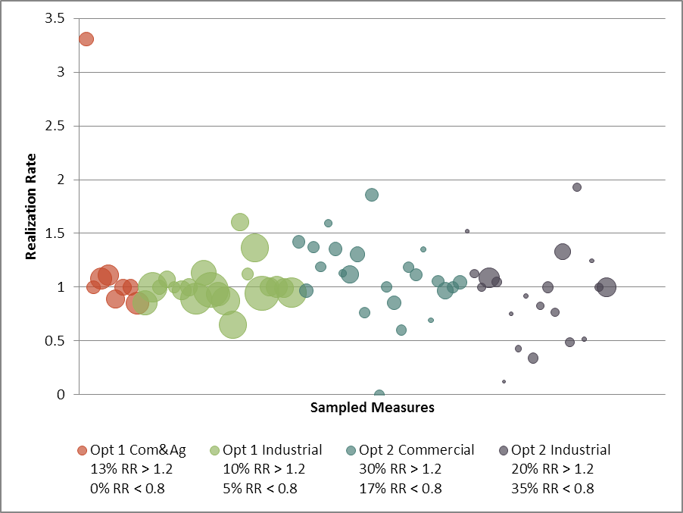
Non-Lighting Realization Rates
Option 1 has less scatter than Option 2

Slide 27
Energy Smart Reserve Projects (ESRP) Realization Rates
All RRs are below 1
Three measures have RR below 0.5 and one RR is negative
Issues:
Multiple projects: downstream reuse saved water assumptions
One project with atypical first-year operation

Slide 28
Adherence to Protocols and Guidelines

Slide 29
Compliance with
Protocol Selection Guideline
Option 1 has high compliance
Option 2 lower compliance
Commercial – More than half not compliant
Compliance may not predict RR

Slide 30
Other Findings
IM Documentation Requirements
Substantial number of invoices missing
Option 1: Lighting (~50%), Non-lighting (~25%)
Some Option 1 Com/Ag completion workbooks missing
Some Option 2 M&V plans missing (~17%)
Other documentation
Some “Working” models missing, especially for Option 2 (~25%)
TAP Assignment
Option 1 Lighting calculator does not use TAP codes
Option 2 has high rate of misclassification for Lighting and Non-Lighting (~48%)

Slide 31
Other Products
COTR Oversight
Site-specific results provided to BPA COTRs for oversight purposes
Lighting Metering Data
Data to inform RTF lighting standard protocol
Commercial momentum savings and HVAC interaction factors

Slide 32
Recommendations

Slide 33
Increasing Reliability of
M&V Savings Estimates
Avoid Embedded Realization Rates
Clarify M&V Protocols
Improve QC for ESRP projects
Improve Lighting Calculators
Avoid or Improve Simplified Saving Calculators
33

Slide 34
Improving Program Documentation
Require Working Models
Obtain and Store Contractor Invoices
Improve Document Organization and Version Control
Document: Project Specs, Milestones,
M&V Protocol, Project Engineer
Improve TAP Coding
Investigate Opportunities for Reducing Reporting Burden

Slide 35
Improving Future Evaluations
Align evaluation protocols with M&V protocols
Consider faster or real-time evaluation
Require and simplify end user contact
Improve tracking of utility and end-user contact
Ensure all site-specific projects are included in evaluation

Slide 36
Next Steps
Design
Implement
Evaluate
Next:
Decide on recommendations
What else can we learn?

Slide 37
Questions?
Report and highlights:
www.bpa.gov/goto/evaluation
Lauren S.M. Gage
lsmgage@bpa.gov

