Slide 1
Instructions:
This is a customizable slide deck to present a general overview of BPA’s energy efficiency program and the value energy efficiency can provide to a customer utility. Please save a local file on your computer. If you are seeking additional content or assistance with customization, please contact your Energy Efficiency Representative.

Slide 2

Energy Efficiency

Slide 3
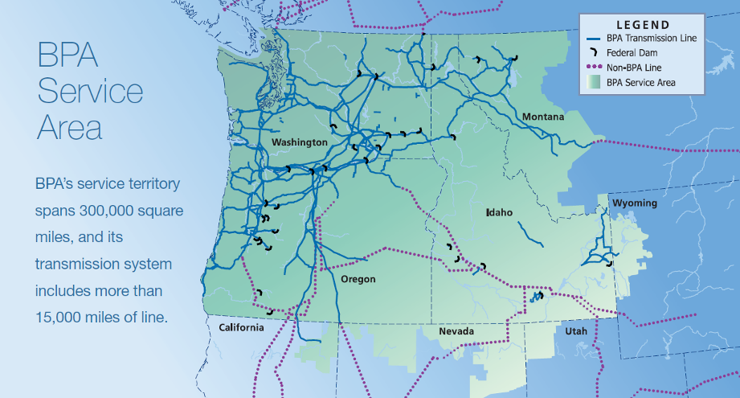
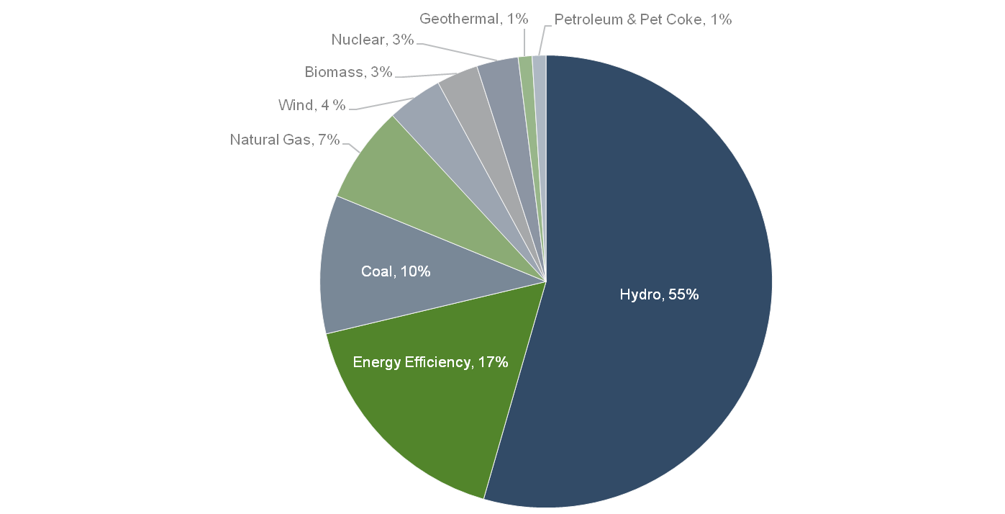
BPA Service Territory
Source: 6th Power Plan Mid Term Assessment March 15, 2013

Slide 4

THE BASICS OF ENERGY EFFICIENCY
What is Energy Efficiency?
Provides customers with the same energy service.
Does not decrease comfort, utility, output or value.
Reduces the amount of kWh being used.
Power Act: “conservation" means any reduction in electric power consumption as a result of increases in the efficiency of energy use, production, or distribution.

Slide 5
THE VALUE OF ENERGY EFFICIENCY
The primary benefits of Energy Efficiency:
Lower energy bills.
Good for the environment.
Customer satisfaction.
Economic development.
Enhances quality of life.

Slide 6
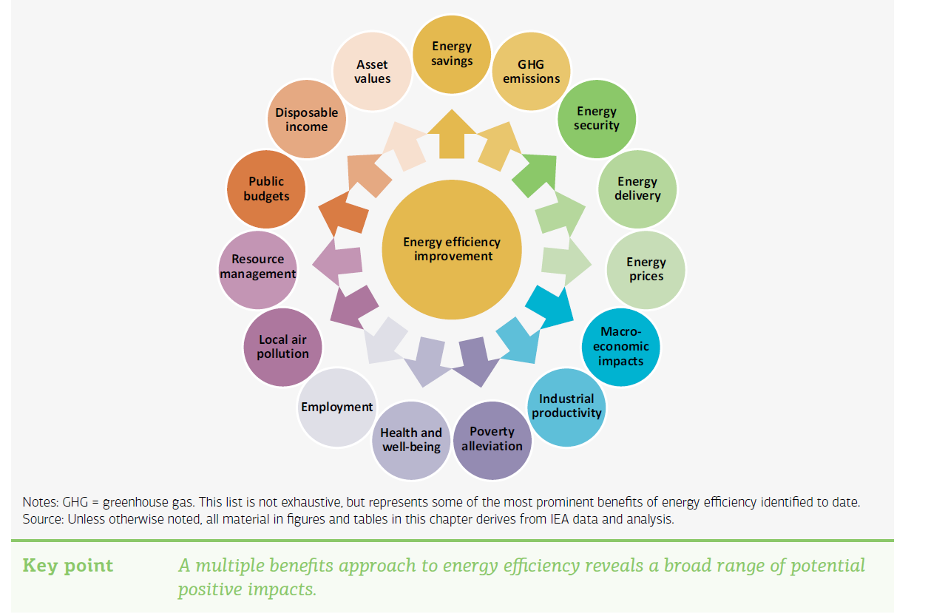
BENEFITS OF ENERGY EFFICIENCY
Primary benefits:
Other benefits:
Lower energy bills.
Good for the environment.
Customer satisfaction.
Economic development.
Enhances quality of life.

Slide 7

WHY BPA AND ENERGY EFFICIENCY?
It is a strategic priority
“The Bonneville Power Administration’s mission is to create and deliver the best value for our customers and constituents…”
Energy efficiency provides the best value because it allows the agency to do more with the system, i.e., “stretching the river.”
Investments in energy efficiency allow the agency to avoid having to buy more expensive power and additional transmission assets to deliver that power.

Slide 8


WHY BPA AND ENERGY EFFICIENCY?
1980 Power & Conservation Act
The Act established the Northwest Power Planning Council, which prepares a 20-year Power Plan every five years.
The Power Plan identifies the best mix of resources, including conservation, to meet Northwest power needs, based on total resource cost.
The Act directs the Administrator to, “acquire such resources through conservation, implement all such conservation measures…to reduce load, as the Administrator determines are consistent with the plan.”
As a result, BPA established the Energy Efficiency department to satisfy this statutory obligation.
For the Seventh Northwest Power Plan, BPA is currently planning to achieve 42% of the regional energy-efficiency target — 588 aMW between 2016 and 2021 — in concert with its public power customers.

Slide 9
BPA’S ROLE IN ENERGY EFFICIENCY
Roles and Responsibilities
Conducts a public process to establish a framework for BPA and the public utilities to acquire cost-effective energy efficiency in the Pacific Northwest.
Guides the delivery of opportunities and programs, and provides the necessary tools, technical support and financial resources to our utility customers.
Promotes energy efficiency, renewable resources, and new and emerging technologies through numerous channels, including programmatic efforts, market transformation and non-programmatic savings.
Dedicated to acquiring energy efficiency consistent with sound business principles, and environmental stewardship and accountability.

Slide 10
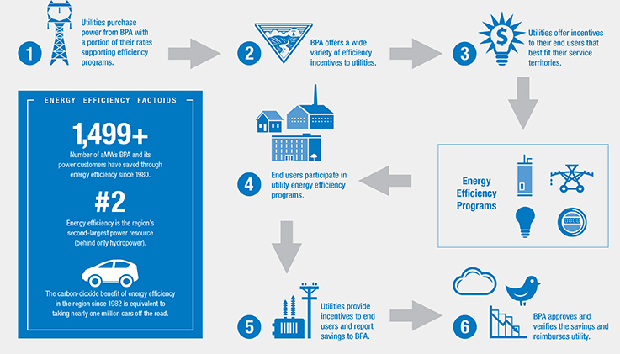
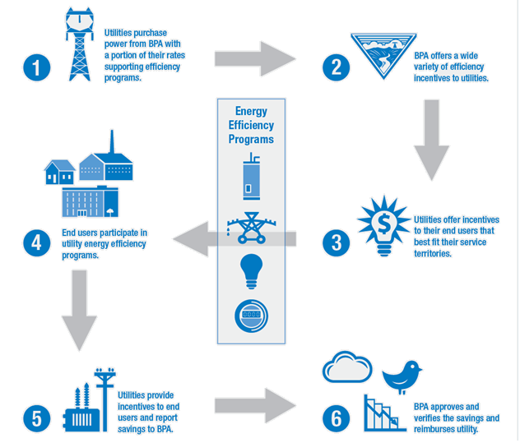
BPA’S ROLE IN ENERGY EFFICIENCY
The Programmatic Energy-Efficiency Process:

Slide 11

BPA’S ROLE IN ENERGY EFFICIENCY
The Energy Efficiency Value Stream:
New technologies
Measure development
Savings robustness
Menu of programs & measures
Trade Ally Networks
Engineering technical support
Momentum savings
Regional advocacy
Codes and standards

Slide 12


THE VALIDATION OF SAVINGS
Is it Real?
The Regional Technical Forum is a group created at the direction of Congress, that establishes savings for energy-efficiency measures, creates installation standards, establishes measurement and verification protocols, market research standards and evaluation protocols. All of this work is based on rigorous empirical research.
BPA requires rigorous evaluation, measurement and verification of the custom projects we support to ensure the region can count on the savings we claim. BPA also performs regular program evaluations to determine the effectiveness of its energy-efficiency portfolio.

Slide 13
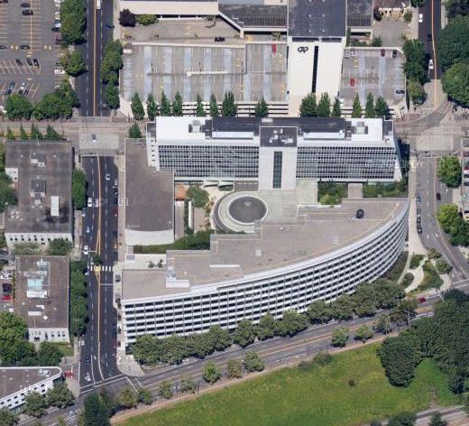
WORKING WITH UTILITIES
Collaboration is Key
BPA relies on its customer utilities to execute energy-efficiency programs.
Utilities offer the programs and measures that are right for their customers.
Utilities largely control the funding to support energy-efficiency programs.

Slide 14






BPA EE Programs
Program Sectors
Residential: Single-family, multifamily, and manufactured homes.
Commercial: Businesses, institutional buildings, miscellaneous end-uses.
Industrial: Manufacturing, municipal utility services.
Agricultural: Irrigation, on-farm production, aquaculture, dairies.
Multisector: Nonresidential lighting systems, other miscellaneous end-uses.
Utility Distribution: Electric utility owned/operated equipment and facilities.
Federal: A BPA program that assists federal agencies that are either served by BPA directly or through a utility, to reduce their energy consumption.

Slide 15






EMERGING TECHNOLOGY PROGRAM
Filling the Pipeline
BPA’s Emerging Technology Program analyzes the electricity-savings capabilities of new technologies, which is a primary factor in setting incentive levels aimed at driving consumer adoption.
BPA’s customer utilities provide financial incentives to their end users to install these vetted technologies. Annually, BPA’s customer utilities provide approximately $70 million to end users.

Slide 18

Marketing Materials
These materials are available for utility customization on the BPA marketing portal or in the marketing toolkits on the BPA website.
If you need assistance in creating or customizing marketing materials, please contact your Energy Efficiency Representative.

Slide 19
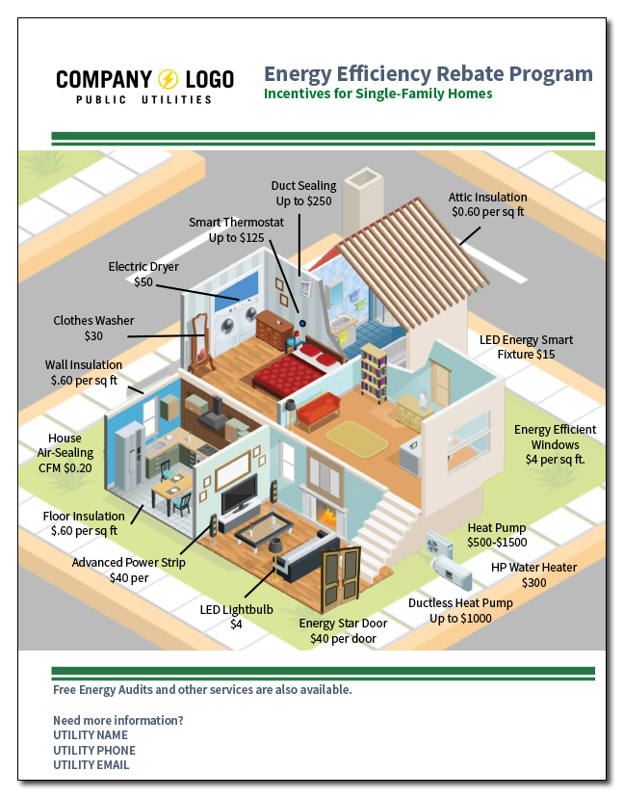
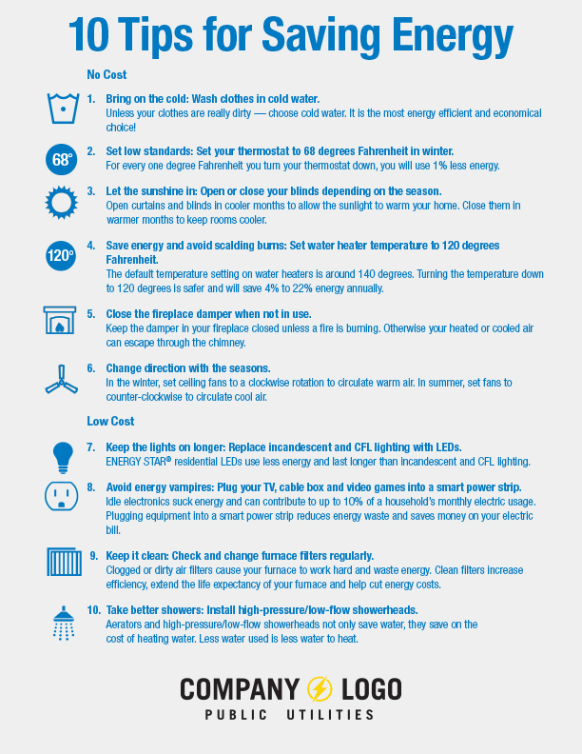

Slide 20



Slide 21



Slide 22



Slide 23



Slide 24



Slide 25



Slide 26



Slide 27



Slide 28



Slide 29



Slide 30


Slide 31


Slide 32



Slide 33

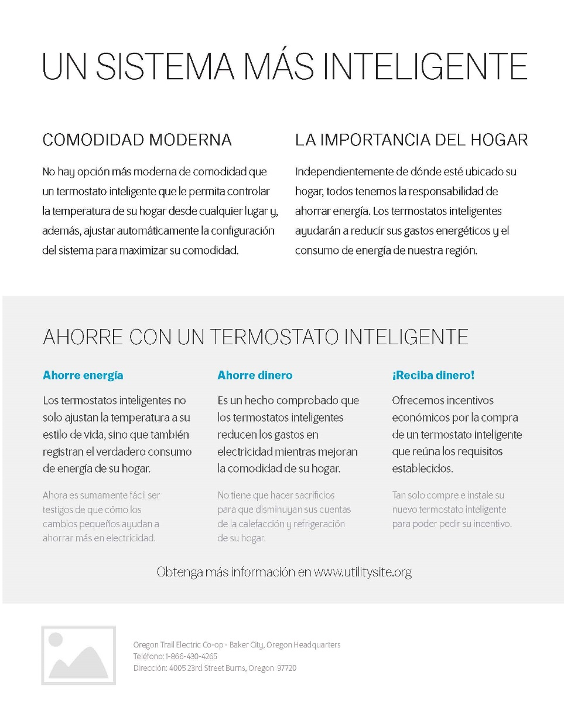

Slide 34



Slide 35



Slide 36



Slide 37



Slide 38



Slide 39


Slide 40



Slide 41



Slide 42




Slide 43




Slide 44
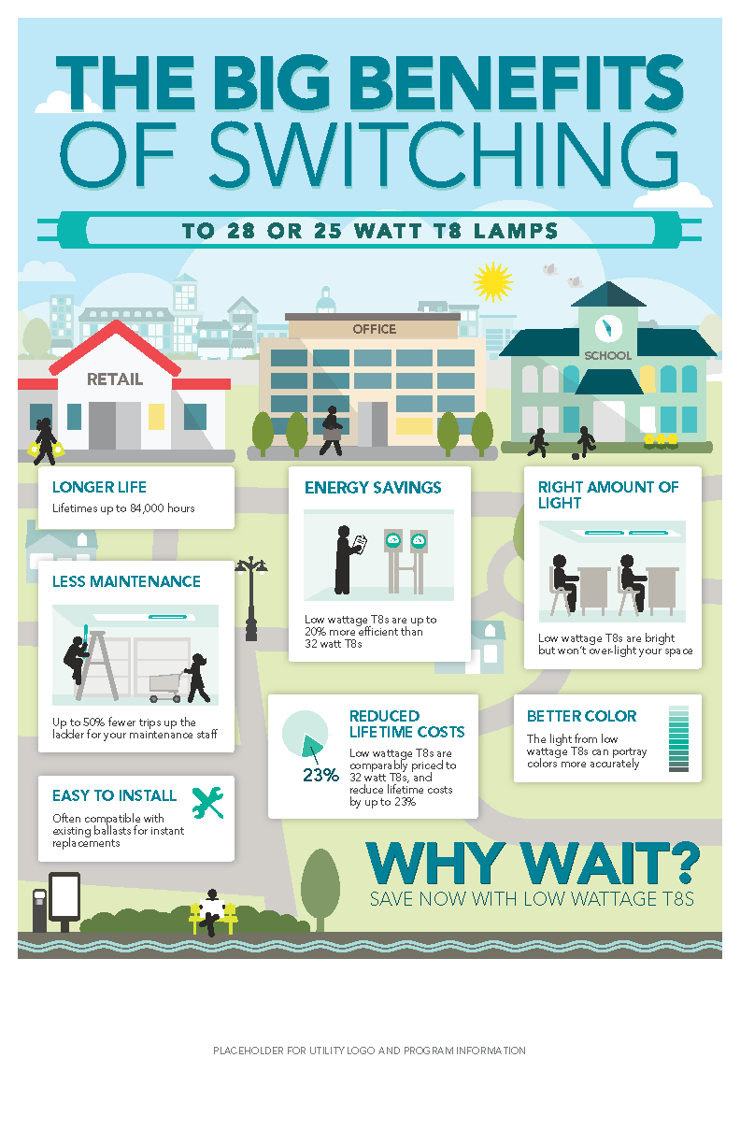


Slide 45



Slide 46

UTILITY NAME
UTILITY WEBSITE
UTILITY ADDRESS LINE 1
UTILITY ADDRESS LINE 2
UTILITY PHONE

Slide 47

www.bpa.gov/energyefficiency

