Slide 1
BPA Energy Efficiency Marketing Portal Training
Instructions for adding images
and changing graphics and content.

Slide 2
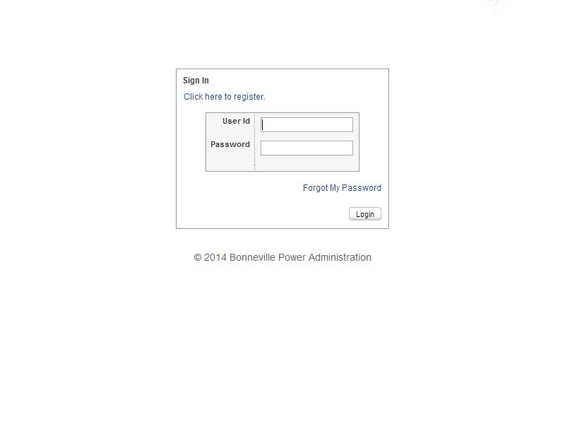
Log In to the MarCom Central Portal: http://marcomcentral.app.pti.com/Bonneville_Power_Administration/bpa

Slide 3
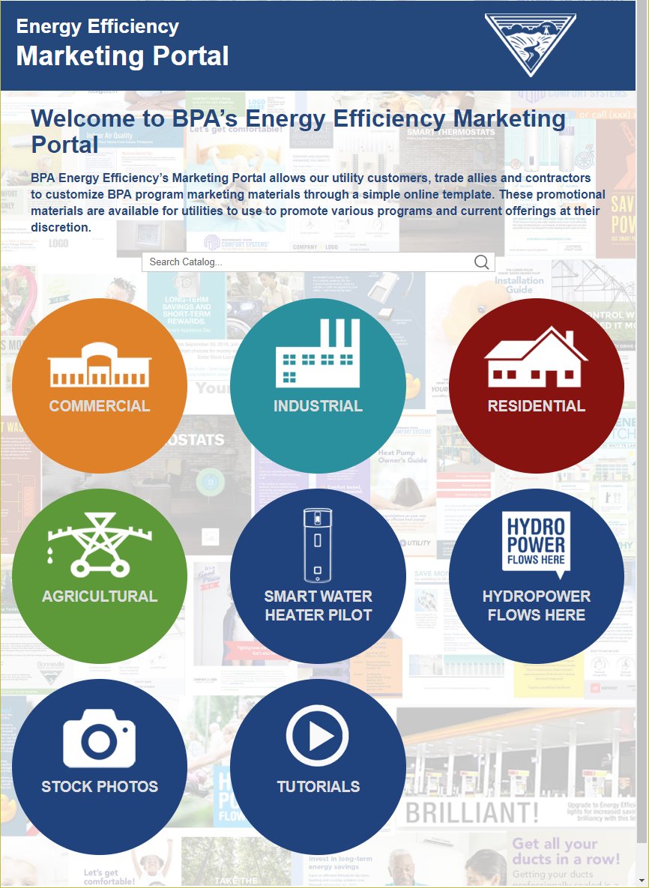
After you log into the website, you will see the Product Catalog page. Select the energy efficiency sector that you are interested in reviewing and click on it.

Slide 4
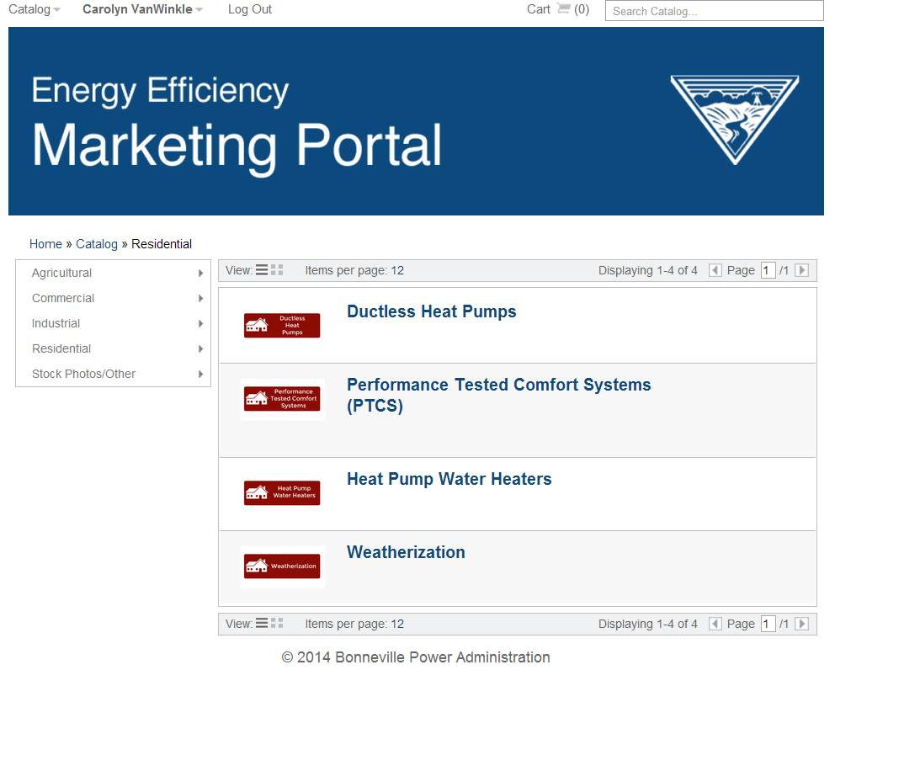
You will then see program options that have customizable promotional materials for your use. Select the program you are interested in promoting.

Slide 5
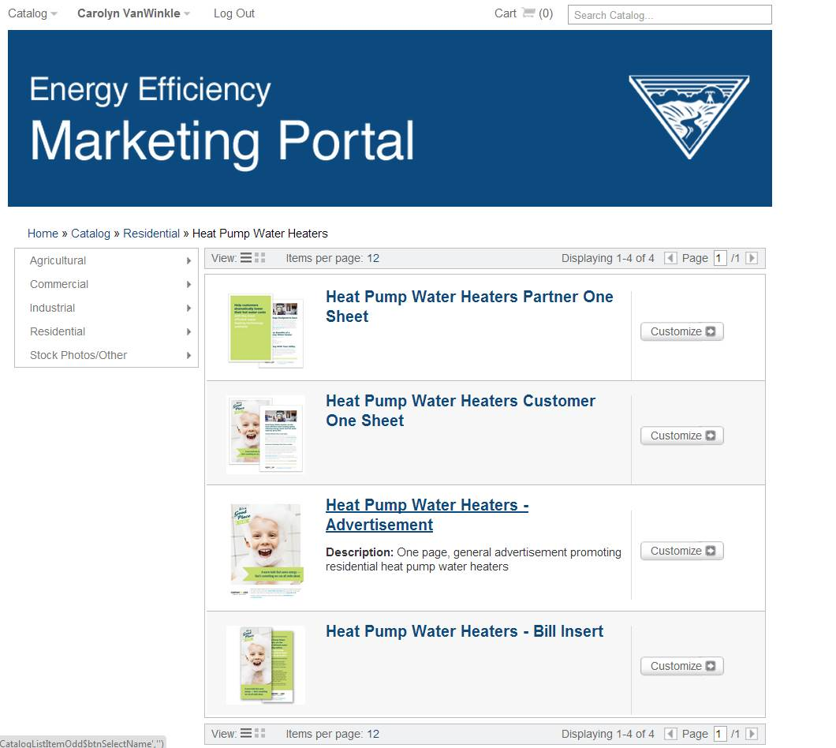
Select the marketing piece that you would like to customize.

Slide 6
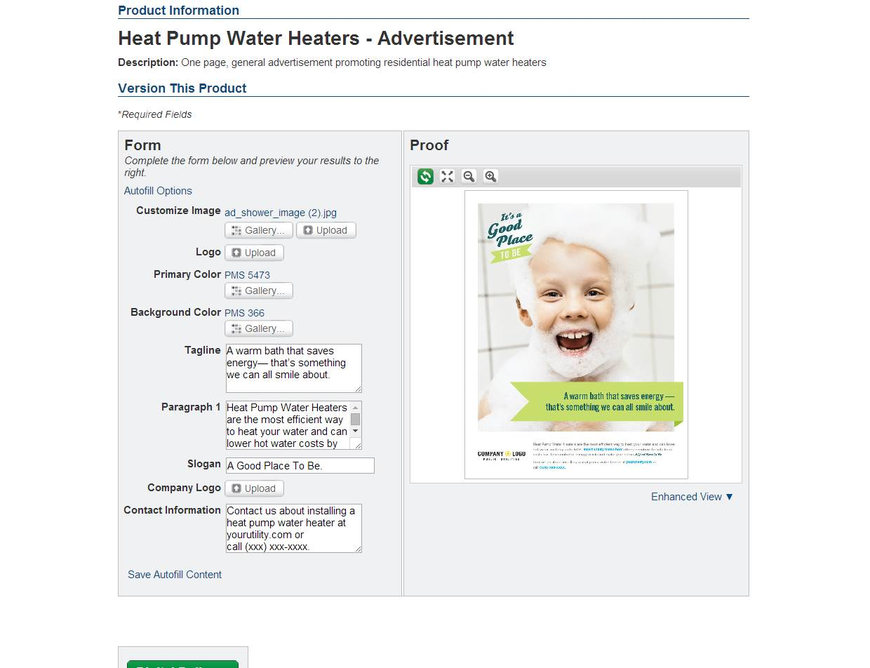
On this page, you will see the customizable form options on the left and the proof on the right. You are ready to begin customizing this advertisement.

Slide 7
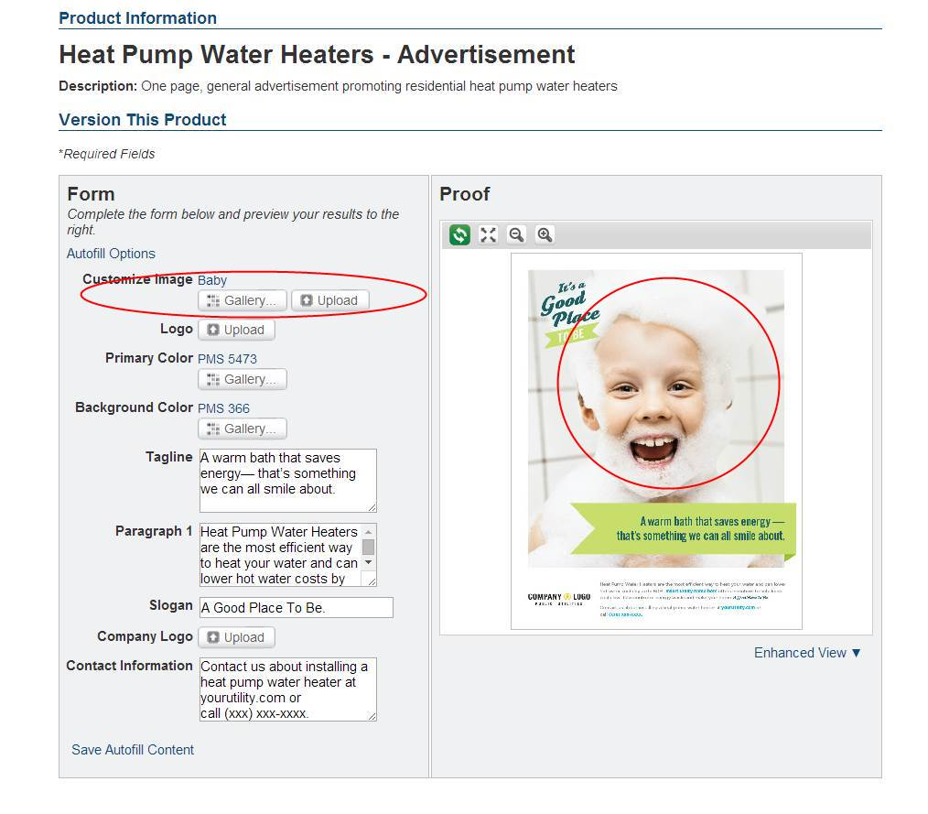
The first option on the form, Customize Image, allows you to change the background image.
Select Upload to search the files on your computer for the new image.

Slide 8
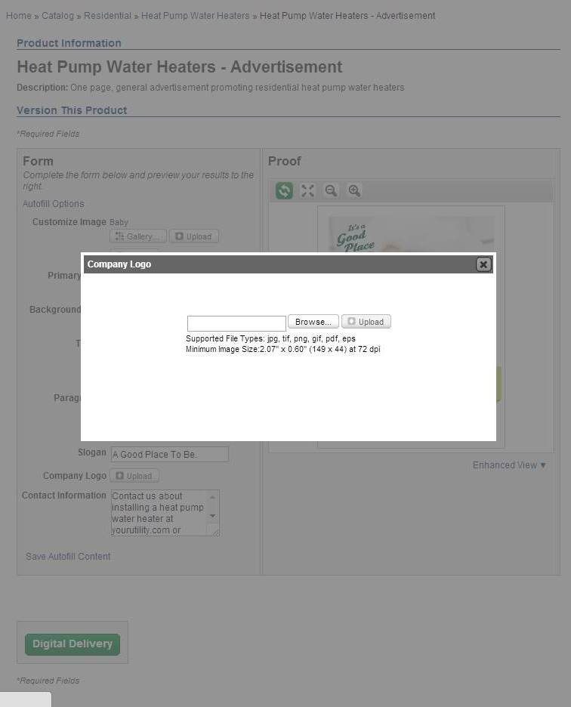
The Browse button allows you to search your computer for the logo file you want to add the advertisement. Select the Browse button, search your files for the correct logo and then select Upload to add new image to the template.

Slide 9
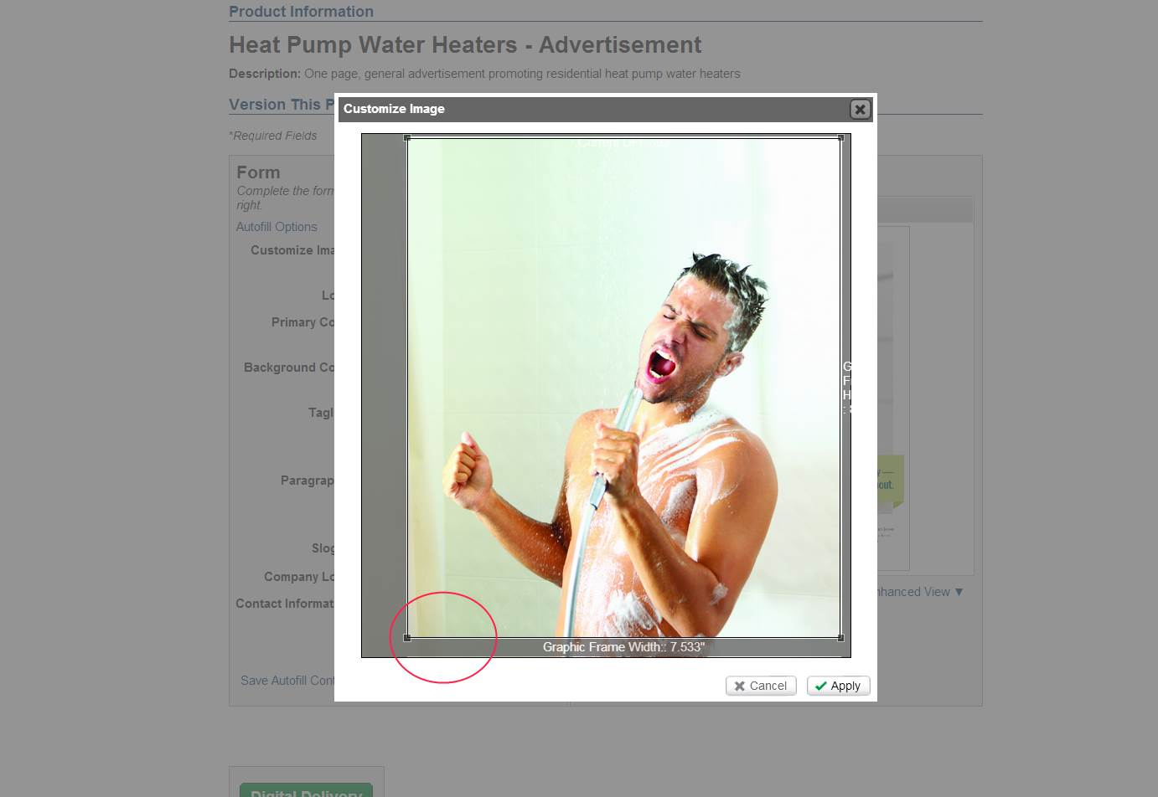
Once the image is uploaded, you have the ability to crop it as needed. Use your cursor to move along the lines of the Graphic Frame and crop the image.

Slide 10
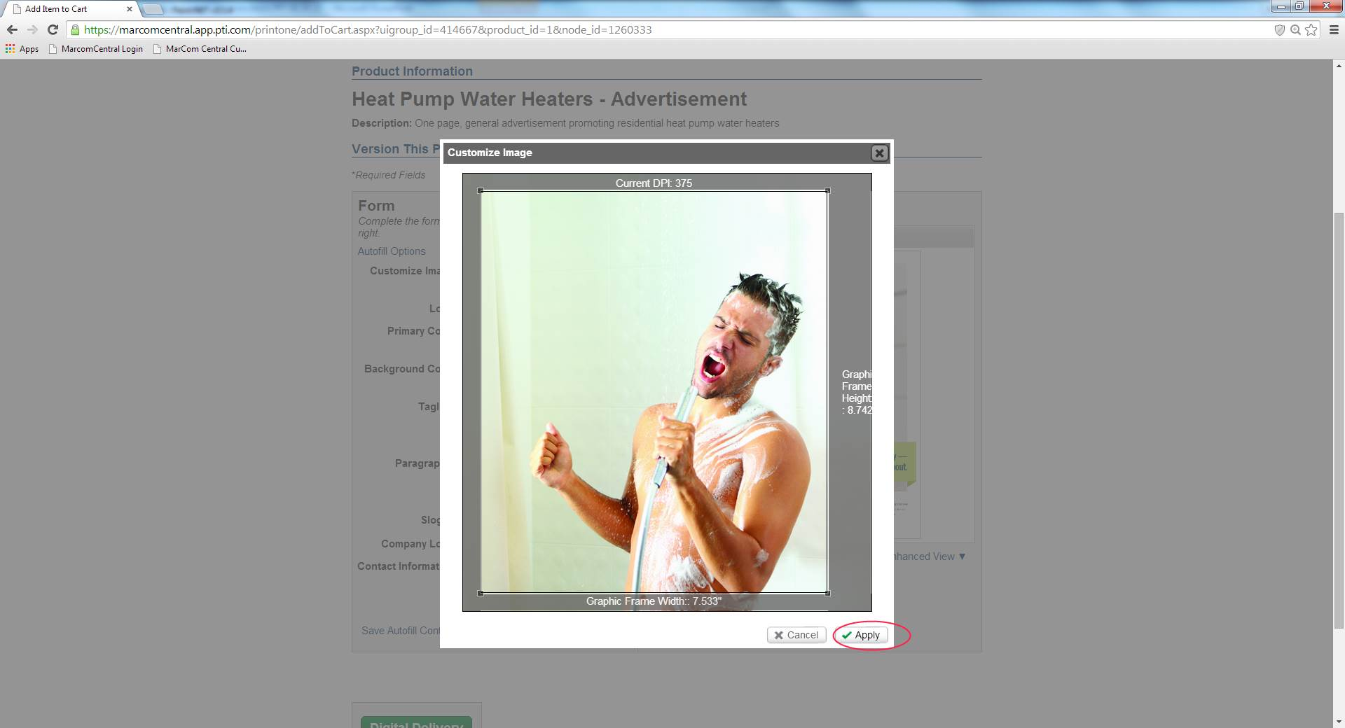
Once you have the final image you want to upload. If it is correct, click Apply.

Slide 11
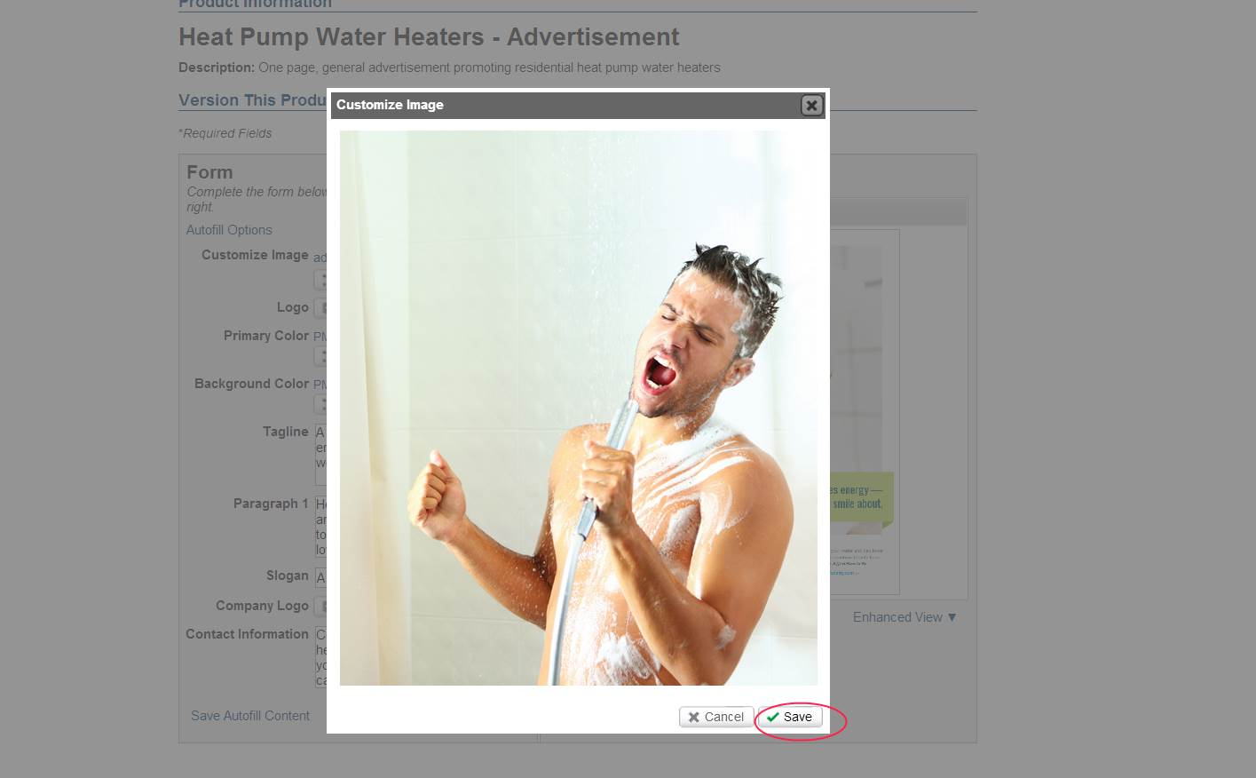
The program will give you one more prompt to Save the final image and upload it to the template.

Slide 12
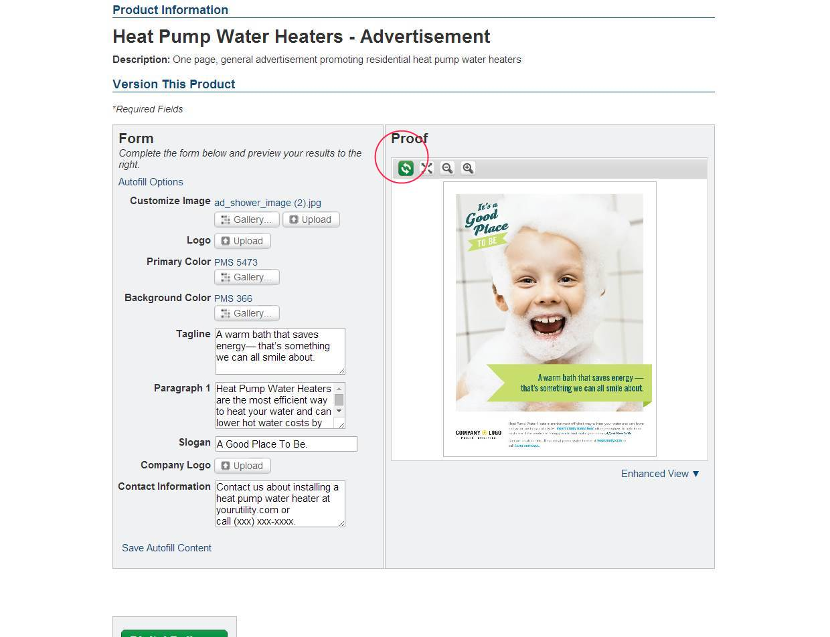
After you upload the new image, the proof screen will still show the original template. To see your new image on the advertisement, select the green arrows under the word Proof.

Slide 13
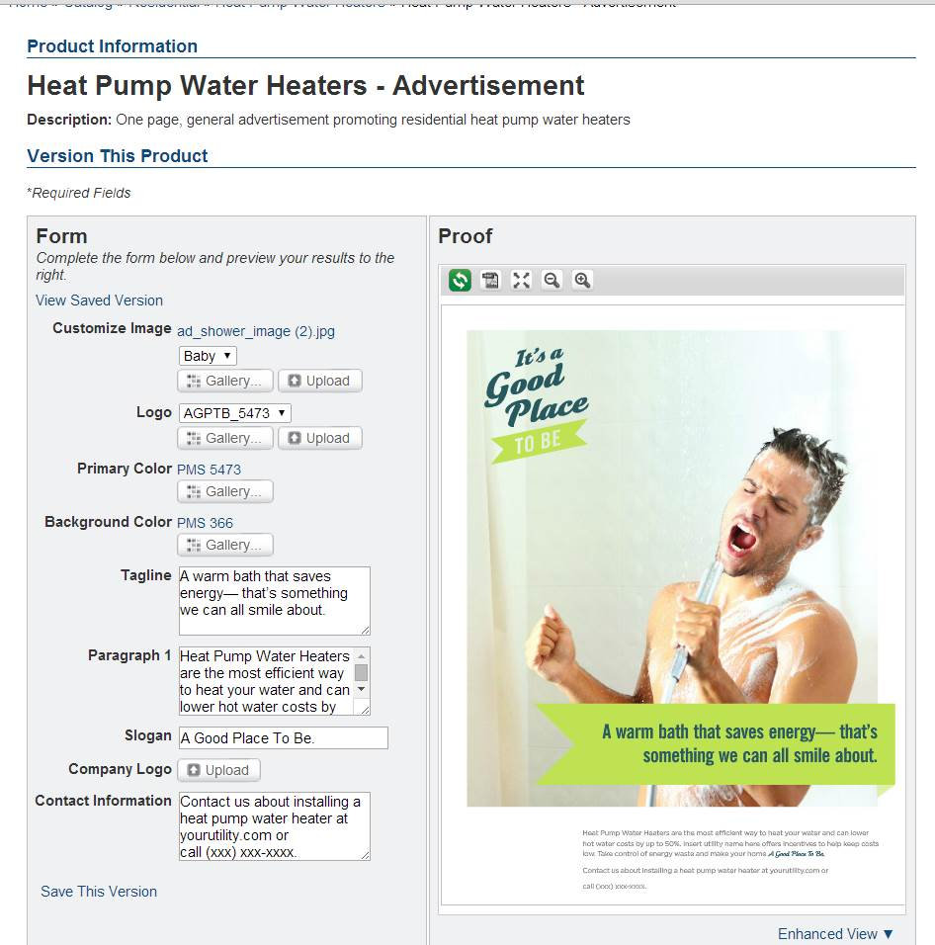
The proof will then update with your new image.

Slide 14
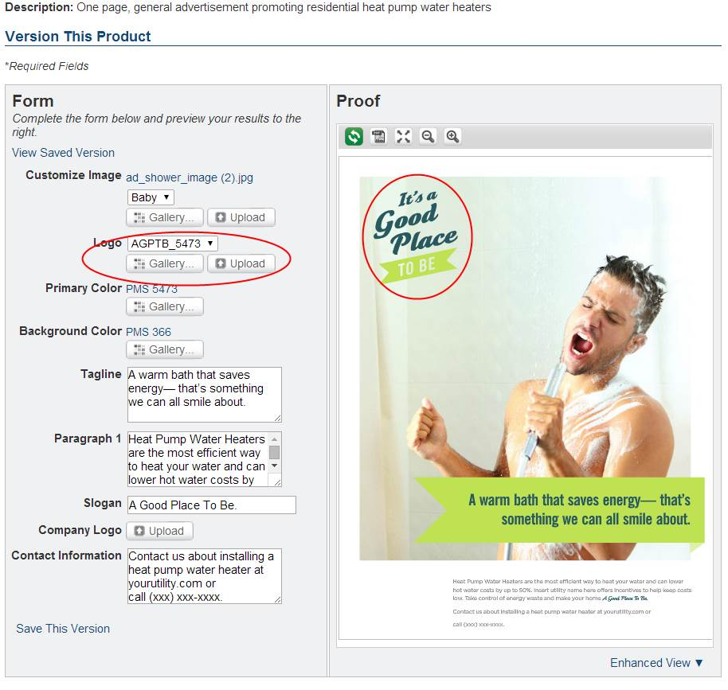
The first Logo that you have the option of changing is located in the top left corner of this advertisement.
To customize this logo you have the choice to:
- Move the drop down to the blank space for no logo
-Select the “It’s a Good Place to Be” logo from the Gallery
-Upload your own logo

Slide 15
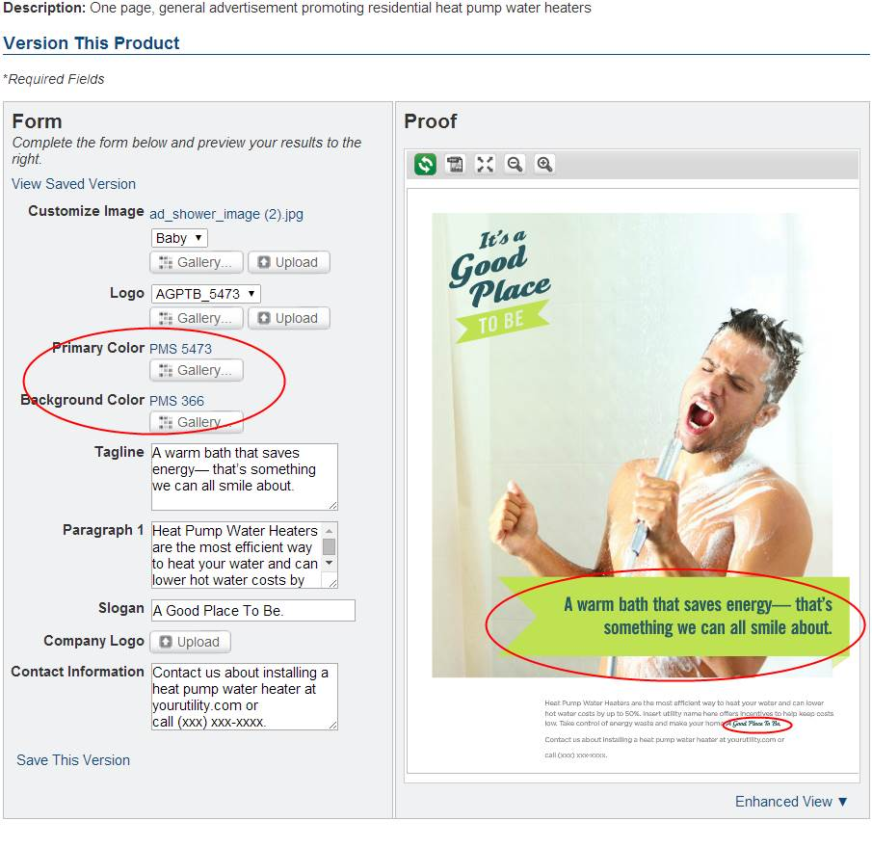
The Primary Color changes the color of the Tagline and Slogan text, and the Background Color changes the color of the banner. Click on Gallery to see your color options.

Slide 16
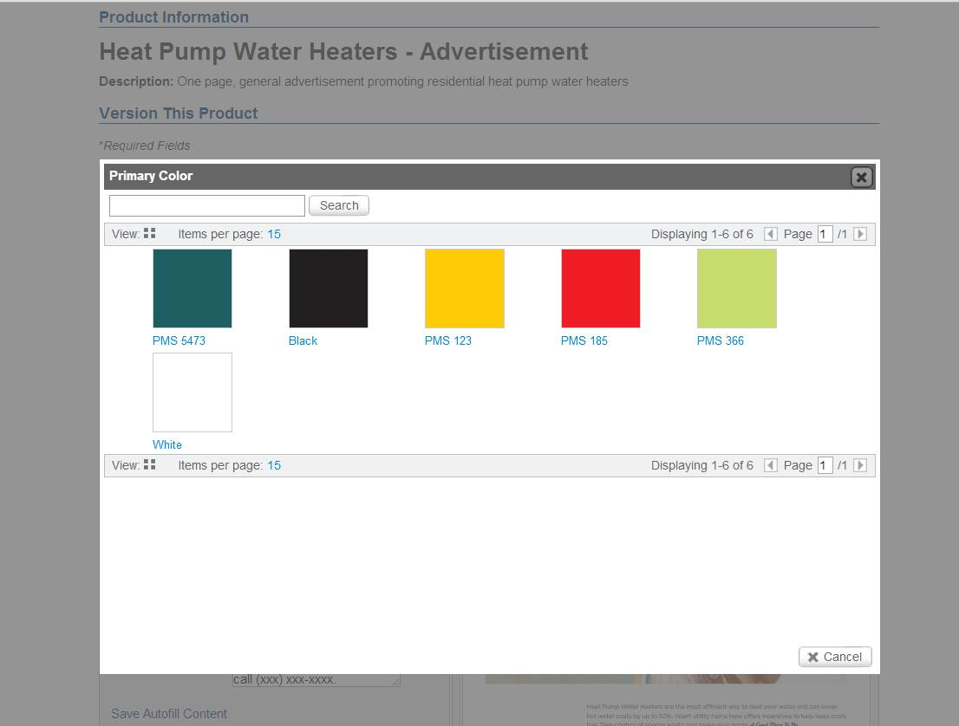
The color gallery gives you several options; however, at this time, you are not able to add any additional Hex color codes to this gallery. If you do need to use a specific color that is not listed here, please contact your EER, and the BPA marketing department can help you.
Click on the colors you would like to update for the text and the banner.

Slide 17
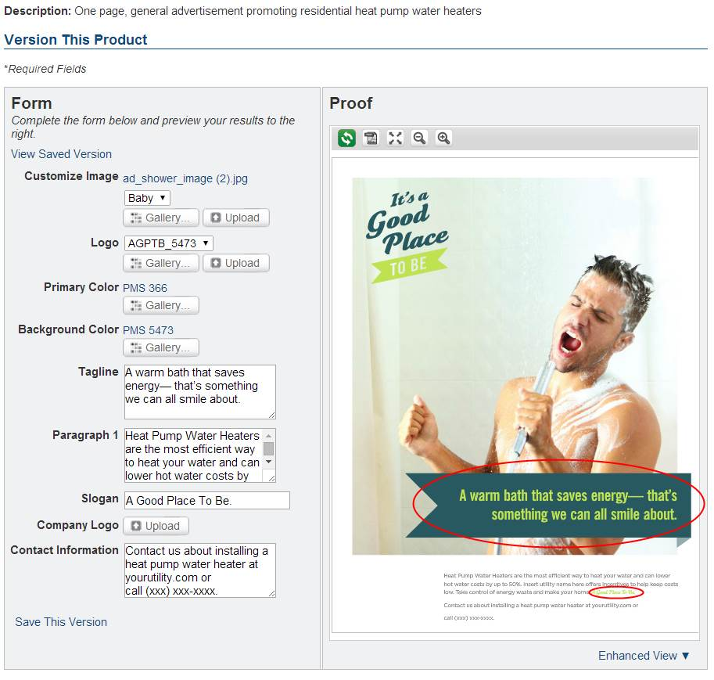
You will first need to Update the Proof to see your new Tagline, Slogan and Background colors.

Slide 18
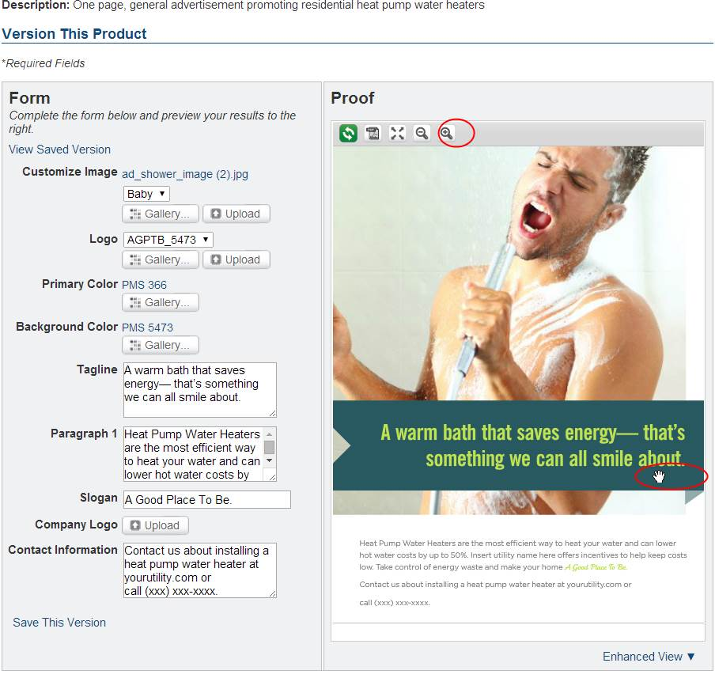
To see the logo and the print at the bottom of the ad in more detail, click on the Plus/magnifying glass symbol. You will then be able to Zoom and move the cursor to the area you need to see in more detail.

Slide 19

To update the copy located in the Tagline. Type the new Tagline copy into the content box.

Slide 20

After you update the Proof, you will see the new Tagline copy.

Slide 21
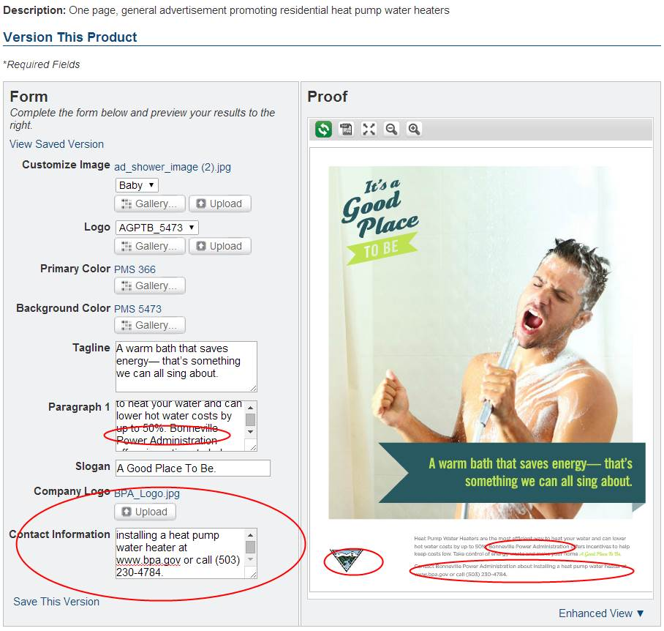
The last step is updating your Contact Information and Company Logo. On this Ad, you add your utility name in Paragraph 1; Upload your Logo; and edit the Contact Information. Once you select Proof, the ad will update.

Slide 22
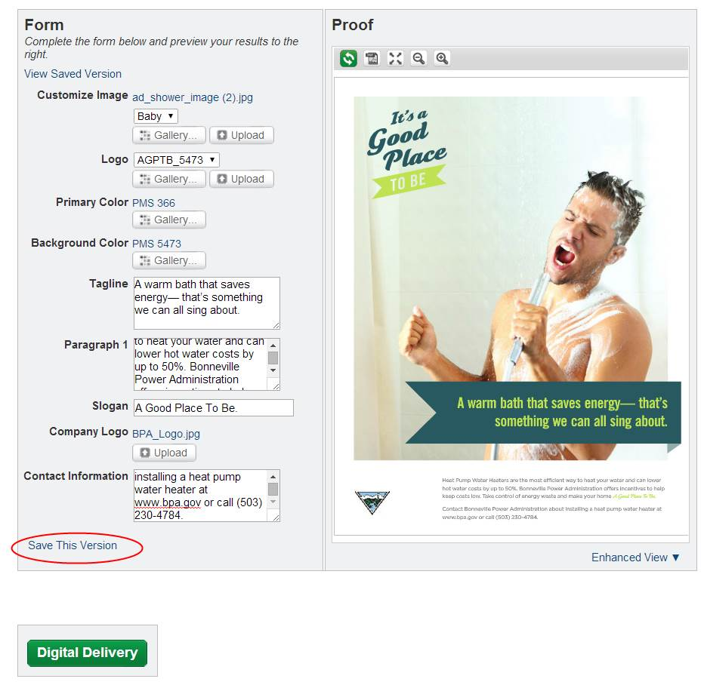
If you would like to Save This Version on the Marketing Portal website to refer to in the future, select Save This Version.

Slide 23
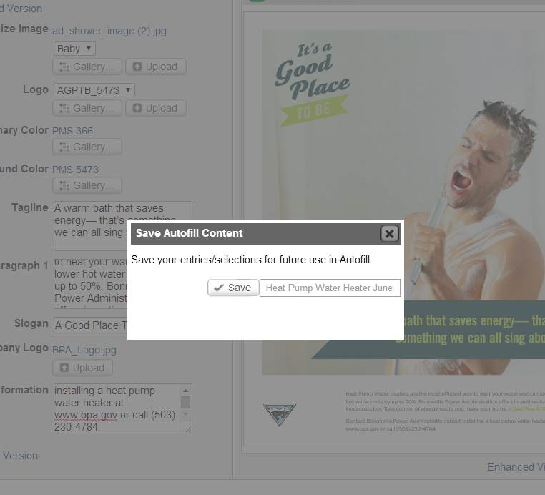
Name your file and select Save.

Slide 24
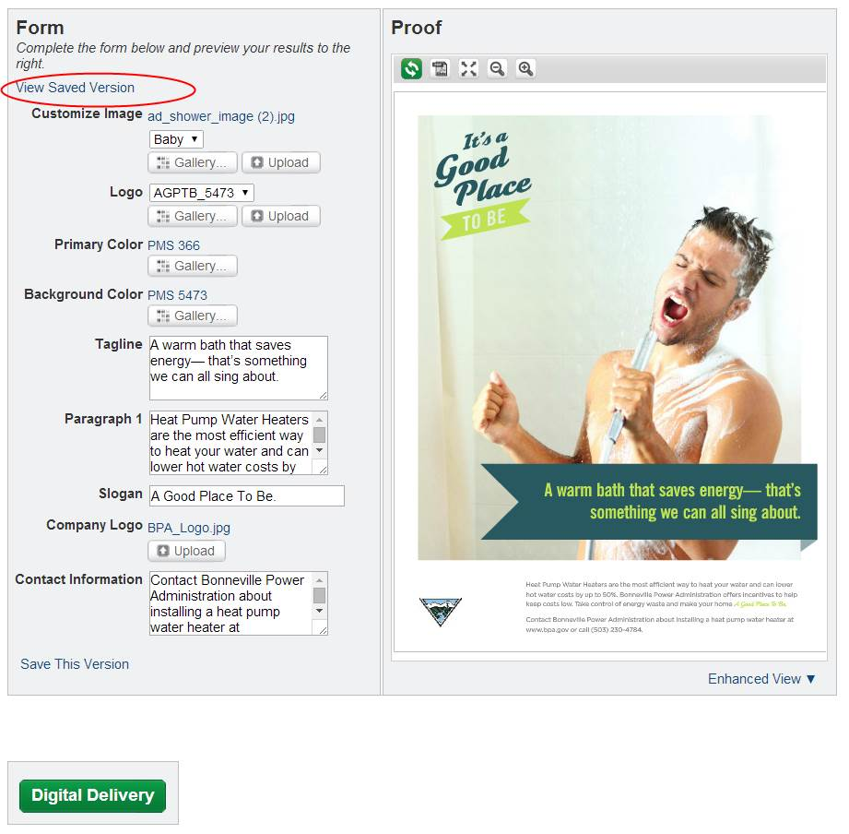
In the future if you would like to retrieve the same flyer from the Marketing Portal, select View Saved Version. After you select the file, you will need to click on the Proof button to see the saved version.

Slide 25
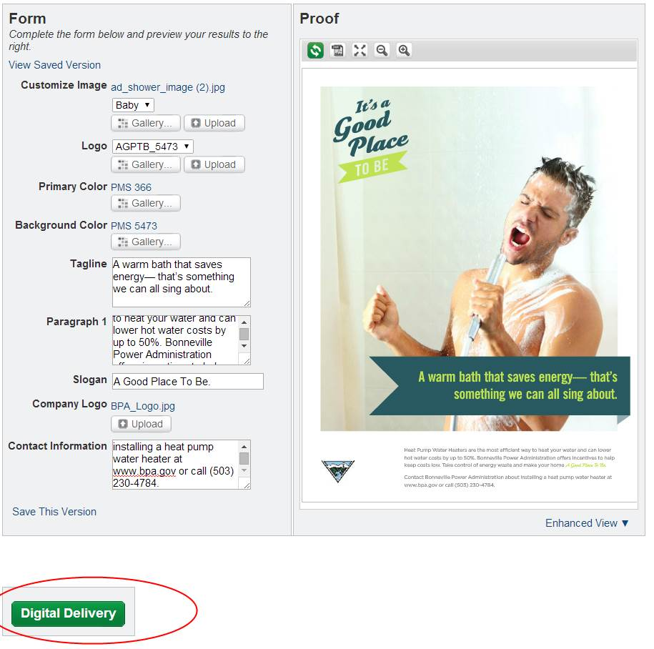
Now you are ready to download your file or email it to a colleague or vendor for printing. Select the green Digital Download button at the bottom of the form.

Slide 26
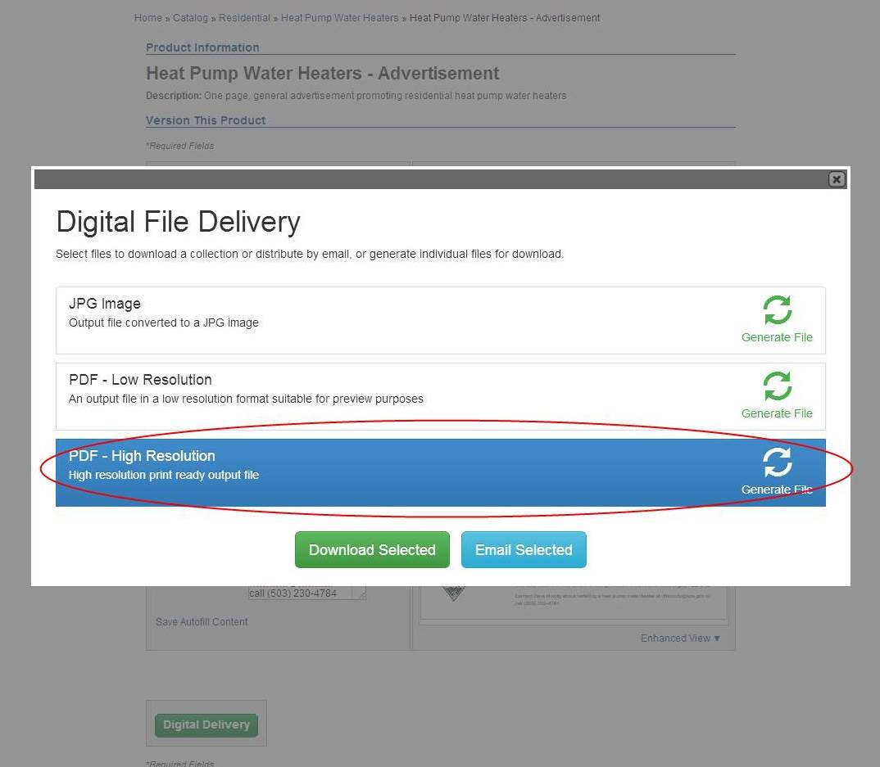
The Digital Delivery button allows you to select the type of digital file you would like to either download to your computer or email to a colleague or vendor.

Slide 27
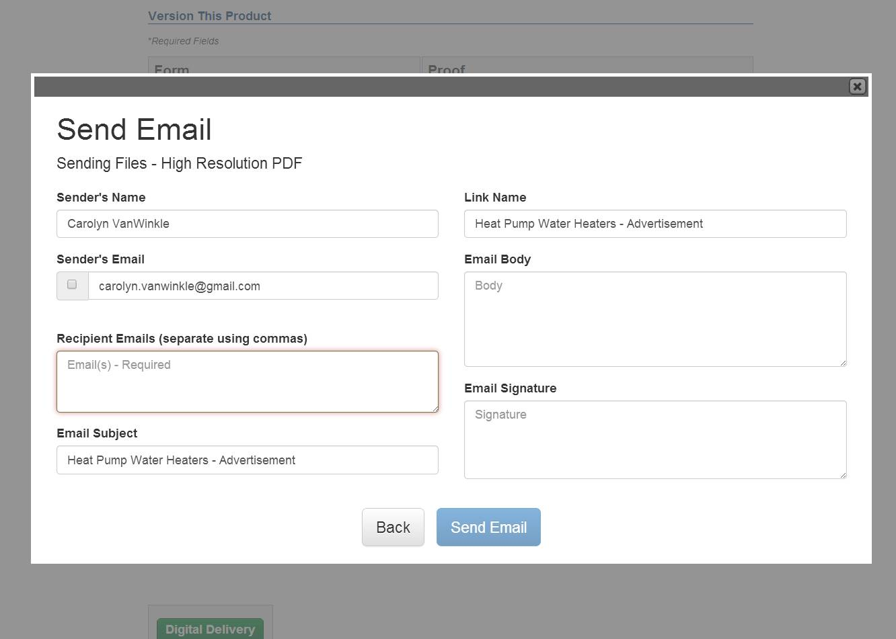
If you choose, Send Email, you will be brought to a screen where you can add email addresses, add a note and your signature.
The email will contain an embedded link to your High Res PDF.

Slide 28
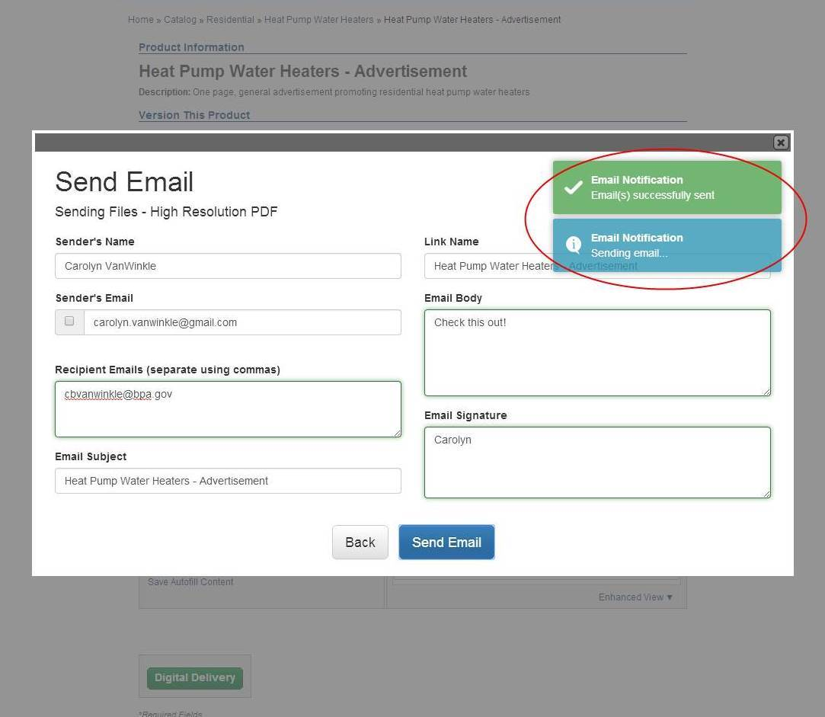
Once you hit send, the you will see a notification that the email was sent.

Slide 29
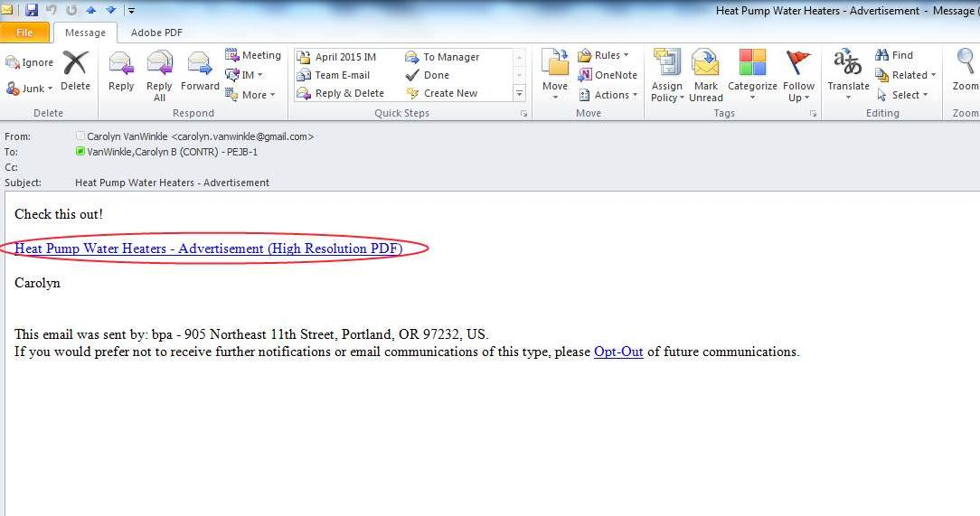
A link to the high resolution proof will be embedded in the sent email.

Slide 30
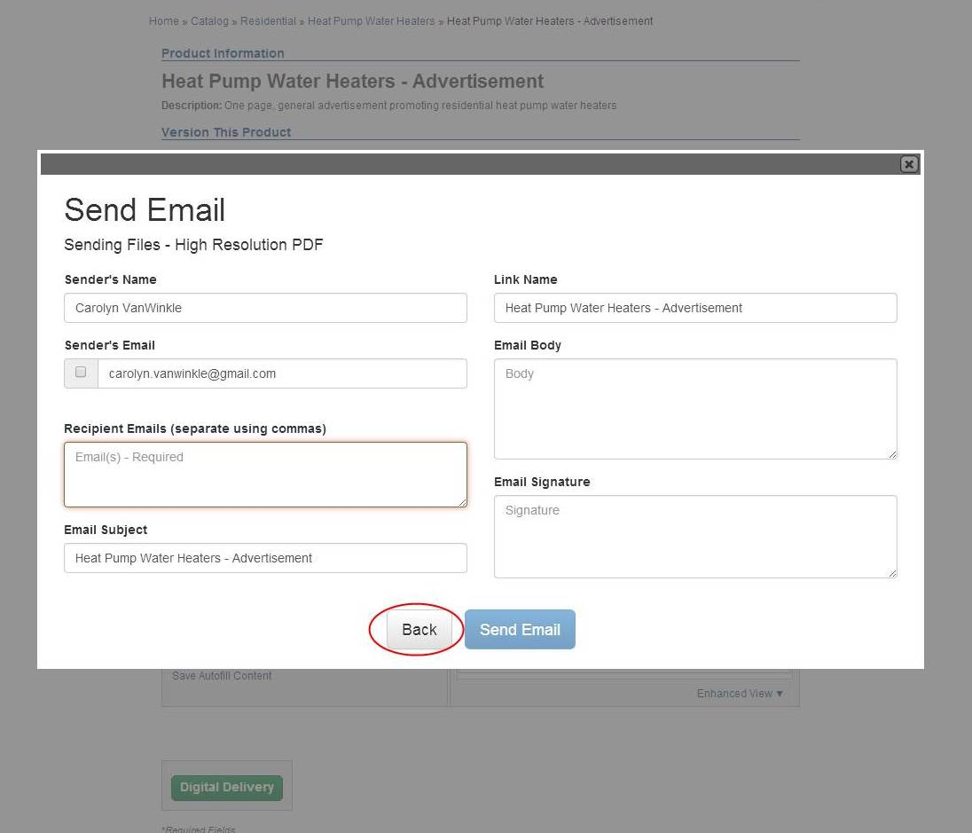
After you send the email, if you would like to go back to download the file to your computer. Select the Back button.

Slide 31
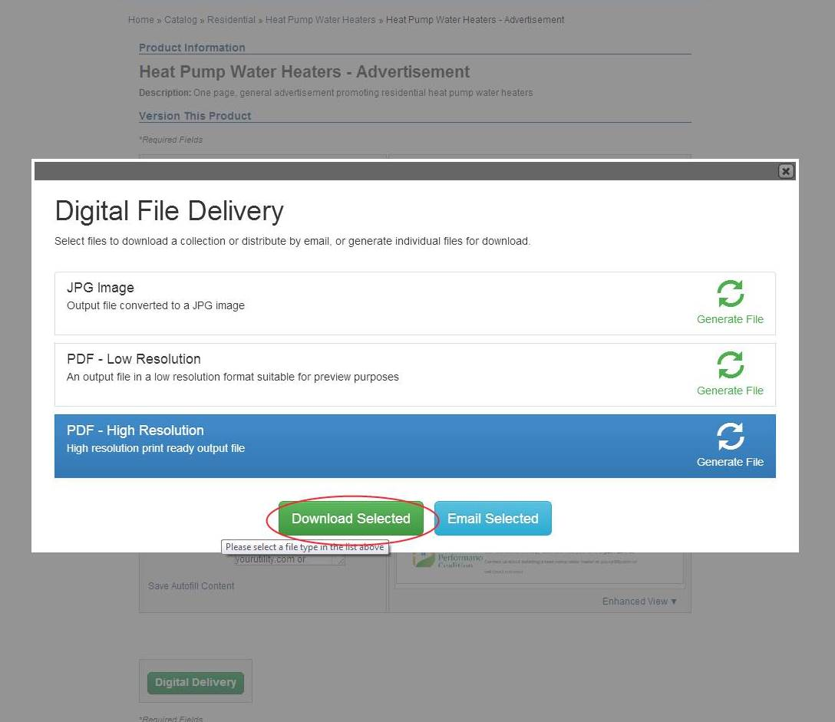
Click on the Download Selected button.

Slide 32
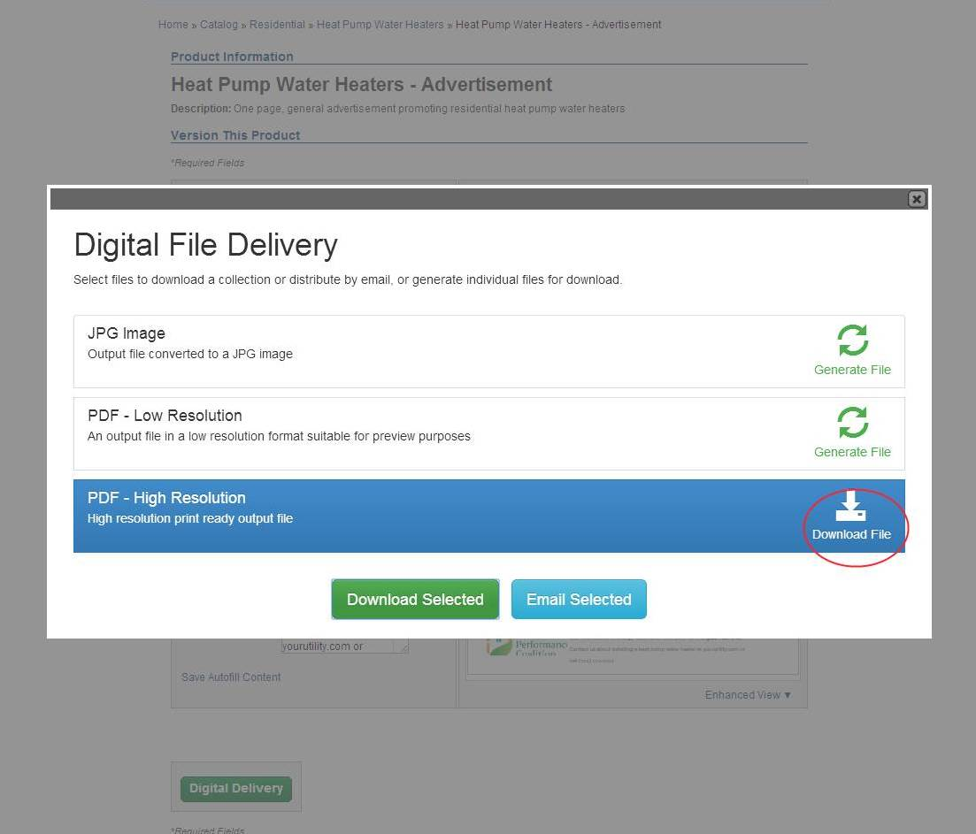
You can now download the file to your computer.

Slide 33
Questions? Contact us.
If you have any difficulty with this website, please contact your EER.

