Slide 1
BPA Energy Efficiency Marketing Portal Training
Instructions for adding utility logo and contact information.

Slide 2
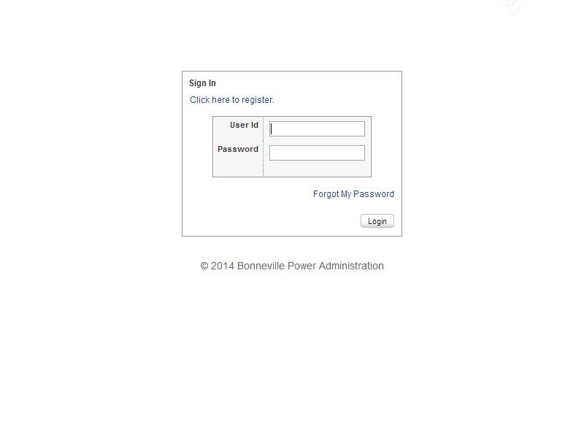
Log In to the MarCom Central Portal: http://marcomcentral.app.pti.com/Bonneville_Power_Administration/bpa

Slide 3
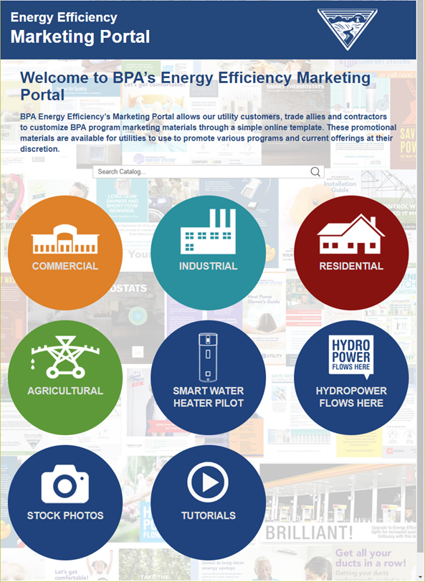
After you log into the website, you will see the Product Catalog page. Select the energy efficiency sector that you are interested in reviewing and click on it.

Slide 4
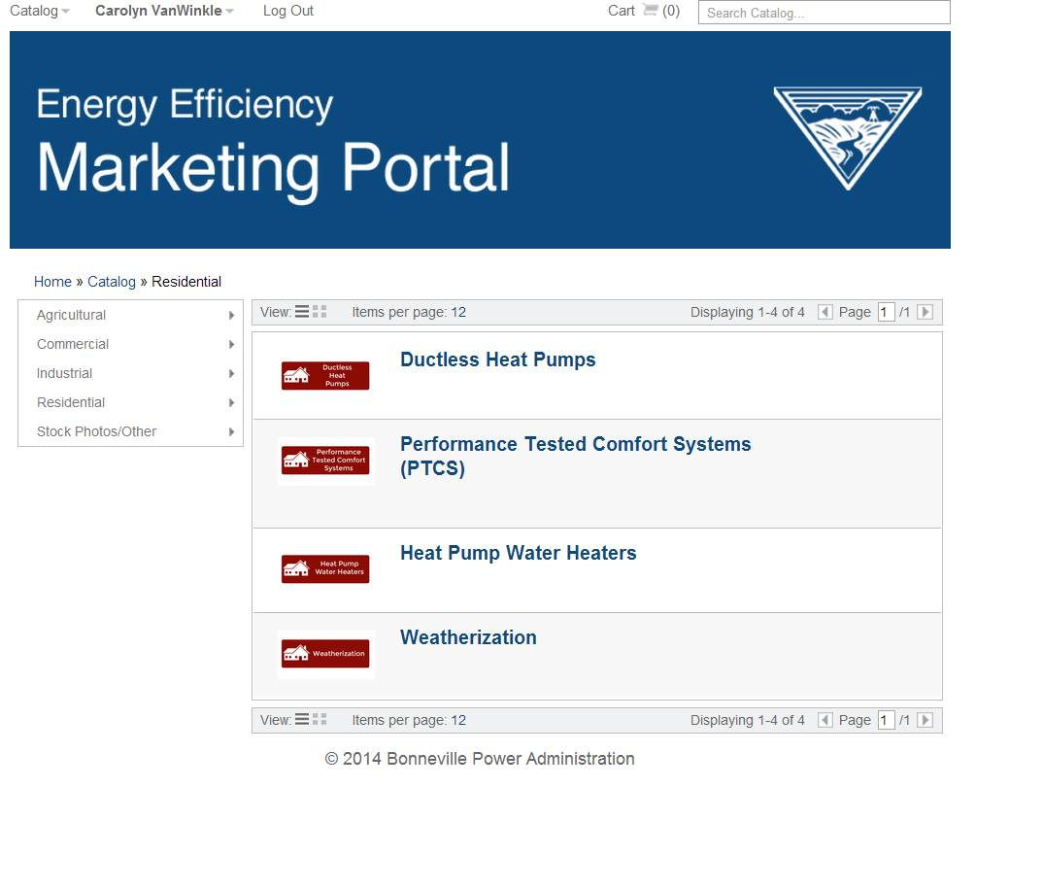
You will then see program options that have customizable promotional materials for your use. Select the program you are interested in promoting.

Slide 5
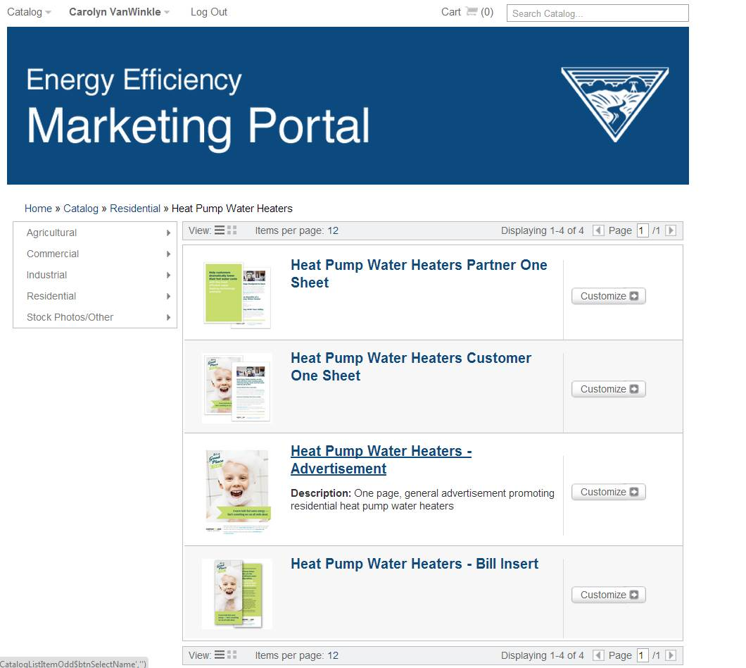
Select the marketing piece that you would like to customize.

Slide 6
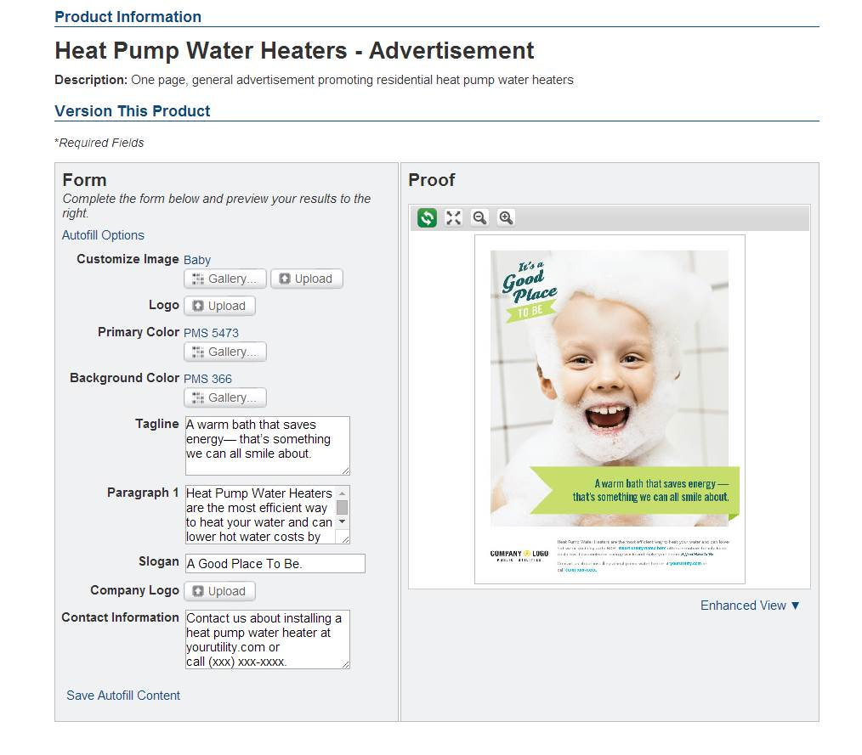
On this page, you will see the customizable form options on the left and the proof on the right. You are ready to begin customizing this advertisement.

Slide 7
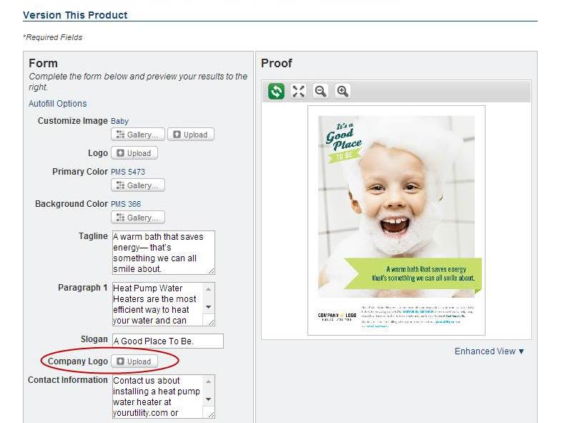
To add your Company Logo, click on the “upload” button next to Company Logo on the form.

Slide 8
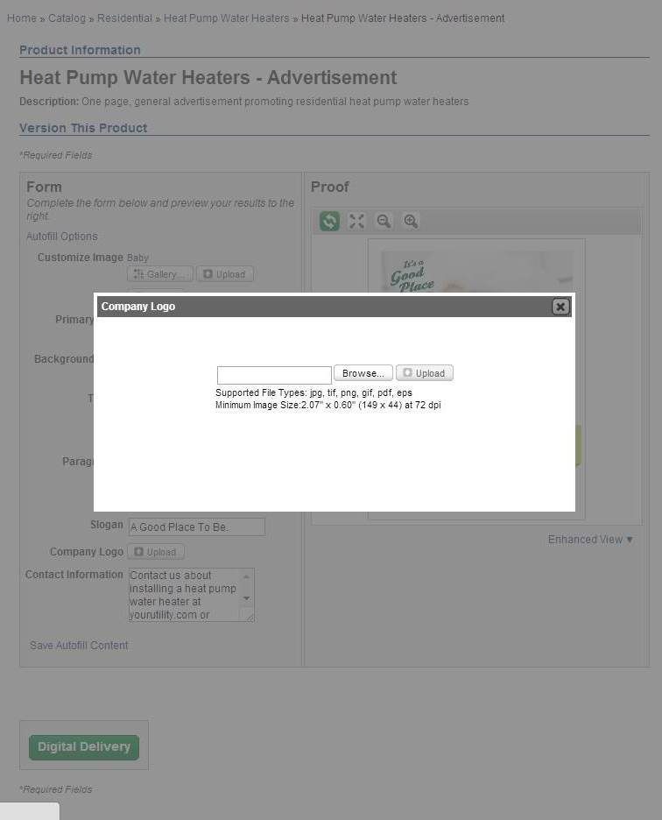
The Browse button allows you to search your computer for the logo file you want to add the advertisement. Select the Browse button, search your files for the correct logo and then select Upload to add the logo to the template.

Slide 9
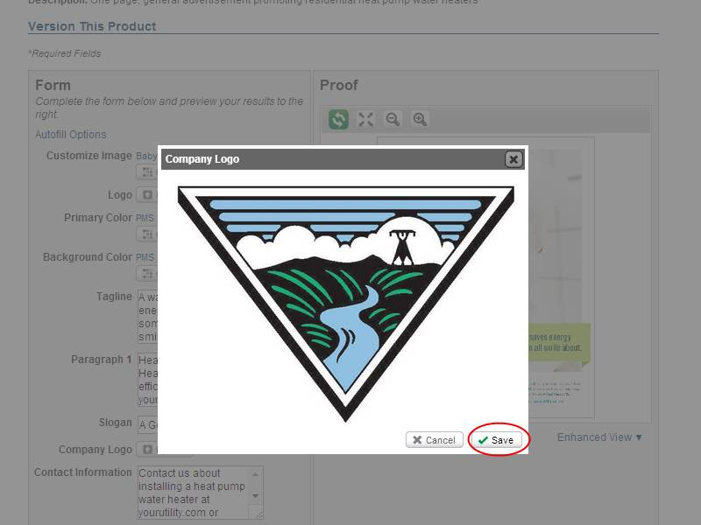
When the logo is finished uploading to the site, you will see it on the screen as it will appear on the advertisement. Select Save to complete the Upload and add it to the template.

Slide 10
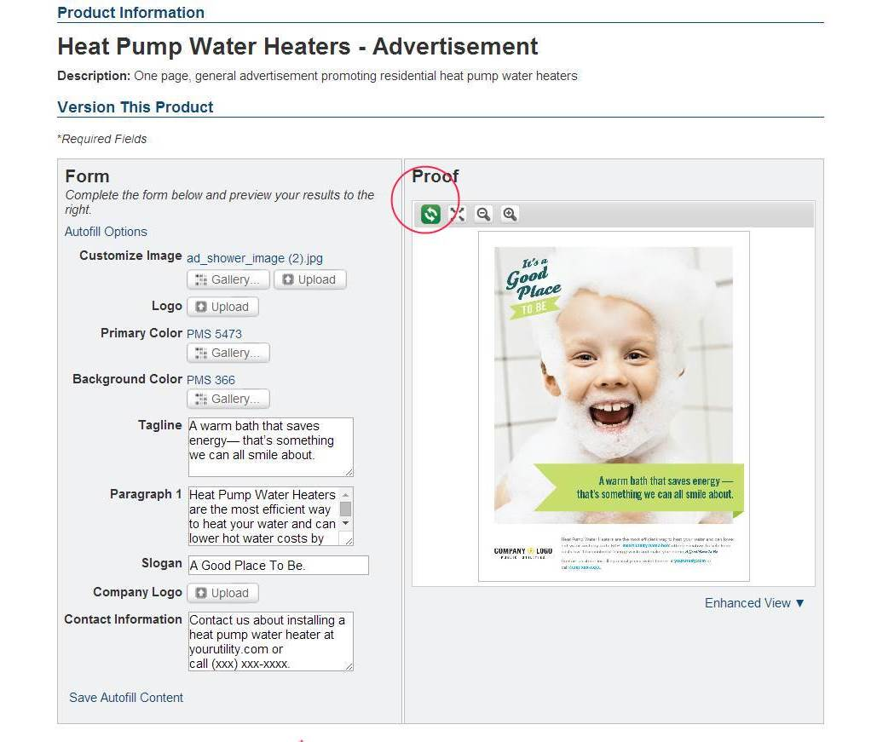
After you upload the new logo, the proof screen will still show the original template. To see your logo on the advertisement, select the green arrows under the word Proof.

Slide 11
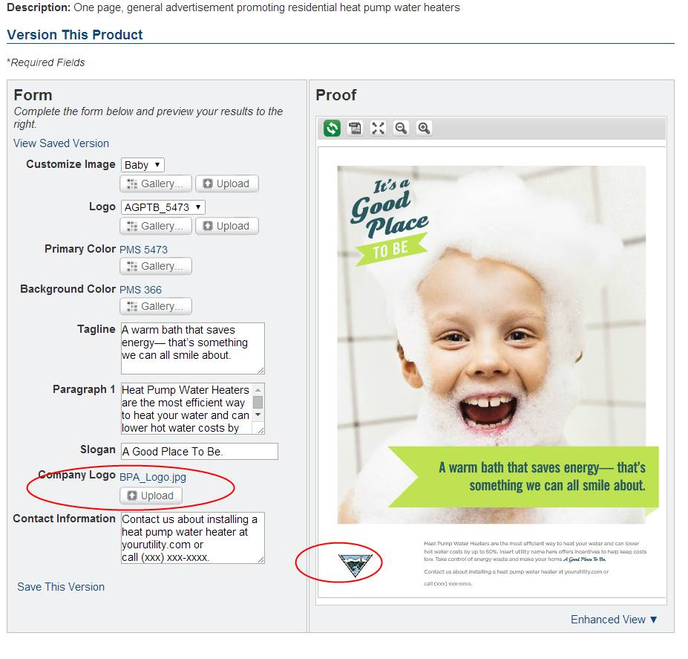
The template is now updated with the new logo.

Slide 12
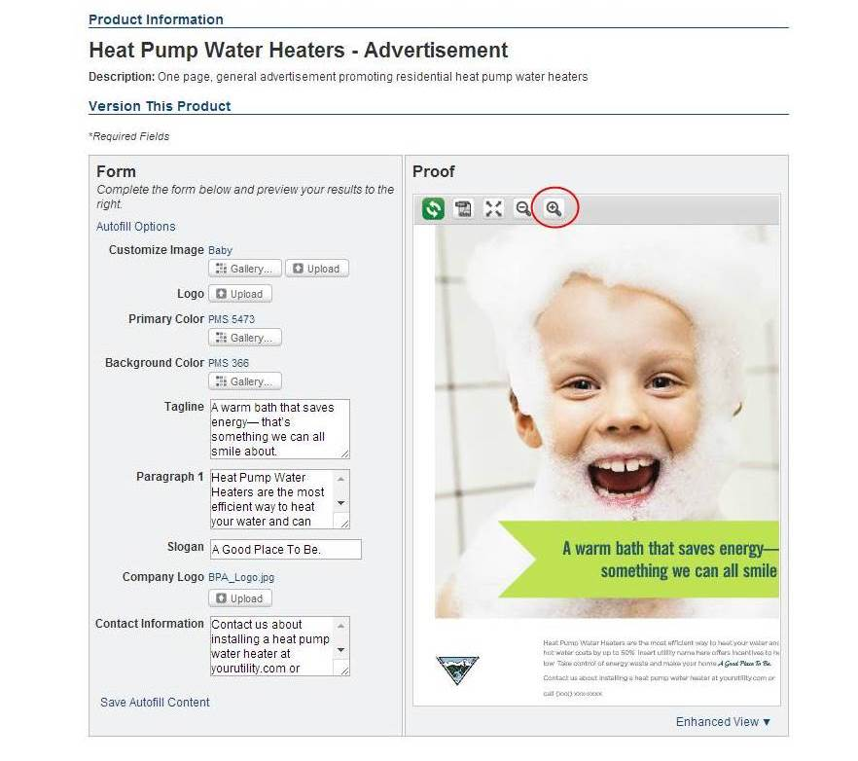
To see the logo and the print at the bottom of the ad in more detail, click on the Plus/magnifying glass symbol.

Slide 13
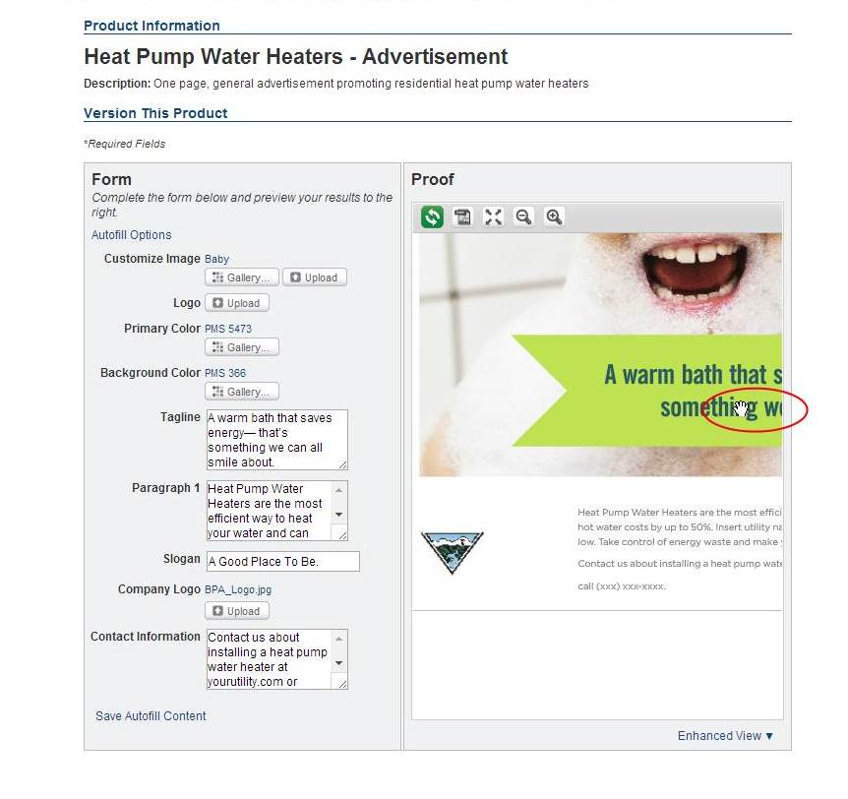
You can now use the cursor to move the advertisement proof and expand the view.

Slide 14
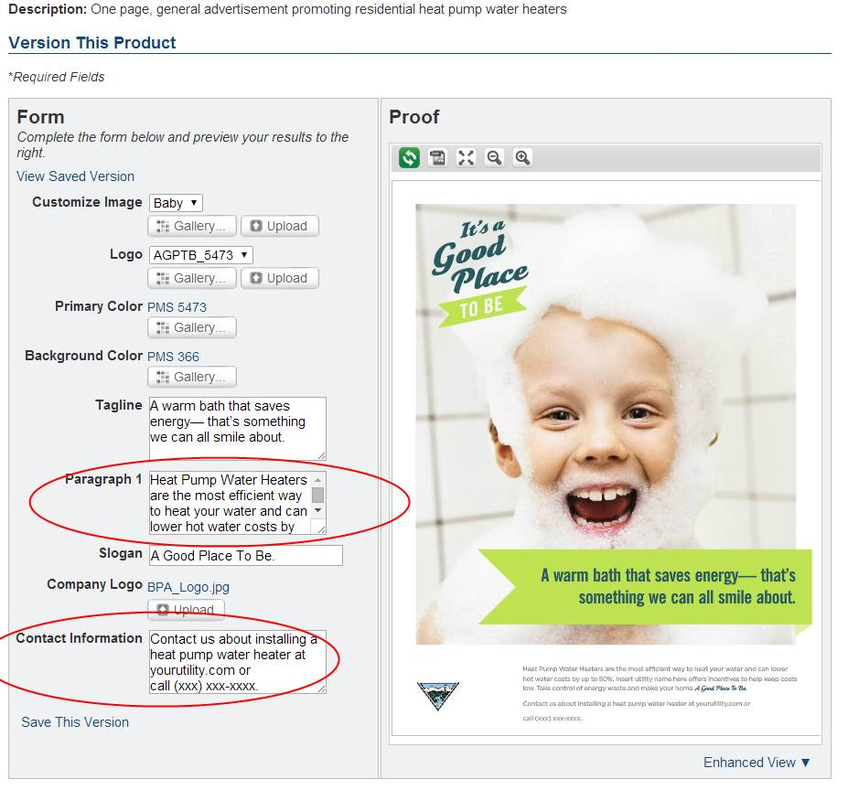
In this advertisement there are two places to update the contact information. In Paragraph 1, you will see a placeholder that says “Insert utility name here”. You can edit this copy as you would in a Word document and add your utility name.
Next in the content box next to “Contact Information”, add the appropriate contact information for your organization.

Slide 15
Again, to update the Contact information in the advertisement, select the green arrows under the word Proof.

Slide 16
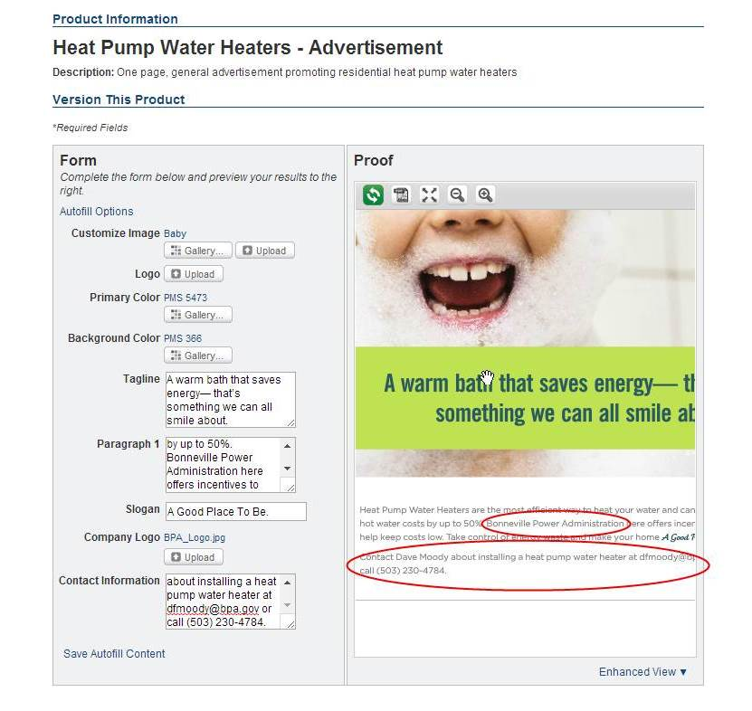
After updating the Proof, you will be able to see your copy changes and confirm that they are correct.

Slide 17
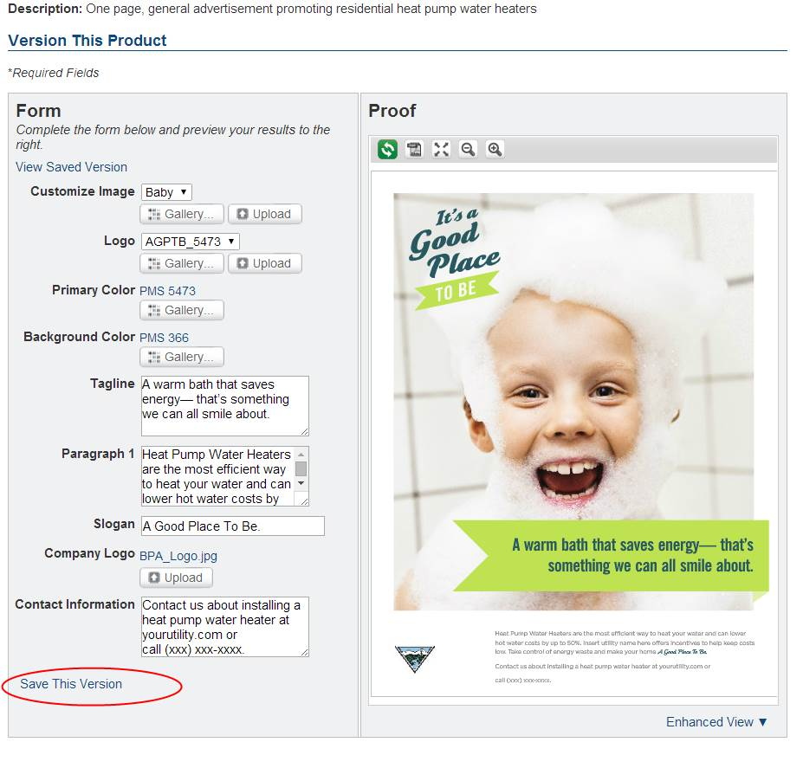
If you would like to Save This Version on the Marketing Portal website to refer to in the future, select Save This Version.

Slide 18
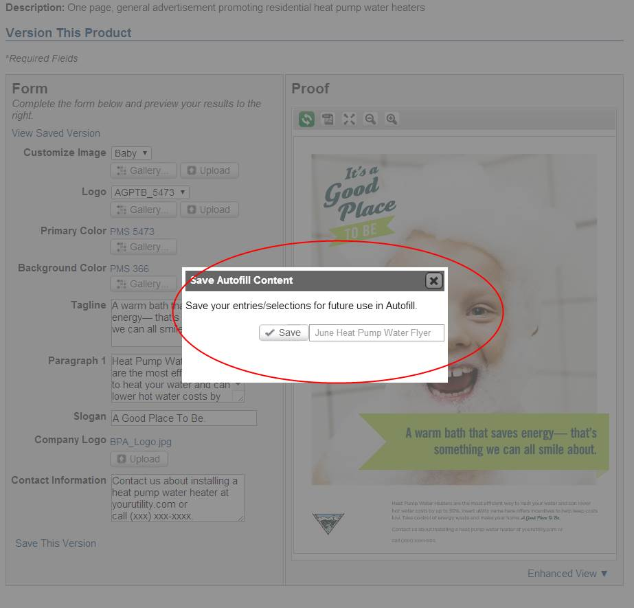
Name your file and select Save.

Slide 19
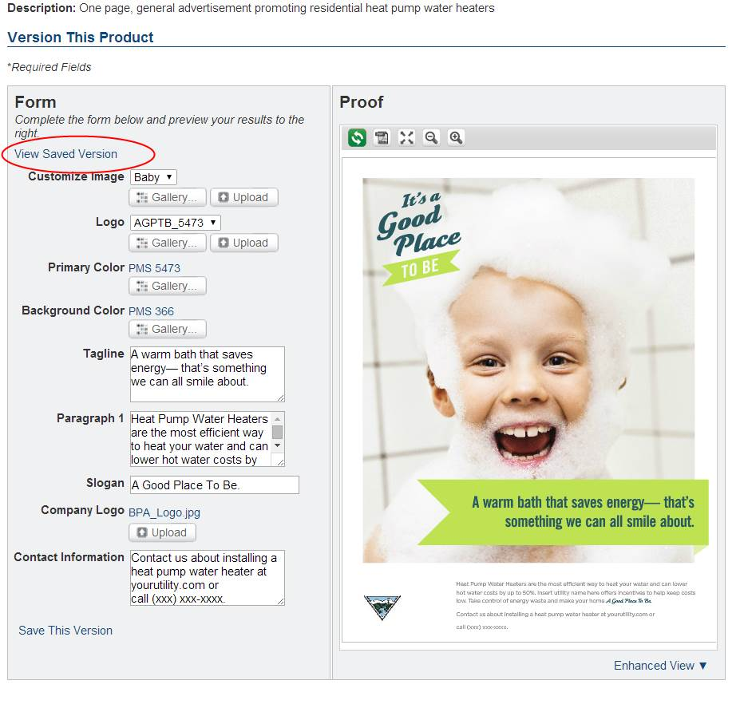
In the future if you would like to retrieve the same flyer from the Marketing Portal, select View Saved Version. After you select the file, you will need to click on the Proof button to see the saved version.

Slide 20
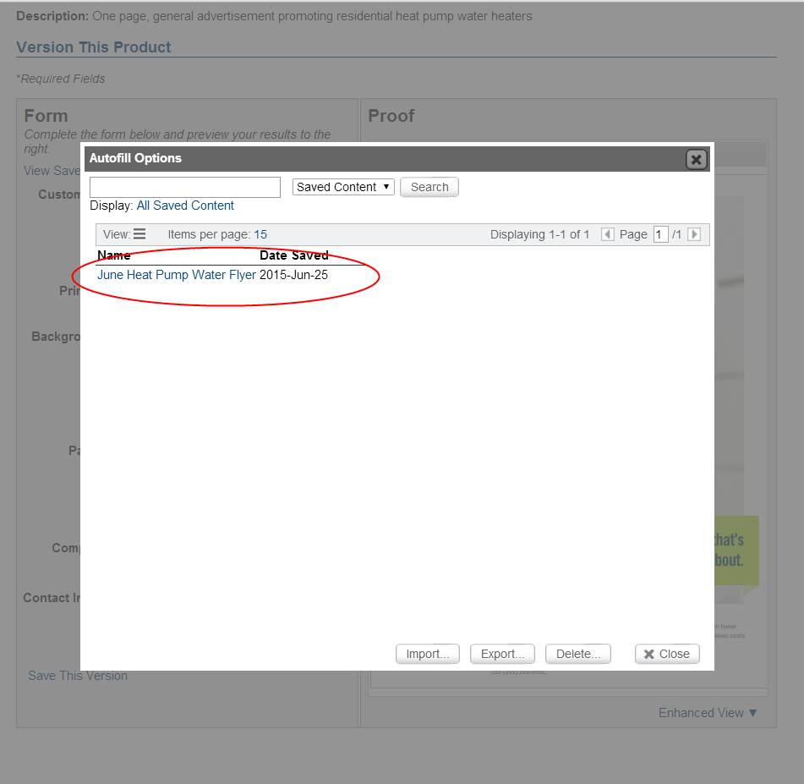
After you select the file, you will need to click on the Proof button to see the saved version.

Slide 21
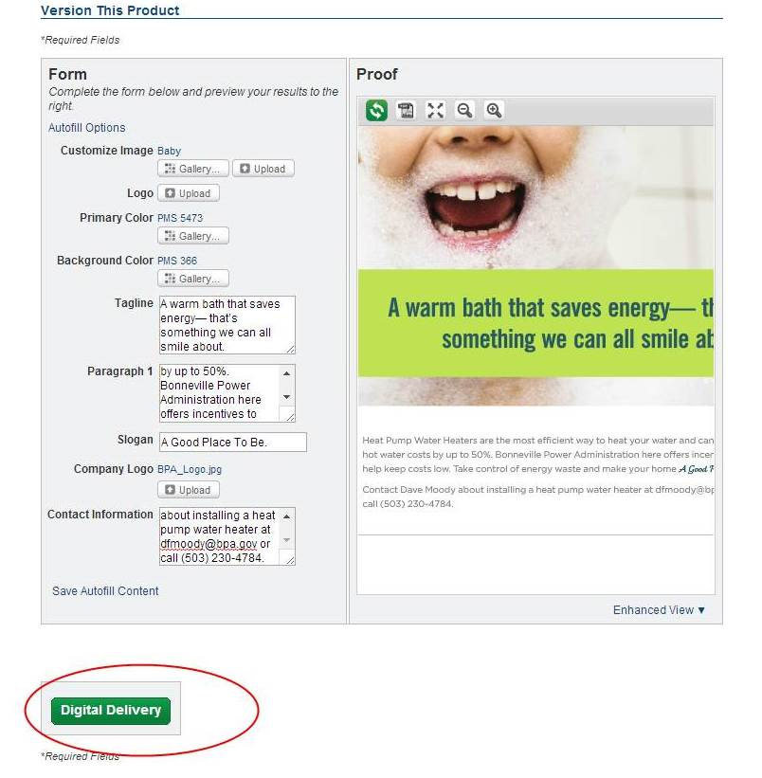
Now you are ready to download your file or email it to a colleague or vendor for printing. Select the green Digital Download button at the bottom of the form.

Slide 22
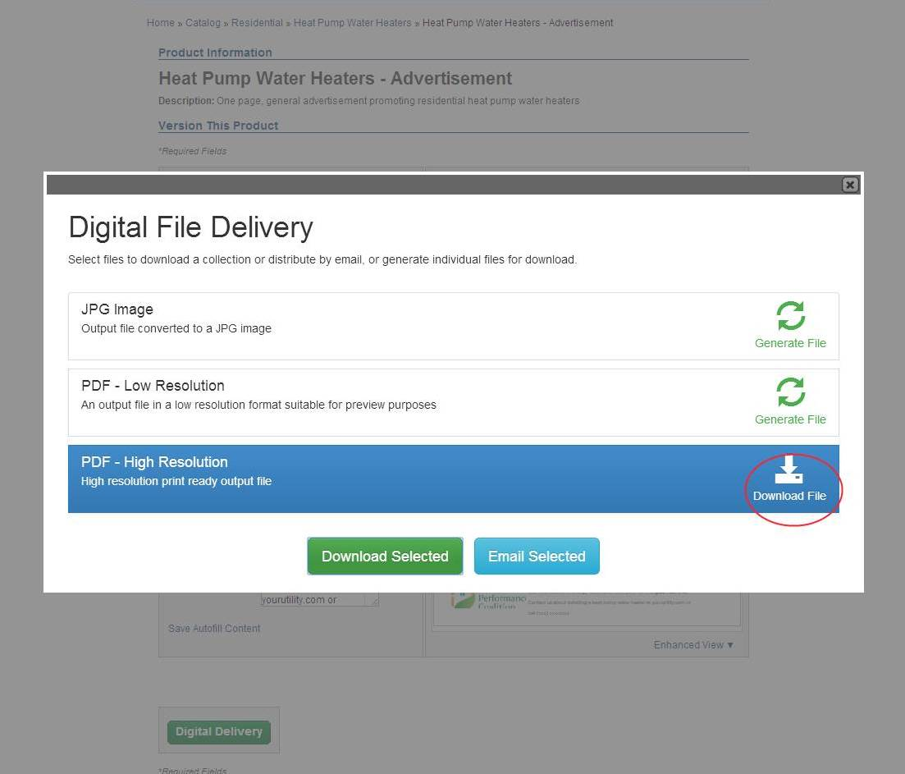
Here you are able to select the type of digital file you would like to either download to your computer or email to a colleague or vendor.

Slide 23
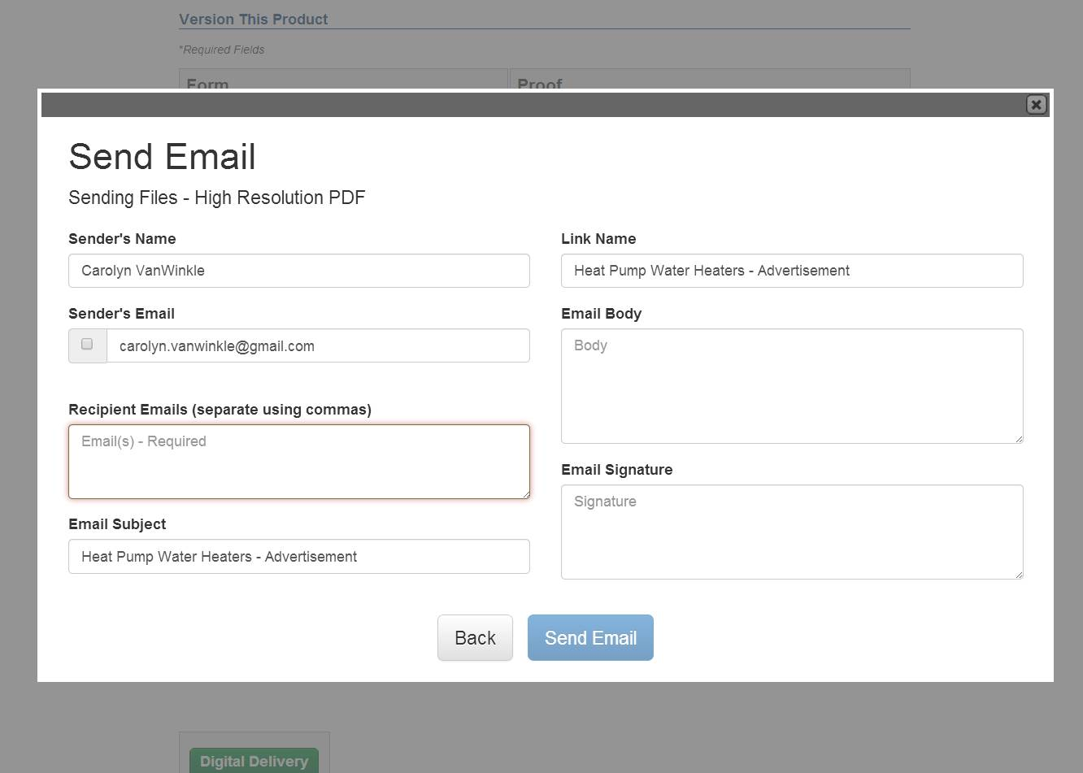
If you choose, Send Email, you will be brought to a screen where you can add email addresses, add a note and your signature.
The email contains an embedded link to your High Res PDF.

Slide 24
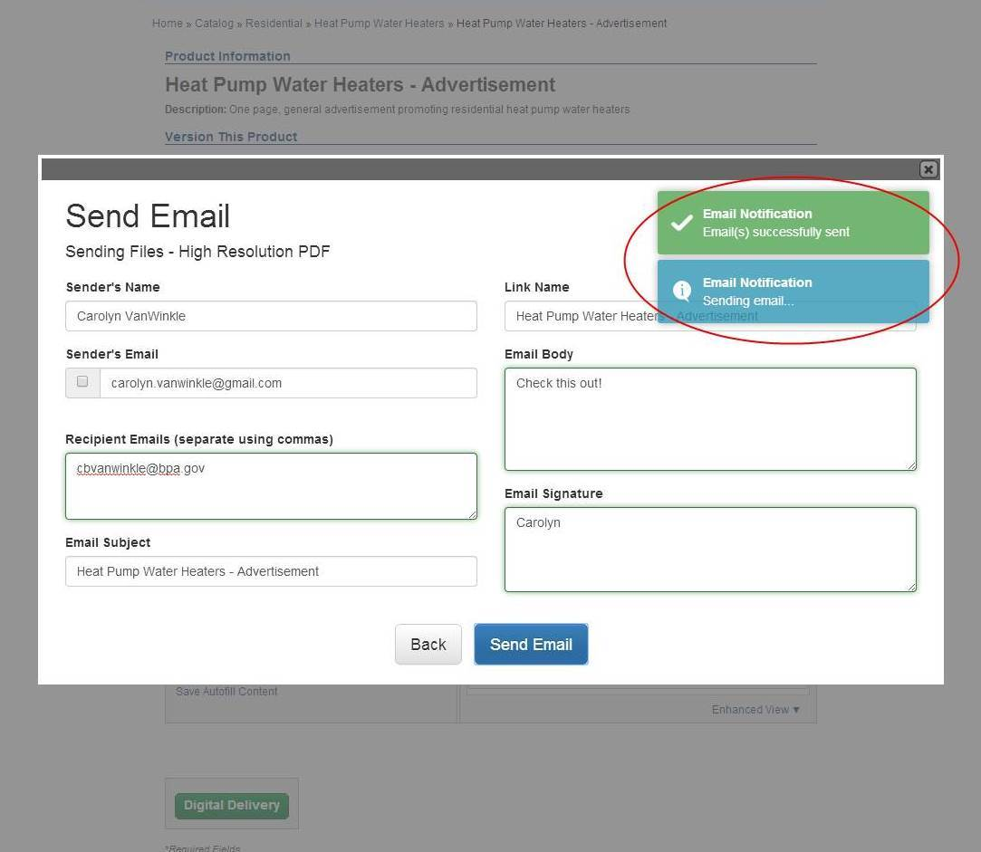
Once you hit send, the you will see a notification that the email was sent.

Slide 25
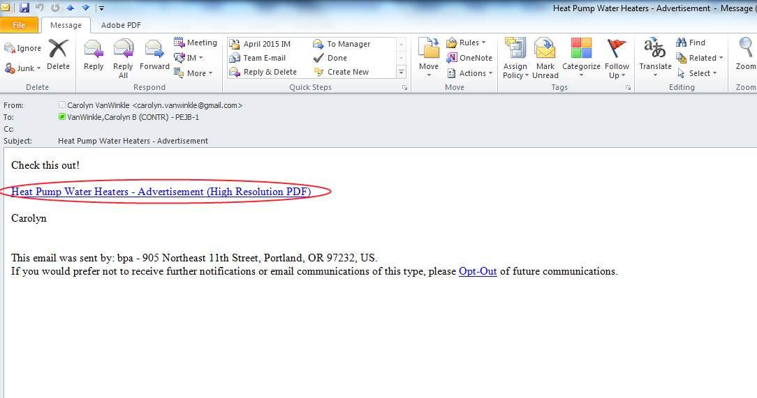
A link to the high resolution proof will be embedded in the email.

Slide 26
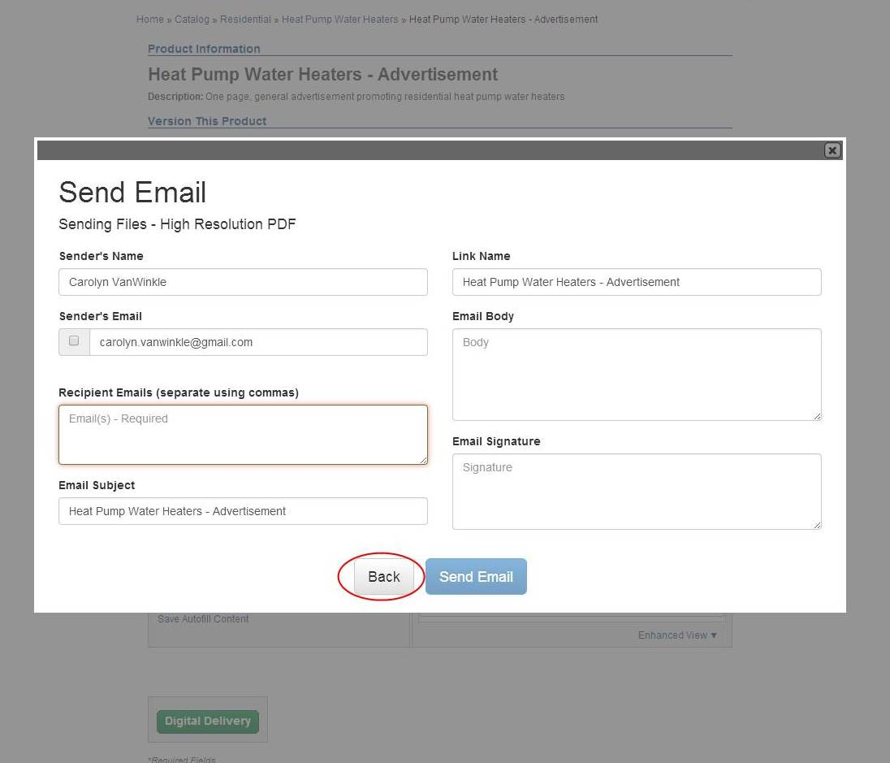
After you send the email, if you would like to go back to download the file to your computer. Select the Back button.

Slide 27
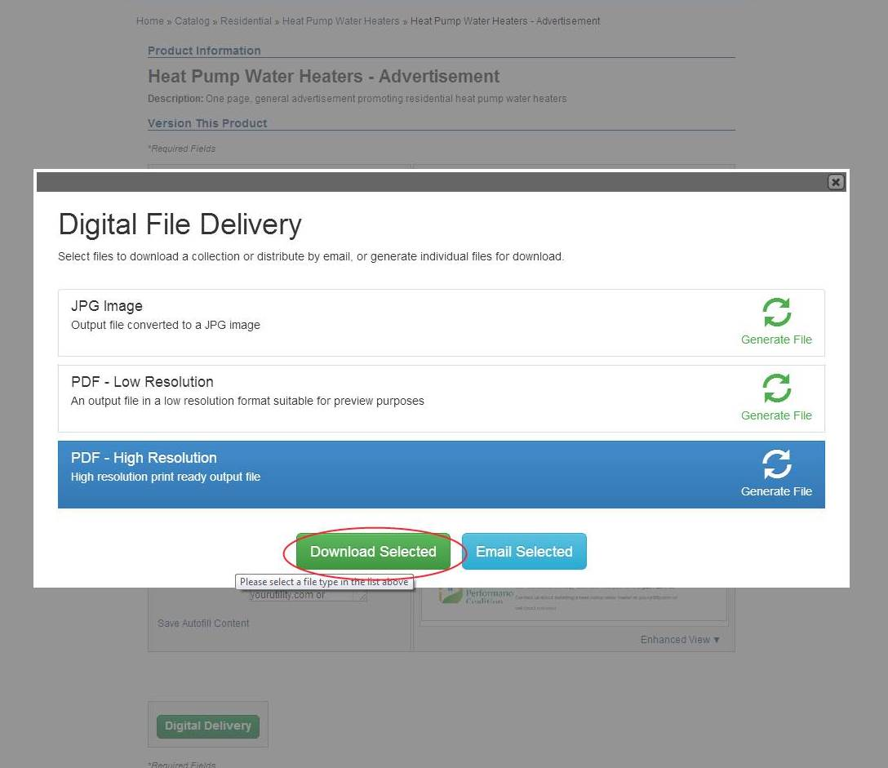
Click on the Download Selected button.

Slide 28
You can now download the file to your computer.

Slide 29
Questions? Contact us.
If you have any difficulty with this website, please contact your EER.

