Slide 1
Market Research & Momentum Savings Team
B O N N E V I L L E P O W E R A D M I N I S T R A T I O N
Quarterly Call | August 4, 2021
Notes:
Photo by Katie Moum on Unsplash.com

Slide 2
Org Name
+
Favorite summer Olympic event
Notes:
Welcome to the third Momentum savings quarterly call of 2021!
Roll call and ice-breaker.

Slide 3
PART 2: PRINCIPLES OF RESEARCHING MOMENTUM SAVINGS

Slide 4
Agenda
Recap: What are Momentum Savings and why do the research?
Principles of Our Work
Ongoing Evolution
Key Takeaways

Slide 5
RECAP: WHAT ARE MOMENTUM SAVINGS AND WHY DO THE RESEARCH?

Slide 6
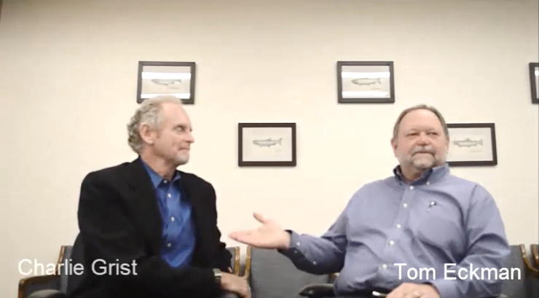
WHAT MOMENTUM SAVINGS ARE
Momentum Savings are cost-effective energy efficiency happening above regional planning baselines (i.e., the Power Plan baseline).
“Non-Programmatic Savings are everything we haven’t counted that’s worth counting.”
Tom Eckman, NWPCC
Notes:
Over the past several decades, a range of mechanisms have contributed to a robust infrastructure for energy efficiency in the Northwest. The region as a whole has done a lot of work to create and push energy efficiency, which has helped create a culture and a market for energy efficiency, and changed how the culture values conservation (adapted from Cadmus, 2011; Navigant, 2016).
While programs have been a significant driver—and will continue to be critical in driving markets towards greater energy efficiency—there is an interconnected web of actions—inextricably linked—that have contributed to the overall energy efficiency of the region. Other market-induced drivers of energy efficiency include technology trends, corporate sustainability policies, and shifts in social norms (e.g. the “green movement”) (Navigant 2016; Cadmus, 2011)
Regardless of the reason, if energy efficiency is happening to a greater extent than planned, and electric consumption is decreasing/lower than planned, this conservation represents generation not needed. (Summarized, in part, from Tom and Charlie video—link below)

Slide 7
Helps us be more responsible stewards of ratepayer funds
Provides a complete picture of the total EE power resource
Offers valuable market intelligence for programs
Delivers critical data support for regional planners
Momentum Savings research…
Notes:
Benefits of Research

Slide 8
PRINCIPLES OF
OUR WORK
1 | Study what matters
2 | Be consistent in methods
3 | Use an open, accessible process
4 | Build regional market intelligence
Notes:
4 principles govern our work.

Slide 9
STUDY WHAT MATTERS
1
Notes:
BPA prioritizes studying markets with high value to BPA and the region. BPA’s research aims to have the greatest impact on BPA’s and the region’s market intelligence about energy efficiency.
BPA weighs many factors in this process, but there are three overarching categories of costs and benefits that BPA assesses in selecting markets for analysis, which I'm going to discuss in the coming slides:
(1) Resource potential assessment; (2) Research value assessment; and (3) Modeling feasibility assessment.

Slide 10
Resource Potential Assessment
1 | Study What Matters
Which market(s) can BEST help BPA meet its power resource needs?
Which market(s) reflect a power resource need, as identified by the Council Power Plan and/or the BPA Resource Program?
Notes:
This first factor BPA considers in choosing markets to study is whether the market has the potential to help meet BPA’s power resource needs.
BPA screens potential markets to study based on several criteria, including:
How important is this market’s equipment to the region?
Is the market a large driver of regional energy consumption?
Is it an important end-use or technology in the BPA Resource Program and/or the Council Power Plan?
Does it help BPA meet its power resource needs?
Is the market undergoing changes that impact its total market energy consumption? Is it more efficient than the Power Plan baseline?
Is it cost-effective at the market level? Is it included in the Power Plan economic savings potential?
How did the Council treat the market’s equipment in the Power Plan?
Are there measures in the Council’s supply curves that include this equipment?
Was it NOT intentionally excluded from the Council Plan?
Was it NOT already assumed to be efficient in the Council baseline or already included in the Council load forecast?

Slide 11
Research Value Assessment
1 | Study What Matters
?
Notes:
Next, BPA considers whether it adds to the regional EE knowledge base by contributing new market intelligence.
For example:
Is there a need for market insight to maximize impact from program investments?
Is there a need to understand trends in energy consumption for power and transmission planning for this market?
Does it help fill data gaps or bolster results from an existing BPA market model?

Slide 12
Modeling Feasibility Assessment
1 | Study What Matters
Notes:
Lastly, we need to consider whether the market can be measured from a technical modeling perspective.
Are there market data available and/or do we think we can feasibly acquire the necessary data inputs?
Are there at least three industry market actors that will be providing data so we can use the data without confidentiality issues?

Slide 13
2
BE CONSISTENT IN METHODS
Notes:
The second principle is to be consistent in methods.

Slide 14
Standard Research Approach
2 | Be Consistent in Methods
Step 5 Conduct Ongoing Research and Update the Market Model
Step 2 Develop the Modeling Methodology
Step 4 Model Savings
Step 1 Characterize the Market
Step 3 Collect Data
1
2
3
4
5
Notes:
Momentum Savings require a fundamentally different quantification approach than Programmatic Savings
BPA uses a structured research process and follows a consistent analytical framework.
For each market of research, BPA conducts five iterative research steps, as shown here.
Step 1. Characterize the Market
Step 2. Develop the Modeling Methodology
Step 3. Collect Data
Step 4. Calculate Savings
Step 5. Conduct Ongoing Research and Update the Market Model
I’m going to discuss each of these over next 5 slides.

Slide 15
Step 1: Characterize the market
2 | Be Consistent in Methods
Step 5 Conduct Ongoing Research and Update the Market Model
Step 2 Develop the Modeling Methodology
Step 4 Calculate Savings
Step 3 Collect Data
1
2
3
4
5
Notes:
The first step BPA pursues in building a market model is characterizing the market.
BPA must understand how products move through the market to end-users and identify the data sources to estimate changes in the market.
Each market contains unique supply channels that represent opportunities for data collection.
Market characterization includes literature reviews, interviews with the market actors, attendance at industry trade shows, and in-depth discussions with subject matter experts to conduct a detailed analysis of supply chain, data availability, and market drivers.

Slide 16
Step 2: Develop the Modeling Methodology
2 | Be Consistent in Methods
Step 5 Conduct Ongoing Research and Update the Market Model
Step 4 Calculate Savings
Step 1 Characterize the Market
Step 3 Collect Data
1
2
3
4
5
Notes:
In the next step, BPA builds on the market characterization by drafting a written methodology for quantifying savings before building the market model.
The draft methodology describes how the research team will address four key questions, BPA’s “Four Question Framework, which are consistent for all markets. They are:
Question 1: What is the market? This question defines the scope of the market model.
Question 2: How big is the market? This question defines the size of the market, typically quantified by number of products entering the market each year.
Question 3: What are the total market savings? This question defines how the research team will calculate market savings (the difference between the baseline and actual energy consumption estimates) for the products in the stock each year of the analysis period.
Question 4: What are the program savings? This question defines how much energy savings utilities reported for the defined market during each year of the analysis period, which BPA subtracts from market savings to calculate Momentum Savings.

Slide 17
Step 3: Collect Data
2 | Be Consistent in Methods
Step 5 Conduct Ongoing Research and Update the Market Model
Step 2 Develop the Modeling Methodology
Step 4 Calculate Savings
Step 1 Characterize the Market
1
2
3
4
5
Notes:
With a written and vetted methodology, BPA next collects the data necessary for the model development.
BPA uses the market intelligence and data sources gathered during the market characterization phase to collect the most robust, accurate data available.
This market data can include: sales data, shipments data, information about the building or housing stock, and consumption data to estimate how a given market is changing over time, and how much of that change is towards energy efficiency outside of utility programs.
BPA pursues sales and/or shipment data through a variety of mechanisms including wholesale distributors, retailers, and manufacturers. BPA also partners with NEEA to collect and/or share data, when appropriate.
Sometimes data is harder than can reasonably be anticipated to come by so BPA employs a “stage gate” prior to building the market model in Step 4 to consider the findings from characterizing the market, drafting the methodology, and collecting data.
BPA will decide, based on the data available, if it is technically feasible to develop a full-market consumption model for a specific market and whether the regional benefits outweigh the costs of the analysis.

Slide 18
Step 4: Calculate Savings
2 | Be Consistent in Methods
Step 5 Conduct Ongoing Research and Update the Market Model
Step 2 Develop the Modeling Methodology
Step 1 Characterize the Market
Step 3 Collect Data
1
2
3
4
5
Notes:
After deciding to move forward with a market model, BPA calculates Momentum Savings by developing a full-market energy consumption model following the process outlined in its methodology.
The key point here is that the market model calculates a baseline consistent with that defined by the Council’s Power Plan.
BPA’s market models produce the following results for each market, at a minimum:
How energy consumption is changing in the market over time
How much total market energy savings occurred from the Council baseline
How much Momentum Savings occurred during the analysis period
How the technology mix is changing annually in the building stock and product flow (sales)

Slide 19
Step 5: Conduct Ongoing Research and Update the Market Model
2 | Be Consistent in Methods
Step 2 Develop the Modeling Methodology
Step 4 Calculate Savings
Step 1 Characterize the Market
Step 3 Collect Data
1
2
3
4
5
Notes:
Finally BPA continuously seeks to improve its market models by conducting additional market research, collecting new data, and improving upon past analyses and methodologies.
BPA uses new data or findings to update the market models on a regular basis (typically at least once during a six-year Action Plan period) to ensure the models reflect the most current data available.
Updating a market model can include a variety of processes such as collecting new sales or shipments data, conducting additional market research, incorporating new stock data, reviewing new technical resources to improve the methodology, and updating program savings analyses to include recent program participation.

Slide 20
3
USE AN OPEN, ACCESSIBLE PROCESS
Notes:
The 3rd principle is to use an open and accessible process.
BPA strives to make each market model meaningful and actionable for regional programs and other regional stakeholders.
We do this by making the model development process and results open and transparent to internal and external stakeholders. The following describes the steps we take to seek third-party external review of its methods and results, characterize uncertainty in the models, and make the model results accessible and transparent.

Slide 21
Stakeholder and Third-Party Review
3 | Use an Open, Accessible Process
Notes:
Third-party external review is a critical component of the modeling process that helps ensure the team both receives unbiased feedback and benefits from fresh perspectives.
BPA engages stakeholders to review and provide feedback throughout the market research process for three primary purposes:
Provide considerations to support BPA’s methodological decisions
Review issues and recommend solutions to areas of uncertainty
Review assumptions to ensure the models produce reasonable and reliable results
External stakeholders may include representatives from the Council staff, the Regional Technical Forum, NEEA, and regional utilities.
BPA also includes input from a team of highly specialized third-party subject matter experts, recruited specifically for each market.
Collectively, these experts can offer a fresh perspective on national best practices and a unique, nuanced point of view based on their deep experience in the selected market.
BPA’s third-party expert panel coordinator selects the team of experts specific to each relevant market and uses that team to vet methods, troubleshoot, and review results for reasonableness throughout the research and modeling process.

Slide 22
Identify Uncertainty in the Models
3 | Use an Open, Accessible Process
Notes:
Any market model will include data gaps, assumptions, and areas of uncertainty. We aim to make these as transparent as possible to acknowledge the limitations of the research and seek input on ways to improve the quality of the work.
We document each market model’s known uncertainty in the methodology memo and engages with stakeholders and the expert panel to identify concerns or opportunities to reduce uncertainty.
We try our best to reduce uncertainty in the market models by pursuing a range of activities specific to each market model’s gaps:
Conduct sensitivity analyses to identify the relative impact the uncertainty in different areas has on model results
Conduct additional market research or data collection specific to the model’s areas of uncertainty
Coordinate with stakeholders and subject matter experts to ensure BPA is always using the best available data and seek additional data or pursue new research, if warranted

Slide 23
Transparent and Accessible Work Products and Results
3 | Use an Open, Accessible Process
Notes:
BPA strives to make market models, results, and analyses accessible to stakeholders for regional load forecasting, program planning, and other regional work.
BPA makes the following documents and work products available, at a minimum, to stakeholders through BPA’s website:
Methodology memos
Final model documents
Market research data and results
Aggregated, anonymized sales data and/or findings memos
Input and analytical spreadsheets with assumptions and data sources
Areas of uncertainty
Stakeholder and expert panel feedback and the research team’s responses and actions taken

Slide 24
4
BUILD REGIONAL MARKET INTELLIGENCE
Notes:
This is our final Principle, and it’s an important one. The Momentum Savings research team aspires to do more than just quantify savings. One of our principles is to provide all stakeholders with actionable data and market insights to support planning and programmatic functions.
That’s why the 4th principle of its research it to Build Regional Market Intelligence.
There are 4 ways we do this, starting with…

Slide 25
Inform Load Forecasting
4 | Build Regional Market Intelligence
Notes:
Assisting regional load forecasting and future Power Plans by providing consumption, power, and baseline data from each of the markets we measure.

Slide 26
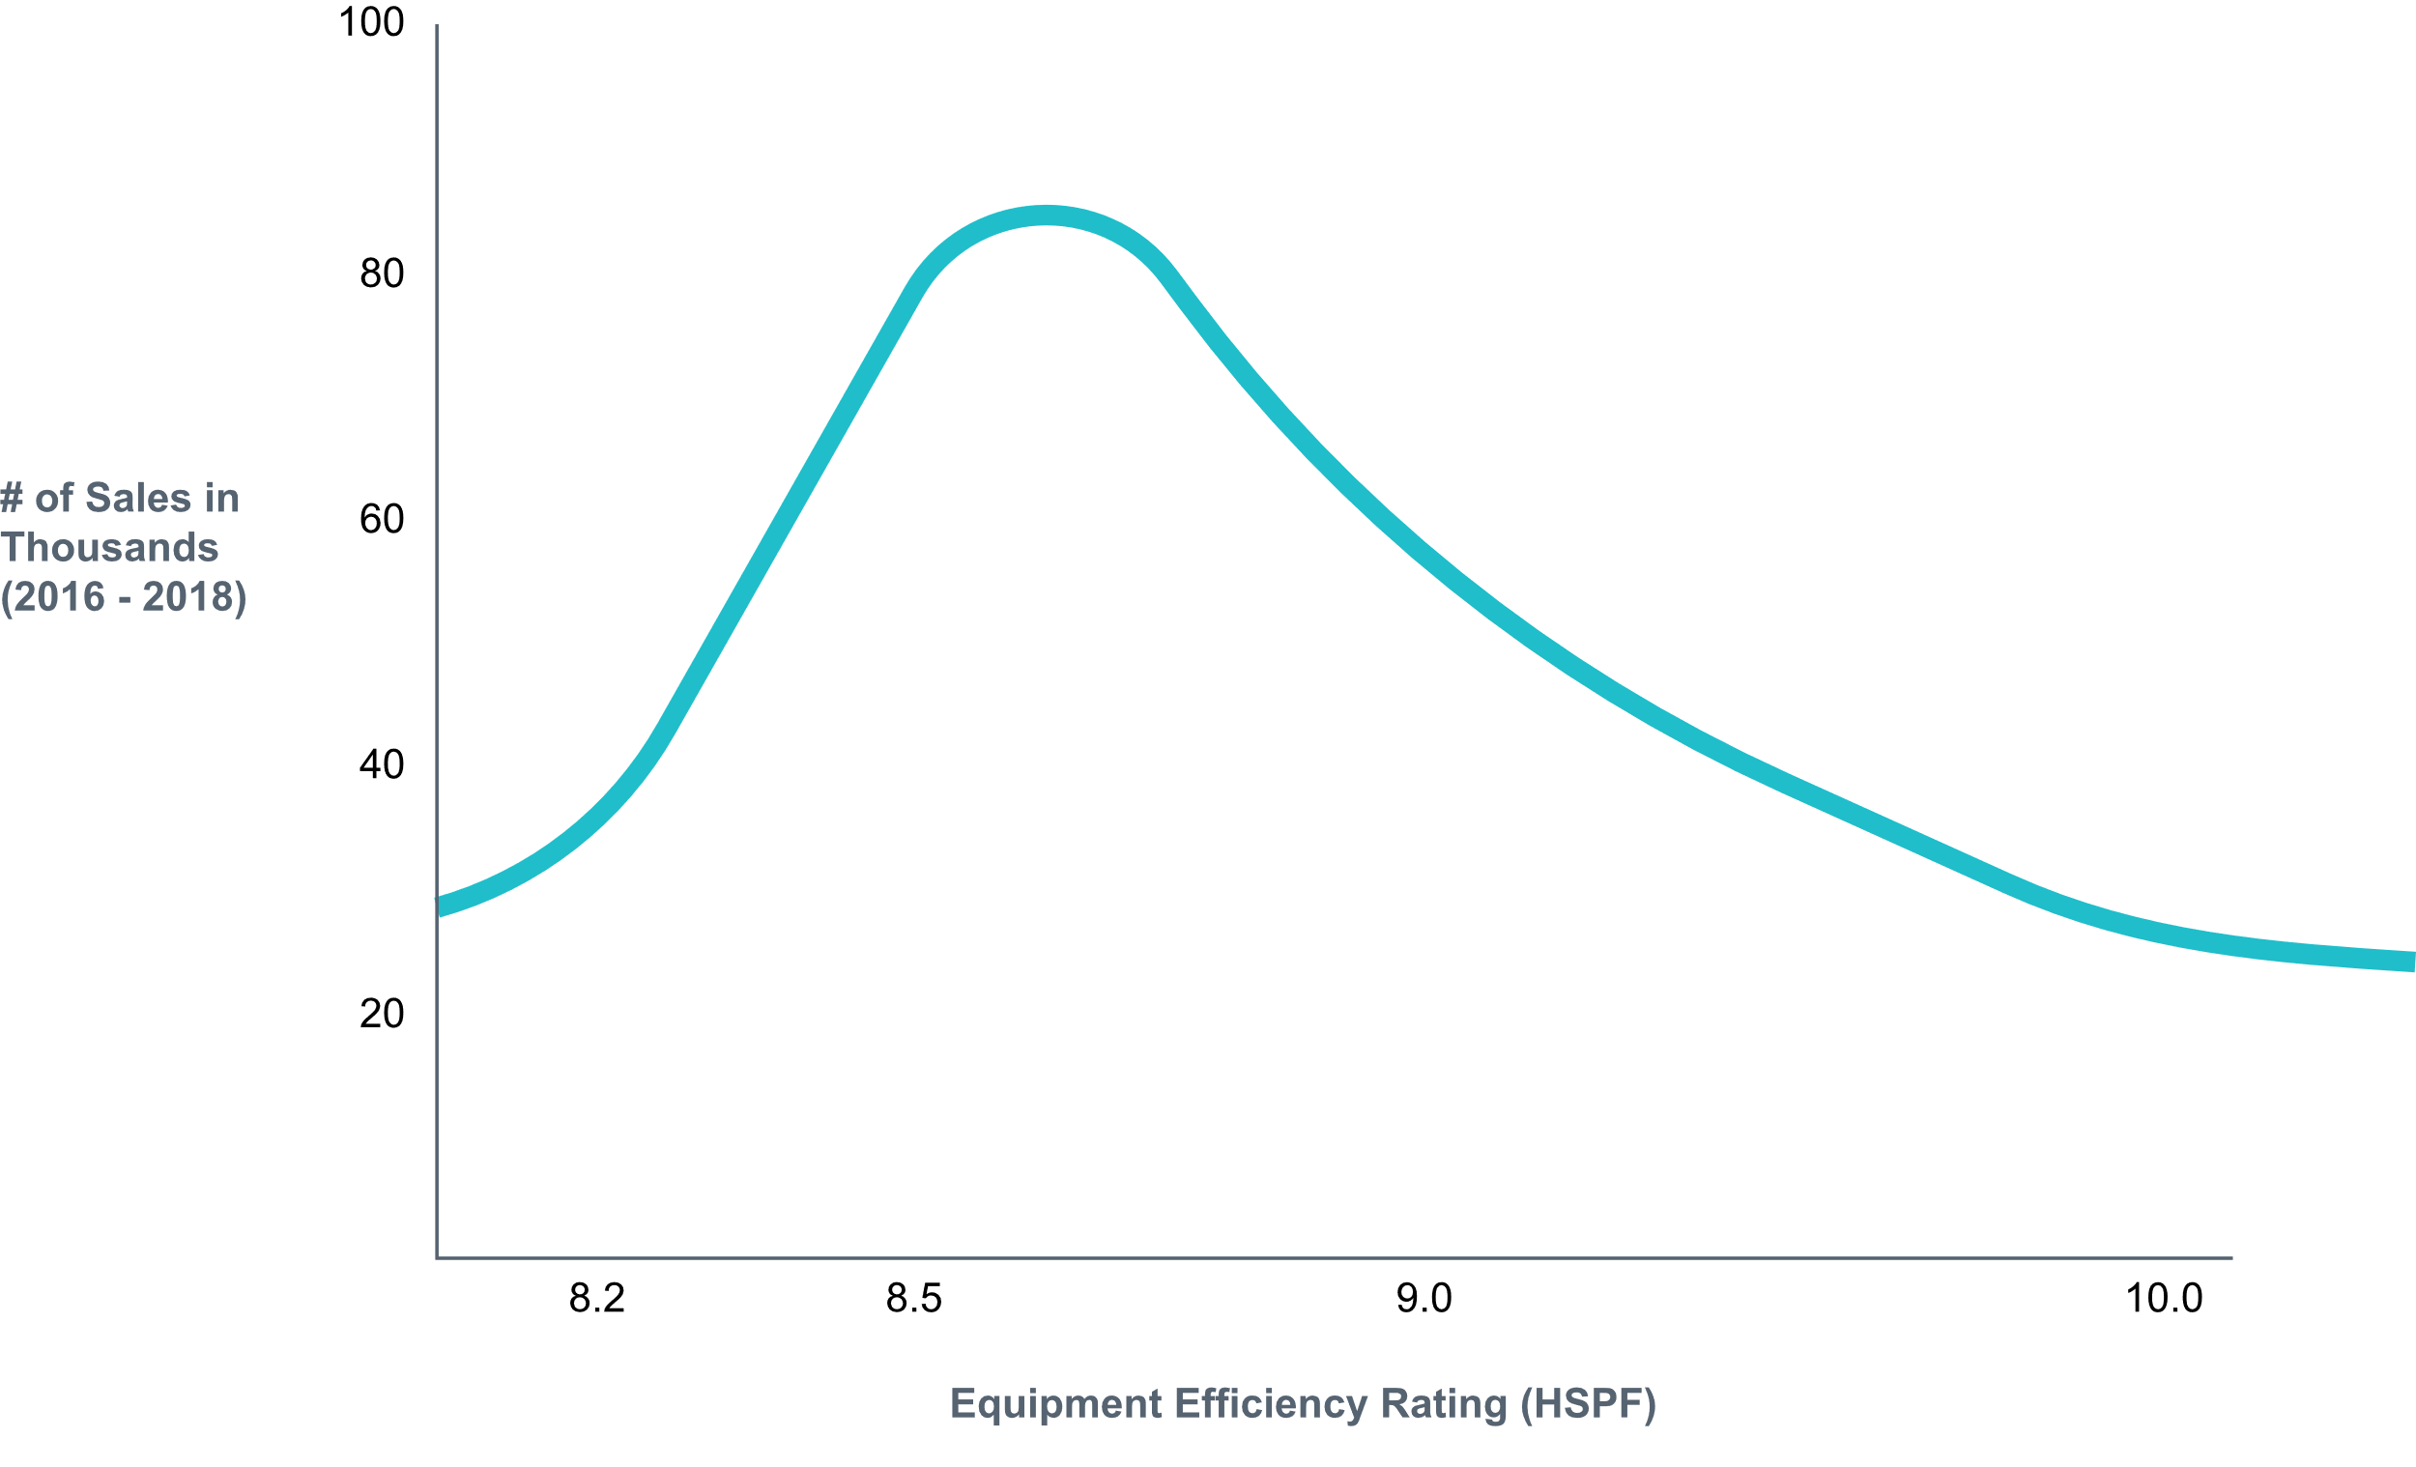
Supports Data Driven Baselines
4 | Build Regional Market Intelligence
Illustrative Only
Current practice baseline
Notes:
Supporting the Regional Technical Form and utility program measure development by confirming where opportunities still exist and where programs have successfully transformed markets
Our extensive efforts to collect sales data are particularly useful for this and have supported RTF and power plan baseline development.

Slide 27
INFORM PROGRAM DESIGN
UTILITY PROGRAMS
NEEA
Notes:
Our market characterization efforts often include many interviews with market actors in addition to data collection.
These findings can help programs better understand the landscape in which they operate, and as necessary, shift the tactics of their programs’ design
They can inform NEEA’s market transformation planning by providing market intelligence on key market actors, leverage points, and strategic opportunities

Slide 28
Help Understand Where To Go Next
4 | Build Regional Market Intelligence
Notes:
Our research helps understand which program opportunities are on the horizon, and what data needs and market intelligence is required to achieved them.
It can help confirm which markets (or market segments) are transformed and which need more work.

Slide 29
These 4 principles govern BPA’s approach to research
1 | Study what matters
2 | Be consistent in methods
3 | Use an open, accessible process
4 | Build regional market intelligence
They serve the larger purpose of our research: achieving the Administration’s goals through the responsible use of ratepayer funds, while adding value to stakeholders.
Summary Key Takeaways

Slide 30
WHAT’S NEXT
Purpose and Principles White Paper (LINK)
Summer Learning Series Finale: September 8th, 9-10am
Next Quarterly Call: November 3rd, 9-10am

Slide 31
B O N N E V I L L E P O W E R A D M I N I S T R A T I O N
THANK YOU
CONTACT
Bonnie Watson, Market Research Team Lead
bfwatson@bpa.gov | 503-230-3693

