Slide 1




Market Research and Momentum Savings Team
Quarterly Call
May 4, 2022
Credit to : https://www.behance.net/diegocarbonell

Slide 2


Role Call
Icebreaker
  Who is your favorite science fiction or Star Wars character?
Credit to : https://www.behance.net/diegocarbonell

Slide 3

Meet the Jedi
Bonnie Watson
Joan Wang
Juan Carlos Blacker
Momentum Savings Jedi Master
Team Lead
Momentum Savings Jedi Apprentice
Market Lead for:
Residential HVAC
Adjustable Speed Drives
Momentum Savings Jedi Apprentice
Market Lead for:
Non-Res Lighting
Commercial HVAC
“The Force is strong in these ones.”

Slide 4

Agenda
1
Highlights from the Commercial HVAC Permit Data study
2
Key findings from our draft Market Models
  Residential HVAC
  Non-Residential Lighting
  Industrial Adjustable Speed Drives
3
Communication plans for full model results
4
New research for 2022 / 2023
“Do or do not, there is no try.” - Yoda

Slide 5

Commercial HVAC
Highlights from the Commercial HVAC Permit Data Study
Credit to : https://www.behance.net/diegocarbonell
Notes:
JOAN

Slide 6
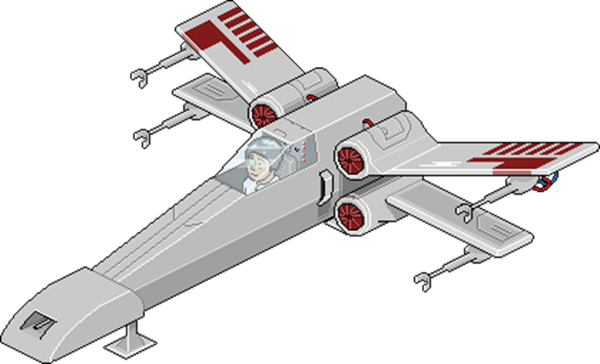





Permit Data Research Timeline
Mid 2020
Late 2020
2021
Late 2021
Early 2022
Sample Frame Defined
Lessons Learned Memo & Final Analysis
Defined Technology Scope
Concluded Data Collection
Permit Data Collection

Slide 7



What Technologies were Considered
Equipment | Technology Categorization
VRF | Principal
DHP | Principal
Ducted Systems | Added to Principal
Heat Recovery | Collected for Principal Systems Only
WSHP | Ancillary
Chillers | Ancillary
Packaged Systems | Ancillary
“Don’t be too proud of this technological terror you’ve constructed.” – Darth Vader
Notes:
To streamline study we needed to categorize the technologies. With guidance from stakeholders and the HVAC expert panel we broke the technologies into “Principal” and “Ancillary” We considered a variety of factors including regional interest, magnitude of market change, weather or not it was included in the 7th PP, etc.
For “principal technologies”. we collected detailed data, to develop UECs and to report market and Momentum savings.
Our focus ended up on VRF and DHP as principal technologies, and we added ducted cooling after collecting the system level data from the permit drawings.
→We waited on the ducted cooling decision partially because we weren’t able to predict how much savings ducted cooling systems would represent, nor how many systems would be included in the sample. This addition ended up doubling the number permits the team collected detailed “stage 2” HVAC data on.
We also decided that it did not make sense to collect air-to-air heat recovery systems as “principal technologies”, but that we should gather them when they were included on a project WITH a principal primary HVAC system. So, for a VRF system that included a DOAS unit, we would collect the details of the DOAS unit.
WSHP and Chillers were identified as ancillary, partially because they were not included in the 7th PP, and partially due to stakeholder concerns on the ability to accurately model energy savings from hydronic systems.

Slide 8
Commercial HVAC Permit Data Sample Frame
Analysis Period
Operational between January 1, 2016 and December 31, 2021
Building Types
Commercial buildings (after data cleaning)
Multifamily buildings with five or more units and four or more floors (if central system)
Geography
Installed in Idaho, Oregon, Washington, or Montana counties served by BPA
Credit to : https://www.behance.net/diegocarbonell
Notes:
All Projects: Sample Frame:
Projects 26,473 6,810
Billion of Improved Value $120 $66
Data Source: Dodge data was found to be the most complete and most established data source for construction projects. We found that it may not include some projects from smaller cities or rural areas, but it’s use by the US Census Bureau gave us confidence that it would provide what we needed.
Project Years: Our goal was to cover projects completed during the 7th Power Plan period, 2016-2021. Since Dodge categorizes projects by start date, it’s hard to forecast accurate completion dates for all included projects. The team elected to gather Dodge data for construction starts from 2015-2019 using our engineering judgement and project completion experience, even though some projects completed outside of the 7th plan period may have been included or excluded.
Excluded from Dodge Data:
-Excluded Building Types:
--Laboratories / non-commercial applications
--Buildings excluded from the 2019 CBSA
--Spaces that are typically non-conditioned
--Refrigerated warehouses
-Multifamily that could not be confirmed at 4+ stories (only common spaces included)
-Projects with low construction values (<200,000 NC, <1,000,000 renovation, since these are less likely to include HVAC in the scope of work)
-Projects in Montana outside of BPA territory

Slide 9
Permit Database and Lessons Learned
Database Tab | Description
READ ME | Project background and general information
Data Dictionary | Definitions of database fields
Stage 1 Project Data | Data Storage Table for all Stage 1 project level information
Stage 2 Heating | Data Storage Table for primary heating equipment
Stage 2 Cooling | Data Storage Table for primary cooling equipment
Stage 2 Supp HVAC | Data Storage Table for supplementary HVAC equipment
Stage 2 HRV | Data Storage Table for air-to-air heat recovery equipment
Population Summary | Summarizes the total extrapolated population of commercial new construction conditioned square footage by domain, the extrapolation process, and the relative precision by domain
Lessons Learned Highlights:
Use a two-stage sampling design and request more projects than the sample requires.
Use online data sources to supplement public records requests.
Work with large jurisdictions in advance of future data collection efforts.
See Lessons Learned Memo
“You must unlearn what you have learned.” - Yoda
Notes:
Database has 4 Parts:
All projects in the sample have a unique project identifier which is consistent across tabs.
This "Project_ID" can be used to map HVAC equipment to a specific project.
Stage 1 Project Data tab includes general project information,
Stage 2 includes the heating system or cooling system associated with specific projects in Stage 1 (by matching project ID).
Lessons Learned:
Acquiring files from jurisdictions and secondary sources
Cataloging HVAC systems
Sampling plan implementation and final sample analysis.
Highlights:
Use online secondary data sources to supplement public records requests.
Work with large jurisdictions in advance of future data collection efforts.
Request more projects than the sample requires to minimize replacement delays.
Take an “account management” approach to working with jurisdictions
Create strong data entry protocols and documentation processes to ensure the final product is accurate.
Continue to build on existing technical resources to support non-technical team members.
Use a two-stage sampling design.
Adjust for large project timelines.
Narrow the scope to new construction only

Slide 10

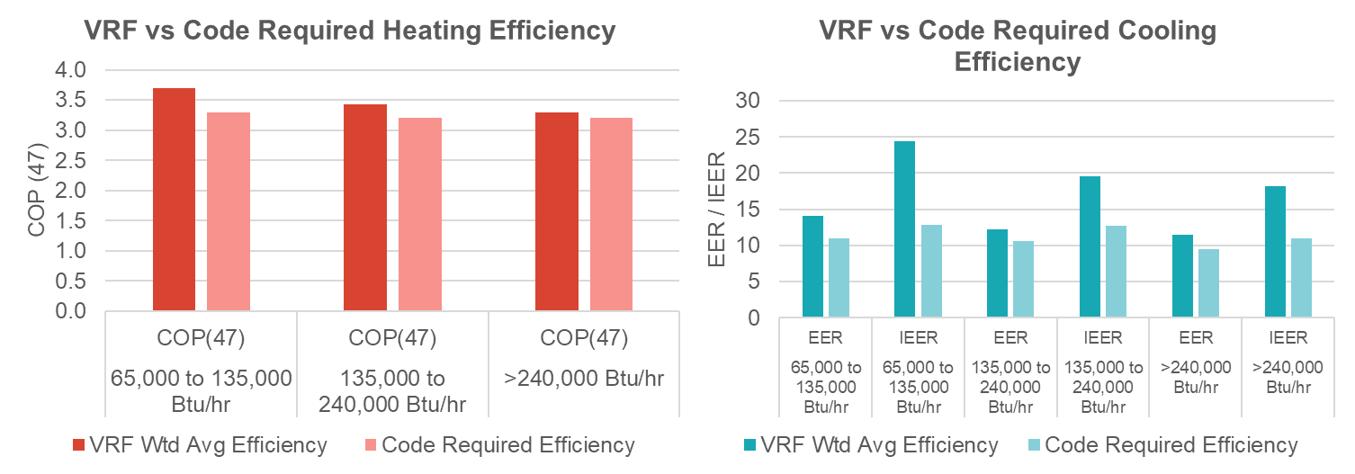
VRF System Performance Exceeds
Code Efficiency
DRAFT
Notes:
Regional average efficiency exceeds code in both heating and cooling modes
Fantastic efficiency gains in part load operation (IEER)
62% of systems also include VRF heat recovery, which can increase system operational efficiency
VRF efficiency gains were lowest for the largest systems, which were also most prevalent.
IMPACT:
Current utility incentives estimate 3-5 kBtu/sf savings for VRF systems. Assuming this is true, the VRF market segment potential is likely on the order of 10 aMW, though may be higher when HRV savings are included.

Slide 11

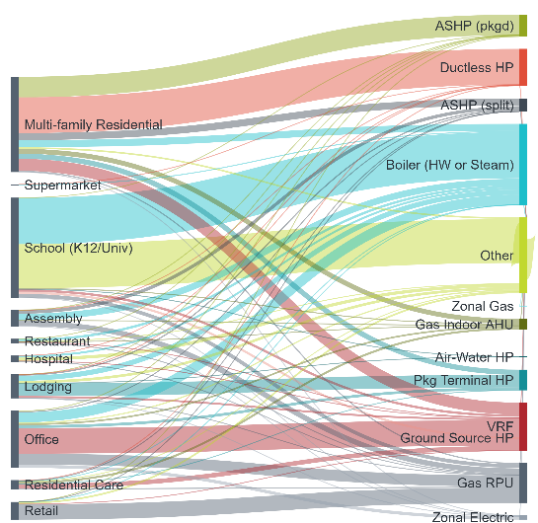
Future Market Modeling Implications
Future modeling and data collection potential areas of focus:
  Segments with good sampling precisions
  Where we expect to find technologies of interest
Office: VRF with HRV/ERV
Multi-Family Residential: VRF, DHP with HRV/ERV
Residential Care: VRF with HRV/ERV
Lodging: VRF with HRV/ERV
“Your eyes can deceive you, don’t trust them.” - Obi-Wan Kenobi
Notes:
Focusing in on the largest market segments (MFR, Office, Lodging, School) also tends to yield our principal technologies of interest.
Future modeling and data collection efforts can be both streamlined and yield improved precision if we’re able to narrow down what we’re trying to collect and model.
Office and MF was nearly 60% of commercial NC square footage.
Get 80% of VRF and DHP systems if we model 4 buildings types, vs trying to sample the whole building population

Slide 12

Key Findings from our Draft Market Models
  Residential HVAC
Credit to : https://www.behance.net/diegocarbonell
Notes:
JOAN

Slide 13
HVAC Technologies in Homes
Fewer electric “toasters” in the mix
26% decrease in homes that use baseboards or eFAF for primary heating
72% of homes now have cooling
Variable speed heat pumps emerging
Central air conditioner sales grew 20% annually in the past 6 years
VSHPs represents nearly 15% of air source heat pump sales in 2020
Credit to : https://www.behance.net/diegocarbonell
Notes:
JOAN
First, one of the biggest shifts in residential HVAC is an increase in cooling.
We saw a rapid increase in CAC sales over the past 6 years, and we’re seeing that show up in the stock with significant increases in homes that have some form of cooling.
We’re seeing about 72% of homes in the region have cooling (which includes whole-home or zonal cooling). That’s means 20% of homes added cooling sometime during the past 6 years.
The increase in CAC and ASHP sales also resulted in almost half of homes in the region (46%) have whole-home cooling.
Several of our market research activities (sales data analysis, market actor interviews, AHR interviews) over the past few years confirm these trends and they all point to significant growth in cooling in the region.
On the heating side, we’re seeing a decline in inefficient electric heating technologies such as electric forced air furnaces (“toasters” with a fan) and baseboards.
The share of homes that use these inefficient electric heating technologies for primary heat decreased by 26% or 11 percentage points, from 43% in 2015 to 32% in 2021.
That means that as these inefficient technologies break or retire, they are not necessarily getting replaced by the same technologies…
Some of them are being replaced with more efficient technologies such as heat pumps, for which we’re seeing a growth over the past few years.
In fact, heat pumps (ASHPs, DHPs, GSHP, PTHP) now provide primary heating to almost a third (27%) of Northwest homes
And one exciting new trend we’re seeing in heat pump sales is the emergence of variable speed heat pumps.
These are also referred to as variable capacity heat pumps or inverter-driven heat pumps.
They are centrally ducted air source heat pumps with a variable speed compressor. The inverter-driven compressor
allows the heat pump to vary its capacity, typically making them more efficient than single- and two-stage
ASHPs.
Sales of VSHPs have increased over the past few years, from almost zero market share to making up nearly 15% of ducted heat pump sales in 2020.
Even though VSHPs are still relatively low volume, market actors we’ve talked recently unanimously confirmed that sales of VCHPs are expected to continue to rise.
There’s a lot of national and regional research and promotion of VSHPs… BPA engineering team is currently conducting a High Performance, High Capacity Heat Pump field study and collaborating with a number of utilities in BPA service territory to field test these high performance heat pumps.
NEEA also has a VSHP program that aims to promote VSHPs through improving federal test procedure and minimum efficiency standard.

Slide 14

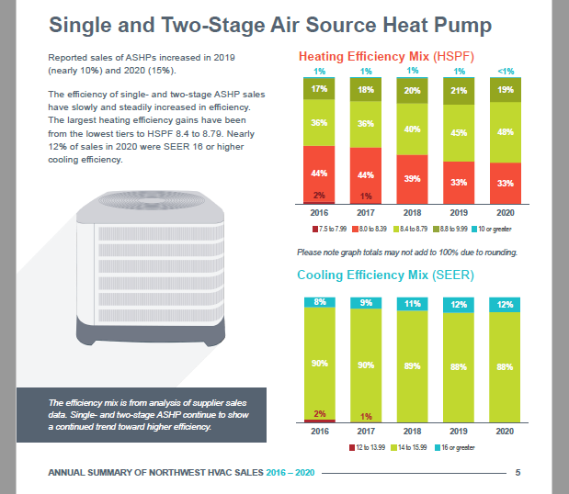
Want to learn more HVAC sales trends?
Summary contains efficiency mix of residential HVAC sales from 2016 to 2020
NEW insights on variable speed air-source heat pumps
https://www.bpa.gov/-/media/Aep/energy-efficiency/momentum-savings/2016-2020-hvac-sales-data-summary.pdf
Notes:
JOAN
More insights to come from the res HVAC market model…
For now, we just published an executive summary that focuses on regional HVAC sales trends over 2016-2020. This summary gives you a great look at the efficiency mix of the sales of ASHPs, DHPs, CACs and gas furnaces and how the efficiency mix changed over time (slowly getting more efficient) from 2016 to 2020. This information comes from sales data that NEEA is collecting directly from HVAC suppliers in the region, and this is an ongoing annual effort that’s super important to help us understand and track this market over time.
In this executive summary, you’ll also see that for the first time ever, we were able to directly identify variable speed heat pumps in the sales data. Which means we now know and can continue to track how many ASHPs are variable speed.

Slide 15

Key Findings from our Draft Market Models
  Non-Residential Lighting
Credit to : https://www.behance.net/diegocarbonell
Notes:
JOAN

Slide 16
The Big Market Transformation Story
Lamp Stock over Time
TLED Boom
“Don’t get cocky, kid.” – Han Solo
Notes:
At the highest level, this is a story of a massive market adoption of a high-efficiency technology.
A lot of hard work by a lot of people.
Tens of thousands of retrofit projects, most of which were incentivized by programs
Programs (Utility and NEEA) Account for Over 75% of Market Savings
Millions of LED lamps and fixtures sold

Slide 17
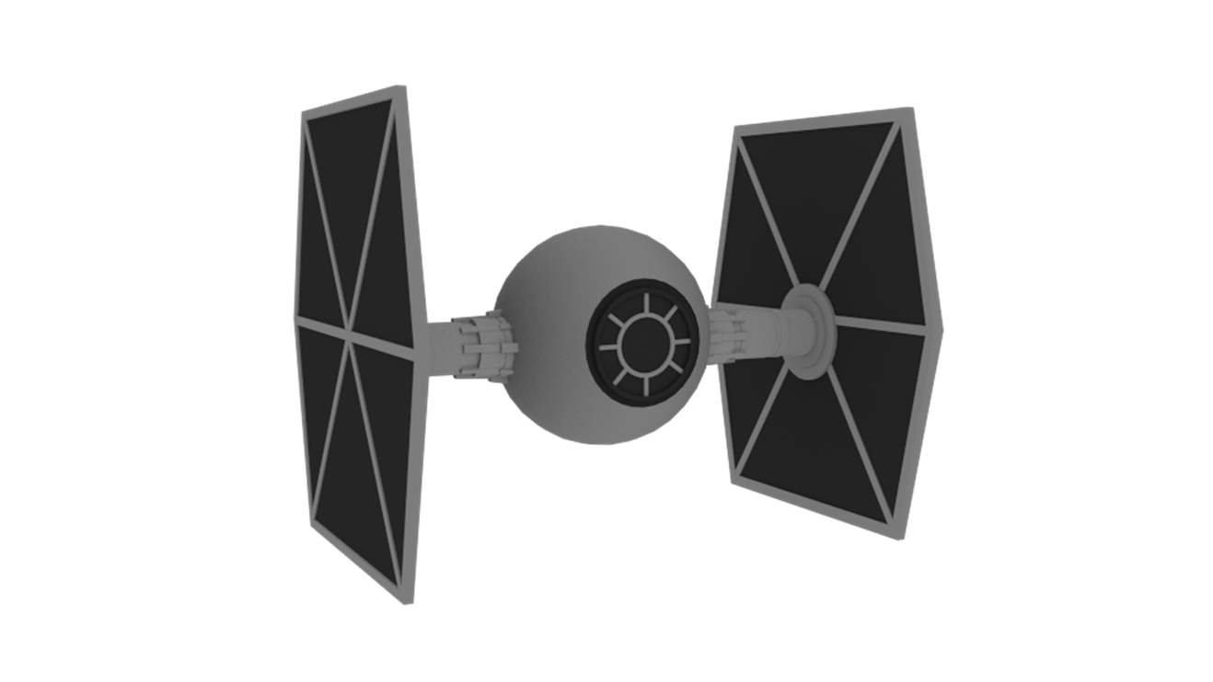
Trends and the Future
Lighting Sales Data Collection
  NEEA Data Collection
  Market Actor Interviews
  LightFair
Controls Market Characterization
  Understand different technology options
  Define supply chain
  Research growth trends
  Determine data availability and gaps
“If you only knew the power of the dark side.” – Darth Vader
Notes:
The Story:
LED GROWTH causing energy consumption to fall
TLEDs - Meteoric growth
722% growth between 2015 and 2021 in market size
Replaces linear fluorescent lamps – the largest single non-res lighting technology
LED Luminaires – integrated LED fixtures
Obviate the need for lamp & ballast maintenance
Exceedingly long lifetimes & savings persistence
High quality and diverse LED options have made LED adoption easier
LEDs got way cheaper between 2015 and 2021:
TLEDs went from $43 to $12 (-72%)
LED Luminaires went from $181 to $122 (-33%)
LED Lamps went from $13 to $5 (-61%)
Other lighting technology costs stayed relatively steady
Long run average cost – economies of scale

Slide 18
Key Findings from our Draft Market Models
  Adjustable Speed Drives
Credit to : https://www.behance.net/diegocarbonell
Notes:
JOAN

Slide 19
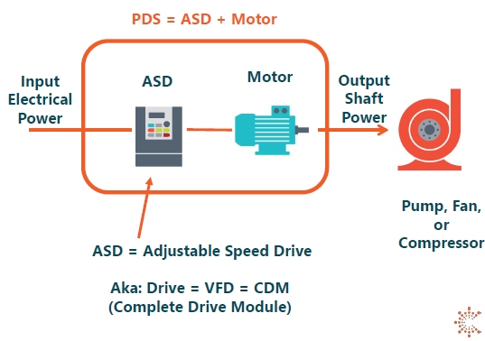
ASDs on Industrial Pumps and Fans
Pumps and fans represent the largest end use within the industrial sector
ASDs save energy by controlling the speed of motors serving pumps and fans
The region has added ASDs to 230,500 industrial pump and fan motor horsepower since 2015!
Credit to : https://www.behance.net/diegocarbonell
Notes:
JOAN
Image from NEEA April 19th Product Council presentation (Power Index: Simplified Savings for Variable Speed Drives)

Slide 20
ASD Saturation over Time
“He’s quite clever, you know…for a human being.” - C-3P0
Notes:
ASD saturation on fans (# of motors): 30% in 2021, 23% in 2015
ASD saturation on pumps (# of motors): 39% in 2021, 27% in 2015

Slide 21

Stay Tuned for Full Model Results
Res HVAC: How many new ASHPs, DHPs, and CACs are people buying every year? How have these new equipment changed the average HVAC energy consumption per home?
Non-Res Lighting: Are we reaching an inflection point with LEDs? Is the plateau from the last 2 years a market indicator or just a temporary COVID reaction?
ASDs: How much energy have ASDs saved for the industrial sector? Where does market potential still exist for ASDs? In which industries?
Notes:
BONNIE

Slide 22
Communication Plans for Full Model Results
Quarterly Calls
ANY REQUESTS?
Webinars
Guest Speakers
Notes:
BONNIE

Slide 23


New Research for 2022 / 2023
EE Action Planning & Long Term Planning: Summer
Controls Market Characterization: June
HVAC Sales Data Analysis: July
ASD Model: September
Com HVAC Model: Fall / Winter 2022 and 2023
Review of Final RBSA: December/January
HVAC Market Intel: After RBSA results
CBSA Working Group: 2023
Notes:
BONNIE

Slide 24
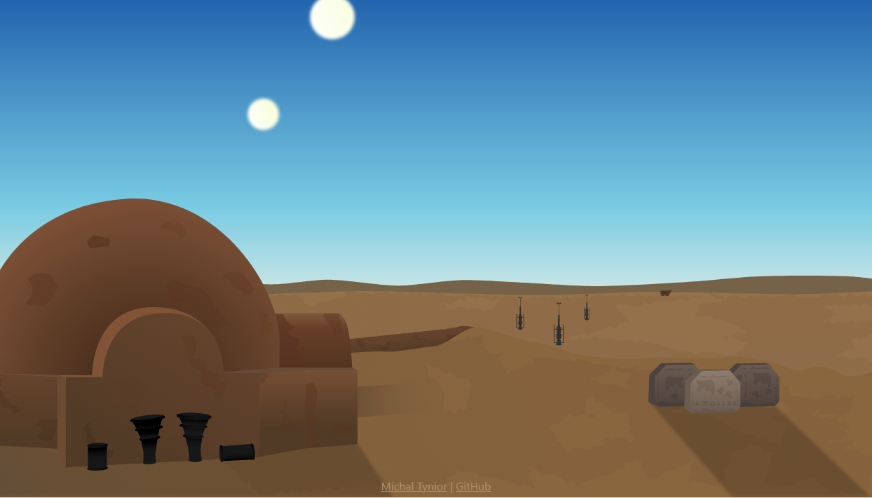

THANK YOU… and…
See you on August 3, 2022

