Slide 1


2020 HVAC Distribution Market Research
JUNE 2, 2021

Slide 2
Agenda
1
High Level Interview Findings
2
Insights: Residential Market
3
Insights: Commercial Market

Slide 3
High Level Interview Findings
1
Notes:
The team completed 27 interviews in winter 2020/2021 with a mix of distributors (11 HVAC, 1 electrical), manufacturer reps (7) and key informants (8). Together, these contacts provided their insights on trends and supply chain dynamics in the regional HVAC industry.
We sought to complete interviews with electrical distributors as well, we prepared a list of 17, and screened 10 of them out because they did not sell HVAC equipment.
Our definition of “distributor” includes a mix of distributors that operate general supply houses (traditional distributors that sell products to contractors directly) and “hybrid” distributors that provide more technical and design services… those folks operate primarily in the commercial market.
We also sought to complete interviews with folks engaged with HVAC retail sales. We only had a few contacts from retail, and were not able to complete interviews with any of them.
We analyzed the findings from the interviews. Most of the data was qualitative, and the team identified themes and consistent responses.

Slide 4





Overarching Findings
  Consolidation and blurred roles in supply chain
  Expected market demand for performance and efficiency
  Proliferating electrification & climate change policies
  Pandemic-driven focus air quality
Contacts focused on adapting to:
Notes:
A few major trends jumped out, none of which are particularly new, but perhaps the urgency and progress indicates a shift is really underway.
We heard that consolidation had continued in the supply chain, although it seemed that this was occurring consistent with prior years. Manufacturers reaching deeper into the supply chain?
We heard a huge focus on efficiency, particularly in the heat pump market – but also in commercial. We’ll talk more about that.
We also heard a market focused on how the proliferating electrification and climate change policies might affect the market. These were not really complaints – more observations and maybe even anticipation that it could help them make the case for certain equipment.
Discussions about refrigerants have been going on for a while. Low global-warming potential refrigerants could increase performance and meet climate goals.
(expanded applications for electric equipment + pressure to improve refrigerants)

Slide 5
Two Emerging Heat Pump Trends
1
Focus on Variable Capacity Heat Pump Applications
2
Expanded Heat Pump Applications

Slide 6
1
Focus on Variable Capacity Heat Pump Applications
A tracking challenge going forward?
  VC equipment enabling more efficient system design for variety of equipment
  Limitations of HSPF and SEER in discerning real-world performance for variable capacity equipment
Notes:
“It’s an inverter driven world”
Variable speed inverter-driven equipment is enabling more efficient system design for many types of equipment (ducted, ductless, central air, even water heating)
VC equipment enabling more efficient system design for variety of equipment
Limitations of HSPF and SEER in discerning real-world performance particularly for variable capacity equipment
Terminology: Inverter-driven, variable capacity and variable speed equipment
Market actors used these terms interchangeably. This equipment is distinct from other types of heat pumps because the compressor and fans vary their speeds to meet heating and cooling demand. This operational efficiency provides energy savings. Variable speed equipment is found in an increasing number of heat pump applications.
Implication/Recommendation: As the market shifts towards more variable speed equipment, it will be increasingly important to track sales and impact of these systems on the region’s energy consumption. Before new industry rating systems are established, Bonneville could consider using existing resources such as the Cold Climate Air Source Heat Pump (ccASHP) Product List and program tracking data to track variable speed heat pumps in the distributor sales data.

Slide 7
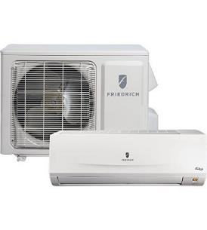
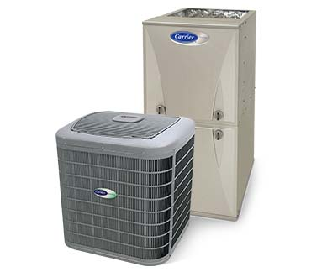
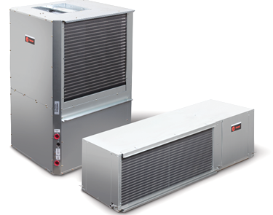
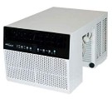
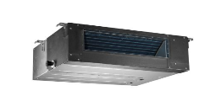
Increasing number of products with VS
Central Forced Air
Mini-Split
Packaged
Micro HP
Variable speed control of compressor and fans improves efficiency relative to single speed. However, It’s not easy to discern the central VSHP in the market right now.
Notes:
NEEA is leading some regional efforts that reflect both of these challenges. Discerning VS/VC equipment in the market AND understanding the performance relative to single speed in specific conditions.
Those of you tracking NEEA’s efforts to create “archetypes” for heat pump performance and assess the real world performance of variable speed/inverter-driven equipment will probably have seen this information before. Our interviews confirmed a market trend toward variable speed/inverter driven equipment being added to multiple types of heat pumps…
We also heard this technology increasingly found in water heaters and other types of equipment, including commercial equipment.
The BPA and Cadeo teams are working to confirm/disconfirm the presence of a specific indicator for VS equipment.

Slide 8
2
“Mix and Match” Heat Pump Solutions Emerging
A market research/market intelligence challenge going forward?
  Customized to match needs of any given home
  Single compressor that can be paired with a variety of indoor/air handling units
Notes:
As the selection of “mix-and-match” products increases, market observers should expect to see inverter-driven outdoor units that have been historically associated with ductless heat pumps used with a variety of product types, including ductless, ducted, and central indoor units.
An outdoor unit is an ASHP or DHP unit located on the outside of the house, that has the compressor and the condensing coil/evaporator coil.
Distributor sales data model numbers typically include the model’s outdoor unit. The efficiency of a system is based on the efficiency of the outdoor unit.
In the past, outdoor units could be confidently assigned to a specific system type. That is less likely to be true in the future.
With manufacturer product lines increasingly mixing and matching equipment, outdoor units (especially inverter-driven outdoor units) will be used with a variety of systems, making it harder to identify the specific application for these compressor units.
At the same time, there is evidence that these high performance, high efficiency products do not yet represent the bulk of market sales. Analysis of regional distributor sales trends from 2016-2019 indicate that products are clustering in the middle of the efficiency spectrum while sales of the highest tiers are relatively flat.
How can the region track the proliferation of these systems?
Are programs seeing evidence of this (yet)?

Slide 9
“Mix & Match”
Analytical challenges?
Inverter-driven outdoor units that were traditionally associated with
mini-splits are increasingly associated with a variety of product types
Old
Emerging
Central Forced Air
Inverter-driven compressor + ??
Central Forced Air
Mini-Split
Notes:
It's not necessarily outdoor units being associated with a variety of product types, it's more that DHPs are being associated with new indoor configurations.
Not the end of the world from an efficiency mix perspective (we can tell the efficiency of the unit from the outdoor unit), we just don't know how that air is being delivered inside, which is more a UEC issue… we expect those of you working in programs might be seeing some of these “mix and match” systems… maybe they are concentrated in New Construction… stock studies and longitudinal market tracking will help us understand.
Implication/Recommendation: The region should continue to look out for the emergence of these “mix-and-match” products and ensure that program tracking, field research or market research verify both the installed outdoor unit and what it is paired with. If these “mix-and-match” products become more prevalent, tracking sales of and studying the energy consumption of these systems will become increasingly important to accurately characterizing the market.

Slide 10
Tracking challenges
Process used to categorize and track equipment could make it difficult to assess these trends
  HSPF/SEER not sufficient for identifying performance of variable speed
  Not easy to track “mix and match” systems
  No current AHRI marker for variable speed
Notes:
It’s important to note that while these trends emerged somewhat loudly from our interviews, it’s difficult to confirm/disconfirm the velocity of the change happening, as the tracking systems and product categories we use right now might not be sufficient.
In future rounds of analysis, BPA is focused on testing efforts to estimate the portion of the market that is variable speed (not always directly related to HSPF), but sorting out the design of installed systems might require more detailed information from programs, permits, or stock studies.
Note that some of the challenges associated with discerning the efficient option have been documented by NEEA and others in on-going work. This is also the subject of NEEA’s effort to develop VSHP archetypes that account for performance differences by climate, home type, equipment size and so on.
Test procedures used to derive Heating Seasonal Performance Factor (HSPF) and Seasonal Energy Efficient Ratio (SEER), can underrepresent the performance of variable speed equipment because current test procedures do not account for the control algorithms of variable capacity equipment.
These “mix and match systems” often integrate a DHP style outdoor unit, but are not necessarily consistent with how we think of a typical DHP system.

Slide 11
Insights: Residential Market
2
Notes:
We also sought to update our understanding of the overall supply chain and, by extension, the coverage of the sales data.

Slide 12
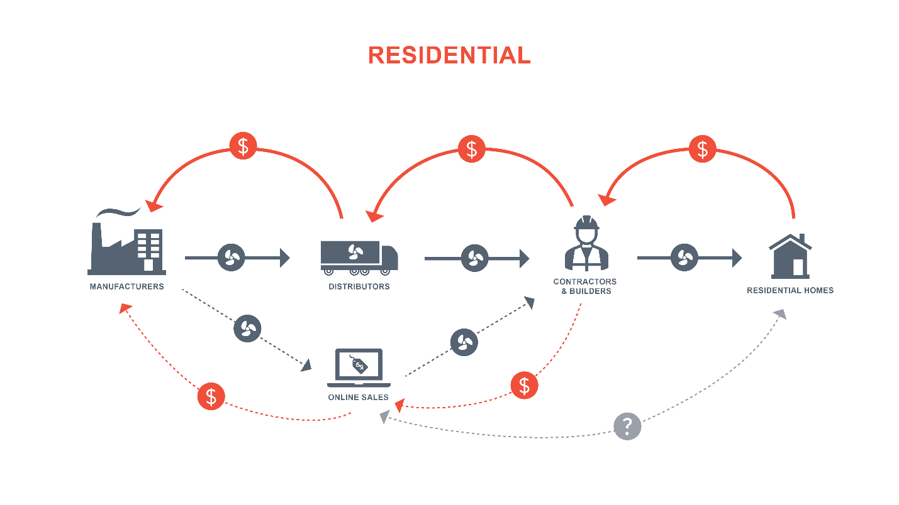
Evolving Residential
Supply Chain
Notes:
The main adjustment we made to the residential supply chain this year is to acknowledge the presence of online and retail sales that can flow both directly to contractors and, to a lesser extent, to homeowners.
Estimates of the product volume flowing through this channel vary by product, with DHPs and CAC the most commonly mentioned. For any of you not regularly shopping for heating or cooling equipment, you can buy a DHP directly through Home Depot.com now, and there are several large online suppliers, HVAC direct.com, AC online.com… you’ll see a variety of equipment available there.
The challenge is accessing information about the RELATIVE volume of sales flowing through this channel at this point. Some contacts were dismissive of this trend, but most acknowledged it was real and growing. Those willing to estimate tended to report “double digits” (as opposed to single digits, which some folks have heard for years)… maybe as high as 10-15%?
No one knows exactly how large, as one contact put it “everyone wants that number.”

Slide 13







Residential trends
Increasing sales… supply chain disruptions
Heat pumps rising
  Electrification
  Whole home
  Variable Speed
Air quality and ventilation features
Notes:
In interviews, contacts described increased residential sales, this was described as reflecting overall investment in residential comfort and renovations, with families working and schooling from home.
One contact noted that people “weren’t even changing their filters” and are now interested in additional air quality technologies such as UV light or advanced filtration.
Electrification effect, particularly in areas of the Northwest influenced by codes and policies designed to combat climate change. We have 99% furnace and 28 SEER furnace on the market right now.
Expanding the number and configurations of homes that can be effectively served by heat pump technology by combining ductless and ducted equipment and replacing forced air furnaces
Electrification and whole home solutions consistent with prior years’ AHR findings.

Slide 14
Ducted ASHP: HSPF Trends
Notes:
Let’s turn to some details on specific technologies.
BPA’s Res HVAC Market model (completed in 2019) indicates that approximately 60,000 central system ASHP were sold in the NW in 2018. Interviewees largely agreed with this estimate—note that they also report total sales are increasing.
Largest share is in HSPF 8.5. Sales below 8.2 dropped to zero over the past two years as they are below code minimum.
Set to increase in 2023.
We see slight drops in HSPF 9.0 and 12.0.
Sales increasing, interviewees agree with total market estimate
Market momentum toward heat pumps
Sales clustering in mid-efficiency tier
(Note that mid-efficiency tier is still more efficient than other technology options.)
Regarding cooling efficiency as measured by SEER ratings, 80% or more of all sales have been at SEER 14 for four years in a row. The top bin, SEER 16 has been stable at 18% for three years in a row.
Pretty uninteresting graph…. Shows the stability of SEER ratings in ASHP efficiency mix. Note that these products are typically marketed and selected based on HEATING efficiency, so the SEER level reflects the efficiency of the fans and compressors in heat pumps selected for heating.

Slide 15
Ductless Heat Pumps
Notes:
So, what about DHPs…
BPA’s Res HVAC Market model indicates that approximately 40,000 DHPs were sold in the NW in 2018. Mix of responses indicate that it should be higher. All 13 respondents reported that DHP sales increased from 2018 to 2019 and continued to do so in 2020.
Year over year sales increasing.
Cold climate sales increasing, particularly east of Cascades, supported by program activity
Overall findings consistent with what we learned at AHR last year.

Slide 16








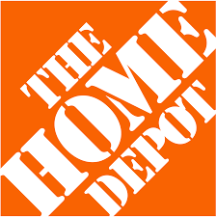


DHP Sales Paths(s)
Electrical distributors not major source of sales
Portion of sales flowing through online and retail unknown; most to contractors
Notes:
Market observers have speculated that DHPs are being sold through paths other than traditional HVAC distribution… for example electrical distributors or retail and online sales.
It is true that some electrical distributors are selling DHPs, but at a very low level relative to their HVAC counter parts.
However, the portion of sales through online and retail outlets is harder to estimate and is reportedly “growing”…. This remains a gap.
Direct to consumer sources are not captured in existing data, and they are difficult to estimate (myriad players, different business models, online sales). HVACdirect, AC online, Home Depot.com, DIY specialists. Products come ready to install with instructions, just need licensed contractor to make the connection.
It’s important to keep in mind that the HVAC distributors we interviewed see these online sales as a threat and tend to be dismissive. Most would not estimate a volume, in part because they do not have visibility into that channel. Estimating this will be increasingly important.
Estimates varied from zero to 10%, most offered 5% or less
“Online [sales] are probably more than electrical or plumbing distributors. I think online is higher than you think, maybe 10-20%.”

Slide 17
Natural Gas Furnaces
Notes:
Natural gas furnace sales have been pretty consistent over the past four years… a slight increase toward 95+ AFUE, but a persistent 30% or more at 80-90.
This suggests a somewhat bifurcated market – (indicative of condensing furnace)
The team asked the 10 contacts with experience selling natural gas furnaces about that market estimate. Seven contacts reported this estimate seemed reasonable, while three argued that the estimate is too low.
Market size estimate earned mixed assessments. 110,000-160,000 vs. 100k
Sales increasing, low natural gas costs, existing infrastructure
Increased sales could be from new construction, conversion of existing electric and converting legacy oil heat/delivered fuels. We don’t know precisely if natural gas equipment is taking load from specific equipment.

Slide 18
Central Air Conditioning
Notes:
Finally, CAC…
The market model estimated that 76,000 CAC systems were sold in the Pacific Northwest region in 2018. Eight interviewed market actors sold CAC systems, six of whom agreed that this market sales estimate is reasonable while offering caveats indicating uncertainty.
The trends show an encouraging shift toward higher efficiency products, although sales at the highest tier remain flat (SEER 13 is the current federal minimum, set to increase in 2023).
Sales trends less clear; increasing interest in cooling, but competition with heat pumps.
Pandemic increased interest in home cooling last year
“We still sell air conditioners, but we are focusing on heat pumps
Consistent with AHR results, which indicated that whole home cooling is increasing… it will be interesting to see if more of these systems become heat pumps and provide both heating and cooling. Some have speculated the existing natural gas equipment fleet could be used as backup in this scenario…

Slide 19
Insights: Commercial Market
3
Notes:
A quick caveat that we were really focused on the residential market and had a more specific set of questions for the residential product sales… we included some high level commercial trends and supply chain questions, but do NOT have the same level of detail. So, just a few slides here.

Slide 20
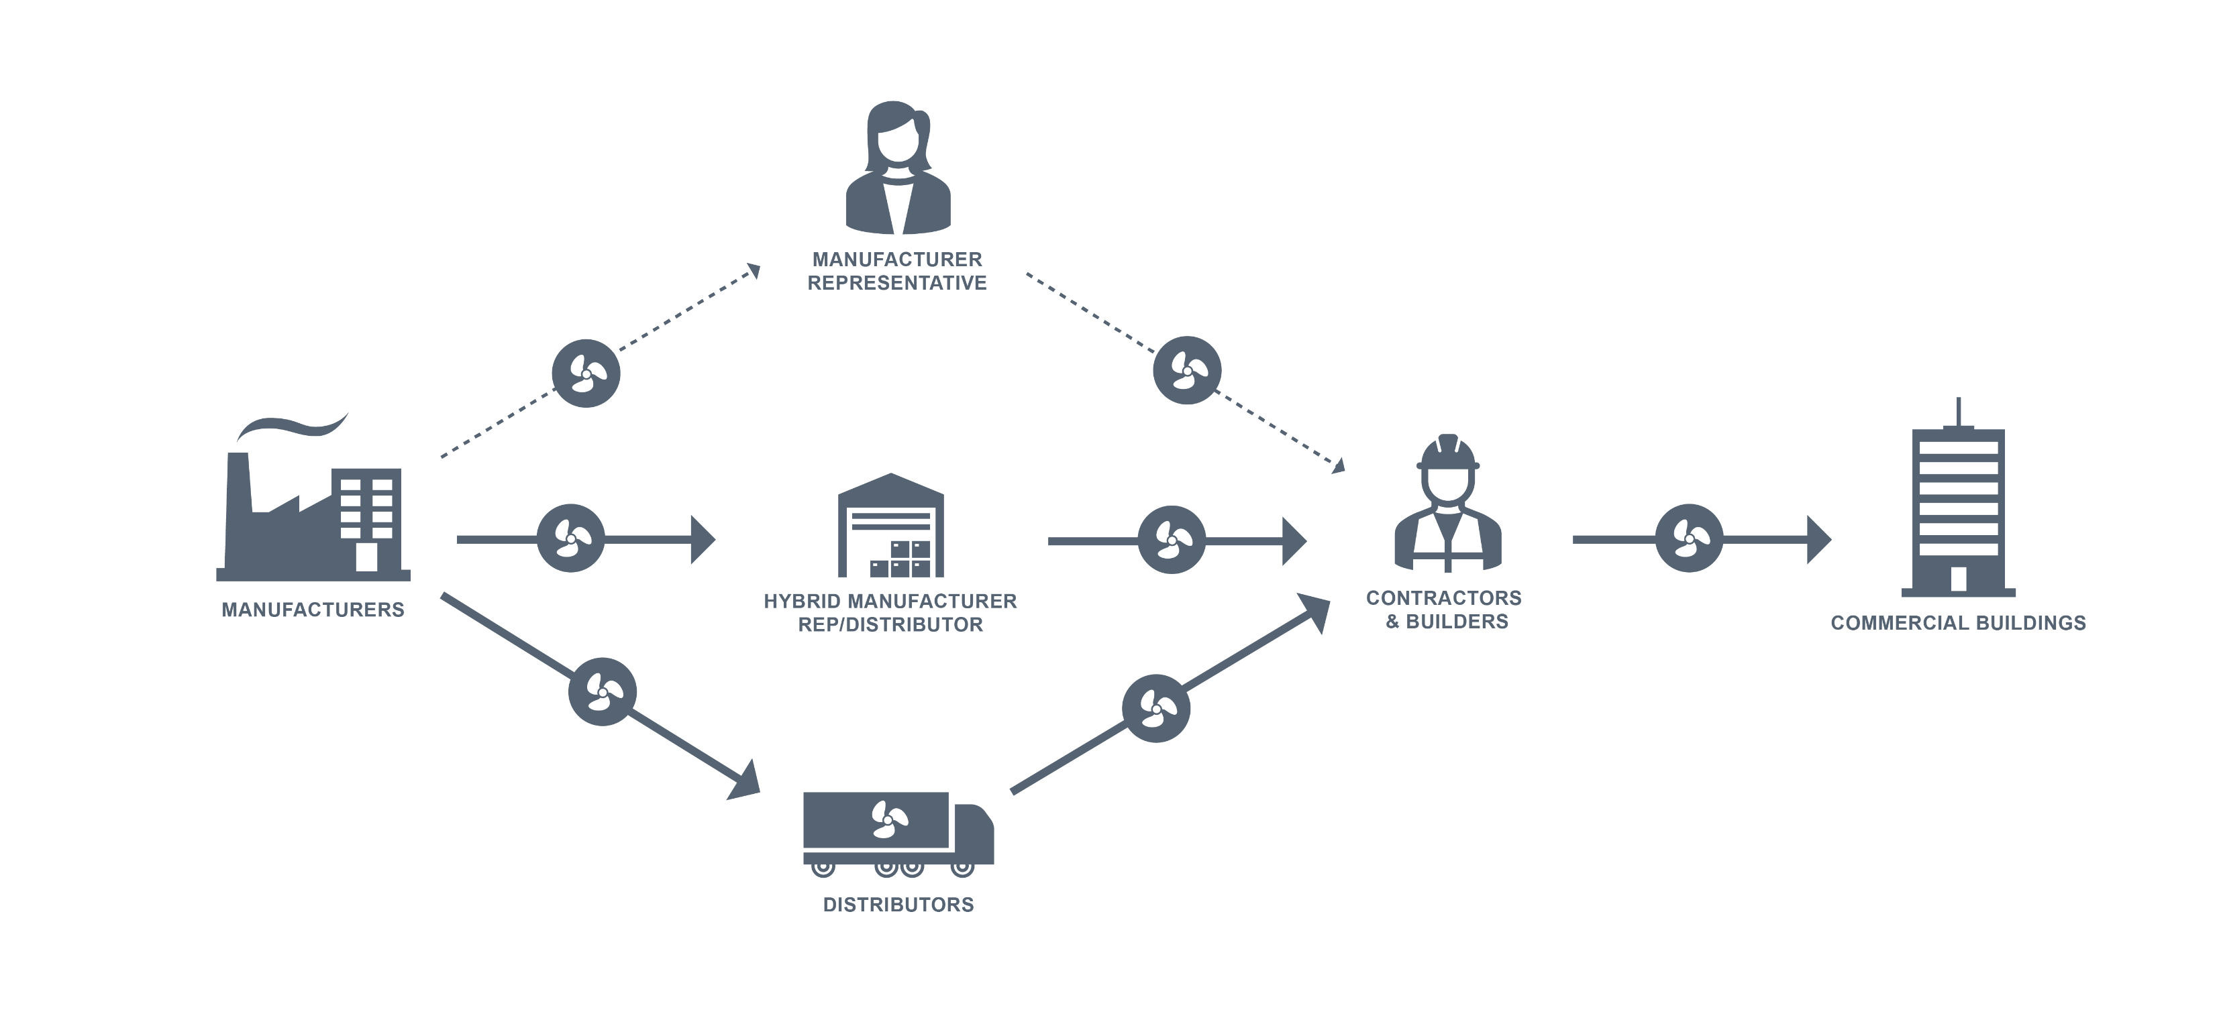
Commercial Market: Multiple product flows
Notes:
It’s clear that manufacturer reps have influence in the commercial market, and are often involved in specifying or influencing specs for custom equipment. Man reps also have some influence on what is stocked at distribution.
We also heard that traditional HVAC distributors (those operating general supply houses) sell some commercial equipment, although this tends to be non-custom, commodity type equipment that is bought “off the shelf”…
What’s new in this diagram is acknowledging the presence of “hybrid” organizations (some have called them “super reps”) that fulfill both roles—they rep specific products like a “traditional” manufacturer rep, but they also sell the products (as a traditional distributor might). They also tend to provide system design and mechanical engineering type services and work with design+build firms and others specifying in the commercial market. We added these entities to the diagram here.
This is different from the general supply house organization associated with traditional HVAC distribution. These “hybrid” or “super rep” organizations are more common in the commercial market and are distinct in that they are manufacturer reps who ALSO sell products directly, generally with design or consulting services embedded. Air Reps and Johnson Barrow are examples of these types of organizations. (Geary Pacific and Airefco are examples of traditional distributors that operate general supply houses.)
In addition, the product flow arrows from manufacturer to man rep to contractor are not solid…it’s not so much that the manufacturer rep is stocking and delivering product (the hybrid orgs are) as much as the man reps are influencing product choice and sales. The man rep can and will facilitate product sales—working closely with the mechanical engineer designing and specifying equipment and will facilitate direct sales to commercial sites/site contacts. Reps are also influencing wholesale customers (distributors).
A high level takeaway for the commercial market. It can be somewhat unsatisfying to have so many grey areas and overlapping roles, but it is important to acknowledge that the commercial market includes a range of professionals and suppliers that do not neatly comply with our definitions. This hieroglyph map provides a conceptual framework for understanding the three main sources of product in the commercial market. The extent to which one or another path dominates will reflect the type of equipment, the type of project, and the project contact (is it an existing building, a design+build firm, a contractor with an emergency repair?).

Slide 21

Distributors have a role in commercial equipment sales, but primarily commodity packaged equipment
  Packaged systems
  Retrofit kits
  Unitary HVAC under 5 tons
  DHPs
  RTUs
Notes:
We just talked a bit about this, but we asked specifically about the role of traditional distribution organizations in the commercial market. Remember, our main objective was to understand the coverage of the regional HVAC distributor data set, not characterize the entire commercial market. What did we hear?
Traditional “distribution” organizations – those big HVAC supply houses do not play a major role in commercial equipment sales, but interviewees indicated that high volume, commodity, non-custom commercial equipment is often sold through traditional distributors.
There is some contradiction here, as these products are often technically available from these distributors, but we don’t see this volume from the NEEA collected distributor dataset. It could be that the sales data to not reflect commercial equipment sales well, or that a different set of distributors is involved.
“All of that equipment flows through traditional HVAC distribution. Rep firms come in when you get into very large mechanical equipment.”

Slide 22




Commercial product trends
VRF increasing in popularity & sales
Heat recovery chillers promoted by new manufacturers/competitive pressure from overseas
Air filtration & air quality
Controls; cloud based direct communication & diagnostics
Electrification
Notes:
Consistent with AHRI, with maybe more emphasis on air filtration and air quality from the pandemic.
“We are cleaning up combustion more now. Oftentimes, trends start in the residential sector first because there is so much volume, then commercial tends to follow.”
Here’s what we heard to watch for in the commercial market.
VRF; particularly in retrofit applications
Energy recovery ventilation; particularly Ventacity
An increased focus on integrated design; building designed for ventilation and integration of HVAC
New equipment includes specific equipment mentioned; Ephoca HPAC 2.0, CO2 hot water heating; new refrigerants

Slide 23
Thank you!
JOAN WANG
Project Manager
jjwang@bpa.gov

Slide 24
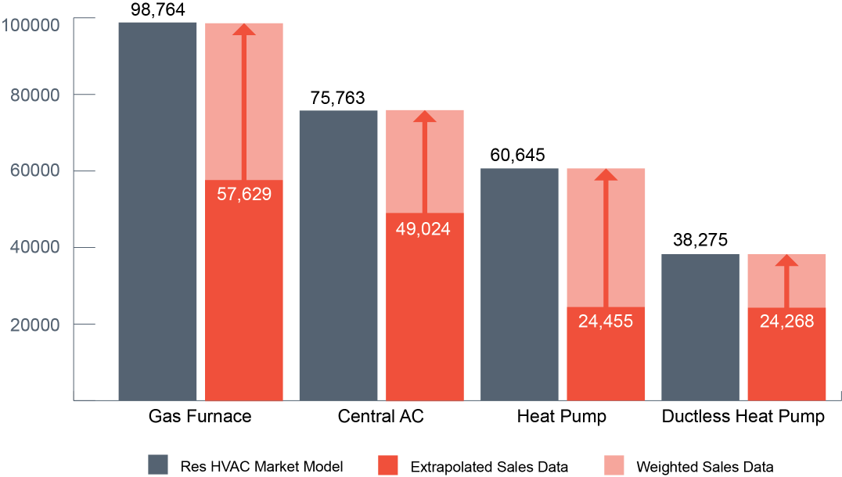
Question: how accurate are our total market sales estimates?
Notes:
This scope included a separate task that analyzes and extrapolates regional HVAC sales, based on a distributor sales data set collected by NEEA. These data are used to establish the efficiency mix for the “big four” residential technologies.
The coverage from this distributor sales dataset has been consistent over the years (2016-2019).
This chart shows the 2019 sales volume from 10 distributors (the dark red bars), and shows that they are about 35-45% of the total market sales predicted by BPA’s current residential HVAC market model (the dark grey bars).
The model’s total market sales estimates for gas furnaces are at about 100k per year. CAC, just under 80 and HP about 60, and DHP about 40.

Slide 25
Overall, market estimates seemed reasonable
Residential Technology | Too high | Too low | About right
Gas Furnace (100,000 units) |  | 2 | 7
Central AC* (76,000 units) |  | 1 | 6
Heat Pump* (61,000 units) |  |  | 6
Ductless Heat Pump (38,000 units) | -- | 2 | 10
*CAC and ASHP responses included several that were unwilling to estimate.
Notes:
We asked contacts that sold or monitored the market for specific technologies to react to the model’s forecasted sales for each of the four primary residential technologies displayed on the prior slide.
Overall, contacts generally agreed that the estimates seemed reasonable. A few thought they were too low.
Several CAC respondents really couldn’t estimate. The one that thought it was low thought it should be closer to 100,000.
Similar, four ASHP couldn’t estimate total market.

Slide 26
Residential Products: Interviewee coverage
Product | Count of Market Actors
Air source heat pumps (ASHP) | 10
Zonal equipment (like wall heaters and baseboards) | 2
Ductless heat pumps (DHP) | 13
Thermostats | 11
Natural gas furnaces | 10
Electric furnaces | 7
Central air conditioning | 10
Notes:
The team asked contacts with residential product experience to discuss overall trends in product sales, how the sales path differs from residential products and about observed shifts in manufacturing, distribution, or costs. This is the equipment market actors reported selling.

Slide 27
Commercial Products: Interviewee coverage
Product | Count of Market Actors
Rooftop units | 11
Commercial split systems (air conditioning and heat pump) | 9
Packaged terminal heat pump, packaged terminal air conditioning (PTHP/PTAC) | 8
Variable refrigerant flow systems (VRF) | 9
DHPs for commercial applications | 9
Energy recovery ventilators (ERV/HRV) | 8
Notes:
The team asked contacts with commercial product experience to discuss overall trends in product sales, how the sales path differs from residential products and about observed shifts in manufacturing, distribution, or costs. This is the equipment market actors reported selling.
We did not dive deeply into each product (commercial was a secondary focus)

