Slide 1

Commercial Sector Updates

Slide 2
Agenda
Non-residential Lighting Trends
Trade Ally Network NW Marketing Efforts
Energy Project Manager for the Commercial Sector

Slide 3
Non-residential Lighting Trends
Notes:
The COVID era was not kind to non-residential lighting. We’re zooming in a little here, just looking at retrofit projects using BPA lighting calculator, where we saw a 56% drop in 2020 year over year. 2021 had a decent rebound but was still 33% off robust 2019 results.

Slide 4
Uneven Impacts
Notes:
Exterior fixture replacements is our largest single technology category- saw a steep decline in 2020 (56%) but bounced back in 2021 to exceed pre-COVID trend (+18%)
LED tubes is our 2nd largest category- saw a 75% decline in 2020 and while 2021 saw a bounce it was still down 66% from 2019 levels
High bay fixture replacements is our 3rd largest category- saw the smallest decline in 2020 (33%) and saw a modest increase in 2021

Slide 5
Controls Uptake
Notes:
Controls have struggled

Slide 6
Incentives vs Project Cost
Notes:
Incentives are covering less of the project costs than they used to. The graph represents all lighting calculators submitted to BPA, but while the % are a bit higher for ID/MT/NV, the trend is same (high of 56% to a low of 40%).

Slide 7
Next Steps for Lighting
Gap analysis of participating Trade Allies
Renewed in-person training schedule
Targeted incentive increases in FY2024?
Other?

Slide 8
Trade Ally Network NW Marketing

Slide 9



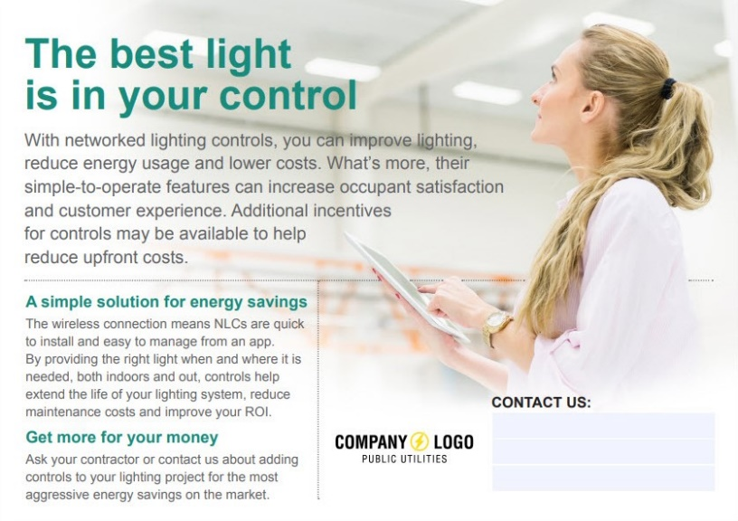
What is the #1 Request from Trade Allies in The Network?
Notes:
Trade Ally Network NW developed Marketing Toolkits for Utility Incentive Programs to easily produce Utility Co-Branded digital (or print) campaigns for available energy efficiency incentives
Pick a campaign: Connected Thermostats, Advanced Rooftop Controls, Ductless Heat Pumps, Seasonal HVAC Opportunities, Networked Lighting Controls, Packaged Terminal Heat Pumps
Download Available Content: PDF – “Just add your logo”, Adobe InDesign Files – “fully customizable”
How else can The Network help utilities drive Energy Efficiency leads to Trade Allies?

Slide 10

Opportunity Knocks
Targeted outreach of local businesses
Evaluation of lighting and HVAC savings opportunities
Reports include utility-specific ROI calculations
Referrals to local Trade Allies who have committed to timely bids
Notes:
Regular LED lighting does not need additional market support, NLC Toolkit to drive controls market

Slide 11
The survey says…
25% HVAC Trade Allies cite “Lack of market interest in energy efficiency equipment” as a barrier to leveraging energy efficiency programs
HVAC Trade Allies value:
  44% Connection to Utilities
  38% Marketing Materials (Leads)
  38% Sales Support (Leads)
Lighting Trade Allies that regularly quote Networked Lighting Controls value:
  46% Connection to Utilities
  41% Technical Support
  32% Sales Support (Leads)
Notes:
Regular LED lighting does not need additional market support, NLC Toolkit to drive controls market

Slide 12
Energy Project Manager

Slide 13
Overview
Help customer sites prioritize energy projects by co-funding an EPM.
Provides $0.025/kWh in addition to standard incentives, such as from custom projects or lighting
Key deliverable is a comprehensive site plan detailing project pipeline
Updated requirements:
Sites must identify 200,000 kWh of projects, including at least one non-lighting project.
BPA Willingness to Pay capped at $150K per biennium
Incentives paid after project completion
Commercial and Industrial sites are eligible

Slide 14
EPM Benefits
Assigned EPM
EE Project List
EE Goal
Higher savings and robust pipelines

Slide 15
Thank you!

