Slide 1

BPA Residential Low-Income Energy Efficiency Programs
Amy Burke,
Low-Income & Weatherization Program Manager

Slide 2
“
For more than three decades, BPA, public utilities, Community Action Agencies, tribes and states have worked to improve equitable access to energy efficiency for all Northwest residents.
~ BPA’s Low-Income Energy Efficiency New Opportunities Guide
Picture courtesy of the Coeur d’Alene Tribe

Slide 3
Agenda
High Level Overview of Low-Income
Utility Low-Income EE Program Activity
Low-Income EE Grants
Known Challenges with Low-Income
A Nod to New Federal Funding
Discussion & Wrap-Up

Slide 4

BPA Tribal & Low-Income Energy Efficiency
Mission: Public interest funding aimed at providing equitable access to energy efficiency across the Pacific Northwest at low or no cost to qualifying residents.

Slide 5
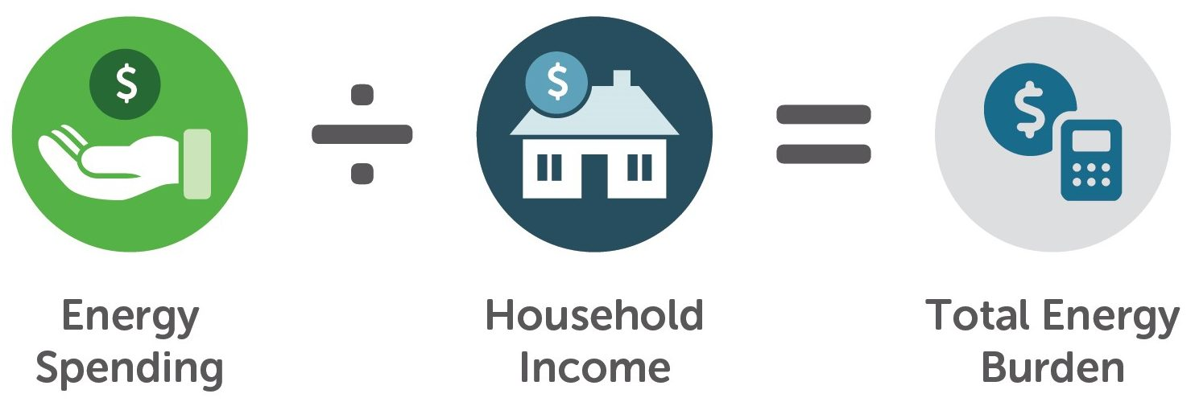
Energy Burden
The Pacific Northwest Regional Energy Burden for Median to Low-Income Earners is 6.8% compared to 2.3% for median earners.
ACEEE-01 Energy Burden - National.pdf

Slide 6
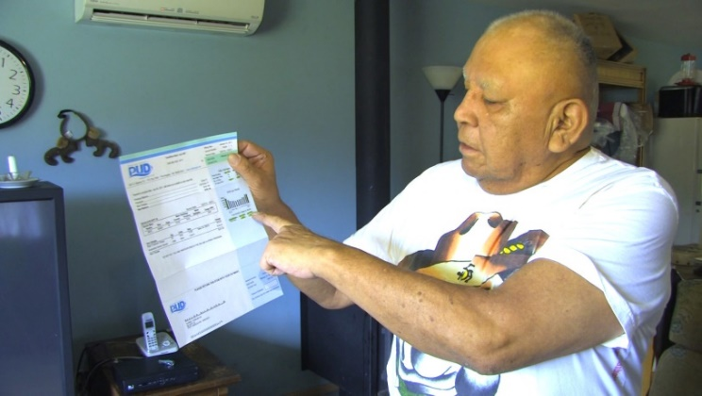
What is the Benefit?
Making energy efficiency upgrades can:
Reduce energy bills and energy burden
Fix health and safety issues
Reduce home fires
Improve indoor air quality
Reduce environmental related illnesses
Help residents stay in their home
Make homes more comfortable and livable for future generations
And more…
Picture courtesy of the Lower Elwha S’KallamTribe

Slide 7
One Mission, Two Programs
Utility Low-Income EEI
Residential energy efficiency deemed measures implemented through utility programs using rate-payer funding. Some utilities work with local tribes.
State & Tribal Grants
Separate budget and implementation process, established with state agencies and regional tribal partners to fund qualifying residential energy efficiency projects.

Slide 8
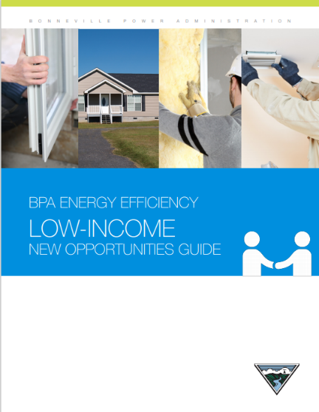
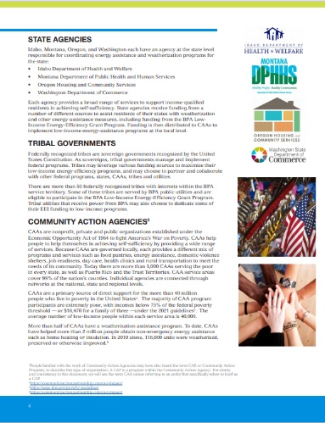
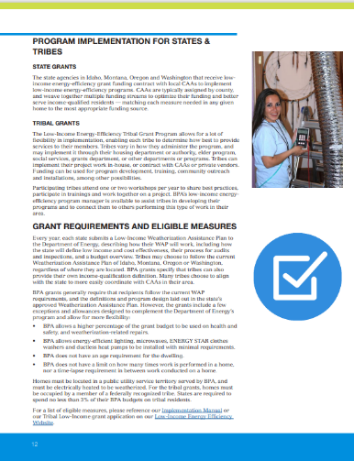
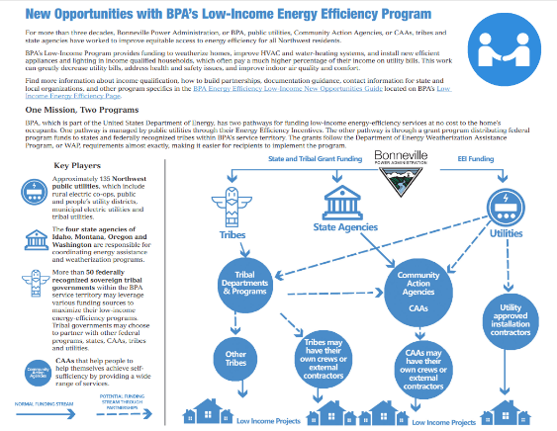
BPA Energy Efficiency Low-Income New Opportunities Guide
Public reference guide for all things BPA Low-Income: Low Income Energy Efficiency - Bonneville Power Administration (bpa.gov)
Advice on building relationships and working with Community Action Agencies (CAA)
CAA and utility contact information
Example tribal and utility case studies and agreements
List of federally recognized tribes in BPA’s service territory
Summary Document
In English and Spanish

Slide 9
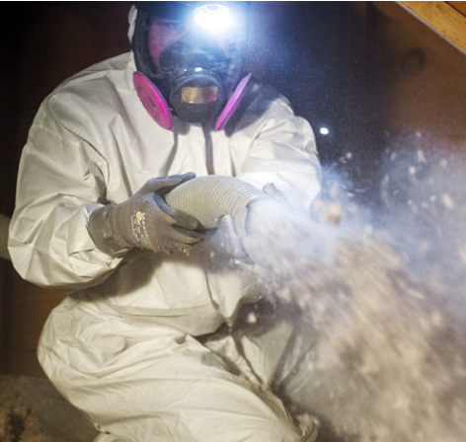
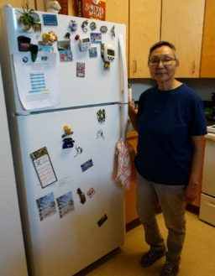
Insulated Exterior & Patio Doors
Prime & Storm Windows
Air Sealing
PTCS Ducted Air Source Heat Pumps
Insulation
Ductless Heat Pumps
Not Just Weatherization
Weatherization
Duct Sealing
HVAC
Duct Insulation
Lighting (LED)
Smart Thermostats
Limited to LIEE Grants
Water Heating
Appliances (Clothes Washers, Refrigerators, Microwaves)
40 Gallon Heat Pump Water Heaters
Manufactured Home Replacements
Whole Home Air Conditioners
Tier 1 - 4 Heat Pump Water Heaters

Slide 10
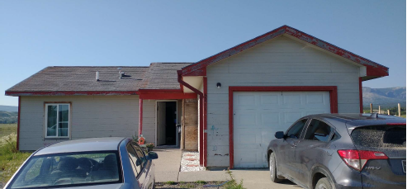
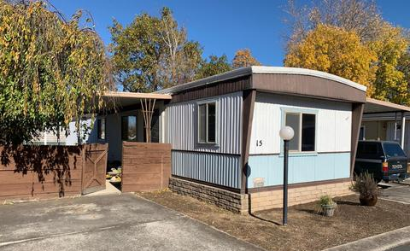
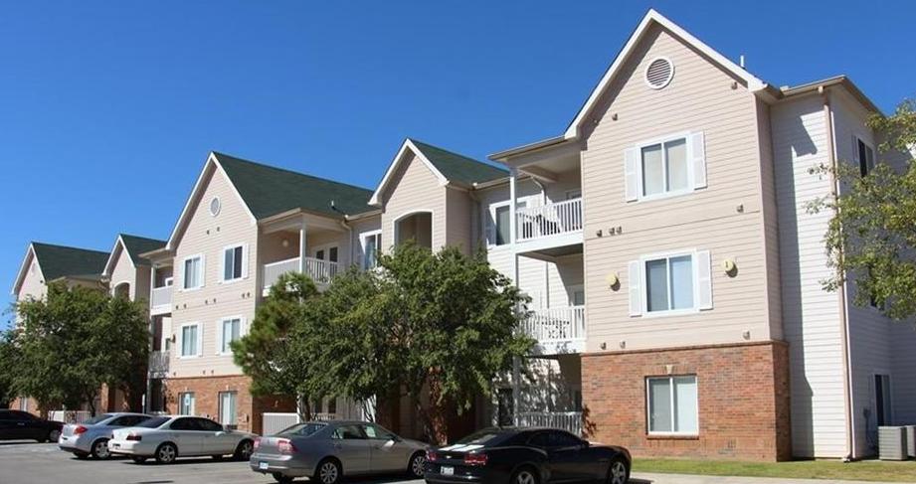
Qualifying Home Types
Measures available for single family, manufactured homes, and multifamily low and high-rise buildings.
However, not all measures are applicable to each housing type. See IM for more details.
Available to landlords and renters too!

Slide 11

Higher incentives
Costs of most low-income energy-efficiency measures are reimbursed dollar-for-dollar. Some have payment cost caps up to a certain amount.

Slide 12
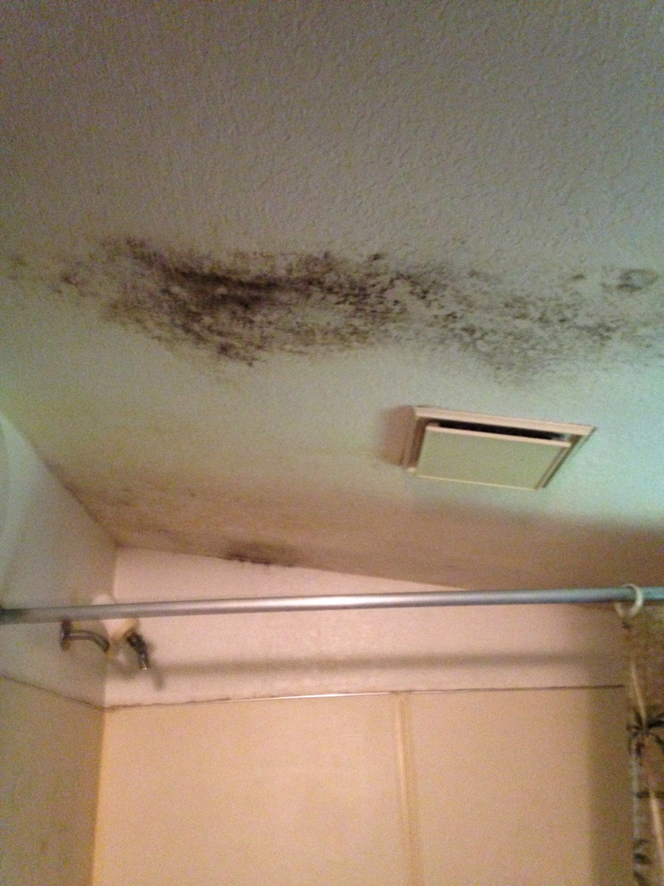
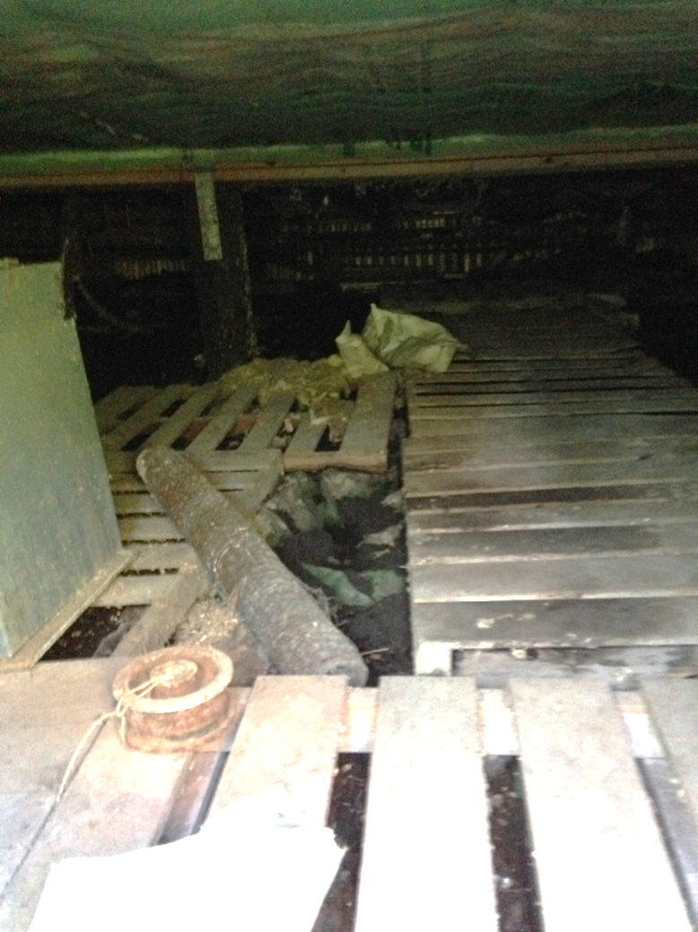
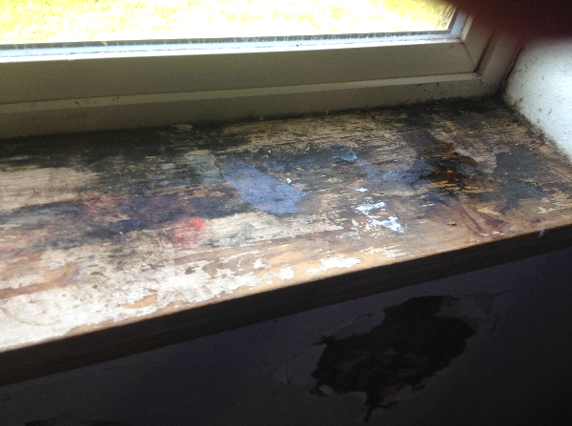
Related Repair Costs
Additional coverage for health & safety repair costs.
Key focus area in both utility and grant program implementation.

Slide 13
BPA Utility Low-Income Programs: Oregon

Slide 14




Between 2017 to September 2022:
Partnership
EE savings
HVAC & Water Heating
Weatherization
Region-wide: 53 utilities claimed low-income measures.
17 local utilities in this region have participated.
Region-wide: About 3 aMW have been saved in low-income projects.
Local utilities in this region have saved about 0.46 aMW in low-income.
Region-wide: About 4,900,000 sq. ft. of low-income Wx projects completed.
Local utilities 592,185 sq ft of low-income Wx projects.
Region-wide: About 5,330 completed low-income HVAC projects.
Local utilities have completed 1,063 low-income HVAC projects.

Slide 15
Local Utility LIEE Measures:
2017 – Sept 2022

Slide 16
BPA Low-Income Energy Efficiency Grants

Slide 17


State grants
Budgets align with BPA’s rate period.
State grants established with:
Washington
Oregon
Montana
Idaho
Tribal grants
Awarded as needed as funding is available.
Consistent outreach throughout the year to regional tribes to identify qualifying projects and funding needs.
BPA Grant manager works closely with BPA Tribal Affairs Liaisons.

Slide 18


Partnership
EE Projects
Investment
Flexible implementation
4 state agencies, 26 tribes, and many Community Action Agencies have participated since 2009.
Supports government-to-government partnership.
Nearly 14,500 projects completed with State Grant funding since 2016.
Additional funding to support training needs, travel, health and safety repairs, and administrative and tribal indirect costs.
Iterative discussions with states and tribes to support their implementation.
Hands-on support always available.

Slide 19
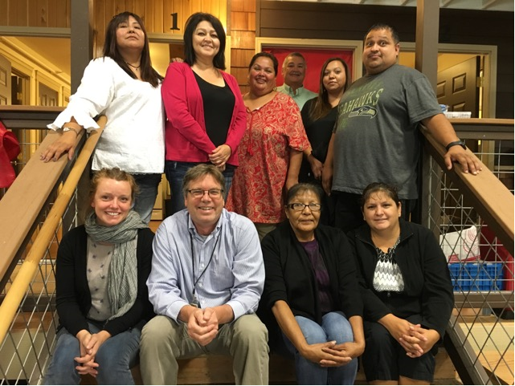
Tribal Grants
Federally recognized tribes in Washington with all of part of their lands served by BPA (included in the Low-Income Energy Efficiency New Opportunities Guide):
Cowlitz Indian Tribe
Confederated Tribes and Bands of the Yakama Nation
Confederated Tribes of the Colville Reservation
Hoh Indian Tribe
Jamestown S’Klallam Tribe
Kalispel Tribe of Indians
Lower Elwha S’Klallam Tribe
Makah Indian Tribe
Nooksack Indian Tribe
Puyallup Indian Tribe
Quileute Nation
Quinault Indian Nation
Shoalwater Bay Tribe
Skokomish Tribal Nation
Snoqualmie Indian Tribe
Squaxin Island Tribe
Stillaguamish Tribe of Indians
The Confederated Tribes of the Chehalis Reservation
Tulalip Tribes
NOTE: Tribal members don’t have to live on the reservation to receive benefits, but they do have to receive power from a BPA customer utility.

Slide 20
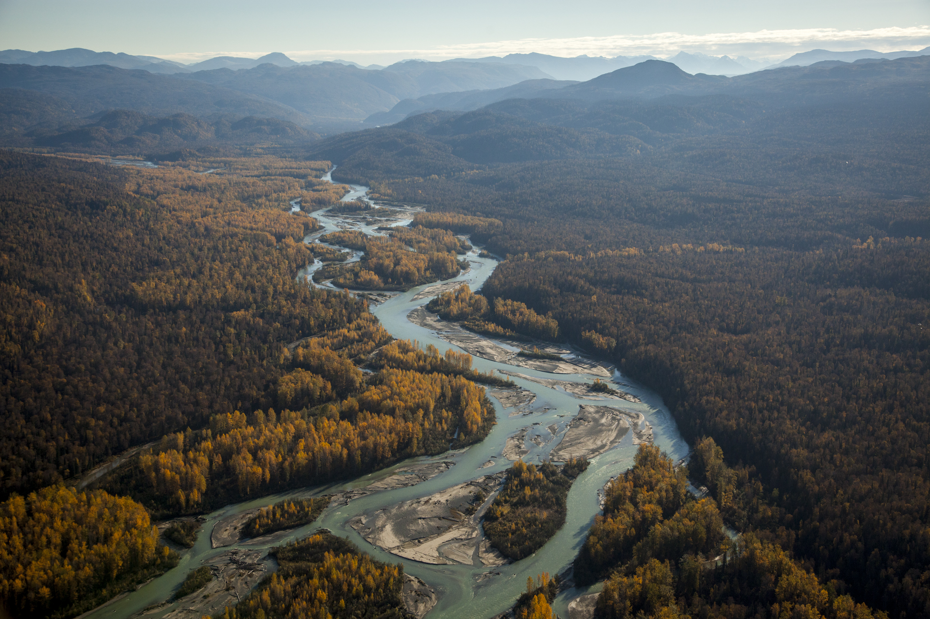
Braiding Utility EEI and LIEE Grant Funding
IM Language:
Customers may combine funding sources within a residence, but may not combine funding from multiple BPA sources for the same measure.
Translation:
No double dipping for the same project.
Example:
In the same home, BPA LIEE grant dollars can be used to install a heat pump and BPA Utility EEI dollars can be used to install the insulation.

Slide 21
General Challenges Implementing Low-Income

Slide 22
Challenges to Overcome in Implementation
Income qualification requirements
Limited contractor capacity in some areas, resulting in long waitlists for project completion
Rising equipment costs
Long wait times for order fulfillment due to supply chain issues
Making the case to renters/landlords for energy efficiency
Tribal housing departments and authorities inundated with requests
Lingering ongoing issues with Covid-19 pandemic

Slide 23
Income Qualification Guidelines
Match any existing federal, state or tribal program guidelines, including but not limited to:
LIHEAP
HUD
HHS (Health & Human Services)
NAHASDA
TANF
SSI
DOE (Department of Energy)
And many more…
Income qualifications follow the U.S. Department of Energy WAP definition of 200% of the federal poverty-income level based on household size.
2022 POVERTY GUIDELINES FOR THE 48 CONTIGUOUS STATES AND THE DISTRICT OF COLUMBIA
Persons in family/household | Poverty guideline | 200% of the Federal Poverty Guideline
1 | $13,590 | $27,180
2 | $18,310 | $36,620
3 | $23,030 | $46,060
4 | $27,750 | $55,500
5 | $32,470 | $64,940
6 | $37,190 | $74,380
7 | $41,910 | $83,820
8 | $46,630 | $93,260

Slide 24

Prepare for Federal Funding!
Additional federal funding through the IRA (Inflation Reduction Act) for low-income energy efficiency work may be available for you.
BPA staff are researching what additional resources may be available and how this new funding will impact our programs.
BPA staff are discussing how to streamline our own low-income programs so you can more easily leverage BPA and federal IRA dollars.
A checklist for utilities is currently in development for how to participate in and build your own low-income program.
Seeking stakeholder input on our low-income programs to try and overcome some of these challenges.

Slide 25
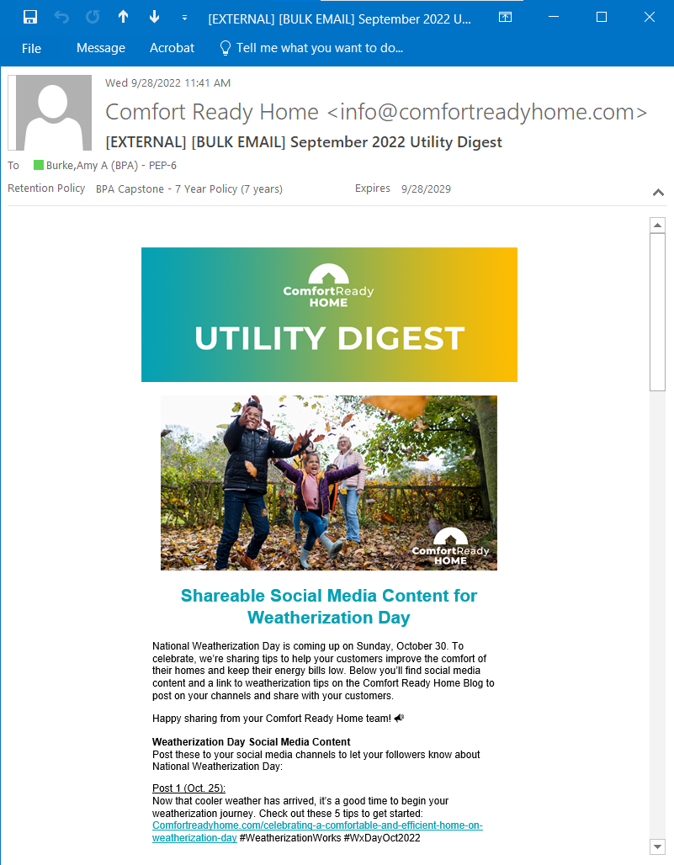
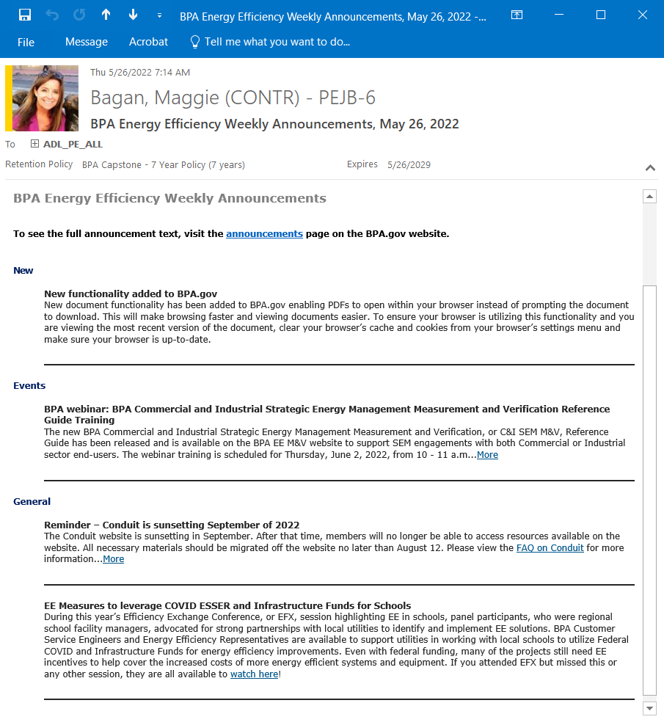
Prepare for Federal Funding!
Keep an eye on the EE Announcements and the Comfort Ready Home newsletter for more information!

Slide 26

General Discussion

Slide 27
For utilities offering low-income incentives, what are your biggest implementation challenges?

Slide 28
For utilities who don’t offer low-income incentives but would like to, what resources do you need to get started?

Slide 29
Besides Community Action Agencies, what other groups in your communities could help reach underserved communities with high energy burdens?

Slide 30
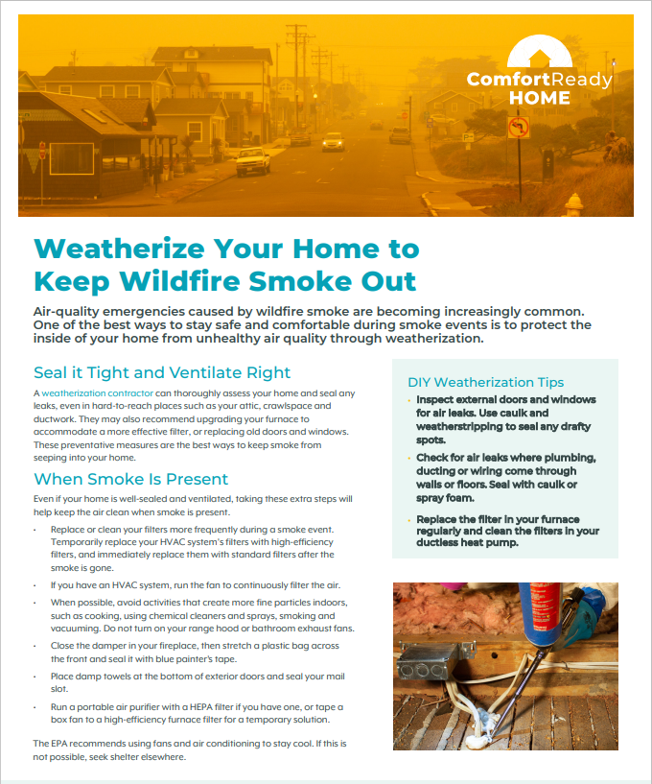
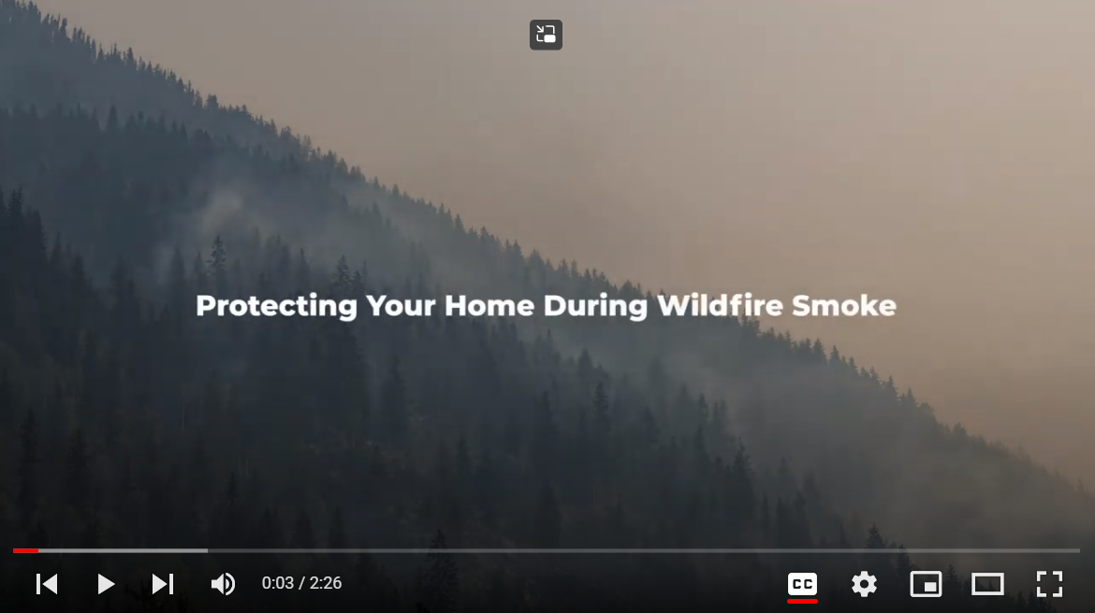
Your Home & Wildfires: Comfort Ready Home Resources
Protecting Your Home from Wildfire Smoke - YouTube
CRH_Weatherize-Your-Home-to-Keep-Wildfire-Smoke-Out.pdf (pcdn.co)

Slide 31
Thank you!
For further questions, utilities can reach out to their Energy Efficiency Representative or contact Amy Burke at aaburke@bpa.gov or call 503.230.4364.

