Slide 1
Resource Program, Cost Effectiveness and EE Action Plan

Slide 2
A Review of Resource Program Findings

Slide 3
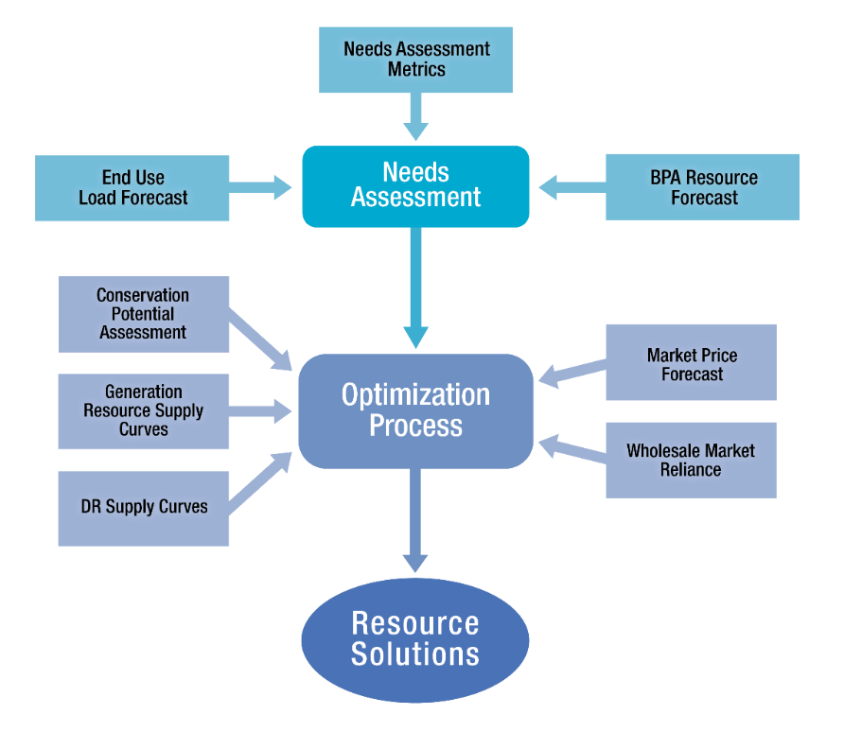
2022 Resource Program Process

Slide 4
Refresher: Portfolio Optimization
Step 1: Find Portfolio 1, the “least-COST” mix of resources that meet P10 HLH Energy needs and don’t violate Market Purchase Limit
Step 2: Find Portfolio 40, the “least-RISK*” mix of resources that meet P10 HLH Energy needs and don’t violate Market Purchase Limit
Step 3-40: Incrementally add budget to Portfolio 1’s budget value and remix resources to find risk minimizing combination at given budget level
*Risk is the variance in total portfolio cost across iterations, with expected resource costs and expected market prices causing most of the variance

Slide 5
Preliminary Resource Solutions Summary
EE aMWs are consistent with Council target in Power Plan.
DR shows up as a regularly deployed, low impact, low cost energy related load management product.
Renewables are selected to reduce volatility in risk reducing scenarios, highlighting the potential benefit of resource diversity from potential thin-market futures.

Slide 6
EE Results and Comparison to 2020
2022RP Cumulative Savings (aMW) |  |  |  |  | 2020RP Cumulative Savings (aMW)
 | 2-year | 4-year | 10-year |  |  | 2-year | 4-year | 10-year
Portfolio 1 | 96 | 223 | 723 |  | Portfolio 1 | 111 | 229 | 506
Portfolio 2 | 103 | 242 | 785 |  | Portfolio 2 | 123 | 250 | 501
Portfolio 3 | 105 | 245 | 787 |  | Portfolio 3 | 126 | 256 | 505

Slide 7
Comparison to Council’s 2021 Power Plan
The 2022 Resource Program uses updated EE supply curves from the 2021 Plan
  BPA’s market price forecast, needs assessment, market purchase limits
2022 RP, Portfolio 1 EE Savings over 2021 Plan Timeline:
NWPCC 2021 Draft Plan EE target for BPA is 270-360 cumulative aMW by 2027¹
Corresponding to NWPCC 2021 Plan Timeline (Cumulative aMW of EE)
 | 2022* | 2023* | 2024 | 2025 | 2026 | 2027
2022 RP Port 1 | 38 | 76 | 119 | 171 | 231 | 299
1Source: NWPCC 2021 Draft Plan, Section 8. https://www.nwcouncil.org/sites/default/files/2021powerplan_2021-5.pdf
*Represents anticipated EE acquisitions for 2022 and 2023, prior to 2022 RP study horizon

Slide 8
Demand Response in 2022 RP
Demand Response Capacity (Peak MW)
Portfolio | Season | 2-year | 4-year | 10-year
1 | Summer | 213 | 436 | 371
 | Winter | 158 | 283 | 243
2 | Summer | 213 | 474 | 488
 | Winter | 158 | 283 | 260
3 | Summer | 213 | 474 | 488
 | Winter | 158 | 283 | 260
Least-cost DR totals are mainly comprised of four products: DVR, and Residential, Commercial, and Industrial CPP programs.
DVR comprises roughly half of the total for the 2-year and 4-year periods.
Risk-reducing portfolios start to add other DR products
Portfolio 1 acquires DVR and CPP
  And winter residential BYOT in 2033
Portfolios 2 and 3 acquire those and additionally Residential Summer TOU in 2024

Slide 9
What was Picked:
Resource Program and Power Plan,

Slide 10
Residential by End Use
 | 2022 | 2023 | 2024 | 2025 | 2026 | 2027
Portfolio 1
Water Heating | 1.9 | 3.4 | 5.1 | 7.1 | 9.4 | 11.8
HVAC | 3.3 | 4.2 | 5.5 | 7.0 | 8.7 | 10.8
Electronics | 0.3 | 0.5 | 0.9 | 1.3 | 1.7 | 2.3
Lighting | 0.4 | 0.7 | 0.9 | 1.1 | 1.3 | 1.6
Refrigeration | 0.1 | 0.2 | 0.2 | 0.3 | 0.4 | 0.5
Food Preparation | 0.0 | 0.0 | 0.0 | 0.0 | 0.0 | 0.0
Other | 0.0 | 0.0 | 0.0 | 0.0 | 0.0 | 0.0
Subtotal | 5.9 | 8.9 | 12.6 | 16.8 | 21.5 | 26.9
Incremental Portfolio 2
Water Heating | 0.1 | 0.2 | 0.3 | 0.4 | 0.6 | 0.7
Food Preparation | 0.0 | 0.0 | 0.0 | 0.0 | 0.0 | 0.0
Subtotal | 0.1 | 0.2 | 0.3 | 0.4 | 0.6 | 0.7
Portfolio 1 & 2 Total | 6.0 | 9.1 | 12.9 | 17.2 | 22.1 | 27.6
Notes:
HVAC includes weatherization, roughly 50/50 split between weatherization and systems
Note ramping: because some of the “bread and butter” measures have gone away, measures remaining are where there is not as much traction now: HPWH, smart thermostats

Slide 11
Residential Measures Selected by
Resource Program and Power Plan
RP
Both
PP
Heat Pump Water Heaters▼
Clothes Washers
Smart Thermostats
Televisions
Some Insulation
Thermostatic Valves
Some Windows
EV Chargers
Clothes Dryers
Lamps/Fixtures
Some Fridges/Freezers
Duct Sealing
Some DHPs
Neither
Power Strips
Air Sealing
Behavior
ASHPs
Cooking
▼ = Additional Portfolio 2 Selections
Note: These lists should be interpreted as indicative of general trends, as some measures have many variations with potentially different results.
Notes:
Note that there are measures that are traditional part of programs that were not selected by RP, PP.
Things have changed significantly in both the Power Plan and the Resource Program.
Don’t have all the answers now. EEAP management team going through a decision making process on cost effectiveness.
Things have changed significantly in both the Power Plan and the Resource Program.
A new challenge for this EEAP process will be to identify how to use budget to achieve goals of RP & PP, and hopefully have budget left over to offer measures that BPA’s utility customers value for other reasons.

Slide 12
Commercial by End Use
Portfolio 1 | 2022 | 2023 | 2024 | 2025 | 2026 | 2027
Lighting | 13.4 | 13.9 | 14.6 | 15.2 | 14.9 | 14.7
Electronics | 1.8 | 2.6 | 3.1 | 3.5 | 3.7 | 3.7
Refrigeration | 1.3 | 1.6 | 2.1 | 2.6 | 3.1 | 3.7
HVAC | 0.9 | 1.1 | 1.3 | 1.6 | 1.9 | 2.2
Motors/Drives | 0.5 | 0.6 | 0.8 | 1.0 | 1.3 | 1.6
Food Preparation | 0.2 | 0.3 | 0.5 | 0.7 | 0.9 | 1.1
Process Loads | 0.4 | 0.5 | 0.6 | 0.7 | 0.8 | 0.9
Water Heating | 0.1 | 0.2 | 0.3 | 0.4 | 0.5 | 0.6
Whole Bldg/Meter Level | 0.0 | 0.0 | 0.0 | 0.1 | 0.1 | 0.2
Subtotal | 18.4 | 20.9 | 23.3 | 25.7 | 27.1 | 28.7
Incremental Portfolio 2
Refrigeration | 0.3 | 0.4 | 0.6 | 0.8 | 1.1 | 1.4
Motors/Drives | 0.2 | 0.3 | 0.4 | 0.5 | 0.6 | 0.8
Lighting | 0.6 | 0.7 | 0.8 | 0.8 | 0.8 | 0.8
HVAC | 0.0 | 0.1 | 0.1 | 0.2 | 0.4 | 0.6
Food Preparation | 0.0 | 0.0 | 0.0 | 0.1 | 0.1 | 0.1
Water Heating | 0.0 | 0.0 | 0.0 | 0.1 | 0.1 | 0.1
Whole Bldg/Meter Level | 0.0 | 0.0 | 0.0 | 0.0 | 0.0 | 0.1
Compressed Air | 0.0 | 0.0 | 0.0 | 0.0 | 0.0 | 0.0
Subtotal | 1.2 | 1.6 | 2.0 | 2.6 | 3.2 | 3.8
Portfolio 1 & 2 Total | 19.6 | 22.4 | 25.4 | 28.2 | 30.3 | 32.6
Notes:
RTF Regional Conservation Progress report shows about 10 aMW per year for each of BPA and self-funded commercial lighting savings.

Slide 13
Commercial Measures Selected by
Resource Program and Power Plan
RP
Both
PP
Lighting
Servers
Pumps▼
Cooking Equipment▼
Power Supplies
ARC HVAC Controls
Some Exterior Lighting▼
Some DHPs
Refrigeration System Controls▼
Heat Pump Water Heaters▼
Some Refrigeration System
Some HVAC Systems▼
Engine Block Heaters
Fans
DHW Circulation Pumps
Neither
Power Strips
Windows▼
Thermostats
PTHPs
VRF
Most SEM▼
▼ = Additional Portfolio 2 Selections
Note: These lists should be interpreted as indicative of general trends, as some measures have many variations with potentially different results.
Notes:
Note differences in RP/PP:
Residential measures more on peak.
Industrial measures are more flat/off-peak
Commercial in the middle: variation by measure: PP selecting flatter measures

Slide 14
Industrial by End Use
Portfolio 1 | 2022 | 2023 | 2024 | 2025 | 2026 | 2027
Process Loads | 2.0 | 2.7 | 3.4 | 4.2 | 4.9 | 5.7
Whole Bldg/Meter Level | 1.7 | 2.1 | 2.6 | 3.1 | 3.5 | 4.1
Lighting | 1.8 | 1.8 | 1.8 | 1.8 | 1.8 | 1.6
Refrigeration | 0.9 | 0.9 | 0.9 | 0.9 | 0.9 | 0.8
Compressed Air | 0.6 | 0.7 | 0.8 | 0.6 | 0.6 | 0.5
HVAC | 0.4 | 0.4 | 0.4 | 0.4 | 0.4 | 0.4
Water/Wastewater | 0.3 | 0.3 | 0.3 | 0.3 | 0.3 | 0.2
Motors/Drives | 0.0 | 0.0 | 0.0 | 0.0 | 0.0 | 0.0
Subtotal | 7.8 | 9.0 | 10.3 | 11.2 | 12.4 | 13.3
Incremental Portfolio 2
Lighting | 1.5 | 1.5 | 1.5 | 1.5 | 1.5 | 1.3
Whole Bldg/Meter Level | 0.9 | 0.9 | 0.9 | 0.9 | 0.9 | 0.9
Compressed Air | 0.3 | 0.3 | 0.3 | 0.6 | 0.7 | 0.7
Motors/Drives | 0.1 | 0.1 | 0.2 | 0.3 | 0.4 | 0.5
Subtotal | 2.7 | 2.8 | 2.9 | 3.3 | 3.5 | 3.5
Portfolio 1 & 2 Total | 10.5 | 11.8 | 13.1 | 14.4 | 15.8 | 16.8

Slide 15
Industrial Measures Selected by
Resource Program and Power Plan
RP
Both
PP
Air Compressors▼
HVAC
Compressed Air
Demand Reductions ▼
Lighting ▼
Process Improvements
Advanced Motors
Pumps
Fans
More Expensive SEM ▼
Refrigeration Improvements
Water Supply
Some Lighting
SEM
Neither
Wastewater
▼ = Additional Portfolio 2 Selections
Note: These lists should be interpreted as indicative of general trends, as some measures have many variations with potentially different results.
Notes:
Industrial measures have flatter load profiles, more off-peak energy savings, Council selecting more measures than Portfolio 1 in RP.

Slide 16
Agricultural by End Use
Portfolio 1 | 2022 | 2023 | 2024 | 2025 | 2026 | 2027
Irrigation | 0.90 | 0.91 | 0.94 | 0.98 | 1.02 | 1.01
Lighting | 0.05 | 0.09 | 0.11 | 0.13 | 0.15 | 0.17
Refrigeration | 0.01 | 0.01 | 0.02 | 0.03 | 0.05 | 0.07
Motors/Drives | 0.07 | 0.07 | 0.07 | 0.07 | 0.07 | 0.07
Process Loads | 0.00 | 0.01 | 0.01 | 0.01 | 0.01 | 0.01
Subtotal | 1.03 | 1.09 | 1.15 | 1.22 | 1.31 | 1.33
Incremental Portfolio 2
Irrigation | 0.00 | 0.00 | 0.01 | 0.01 | 0.02 | 0.03
Motors/Drives | 0.01 | 0.01 | 0.01 | 0.02 | 0.02 | 0.02
Process Loads | 0.00 | 0.00 | 0.00 | 0.00 | 0.01 | 0.01
HVAC | 0.00 | 0.00 | 0.00 | 0.00 | 0.01 | 0.01
Subtotal | 0.02 | 0.02 | 0.03 | 0.04 | 0.05 | 0.07
Portfolio 1 & 2 Total | 1.05 | 1.11 | 1.18 | 1.26 | 1.36 | 1.40

Slide 17
Agricultural Measures Selected by
Resource Program and Power Plan
RP
Both
PP
Some Irrigation Hardware
Irrigation System Improvements
Pump Replacements
Dairy and Area Lights
Some Stock Tanks ▼
Motor Rewinds▼
Engine Block Heaters
Dairy Refrigeration
Neither
Variable Rate Irrigation
▼ = Additional Portfolio 2 Selections
Note: These lists should be interpreted as indicative of general trends, as some measures have many variations with potentially different results.

Slide 18
Utility System by End Use
Portfolio 1 | 2022 | 2023 | 2024 | 2025 | 2026 | 2027
Utility System | 0.05 | 0.10 | 0.17 | 0.28 | 0.42 | 0.60

Slide 19
Utility Distribution System Measures Selected by Resource Program and Power Plan
RP
Both
PP
Level I CVR: LDC with no VVO
Neither
Level II CVR: LDC with VVO & AMI
Note: These lists should be interpreted as indicative of general trends, as some measures have many variations with potentially different results.

Slide 20
The Elephant in the Room:
Cost Effectiveness Constraints

Slide 21
Historical Context
  The Council uses the Total Resource Cost (TRC) Test at the measure level to determine cost effectiveness.
  BPA has historically used the Council methodology averaged at a technology level.
  When low cost conservation is abundant, and other resources are expensive, this produces a robust portfolio of offerings.

Slide 22
How Cost Effectiveness is Calculated

Slide 23
Major Drivers of Cost Effectiveness
Cost Effectiveness
Avoided Cost of Energy
Savings
Measure Cost

Slide 24
What has Shifted
Availability of Low Cost Efficiency
Cost of Other Resources
Notes:
Prices for other resources (renewables and gas) have plummeted.
Much of the lowest cost EE has been achieved.
These changing economics have shifted the “least cost” way of meeting regional resource needs.
Many higher cost measures are no longer cost effective by historical measurements.

Slide 25
What Does this Mean?
  UES portfolio at large is not cost effective under 2021 Power Plan.
  Residential sector would be most impacted by changes with many residential offerings no longer cost effective.
  Residential HVAC (and DHPs specifically) has the most significant impact.

Slide 26
BPA’s New Approach
Move cost effectiveness threshold to the portfolio level
Use a screening procedure on non-C/E measures
Sector-specific C/E plans
Work with regional stakeholders and the RTF to help steer long term change.
Gives BPA the most flexibility while ensuring the portfolio overall is cost effective

Slide 27

Screening Process
Screening criteria align with cover:
  Resource Program and Power Plan prioritization
  Resource needs
  Capacity needs
  Utility customer success
  Market transformation
  Program implementation (ease, feasibility)
  Environmental benefits
Tool meant to structure decision-making and provide documentation

Slide 28
EE Action Plan

Slide 29
Planning for Program Evolution
Inputs from the Power Plan and Resource Program may impact BPA’s programs
  Increasing/decreasing incentives
  Evolving regional infrastructure programs
  Removing low priority measures
  Updated approach to managing cost effectiveness
  Change in focus for research activities (Momentum and Emerging Tech) to align with priorities
  Greater focus on technologies with the greatest impact on managing peak load (thermostats, water heating, CVR/DVR, technologies with a EE/DR intersection)
To plan for these changes and document our approach, BPA publishes an EE Action Plan

Slide 30
What is the EE Action Plan?
Plan for how BPA’s EE & DR programs will balance the needs of the 2021 Power Plan, BPA Resource Program, and utility customers
Operational plan for EE and DR for the next 6 years
Reference for BPA staff and external stakeholders
Tool to communicate direction of BPA programs
Description of the value of EE & DR beyond the savings
Review of opportunities and risks
Notes:
So, what is the EE Action Plan?

Slide 31
Balancing Priorities
Power Plan
Achieving the Council’s target
Prioritizing cost effective measures
Resource Program
Acquiring savings with the greatest system benefit
Customer Needs
Ensuring all customers can implement programs
Supporting small, rural, and residential utilities

Slide 32
Timeline and Process
Initial Analysis
(Spring/Summer)
External Review
(Winter)
Final Publication
(Winter/(Spring)
Bottoms Up Planning
(Summer/Fall)
Drafting Action Plan
(Fall)
  Finalize and review model inputs
  Internal workshops and input gathering
  Create tools and resources to support bottoms up analysis
  Portfolio screening for non cost effective measures
  Bottoms up analysis and forecasting by the Programs team
  Balance sector level forecasts
  Draft Action Plan content
  Internal review
Publish draft for review and formal public comment
Edit based on comments received
Final plan incorporating public comments is published

Slide 33
Action Plan Outcomes
Refined Measure Offerings
Some measures may be removed from the measure list.
Revised Program Plans
Program planning evolves to target high priority measures
Goals, Milestones, and Resources
Balance sector level forecasts
A Living Document
Actions to prioritize most cost effective applications (higher incentive / program promotion)
Continued focus on weatherization and some HVAC
Establish organizational goals
Publish draft for review and formal public comment
Will be updated over the course of the next 6 years to reflect operating conditions
Identify a plan to achieve goals

Slide 34
Q&A

