Slide 1
Oregon Roundtable Utility Distribution Sector Update
Tony Koch
October 19, 2022

Slide 2
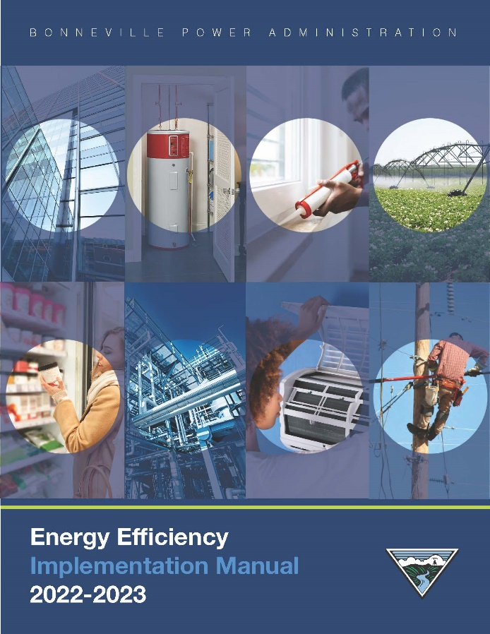
Implementation Manual – Section 12 What Measures are in this Sector?
Mainly two groups
Re-conductor &Transformers (35 year measure): $0.35/kWh
There several other measures: voltage increase, power factor correction, etc but they are infrequently submitted/reported
CVR / VO (10 year measure life): $0.25/kWh incentive
Conservation Voltage Reduction, also referred to Voltage Optimization
2

Slide 3
Summary of Custom Projects reported to BPA in the past 8 years
Transformer upgrades/
Re-Conductoring
Voltage Optimization/
Conservation Voltage Reduction
0.35/kWh EEI incentive
40 projects since 2014
Potential incentives ranging from $3,500 to $210,000
Energy savings in the range of 10,000 to 600,000 kWh/year
0.25/kWh EEI incentive
10 projects since 2014
Potential incentives ranging from $40,000 to $550,000
Energy savings ranging from 150,000 to 2,200,000 kWh/year

Slide 4
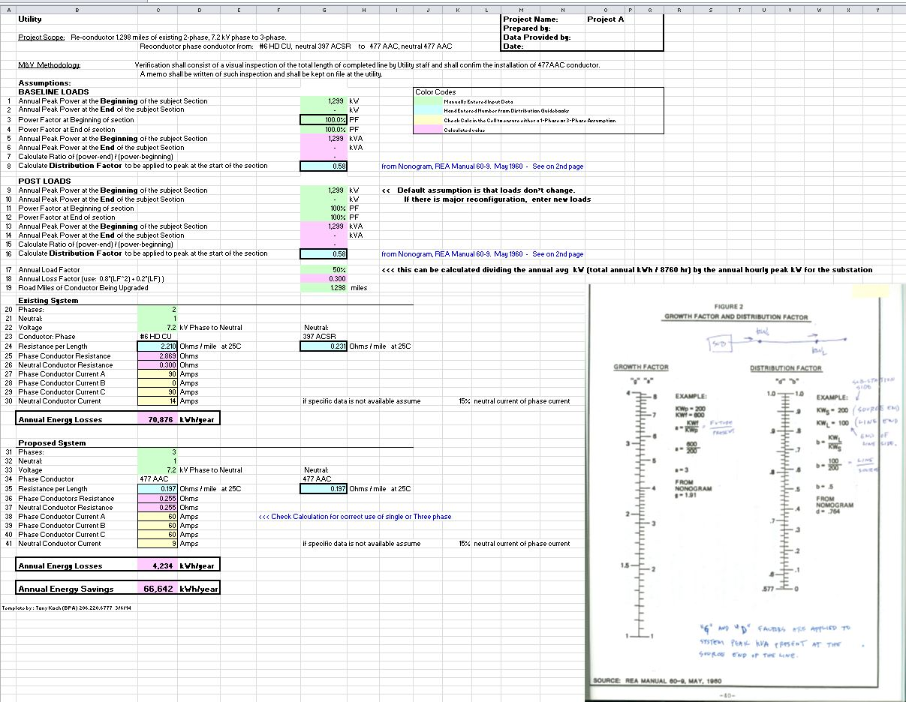
Example of re-conductor energy savings calculation
Section load inputs: annual average
and peak,
re-conductor length
Existing system configuration and materials
Proposed system configuration and materials
Annual energy savings
Distribution Factor

Slide 5
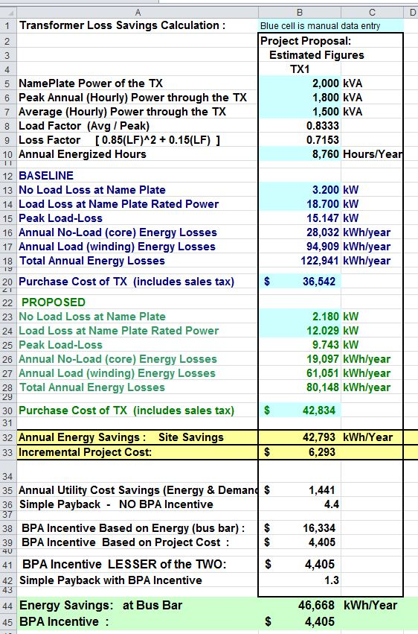
Example of transformer energy savings calculation
Nameplate and Load inputs: annual average and peak
Existing system losses
Proposed system losses
Annual energy savings

Slide 6
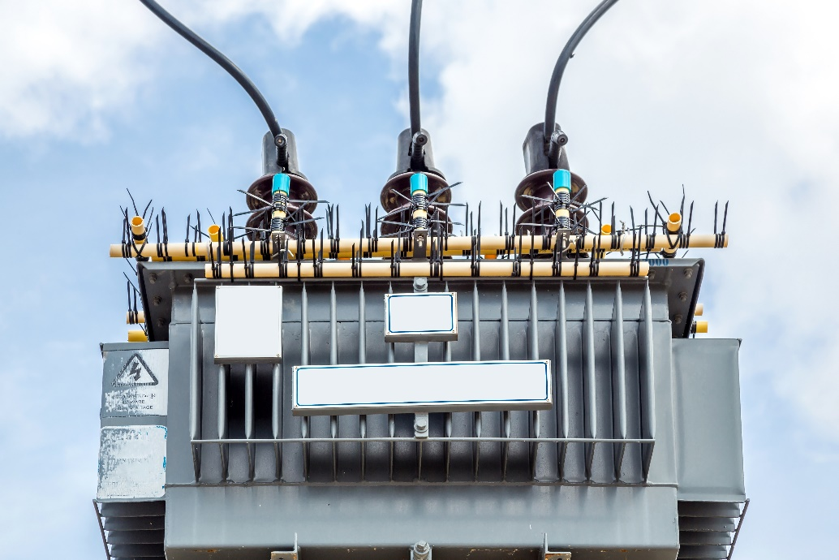
Reconductor-Transformer Calculator (Program in Beets)
What is it?
New streamlined process for these two measures, an alternative to custom project submittal
Project support document files can be attached to the calculator (all in 1 file)
More automated data entry fields
Can handle up to 6 transformer and 6 reconductor measures in 1 file

Slide 7
BPA Technical Support Team
Current team:
Tony Koch, Nathan Kelly, and David Bell
Both Nathan and David are degreed Electrical Engineers
Tony is lead for customer support function
Nathan is lead for internal QC review function
David, brings 25+ years of CVR deployment experience
Can bring operational expertise to utility engineering staff
This is a relatively new offering from BPA in the area of CVR
We seek to engage on the topic of CVR with more utilities in the coming years. This is currently a measure with very little uptake regionally

Slide 8
Distribution Transformer Efficiency Study
BPA has published two reports in 2021
The market review effort was performed to address incremental efficiency (above DOE-2016 Efficiency Requirement)
The report identifies that liquid filled amorphous core transformers can offer cost effective energy savings beyond current practice
https://www.bpa.gov/energy-and-services/efficiency/emerging-technologies/portfolio

Slide 9
The Utility Distribution: New Opportunities Guide
A marketing document to share with other staff
https://www.bpa.gov/-/media/Aep/energy-efficiency/utility-toolkit/uds-nog.pdf

Slide 10
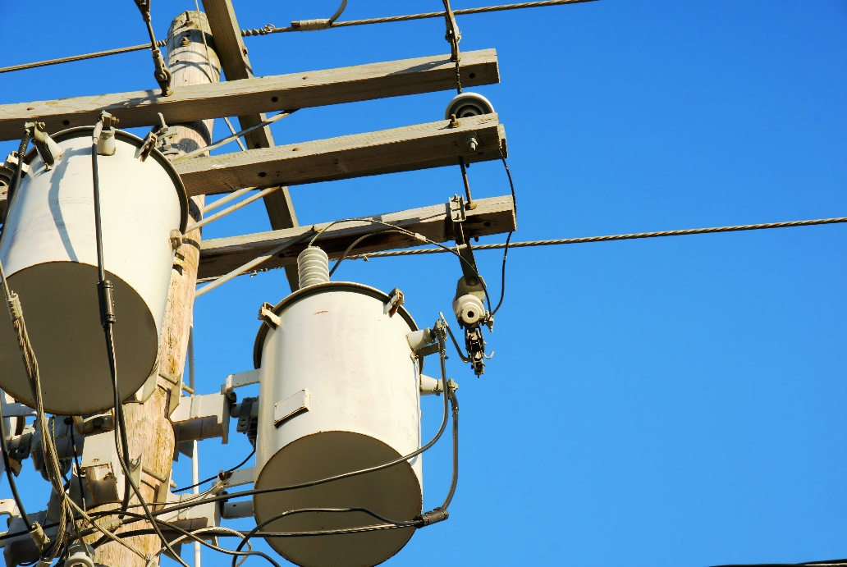
Contact Info for Technical Customer Service
Tony Koch, PE, CEM,
Mechanical Engineer
jakoch@bpa.gov
206.220.6777

