Slide 1
NEEA Overview
Fall 2022 BPA Utility Roundtables
BJ Moghadam
NEEA - Sr. Manager, Stakeholder Relations
Notes:
Good morning everyone, I’m BJ Moghadam, NEEA Sr. Manager of Stakeholder Relations.
I just wanted to start with a quick thanks to [Dan / Brice & Corinne / Dan & Lindsey / Melissa] and to Jamae and team for making time for NEEA on today’s agenda, and to thank you all for taking the risk of starting your day with me.
I’ve been with NEEA for close to 10 years now, and a big part of my role in Stakeholder Relations is listening to our stakeholders and bringing that perspective in-house to help NEEA do its work more in sync with yours.
Very little of that job involves getting good at presenting to stakeholders about NEEA, so you’re gonna get my version of that today.
The areas I plan to hit quickly are:
An overview of the alliance, including our funding partners and market partners
A few quick highlights from the work, from the program portfolio, emerging tech work, and research efforts
And time for comments and questions
So, starting with the Alliance.
NEXT SLIDE

Slide 2
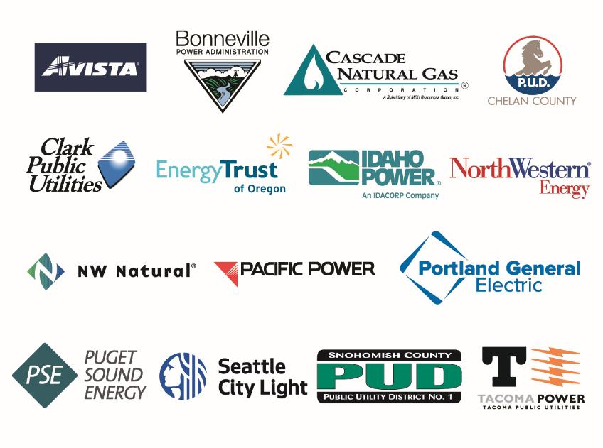
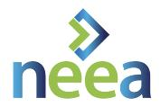
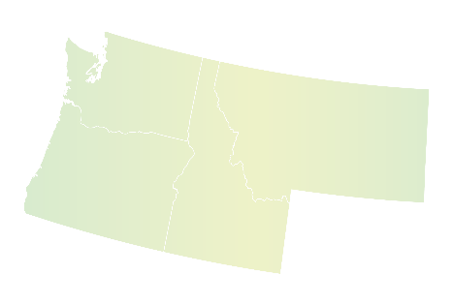
The Alliance
Notes:
Here’s one view of the Alliance, and these are the key entities that both fund and govern NEEA
Funder-wise though, this is just the tip of the iceberg when you consider Bonneville’s many smaller public utility customers, which are funders of NEEA, through Bonneville
And to provide another view… NEXT SLIDE

Slide 3
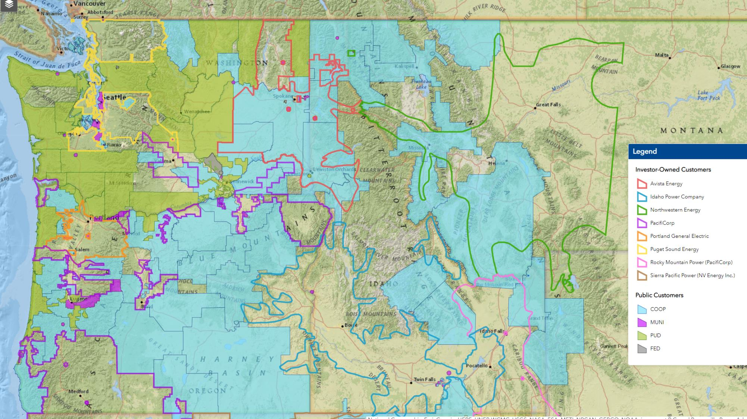
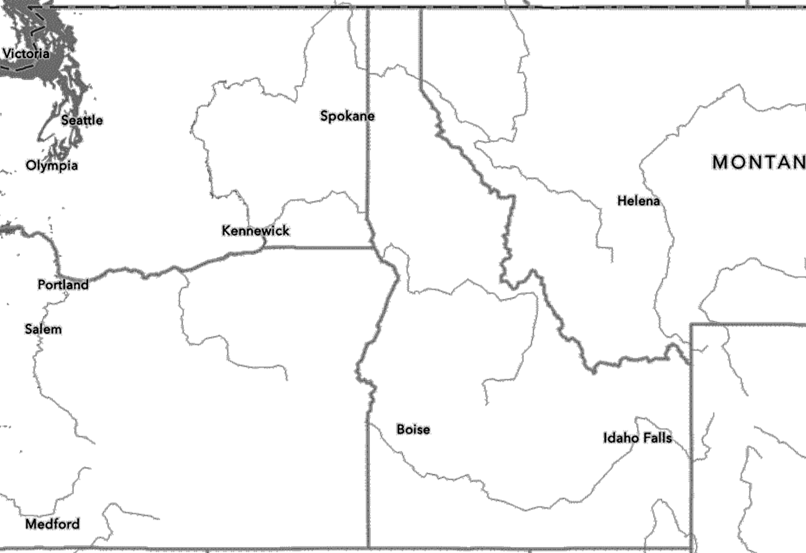
NEEA’s Regional Role
Notes:
I made this map on BPA’s very cool mapping tool, and I show this slide during my “Stakeholders 101” training for new employees at NEEA, and feel it’s relevant for this too.
The 2 points I like to make with this slide are:
1. The first is just appreciating what this geographic footprint represents, and ALLLL the diverse characteristics and perspectives and policies and politics. And then consider our funding utilities:
Single and multi-state utilities
Urban and rural utilities
Very large to very small
For profit and non-profit utilities
Electric-only, gas-only, and dual-fuel
Cold climate and coastal climate…
It’s a melting pot… So that’s point 1, just be aware, and empathetic, and flexible
And TWO – Most of us can find ourselves on this map, as one of the 13 million people who enjoy all the comforts that come with reliable, affordable power, at our homes and workplaces, and our grocery stores and restaurants and on and on. And that’s the point – we might get tunnel vision sometimes, focused on energy efficiency, but THAT’s the business our funding utilities are in – powering our lives and just about the entire economy. And it’s SUCH big business that a whole industry exists just to keep the system and everything dependent on it, efficient. And that’s where NEEA fits in – a small but significant player in the energy efficiency arena – regionally and nationally.
So, that’s the funder side of the alliance, let’s look at the market side…. NEXT SLIDE

Slide 4
Who We Work With
Manufacturers
Retailers
Government
Other
Notes:
Generally, NEEA’s market transformation work involves partnerships at the mid- and upstream levels, with manufacturers, retailers, wholesale distributors, and some government entities and NGOs
Where a NEEA market transformation strategy involves engaging “downstream” with end-use customers, whether it’s an incentive program or marketing or research, we try to coordinate that work closely with our funders through our various stakeholder forums and communication channels.
So Why an Alliance? NEXT SLIDE

Slide 5
Market Influence
Economies of Scale
Why an alliance?
Risk Pooling
Notes:
In a nutshell, these are the 3 big categories of working as an alliance to achieve energy efficiency:
Greater Influence: Like I mentioned, we use the power of the region’s 13 million energy consumers to get the attention of manufacturers, retailers and other partners.
Economies of Scale: We combine efficiency dollars from across the region to do things more cost-effectively (a good example is our building stock assessments, which I’ll hit on later); and,
And finally, there’s risks in trying out new and emerging technologies. If a technology fails, which has happened, or isn’t right for our region, no single utility is on the hook. The result is less risk for individual utilities and a lot more investment in emerging technology.
So, what do our funders get out of it? NEXT SLIDE

Slide 6
Alliance Value Streams
Savings
Training
Pipeline
Influence
Research
Data
Notes:
Now I’m not about to come here and tell YOU what YOU value about NEEA, but here are some of the key value streams the alliance supports, and ideally, at the end of the day, everyone putting into the pot is getting some combination of things they value out of it.
Some of our funders value the energy savings, whether its for compliance or just keeping downward pressure on rates. Market Transformation has a good track record of achieving savings very cost effectively.
Some rely on emerging technology pipeline for identifying good options for utility incentive programs
Some rely less on these more tangible things and more on the infrastructure benefits like the research and trainings NEEA supports
Another is influence: Because of NEEA’s reach to manufacturers and other upstream players, we’re able to provide a valuable feedback loop from the customer or retailer or trade ally experience, and help influence product design and performance.
AND IF THERE’S ONE THING YOU TAKE AWAY, in terms of what and WHY NEEA *is*, maybe it’s this----All of these benefits are the direct result of Energy Efficiency leaders in this region, *very much* including Bonneville, saying “we know what we’re doing individually, and we know we could achieve more by working together, so what is that?” And actually putting their money where their mouths are and working with each other through all their differences to make it happen. And it’s not easy, but they do it, and they’ve done it for a long time, and for me, *THIS* is what makes this alliance special, and working with you all rewarding.
So, speaking of the work, let’s take a look at a few examples. I’m going to breeze through these pretty quick so we have time for comments/Q&A.
NEXT SLIDE

Slide 7
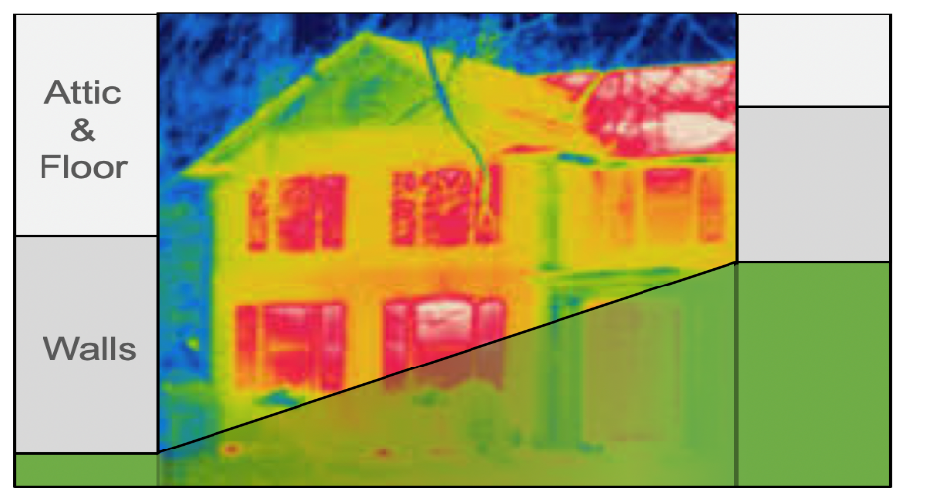
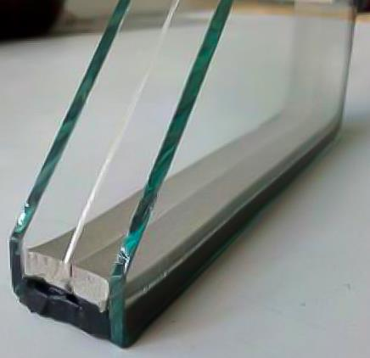
Program Highlight:
High Performance Windows
8%
Area
45%
Heat Transfer
Windows
Notes:
A recent entrant in our market transformation portfolio: High Performance Windows
These are residential windows with an insulation value, or U-value 0.22 or less, with weight and dimensions comparable to double pane but performance comparable to triple-pane. Most in the market have 3 panes, but there are some double-pane achieving the U-value of 0.22.
They’re great for cold- and more temperate climates, and deliver both heating and cooling benefit, and electric and gas savings
The initial target is Res New Construction, as a stepping stone to larger retrofit market [– single- and multi-family residential, and potentially small commercial.]
NEEA’s initial strategy is working with builders and their window suppliers to drive up demand, sending a signal to manufacturers to scale production and help lower first cost to the consumer.
Over the long-term the program is pushing for the new ENERGY STAR 7.0 windows specification which meets these performance levels.
[Once the new specification goes into effect the program will be able to reach the broader windows market through retailers to drive volume up and manufacturing costs further down. ]

Slide 8
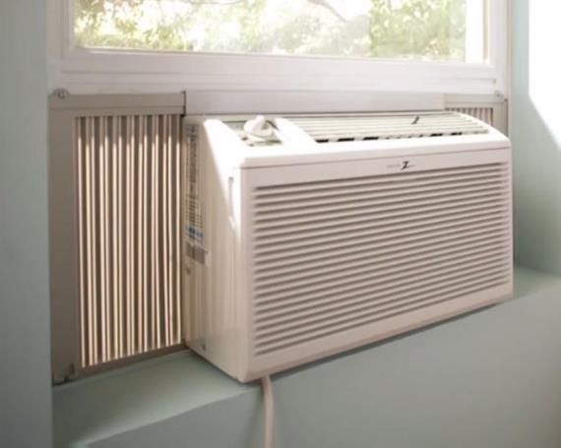
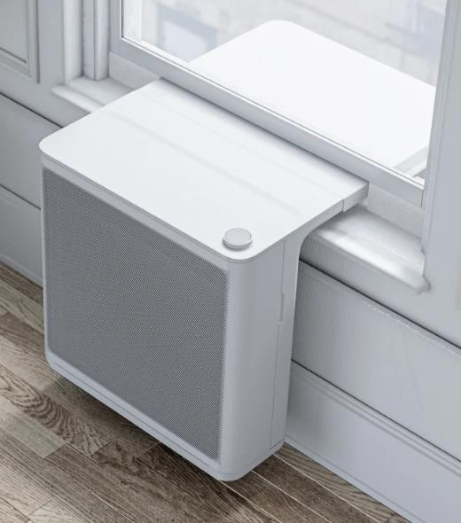
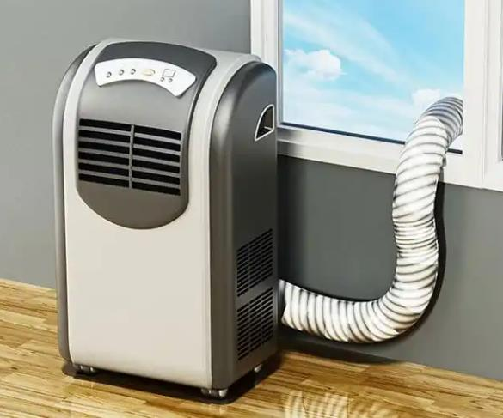
Emerging Tech Highlight:
Micro Heat Pumps
Notes:
Now here’s an example from our emerging tech pipeline.
Micro heat pumps - they run on 120 volts and can be easily installed by the customer.
They’re taking 3 basic forms and ones we’re used to seeing in these types of units, but these are primarily for heating, and have the potential to save as much energy as a small ductless heat pump (for around $2000 instead of double or more).
I’m told the manufacturers are already working cold-climate models, which has been a major focus for the NEEA and Bonneville teams, on heat pumps in general in recent years.
Preliminarily, we’re not seeing a clear Market Transformation play for NEEA, but depending on what we learn, these could be a good candidate for a utility measure.
We’ll know more after some field research in Q1, testing 3 different products to learn about the customer installation experience and satisfaction, and the team is working closely with BPA folks on this
(IF ASKED: 6 Gradient, 6 Midea window HPs, 4 portable units).
So, stay tuned for more on this…

Slide 9
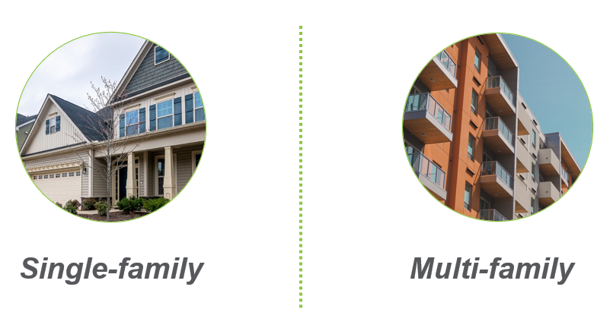
Research Highlight:
Residential Building Stock Assessment (RBSA)
Notes:
Switching now to a few timely examples of the research NEEA does
The Residential Building Stock Assessment is WELL underway, with results expected in Q2 next year, and these results are used to inform Conservation Potential Assessments, Integrated Resource Plans, RTF measures, Utility Programs, and beyond.
The study
Collects characteristics on building equipment that affect energy use
Collects energy use and demographic data
Is representative of the entire region, including urban and rural territories and all income levels.
And Bonneville is over-sampling 350 single-family homes with additional HVAC testing for a more precise modeling of Bonneville’s sub-regions.
ONE ASK FROM THE TEAM: They were very excited I was going to be talking to y’all, and noted that we’re starting to contact utilities for participant's billing data, which is critical for the study. So, for one, please know these requests are not a scam, and don’t hesitate to call the listed contact and grill them with any questions to verify. And two, anything you can do to be responsive to these requests is tremendously helpful to the study.

Slide 10
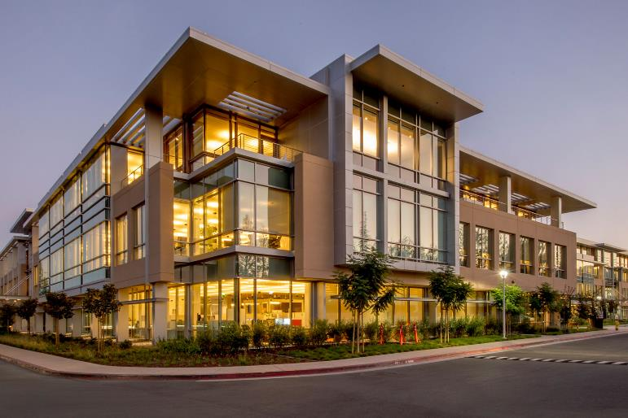
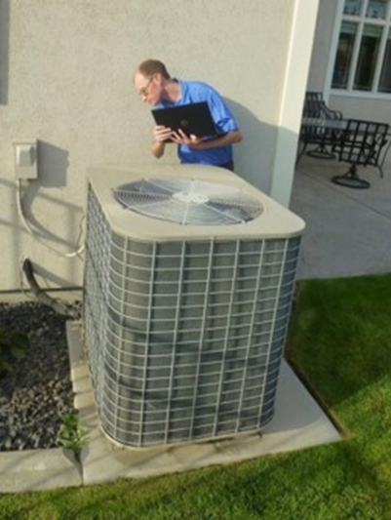
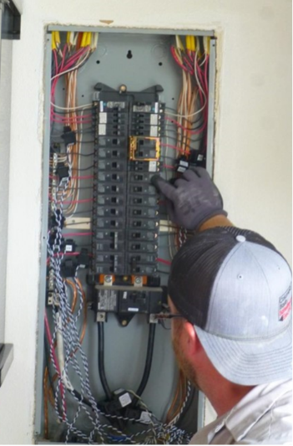
Research Highlight:
Commercial Building Stock Assessment (CBSA)
+
End-Use Load Research
Notes:
Two more research highlights very quickly:
The Commercial Building Stock Assessment, and
The End Use Load Research project
The CBSA is very similar to the Residential stock assessment –
A regional study on building characteristics, installed equipment, and energy consumption for commercial buildings throughout the Northwest
Like the RBSA, it’s a key input for the Northwest Power Plan, utility conservation programs, codes and standards work, and beyond.
This is NEEA’s 5th CBSA since its first in 2003, and all the preliminary coordination is just getting kicked off now, with recruiting starting in 2024 and a final report expected in 2025
And the End-Use Load Research study comprises 2 different studies: A Home Energy Metering Study and a Commercial Energy Metering Study
If you’re like me, you might ask – aren’t we already doing this with the RBSA and CBSA?
Well apparently not
The stock assessments are all about the buildings and equipment in them and overall energy use.
Whereas the End-Use Load Research studies go deep into metering how different types of customers use electricity around the clock in their homes and businesses
And this more-granular data will
help improve demand forecasting for future energy resource needs
inform conservation programs and those aimed at peak-reduction during extreme weather conditions
And ultimately, save the region millions on future energy investments
COVID has thrown a bit of a monkeywrench into the original timing but these studies should be complete in 2024

Slide 11
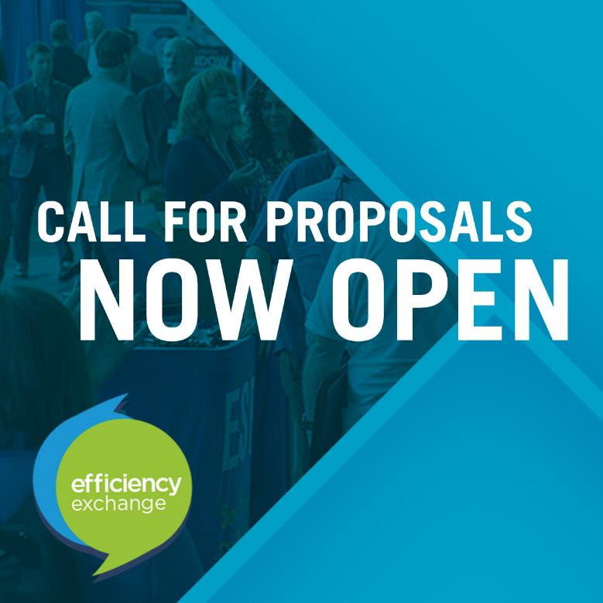
EFX23 – Call for Conference Sessions
Submit your ideas for conference sessions and keynote speakers
September 15 – October 28
www.neea.org/EFX
Notes:
And lastly, while I’ve got you, we’re gearing up for Efficiency Exchange 2023!
The call for session ideas is open through Oct 28
There’s no limit on number of session ideas so share with your teams and go the website to submit as many as you’d like
The 2023 conference will be a hybrid event, like this one – with a virtual participation option and the event being held in Portland on May 2-3 . Next year is Coeur d’Alene Idaho.

Slide 12
And finally…
Q&A

Slide 13
BJ Moghadam
Sr. Manager, Stakeholder Relations
503-688-5443 | bjmoghadam@neea.org
Notes:
It’s been a pleasure connecting with you all today, even if virtual. Here is my contact information and I’d encourage you to use it. It’s rare that I have the best answer to the various questions about our work, but I know how to find who does!

