Slide 1


BEETS Training & Transition Update
October 19, 2022

Slide 2
Today
# | Agenda Item | Duration | Presenter
1 | BEETS Update | 5 mins | Adam Morse, BEETS Project Lead
2 | What’s Changing? | 10 mins | Melissa Podeszwa, BEETS Customer Lead
3 | Customer Training & Transition Customer Transition Support Model What to expect during the transition Instruction Led Training Overview | 15 mins | Jen Mancke, BEETS Change Manager
4 | Q&A | 10 min | All
5 | Next Steps | 5 mins | Jen Mancke, BEETS Change Manager
Notes:
UES Bulk Upload Inform
Training Plan – Utility Driven (system how long to get up and running)
C2 Review Goes
Show them an example template
Dashboard
Work Center?

Slide 3
BEETS Update & Timing
BEETS is now live for Soft Launch Utilities! Reporting thus far has been smooth and uneventful. Transition of all utility customers is a GO for the mid-November.
Key Rollout Dates:
Soft Launch: October 3, 2022 (Now Live!)
Last Reporting in IS2.0: November 3, 2022
Full Launch (All Utilities): Target Date of November 16, 2022
2022 |  |  | 2023
Sept | October | November | December | January | February+
TODAY
Last Reporting in IS2.0 (11/3/22)
Ongoing training and support to be scheduled as needed
Soft Launch:
Utility Focus Group
PNGC Utilities
All BPA Staff
Full Launch Go Live
(~Nov. 16, 2022)
Soft Launch*
(Oct. 3, 2022)
TRAINING: Soft Launch Group
VIRTUAL INSTRUCTOR-LED TRAINING:
All Utilities
DROP-IN OFFICE HOURS:
All Utilities

Slide 4
BEETS Soft Launch so far…by the numbers.
As of Friday October 14th….
18 utilities reported in BEETS across 7 programs
908 applications submitted
568 projects/measures approved through compliance
1,150,365.5 kWh in projected busbar energy savings
$1,279,281.41 in projected EEI payments

Slide 5
Questions?
What’s Changing?

Slide 6






What’s Changing? – BPA EE Reporting Process
Current
Future
Customers always get paid at 30 days
Customers could get paid in LESS than 30 days
30 day invoicing
clock
Net 10 payment clock
~ 7 – 10 business days
Customer compiles and submits invoice package
BPA performs Compliance Review*
BPA issues payment
Customer submits application
BPA performs Compliance Review*
Customer
invoices
*NEW*
BPA issues payment
Technical Review
(If Applicable)
*Oversight performed if applicable

Slide 7
What’s Changing? – Performance Payments
Current
Future
Automatic, but not flexible:
Automatic Payment or request to Opt Out
One bucket of funding for all payments
Same Invoice for EEI and Performance Payments
More steps, but more flexible:
Customers control if, when and how much is paid
Separate EEI & Performance Payment buckets
Separate invoices for EEI and Performance Payments

Slide 8
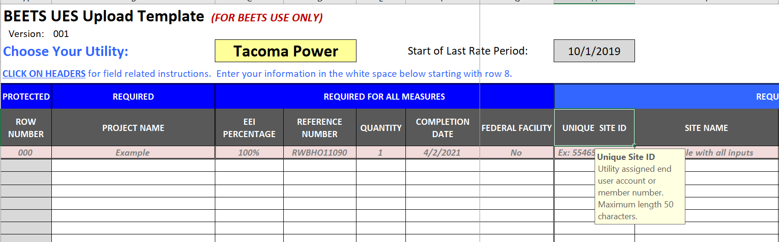
What’s Changing? – UES Measures
New Requirements*:
Make/Model/Installed Cost now required for Residential DHPs and select Commercial Measures
Make/Model now required for Advanced Smart Thermostats
Primary Heating System Type now required for Residential ‘Any Electric’ Insulation, Windows, and Prescriptive Duct Sealing (unless specified in Reference Number Measure name)
Changes to UES Measure Template:
Similar format modified to reflect BEETS
‘Smarter’ validation and Error Checks built in to catch common errors
‘Tips’ available by clicking on column headers
*Be sure to refer to the Implementation Manual for specific requirements

Slide 9
Questions?
Customer Training & Transition

Slide 10

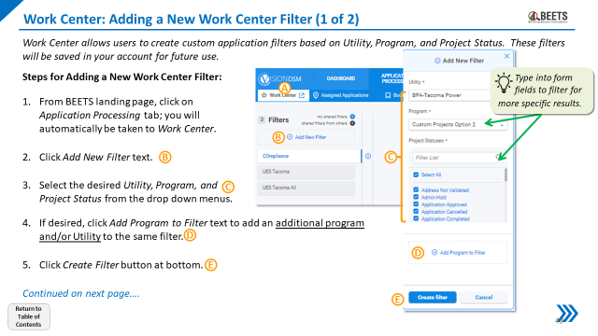
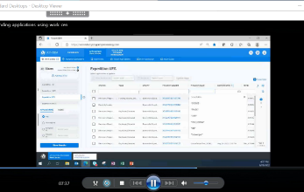


BEETS Customer Transition Support Model
In the weeks preceding and after the BEETS transition, customers will have access to multiple support channels to accommodate for different learning styles, schedules, and reporting cadences.
Facilitated
On Demand
Instructor Led Virtual Training Sessions
Self-Paced Step-by-Step Training Guides and Videos
Customers can attend one or more repeat training sessions in demo format that will be offered multiple times through 2022 and into early 2023*
Training materials will be available for customers to view and download on BPA.gov at their convenience
Virtual BEETS ‘Drop-in’ Office Hours
1:1 Energy Efficiency Representative Support
Customers have access to ‘drop-in’ office hours during the transition. These sessions provide an opportunity for users to go directly to the BEETS experts for support with initial reporting.
EERs will be trained and ready to walk individual customers through any or all of their early submittals into BEETS
*NOTE: We recommend customers attend training sessions as close to first reporting activity as possible

Slide 11
What to expect during the transition – Before Go Live
Go Live Target Date 11/16/22
Now until Go Live
Reporting | All final IS2.0 reporting must be completed by November 3, 2022 deadline Recommend completing all time sensitive or urgent reporting in IS2.0 Custom Projects with an approved Completion Report (CRR) should be invoiced through IS2.0 Reporting that cannot be submitted prior to 11/3 can then be reported through BEETS No reporting will be accepted from 11/3 until Go Live; for approximately two weeks ahead of Go Live, there will be a reporting blackout period, during which BPA completes invoice approvals in IS 2.0 and prepares BEETS New bulk upload templates (i.e. UES, Non-Reportable, C2, etc.) and Measure Lists will be posted to BPA.gov no later than 11/1;
Customer Transition Support | Virtual Instructor Led Training starts on November 1, 2022; consists of a two module series offered multiple times to accommodate for customer availability and reporting cadences

Slide 12
What to expect during the transition – After Go Live
Go Live Target Date 11/16/22
After Go Live
Reporting | All reporting will be done in BEETS after Go Live; reporting must be done in BEETS as IS2.0 will no longer be accessible to customers In-Flight Custom Projects that will not invoice in time for the 11/3 transition date should be entered through the proposal process in BEETS after Go Live; your ESIPs and CSEs will be on hand to guide you through the process When possible, hold reporting to 2023; customers are welcome to report anytime, but to ensure a smooth transition, we request that non-time sensitive reporting be held until early 2023
Customer Transition Support | It is not expected, nor recommended, that customers submit the first few applications alone, the BPA team will be available for personal walkthroughs Virtual Instructor Led Training continues through January; consists of a two module series offered multiple times to accommodate for customer availability and reporting cadences BEETS Virtual Drop-In BEETS Hours start at Go Live and run through January; open virtual office hours with the BEETS Project team will be offered for all users to ask questions and have support walking through early submittals EERS on hand to walk customers through early submittals;

Slide 13
Virtual Instructor-Led Customer Training Session Modules
Virtual training sessions will be offered for new users to build basic foundational knowledge in support of other hands on learning:
Led by BEETS project team & BPA system experts to ensure information is relevant to BPA customers
Consist of a two-module series – recommended that most utilities attend both modules at least once
Offered in multiple options from Go Live (Target Date 11/16) through January 2023 to accommodate for various schedules & reporting cadences; more will be offered as needed
Sessions are interactive, but demo only
 | Module 1: BEETS 101 | Module 2: Invoicing, Dashboards, and Reports
Description | Learn how to navigate and report activity in BEETS | Learn how to submit EEI and Performance Payment Invoices & Run Reports on BEETS Reports Portal (SSRS)
Length | 150 mins (virtual – with break) | 90 mins (virtual)

Slide 14
Virtual Instructor-Led Customer Training Session Dates
Repeat trainings will be offered multiples times to accommodate different schedules and reporting cadences
It is recommended that all BEETS users attend at least one session for each module, but customers are welcome to attend multiple sessions if helpful
Highly recommended that customers attend training as close to your first intended reporting as possible
Training invites will be distributed via weekly announcements starting on October 20th
I want to start reporting in…. |  | …so I should attend one each of these sessions:
November or early December 2022 |  | Module 1: BEETS 101 Tues Nov. 1, 2022, 9:30am – 12:00pm PT, or Wed Nov. 2, 2022, 9:30am – 12:00pm PT | Module 2: Invoicing, Dashboards, and Reports Tues Nov. 8, 2022, 10:00am – 11:30am PT, or Wed Nov. 9, 2022, 10:00am – 11:30am PT
Later in 2022 |  | Module 1: BEETS 101 Mon Nov. 28, 2022, 9:30am – 12:00pm PT, or Wed Dec. 14, 2022, 9:30am – 12:00pm PT | Module 2: Invoicing, Dashboards, and Reports Tues Nov. 29, 2022, 10:00am – 11:30am PT Thurs Dec. 15, 2022, 10:00am – 11:30am PT
Early 2023+ |  | Module 1: BEETS 101 Wed Jan. 4, 2022, 9:30am – 12:00pm PT, or Wed Jan. 18, 2022, 9:30am – 12:00pm PT | Module 2: Invoicing, Dashboards, and Reports Thurs Jan. 5, 2022, 10:00am – 11:30am PT, or Thurs Jan. 19, 2022, 10:00am – 11:30am PT
2022
2023

Slide 15
Full Launch Customer Transition Calendar
 | October |  | November |  |  |  |  | December |  |  |  | January
 | Week of 10/17 | Week of 10/24 | Week of 10/31 | Week of 11/7 | Week of 11/14 | Week of 11/21 | Week of 11/28 | Week of 12/5 | Week of 12/12 | Week of 12/19 | Week of 12/26 | 1/2 - 1/31
Key Dates | Webinar (10/18) OR RT (10/18 & 10/19) | WA RTs (10/24 – 10/27) | C-BEASST RT (11/3) IS2.0 Reporting Deadline (11/3) |  | GO LIVE (~11/16) |  |  |  |  |  | Holiday
Customer Training and Support Channels (Training Sessions will be Recorded)
Module 1: BEETS 101 |  |  | 2x |  |  |  | 1x |  | 1x |  |  | Bi-Weekly
Module 2: Invoicing, Dashboards, and Reports |  |  |  | 2x |  |  | 1x |  | 1x |  |  | Bi-Weekly
Office Hours (90 min) |  |  |  |  | Daily | 11/21 & 11/22 | 3 - 4x | 3 - 4x | 3 - 4x | 3 - 4x |  | 3 - 4x (as needed)
*Customer Service Team Meetings (EERs, COTRs, Engineering Team, and ESI) will be held weekly to knowledge share and discuss customer feedback

Slide 16
Next Steps
If you haven’t completed your User Access forms, please return to you EERs ASAP
Submit final reporting into IS2.0 no later than 11/3; contact your EER if you have any concerns
Virtual Live Instructor led Training sign-ups will be distributed via weekly announcements; sign up for ones that are close to your first reporting deadline
Reach out to your EERs or contact BEETS@bpa.gov with any questions
More training and support information will be posted in the next couple weeks on the BEETS site on BPA.gov; will announce when ready

Slide 17
Q&A

Slide 18
Appendices

Slide 19
Training Dates
Sign-up information will be distributed in the BPA weekly announcements.
Recommended sessions for those who plan to report in BEETS ASAP (i.e. November):
  Tuesday November 1, 2022, 9:30am – 12:00pm PT (MODULE 1: BEETS 101)
  Wednesday November 2, 2022, 9:30am – 12:00pm PT (MODULE 1: BEETS 101)
  Tuesday November 8, 2022, 10:00am – 11:30am PT (MODULE 2: Invoicing, Dashboards, and Reports)
  Wednesday November 9, 2022, 10:00am – 11:30am PT (MODULE 2: Invoicing, Dashboards, and Reports)
Recommended sessions for those who plan to FIRST report in BEETS later in 2022 (i.e. December):
  Monday November 28, 2022, 9:30am – 12:00pm PT (MODULE 1: BEETS 101)
  Tuesday November 29, 2022, 10:00am – 11:30am PT (MODULE 2: Invoicing, Dashboards, and Reports)
  Wednesday December 14, 2022, 9:30am – 12:00pm PT (MODULE 1: BEETS 101)
  Thursday December 15, 2022, 10:00am – 11:30am PT (MODULE 2: Invoicing, Dashboards, and Reports)
Recommended sessions for those who plan to FIRST report in BEETS in early 2023:
  Wednesday January 4, 2022, 9:30am – 12:00pm PT (MODULE 1: BEETS 101)
  Thursday January 5, 2022, 10:00am – 11:30am PT (MODULE 2: Invoicing, Dashboards, and Reports)
  Wednesday January 18, 2022, 9:30am – 12:00pm PT (MODULE 1: BEETS 101)
  Thursday January 19, 2022, 10:00am – 11:30am PT (MODULE 2: Invoicing, Dashboards, and Reports)

Slide 20




BEETS Performance Payments Process
Allocate Performance Payment Budget
Utility allocates desired EEI funds to Performance Payment Budget at any time during rate period (up to cap).
Claim Performance Payments
EEI Budget
EEI Budget
Utility validates sufficient Earned & Allocated Performance Payment funds.
Utility submits performance payment invoice.*
BPA pays out performance payment funds (net 10).
Performance Payment Budget
Earn Performance Payments
Utility submits measure(s) for approval.
Utility invoices measure(s) at any time.
Available Earned Performance payment amount increases.
Earned Performance Payments
*Invoices submitted with insufficient funds will need will need to be resubmitted
Notes:
Move slide up

