Slide 1

PTCS® Duct Sealing
Certification Training

Slide 2


Agenda & Logistics
Trainer Introduction
Agenda
  In-Class and Off-Site Training Schedule
  Exam
Logistics
  Restroom Location
  Breaks and Lunch
  Review Folder Contents
Symbols
In spec | Common inspection failure
Notes:
Review Binder Contents: PTCS Duct Sealing Specification, PTCS Duct Sealing Form, Testing Protocol Graphics, Certified Technician Application (touched on at the end)
Spec Symbol: will show up when an item is required in the spec

Slide 3
The PTCS Program
Pacific Northwest regional program promoting quality duct sealing and installation of AHRI rated high efficiency heat pumps
  Measures offered are:
  126* participating Pacific Northwest Utilities
  1434* active technicians
  107,957* approved HVAC installations since 2006
  6.4 million population and 2.5 million housing units in BPA territory
PTCS and Prescriptive Duct Sealing Air Source Heat Pump | Variable Speed Heat Pump Ground Source Heat Pump
*As of August 2018
Notes:
Participating utilities- 126 unique utilities between gas and electric per registry measure export
Active HVAC technicians- 1434 technicians who are BPA approved and have last activity in 2016 or later
Approved Installs- 107,957 measures with status accepted, BPA approved, or PTCS certified only. Duct seal and heat pumps

Slide 4
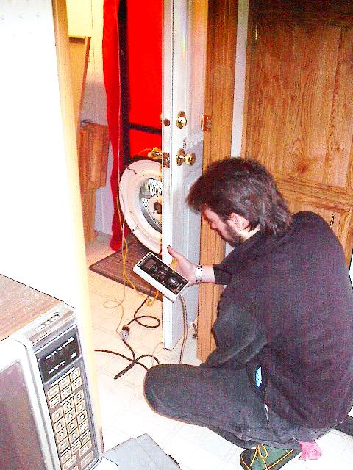
Course Content
Section 1: Introduction & Pressure Basics
Section 2: Manometer & Blower Door
Section 3: Duct Blaster
Section 4: Duct Leakage to Outside Test
Section 5: Diagnosis & Planning

Slide 5
Course Content, continued
Section 6: Duct Sealing and Repair
Section 7: Manufactured Homes
Section 8: Combustion Safety
Section 9: Participation Rules & Paperwork
Section 10: Resources
Certification Exam!

Slide 6
Section 1 of 10:
Introduction & Pressure Basics

Slide 7



Section 1: Introduction and Pressure Basics
Section 1: Introduction
Prescriptive vs PTCS
What’s Involved?
Building Science Overview
  Pressure
  Flow
  Outside vs. Inside Ducts
Equipment Preview

Slide 8
Types of Duct Sealing Certifications
Section 1: Introduction
PTCS Duct Sealing
  Pre and post duct leakage testing required
Prescriptive Duct Sealing
  Duct testing not required, but all other sealing specs required
  Required to seal all opportunities
  Check which measures your utility offers
  This training certifies you for both!

Slide 9
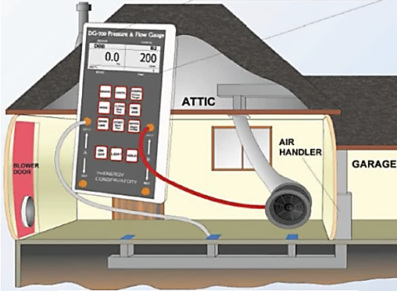
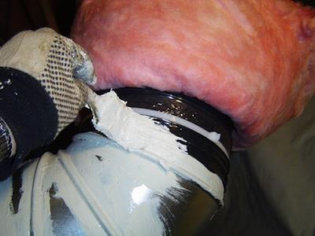
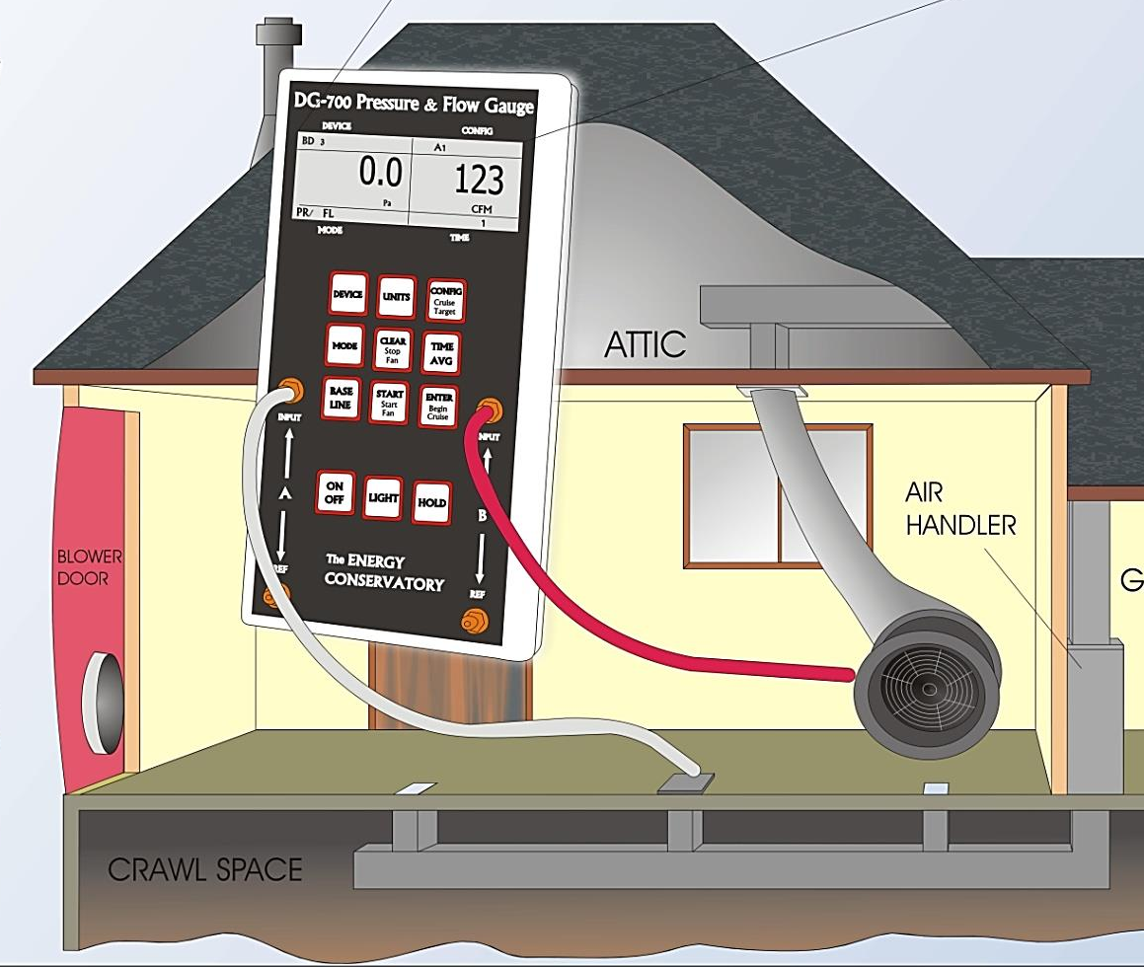
What’s Involved?
Section 1: Introduction
Measuring the leakage with fans
Sealing all opportunities
Measuring again for the difference*
* Prescriptive duct sealing does not require measuring leakage.

Slide 10
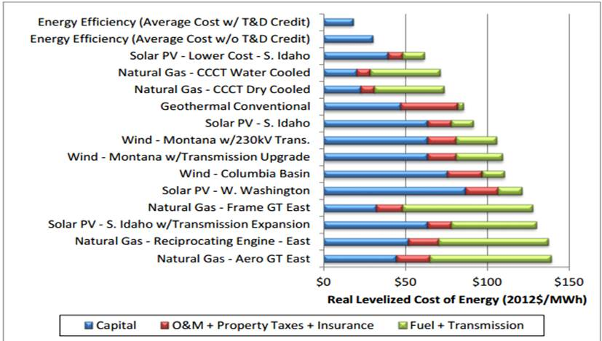
Section 1: Introduction
Cost of Electricity
(2016 $/MWh)
10
Slide courtesy of Tom Eckman, NWPCC
Notes:
Pay people to use less – costs $30
Gas Power Plants -- $90
Wind -- $100 - $140
Solar Electric -- $240

Slide 11

Know Before You Begin…
Section 1: Introduction
  Duct installation must comply with all applicable codes. (Note: PTCS is not a code requirement)
  Ducts cannot be approved if they have previously sealed through this PTCS or the Prescriptive Duct Sealing programs unless a utility
  pre-inspection confirms additional sealing
  is required.
11

Slide 12
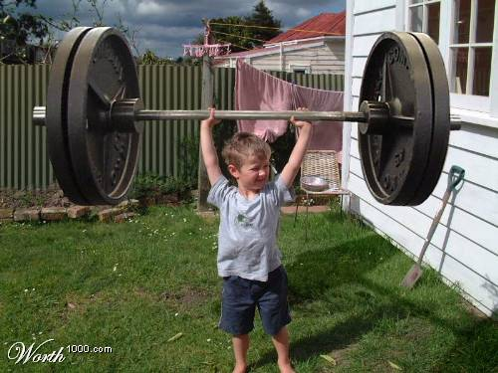
What is Pressure?
Section 1: Introduction
Weight per unit area
Pounds per square inch (PSI)
Inches of water column
(inH₂O) or (IWC)
Pascal (Pa): Newtons per square meter
(850 lbs per 2 small feet)
12

Slide 13
Section 1: Introduction
Pressure Equivalents
1 PSI = 144 LBS/sq. ft.
1PSI = 27.7 inches of water
1 in H₂O = 250 Pascals (Pa)
50Pa = 0.2 inches H₂O (in H₂O)
25Pa = 0.1 in H₂O
Duct Testing will pressurize to 50 Pa or 0.2 in H₂O
13

Slide 14

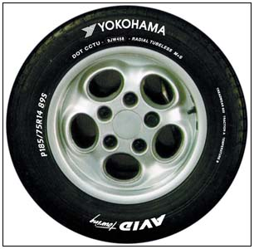
Exercise: Pressure Basics
Section 1: Introduction
Truck tire pressure: 32 PSI
Convert to inH₂O:
Convert to Pa:
32 PSI X 27.7 inH₂O/PSI = 886.4 inH₂O
886.4 inH₂O X 250 = 221,600 Pa
Notes:
On average, light duty truck tire pressure is recommended to be around 32 PSI.
Click for once for first answer
Click again for second question
Click again for second answer

Slide 15
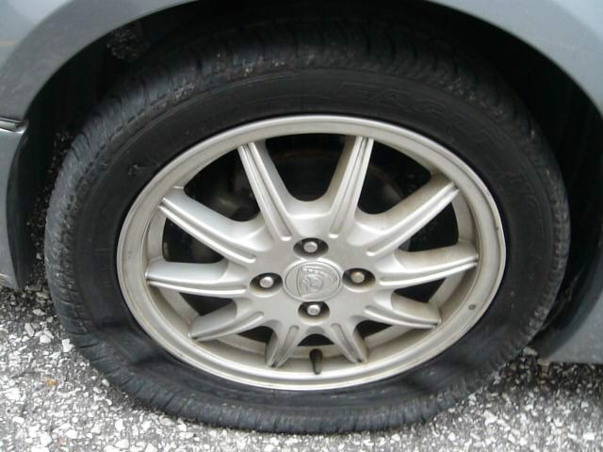
Why Does Air Leak?
Section 1: Introduction
Given the opportunity (a hole), air in the tire will leak, or flow
from high pressure (inside)
to low pressure (outside).
How does a tire go from
32 PSI to this?
Flow = Pressure X Size of Hole
Notes:
How does a tire go from having 32 PSI to this?

Slide 16


Flow – The Hole
Section 1: Introduction
Same size tank (pressure), different size hole
Flow = Pressure X Size of Hole

Slide 17
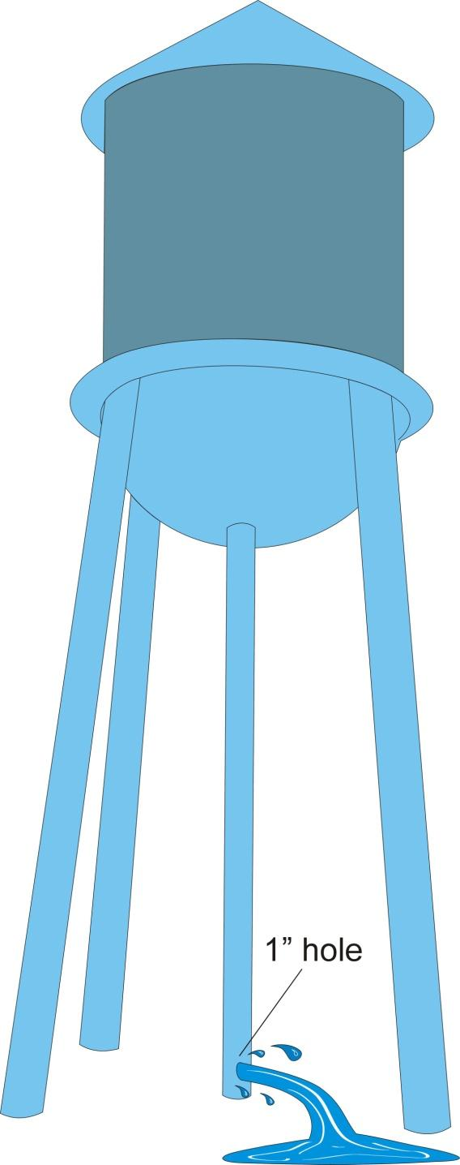
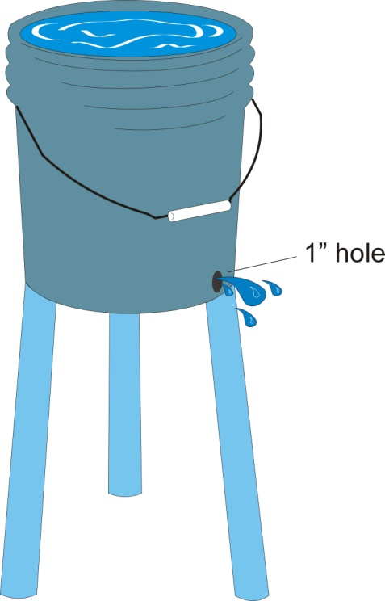
Flow – The Pressure
Section 1: Introduction
Same size hole; different size tank (pressure)
Flow =
Pressure X Size of Hole

Slide 18
Flow – Calculation and Measurement
Section 1: Introduction
Flow CFM* =
Pressure difference on either side of the hole X Size of Hole
*CFM (Cubic Foot per Minute) of air:
Rate of flow just like gallons per minute
12 inches
12 inches
12 inches

Slide 19
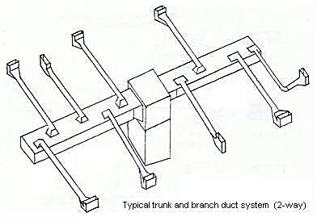
Pressure Basics
Section 1: Introduction
Holes in duct systems – which hole will leak more air?
Typical trunk and branch duct system (2-way)
Answer: By the fan, where the air pressure is the highest.
Notes:
The holes in high pressure areas of the duct system will leak more than the ones in low pressure areas; even if they are the same size.

Slide 20
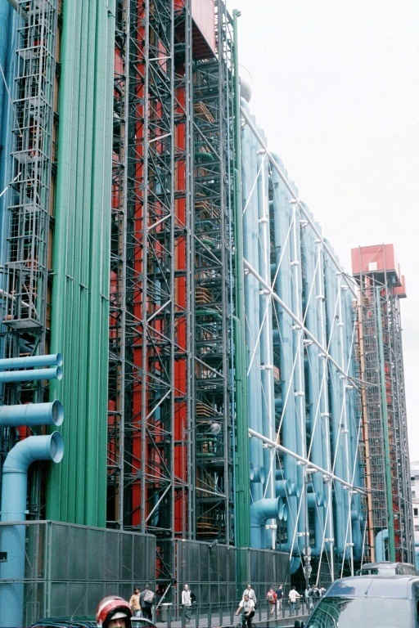
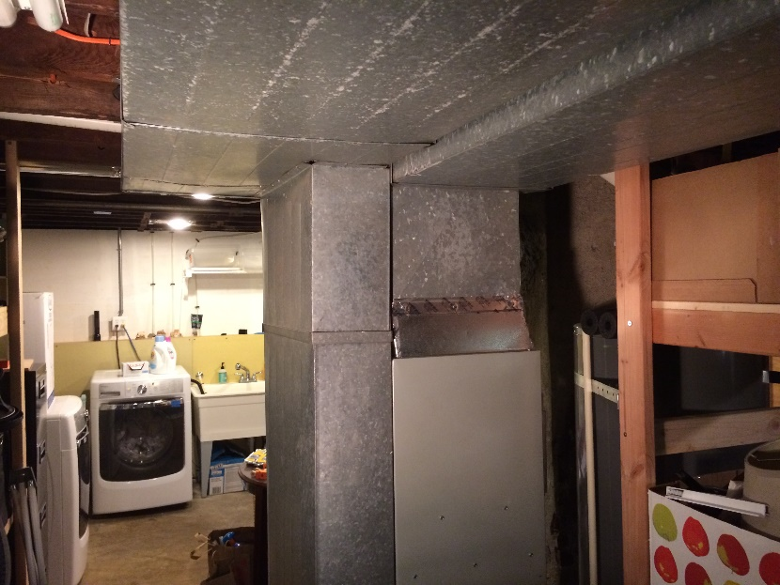
Outside vs. Inside
Section 1: Introduction
At least 30% of supply ducts must be “outside” in unconditioned space and accessible.*
?
What does “outside” mean?
*See exception for high operating pressure leaks in PTCS Duct Sealing specification section 1.

Slide 21
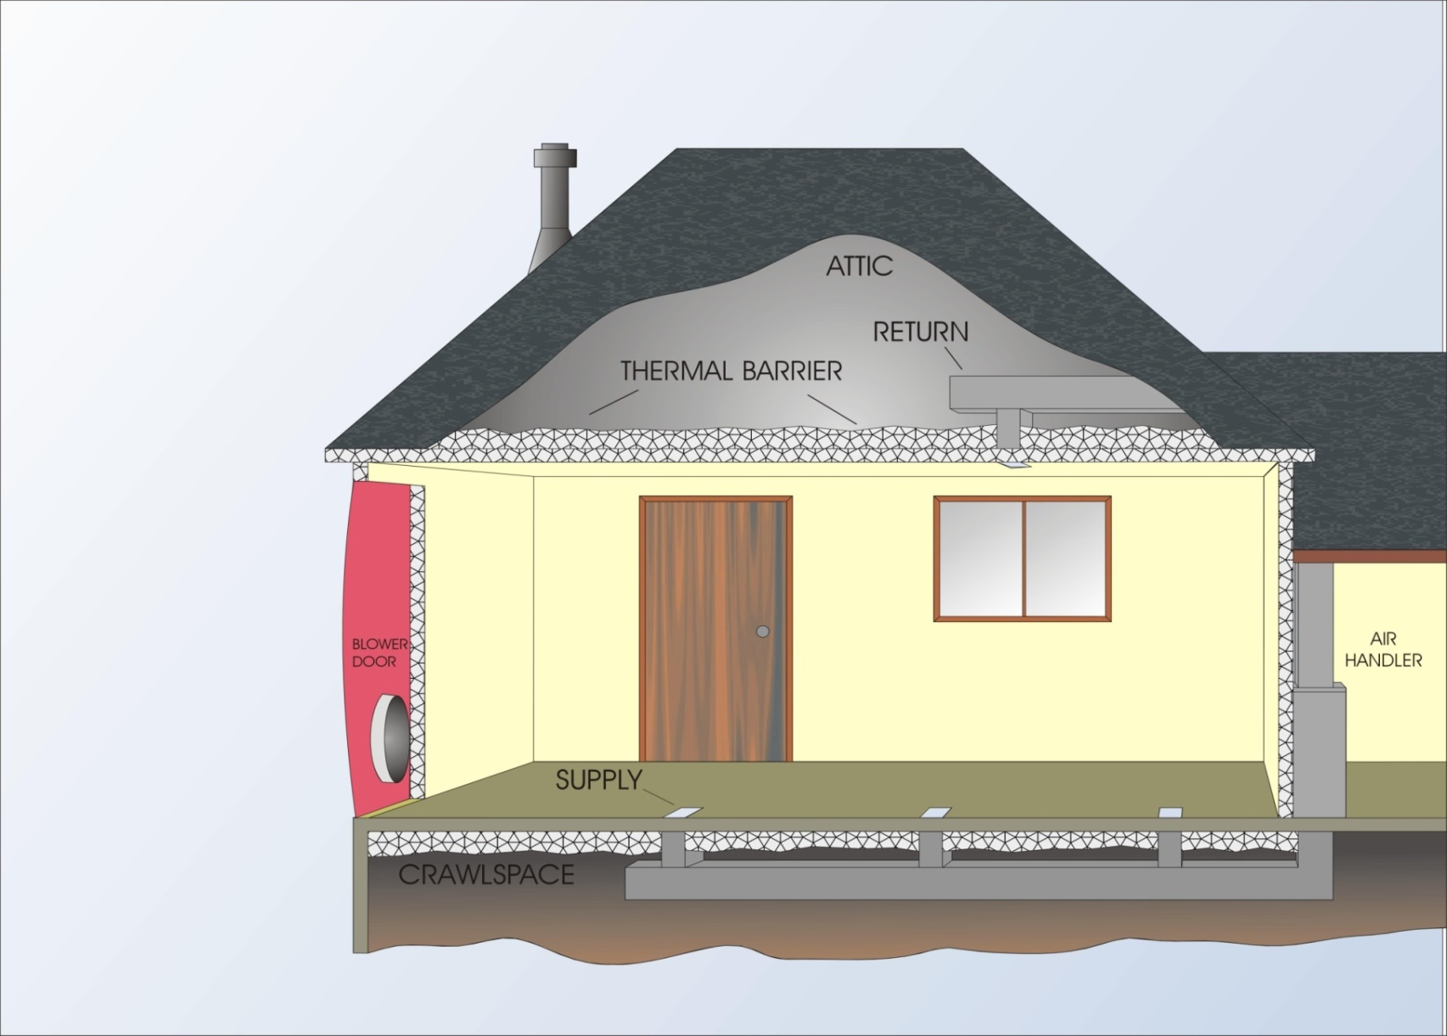
Outside vs. Inside
Section 1: Introduction
“Outside”
“Inside”
Notes:
Thermal barrier house picture here
In a perfect world, this is how all houses would be built.
In the real world, many times you’ll have to make the determination if it’s inside or outside

Slide 22
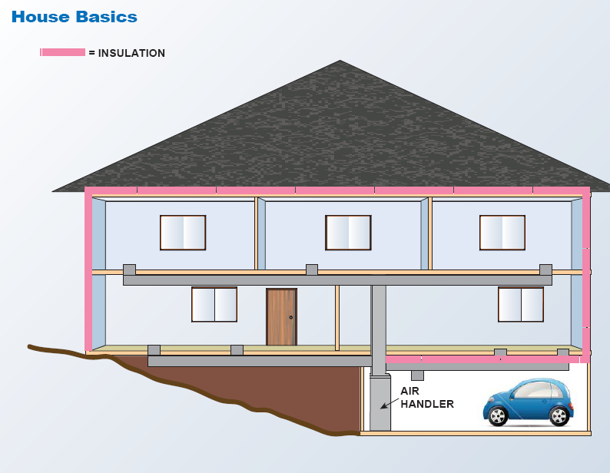
Outside vs. Inside
Section 1: Introduction
Is this space inside or outside?

Slide 23
Outside vs. Inside Energy Savings
Section 1: Introduction
Ducts Inside Thermal Barrier
Ducts Outside Thermal Barrier
Average = 72%
Data from Ecotope Inc.
Notes:
1st screen – ‘going back to the earlier graphic
Click – houses that have ducts inside what we call ‘thermal barrier’
Click – houses that have ducts outside what we call ‘thermal barrier’
Click – Average is 72.6%

Slide 24

Equipment Preview
Section 1: Introduction
Manometer
Blower Door
Duct Blaster
24

Slide 25
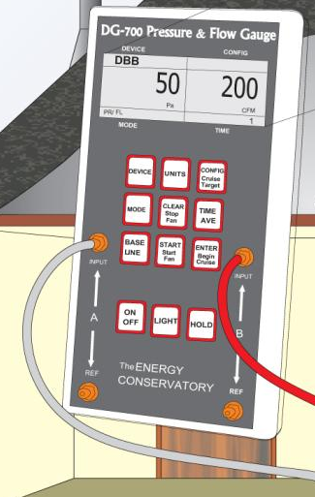
Preview: Manometer
Section 1: Introduction
Measures…
  Pressure and calculates CFM
  Pressure difference between two areas
Different types:
  Energy Conservatory DG 1000
  Energy Conservatory DG 700
  Retrotec DM-2
Notes:
For PTCS trainings, we use Energy Conservatory Equipment unless otherwise stated.
Ask class who is using the DG1000 and eventually trainers will have them.

Slide 26
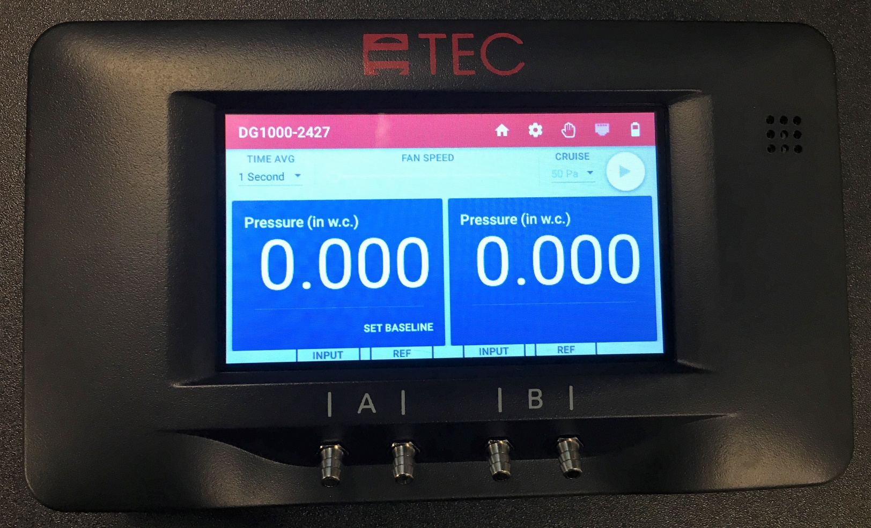
New Model: DG1000
Section 1: Introduction

Slide 27
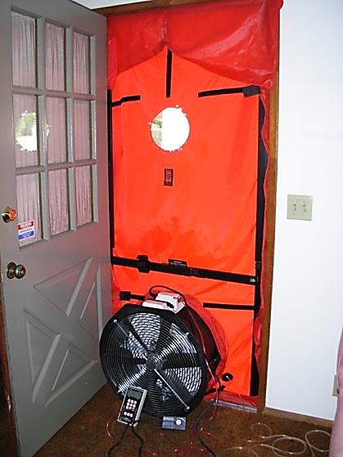
Preview: Blower Door
Section 1: Introduction
Measures air leakage through gaps and cracks in the building shell and ducts
Example:
If fan is blowing 2,000 CFM out of the house, 2,000 CFM of air must be leaking in through holes in the house.

Slide 28
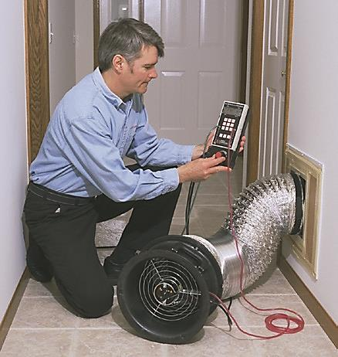
Section 1: Introduction
Preview: Duct Blaster
Use same principles to measure duct system leakage
All registers are masked off for the test and the duct blaster fan is used to pressurize the duct system

Slide 29
Equipment Maintenance
Section 1: Introduction
Manometers
  Should be recalibrated every two years
  A field calibration check should be completed annually or whenever a gauge has been dropped or damage suspected. This procedure can be found at the link below.
Flow Plates
  Modified and damaged flow places will give you incorrect readings
  Energy Conservatory can provide gasket replacements
Blower Door and Duct Blaster Fans
  These maintain their calibration unless physical damage occurs to the fan or flow sensing system. A fan field check procedure can be found at the link below.
  Visit: https://energyconservatory.com/calibration-repair/ for more info.
Notes:
Calibration of a TEC digital pressure gauge is $135 (DG-2, DG-3, DG-500, DG-700, DG-1000). Calibration of a TEC APT device is $175. This price includes return ground shipping within the continental 48 states and Canada. Turn around time at our facility for calibration is typically 2-3 days following receipt of the instrument (assuming no repairs are necessary).

Slide 30
Section 1: Introduction
Duct Leakage to Outside
Using the blower door to equalize pressure between the ductwork and the house, we eliminate any leaks to the inside and are able to determine how much leakage to the outside there is.
Duct
House
+50PA
+50PA

Slide 31
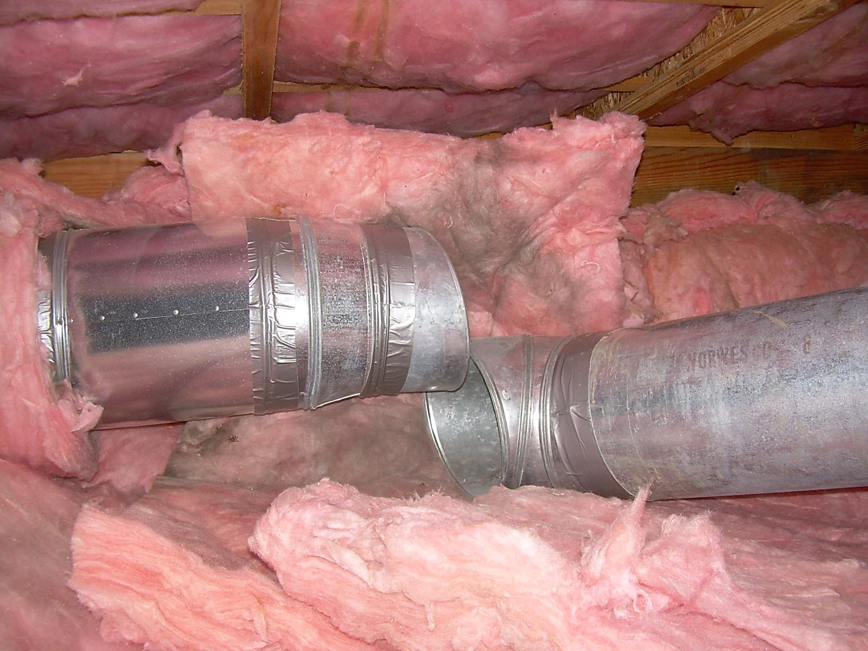
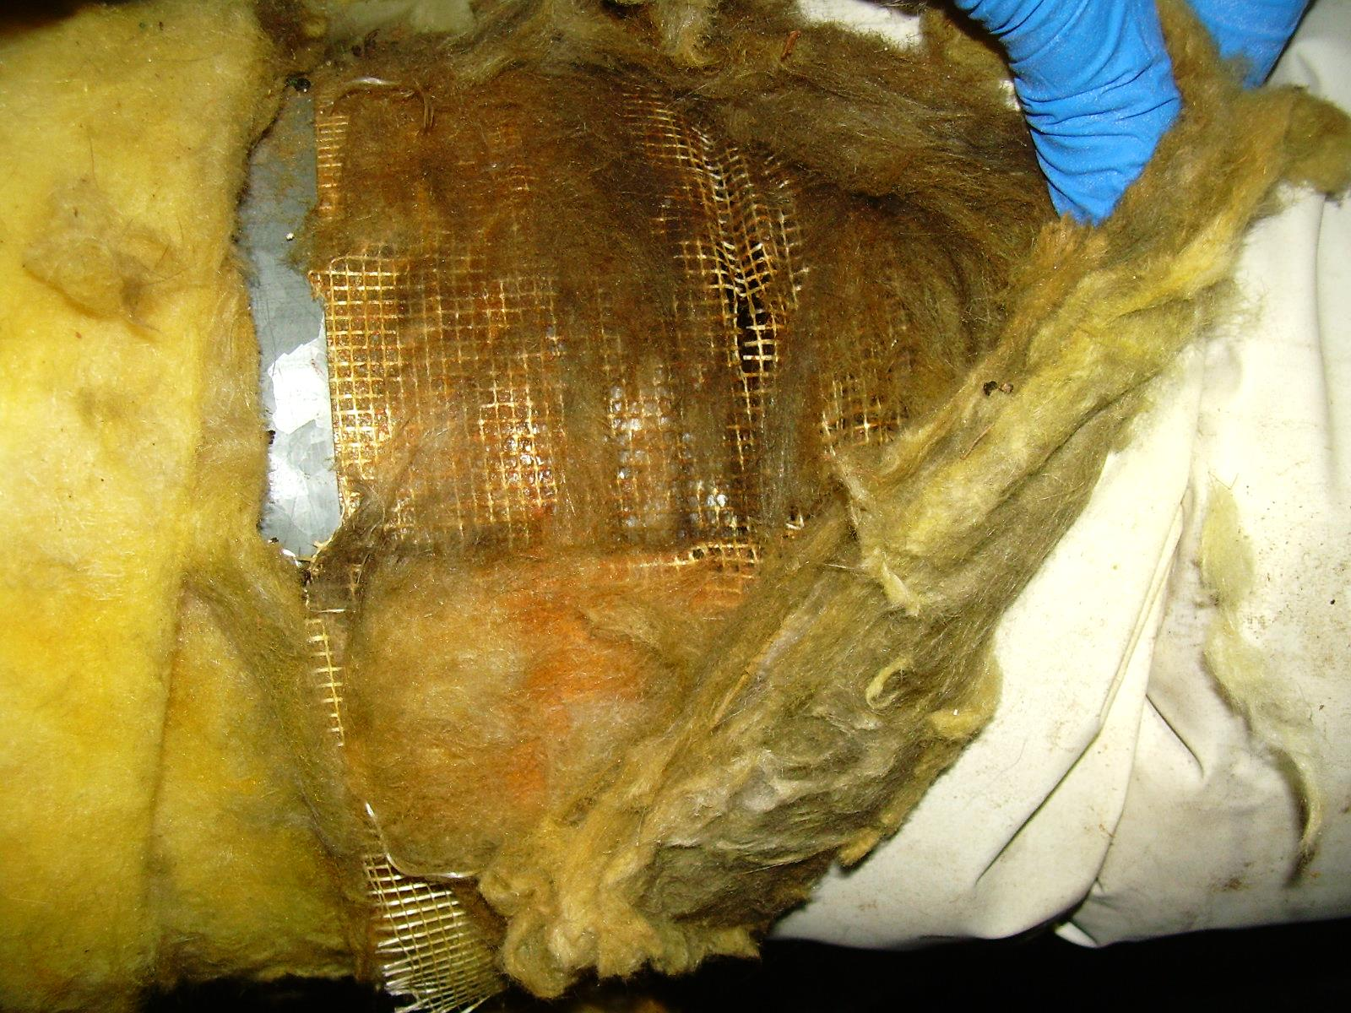
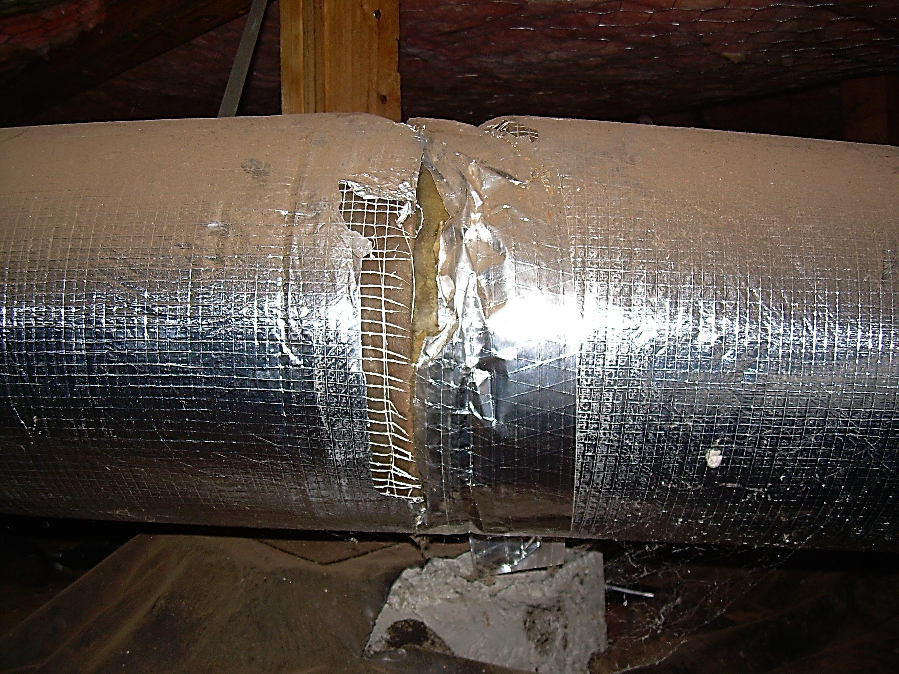
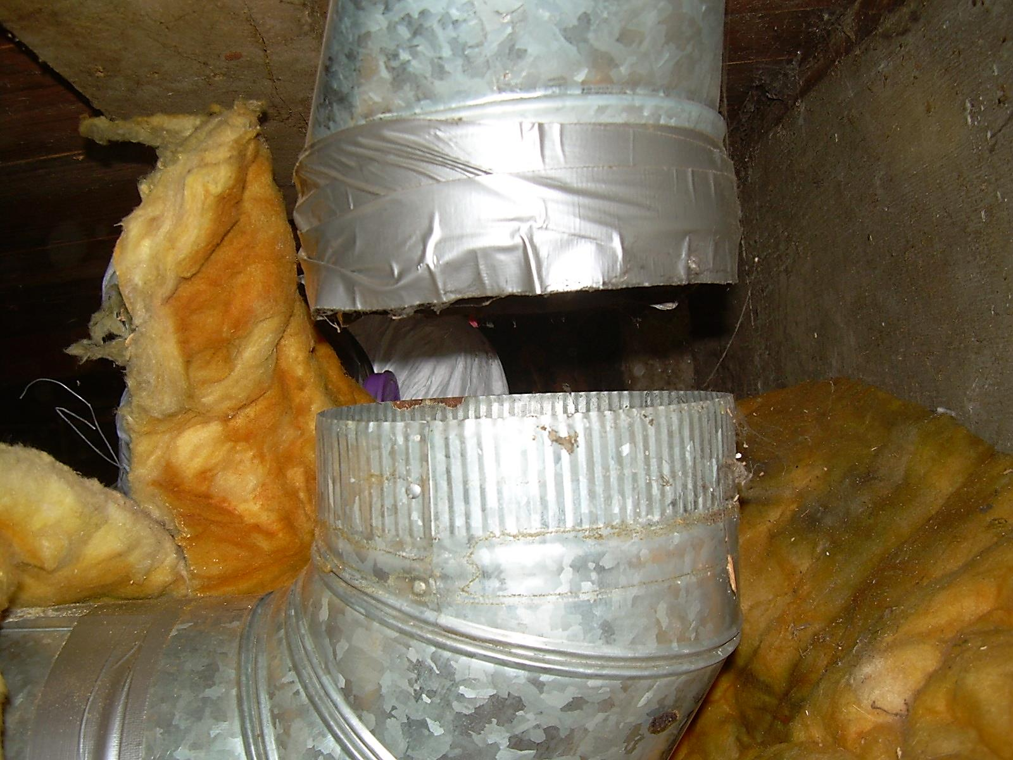
The Bad and the Ugly
Section 1: Introduction

Slide 32
Section 2 of 10:
Manometer & Blower Door

Slide 33
Section 2: Manometer and Blower Door
    Manometer
        Channels
        Manometer Law Expression
    Blower Door
        What It Does and Parts Review
        Blower Door Safety
        Pressure Conversion
        Depressurizing a House
    Off-Site Exercises

Slide 34
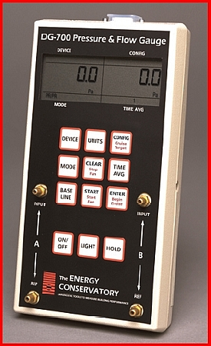
The DIGITAL Manometer
Section 2: Manometer and Blower Door
Input = 1st area
Reference = 2nd area

Slide 35

The Manometer
Section 2: Manometer and Blower Door
The Manometer Law:
____________ with reference to ___________
(WRT)
Input
Reference

Slide 36
The Manometer Law
Section 2: Manometer and Blower Door
The manometer law: simple expression allowing us to keep things straight when taking pressure measurements in a building
___________ with reference to ___________
(WRT)
Hallway
Bedroom
House
Ducts
Outside
House
House
Attic
(Input)
(Reference)

Slide 37
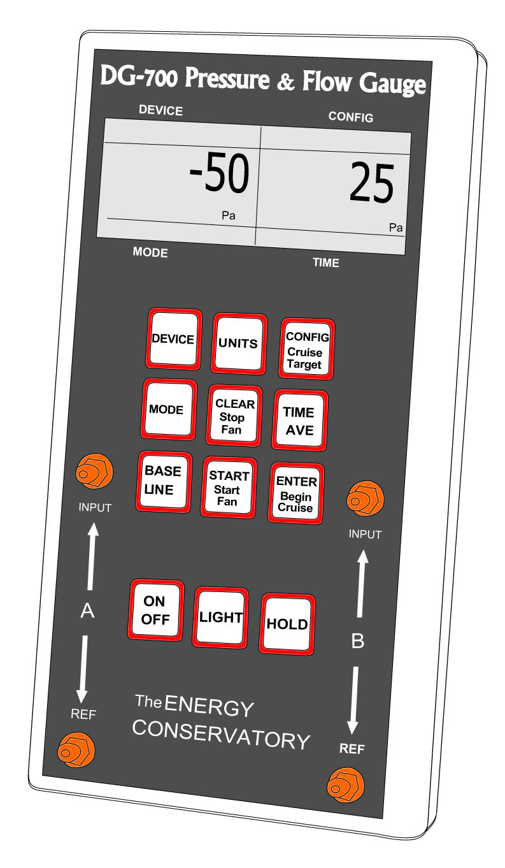
The Manometer
Section 2: Manometer and Blower Door
The DG-700 manometer also has 2 channels:
Channel A
Channel B

Slide 38
The Manometer
Section 2: Manometer and Blower Door
Displays the difference in pressure between the input and the reference.
Does not display the difference in pressure between channels.

Slide 39
Exercise - Manometer Connections
Section 2: Manometer and Blower Door
Draw connections noted on house diagrams on page 26 and 27 of your trainee manual.

Slide 40

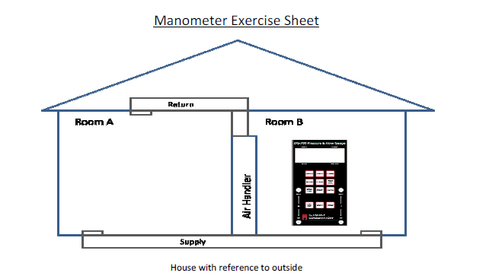
House WRT Outside
Section 2: Manometer and Blower Door
Return
Room A
Room B
Air Handler
Supply

Slide 41
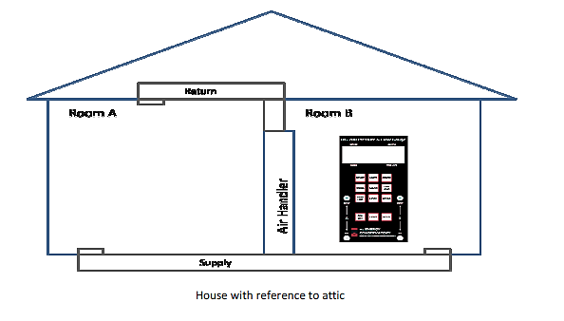
House WRT Attic
Section 2: Manometer and Blower Door
Return
Room A
Room B
Air Handler
Supply

Slide 42
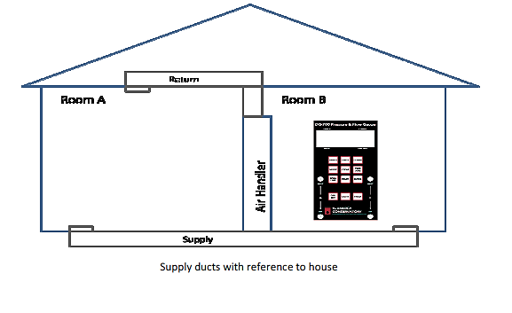
Supply Ducts WRT House
Section 2: Manometer and Blower Door
Return
Room A
Room B
Air Handler
Supply

Slide 43
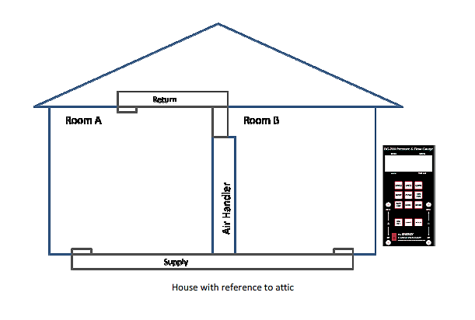
House WRT Attic
Section 2: Manometer and Blower Door
Return
Room A
Room B
Air Handler
Supply

Slide 44
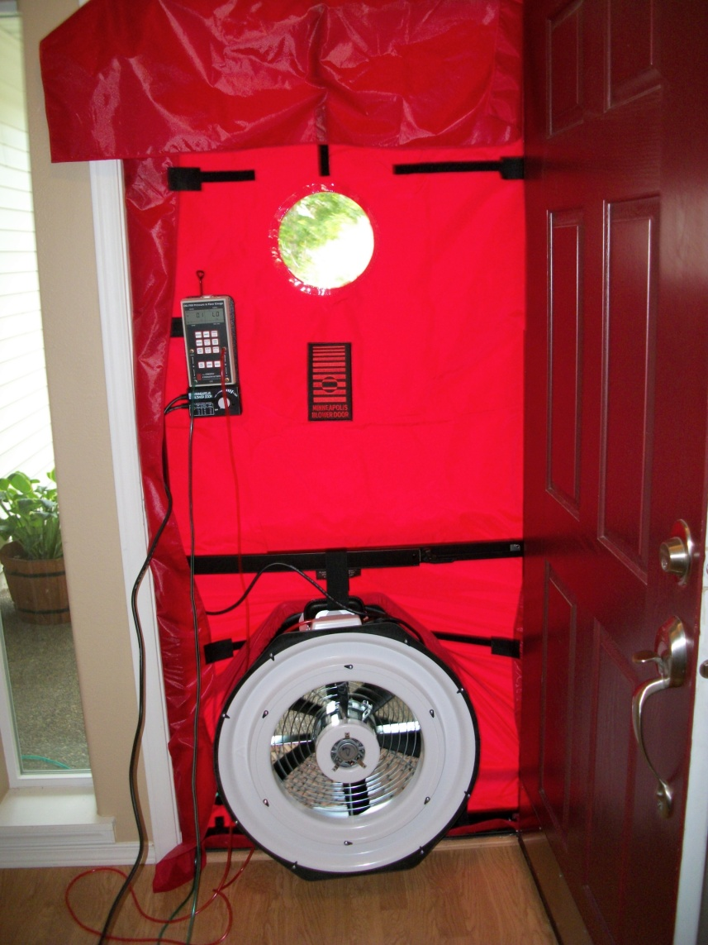
Blower Door: What It Measures
Section 2: Manometer and Blower Door
One tool with many uses…
Measures air leakage rates and identifies air leaks in a building shell
Locates duct leakage
Pressurizes the house during a Leakage to Outside duct test
        Requirement for PTCS program

Slide 45
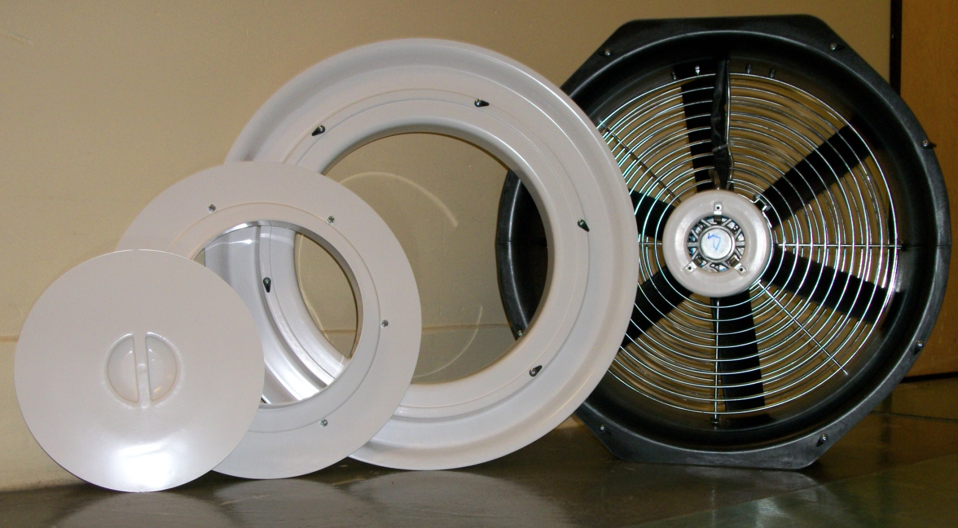
Blower Door Parts: Rings
Section 2: Manometer and Blower Door
Fan (No ring=Open config)
Ring A
Ring B
Fan Cover

Slide 46
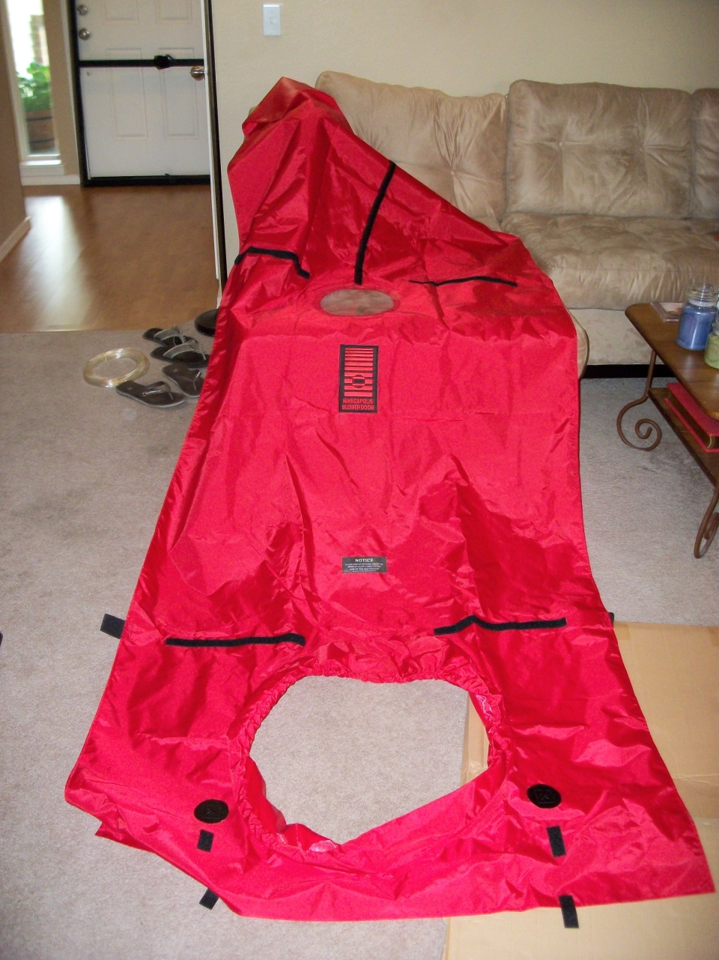
Parts: Nylon Skin
Section 2: Manometer and Blower Door
Fits over metal door frame with Velcro snaps
View Window
Hose Eyelets
Fan Opening

Slide 47
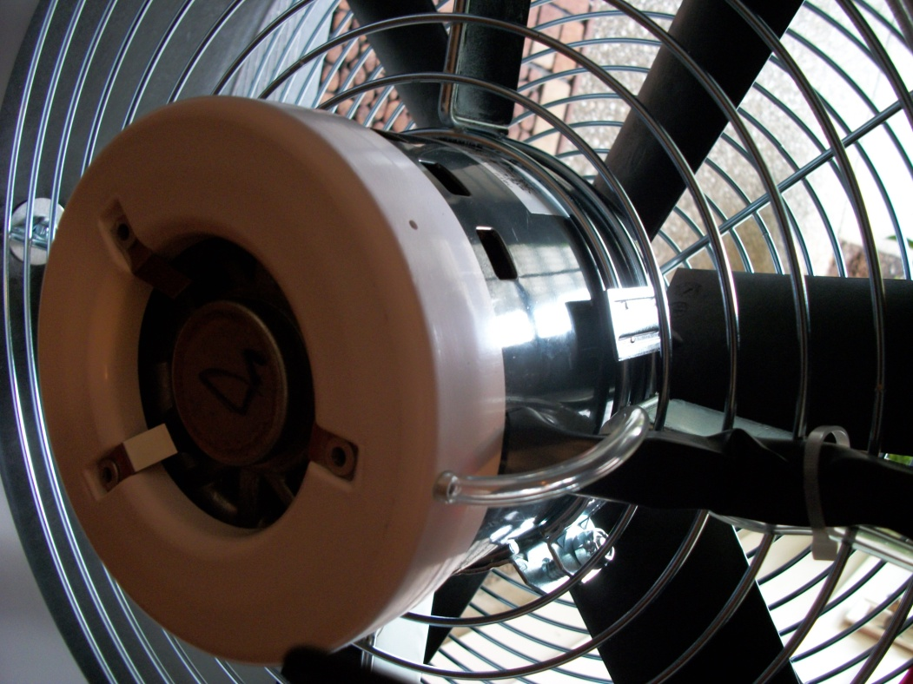
Parts: Pressure Sensor Ring
Section 2: Manometer and Blower Door
Pressure Sensor
Manometer measures pressure difference
Higher pressure drop = More flow
Flow = Pressure X Size of Hole
Notes:
Pressure sensor on back side of fan
Size of hole (ring) is programmed into manometer
With the same configuration (ring size) the higher the pressure, the higher the flow
Pressure x size of hole = flow

Slide 48
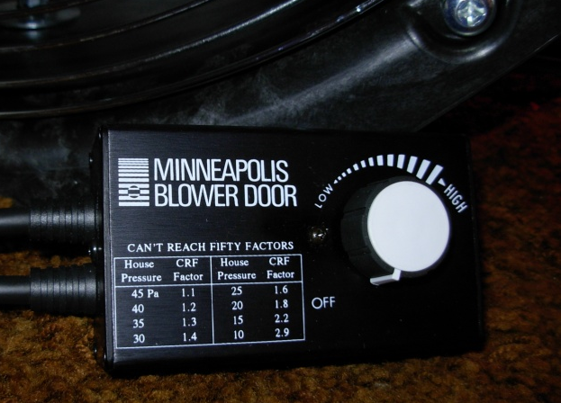
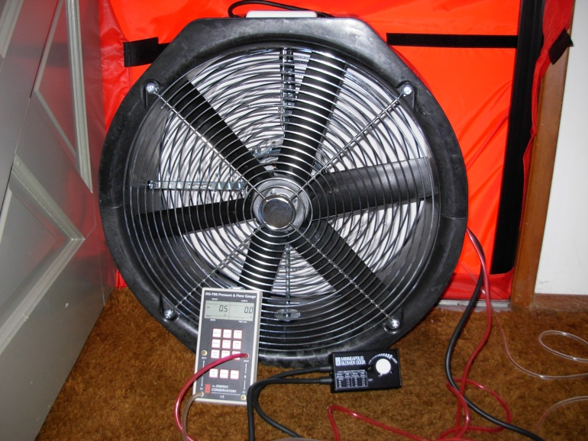
Parts: Blower Door Controller
Section 2: Manometer and Blower Door
Controls fan speed
Turn knob until house pressure is 50 Pa WRT outside
“Can’t Reach Fifty” (CRF) Factors

Slide 49
Flow Range
Section 2: Manometer and Blower Door
Pressure x Hole Size = Flow
Energy Conservatory Blower Door Model 3
Fan Configuration | Flow Range (CFM)
Open Fan | 6,300–2,430
Ring A | 2,800–915
Ring B | 1,100–300
Ring C | 330–85
Larger opening = Greater the flow

Slide 50
Handout: Convert Fan Pressure to CFM
Section 2: Manometer and Blower Door
Blower Door Flow (CFM)
Fan Pressure (Pa) | Open Fan | Ring A | Ring B | Ring C
16 |  |  |  | 89
18 |  |  |  | 94
20 |  |  |  | 99
22 |  |  |  | 104
24 |  |  |  | 109
26 | 2,484 | 931 | 305 | 114
28 | 2,576 | 965 | 316 | 118
30 | 2,664 | 998 | 327 | 122
32 | 2,749 | 1,030 | 338 | 127

Slide 51
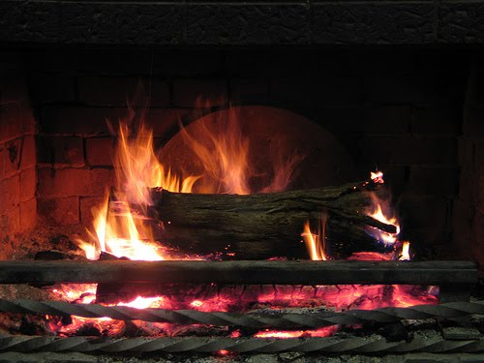
Blower Door Safety
Section 2: Manometer and Blower Door
Do not use the blower door if you see:
  Fire
  Ash
All gas appliances (combustion furnaces and water heaters) must be off (set it to pilot)
Fireplace present: cover ashes with wet newsprint
Shut fireplace damper: if stuck open, cover fireplace
Notes:
Fire: pressurize the home = blast furnace
Ash: depressurize the home = ashes spread

Slide 52
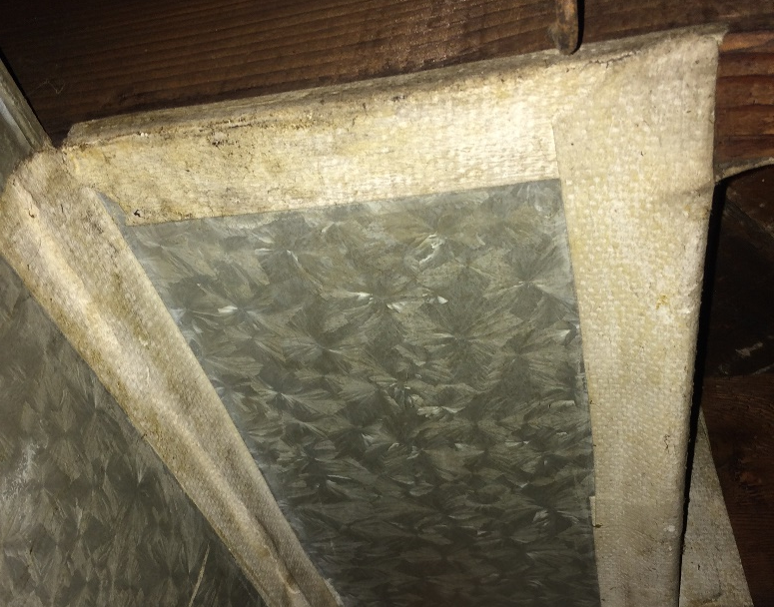
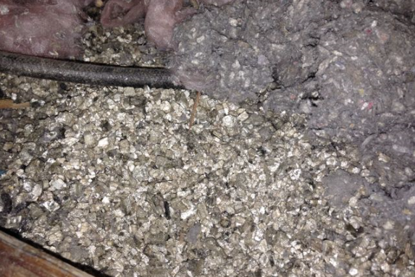
Asbestos
Section 2: Manometer and Blower Door
Do not use the blower door or duct blaster if you see or suspect asbestos containing materials!
  Stop work immediately and notify the homeowner that site requires professional assessment, and possibly remediation, before work or testing can be done

Slide 53
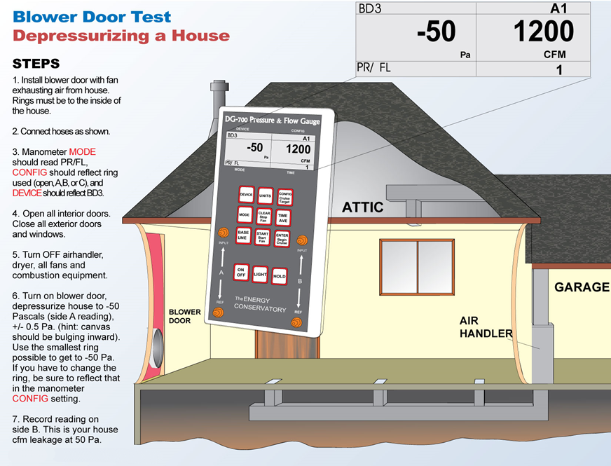
Section 2: Manometer and Blower Door

Slide 54
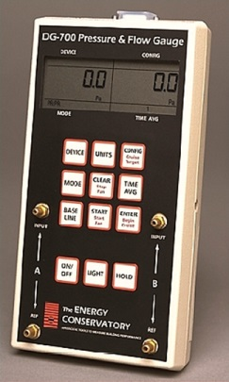
Configuring the Manometer
Section 2: Manometer and Blower Door
House Pressure
Fan Pressure
PR/PR (Pressure/Pressure) Mode
-50.0 Pa House pressure (Channel A)
130.2 Fan pressure (Channel B)
House Pressure
House Flow
PR/ FL (Pressure/Flow) Mode
Blower Door 3 (BD 3)
-50.0 Pa House pressure (Channel A)
2041 CFM House leakage (Channel B)
Ring A (Channel B)
Notes:
Now the manometer can tell us how much air is flowing through the fan at a given time

Slide 55
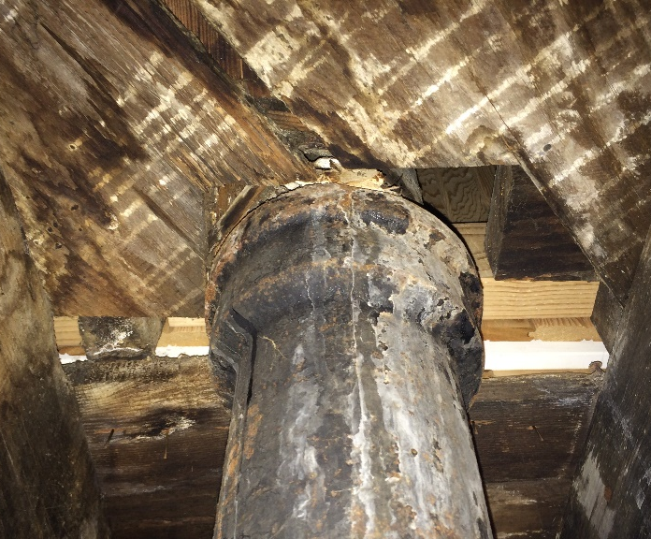
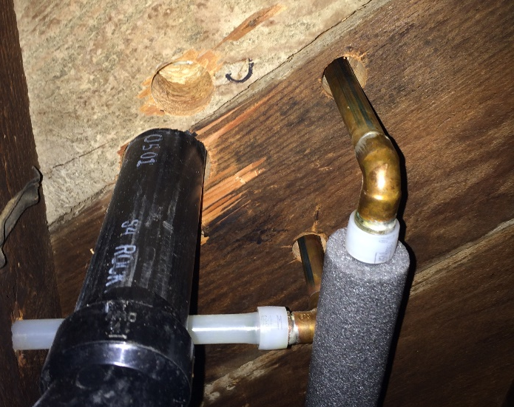
Air Leakage in Homes
Section 2: Manometer and Blower Door
Blower door can help find air leaks, measure air sealing progress, and measure amount of leakage in a home
Find and seal the big holes first, don’t sweat the small stuff
        BIG LEAKS = Holes around plumbing stacks, under bath tubs, and open framing chases leading to attic and crawlspace
        Small Leaks = Caulking around door and windows
        Duct leakage is also a building air leak

Slide 56
Air Leakage in Homes
Section 2: Manometer and Blower Door
Is this house tight or a leaker?
Simple rule of thumb:
        If the CFM 50 < square footage of the home, not too bad
1,800 square foot home
1,550 CFM50
Not bad!
1,100 square foot home
2,140 CFM50
Is there a window open?!
Notes:
Mention air sealing standards and mechanical ventilation needs

Slide 57
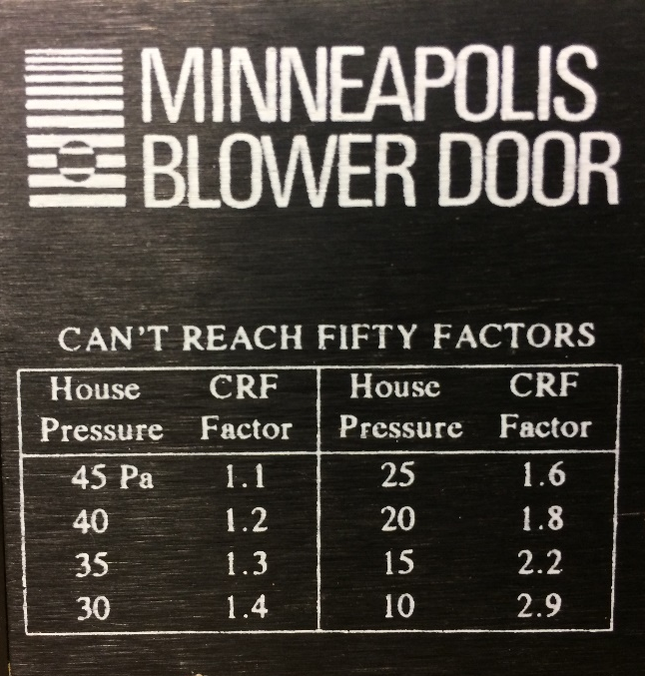
Section 2: Manometer and Blower Door
House Pressure: Can’t Reach 50 Pa
Use the same house pressure for the pre- and post- testing
If the house can only get to 25 Pa:
Test at 25 Pa and multiply the blower door CFM by 1.6.
Can’t Reach Fifty (CRF) Factors
Blower Door # x 1.6 = Blower Door @ 50 Pa

Slide 58
What Did You Learn?
Section 2: Manometer and Blower Door
Is caulking around windows and doors the biggest opportunity for stopping leaks in the building (besides ducts)? How do we know?
    No, leaks through the attic and the floor can be greater.
Is a manometer only useful when used with a Blower Door or Duct Blaster?
    No
Can you feel the pressure of 50 Pascals?
    No
What’s the worst thing that can happen when you do a Blower Door test?
    BURN DOWN THE HOUSE
Is 1000 CFM for a 2,000 sq ft house big or small?
    Small
Notes:
Around 1979, With the help of the blower door, the researchers discovered that hidden leaks accounted for a much greater proportion of air leakage in a home than the more obvious culprits, such as windows, doors, and electrical outlets--a giant leap forward in our understanding of how a house operates (and malfunctions).

Slide 59
Section 3 of 10:
Duct Blaster

Slide 60
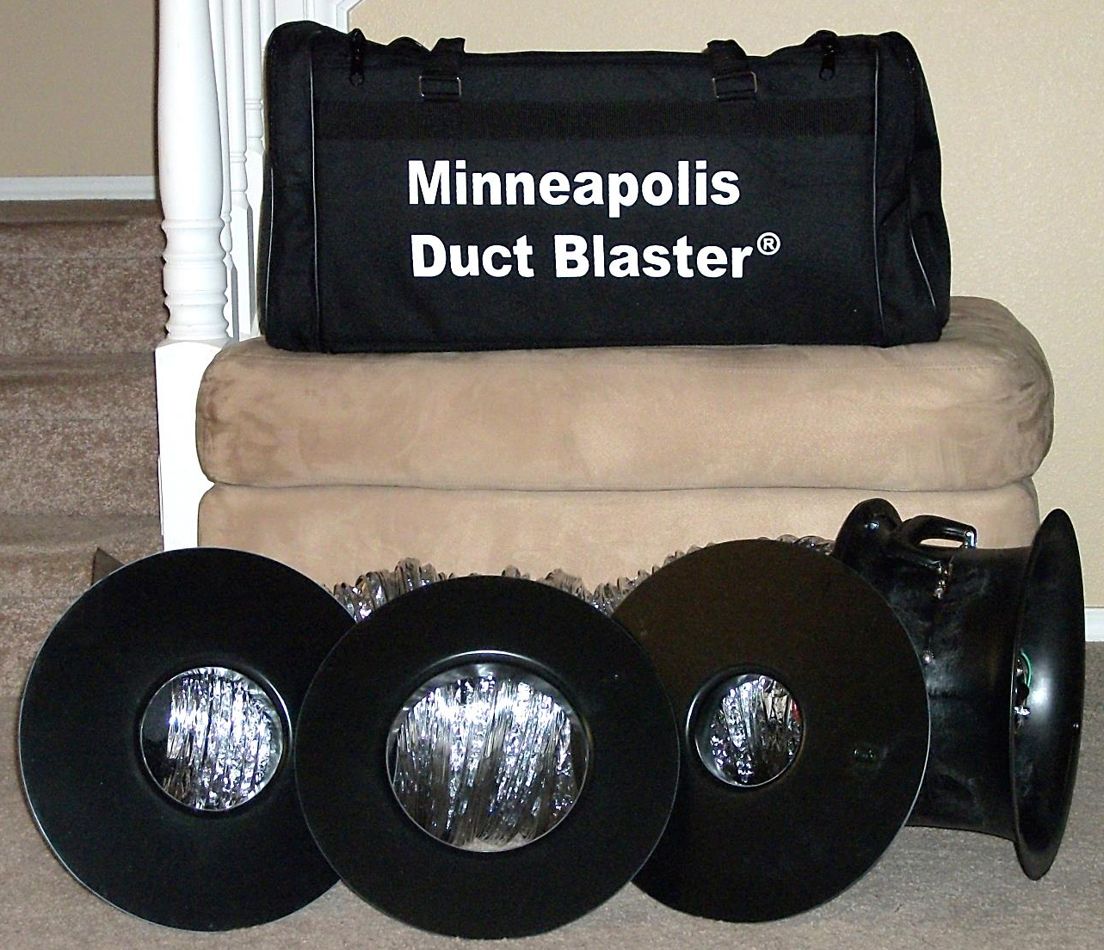
Section 3: Duct Blaster
Section 3: Duct Blaster
    Parts
    Flow
    Ring Capacity
    Set Up
    Measuring and Conversion
    Off-Site Exercises

Slide 61
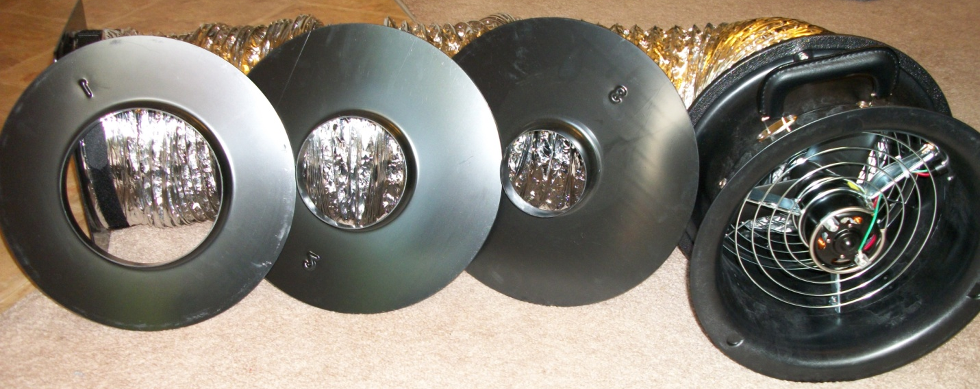
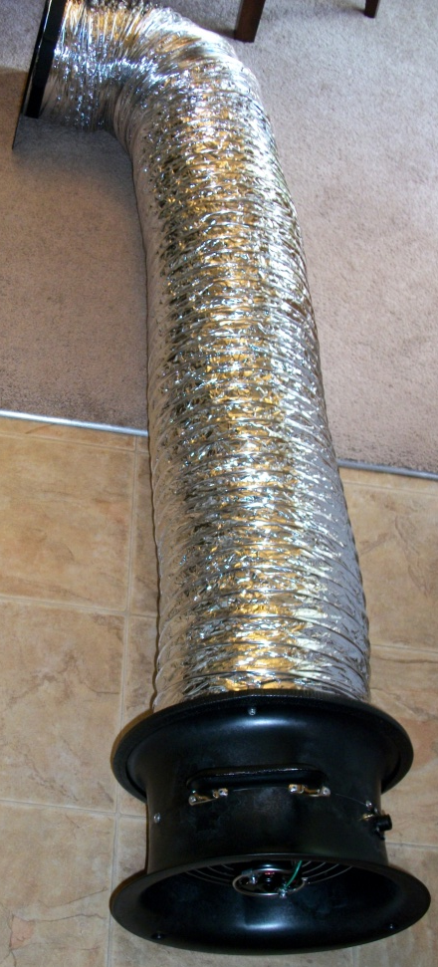
Duct Blaster Parts
Section 3: Duct Blaster
The Snorkel
The Rings
The Fan

Slide 62
Duct Blaster Parts
Section 3: Duct Blaster
Snorkel
Fan Housing
Fan Housing
Mounting Plate

Slide 63
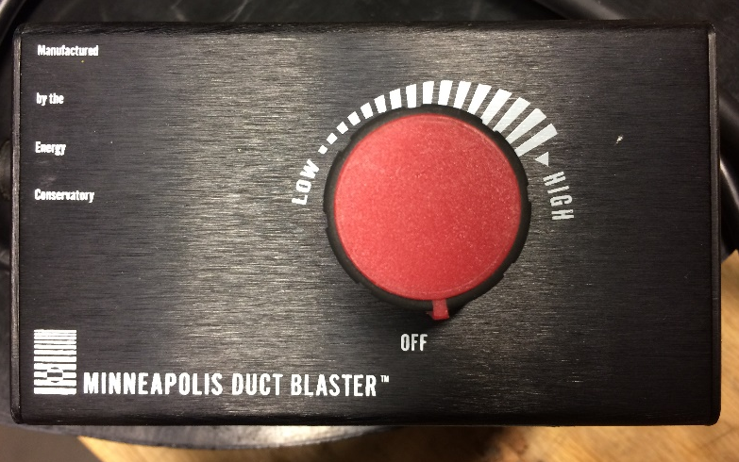
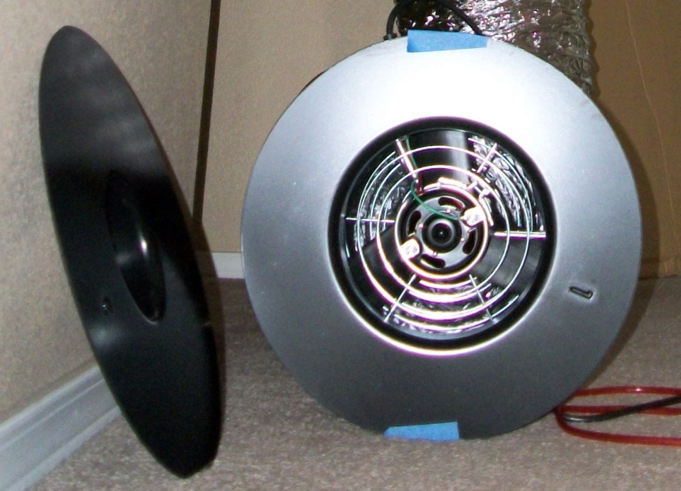
Duct Blaster Parts
Section 3: Duct Blaster
Fan speed controller: Control the pressure
Rings: Changes the size of the hole
Remember….Flow = Pressure x Size of Hole
Notes:
If the fan has to move 500 cfm to maintain 50 Pa, the system has a lot more leaks than if the fan only has to move 100 cfm to maintain 50 Pa.

Slide 64
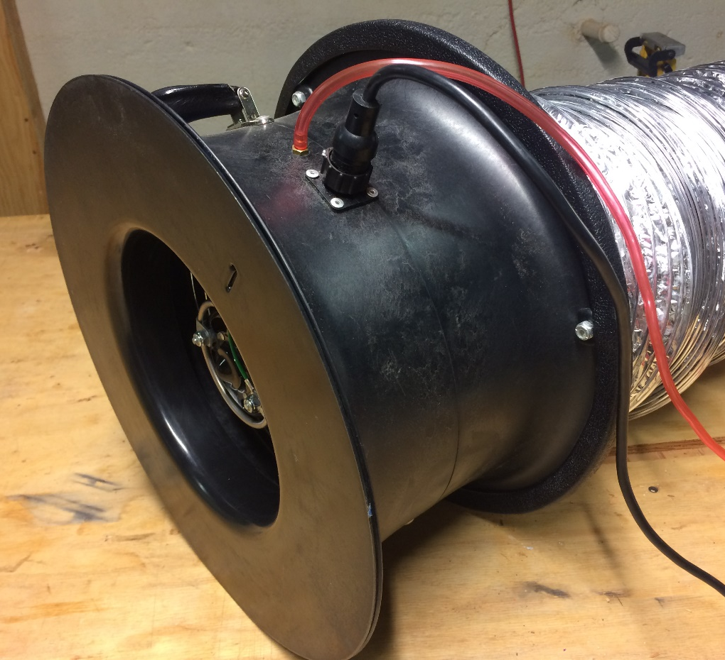
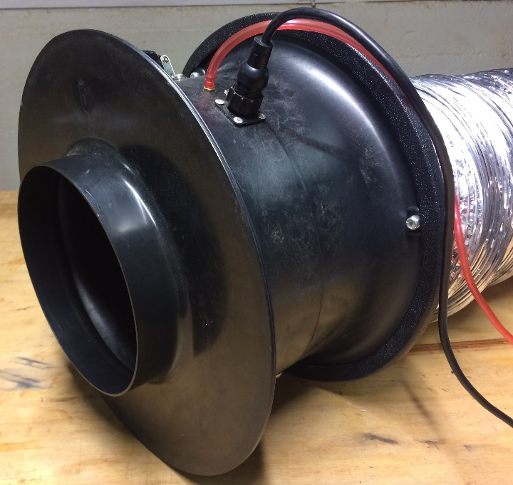
Duct Blaster Parts
Section 3: Duct Blaster
Place rings in the “Innie” position
“Outie”
“Innie”

Slide 65
Ring CFM Capacity
Section 3: Duct Blaster
Fan Configuration Flow Range (CFM) for Series B DB Fan
Open (no Flow Ring) | 1,500–600 CFM
Ring 1 | 800–225 CFM
Ring 2 | 300–90 CFM
Ring 3 | 125–10 CFM

Slide 66

Section 3: Duct Blaster
Preview: Static Pressure Tap

Slide 67

Types of Tests
Section 3: Duct Blaster
Total Duct Leakage
  Only requires using the duct blaster
  Measures leaks of the entire system regardless of being inside conditioned space
  Typically used for new construction or code testing

Slide 68

Types of Tests
Section 3: Duct Blaster
Leakage to Outside
  Requires running the blower door and duct blaster simultaneously
  Only measure leaks outside of conditioned space
  This is the required test for PTCS!

Slide 69
Section 3: Duct Blaster
Total Duct Leakage Test: Steps
Step 1
Step 2
Step 3
Step 4
Step 5
Tape registers
Connect duct blaster to the duct system
Insert static pressure tap in one of the registers
Configure manometer to read CFM AND pressures (Mode, Device, Configuration buttons)
Connect hose from register to manometer, and fan pressure fitting to the manometer

Slide 70



Section 3: Duct Blaster
Tape the Registers
Finding them is often the hardest part!

Slide 71

Attaching to the Return Grille
Section 3: Duct Blaster
Step 1
Step 2
Step 3

Slide 72

Attaching to the Air Handler
Section 3: Duct Blaster
Step 1
Step 2
Step 3

Slide 73

Direct Attachment to the Air Handler
Section 3: Duct Blaster

Slide 74


The Duct Blaster Connections
Section 3: Duct Blaster
Fan Pressure Tap
Electrical Connection
Notes:
Clarify the unique plugs for the line voltage. Can’t interchange with blower door controller

Slide 75

Pressurizing Ducts: Duct Leakage Test
Section 3: Duct Blaster
Duct blaster blows air into duct system (increases pressure)
Air blows out the leaks in the system (registers are blocked)
Air blowing in has to be blowing out (leaks)
Grill covered with clear tape!
Notes:
By blowing air into the duct system with the registers sealed off we increase the pressure in it.
Since we know how big the ‘hole’ is (ring on duct blaster); and we know what the pressure difference is on either side of the fan, we can determine how much air is flowing.

Slide 76


Pressurizing the Ducts
Section 3: Duct Blaster
Manometer ‘knows’ size of hole (ring) and pressure difference.
Flow = Pressure x Size of Hole
Notes:
By blowing air into the duct system with the registers sealed off we increase the pressure in it.
Since we know how big the ‘hole’ is (ring on duct blaster); and we know what the pressure difference is on either side of the fan, we can determine how much air is flowing

Slide 77

The Set Up
Section 3: Duct Blaster
Side A: measures duct pressure
Side B: measures fan pressure and calculates flow reflected as CFM

Slide 78
Section 3: Duct Blaster
Total Duct Leakage Test: Set Up
Diagram included in training packet and in Appendix C of the PTCS Duct Sealing Specification

Slide 79

Configuring the Manometer
Section 3: Duct Blaster
MODE
  Tells manometer what measurements to display
  (e.g. pressure or flow)
DEVICE
CONFIG
DEVICE
  Tells manometer what equipment is being used
DEVICE
CONFIG
MODE
MODE
CONFIG
  Tells manometer what the equipment configuration is
  (ring number)
Notes:
Cycle through the different modes
To help tech’s remember the 3 buttons they need to use, use the phrase “More Darn Calculations” MDC

Slide 80
Configuring the Manometer - MODE
Tell it what you want to read
Section 3: Duct Blaster
MODE
PR/PR
Measures pressure difference between “input” and reference on both channels A and B
PR/FL
Measures amount pressure recorded (channel A) and amount of air flowing through device (channel B)
PR/FL50
Calculates amount of air flow through device on channel B if pressure on channel A was 50Pa (for homes only)
PR/FL@25
Calculates amount of air flow through device on channel B if pressure on channel A was 25 Pa (for ducts)
Notes:
PF Fl 50 is for homes
FR Fl 25 is for ducts

Slide 81
Configuring the Manometer - DEVICE
Tell it what you’re connected to
Section 3: Duct Blaster
DEVICE
BD3
Blower Door Model 3
DB A
Duct Blaster Model A (White Fan)
DB B
Duct Blaster Model B (Black Fan)
TF, EXH,
BD4, etc.
TrueFlow Plate and other Energy Conservatory Equipment.

Slide 82
Configuring the Manometer - CONFIG
Tell it how big the hole is (what ring)
Section 3: Duct Blaster
CONFIG
Open
Open fan, no ring attached
A1
Ring A (Blower door);
Ring 1 (Duct Blaster)
B2
Ring B (Blower Door);
Ring 2 (Duct Blaster)
C3
Ring C (Blower Door);
Ring 3 (Duct Blaster)

Slide 83
Configuring the Manometer
Section 3: Duct Blaster
Duct Pressure
Fan Pressure
PR/PR (Pressure/Pressure) Mode
50.0 Pa Duct pressure (Channel A)
180.3 Fan pressure (Channel B)
Duct Pressure
Duct Flow
PR/ FL (Pressure/Flow) Mode
Duct blaster B (DB B)
50.0 Pa Duct pressure (Channel A)
212 CFM Duct leakage (Channel B)
Ring 2 (Channel B)
What does the beeping sound mean?
Notes:
Now the manometer can tell us how much air is flowing through the fan at a given time

Slide 84

Convert Fan Pressure to CFM
Section 3: Duct Blaster
Minneapolis Duct Blaster (Series B): Flow Conversion Table

Slide 85

Section 3: Duct Blaster
Duct Pressure: Can’t Reach 50 Pa
Use the same duct pressure for the pre and post testing
If the ducts can only get to 25 Pa:
Test at 25 Pa and multiply the duct leakage CFM by 1.6.
Can’t Reach Fifty (CRF) Factors
Duct Blaster # x 1.6 = Duct Leakage @ 50 Pa

Slide 86
Testing at 50Pa versus 25Pa
Section 3: Duct Blaster
Duct Pressure
Fan Pressure
PTCS requires testing ducts at 50 Pa test pressure
  Unless the ducts or house won’t reach pressure, then use a correction factor
Many other organizations test at 25 Pa
  WA, MT, ID state energy code
  RESNET, ENERGY STAR® Homes
Duct Pressure
Duct Flow

Slide 87
What did you learn?
Section 3: Duct Blaster
Are the rings supposed to be put on the fan in the Innie position or Outie position?
    Innie
How do you know which ring to use?
    Start with middle size. If you can’t get to 50 Pa, put on a bigger one.
Can the Manometer inform the tester of all of these items at one time? Fan Pressure, Duct Pressure and Fan CFM.
    In configuring, you choose fan Pressure OR Fan CFM
In configuring the manometer, what three buttons do you need to use (remember M,D,C)?
    More Darn Calculations
If you seal the ducts and you reduce the duct leakage to the outside by 300 CFM, how much would you reduce the house leakage by?
    300 CFM
Notes:
Note the phrase on how to remember MDC in question 4

Slide 88
Section 4 of 10:
Duct Leakage
to Outside

Slide 89
Section 4: Duct Leakage to Outside
Section 4: Duct Leakage to Outside
How to measure the leaks that cause wasted energy leakage to outside
  Ducts on Inside
  Pre-Leakage Requirements
  Really Leaky Systems
  Testing Set-Up

Slide 90

Section 4: Duct Leakage to Outside
Leakage to Outside
Not for PTCS
Total Leakage
  Only use duct blaster
Leakage to outside
  Use duct blaster and blower door
    Won’t let duct leaks go back into house; only measures outside duct leaks
Pressurizing the house to 50 Pa stops the leaks that are inside the house
Notes:
Water pipe and pool of water analogy

Slide 91

Ducts on the Inside
Section 4: Duct Leakage to Outside
Notes:
This is new construction, but used to demonstrate “ducts inside”

Slide 92

Section 4: Duct Leakage to Outside
Ducts Sealing in Basements
May improve comfort
May be critical in avoiding back drafting
Energy savings of less than 2%
Duct sealing in basements not eligible. However, vented crawlspaces, attics with floor insulation, and unheated garages considered unconditioned space.

Slide 93

Diagram included in training packet and in Appendix A of the PTCS Duct Sealing Specification

Slide 94
Configuring the Manometer(s)
Section 4: Duct Leakage to Outside
Blower Door Manometer
House Pressure
Fan Pressure
PR/PR (Pressure/Pressure) Mode
50.0 Pa House pressure (Channel A)
No Fan pressure connection needed (Channel B)
Notes:
Now the manometer can tell us how much air is flowing through the fan at a given time

Slide 95

Diagram included in training packet and in Appendix A of the PTCS Duct Sealing Specification
Notes:
Mention what needs to be done if testing on the air handler in the garage – add another tube to ref tap on channel A and run into house.

Slide 96
Configuring the Manometer(s)
Section 4: Duct Leakage to Outside
Duct Blaster Manometer
Duct Pressure
Fan Pressure
PR/PR (Pressure/Pressure) Mode
0.0 Pa Duct pressure (Channel A)
172.4 Fan pressure (Channel B)
Duct Pressure
Duct Flow
PR/ FL (Pressure/Flow) Mode
Duct blaster B (DB B)
0.0 Pa Duct pressure (Channel A)
82 CFM Duct leakage (Channel B)
Ring 3 (Channel B)
Notes:
Now the manometer can tell us how much air is flowing through the fan at a given time

Slide 97
Section 4: Duct Leakage to Outside
House or Ducts Can’t Reach Pressure
Use the same test pressure for the pre and post testing
If the house OR ducts can only get to 25Pa:
Test at 25 Pa and multiply the duct leakage CFM by 1.6.
Can’t Reach Fifty (CRF) Factors
Duct Blaster # x 1.6 = Duct Leakage @ 50 Pa

Slide 98
Equipment Tip!
Section 3: Duct Blaster
Fan Pressure ≠ House Pressure
Don’t confuse duct blaster fan pressure with blower door house pressure
Blower door house pressure will always be +50 Pa WRT outside unless using CRF factors
Duct blaster fan pressure displayed on manometer channel B when in PR/PR mode

Slide 99
Leakage Requirements: Single Family Homes
Section 4: Duct Leakage to Outside
Qualifying Pre-Sealing Leakage
Pre-Test Leakage Requirements
Home more than 1667 sq. ft. | Equal to or greater than 250 CFM
Home less than 1667 sq. ft. | Equal to or greater than 15% of home sq. ft.
Post-Sealing Leakage Preview (meet one of the following after sealing):
  CFM equal to or greater than a 50% reduction OR
  CFM equal to or less than 10% of home’s sq. ft.
* Prescriptive Duct Sealing does not have a pre-test leakage requirement

Slide 100
Leakage Requirements: Manufactured Homes
Section 4: Duct Leakage to Outside
Qualifying Pre-Sealing Leakage
Pre-Test Leakage Requirements
Single wide | Equal to or Greater than 100 CFM
Double wide | Equal to or Greater than 150 CFM
Triple wide | Equal to or Greater than 225 CFM
Post-Sealing Leakage Preview (meet one of the following after sealing):
  Single wide: Equal to or Less than 50 CFM
  Double wide: Equal to or Less than 80 CFM
  Triple wide: Equal to or Less than 110 CFM
  OR Equal to or Less than a 50% Reduction
Prescriptive Duct Sealing does not have a pre-test leakage requirement

Slide 101
Example: Pre-Test Leakage, Site Built Home
Section 4: Duct Leakage to Outside
  2,000 sq. ft. home
  Home Pressure: 50 Pa to outside
  Pre-test leakage: 354 CFM
Home is greater than 1,667 sq. ft., so pre-test leakage must be greater than or equal to 250 CFM
This home’s pre-sealing leakage qualifies!

Slide 102


Recording Results – Paper Form
Section 4: Duct Leakage to Outside

Slide 103


Recording Results – Mobile Entry
Section 4: Duct Leakage to Outside

Slide 104

Really Leaky Duct Systems
Section 4: Duct Leakage to Outside
Catastrophically leaky return?
In cases where return ducts are non-existent, panned joists, or inaccessible, a supply side only test may be used to determine the duct leakage
Set up duct blaster on a supply register
Block off return at the air handler
  Contractor bag over filter
  Corrugated board in place of filter
Place pressure tap at far end of supply
Notes:
Be extra careful, and realize different people might get very different results on these types of homes.

Slide 105

Section 4: Duct Leakage to Outside
Supply Side Only Test
Conduct a Supply Side Only Test AFTER verifying returns like these:

Slide 106
Poor Connections
Section 4: Duct Leakage to Outside

Slide 107


Slide 108


Toe Kicks: Beware!
Section 4: Duct Leakage to Outside
Notes:
Discuss toe kicks and impacts to testing

Slide 109

Toe Kicks: Beware!
Section 4: Duct Leakage to Outside
Tape at the floor, not at the door!
Notes:
Or maybe don’t tape at all!

Slide 110


Section 4: Duct Leakage to Outside
Measuring Duct or Shell Leakage?
Foam Blocks will result in a lower leakage rate than taping over the register

Slide 111
Foam Blocks vs Tape
Section 4: Duct Leakage to Outside
If gaps exist between the boot and the floor or ceiling…
Taping over the register | Foam Block
Duct blaster will “see” the gaps | Will seal duct and not show leakage at gaps

Slide 112
Static Pressure Tap Location
Section 4: Duct Leakage to Outside
Pressure can vary by as much as 100 Pa depending on where you measure it.
Check if pressure tap is at a representative position!
  “Devices” (e.g., coils coupled with leaky duct systems) can cause big pressure drops.
  Cavity returns or returns with big holes: where pressure tap is placed can have a HUGE effect! Better to just test the supply side.
  Register with a loose duct run will record a very different pressure than one connected firmly.

Slide 113


Slide 114


Minimizing Differences in Tests
Section 4: Duct Leakage to Outside
Document on form where duct blaster and pressure tap are installed!

Slide 115

Number One Piece of Advice
Section 4: Duct Leakage to Outside

Slide 116
Section 4: Duct Leakage to Outside
Repeatable Testing: Careful Setup
Best locations to connect fan to: Main return or air handler cabinet
Don’t miss registers (tape carefully for testing)
Foam blocks result in lower leakage than taping the register
Cavity Returns: better to just test the supply side
“Devices” (e.g., coils) with leaky duct systems can cause pressure drops
One or both sides very leaky? Consider a split system result. Block off one side of system at air handler and test side of interest.
Very leaky systems = Very different results
Everybody test the same way
Notes:
Everybody test the same way (note how registers blocked and position to pressure tap)

Slide 117

Sensor Sensitivity
Section 4: Duct Leakage to Outside
Check Sensor Ring for plugging (especially for a fog test)
Check the hose connecting the pressure tap to the sensor ring
Notes:
Check for cracks

Slide 118

Anyone using Aeroseal?
Section 4: Duct Leakage to Outside
Aeroseal is approved for use with PTCS with a few exceptions:
  Add a note upon Registry entry
  Pre-test and post-test MUST satisfy program requirements
  Both supply and return side must be sealed
  All other specifications required including duct repair, tape removal and duct support

Slide 119

Section 4: Duct Leakage to Outside
New Puppy, Old Hose
Good idea to check hoses frequently
Age
Prolonged crimping
Tool nicks

Slide 120
Exercise: Duct Leakage to Outside
Section 4: Duct Leakage to Outside
Draw connections between equipment and house on diagrams on page 28 of your trainee manual.
Notes:
Create two exercise diagrams. One has a drawing of the house, BD, BD, and 2 manometers. You have to draw lines where the tubes go. The second one is the same as the first except the DB is set up in the garage with manometer in the garage.

Slide 121

Exercise: Duct Leakage to Outside
Section 4: Duct Leakage to Outside

Slide 122

Exercise: Duct Leakage to Outside
Section 4: Duct Leakage to Outside

Slide 123
What did you learn?
Section 4: Duct Leakage to Outside
Are leaks in ductwork that is located within the house (in conditioned spaces) an energy waster?
  No
Do ducts that are insulated still need to be sealed?
  Yes
Can you do a leakage to outside test with a Blower Door only?
  No
What pressure are the ducts and what pressure is the house (both WRT outside) when you do a leakage to outside test?
  Positive 50 Pa

