Slide 1

Section 5 of 10:
Diagnosis &
Planning

Slide 2

Section 5: Diagnosis and Planning
Section 5: Diagnosis and Planning
Initial Inspection
Plan of Action
Is Duct Sealing Enough?

Slide 3


Inspect Before You Test
Section 5: Diagnosis and Planning
The occupants—do ask and do tell
Four of your five senses: eyes, ears, nose and sense of touch

Slide 4

General Advice!
Section 5: Diagnosis and Planning
Keep an open mind: observations and testing lead to conclusions
Diagnosing is like solving a murder mystery: likelihood of a conspiracy of suspects
Gather all the facts before jumping to conclusions

Slide 5

Purposes of the Initial Inspection
Section 5: Diagnosis and Planning
Find the major problems
Decide if duct sealing is enough
Decide if part or the whole duct system needs replacing
Decide what further tests need to be done

Slide 6

Questions for Occupant
Section 5: Diagnosis and Planning
Do you have rooms that are too cold in winter and/or too hot in summer?
  May help find duct disconnects and/or proof of poor duct design
Do you pay high energy bills?
  Gives you a sense of occupants’ frustration levels and their energy use. If you are familiar with typical energy use in your area, looking at their bills can give you a wealth of information.

Slide 7
Questions for Occupant
Section 5: Diagnosis and Planning
Do you notice any unusual smells when the air handler turns on?
  Smells such as creosote, eau de crawlspace, or garage odors can give you solid clues concerning disconnected ducts.
Do you notice insulation on your furnace filter?
  Insulation on the furnace filter is another good indicator of serious duct problems in the attic.

Slide 8
Conducting the Visual Inspection
Section 5: Diagnosis and Planning
Really obvious or DUH (dumb, unbelievably humbling) tests inside the house
  Does air come out of all the registers?
    If not, dampers may be shut, but it might also be due to disconnects.
  When you remove the register or grille, do you see duct work? Or do you see the crawlspace, the attic or the neighbor’s cat?

Slide 9
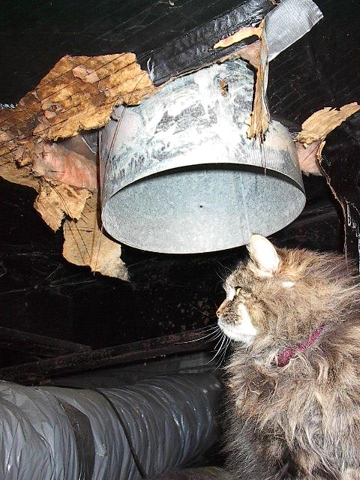
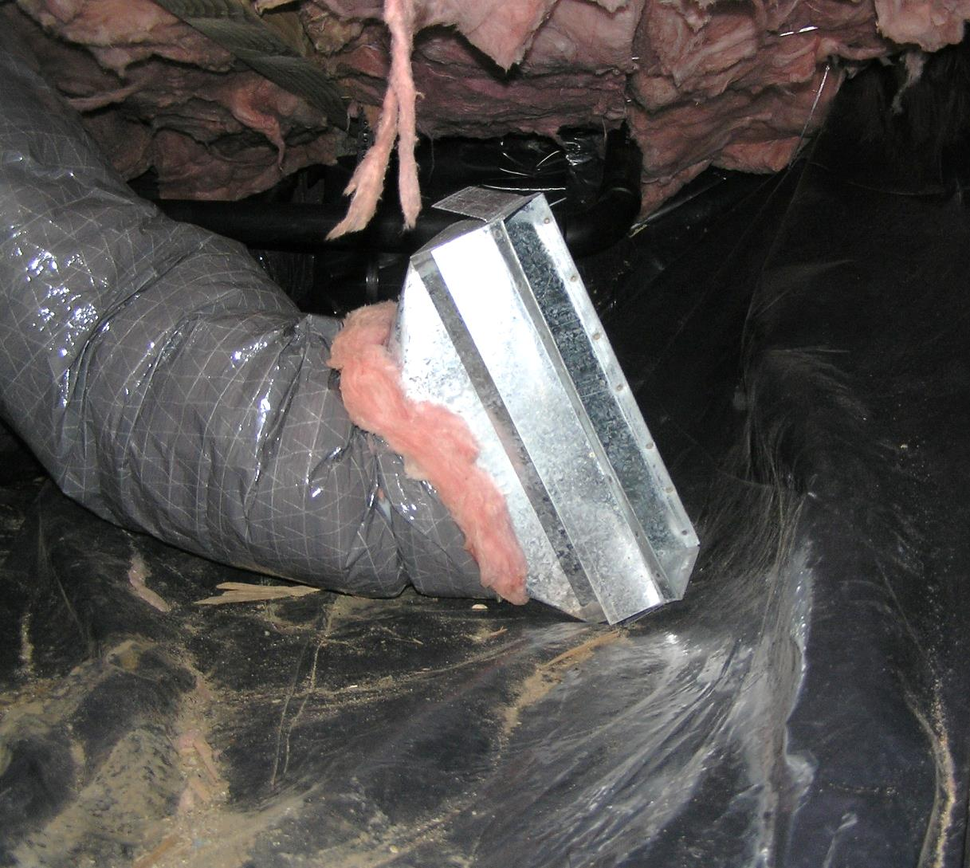
The Never Connected and the Disconnected
Section 5: Diagnosis and Planning

Slide 10
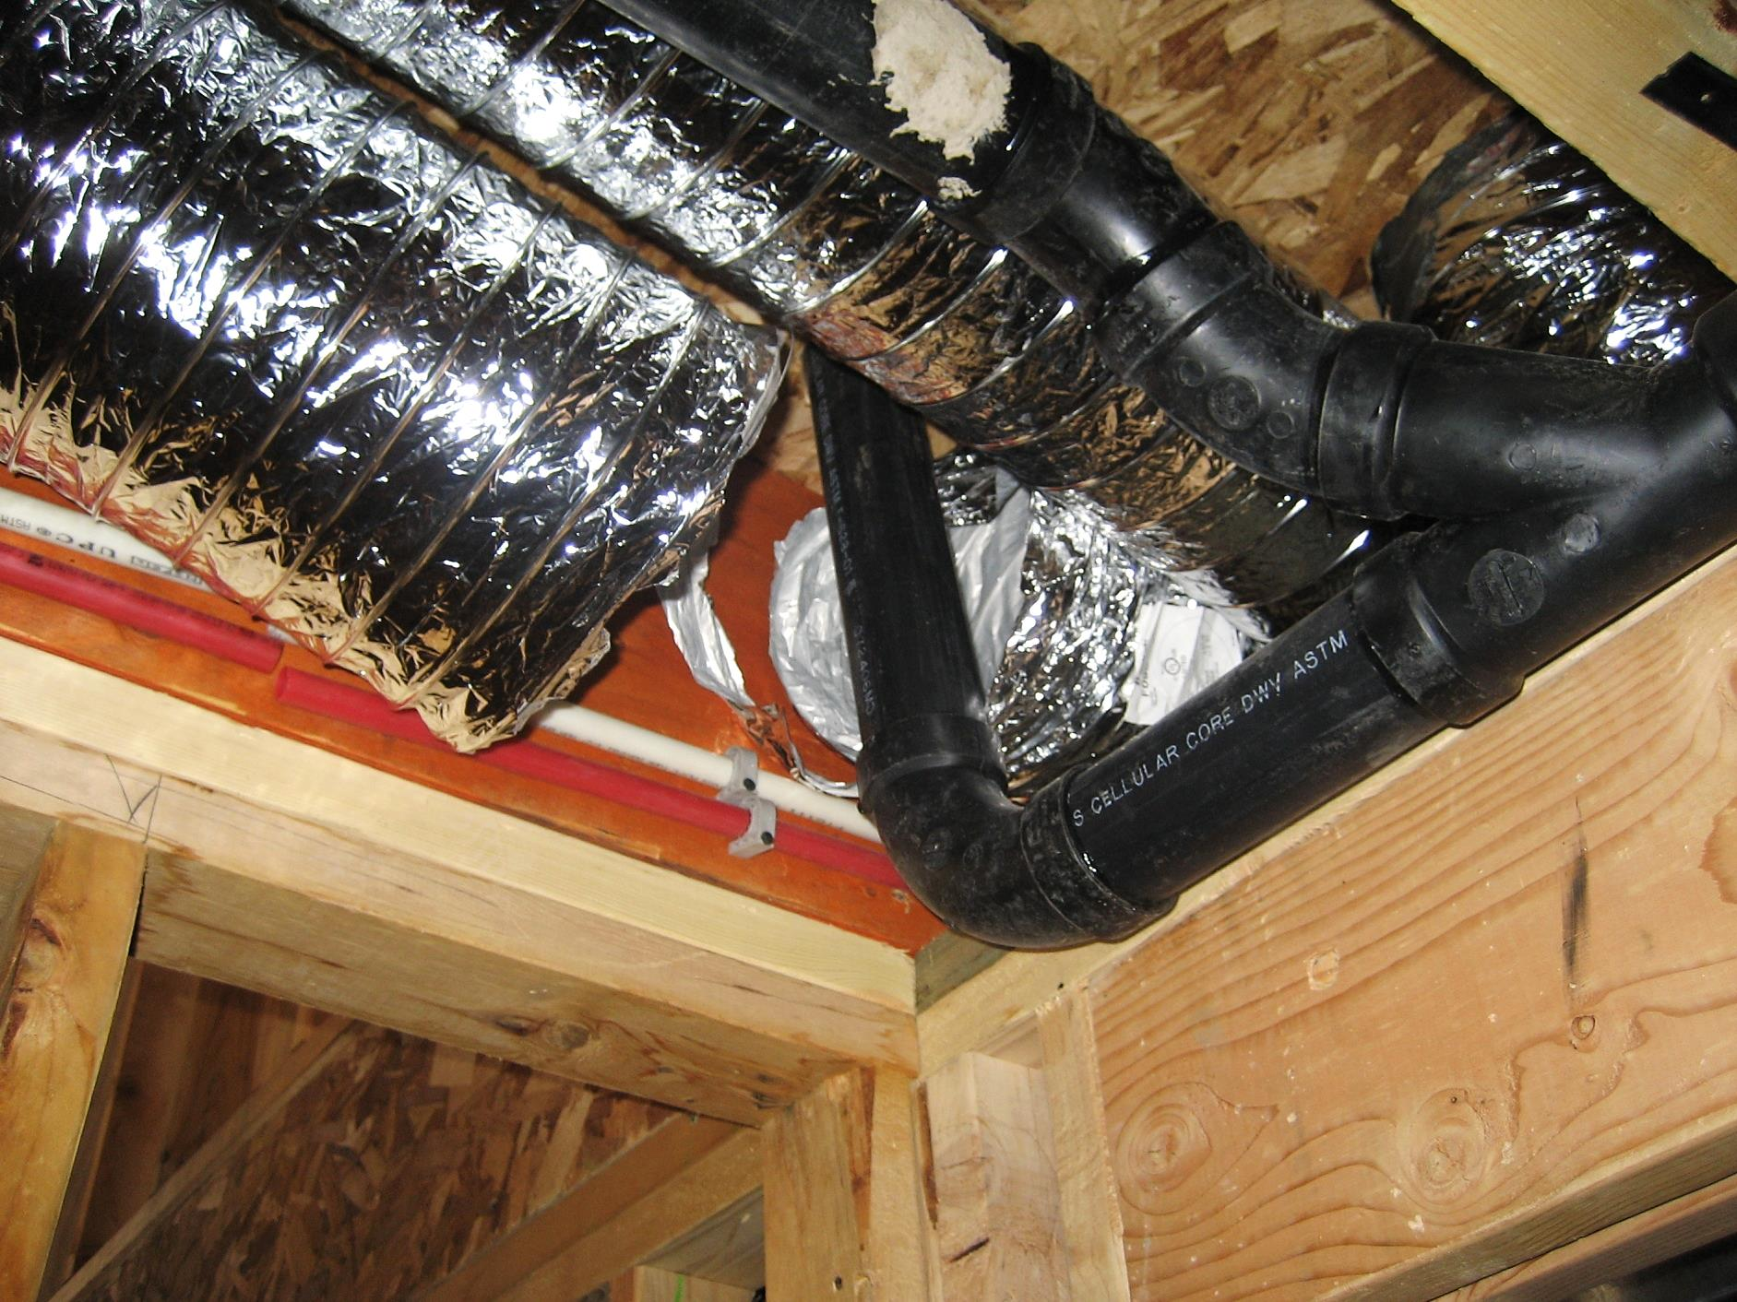
Section 5: Diagnosis and Planning

Slide 11
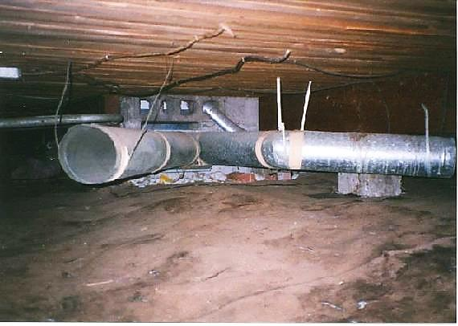
Look for BIG Leaks
Section 5: Diagnosis and Planning
Disconnects or “never connects” are more common than expected.

Slide 12
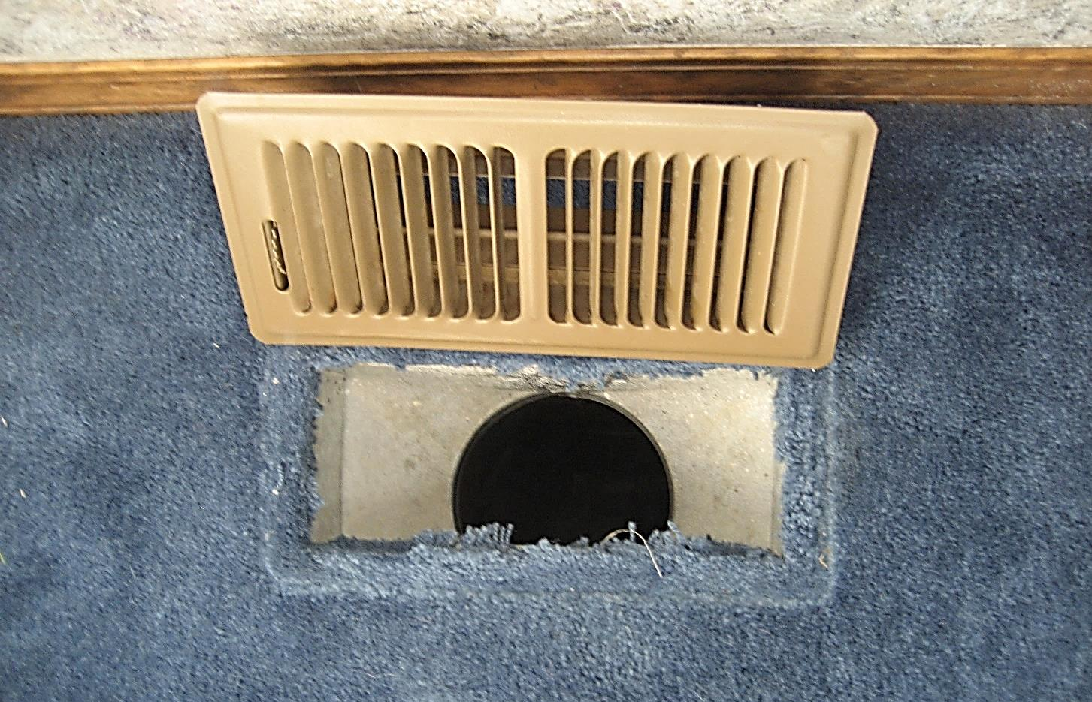
Look in the Duct System’s Access Points
Section 5: Diagnosis and Planning

Slide 13
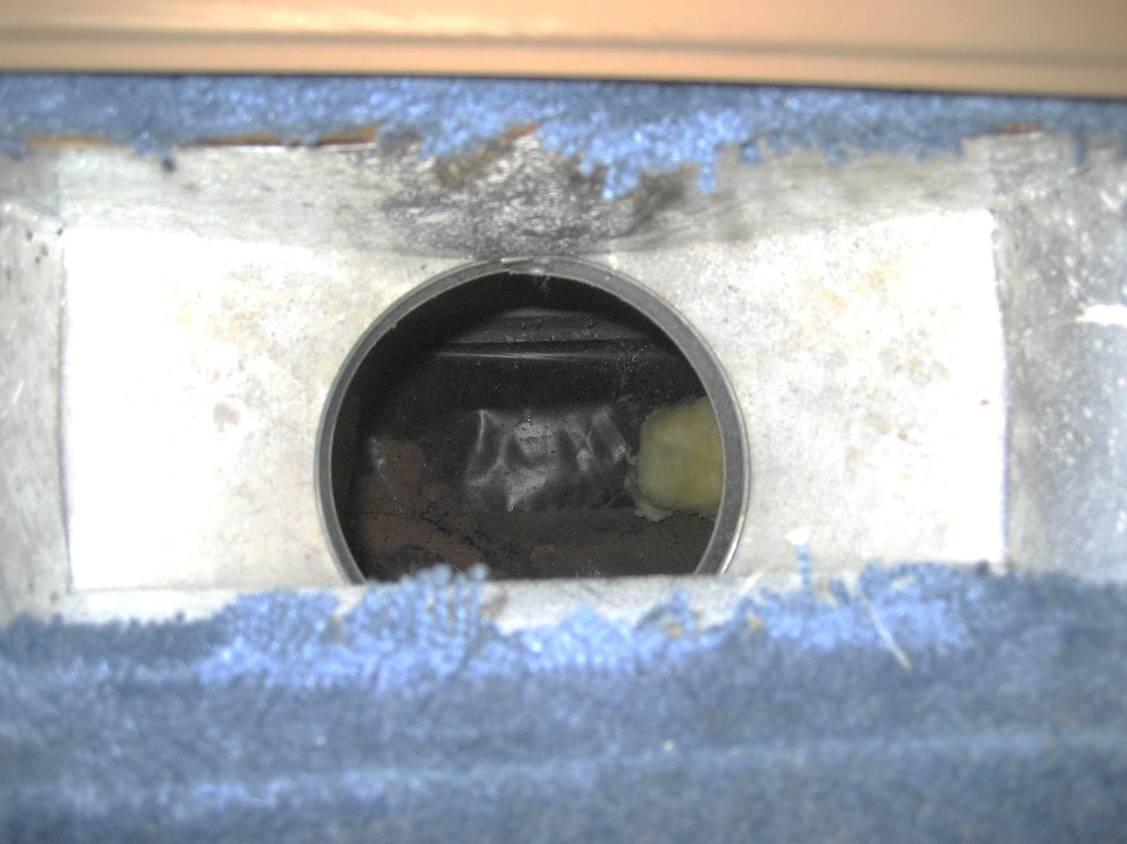
Do You See the Duct or the Dirt?
Section 5: Diagnosis and Planning

Slide 14
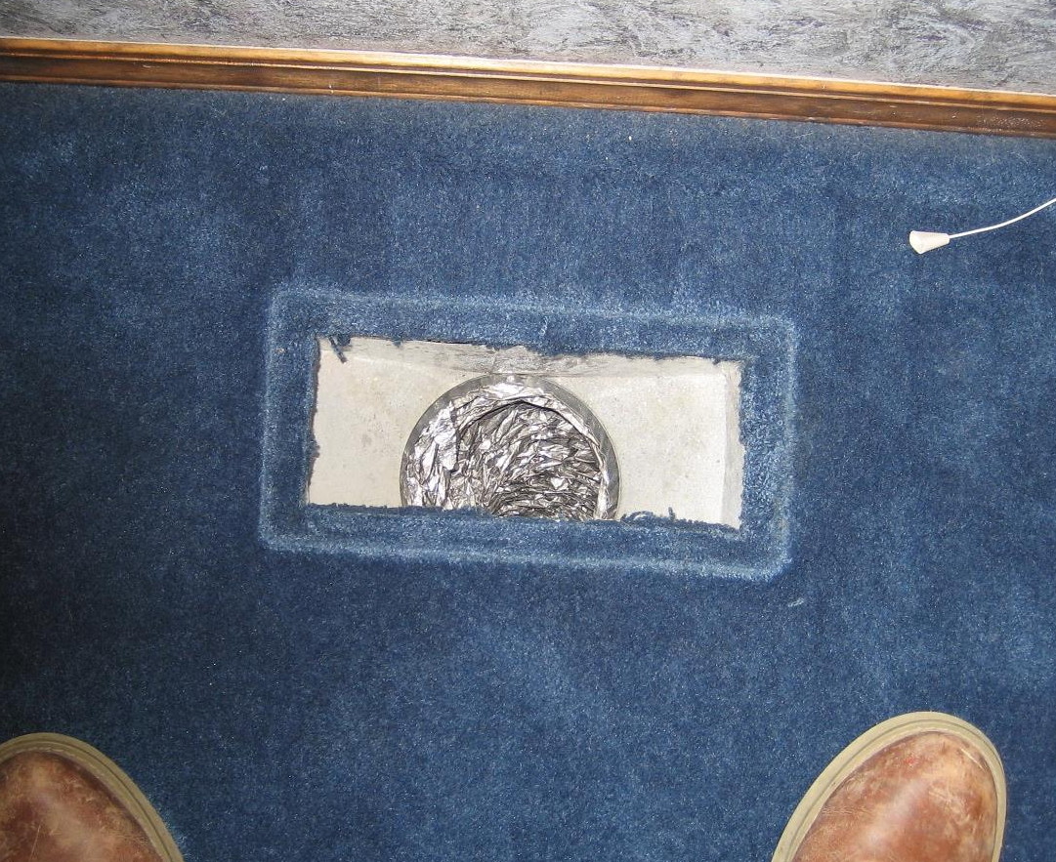
Duct or Dirt?
Section 5: Diagnosis and Planning

Slide 15
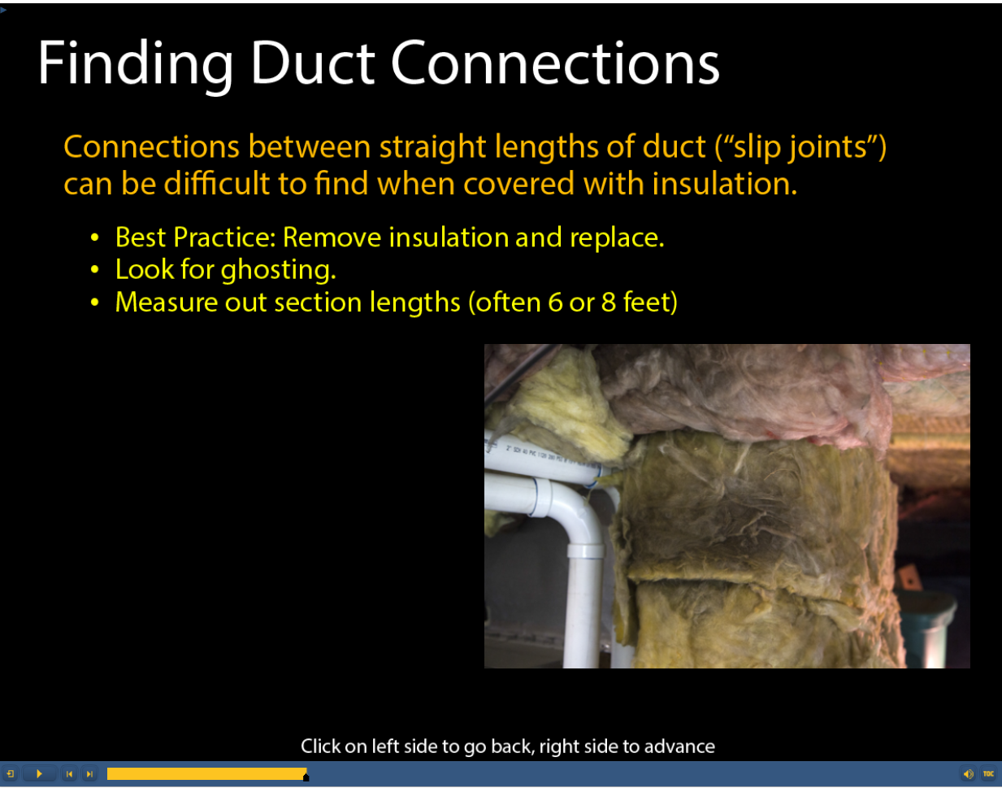
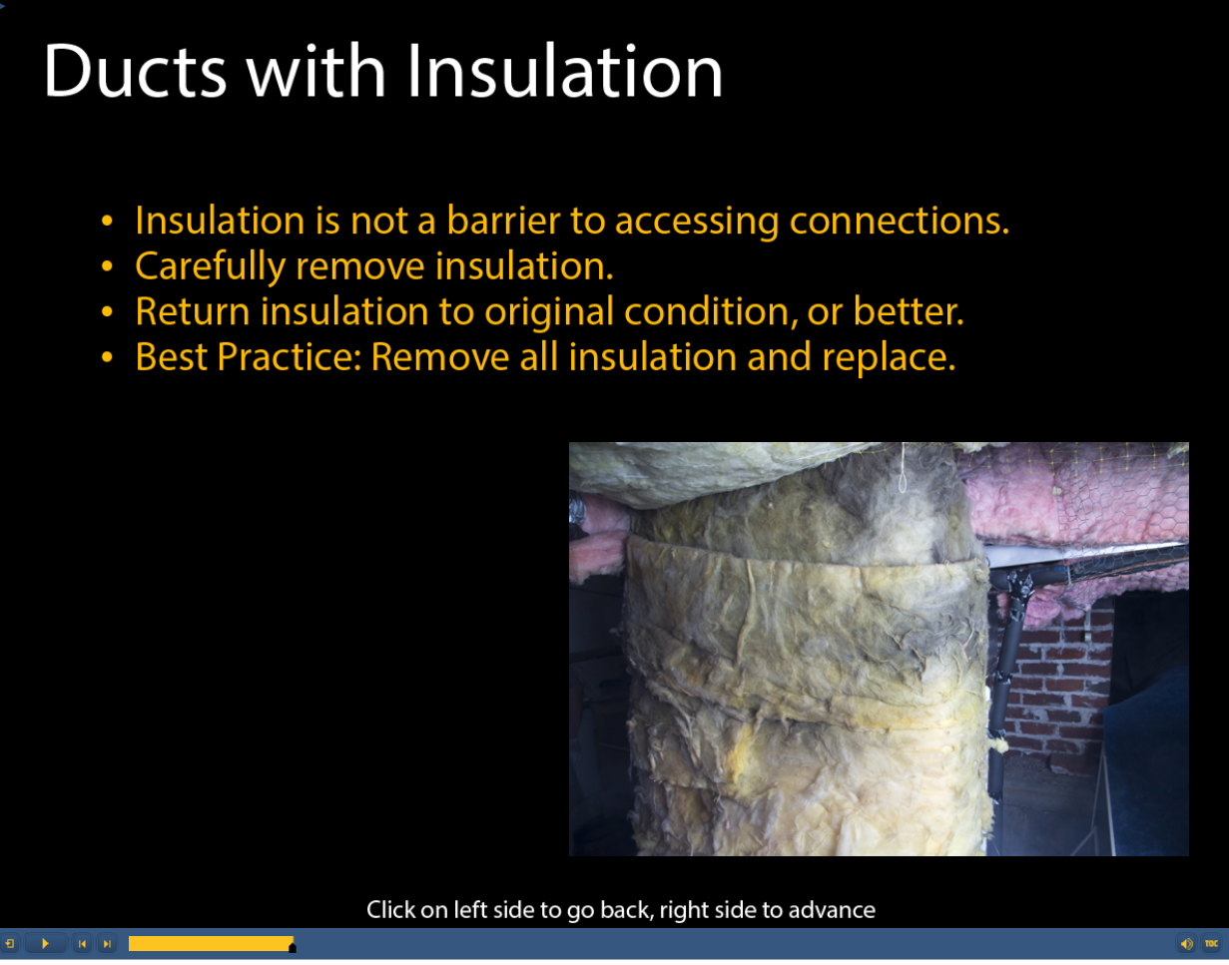
Signs of Leaks Behind Insulation
Section 5: Diagnosis and Planning
  Look for insulation dirty from years of air leakage known as “ghosting”

Slide 16
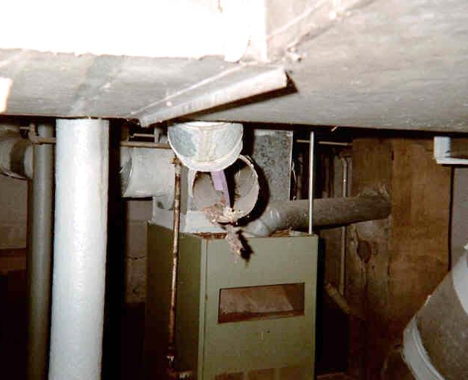
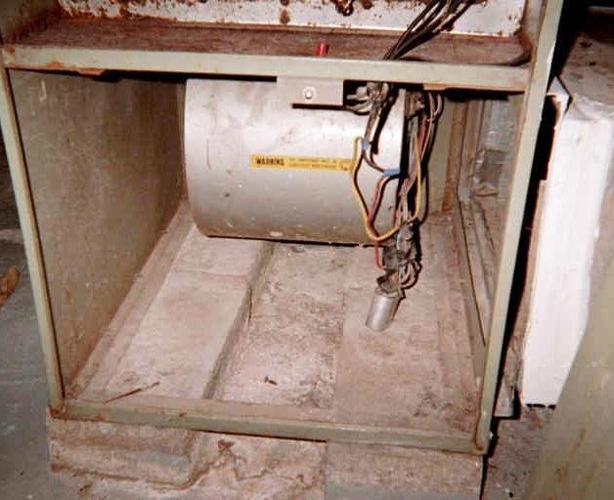
Section 5: Diagnosis and Planning
More BIG Holes
Is test meaningful with huge disconnects?
Systems not really connected probably can’t be pressurized to 50 Pa
Make note on form if house couldn’t be pressurized and number of disconnects
138

Slide 17
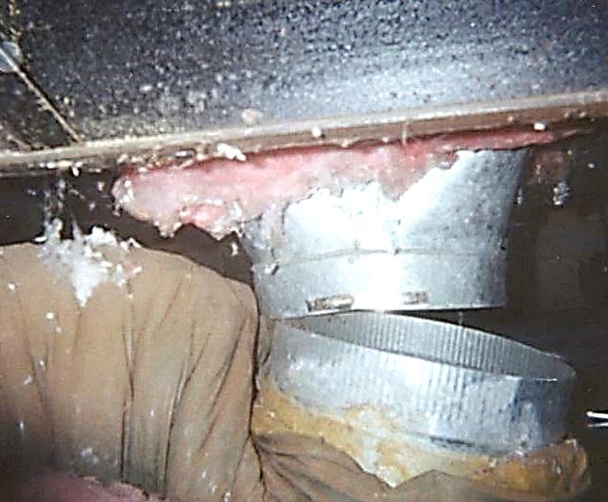
Sealing Big Leaks
Section 5: Diagnosis and Planning
Sealing big leaks improves air flow to registers
May restrict airflow through the fan, creating greater static pressure at the fan.
  Fixing large holes may cause air conditioners and heat pumps to freeze up and cause gas furnaces short cycle on the high limit.

Slide 18
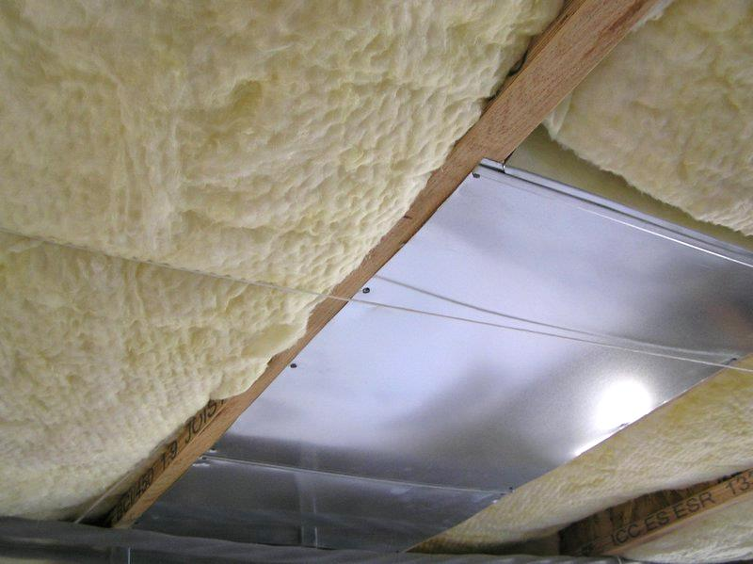
Panned and Cavity Returns
Section 5: Diagnosis and Planning
Simply BIG leaks spread over a large area
Hard to seal
Consider replacing them if possible
Add end caps on panned returns

Slide 19
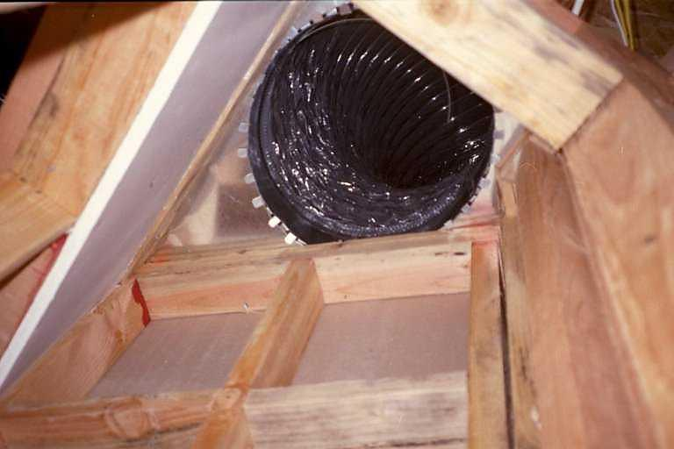
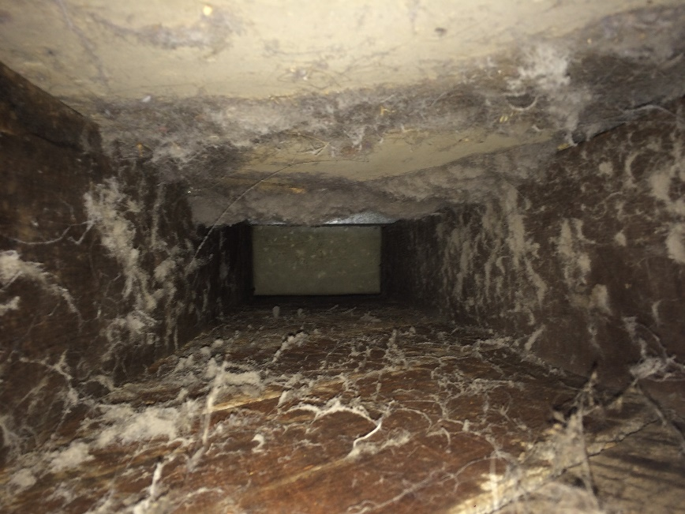
Panned and Cavity Returns
Section 5: Diagnosis and Planning
Find these BEFORE starting testing and sealing
Do a supply side only test

Slide 20
Where to Start
Section 5: Diagnosis and Planning
Areas that yield the greatest sealing bang for your buck:
  High-pressure areas (air handler connection, plenum, trunk line)
  Supply Side
  Common problem areas (Y’s, takeoffs and elbows)
Don’t seal ducts in conditioned space
Seal returns, but don’t sweat the details here

Slide 21
Section 5: Diagnosis and Planning
The Distance Rule
The greater the distance from the fan, the more a leak becomes a hole.
  Near the fan: greatest pressure in the system (usually 40–100 Pa)
  Fan discharge: hottest or coldest air
  Air handler and plenum: sweat the details here

Slide 22
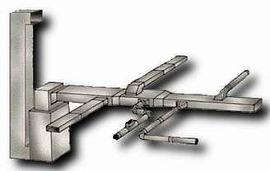

Section 5: Diagnosis and Planning
Follow the Pressure
Boots for show, plenums for dough!
Return
Boot
Supply
Elbow

Slide 23

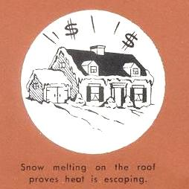
What Problems Are You Trying to Fix?
Section 5: Diagnosis and Planning
If the problem is one of higher than expected costs, duct sealing may be enough.
Excessive fuel bills prove the cost of invisible waste.
Snow melting on the roof proves heat is escaping.

Slide 24

Diagnosis
Section 5: Diagnosis and Planning
The Three R’s of Duct Triage
  Repair
  Replace
  Reengineer

Slide 25
Partial List of Repairs
Section 5: Diagnosis and Planning
Panned over joists | Rusted out sheet metal
Undersized return duct work | Rodent-infested anything
Broken electronic air cleaners | Damaged duct board
Wet flex ducts | Crushed registers and grilles
Crushed flex ducts | Flaking flex ducts
Fittings that can be replaced by less restrictive ones

Slide 26
When to Replace
Section 5: Diagnosis and Planning
The duct system is falling apart:
  Rusted sheet metal
  Rotting flex duct
  Duct board filleted open or air barrier missing;
Replacing deteriorating ducts is often faster than repairing and sealing them.
Often times easier to sell, too.

Slide 27
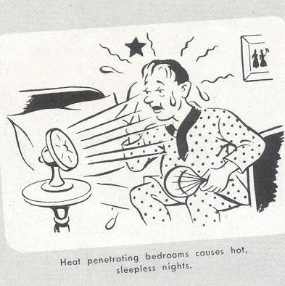
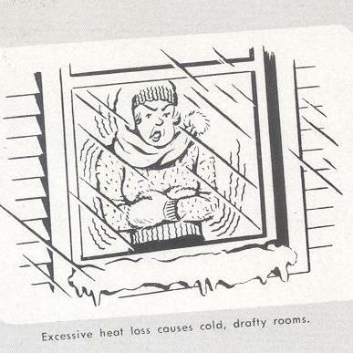
What Problems Are You Trying to Fix?
Section 5: Diagnosis and Planning
Fixing comfort problems usually requires reengineering, so don’t overpromise results
  A room that needs 300 CFM still needs 300 CFM no matter how leaky

Slide 28
Other Diagnostic Tests
Section 5: Diagnosis and Planning
Further Pinpoint Leaks with Diagnostic Equipment
  Dominant Duct Leakage Test
  Pressure Pans

Slide 29
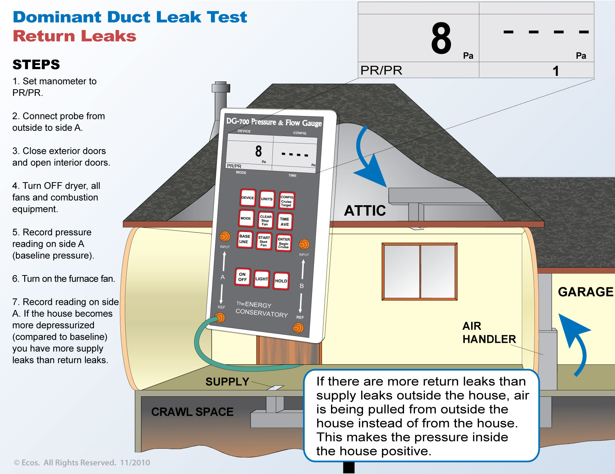
Dominant Duct_Return

Slide 30
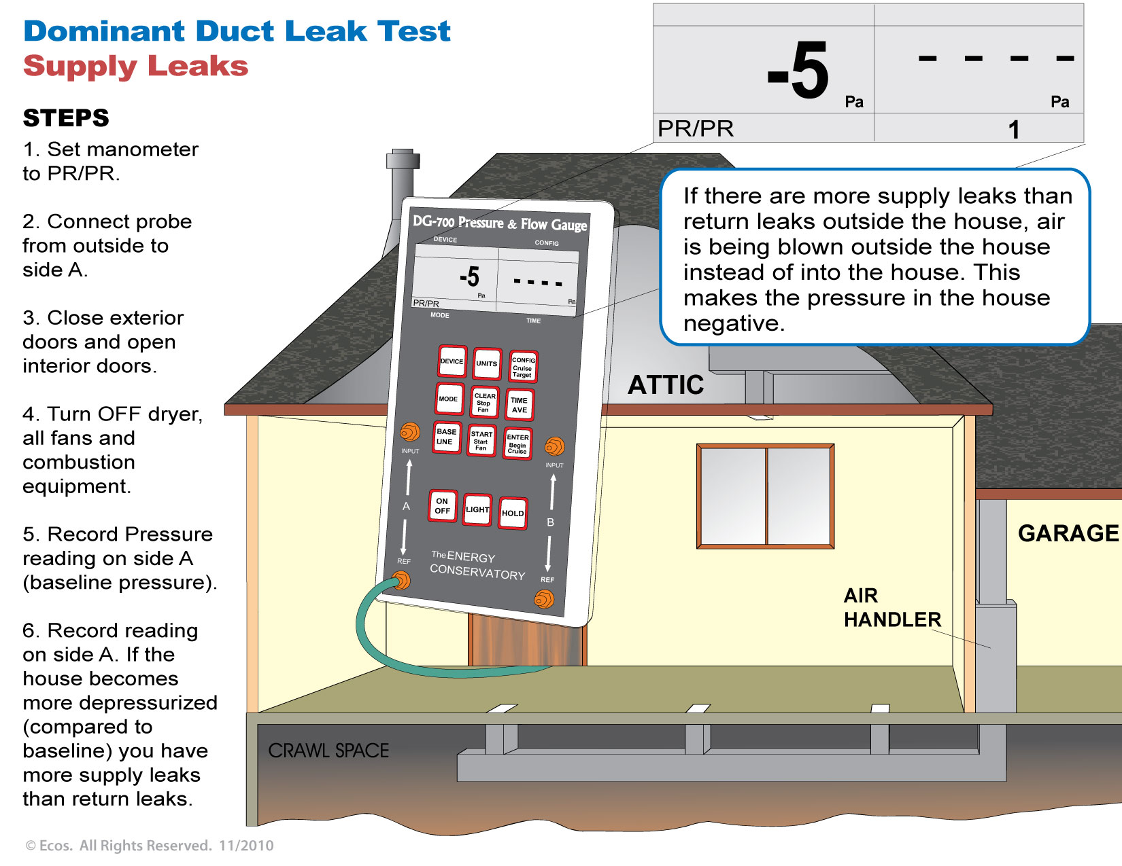
Dominant Duct_Supply

Slide 31
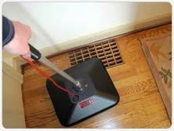
Pressure Pans
Section 5: Diagnosis and Planning
Quick and informative test
Helps locate where leaks are
Does not measure how much leakage

Slide 32
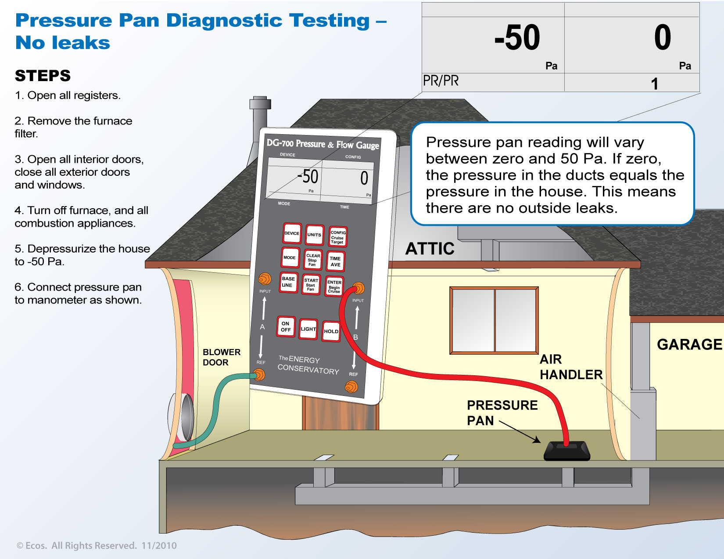

Slide 33
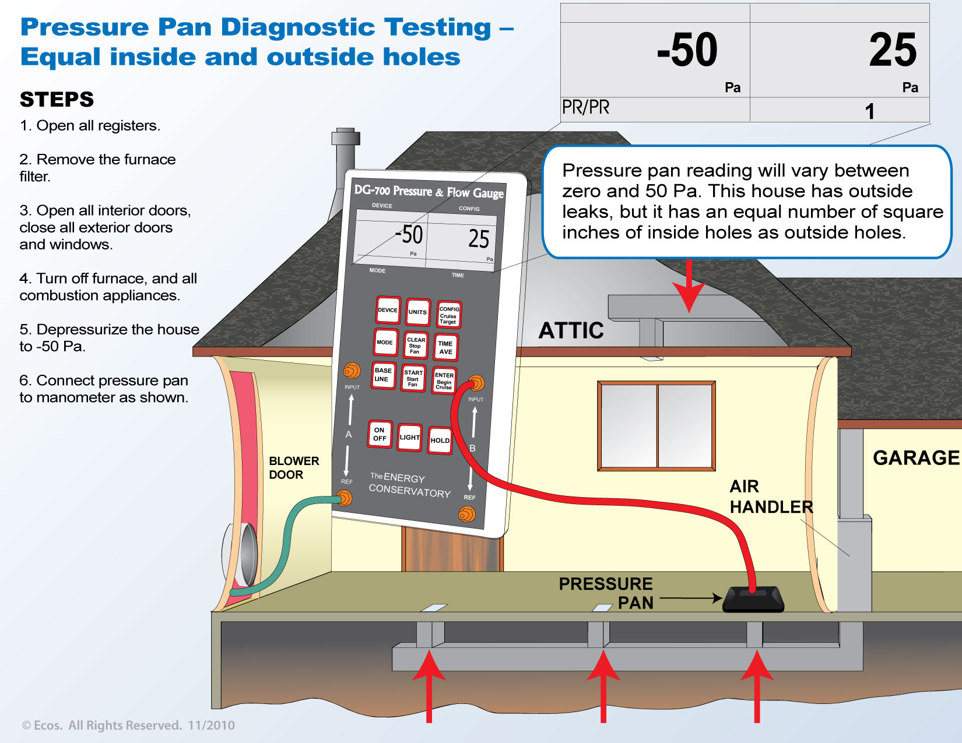

Slide 34
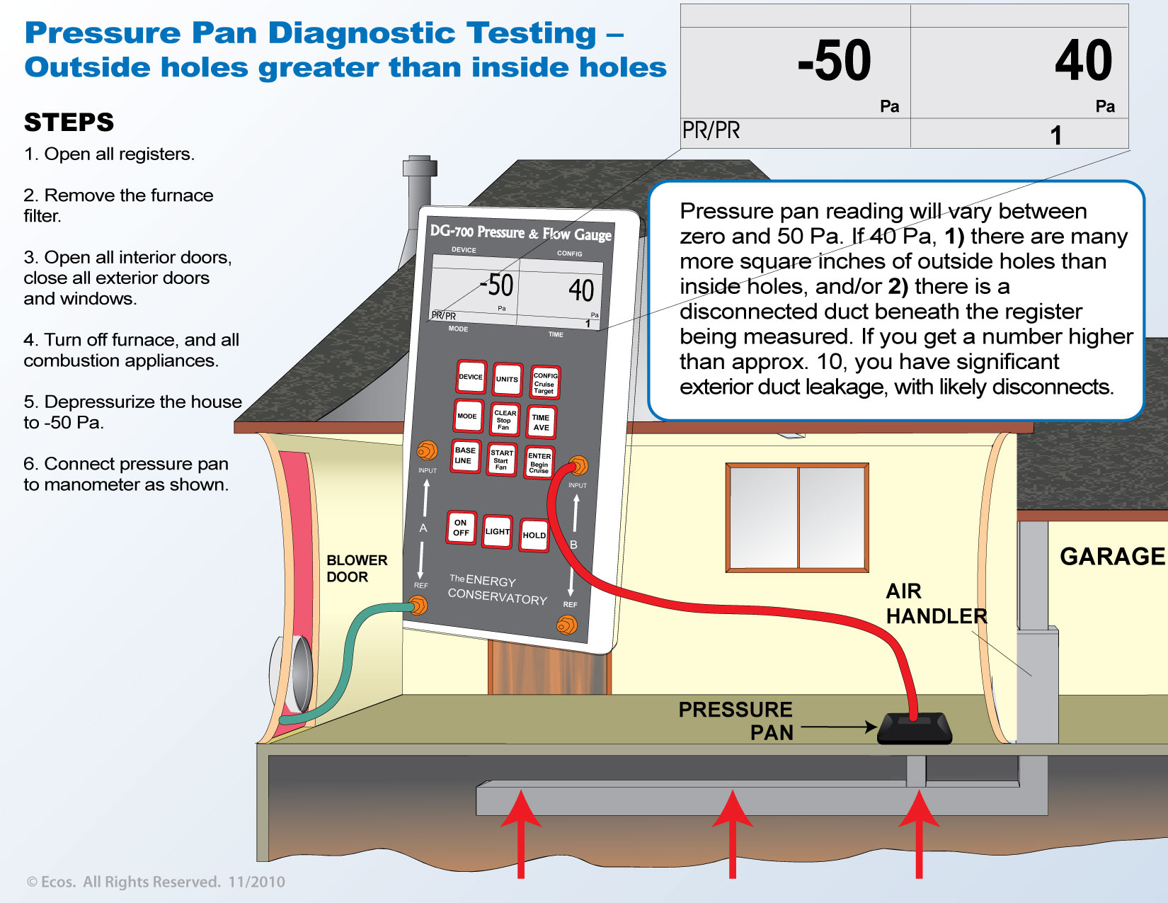

Slide 35


Slide 36
Section 5: What did you learn?
Section 5: Diagnosis and Planning
  Does fixing ductwork sometimes cause unexpected bad consequences (can the cure be worse than the illness)?
    Yes
  Are 2 people testing a house likely to come up with identical answers if the duct blaster and/or static pressure tap were in different locations?
    No, testing technique does matter for repeatable results.
  Should you start with the easily accessible leaks, like the boots?
    No
  What are the most important leaks to seal, no matter what the Duct BlasterTM tells you?
    High-pressure leaks and disconnects are the highest priority.

Slide 37
Section 6 of 10:
Duct Sealing
& Repair

Slide 38

Fix the Leaks!
Section 6: Duct Sealing and Repair
What is considered accessible?
Duct Insulation
Keys to Tighter Ducts
Tape
Supporting Ducts
Tools & Materials

Slide 39


Fasten, Support, and Seal ’Em!
Section 6: Duct Sealing and Repair
All accessible portions shall be repaired, mechanically fastened, supported, and exposed and sealed with approved materials where needed.

Slide 40
What’s Considered “Accessible”?
Section 6: Duct Sealing and Repair
Air handler to plenum connection
Interior liners on manufactured home crossover ducts
  Flex ducts connections with properly secured exterior liners may have interior liners that are not accessible
Belly of manufactured home if non-intrusive visual inspection identifies large holes

Slide 41
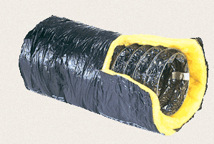
Duct Insulation
Section 6: Duct Sealing and Repair
Not a barrier to accessibility
When removed, shall be re-installed and securely attached with mechanical fasteners, such as…
  Permanent plastic straps
  Nylon twine
  Fastening material specified by manufacturer
Mastic cannot effectively hold insulation in place

Slide 42
Glossary
Section 6: Duct Sealing and Repair
Take Offs: “take off” from supply trunks
Trunks: sections that supply air to duct runs
Return
Boot
Supply
Duct runs: serve individual rooms
Elbow
Branch Ductwork

Slide 43
Keys to Tighter Ducts
Section 6: Duct Sealing and Repair
Remove old tape
Mechanically fasten and make necessary repairs
  Tension tie inside and outside liners of flex duct and screw together metal duct
  Secure insulation with nylon webbing, PanduitTM straps or other lasting material.
Support ducts and fasten boots to subfloor
Seal with UL-181 listed mastic
  Plug, don’t paint: Mastic should be about the thickness of a nickel to seal
Reinstall insulation

Slide 44
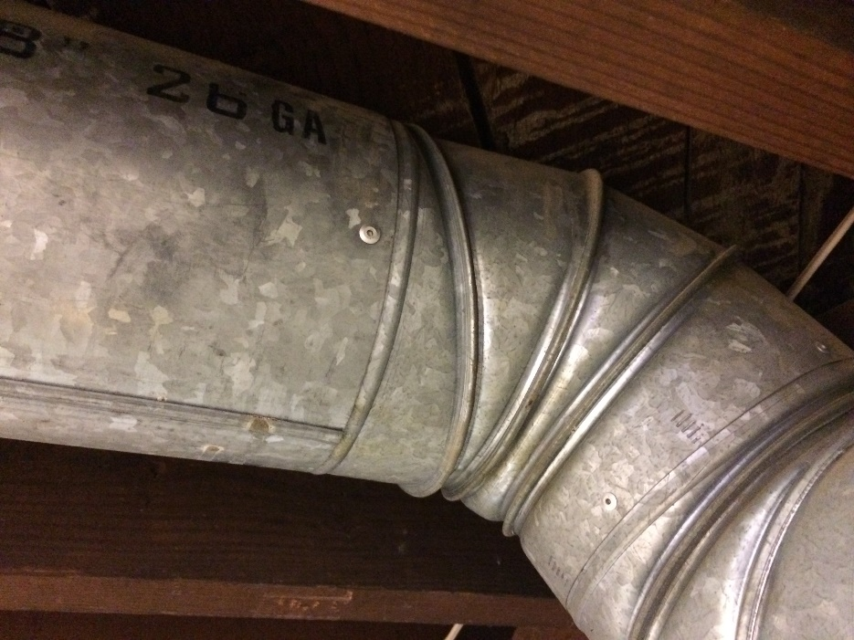
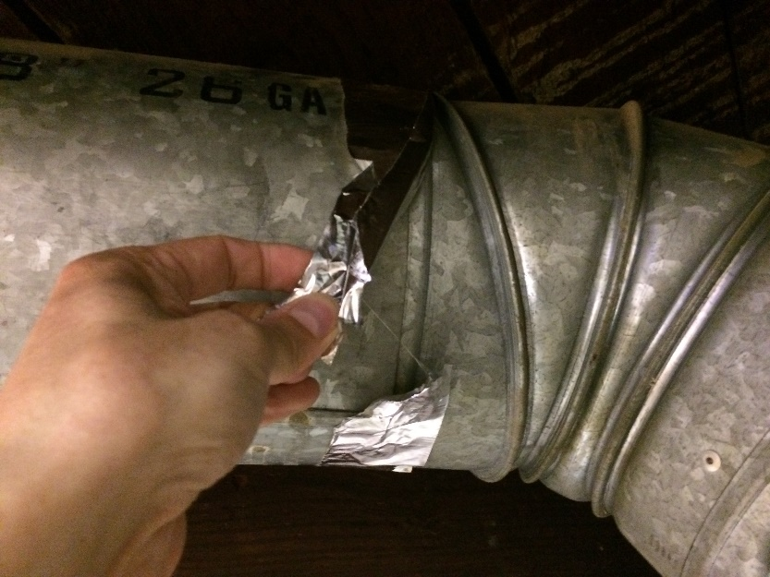
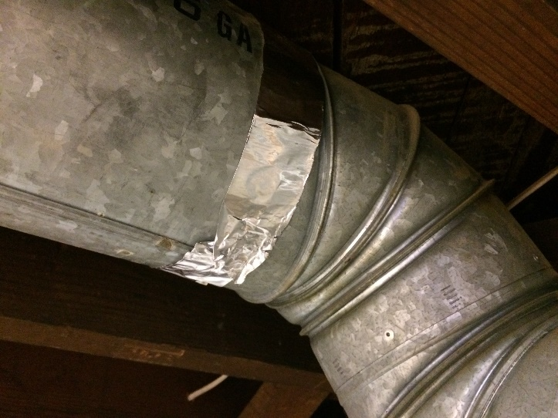
Section 6: Duct Sealing and Repair
Tape Removal
Tape can cover poor workmanship; mastic cannot
Tape is neither a fastener nor a permanent sealant
Tape must be removed!

Slide 45
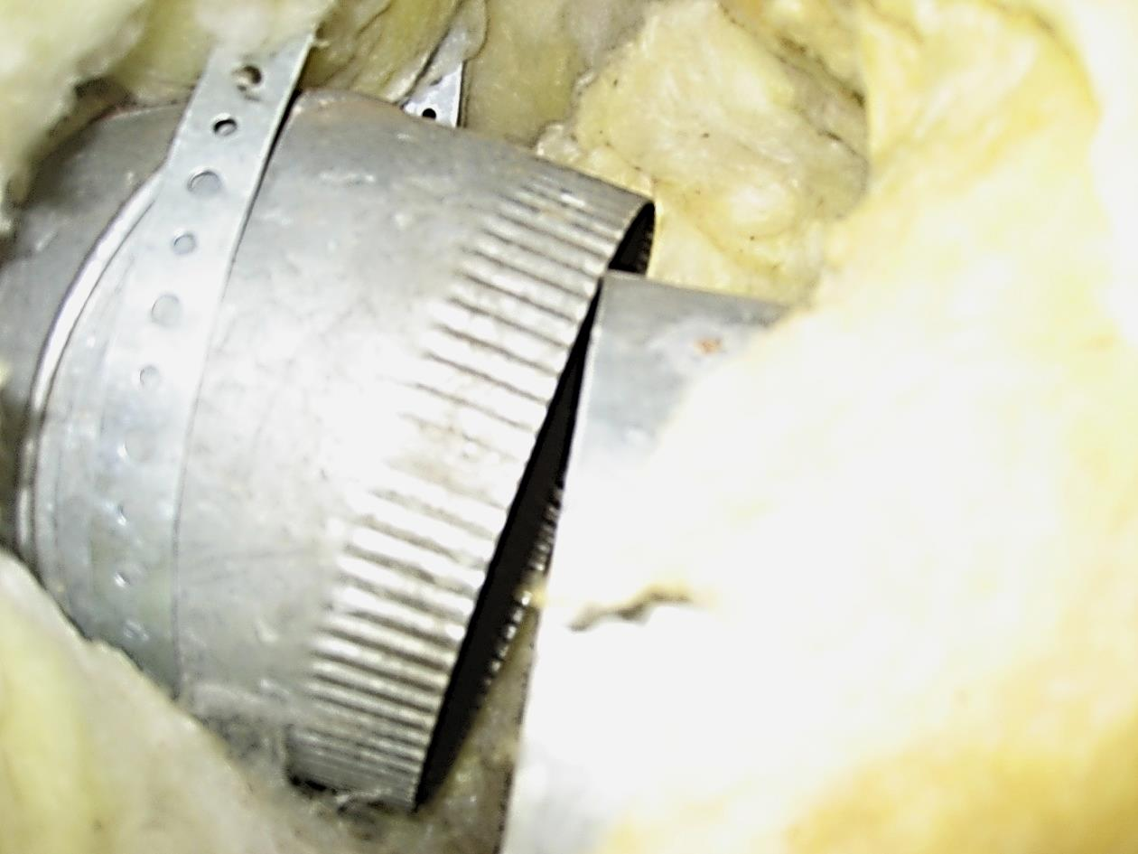
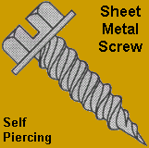
Mechanically Fastened
Section 6: Duct Sealing and Repair
Each connection must be mechanically fastened before sealing with at least 3 screws

Slide 46
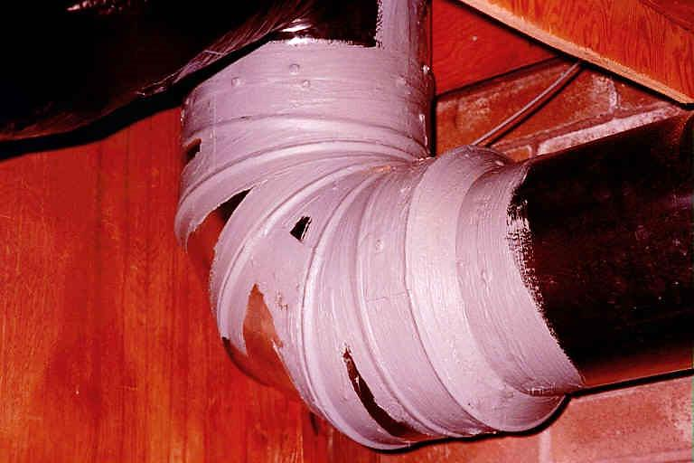
Section 6: Duct Sealing and Repair
Maximize Long-Term Energy Efficiency
Seal with Mastic
Tape: not a fastener or permanent sealant
Pay attention to gores

Slide 47
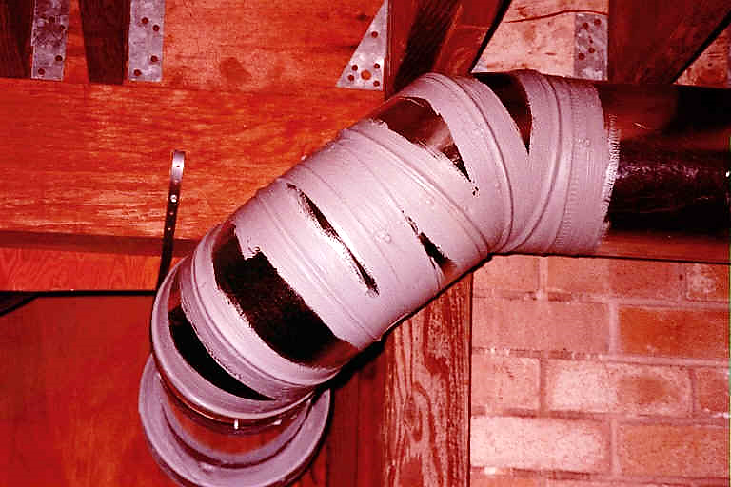
Section 6: Duct Sealing and Repair
Mechanical Fastening & Mastic
Permanent Fix
Mechanically attached sheet metal sealed with mastic is permanent
Tape of any kind might not be permanent
Tape of any kind allows for poor workmanship
169

Slide 48
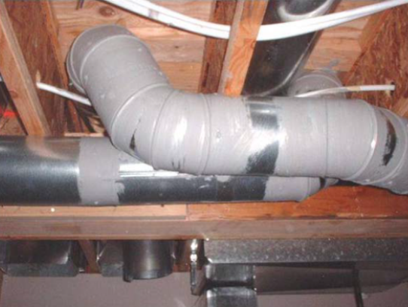
Sealing Locations
Section 6: Duct Sealing and Repair
Air handler to plenum
Plenums
Take-offs
Slip joints
Branches, Ts and Ys
Elbows and gores
Boots
Notes:
Seal all the connections where duct sections meet, adjustable gores on elbow ducts, the boots, and the boot to floor connections. You must seal all accessible returns too.
The boots can be difficult to seal when they are located near foundation walls. A best practice in this case is to seal the boot from both the crawlspace and from the inside the home. Remove the register grille to access the boot from the top side. Make sure the boot is mechanically fastened to the floor system.
Be careful not to damage carpet or home furnishings with the mastic. Use a wet towel to clean up any mastic left behind and be sure to put the grille back in place when you’re done.

Slide 49
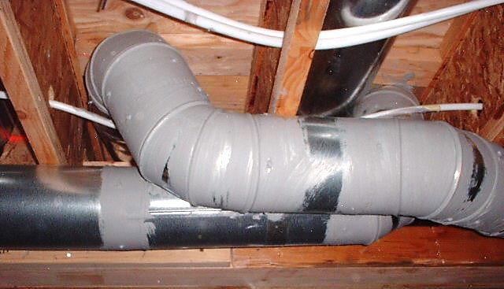
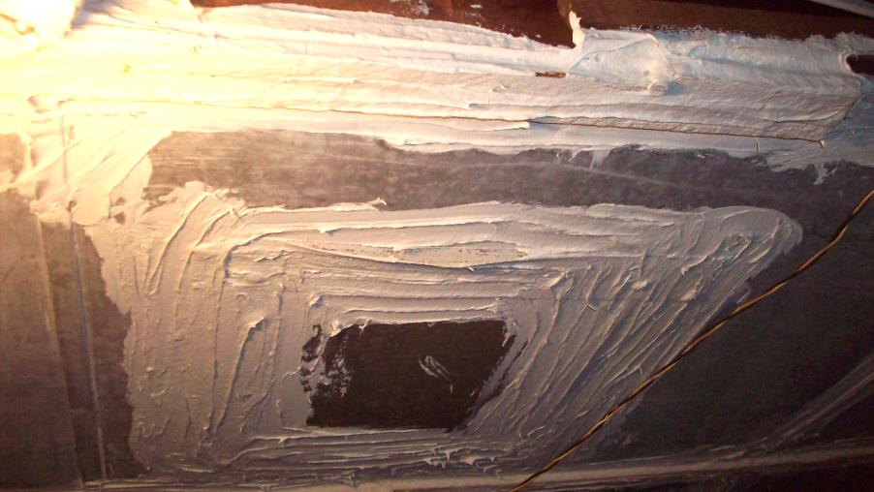
Applying Mastic
Section 6: Duct Sealing and Repair
PLUG, don’t paint!
Thick as a nickel (about 1/16 in. thick)!

Slide 50
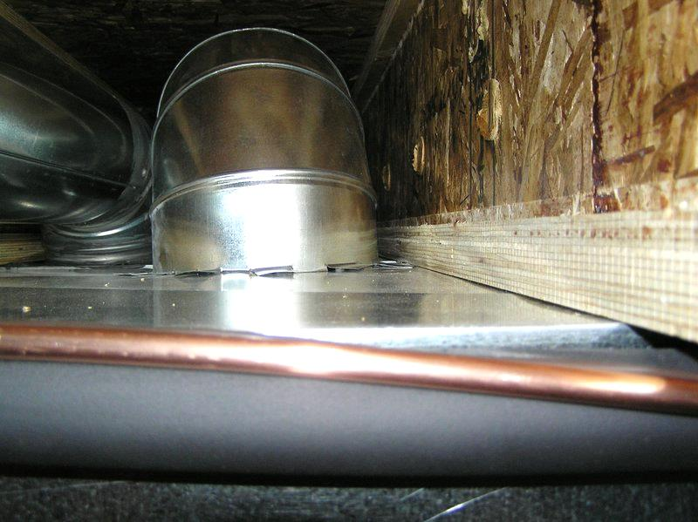
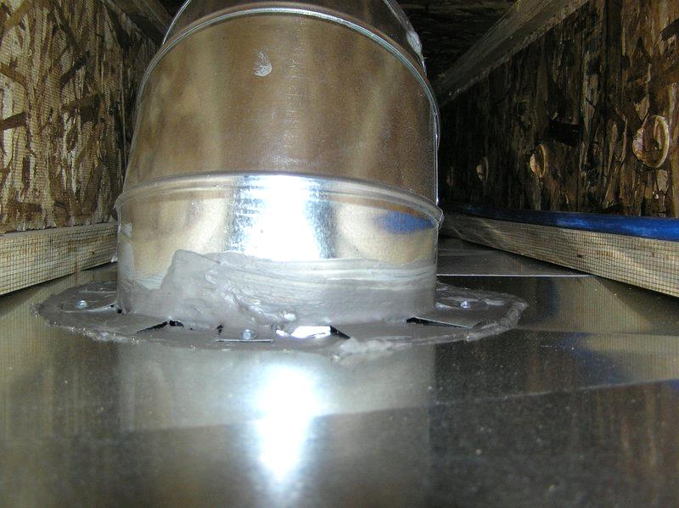
Section 6: Duct Sealing and Repair
Mastic Used, But Still Leaking

Slide 51
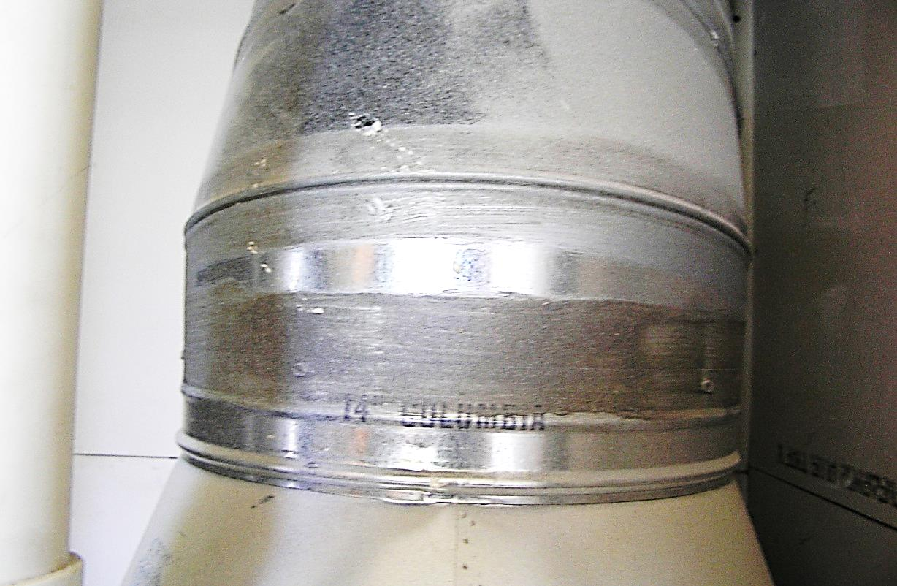
Too Thin to Win
Section 6: Duct Sealing and Repair
Not applying enough mastic will allow air to continue leaking out.

Slide 52
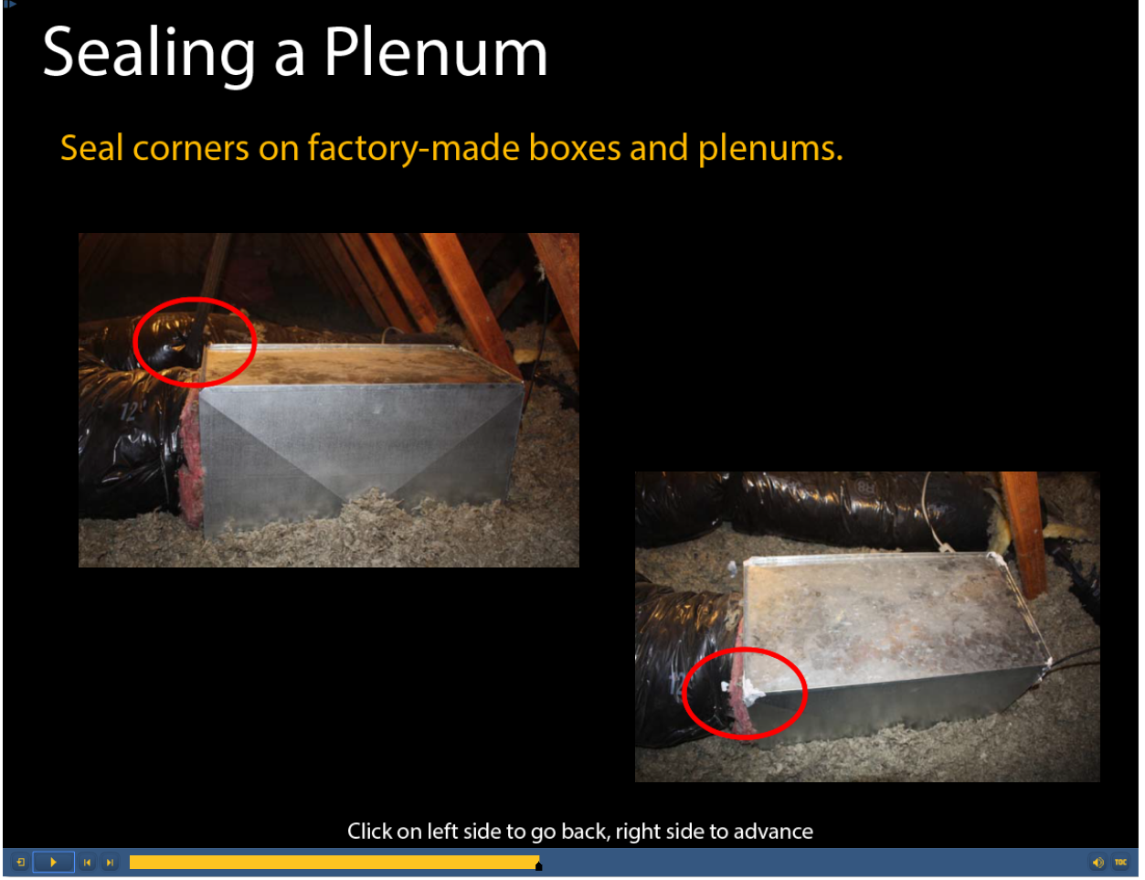
Plenum Corners
Section 6: Duct Sealing and Repair
Seal corners on factory-made boxes and plenums
Notes:
Most of the seams on the plenum or the return box are mechanically pressed at the factory and are fairly airtight. But an important exception is at the corners. These spots usually have gaps where the metal is folded over and joined together. A good blob of mastic at each of these locations will make these boxes air-tight.

Slide 53

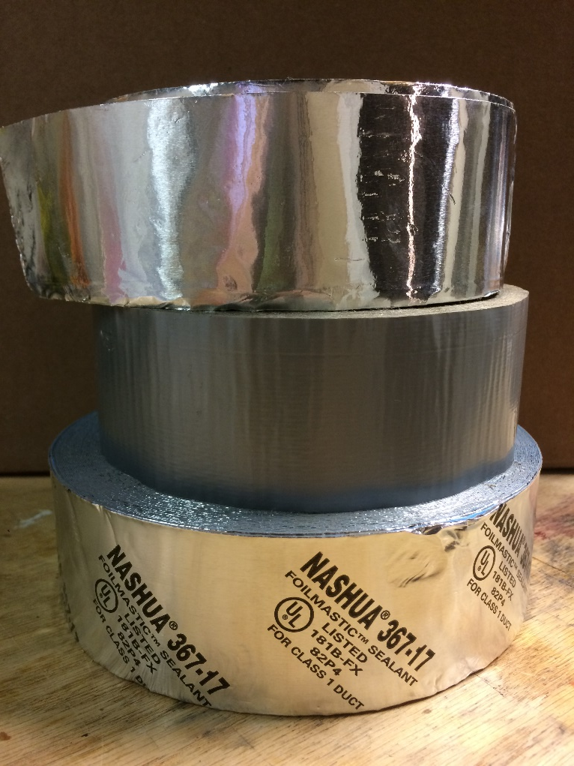
Section 6: Duct Sealing and Repair
Where Tape is Allowed?
Approved tape is only allowed on the air handler cabinet and air handler to plenum connection
Not all tape is created equal
At air handler, use foil faced, butyl backed “roll mastic” sealant
175

Slide 54
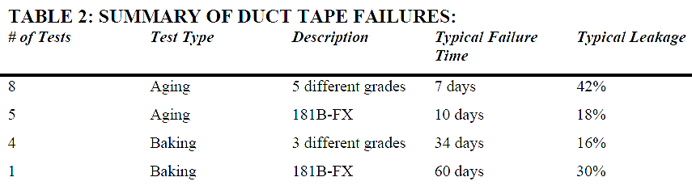

Duct Tape is Temporary
Section 6: Duct Sealing and Repair
Source: eetd.lbl.gov/IE/pdf/LBNL-41434.pdf

Slide 55
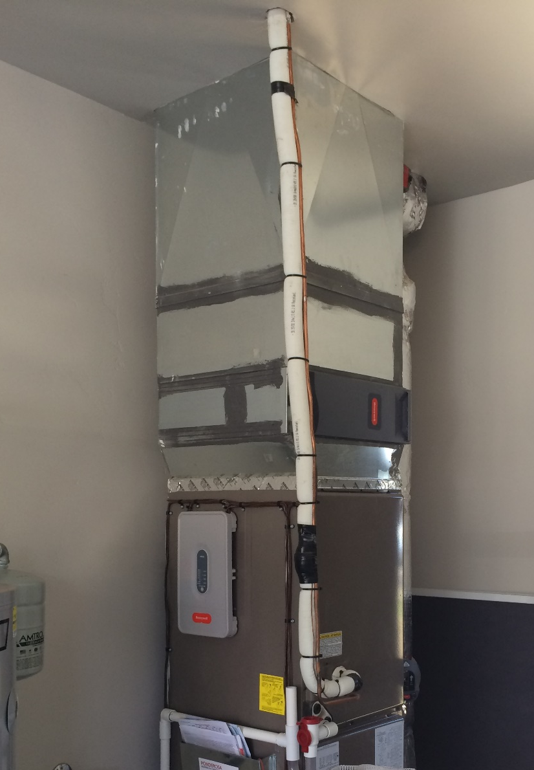
Air Handler to Plenum
Section 6: Duct Sealing and Repair
Approved tape is only allowed on the air handler cabinet and air handler to plenum connection
All other connections on plenum must be sealed with mastic!

Slide 56
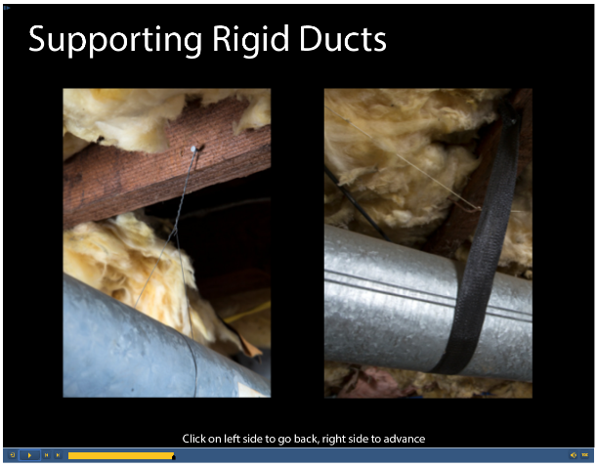
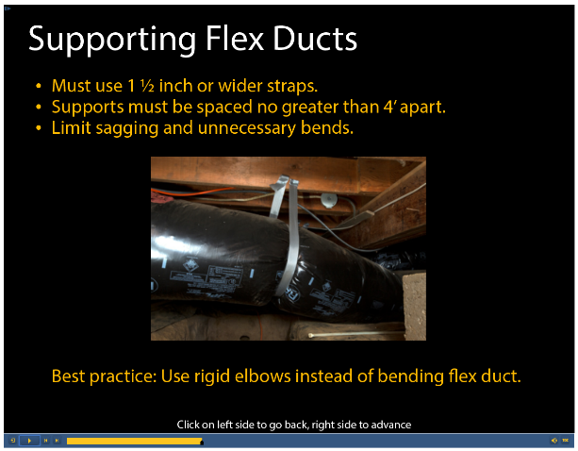
Supporting Ducts
Section 6: Duct Sealing and Repair
All accessible portions of the duct system shall be supported
Notes:
Flex ducts can bend and crimp, so you need to support them differently than rigid ducts. The supports must be at least one and a half inches wide so they don’t pinch into and damage the duct’s outer liner.
Supports are especially important near connections with rigid ducts, where the weight of an unsupported duct can pull the connection loose. Sags in the duct restrict it and restrict airflow. To prevent sags, cut the ducts to the proper length and install supports every four feet.
It’s a best practice to use a rigid elbow rather than simply bending the flex duct. The bends create uneven surfaces inside of the ducts, which restrict airflow through the duct. Also, the vertical connection between the flex duct and a boot is difficult to support and can slip off.

Slide 57
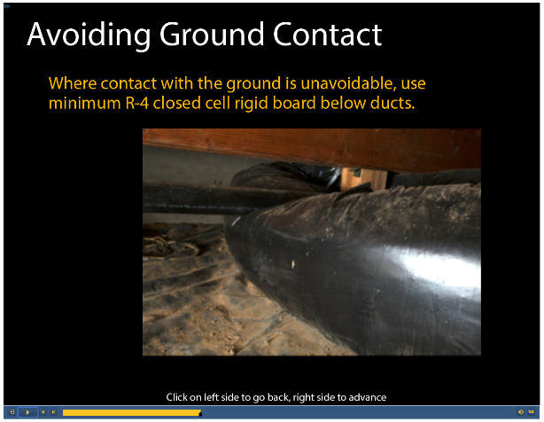
Supporting Flex Ducts
Section 6: Duct Sealing and Repair
Must use 1 ½” or wider straps
Supports must be spaced no greater than 4’ apart
Limit sagging and unnecessary bends
Avoid ground contact. If unavoidable, R-4 min closed cell foam board can be placed between the duct and ground
Notes:
Flex ducts can bend and crimp, so you need to support them differently than rigid ducts. The supports must be at least one and a half inches wide so they don’t pinch into and damage the duct’s outer liner.
Supports are especially important near connections with rigid ducts, where the weight of an unsupported duct can pull the connection loose. Sags in the duct restrict it and restrict airflow. To prevent sags, cut the ducts to the proper length and install supports every four feet.
It’s a best practice to use a rigid elbow rather than simply bending the flex duct. The bends create uneven surfaces inside of the ducts, which restrict airflow through the duct. Also, the vertical connection between the flex duct and a boot is difficult to support and can slip off.

Slide 58
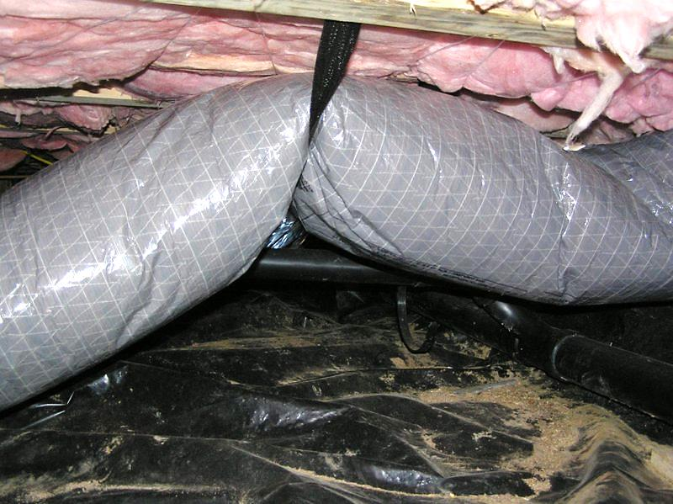
The Permanent Heimlich Maneuver
Section 6: Duct Sealing and Repair
Notes:
Add presenters notes on how to fix

Slide 59
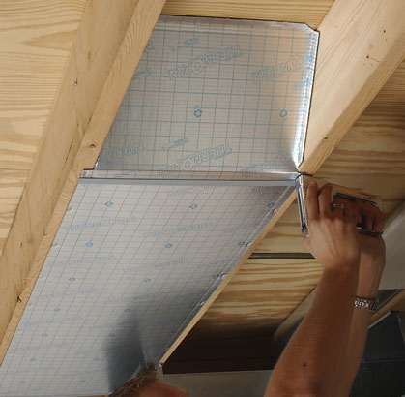
Thermo Pan
Section 6: Duct Sealing and Repair
Notes:
Mention thermopan and the uses, especially end caps

Slide 60
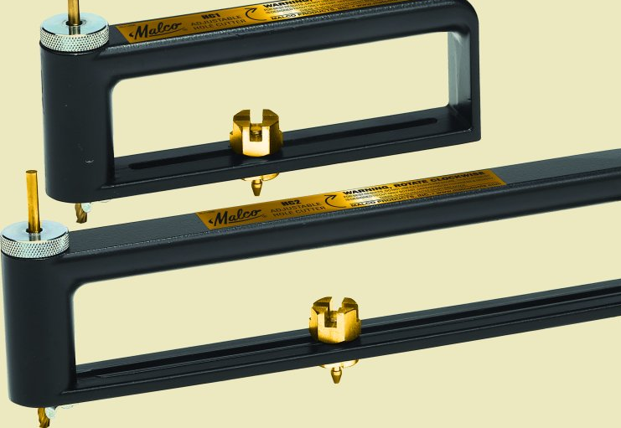
Circle Cutters
Section 6: Duct Sealing and Repair
Cut circles in flat sheet metal, allowing access to the inside of the duct to be sealed from the inside.
Drill Bit
Pivot Point

Slide 61
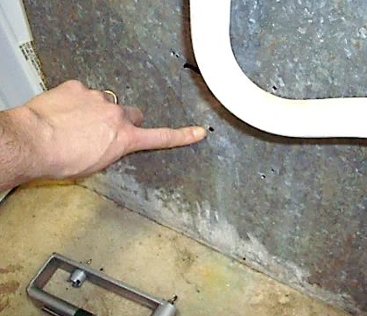


Circle Cutter: Making Access Holes
Section 6: Duct Sealing and Repair
Step 1: Attach Circle Cutter drill bit to a drill; drill a hole in center of the circle to be cut
Step 2: Adjust Pivot Point Set Screw for size hole to be cut (usually 12”)
Pivot Point Set screw
Step 3: Place the Pivot Point into drilled hole (Step 1); drill a starting hole on circumference of circle to be cut

Slide 62



Section 6: Duct Sealing and Repair
Circle Cutter: Making Access Holes, continued
Step 4: Push Circle Cutter around to cut out circle; inspect sharp edges before sealing
Step 5: Seal ALL seams (reach through access hole)
Tip: brush attached to a stick is useful to seal out of reach seams
Step 6: Close gap between seams by screwing them together before sealing.

Slide 63


Section 6: Duct Sealing and Repair
Circle Cutter: Making Access Holes, continued
Step 7: Seal all seams with a thick coat of mastic.
Step 8: Reach up and seal the Furnace to Can connection on all four sides
Furnace to Can Connection

Slide 64



Section 6: Duct Sealing and Repair
Circle Cutter: Making Access Holes, continued
Step 9: Apply a thick coat of mastic around the rim of the access hole
Step 10: Attach a rectangular plate over the hole
Must overlap each side by at least 2”
Use at least three screws per side so plate lays flat
Apply a UL-181 metal tape along all four sides

Slide 65



Take Offs
Section 6: Duct Sealing and Repair
Flexible elbows can be used as Take Offs
Flat surface take off
Saddle take off

Slide 66


Cone Saddle Take Offs
Section 6: Duct Sealing and Repair
Usually are attached to the duct, with the insulation pinned between the take off and the duct it’s attached to.
Because insulation can’t stop air from leaking, the insulation must be removed from under the take off before applying the mastic.

Slide 67

Section 6: Duct Sealing and Repair
Sealing Cone Saddle Take Offs
Step 1: Unscrew take off and pull insulation back so the take off can be reattached without pinning insulation under the take off
Step 2: Place take off onto the duct; ensure no gap is between take off and duct.
No gaps between take off and duct

Slide 68


Sealing Cone Saddle Take Offs, continued
Section 6: Duct Sealing and Repair
Step 3: Screw the take off back onto the duct; ensure it remains flush with duct
Step 4: Apply mastic around joint between take off and duct; include surfaces of take off and duct

Slide 69


Sealing Cone Saddle Take Offs, continued
Section 6: Duct Sealing and Repair
Step 5: Fold the pushed back insulation onto the duct section; use wet mastic to glue insulation to duct work
No insulation gaps on the duct
Step 6: Reattach insulation with duct strapping or nylon tie

Slide 70

Crimping Tool
Section 6: Duct Sealing and Repair
Used to fit two sections of the same size of metal duct together.
Circumference of one duct section is reduced by crimping it so it can easily fit into the non-crimped section.
Tip: Always use gloves when working with sheet metal

Slide 71



Using the Crimping Tool
Section 6: Duct Sealing and Repair
Step 1: Seat a section of duct fully into jaws of the crimper; squeeze tight
Step 2: Continue all the way around, ensuring complete coverage

Slide 72


Using the Crimping Tool
Section 6: Duct Sealing and Repair
Step 3: After duct is fully crimped, insert fully into uncrimped section
Step 4: Mechanically fasten the two sections together using at least three sheet metal screws equally spaced.

Slide 73

Notcher Tool
Section 6: Duct Sealing and Repair
Used to take a triangle “bite” out of the edge of sheet metal to make start collars from either straight pipe or elbows.

Slide 74



Using the Notcher Tool, continued
Section 6: Duct Sealing and Repair
Step 1: Insert the sheet metal fully into the jaws of the Notcher; squeeze tight until a triangle drops out
Triangle notch
Folded back notch
Step 2: Continue around making the notches about 1–2 inches apart; fold every other tab back so it projects out at 90 degrees

Slide 75



Using the Notcher Tool, continued
Section 6: Duct Sealing and Repair
Step 3: Insert non-folded tabs into the duct opening; push duct into opening so folded tabs are flush with duct
Folded back notch
Step 4: Reach in to take off and fold tabs back against inside of duct
Fold these tabs back
Step 5: Screw the take off in place using at least 4 screws

Slide 76

Flex Duct Knife
Section 6: Duct Sealing and Repair
Used to cut flex duct and spiral wire of the flex duct. Has a dual edge blade that allows for cutting in two directions.
Wire Cutter Jaws

Slide 77


Using the Flex Duct Knife
Section 6: Duct Sealing and Repair
Step 1: Puncture flex duct with tip of the knife; ensure it is the outer liner, the insulation and the inner liner
Step 2: Cut around the duct; ensure to cut through all the layers

Slide 78


Using the Flex Duct Knife, continued
Section 6: Duct Sealing and Repair
Step 3: Cut the wire inside the inner liner using the wire cutter. NEVER use snips for this.
Step 4: Use the knife to cut away any remaining materials. Don’t pull the duct apart!

Slide 79


Nylon Ties and The Tensioning Tool
Section 6: Duct Sealing and Repair
Flex duct connections require nylon straps (or equivalent) on both inner and outer liners and tightened with a tensioning tool
All flex duct shall be joined to a section of rigid duct of matching diameter including locations where two separate sections of flex duct meet

Slide 80



Using Nylon Ties
Section 6: Duct Sealing and Repair
Step 1: Pull back the outer liner and insulation exposing at least one foot of inner liner
Step 2: Pull inner liner over the sheet metal duct part you are connecting to; pull liner up at least 2”
Step 3: Place tie around duct (ribs to the inside); ensure liner is under the tie and hand tighten

Slide 81



Using Tensioning Tool
Section 6: Duct Sealing and Repair
Step 4: Insert the end of the tie into the tensioning tool; squeeze several times until tie is tight
Step 5: Pull duct insulation and outer liner up over metal pipe as much as possible
Step 6: Place and hand tighten a tie around the outer liner; tightly secure outer liner with tensioning tool
Notes:
Mention not adding screws in Panduit straps

Slide 82
Flex Duct Torture Test
Section 6: Duct Sealing and Repair
Notes:
Point out the impact of screws and mastic

Slide 83

Attaching the Boot to the Sub-Floor
Section 6: Duct Sealing and Repair
Boots shall be mechanically fastened to the sub-floor.
They are often not, leaving large gaps. Roofing nails or sheetrock screws must be driven through the boot into the sub-floor to fix the gaps.

Slide 84



Section 6: Duct Sealing and Repair
Attaching the Boot to the Sub-Floor, continued
Gap between boot and sub-floor
Step 1: Make a hole in boot with a punch or awl to ease nailing the boot
Roofing nail placed in punched hole
Step 2: Hammer nail through boot into sub-floor using a sheet metal hammer
Note: Hammer side used to drive nails on long sides of the boot.

Slide 85



Attaching the Boot to The Sub-Floor, continued
Section 6: Duct Sealing and Repair
Right angle drill attachment
Step 3: Drive screws flush with boot using right angle drill; register must fit into boot after repairs
Step 4: Replace register into boot flat against the floor
Note: If it does not lay flat, nails or screws may need to be driven deeper into the boot.

Slide 86

Duct Board
Section 6: Duct Sealing and Repair
Foil is the air barrier; must be airtight

Slide 87

Thermo Flex Brand Flex Duct
Section 6: Duct Sealing and Repair
Do not repair or seal, REPLACE!
Inner liner is mesh, so outer liner is the air barrier and often deteriorated

Slide 88

How Would You Fix This?
Section 6: Duct Sealing and Repair

Slide 89


Toe Kicks: How Would You Seal These?
Section 6: Duct Sealing and Repair

Slide 90

Toe Kicks: How Would You Seal This?
Section 6: Duct Sealing and Repair

Slide 91


Section 6: Duct Sealing and Repair
How Would You Fix These?

Slide 92

Section 6: Duct Sealing and Repair

Slide 93

The Rules
Section 6: Duct Sealing and Repair
Do No Harm
Seal outside ducts
Seal big holes
Seal high pressure holes
Don’t waste time on returns if there is no return
Make your work permanent
Measure your work to prove what you did and improve crew morale
Reward the people doing the hard work
Clean up!

Slide 94
Leakage Requirements: Single Family Homes
Section 6: Duct Sealing and Repair
Qualifying Pre-Sealing Leakage Reminder
  Home more than 1,667 sq. ft.: Equal to or greater than 250 CFM
  Home less than 1,667 sq. ft.: Equal to or greater than 15% of home sq. ft.
Post-Sealing Leakage (meet one of the following after sealing):
Post-Test Leakage Requirements
CFM equal to or greater than a 50% reduction OR
CFM equal to or less than 10% of home’s sq. ft.
Prescriptive Duct Sealing does not require post-test leakage testing

Slide 95
Leakage Requirements: Manufactured Homes
Section 6: Duct Sealing and Repair
Qualifying Pre-Sealing Leakage Reminder
  Single wide: Equal to or Greater than 100 CFM
  Double wide: Equal to or Greater than 150 CFM
  Triple wide: Equal to or Greater than 225 CFM
Post-Sealing Leakage (meet one of the following after sealing):
Post-Test Leakage Requirements
Single wide | Equal to or Less than 50 CFM
Double wide | Equal to or Less than 80 CFM
Triple wide | Equal to or Less than 110 CFM
OR Equal to or Less than a 50% Reduction
Prescriptive Duct Sealing does not require post-test leakage testing

Slide 96
Example: Post-Test Leakage, Site Built Home
Section 6: Duct Sealing and Repair
  2,000 sq. ft. home
  Home Pressure: 50 Pa to outside
  Pre-test leakage: 354 CFM (Qualifies)
  Target Post-test leakage (target only one):
175 CFM or less (At least a 50% reduction)
OR
200 CFM or less (At least 10% of floor area)

Slide 97


Recording Results
Section 6: Duct Sealing and Repair

Slide 98
Section 6: What Did You Learn?
Section 6: Duct Sealing and Repair
True or False – Duct tape is the best fastener (why else would it be named that?)
  False
If ducts are covered with insulation, should you leave them alone (either because it is an air barrier or so you don’t damage the insulation)?
  No
Which of the following describe ducts?
  Panned joists
  Boots
  Trunk
  Duct board
  Flex duct
  All of the above
True or False – You only need a thin layer of mastic.
  False

