Slide 1

Section 7 of 10:
Manufactured
Homes

Slide 2
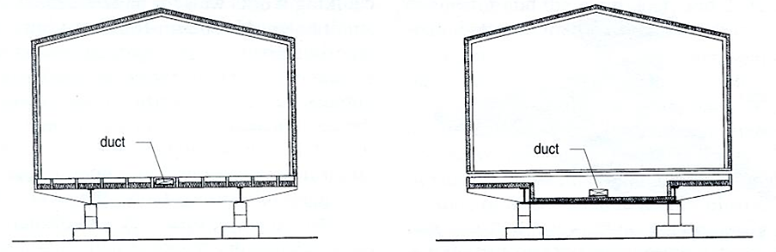
The Basics: Mobile Home Heating System
Section 7: Manufactured Homes
Duct Location
Lengthwise Joists | Main duct installed between floor joists, touching flooring material
Crosswise Joists | Main duct installed below the floor joists

Slide 3
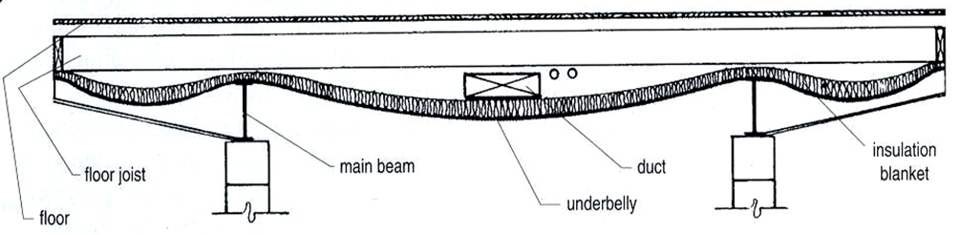
Crosswise Floor Joists
Section 7: Manufactured Homes
Underbelly drops down in the center
Provides more room in the duct and insulating blanket below the duct

Slide 4
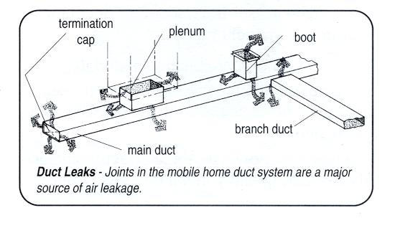
Parts of the Duct System
Section 7: Manufactured Homes
Most, if not all of this, is within underbelly
Majority accessible from inside home or underneath by disconnecting crossover

Slide 5
Duct BlasterTM Fan Connections

Slide 6

Duct Blaster Fan Connections
Section 7: Manufactured Homes
  Four Common Connection Points
  Open Plenum
  Furnace Opening
  Furnace Return
  Supply Register

Slide 7
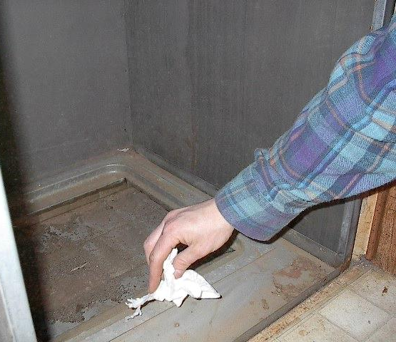
Open Plenum Connection
Section 7: Manufactured Homes
Wipe away any dust around base of the plenum (tape will not stick well to dusty surfaces)

Slide 8
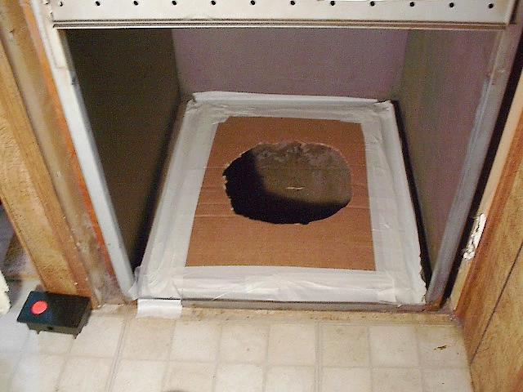
Open Plenum Connection
Section 7: Manufactured Homes
Cover plenum base with a piece of cardboard with a Duct Blaster fan-sized hole; cover all other openings with tape

Slide 9
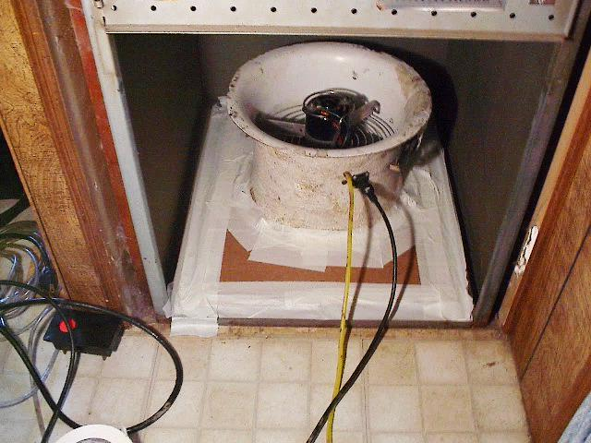
Open Plenum Connection
Section 7: Manufactured Homes
Connect Duct Blaster Fan to the cardboard with tape

Slide 10
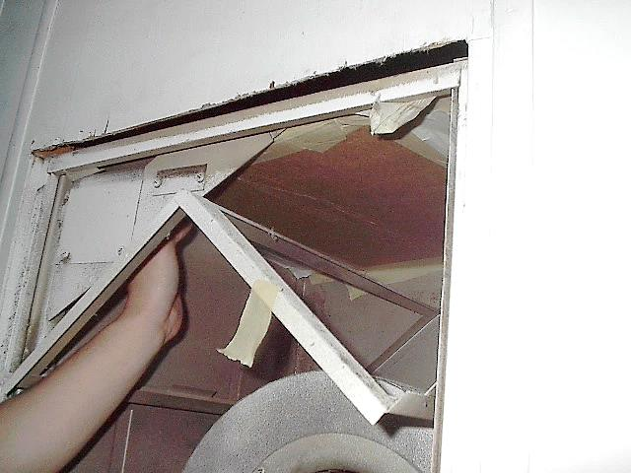
Furnace Opening Connection
Section 7: Manufactured Homes
Use piece of cardboard and tape to seal off the return to the furnace

Slide 11
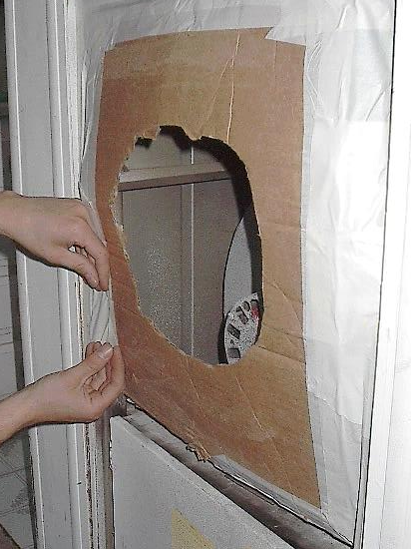
Furnace Opening Connection
Section 7: Manufactured Homes
Cover opening of the furnace with a piece of cardboard with a hole cut in it where snorkel can attach. Cover all other openings with tape

Slide 12
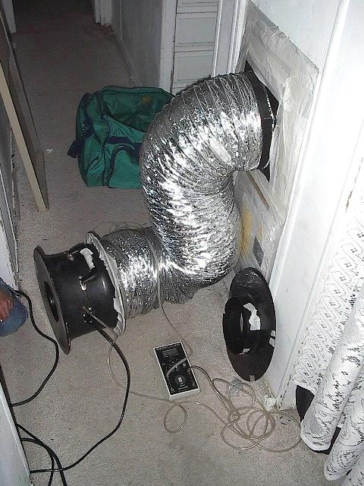
Furnace Opening Connection
Section 7: Manufactured Homes
Connect the Duct Blaster snorkel to the cardboard with tape

Slide 13
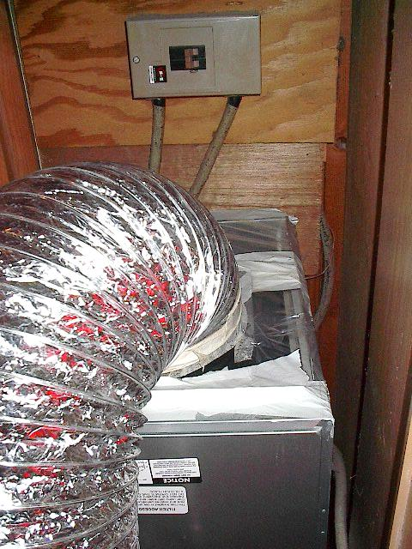
Furnace Return Connection
Section 7: Manufactured Homes
Attach the Duct Blaster snorkel to the furnace return; cover any gaps with tape
233

Slide 14
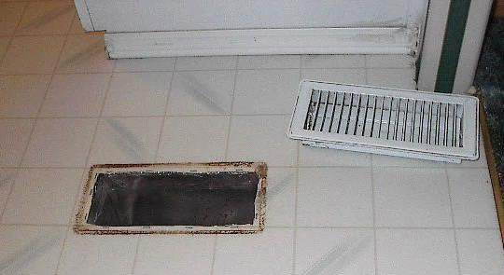
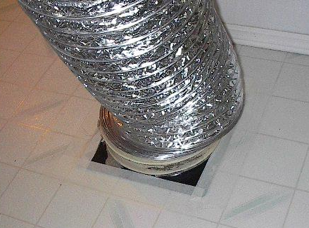
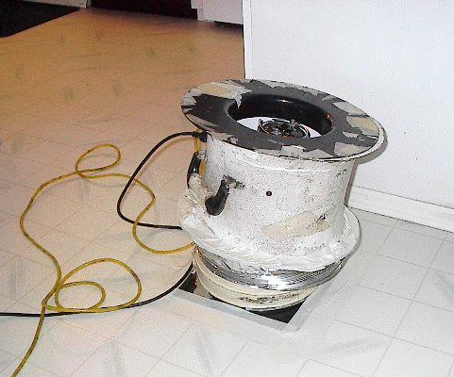
Snorkel to Register Connection
Section 7: Manufactured Homes
Remove the register cover; set aside
Connect Duct Blaster snorkel to the open register using tape. Remember to tape off the return when using this method.
234
Notes:
Do not put duct blaster directly on floor like the far right photo

Slide 15
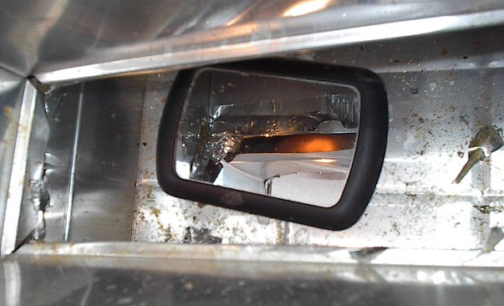
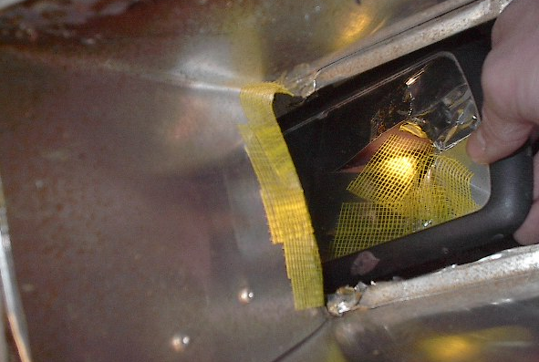
Repair the Boot
Section 7: Manufactured Homes
Remember to always repair the boot!
Don’t have a mirror? Take a picture with your phone to check boot condition
235

Slide 16
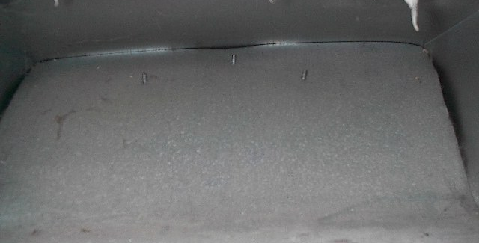
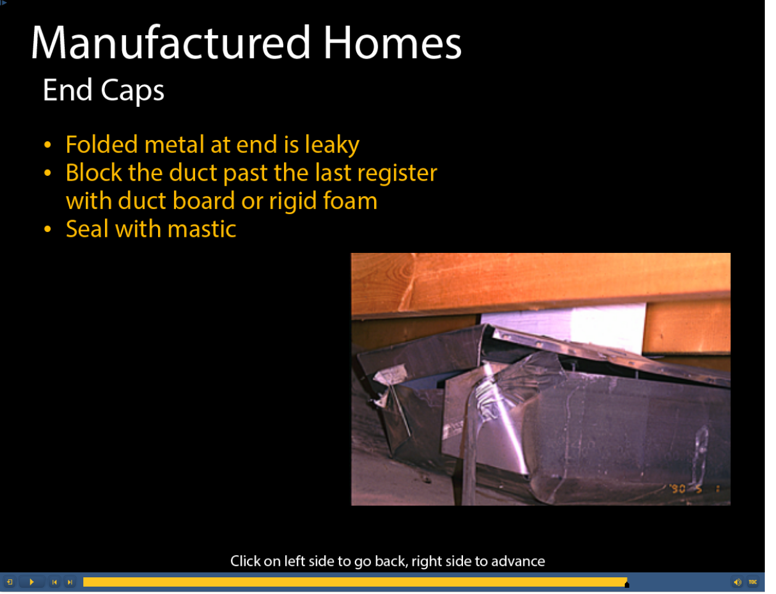

End Caps
Section 7: Manufactured Homes
End caps required on ducts extending beyond last register
Construct using sheet metal or other UL-181 approved rigid material
Seal with mastic
236

Slide 17
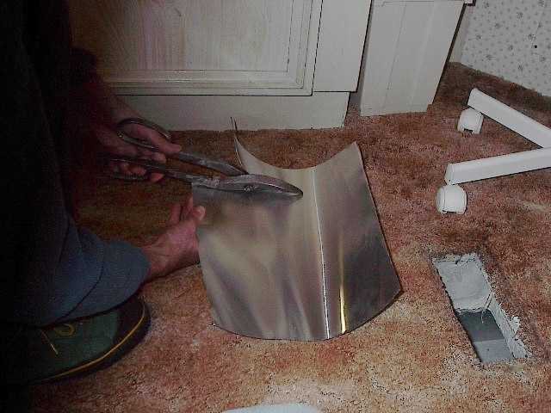
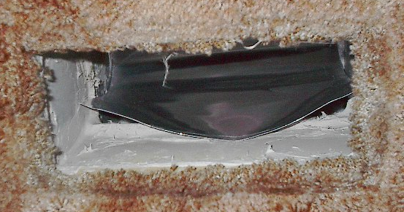
Section 7: Manufactured Homes
End Caps:
Step 1: Cut sheet metal scoop a little smaller than needed and place into boot.

Slide 18
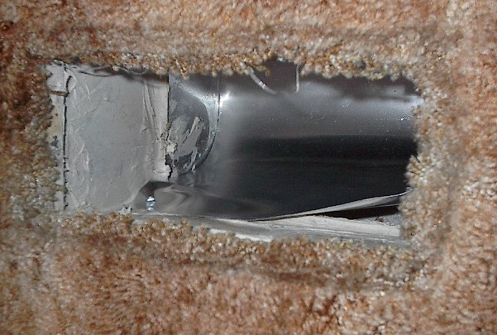
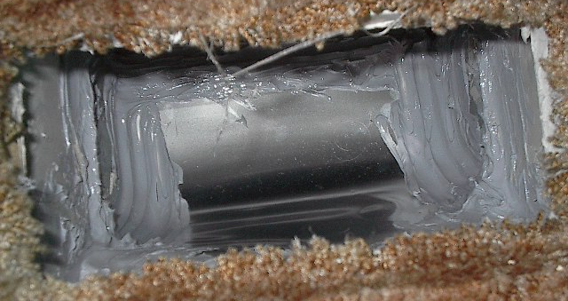
Section 7: Manufactured Homes
End Caps:
Step 2: Screw into place and seal with mastic.

Slide 19
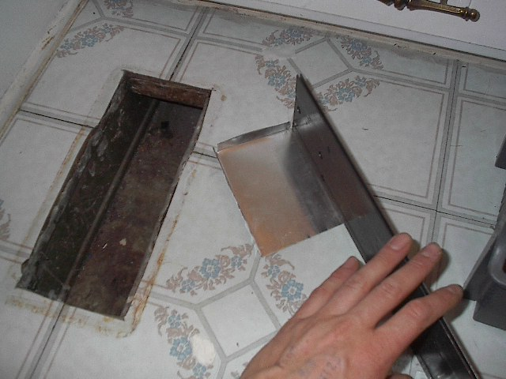
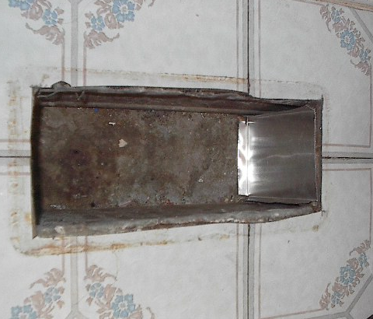
Section 7: Manufactured Homes
End Caps:
Step 3: Lateral ducts sometimes need end caps too.

Slide 20
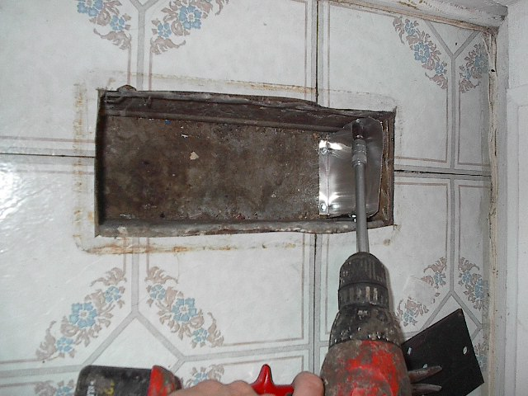
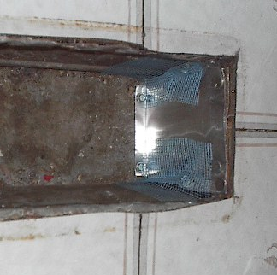
Section 7: Manufactured Homes
End Caps:
Step 4: Screw in place and prep for mastic.

Slide 21
Plenum Seal

Slide 22
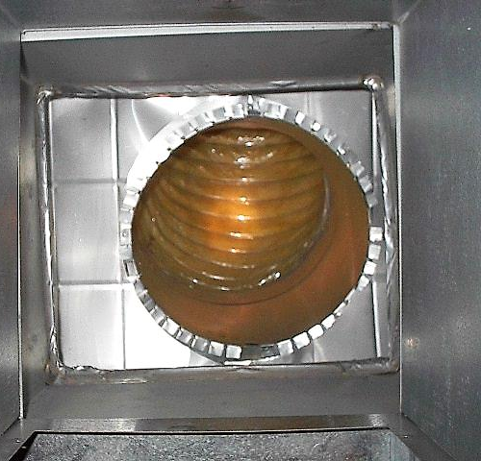
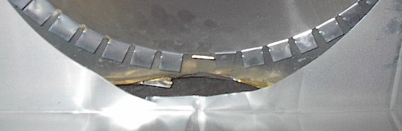
Plenum Connection
Section 7: Manufactured Homes
Connection below a plenum (view from above)
Large Gap
Close up!

Slide 23
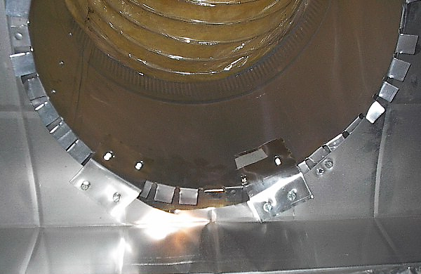
Section 7: Manufactured Homes
Plenum Connection:
Step 1: Sheet metal straps and screws are used to secure
the cross-over to the duct.

Slide 24
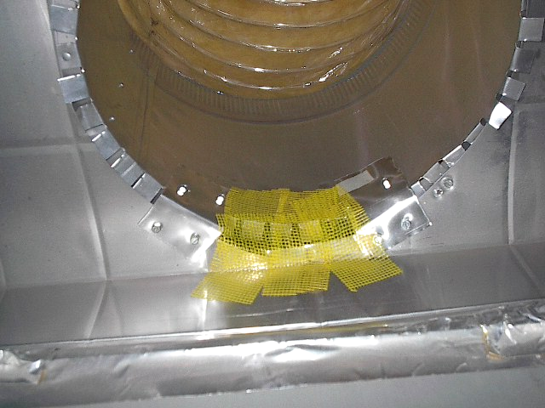
Section 7: Manufactured Homes
Plenum Connection:
Step 2: Mesh is used to cover the rest of the gap.

Slide 25
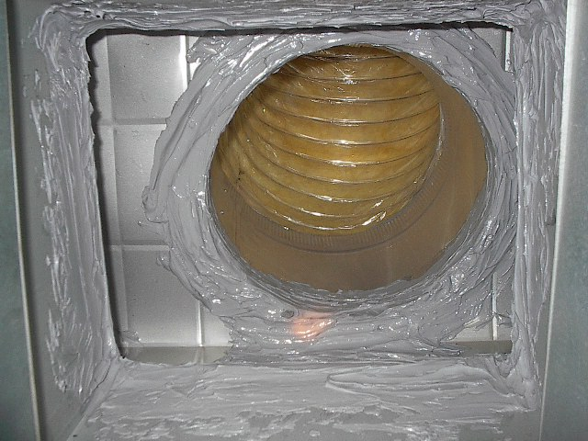
Section 7: Manufactured Homes
Plenum Connection:
Step 3: Finally, all seams around the cross-over to duct are sealed, as well as the furnace to plenum seams.

Slide 26
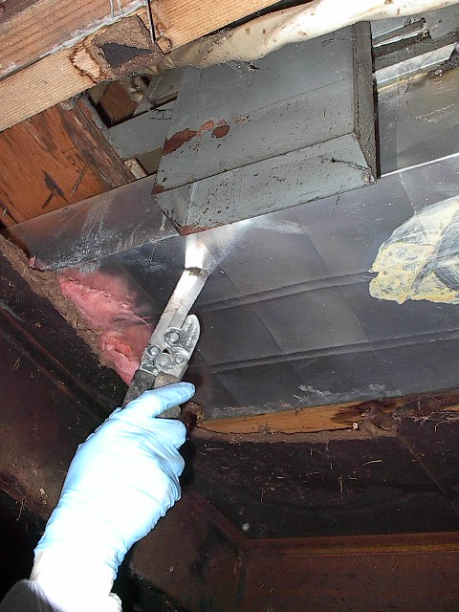
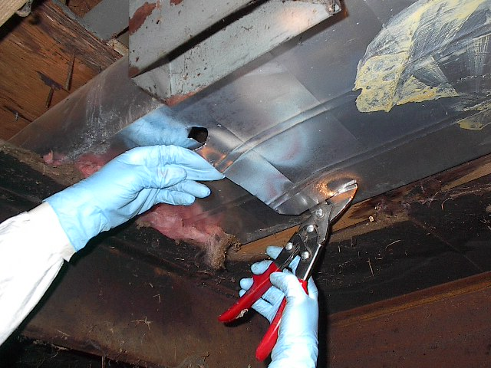
Section 7: Manufactured Homes
Use a duct knife to cut into the plenum. Make this cut directly below the furnace.
Use shears to cut a hole large enough to allow access to the interior of the plenum.

Slide 27
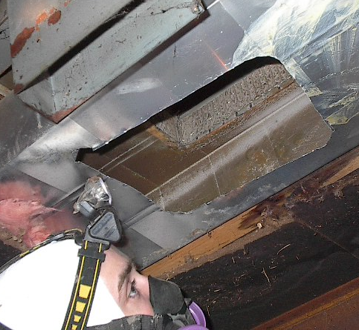
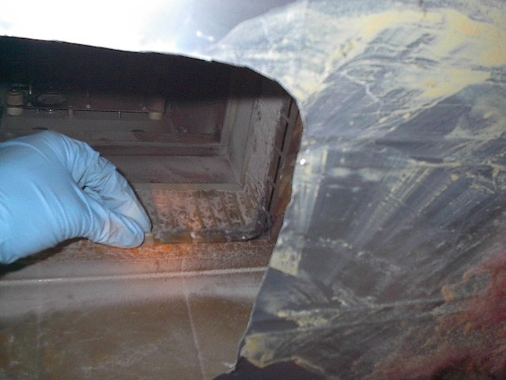
Section 7: Manufactured Homes
Scope for any major leakage. Ensure all the flanges that secure the furnace to the plenum are securely folded over.
247

Slide 28
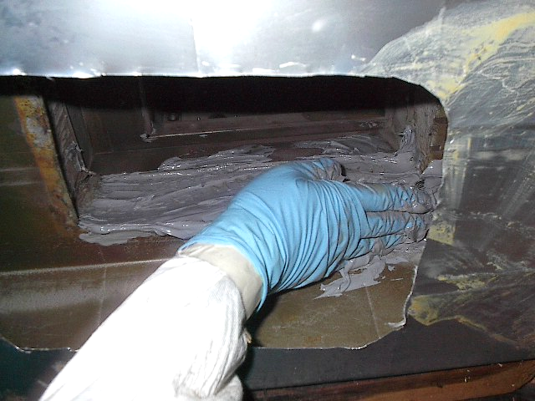
Section 7: Manufactured Homes
Apply mastic to the seams were the furnace and plenum connect. Use mesh tape first to cover gaps larger than 1/4 inch.

Slide 29
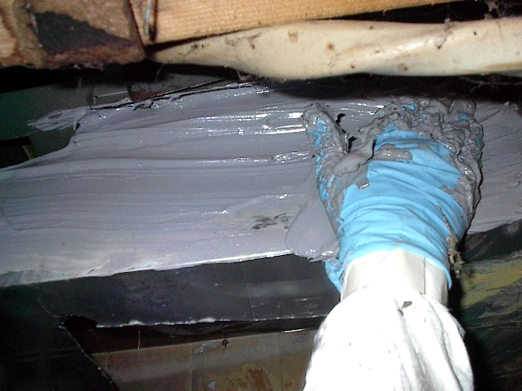
Section 7: Manufactured Homes
Apply mastic to the outside seams if there is nothing structural in the way (flooring trusts, 240 volt wiring).

Slide 30
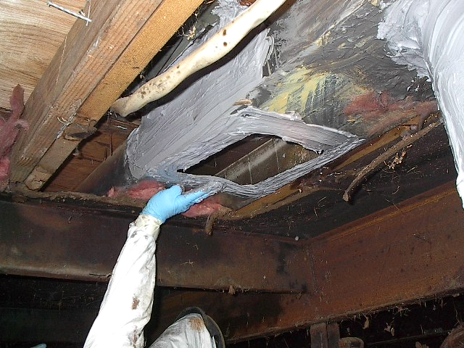
Section 7: Manufactured Homes
Now repair the opening you made to the plenum by first applying mastic to the edge of the hole you cut.

Slide 31
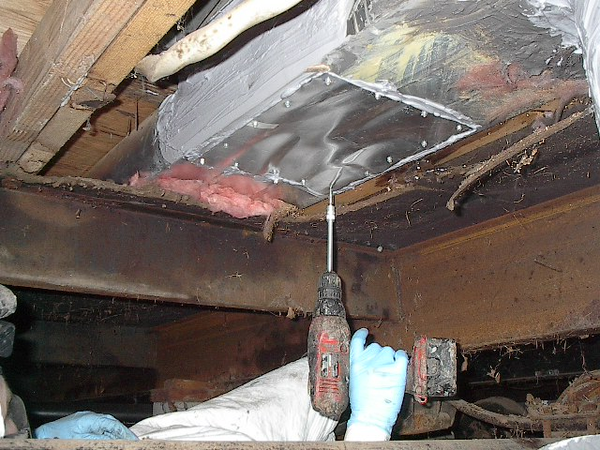
Section 7: Manufactured Homes
Using a screw gun, fasten a piece of sheet metal to cover the entire opening. Make sure there are no gaps around the existing hole.

Slide 32
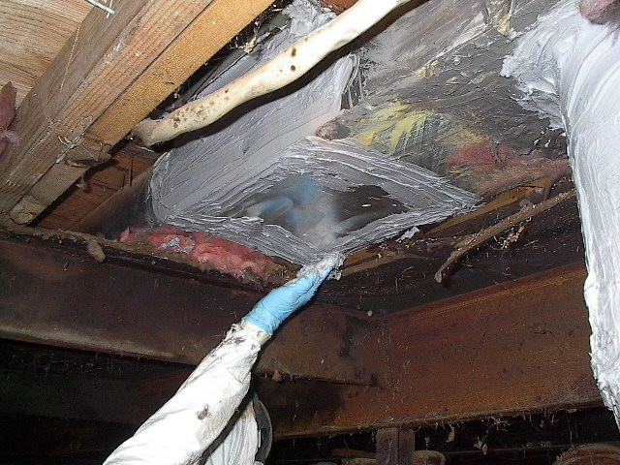
Section 7: Manufactured Homes
Apply mastic to the edge of the sheet metal cover to ensure a tight seal.

Slide 33
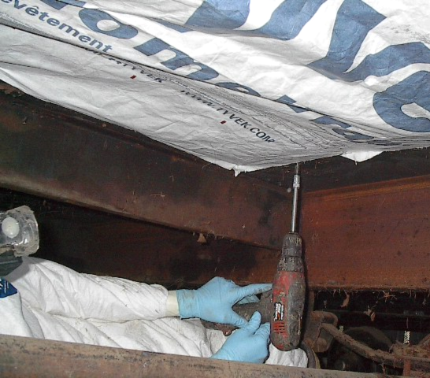
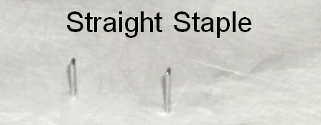
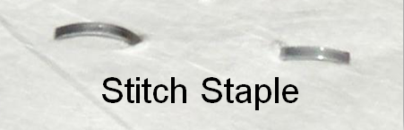
Section 7: Manufactured Homes
Use screws and washers, or a stapler, to attach a Tyvek™ patch over the hole in the belly.
253

Slide 34
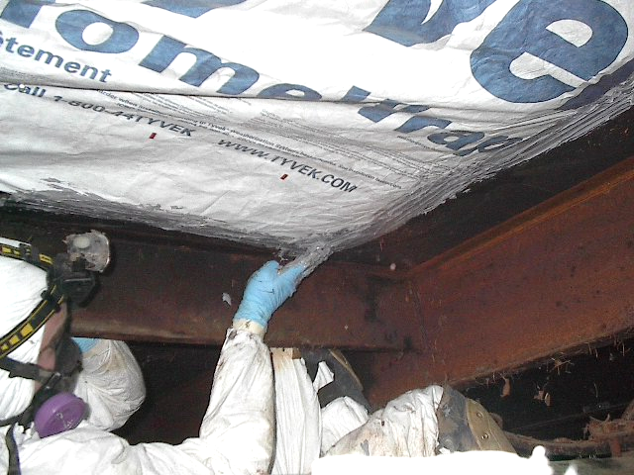
Section 7: Manufactured Homes
Apply mastic to the entire edge of the Tyvek to ensure a tight seal.

Slide 35
Cross-Over Repairs

Slide 36
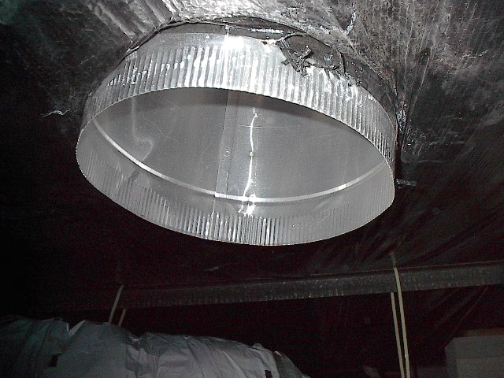
Section 7: Manufactured Homes
Remove the old cross-over duct and any remnants that were used to connect it to the take-off. A clean working surface is needed for a tight seal.

Slide 37
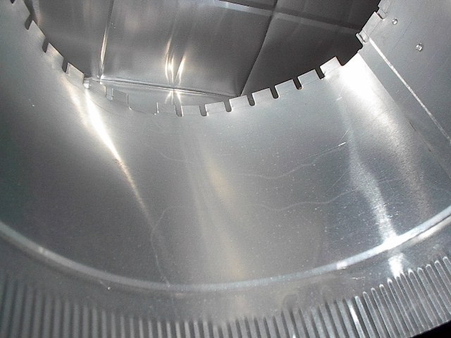
Section 7: Manufactured Homes
Look for unfolded connection tabs in the interior of the take-off were it connects to the duct.

Slide 38
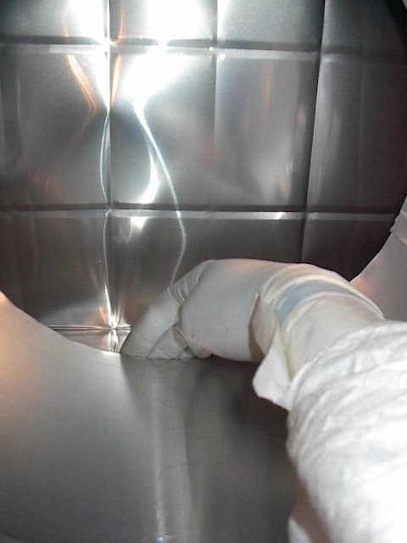
Section 7: Manufactured Homes
Fold over any unfolded connection tabs.

Slide 39
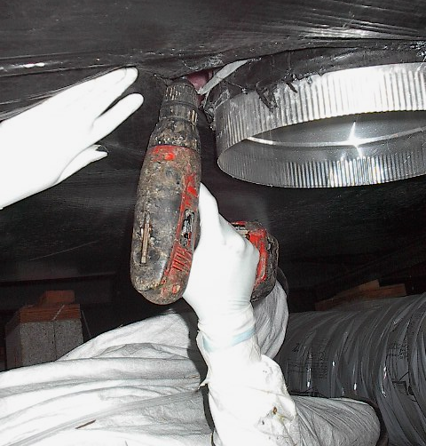
Section 7: Manufactured Homes
Using a screw gun, attach the connection lip to the duct work. Use at least one screw on all four sides to secure it to the duct.

Slide 40
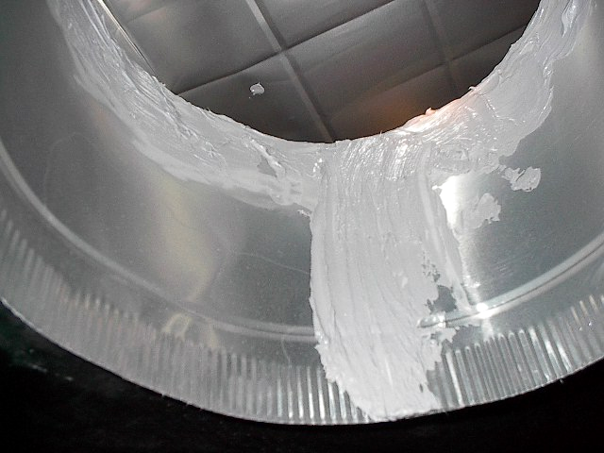
Section 7: Manufactured Homes
Apply mastic to the duct take-off seam.

Slide 41
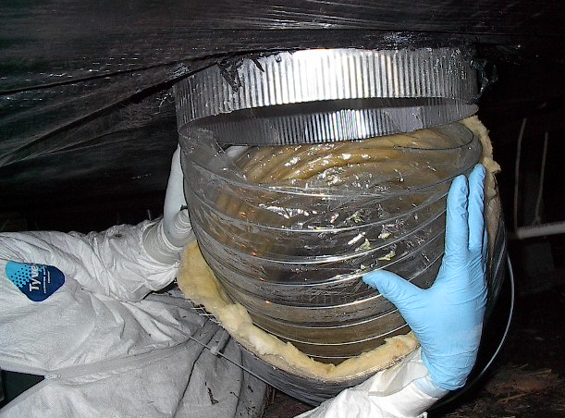
Section 7: Manufactured Homes
Slip the inner lining of the cross-over, around the take-off of the duct work. Slide the lining up far enough so that two loops of the inner lining support are inside the ductwork.

Slide 42
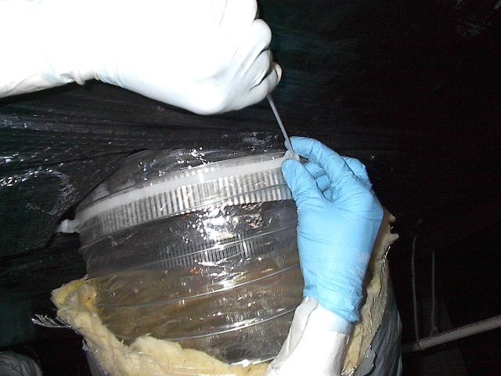

Section 7: Manufactured Homes
Hand tighten the Panduit™ strap around the inner lining of the crossover.
Use the Panduit™ gun to tighten and snip off the excess strap.
The ribs of the strap should face inside.
262

Slide 43

Section 7: Manufactured Homes
Prepare a Panduit™ strap for the exterior of the cross-over duct. Place it around the cross-over down from the connection.

Slide 44


Section 7: Manufactured Homes
Hand tighten the Panduit™ strap around the outer lining of the crossover.
Use the Panduit™ gun to tighten and snip off the excess strap.

Slide 45

Section 7: Manufactured Homes
Make sure the cross-over duct is elevated at least 6 inches off the ground.

Slide 46

Carpe Seal ’Em
Section 7: Manufactured Homes

Slide 47
Section 8 of 10:
Combustion Safety

Slide 48

Section 8: Combustion Safety
Section 8: Combustion Safety
CO Alarm Requirement
Carbon Monoxide
Combustion Safety Plan

Slide 49


Combustion Equipment? CO Alarm Required
Section 8: Combustion Safety
If there’s anything that burns any fuel in the house or attached structure, the program requires that a CO alarm be installed.
    No matter if it uses gas, propane, fuel oil, wood, etc. –
    just that it burns something
Notes:
Even if homeowner has a fireplace that is rarely if ever used and they feel they don’t need a CO detector, it’s still required.

Slide 50
Combustion Safety Testing Can Include…
Section 8: Combustion Safety
Polluting equipment not allowed in a home
Carbon Monoxide (CO) testing
Gas leak testing
Back drafting testing in room with CAZ equipment
Carbon monoxide monitor requirement
Measurement of flue gases
Notes:
Cover the different levels of CAZ testing and what PTCS requires. This exposes them to the different protocols available and they can formulate their own combustion safety plan.

Slide 51
Affect of Carbon Monoxide (CO)
Section 8: Combustion Safety
Even in small concentrations, it can cause sickness and even death.
PPM CO in air | Symptoms experienced by healthy adults | Comments
Less than 35 ppm | No effect in healthy adults | 35 ppm is WISHA 8-hour average permissible limit
200 ppm | Headache, fatigue, nausea, dizziness | 200 ppm is the WISHA ceiling limit
400 ppm | Severe headache, fatigue, nausea, dizziness, confusion, can be life-threatening after 3 hrs of exposure
1,500 ppm | Headache, dizziness, nausea, convulsions, collapse, death within 1 hour | Greater than 1,500 ppm are considered “immediately dangerous to life or health”
3,000 ppm | Death within 30 minutes
6,000 ppm | Death within 10–15 minutes
12,000 ppm | Nearly instant death

Slide 52



Causes of CO in Homes
Section 8: Combustion Safety
Urban Traffic
Cars started in garages
Unvented combustion equipment
Backdrafting combustion equipment
Failed heat exchangers
General Rule
If there is combustion, there might be CO
Corroded and cracked furnace heat exchanger

Slide 53




Unvented Combustion Equipment: Not Safe
Section 8: Combustion Safety

Slide 54


Section 8: Combustion Safety
CO By-Product of Incomplete Combustion
Large amounts of heat energy are released during the combustion process

Slide 55

Section 8: Combustion Safety
Potential Negative Effects of Duct Sealing
A lower rate of dilution
Back drafting of combustion equipment
Build up of CO in the home
Duct Sealing companies should have a plan to reduce liability

Slide 56

Section 8: Combustion Safety
Why Category I Appliances Vent
When air is heated the molecules move further apart making it less dense than the surrounding air.
Denser air pushes the lighter air up the vent.

Slide 57

Section 8: Combustion Safety
Buoyancy Creates Draft Pressure
The driving force that moves a hot air balloon up is the same driving force that vents the gas water heater.
Buoyancy, not heat.

Slide 58
Driving Forces That Make Air Move
Section 8: Combustion Safety
Wind
Stack (Chimney Effect)
Exhaust Fans
Duct Leakage
Unbalanced Forced Air Systems (interior door closure)

Slide 59
Competing Pressures
Section 8: Combustion Safety
Driving forces compete for the same air
Draft is a very weak force; loses out to stronger pressures

Slide 60

Section 8: Combustion Safety
DO NOT Create Back Drafting Problems
Turning on exhaust fans and leaky supply ducts outside the house can create negative pressure in the room where the combustion equipment is located.
  May cause combustion gases to be pulled down the flue
  Back drafting combustion appliances can produce large amounts of CO, often in the thousands of parts per million.

Slide 61
Section 9 of 10:
Participation Rules & Paperwork

Slide 62
Section 9: Participation Rules & Paperwork
Next Steps to Certification
Online Account
Technician Application
Entering a Job into the Mobile Registry
Quality Assurance Inspections

Slide 63
Next Steps to Certification
Section 9: Participation Rules & Paperwork
Step 1
Pass this training’s exam
Step 2
Create online account on ptcs.bpa.gov
Step 3
Submit Certified Technician Application found in “How to Participate” section on www.bpa.gov/goto/reshvac

Slide 64


Step 2: Create Online Account Now!
Section 9: Participation Rules & Paperwork
Go to ptcs.bpa.gov and click “Register” to create a profile.
Mobile view
Desktop view
Account will be activated and tech ID assigned when all the steps are completed.

Slide 65

Step 3: Certified Technician Application
Section 9: Participation Rules & Paperwork
Find it at the end of your Trainee Manual or in “How to Participate” section on www.bpa.gov/goto/reshvac
Submit photos or scans of completed & signed application by email to ResHVAC@bpa.gov or fax it to 1-877-848-4074
Note: Submit this form when tech is new, receives additional training, or needs to update company info.

Slide 66
Next Steps: Some Clarification
Section 9: Participation Rules & Paperwork
A non-PTCS Certified technician can seal the ducts, but a PTCS certified technician must perform the leakage tests and inspect the duct sealing.
Certification will follow you to any company. Submit new Certified Technician Application to update information.

Slide 67
Beyond Certification
Section 9: Participation Rules & Paperwork
Enter in Online Registry*
Test and Seal Ducts
Submit Documentation to Utility
May qualify for a Quality Assurance Inspection
Get Certified
*Enter using mobile device with internet access or use the optional form for later entry

Slide 68

Entering a Job: Online Registry
Section 9: Participation Rules & Paperwork
Log in to installing technician’s account at ptcs.bpa.gov and click “Enter a Project” or click “Contractors” and select “Enter a Job”.
For a guide on entering a job online, see page 19 in your Trainee Manual.
Mobile view

Slide 69
Mobile Registry Updates
Section 9: Participation Rules & Paperwork
Online registry optimized for use on any mobile device
  Not an app you download
Save progress function to complete entered data later
  Enter job data before, during, and after installation by saving your progress
Times out after 4 hours of inactivity
Informational bubbles explaining some program components
Some limitations
  No offline entry mode. Can’t use without internet access.
  Optional forms available to record data for later entry, but not required to submit.

Slide 70
Exercise: Optional Mobile Entry Practice
Section 9: Participation Rules & Paperwork
Go to test site on a mobile device: https://ptcs.test.bpa.gov
  Only a test environment. Nothing will publish live on this site.
Sign in:
  Username:TestContractor
  Password: Ptcs1234
Enter a job:
  Active physical address
  Enter any data. Some suggestions:
    Pre-test Ring 1, Fan Pressure 86 Pa, and CFM 382
    Post-test Ring 3, Fan Pressure 140 Pa, and CFM 74

Slide 71
Registry Entry Tip!
Section 9: Participation Rules & Paperwork
Fan Pressure ≠ House Pressure
Upon entry into the registry, enter the correct duct blaster fan pressure and not the house test pressure of 50 Pa.
If you do this, your house may be rejected
The registry calculates the flow in CFM using:
  Ring Size
  Fan Pressure

Slide 72
Troubleshooting Entry Issues
Section 9: Participation Rules & Paperwork
Contact the PTCS team if:
  Address isn’t validating
  Need to enter in a second system
  Can’t find an entered job
  Need to edit an address or submitted data
  Need immediate review of “Pending” entry (reviewed regularly)

Slide 73


Section 9: Participation Rules & Paperwork
Optional PTCS Duct Sealing Form
If no internet or mobile device is available or the job cannot be entered online for any reason, this form is available to record the data for later entry.
Can be found on ptcs.bpa.gov and at the end of your manual.
* Some participating utilities require installation form, please check with utility prior to job submission

Slide 74

Section 9: Participation Rules & Paperwork
Notifying Utility of the Completed Job
Technician or company required to notify the utility of the completed job.
Contact customer’s utility for information on required paperwork.
Utilities have access to the online registry and are able to review completed job details.

Slide 75


Quality Assurance Inspections
Section 9: Participation Rules & Paperwork
At least 10% of all jobs are inspected for:
  Measured Leakage
  CO Detector Installed, if required
  Crossover (Manufactured Home)
  Sealing and Repairing Air Handler to Plenum
  Ducts in Good Repair
  Joints Fastened
  Tape Removed and/or Covered with Mastic
  Ducts Sealed
  Duct Insulation Re-installed
Notes:
We try to QA the first 3 jobs a contractor submits. Some utilities do this some do not.

Slide 76

QA Inspection Feedback & Remediation
Section 9: Participation Rules & Paperwork
Inspection feedback will be communicated to the technician and/or their company. See the “PTCS Technician Support Plan” at the end of your Trainee Manual for what to expect if a project does not pass inspection.

Slide 77
Section 10 of 10:
Resources

Slide 78

Program Website
Section 10: Resources
All of the following are on this website: https://ptcs.bpa.gov
  Specifications
  Requirements
  Technical and Training Resources
  Online Registry Resources
  Link to Online Marketing Portal
  Installation Forms
Notes:
Tech and training resources include: Equipment setup diagrams and equipment conversion tables

Slide 79

Program Website: Technical Resources
Section 10: Resources
Go to the “PTCS and Prescriptive Duct Sealing” section on www.bpa.gov/goto/reshvac
Technical Resources for Duct Sealing include:
  Leakage Testing Diagrams
  Blower Door Set Up Diagram
  Flow Conversion Tables

Slide 80

Section 10: Resources
Spanish Materials
Now available in Spanish:
  PTCS training presentations
  Manuals
  Tests
  Forms
Contact Eli Caudill at CLEAResult: eli.caudill@clearesult.com
300

Slide 81


Equipment Discount
Section 10: Resources
Discount now available to purchase duct testing equipment:
  12.5% discount for Blower Door and Duct Blasters from TEC
  12.5% discount for digital gauges from TEC
Discount form included at the end of your Trainee Manual
Submit this form to Eli Caudill at CLEAResult: eli.caudill@clearesult.com

Slide 82

Stay Informed!
Section 10: Resources
Sign up for the Quarterly Newsletter or visit the PTCS website for the latest announcements
  Updated specifications
  Online registry changes
  Common issues in the field
  Updated program requirements
  New technical support resources
  Tips and tricks
Go to https://tinyurl.com/ptcsnewsletter
or email ResHVAC@bpa.gov to sign up. Also sign up from the “Stay Informed!” link on the website.
We guarantee we will not spam you or sell any of your information.

Slide 83

Section 10: Resources
New Training Tools and Support
New LMS site: https://clearesult.moodle.school/login/index.php
      Admin/Sales Webinar
      Heat Pump Sizing Webinar

Slide 84

Good luck on the Exam!
Contact the PTCS Team:
Phone: (800) 941-3867
Email: ResHVAC@bpa.gov
Questions?
Comments?

Slide 85

Energy Trust of Oregon Jobs
For questions concerning PTCS installations for customers of Pacific Power or Portland General Electric, please call 1-866-365-3526 or email Residentialforms@energytrust.org.

