Slide 1
Smart Grid Development by the
U.S. Department of Energy
Presented at Virtual Energy Forum
Dan Ton
Program Manager, Smart Grid R&D
December 1, 2011

Slide 2
Presentation Outline
Overview of Smart Grid
Definition, Goals, Assets, Applications, Values, Barriers
DOE Programs Addressing Smart Grid Barriers
  Recovery Act Grid Modernization Focus Areas
  DOE Smart Grid R&D Program
International Smart Grid Coordination and Collaboration
2

Slide 3
Smart Grid: What is it?
DOE has defined seven core Smart Grid characteristics
Customer Participation
Integrates All Generation and Storage Options
New Markets and Operations
Power Quality for 21st Century
Asset Optimization and Operational Efficiency
Self-healing
Resilient Against Attacks and Disasters
The Smart Grid Initiative is to develop and implement advanced information, communication, and control technologies, along with supportive policies, to
achieve all seven characteristics.
3
Notes:
3

Slide 4
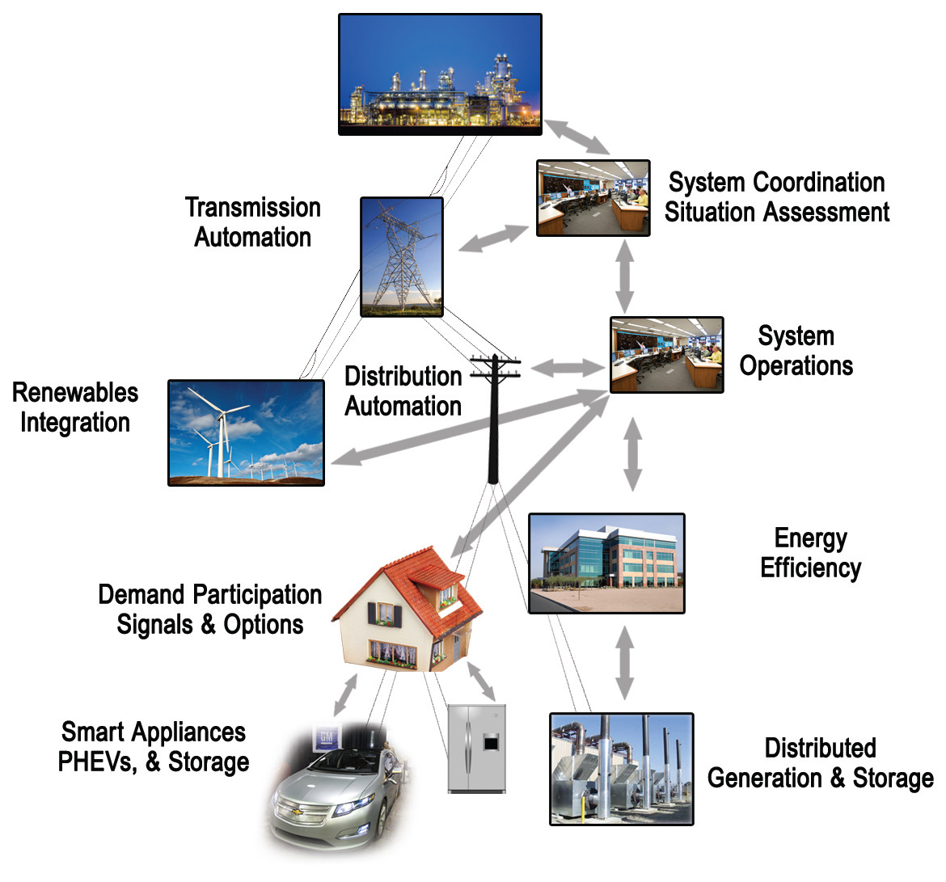
Smart Grid Technology Areas
4
4

Slide 5
Mapping of Smart Grid Assets (Components), Applications, and Technology Areas
technology
areas
manage peak load
wholesale operations
Applications
ancillary services
integrate renewables
enhance reliability
efficiency & carbon
DR
DG
DS
DA/FA*
EVs &
PHEVs
Smart
Meters
Comm.
Networks
Business
Systems
PMUs …
Primary Assets
Enabling Assets
* DA/FA: Distribution automation/feeder automation
5
Notes:
Beyond describing the smart grid as a vision, it is helpful to describe what the smart grid is in terms of
the assets that would be purchased
the applications for which they would be used, from which benefits are derived.
This is shown in the form of a matrix, with a number of key assets on the horizontal axis and broadly-defined categories of some of the major applications on the vertical axis.
These are illustrative of the current and emerging vision for the smart grid. (They are not intended to be definitive or comprehensive lists, but rather will evolve over time.)
The assets are further divided into primary and enabling assets.
Primary assets are the smart grid’s “prime movers,” that is, new assets that are actively controlled to effect change in grid operating conditions.
Enabling assets are the new sensing, software, and information infrastructure required that enables coordination and response to grid conditions. Although more accurately portrayed as a separate third dimension, enabling assets are shown here on the same axis for clarity.

Slide 6
Assets + Applications Value Creation
6

Slide 7
Barriers to a Smart Grid
Businesses, state regulators, and consumer advocates are unconvinced of the value of smart grid technologies due to lack of performance data on costs and benefits
Insufficient or inadequate technologies, components, and systems to leverage IT potential of smart grid
No established standards for interoperability of systems and components
Insufficient cyber security for a smart grid architecture
Lack of a skilled workforce to build, install, operate, and maintain systems and equipment
Consumer understanding of the electrical infrastructure and opportunities enabled by smart grid technologies
7

Slide 8
OE Program Addresses Key Barriers
Barriers to Smart Grid
Inadequate Technologies
&
Components
No
Standards
for
Interoperability
Insufficient
Cyber Security
Lack of a Skilled
Workforce
Lack of a Strong Business Case
Uninformed
Consumers
Federal
Smart Grid
Task Force
Smart Grid R&D
Cyber Security
For Energy
Delivery
Smart Grid
Stakeholder
Books
Smart Grid
Investment
Grants
Energy Storage
R&D
Workforce
Training
Development
Grants
Interoperability
Standards
OE Activities
Smart Grid
Websites
Clean Energy
Transmission
Reliability
Smartgrid.gov
Smart Grid
Demonstration
Program
Infrastructure
Security and
Energy
Restoration
Stakeholder
Engagement
Process
Smart Grid
Information
Clearinghouse
Smart Grid
Development
EPRI
NARUC
FERC
NIST
Smart
Response
Collaborative
DOE EERE
Programs
DHS S&T
DHS NCSD
NIST
DOD Spiders
NERC
State Training
- California
- Arkansas
- Colorado
- Wyoming
- Northern
Plains and
Rocky Mtn
Consortium
Utility
Programs
SmartGrid
Consumer
Collaborative
NARUC
NIST
APPA
DOE ARPA-E
FERC
Other Activities
DOD Spiders
NRECA
The Galvin
Initiative
EPRI
ISGAN
PSERC
8

Slide 9
Recovery Act
Grid Modernization Focus Areas
9

Slide 10
Recovery Act – Grid Modernization
    Programs created by statute
      Energy Infrastructure Security Act 2007:
            Smart Grid Investment Grants (Sec. 1306)
            Smart Grid Regional Demonstrations
            (Sec.1304)
      Recovery Act Directed Programs:
          Workforce Training - $100M
              Interconnection-wide
              Transmission Planning and
              Resource Analysis - $80M
              Interoperability Standards
              - $12M
          Additional OE initiatives
              State & Local Energy Assurance
              State Regulatory Assistance
One-time Appropriation,
$4.5B in ARRA funds
  $620M for demonstration projects
  $3.425B for deployment projects
Resource Assessment &
Transmission Planning
Smart Grid Interoperability Standards
Other
Top 10 States by Total Awarded
State | Amt ($M)
NC | 434
CA | 419
TX | 293
NY | 276
FL | 270
PA | 265
MD | 233
DC | 213
AL | 166
OH | 146
Workforce Training
Smart Grid Demos
Investment Grants
$4.5 billion obligated by end of FY10
$1.6 billion paid out to date
10
Notes:
Major Awards in top 10 states
NC – SGIG: Progress $200M, Duke $200M – SGDP: Duke $22M - Workforce: Duke $3.5M, NC State $2.5M
CA – SGIG: Sacramento Muni $128M, SDG&E $28M, Burbank $20M, Glendale $20M – SGDP: LA DWP $60M, SoCalEd $40M (SG) and $25M (storage), PG&E $25M, Primus Power $14M
TX – SGIG: Centerpoint $200M, Reliant $20M, Golden Spread $17M, Denton County $17M – SGDP: Pecan Street $10M
NY – SGIG: ConEd $136M, NY ISO $38M, SGDP: ConEd $45M, NY State Elec & Gas $30M, Long Island Pwr $12.5M
FL – SGIG: Florida Pwr & Light $200M, Lakeland $15M, JEA $13M, Leesburg $10M, Tallahassee $9M, Talquin $8M
PA – SGIG: PECO $200M, PPL $19M, PJM $14M – Interconnection Planning: PJM $16M
MD – SGIG: BG&E $200M
DC – SGIG: PEPCO $105M (work performed in MD), PEPCO $45M (work in DC)
AL – SGIG: Southern $165M
OH – SGIG: FirstEnergy $57M – SGDP: Columbus Southern (AEP Ohio) $75M

Slide 11
Recovery Act – Grid Modernization Goals
Deployment of Smart Grid Technologies
15.5 million smart meters
800 Phasor Measurement Units
6,500 Distributed Circuits
Economic Benefits
Reductions in monthly bills for customers with smart meters and enabling technologies
Reductions in peak demand translate to less generation capacity required
Reductions in operating costs for distribution circuits with automated equipment
Reliability Benefits
Reduction in length of power outages
Reduction in frequency and geographic scope of power outages
Environmental Benefits
Reductions in energy wasted (line losses) in distribution circuits
Reduced emissions of CO₂, NO_{X} , and SO_{X} associated with electricity consumption of customers with smart meters and enabling technologies
11

Slide 12
Smart Grid Investment Grants (SGIG)
Number of Projects
Selected Projects
Total Funding | $7,863,897,259
Federal Share | $3,425,938,323
Total Number of Projects | 99
Deployment of current technological components for immediate commercial use
Support of manufacturing, purchasing, and installation of smart grid technologies
Large projects: $20M-$200M Small projects: $394K-$20M (Federal share)
3-year projects
SGIG Recipient Types
12

Slide 13
  Smart Grid Demonstration Program (SGDP)
Number of Projects
Selected Projects
Total Funding | $1,647,637,256
Total Federal Funding | $620,027,274
Total Number of Projects | 32
Demonstrate emerging technologies (including energy storage) and alternative architectures
Validate business models
Address regulatory
and scalability issues
Large projects: $20M-$89M Small projects: $720K-$20M (Federal share)
4-year projects (average)
SGDP Recipient Types
Non-Profit, 9%
13

Slide 14
  Distribution of Projects by Technology
131 total projects in the SGIG and SGDP programs, with some projects installing multiple technologies

Slide 15
  Distribution of AMI Projects
  & Customer Engagement
76 projects have AMI and some type of customer program,
most being pilot activities engaging a limited segment initially
Note: Project components are NOT mutually exclusive

Slide 16
  SGIG: Distribution Automation

Slide 17
  Recovery Act - Transmission
$308M ($153M Federal) dedicated to
10 Transmission Projects
American Transmission Company (PMU)
American Transmission Company (SCADA)
Duke Energy Carolinas
Entergy Services
Midwest Energy
Midwest ISO – 9 transmission utility partners
ISO New England – 7 transmission utility partners
New York ISO – 8 transmission utility partners
PJM Interconnection – 12 transmission utility partners
Western Electricity Coordinating Council – 18 transmission utility partners
By 2013, over 900 networked phasor measurement units (PMUs) will be installed, providing nearly complete coverage of the transmission system.
17
Notes:
Total budget of the SGIG projects is more than $300 million, including 50% from Recovery Act funding, making the projects collectively the single largest synchrophasor effort ever undertaken.
American Transmission Company (PMU) - $1.3M – WI (Waukesha)
American Transmission Company (SCADA) - $11.4M – WI (Waukesha)
Duke Energy Carolinas - $4M - NC
Entergy Services - $4.6M - LA
Midwest Energy - $712k - KS
Midwest ISO - $17.3M – 9 transmission utility partners in:
MT, ND, SD, MI, WI, MI, IA, IL, IN
ISO New England - $8M – 7 transmission utility partners in:
ME, NH, VT, MA, CT, RI
New York ISO - $38M– 8 transmission utility partners in NY
PJM Interconnection - $14M – 12 transmission utility partners in:
DE, IL, IN, KT, MD, MI, NJ, NC, OH, PA, TN, VA, WV, DC
Western Electricity Coordinating Council - $54M – 18 transmission utility partners in:
WA, OR, CA, NV, NM, AZ, UT, ID, CO, WY, MT, ID
NOTE: “over 900” includes 166 installed before ARRA + 804 ARRA

Slide 18
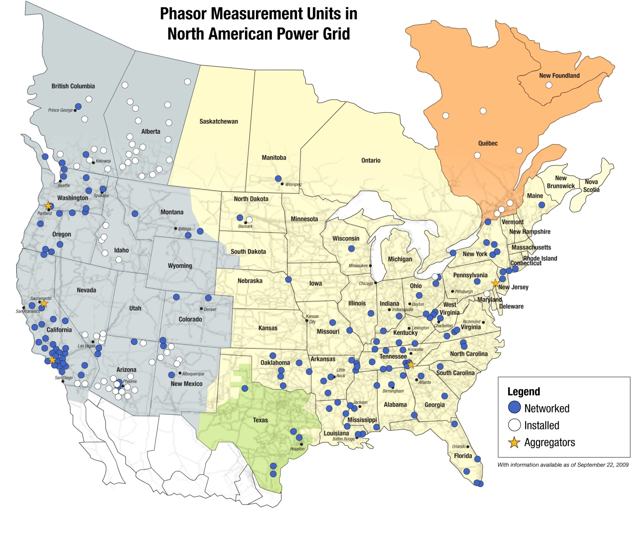
  Recovery Act – PMU Deployment
The SGIG program is supporting the deployment of
804 phasor measurement units (PMUs) across the US.
ATC
48 PMUs
NYISO
39 PMUs
ISO-NE
30 PMUs
WECC
250 PMUs
PJM
81 PMUs
MISO
150 PMUs
Duke Energy Carolinas
102 PMUs
Midwest Energy
21 PMUs
SGIG Total
804 PMUs
Entergy
38 PMUs
FPL
45 PMUs
Source: Map from North American Synchrophasor Initiative, 2009
18

Slide 19
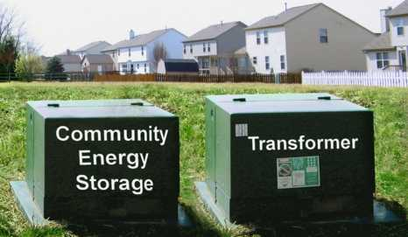
  Recovery Act - Energy Storage
$586 million in private investment from $185 million in federal funds
➔ Better than 3:1
Energy Storage Regional Demonstration Projects Include
Large Battery Systems
(3 projects, 53MW)
Compressed Air
(2 projects, 450MW)
Frequency Regulation
(20MW)
Distributed Projects
(5 projects, 9MW)
Technology Development
(5 projects)
20 Li-Ion community energy storage units on Detroit Edison grid
19
Notes:
Large Battery Systems (3 projects, 53MW)
Primus Power Corp (CA) - $14M award/ $33M cost share
Southern California Edison (CA) - $25M award/ $29M cost share
Duke Energy Business Services (NH company, proj in TX) - $22M award/ $22M cost share
Compressed Air (2 projects, 450MW)
New York State Electric & Gas Corp (NY) - $30M award/ $95M cost share
Pacific Gas & Electric (CA) - $25M award/$330M cost share
Frequency Regulation (20MW)
Beacon Power (MA) - $24M award/$24M cost share
Distributed Projects (5 projects, 9MW)
Detroit Edison (MI) - $5M award/ $6M cost share
Premium Power Corp (MA) - $7M award/ $9M cost share
Public Service Company of New Mexico (NM) - $2M award/ $4M cost share
City of Painesville (OH) - $4M award/ $4M cost share
East Penn Manufacturing (PA) - $2M award/ $2M cost share
Technology Development (5 projects)
Amber Kinetics (CA) - $4M award/ $4M cost share
Seeo, Inc (CA) - $6M award/ $6M cost share
44 Tech, Inc (PA) - $5M award/ $5M cost share
KTech Corporation (NM) - $5M award/ $5M cost share
SustainX, Inc (NH) - $5M award/ $5M cost share

Slide 20
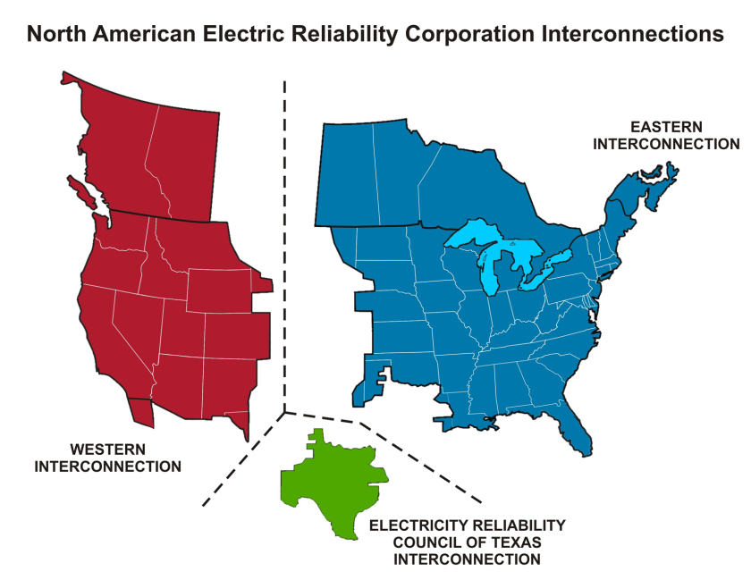
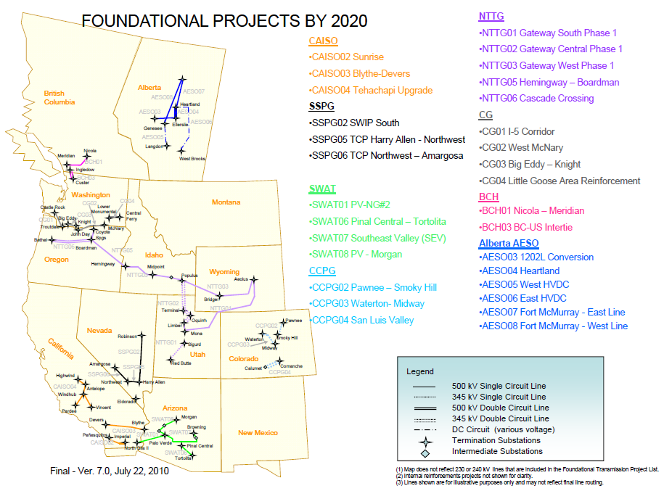
  Recovery Act - Transmission Planning
Consensus scenarios for future electricity supplies and analyzing environmental and other considerations that will be incorporated into transmission plans
Long-term resource and transmission planning studies in 2011, with update in 2013
The knowledge and perspective gained from this work will inform policy and regulatory decisions in the years to come and provide critical information to electricity industry planners, states, and others to develop a modernized, low-carbon electricity system
Time horizon expanded to 20 years
for planning
First time environmental stakeholders included in process
20

Slide 21
  Recovery Act - Workforce Training
Recipients of the Recovery Act funds will provide training
in demand response, distributed generation, energy utilization/optimization, and cost simulations.
$100 million in Recovery Act funds was being offered to
54 workforce training programs. Target benefits include:
  Up to 175,000 technicians, staff, and management positions filled with qualified personnel
  Skilled workforce educated in energy conservation and renewable energy
  Increased investment in advanced laboratory equipment, faculty development, and academic research
  Increased skills and pay rates for technicians and displaced workers
  Increased awareness of cybersecurity issues
21
Notes:
41 of 54 went to universities or other educational institutions, community colleges, or state governments

Slide 22
Smart Grid Benefit Analysis:
DOE Smart Grid Computational Tool (SGCT)
The SGCT is an analysis tool that identifies the benefits of a SG project and guides the user through an analysis which quantifies those benefits.
The SGCT characterizes smart grid (SG) projects by identifying what technology will be installed and what functionality that technology will enable.
Based on the characterization of a project, it identifies the economic, reliability, environmental, and security benefits the SG project will yield.
The SGCT uses user-entered data to calculate the monetary value of benefits and prepares graphs and tables that compare the costs and benefits to help determine the project’s overall value.
The SGCT can also perform a sensitivity analysis.
22

Slide 23
The SGCT can calculate the value of specific benefits*
Benefit Category | Benefit Sub-category | Benefit
Economic | Improved Asset Utilization | Optimized Generator Operation (utility/ratepayer) Deferred Generation Capacity Investments (utility/ratepayer) Reduced Ancillary Service Cost (utility/ratepayer) Reduced Congestion Cost (utility/ratepayer)
 | T&D Capital Savings | Deferred Transmission Capacity Investments (utility/ratepayer) Deferred Distribution Capacity Investments (utility/ratepayer) Reduced Equipment Failures (utility/ratepayer)
 | T&D O&M Savings | Reduced Distribution Equipment Maintenance Cost (utility/ratepayer) Reduced Distribution Operations Cost (utility/ratepayer) Reduced Meter Reading Cost (utility/ratepayer)
 | Theft Reduction | Reduced Electricity Theft (utility/ratepayer)
 | Energy Efficiency | Reduced Electricity Losses (utility/ratepayer)
 | Electricity Cost Savings | Reduced Electricity Cost (consumer)
Reliability | Power Interruptions | Reduced Sustained Outages (consumer) Reduced Major Outages (consumer) Reduced Restoration Cost (utility/ratepayer)
 | Power Quality | Reduced Momentary Outages (consumer) Reduced Sags and Swells (consumer)
Environmental | Air Emissions | Reduced Carbon Dioxide Emissions (society) Reduced SO_{X}, NO_{X}, and PM-10 Emissions (society)
Security | Energy Security | Reduced Oil Usage (society) Reduced Wide-scale Blackouts (society)
*Methodological Approach for Estimating the Benefits and Costs of Smart Grid Demonstration Projects, EPRI, January 2010.
23

Slide 24
Smart Grid R&D Program
24

Slide 25
Smart Grid R&D Program
Dollars in Thousands
FY 2011 | FY 2012 Planning
23,000 | 20,000
R&D Areas Guided
by MYPP* on:
Renewable & distributed systems integration
Microgrids
Integration of Plug-in Electric Vehicles (PEVs)
Modeling & Analysis
Advanced communications
& controls
Foundational standards and best practices
Demand response and consumer acceptance
Promotes the development of an efficient, fully integrated “smart” grid through the adaptation and integration of digital information and communication technologies into the Nation’s electricity delivery system.
* MYPP available at: http://www.smartgrid.gov/sites/default/files/oe_mypp.pdf
25

Slide 26
Smart Grid Characteristics and R&D Program Goals
7 Characteristics
Power Quality for 21st Century
Self Healing
Resilient against Attacks and Disasters
Customer Participation
Integrate All Generation & Storage Options
New Markets and Operations
Asset Optimization and Operational Efficiency
Long-term Goals
Self-healing Distribution Grid
for Improved Reliability
Integration of DER/DR/PEV for Improved System Efficiency
2020 Targets
20% SAIDI
reduction in
distribution outages
>98% reduction
in outage time
of required loads
20% load-factor
improvement
26
Notes:
DER systems defined here are small-scale power generation technologies (typically in the range of 3 kW to 10 MW) that include solar, wind, microturbine, reciprocating engine, CHP, and fuel cell systems.
Required loads to include hospitals, police and fire stations, data centers, telecom switch centers, semiconductor fabs and foundries, military installations, etc.

Slide 27
Renewable and Distributed
Systems Integration (RDSI)
Lower Peak Demand Reduces Infrastructure Investments
9 demonstration projects in 8 states to integrate use of DER to provide at least 15% peak demand reduction on distribution feeder or substation
Projects are either microgrids or are developing technologies that will advance microgrids
Systems must be capable of operating in both grid parallel and islanded modes
$55 million of DOE funds over five years (total value of awards will exceed
$100 million, including participant
cost share)
90%
75%
5% = ~400 hrs/yr
5%
25% of distribution & 10% of generation assets (transmission is similar),
worth 100s of billions of US dollars, are needed less than 400 hrs/year!
27
Notes:
Importance of peak load reduction is depicted in the graph:
25% of distribution capacity (shown in the lower trace) and 10% of generation capacity (shown in the upper trace) are only being used for less than 5% each year; thus, if we could reduce our peak demand, significant savings in capacity upgrades would be realized.
Chevron Energy Solutions—CERTS Microgrid Demo at the Santa Rita Jail - large-scale energy storage, PV, fuel cell
SDG&E—Borrego Springs Microgrid - demand response, storage, outage management system, automated distribution control, AMI
U of HI—Transmission Congestion Relief, Maui - intermittency management system, demand response, wind turbines, dynamic simulations modeling
UNLV—“Hybrid” Homes - Dramatic Residential Demand Reduction in the Desert Southwest - PV, advanced meters, in-home dashboard, automated demand response, storage
ATK Space System—Powering a Defense Company with Renewables - Hydro-turbines, compressed air storage, solar thermal, wind turbines, waste heat recovery system
City of Fort Collins—Mixed Distributed Resources - PV, bio-fuel CHP, thermal storage, fuel cell, microturbines, PHEV, demand response
Illinois Institute of Technology—The Perfect Power Prototype - advanced meters, intelligent system controller, gas fired generators, demand response controller, uninterruptable power supply, energy storage
Allegheny Power—WV Super Circuit Demonstrating the Reliability Benefits of Dynamic Feeder Reconfiguration - biodiesel combustion engine, microturbine, PV, energy storage, advanced wireless communications, dynamic feeder reconfiguration
Con Ed—Interoperability of Demand Response Resources - demand response, PHEVs, fuel cell, combustion engines, intelligent islanding, dynamic reconfiguration, and fault isolation

Slide 28
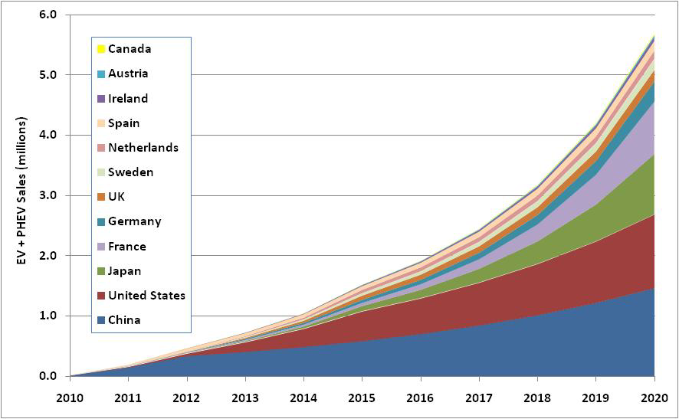
PEV Integration
FY 2011 Smart Grid-Capable EVSE FOA
Reduce current costs of commercially available EVSE (residential and non-residential), with smart grid capabilities, by
50% in 3 years
Key features: Bi-directional communications; Human machine interface for applications to provide local user input/output; PEV load management & smart controls; Conformance to interoperability, cyber security, and safety standards
Source: Transforming Global Markets for Clean Energy Products, IEA (2010)
Announcement of selections for award pending
28
Notes:
The graphic shows projected EV/PHEV annual sales to 2020 based on announced country targets. These projections point toward acceleration of EV and PHEV in the market place beginning ~2015. Smart charging and cost-effective EVSE infrastructure development are key to enable high penetration levels of EV and PHEV into the grid and contribute to maintaining or improving reliability and stability of electricity delivery.

Slide 29
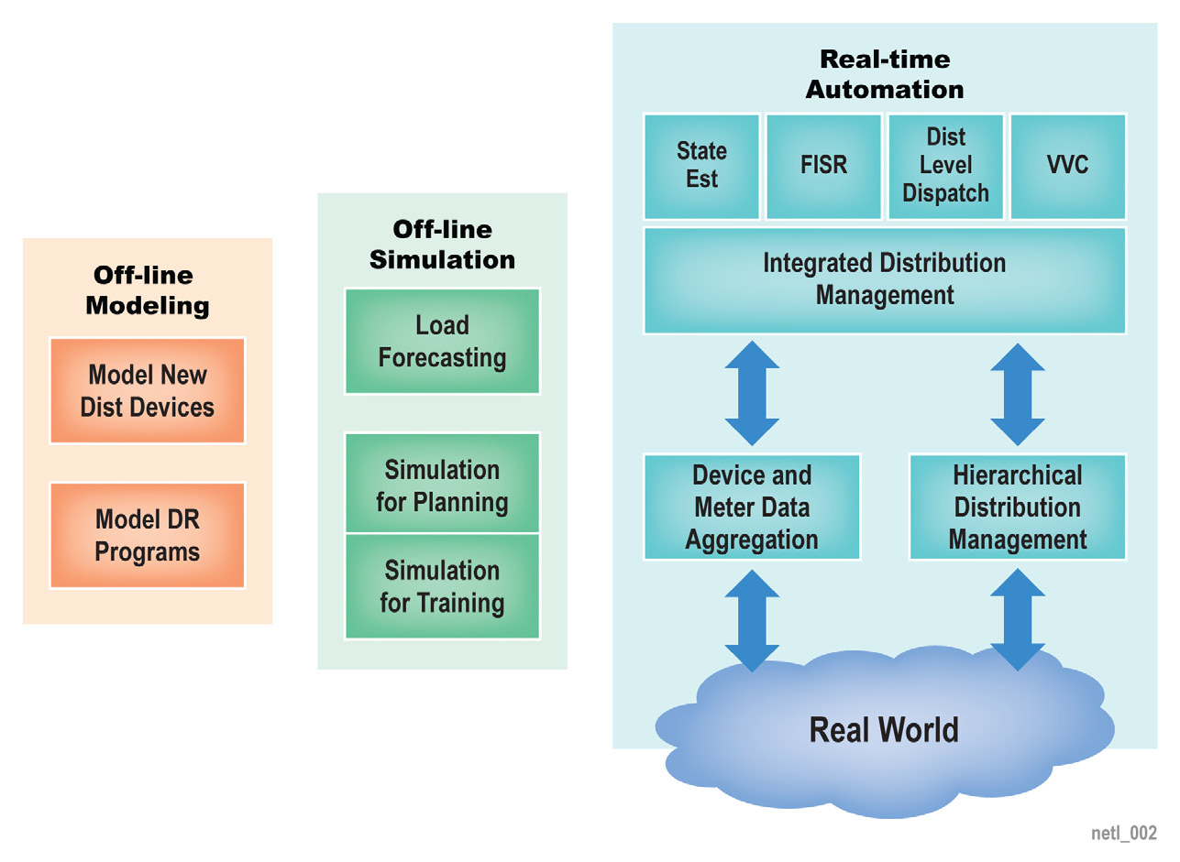
Distribution Automation – FY 2010 FOA Awards
Advanced Communications and Controls
On-Ramp Wireless: Develop a wide area wireless distribution grid sensor and faulted circuit indicator system capable of monitoring underground and other hard‐to‐reach distribution circuits
ABB: Develop a real-time distribution feeder performance monitoring, advisory control, and health management system for enhanced asset utilization and grid reliability
Integrated Distribution
Management System
Seamless integration of AMI & demand response, customer-owned DER, fault location, isolation, & restoration, volt/VAR control, & dynamic reconfiguration for distribution automation
  Boeing Distribution
  Management System
  Alstom’s e-terra integrated distribution management system
29
Notes:
The Boeing Distribution Management System project will leverage the proven interoperability and security of middleware developed for the DoD for highly-automated and self-healing distribution management while integrating both legacy and emerging utility systems.
Alstom will build the capabilities for consumer enablement and integration of DG, energy storage, demand response, and electric vehicle charging onto its commercial e-terra IDMS platform.
Gap Areas for Out-year R&D in Distribution Automation
Fault location, isolation, and service restoration (FLSIR)
Advanced volt/VAR controls

Slide 30
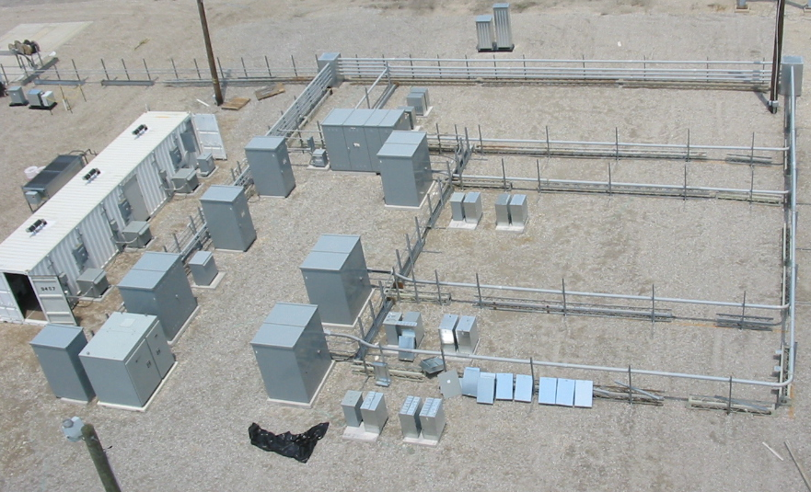
CERTS Microgrid Test Bed
Objective
Expand CERTS Microgrid concepts to address system integration challenges presented by need to accommodate intermittent, distributed renewable electricity sources within utility distribution systems.
Technical Scope
The CERTS Microgrid Test Bed is being expanded through the addition of new hardware elements: (1) a CERTS compatible conventional synchronous generator; (2) a more flexible energy management system for dispatch; (3) intelligent load shedding; (4) a commercially available, stand-alone electricity storage device with CERTS controls; and (5) a PV emulator and inverter with CERTS controls.
The concepts are explored initially through detailed simulation and bench-scale tests at UW and then demonstrated at full-scale using the CERTS Microgrid Test Bed operated by American Electric Power in Groveport, OH.
30
Notes:
30
The Consortium for Electric Reliability Technology Solutions (CERTS) was formed in 1999 to research, develop, and disseminate new methods, tools, and technologies to protect and enhance the reliability of the U.S. electric power system and efficiency of competitive electricity markets. DER integration is one of the five research areas (the other four are: real-time grid reliability management, reliability and markets, load as a resource, and reliability technology issues and needs assessment). Research performers are drawn from 4 national labs, 9 universities, and 8 industry entities.

Slide 31


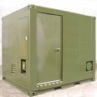







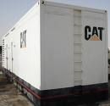

National Lab Team on SPIDERS
(Smart Power Infrastructure Demonstration for Energy, Reliability, and Security)
Cyber Security (INL)
Virtual Secure Enclave
Live Action Network
Secure Distributed Monitors
Situational Awareness
Microgrid (SNL)
Advanced Metering Infrastructure
Substation & Distribution Automation
Two-Way Communications & Control
Adaptive Relaying
Dynamic Control
(SNL, ORNL)
Load Control Systems
Islanding Control System
Energy Management System
Seamless Grid Synchronization
Assistant Technical Manager
(SNL)
Assistant Transition Manager
(PNNL)
Demand Side Management (NREL, ORNL)
Energy Efficiency Technologies
Dynamic Voltage Regulators
Smart Sockets
Automated Load Shedding
Energy Secure Installation
Renewable Integration (NREL)
Photovoltaic
Wind
Fuel Cells
Biofuel
Energy Storage (NREL)
Vehicle-to-Grid
Hydrogen
Batteries
Operational Test Agency
(PNNL)
31
Notes:
31

Slide 32



Smart Grid
Interconnection & Interoperability Standards
In close work with the NIST Smart Grid Interoperability Standards Program
GridWise Architecture Council
Interoperability & Interconnection Standards
Develop and disseminate smart grid interoperability related methods, tools, and education
Leadership and participation in the NIST Smart Grid Interoperability Panel
Annual Grid-Interop forums on smart grid interoperability
IEEE P2030 Series: Smart Grid Interoperability – development of interoperability Guides for smart grid components and the overall system
IEEE 1547 Series of Interconnection Standards - development and harmonization of Interconnection and integration standards
for DER
Interoperability Conformance Testing: Establish test procedures and capabilities
32
Notes:
GWAC tools and education: Interoperability Decision Maker’s Checklist; Interoperability Maturity Model
GWAC community engagement activities: Participation in ConnectivityWeek, GridWeek, and Global Smart Grid Forum, and in NERUC and IEEE meetings.
IEEE 2030
• IEEE P2030 Draft Guide for Smart Grid Interoperability of Energy Technology and Information Technology Operation with the Electric Power System and End-Use Applications and Loads (balloted in 2011, approval by the IEEE Standards Board expected later in 2011)
• IEEE P2030.1 Draft Guide for Electric-Sourced Transportation Infrastructure
• IEEE P2030.2 –Draft Guide for Energy Storage Systems Interoperability with Electric Power Infrastructure
IEEE 1547:
• 1547-2008 Standard for Interconnecting Distributed Resources with Electric Power Systems
• 1547.1-2005 Conformance Test Procedures for Equipment Interconnecting DR with EPS
• 1547.2-2008 Application Guide for IEEE 1547 Standard for Interconnection of DR with EPS
• 1547.3-2007 Guide for Monitoring, Information Exchange and Control of DR
• 1547.4 Guide for Design, Operation, & Integration of Distributed Resource Island Systems with EPS (approved as an official standard in 2011)
• P1547.5 Guidelines for Interconnection of EPS>10 MVA to the Power Transmission Grid
• P1547.6 Recommended Practice for Interconnecting DR with EPS Distribution Secondary Networks
• P1547.7 Draft Guide to Conducting Distribution Impact Studies for DR Interconnection
• P1547.8 (new) Extend use of 1547 (e.g., grid support, energy storage, ride-thru, etc.)

Slide 33
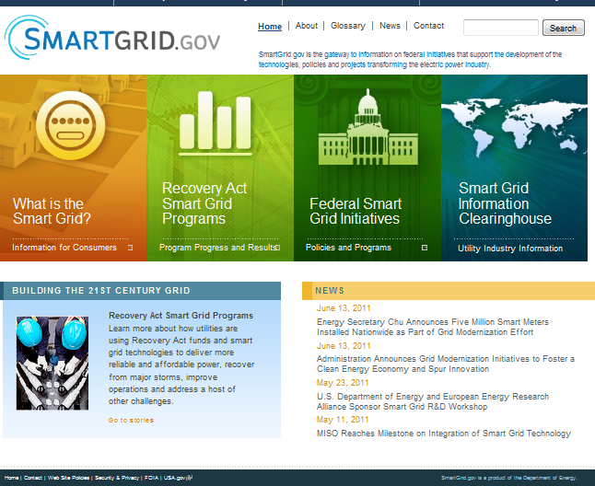
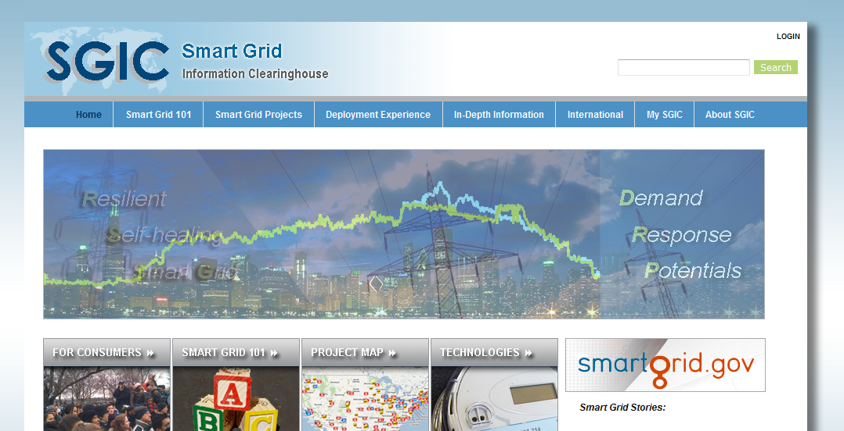
Information Resources
Smart Grid Information Clearinghouse
Smartgrid.gov
Smart grid project summaries (with focus on non-ARRA projects), use cases, and business cases for the U.S. and internationally
>200 & >50 smart grid projects in the U.S. and overseas; >1,000 smart grid-related documents and multimedia (use cases,
c/b analyses, business cases, legislation
& regulation, standards, and technologies)
ARRA smart grid project summaries and other Federal program activities
Reporting of ARRA SGIG & SGDP projects (progress, metrics and benefits, consumer behavior studies) and provision of analysis results to the public
33

Slide 34
International Smart Grid Coordination & Collaboration
34

Slide 35





















International Smart Grid Action Network (ISGAN)
Bringing high-level government attention and action to accelerate
world-wide development and deployment of smarter electricity grids
ISGAN…
Facilitates dynamic knowledge sharing, technical assistance, peer
review and, where appropriate, project coordination
Sponsors activities that accelerate smart grid deployment and
address knowledge gaps
Builds on the momentum of and knowledge created by the
substantial investments being made in smarter grids globally
Fulfills a key recommendation in the Smart Grids Tech. Action Plan
Leverages cooperation with the International Energy Agency,
Global Smart Grid Federation, and other relevant stakeholders
35

Slide 36
ISGAN Scope
KNOWLEDGE SHARING
POLICY, STANDARDS & REGULATION
FINANCE AND BUSINESS MODELS
WORKFORCE SKILLS & KNOWLEDGE
USER & CONSUMER ENGAGEMENT
TECHNOLOGY & SYSTEMS DEVELOPMENT
Five key topic areas
Core emphasis on sharing of knowledge and lessons learned
Projects may cover several topics areas

Slide 37
Four Foundational Projects
1
“Global Smart Grid Inventory”
of enabling programs and policies
2
Smart Grid Case Studies
using a common framework and metrics
3
Benefit/Cost Methodologies
(bottom-up & top-down) and related policy toolkits to assess smart grid investments
Synthesis of Insights for
High-level Decision Makers
(e.g., CEM Ministers) from ISGAN and other
related projects
4
Recognized that ISGAN is not the only entity developing an “inventory”
Several such efforts underway regionally
  ENARD Annex V
  ASGI
  EEGI
  EC-directed (JRC)
  Etc.
Although different drivers for each, there are opportunities for cooperation
37

Slide 38
Others Projects and Collaboration
Proposed or Under Consideration
Smart Grid International Research Facility Network (SIRFN)
Coordination with the ENARD IA (Electricity Networks, Analysis, Research & Development)
Continuing dialog
with private sector and
other stakeholders
(e.g., Global Smart Grid Federation, ADB, SGIP)
Engagement with other international efforts
(e.g., the US-EU Energy Council and APEC Smart Grid Initiative)
Joint Projects with the DSM IA
38

Slide 39
Contact Information
Dan T. Ton
Program Manager, Smart Grid R&D
Office of Electricity Delivery and Energy Reliability
U.S. Department of Energy
(202) 586-4618
Dan.ton@hq.doe.gov
For more information:
OE: www.oe.energy.gov
Smart Grid: smartgrid.gov
39

