Slide 1
Transmission Operations and Maintenance
Nationwide Programmatic Agreement

Slide 2
Introduction
Scope of the Nationwide PA
Transmission operations and maintenance
Purpose of the proposed PA
Nationwide PA process

Slide 3
Scope of the Nationwide PA
Transmission operations and maintenance
  Existing, actively managed transmission infrastructure:
    Transmission lines/corridors, rights-of-way, substations, communication facilities, and access roads
  Undertakings have the purpose of maintaining the reliable and safe operation of transmission infrastructure
  Frequently occur in the same general footprint/impact area as when originally constructed
Does not include new construction of transmission infrastructure or wholesale rebuilds of existing transmission infrastructure
Does not include existing transmission infrastructure on tribal lands
  Tribal lands: “All lands within the exterior boundaries of any Indian reservation and all dependent Indian communities.” (36 CFR 800.16(x)).
Does not include transmission interconnections.

Slide 4
Scope of the Nationwide PA
The Nationwide PA allows FTUs to:
Define APEs and make findings of no historic properties affected and no adverse effect by applying conditions (Appendix G) with no further consultation
Report to consulting parties annually on O&M undertakings covered under the PA
Assume that unevaluated resources are eligible for NRHP listing for purposes of an undertaking when they can be avoided or when other conditions to minimize effects can be applied

Slide 5
Administrative and Other Stipulations
The Nationwide PA also includes the following:
Roles and Responsibilities
Qualifications
Post Review Discoveries
Treatment of Human Remains
Training
Confidentiality
Annual Reporting
Monitoring Implementation of the NPA

Slide 6
Review Process

Slide 7
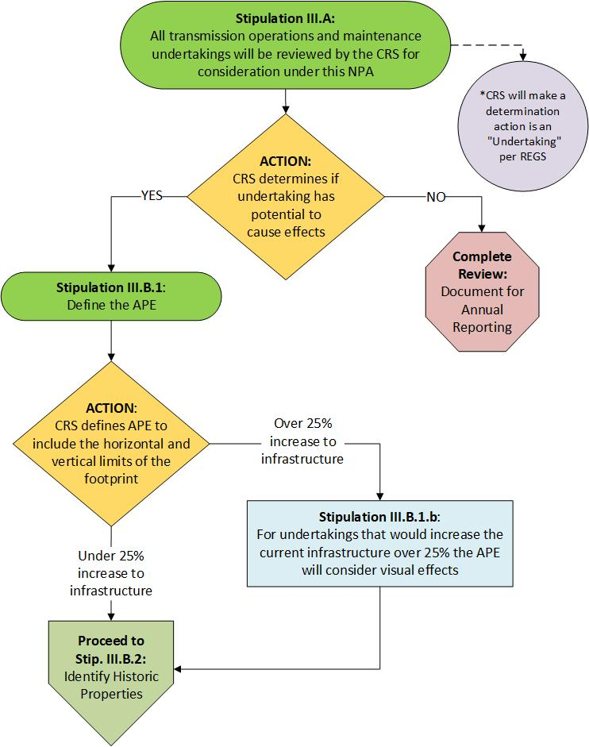
Area of Potential Effects
CRS will determine the undertaking.
CRS will define the APE. No consultation required.
  CRS will consult on an APE only when undertaking would increase height of transmission infrastructure by 25% or more.

Slide 8
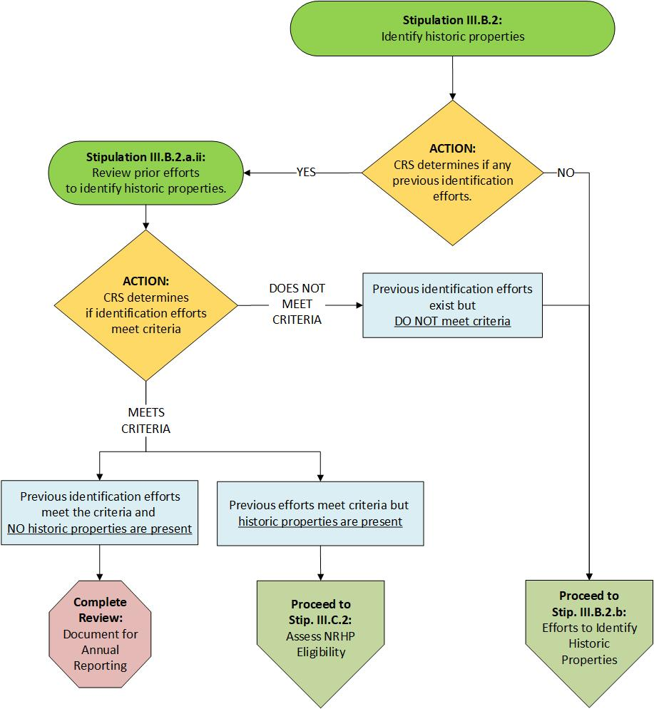
Identify Historic Properties
CRS reviews existing background research/literature
CRS applies criteria for considering PTRCS
If a prior effort to identify historic properties exists, CRS will apply criteria for sufficiency (reasonable and good faith effort)

Slide 9
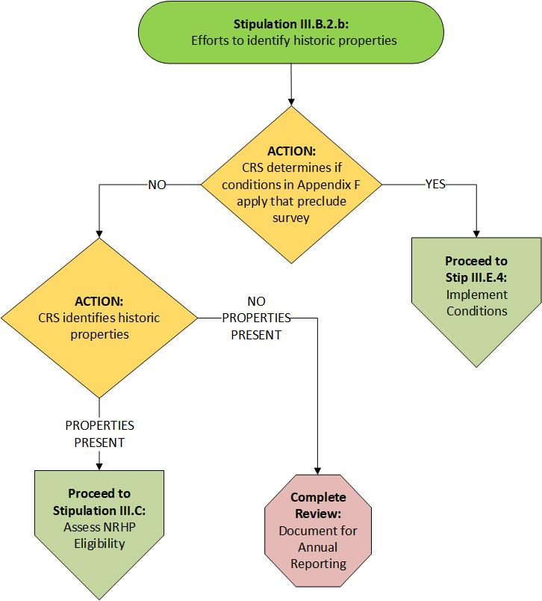
Identify Historic Properties (continued)
CRS determines if Appendix G conditions can be applied that would preclude a survey
If conditions cannot be applied, CRS would further proceed to identify historic properties

Slide 10
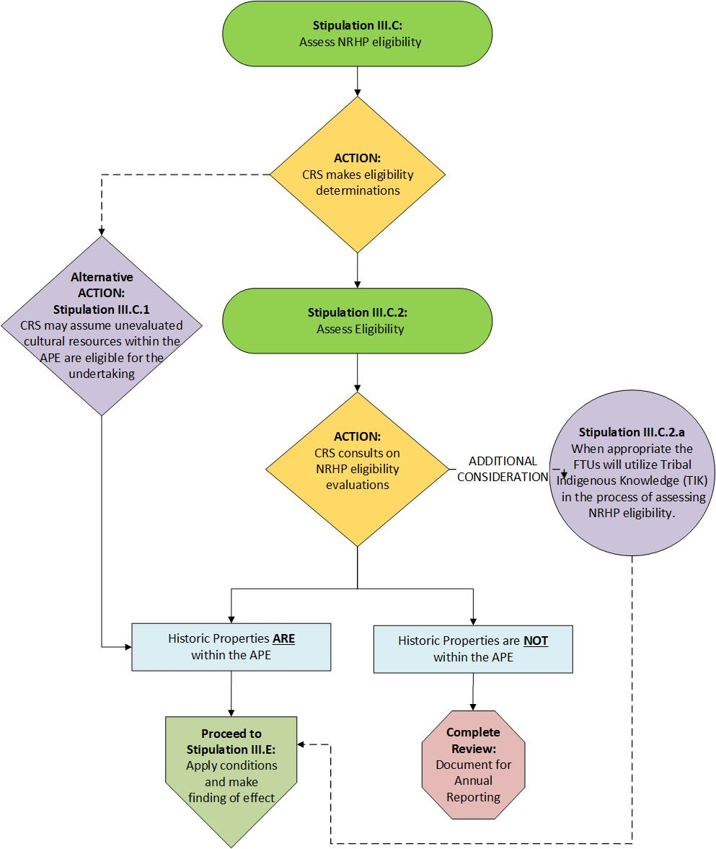
Assess NRHP eligibility
CRS may assume unevaluated resources are eligible for the NRHP for purposes of S106 compliance, when they can be avoided or other conditions to avoid/minimize effects can be applied
If a resource cannot be avoided or other conditions applied, the CRS will consult with appropriate SHPO, Tribes, federal landowners, and other consulting parties when assessing eligibility
If a resource is formally evaluated for eligibility, the CRS will consult

Slide 11
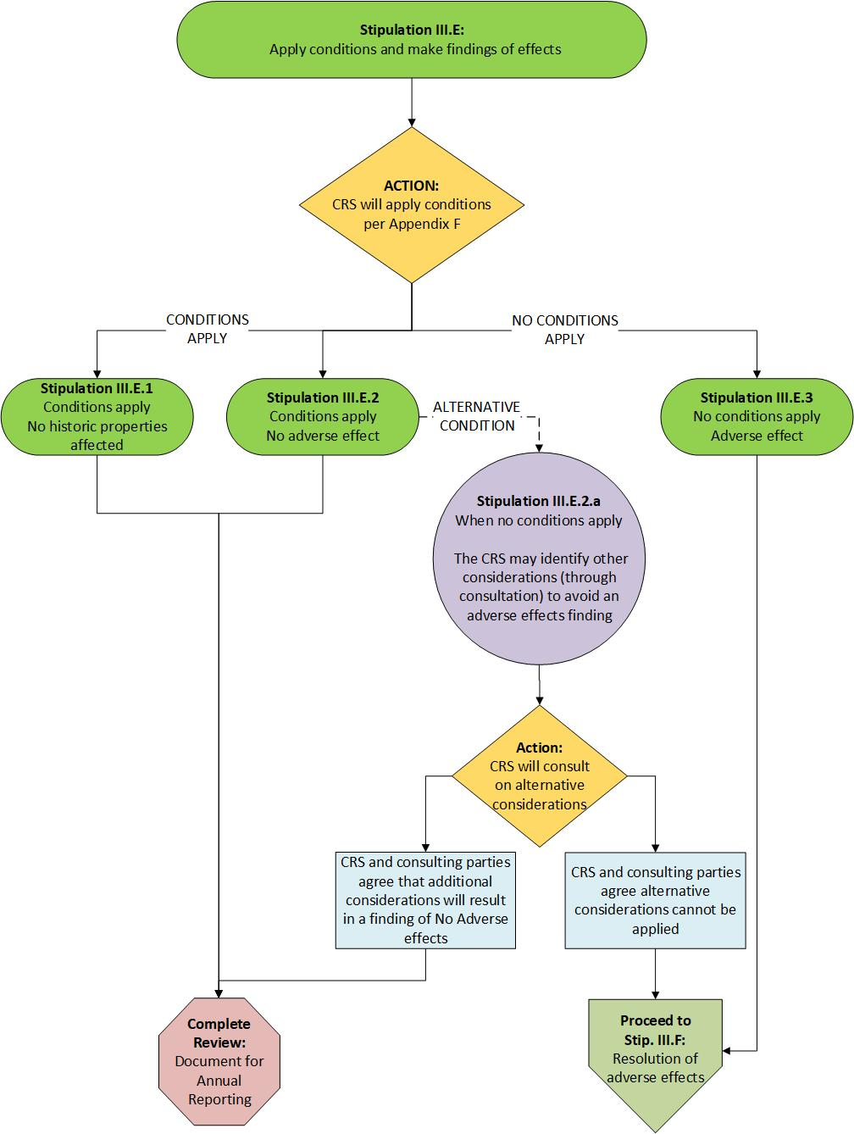
Assess Effects
No historic properties affected = no historic properties present, or conditions can be applied
No adverse effect = historic properties present and conditions can be applied
Adverse effect = consultation

Slide 12
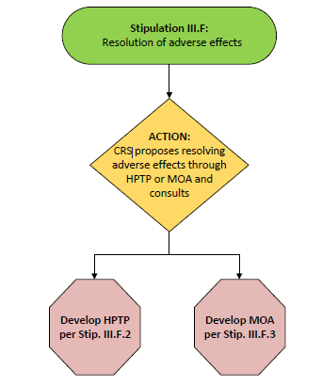
Resolve Adverse Effects
Adverse effect will be resolved through a Historic Properties Treatment Plan (HPTP) or Memorandum of Agreement (MOA)
  CRS will consult with consulting parties on the development of a HPTP/MOA

Slide 13
Annual Reporting
First annual report will be due April 1 of the first full fiscal year following execution of the NPA.

