Slide 1
Bonneville Power Administration
April 2023

Slide 2
BPA at a Glance
Revolving authority to borrow up to $13.7 billion from the U.S. Treasury, increasing to $17.7 billion starting in FY28, $8.0 billion currently available
Access to capital through federal and non-federal sources
Funding Sources
Unique Hydro-Based System
BPA’s customer primarily include Pacific Northwest utilities
FY22 revenue = $4.7 billion; Power Services ~75% and Transmission ~25%
One Agency; Two Business Units
Cost Recovery
BPA is required by law to establish rates to recover all costs
FERC reviews and approves rates to ensure that BPA rates recover all costs
Credit Ratings
Moody’s: Aa2, positive S&P: AA-, stable Fitch: AA, stable
Virtually carbon-free; BPA markets power from 31 federally-owned hydroelectric projects and several non-federal projects

Slide 3
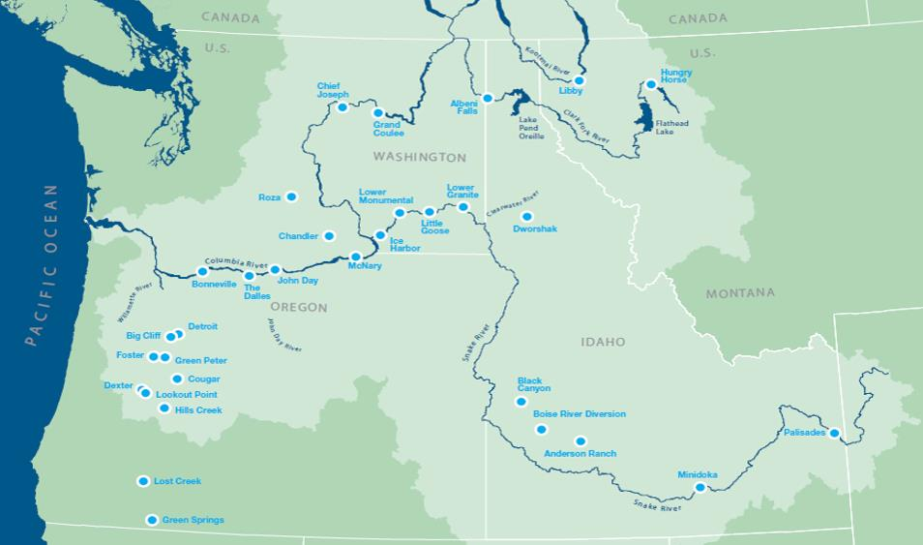
Our Service Territory: Geographic & Economic Diversity
Service territory is ~300,000 square miles across 8 northwestern states serving 14 million people
Market power to over 125 publically-owned and cooperatively-owned utilities providing ~28 percent of power consumption in the PNW
Transmission system includes 15,000 circuit miles of high voltage lines in the PNW
Customers span from major city municipalities and IOUs to small rural electrics
Service territory covers coastal, valley, mountain, and desert terrain

Slide 4
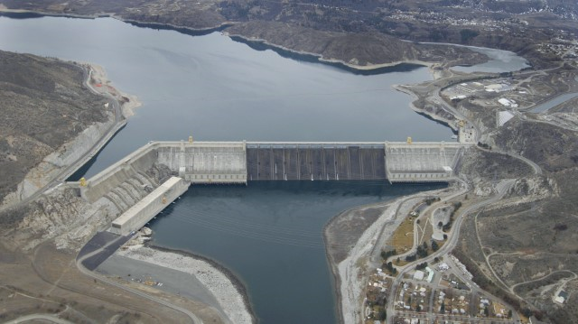
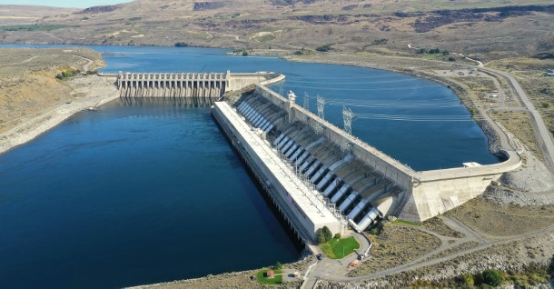
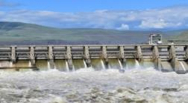
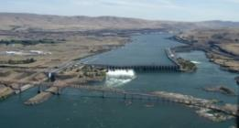
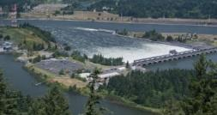
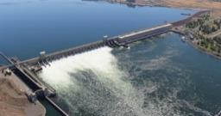
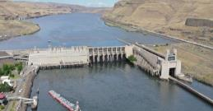
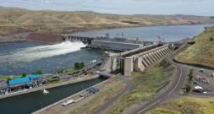
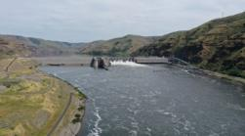
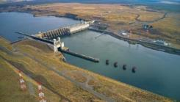
Direct Generation Fleet
Grand Coulee
33 Units; 6,684 MW*
Chief Joseph
27 Units; 2,614 MW*
John Day
16 Units; 2,480 MW*
The Dalles
22 Units; 2,080 MW*
Bonneville
18 Units; 1,221 MW*
McNary
14 Units; 1,120 MW*
Lower Monumental
6 Units; 930 MW*
Little Goose
6 Units; 930 MW*
Lower Granite
6 Units; 930 MW*
Ice Harbor
6 Units; 693 MW*
* Maximum MW capacity
31 total hydro projects, 1 nuclear plant: 206 Units, 23,114 MW Nuclear plant (1 unit): 1,207 MW (rated capacity) Projects not pictured (21 projects): 51 units, 2,254 MW* | Serves 14 million people across the Pacific NW Carbon emission free

Slide 5
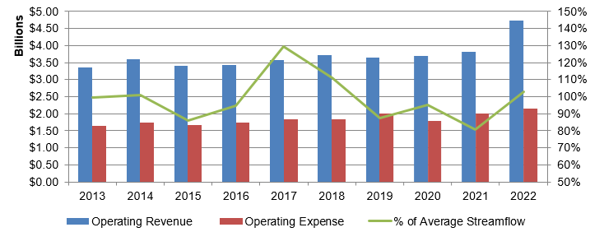
Revenues & Expenses: More Stable than Streamflow
The relationship of operating revenues to operating expenses has been stable when compared to wide variances in stream-flows and hydro-generation
Sales of firm energy and transmission services contribute to the operating revenue stability
% of Average Streamflow
Streamflow data are based on the Operating Year (Aug 1 – July 31) and the financial information is based on the Fiscal Year (Oct 1 – Sept 30)
Notes:
Graph shows Power business line operating revenues and expenses on the left axis
Streamflow percent of average on the right axis
BPA’s primary financial exposure is to market prices and streamflow
However, as this graph indicates, operating revenues and expenses are fairly stable even as streamflow fluctuates
This is due primarily to BPA’s conservative approach to trading
And mechanisms BPA has in place to boost cash reserves when they are low
Additionally, BPA is exposed to regulatory lag from gas prices assumed in rates versus actual gas prices. When gas prices are lower than what is set in rates, BPA typically makes less money than expected, when gas prices are higher BPA typically makes more money than expected.
For this fiscal year, BPA assumed $X gas prices in rates, expected prices are $Y. This is leading to an expected $300m+ in positive net revenue above what was expected when setting rates.
Wtg Avg Market Prices ($/MWh)
Q1 Estimate $55.5
Rate Case $29.8
Difference $25.6
Wtg Avg Gas Price ($/MMBtu)
Q1 Estimate $4.3
Rate Case $2.8
Difference $1.5
Streamflow is measured at The Dalles
FY21 107.33 MAF which was 81% of the average streamflow (1929-2021 avg = 133.01)
Weather & Streamflow Forecast - TDA_LVL_FLOW (bpa.gov)
https://pwrportal.bud.bpa.gov/sites/WeatherStreamflowForecast/SitePages/TDA_LVL_FLOW.aspx

Slide 6
Financial Highlights
Updated Financial Plan in 2022; focused on sustaining financial health over the long-term:
Updated BPA’s leverage goal and added a new policy that targets achieving leverage at or below 60% by 2040.
Maintained strong cost management focus; liquidity policy; and goal of preserving $1.5 billion borrowing authority.
Granted an increase of $10 billion of U.S. Treasury Borrowing Authority in 2021; no access to capital shortfall for the foreseeable future.
BP24 Initial Proposal for Power FY24-25 rates contains +$200 million of added cash flow for risk.
Liquidity tools remain strong:
Ability to draw up to $750 million for expenses on a line of credit with the U.S. Treasury.
Excess cash flow included in rates which can be repurposed to liquidity.
Rates include triggers to protect liquidity.
Post-2028 contract initiative is underway; BPA expects to execute new long-term power sales contracts in FY26.

Slide 7
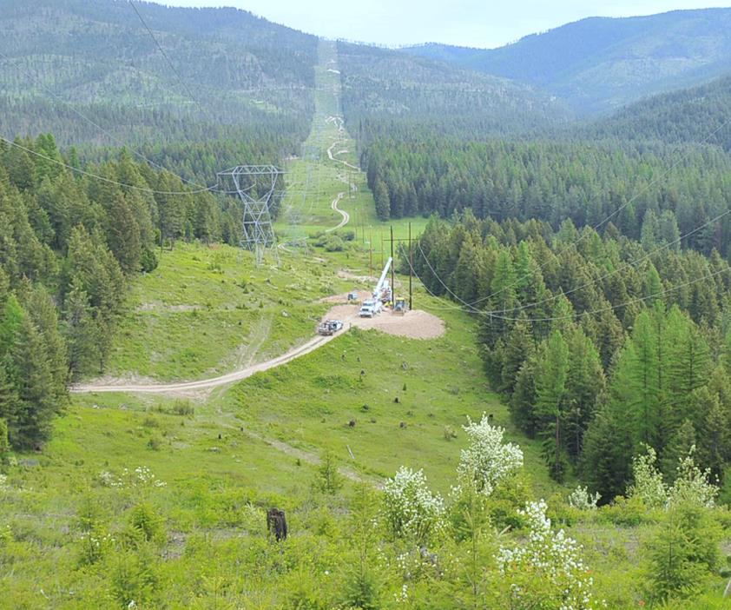
Vegetation Management & Wildfire Mitigation
BPA takes a tiered approach to manage risks in this area:
System Hardening: Foundation; Year-round system modifications and a robust vegetation management program to minimize risk and customer impact
Situational Awareness Monitoring: During fire season, implement enhanced weather monitoring and forecasting by district; Asset management tools used to understand criticality, health & risk
Wildfire Season – Relay & Control Settings: During fire season, utilization of enhanced protection and control settings
Extreme Risk Days (monitoring / resources): In this zone, in identified areas, stand up PSPS Decision making team
Activate PSPS: Last resort; At this stage BPA triggers the Public Safety Power Shutoff
Notes:
Wildfire
BPA has a multifaceted approach
System Hardening
At the core is system hardening
We apply a criticality, health and risk framework
Identify the highest risk facilities, make hardening investments based on this assessment
Recent examples have been replacing insulators and cross arms at high risk facilities
Vegetation Management
Related to system hardening is vegetation management
Veg mgmt. is different for fire mitigation versus reliability
Focus is on targeting and reducing vegetation with more fuel loading
Goals: System reliability, Wildfire risk mitigation
Methods: Annual ground patrols, Semi-annual air patrols
Results: Award winning program, Compliant with NERC rules, Successful WECC audits in the past (BPA has not had any “noncompliance” related to veg mgmt in the last 10 years. WECC removed veg mgmt from the scope of the FY21 audit due to the quality of the documentation and performance of the program.)
Establishment of low growing compatible vegetation
Results in low level fuel loading with respect to wildfire risk
Situational Awareness
Our transmission organization closely coordinates with BPA’s meteorology group
When wind is forecast to be above 60 mph, our PSPS group convenes
Towers are rated for 100mph
PSP is a last resort, PSPS is a pre-emptive action that allows us to switch off lines in high risk areas

Slide 8
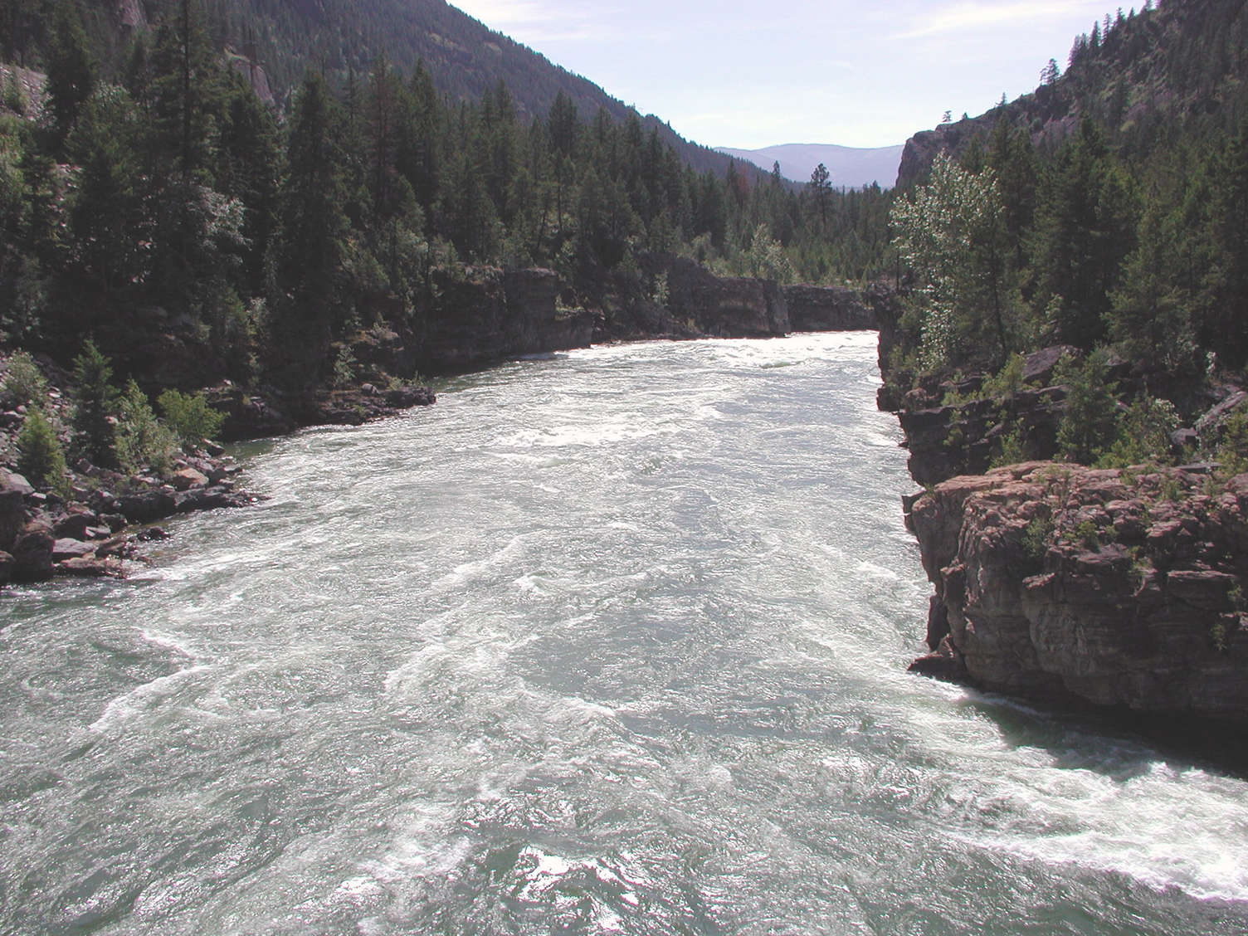
Impact of Climate Change
BPA has been monitoring the impact of climate change for more than a decade
Climate change signals are beginning to emerge in our streamflow records and are expected to continue
As a result of this effort, BPA has recently updated its streamflow forecasting model to utilize the most recent 30-years to better reflect these impacts. The results forecast:
Higher annual volumes as regional precipitation increases
Higher winter and spring flows
Earlier spring runoff peaks are beginning to emerge
Lower June-July flows and longer periods of low summer flows
The upcoming Strategic Plan refresh will frame carbon as an Agency priority, outlining goals and objectives for the coming years

Slide 9
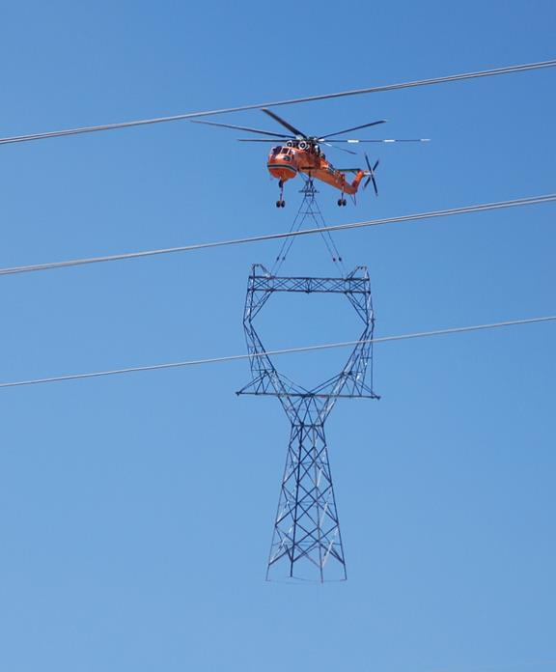
Cyber and Physical Asset Security
Cyber Security
Implementation and monitoring of real time cyber security controls by permanent, full-time team
Coordination with other the federal government agencies
Subject to mandatory NERC reliability standards including Critical Infrastructure cybersecurity standards
24x7 Cyber Security Operations and Analysis Center
Redundant system control centers, geographically separated
Physical Asset Security
Strategy in place to deter, detect, delay, assess, communicate and respond to security-related events
Measures: physical hardening; contract security officers; systems for physical access control, intrusion detection, and video surveillance
Permanent, full-time team dedicated to monitoring threat intelligence information; coordination with state and federal government agencies
High Voltage Transmission Line Tower
High Voltage Transmission Line Tower
Notes:
Marcus talking points:
BPA is very focused on cyber security
We have a robust program
We are continuing to enhance the program with advancements in real-time monitoring, controls and situational awareness
Primary goal to gain telemetry
Understand our environment at all times
Maintaining control of our environment
Subject to, and meeting, NERC and CIP requirements
Coordinating across several federal agencies
Robust 24x7 monitoring, roughly 50 full time employees devoted to cybersecurity monitoring and mitigation

Slide 10
Summary
Statutory Purpose & Obligations
Market power from 31 hydro projects and 1 nuclear plant, carbon-free
Current Risks & Mitigation
Modeling for climate change in BPA’s service territory - warmer and slightly wetter
Strong wildfire mitigation and monitoring - do not expect any material impact to net revenues or ability to deliver power as a result of wildfires
Financial Highlights
Leverage has declined; cash reserves have increased; strong liquidity tools going forward
Own/lease 15,000 miles of high voltage transmission lines, 259 substations
Cash payments for Non-Federal debt are met before payments to the U.S. Treasury
Required by law to establish rates to recover all costs
Robust cyber and physical security programs in place to monitor, detect, and respond to events
Added borrowing authority means no access to capital issues for the foreseeable future
Maintained high-investment grade credit ratings
Moody’s: Aa2, positive
S&P: AA-, stable
Fitch: AA, stable

Slide 11
Energy Northwest 2023-A Bonds
 | Project 1 | Columbia Generating Station | Project 3
Pricing Date* | Tuesday, May 2, 2023
Settlement Date* | Wednesday, May 31, 2023
2023-A (Tax-Exempt)* | $16,260,000 | $428,750,000 | $73,120,000
Optional Redemption* | Par call on 7/1/2033
Ratings (Moody’s / S&P / Fitch) | Aa2 (Positive) / AA- (Stable) / AA (Stable)
Preliminary Energy Northwest 2023-A Bonds Amortization*
*Preliminary, subject to change; when, as, and if issued.

Slide 12
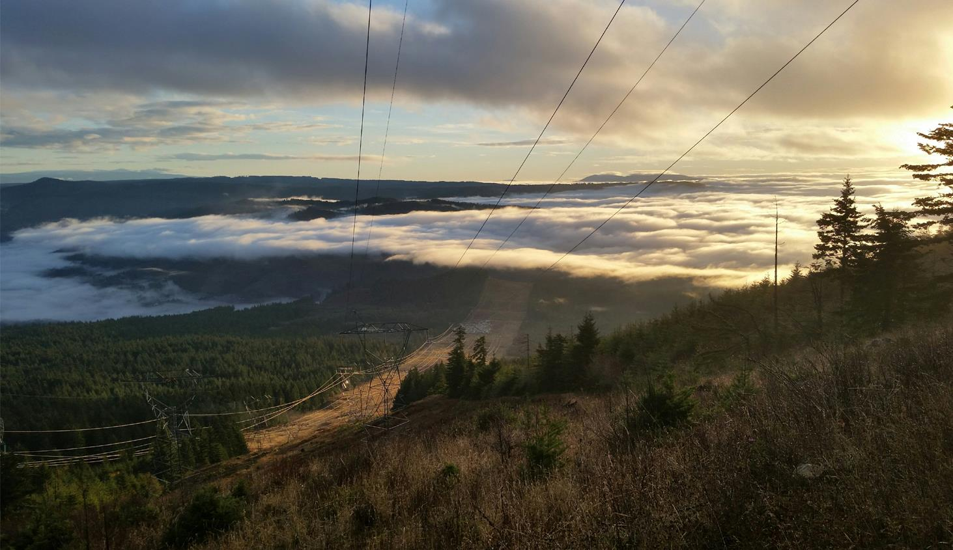
Contact Information
Nadine M. Coseo
Treasury Manager,
Financial Strategy & Operations
(503) 230-3337
nmcoseo@bpa.gov
Alayne M. Switzer
Manager, Revenue Requirement,
Repayment & Investor Relations
(503) 230-4025
amswitzer@bpa.gov
Additional investor information:
https://www.bpa.gov/about/finance/investor-relations
High Voltage Transmission

Slide 13
Questions
Columbia River

