Slide 1
Bonneville Power Administration As of June 7, 2021

Slide 2
The information in this investor presentation is a summary of certain information concerning the Bonneville Power Administration (“BPA”) and is not intended to contain all information material to investors. This investor presentation is provided for your information and convenience only. This investor presentation does not constitute a recommendation or an offer or solicitation for the purchase or sale of any security or other financial instrument or to adopt any investment strategy. In no event shall BPA be liable for any use by any party of, or any decision made or action taken by any party in reliance upon the information contained herein. BPA makes no representations as to the legal, tax or accounting treatment of any BPA-supported security. You should consult with your own advisors as to such matters and the consequences of the purchase and ownership of BPA-supported securities. Past performance is not indicative of future performance, which will vary.
This investor presentation you are about to view is provided as of June 7, 2021. If you are viewing this presentation after June 7, 2021, there may have been events that occurred subsequent to such date that would have a material adverse effect on the financial information that is presented herein, and BPA has not undertaken any obligation to update this investor presentation.
This investor presentation contains statements which, to the extent they are not recitations of historical fact, may constitute “forward-looking statements.” In this respect, the words “estimate,” “project,” “anticipate,” “expect,” “intend,” “believe” and similar expressions are intended to identify forward-looking statements. A number of important factors affecting BPA’s business and financial results could cause actual results to differ materially from those stated in the forward-looking statements.
Bonds supported by BPA’s financial obligations and the obligations of BPA providing such support are not nor shall they be construed to be general obligations of the United States of America nor are such bonds or obligations intended to be or are they secured by the full faith and credit of the United States of America.

Slide 3
Idaho Energy Resources Authority: Transmission Facilities Revenue Bonds
Bonneville Cooperation Project No. 2, Series 2021 (Federally Taxable)
Par Amount* | $309,315,000
Structure* | Fixed Rate Term Bond due September 1, 2046 with Sinking Fund Payments in 2044 and 2045
Interest Payment Dates* | Beginning September 1, 2021 and semiannually on September 1 and March 1 thereafter
Pricing Date* | Tuesday, June 15, 2021
Settlement Date* | Wednesday, June 23, 2021
Security | The Series 2021 Bonds will be special obligations of the Idaho Energy Resources Authority (“IERA” or the “Issuer”) payable solely from the trust estate pledged therefor which trust estate includes amounts derived from rental payments paid to the Issuer. Bonneville’s payments under the Lease-Purchase Agreement will be made solely from the Bonneville Fund. The Lease-Purchase Agreement provides that Bonneville’s obligation to pay the rental payments and all amounts payable under the Lease-Purchase Agreement is absolute and unconditional, and is payable without any set-off or counterclaim, regardless of whether or not the Project financed with the proceeds of the Series 2021 Bonds is operating or operable.
Use of Funds | The proceeds from the sale of the Series 2021 Bonds will be used by the Issuer to: 1) refinance indebtedness issued for the cost of acquiring, constructing, installing and equipping of certain transmission facilities leased to BPA by paying off a construction line of credit issued by Bank of America, 2) acquire transmission facilities from the Port of Morrow, Oregon (POM) which it had acquired, constructed, installed and equipped which are leased to BPA, 3) provide $6.6 million in funding to complete a substation project, and 4) pay costs of issuance of the Series 2021 Bonds (including Underwriters’ discount) and certain administrative costs of the Issuer. POM will use the proceeds of the asset sale to pay off a construction line of credit issued by TD Bank, N.A.
Optional Redemption** | Make Whole Call
Ratings | Moody's: Aa2 (Stable Outlook); Fitch: AA (Stable Outlook)
Tax Status*** | Interest on the Series 2021 bonds is expected to be subject to Federal income tax and exempt from Idaho state income tax (Please refer to Preliminary Official Statement)
Syndicate | TD Securities, BofA Securities, Citigroup, and Wells Fargo Securities
* Preliminary, subject to change; when, as, and if issued;
** To be determined at pricing. Additional call features exist; see The Series 2021 Bonds section in the Preliminary Official Statement.
*** Upon issuance of the bonds, Bond Counsel is expected to deliver an opinion that interest on the bonds is not excluded from gross income for U.S. federal income tax purposes and is exempt from State of Idaho personal income taxes. The form of Bond Counsel opinion is available in the Preliminary Official Statement. Before purchasing bonds, you should consult with your tax advisor concerning your particular tax situation.
Investors should read the entire Preliminary Official Statement carefully before making an investment decision.

Slide 4
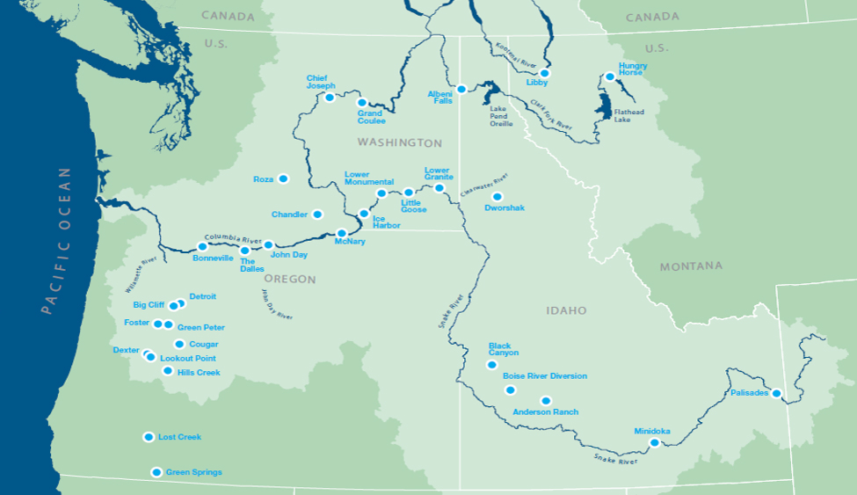
4

Slide 5
Columbia River Basin
Diverse and expansive footprint providing power to 300k square miles served by BPA
Federal dams in the Columbia River Basin contribute approximately 6,300 aMW of firm energy capacity to the region
Storage in both Canada and the U.S. allows BPA to meet loads and increase reliability while still supporting multiple statutory purposes including:
Flood Control
Irrigation
Navigation
Recreation
Investors should read the entire Preliminary Official Statement carefully before making an investment decision.

Slide 6
BPA at a Glance
One Agency with Two Business Units
Power Services and Transmission Services revenue was approximately $3.7 billion in FY20
BPA’s customers primarily include utilities throughout the Pacific Northwest
Unique Hydro-Based System
Virtually carbon-free, BPA markets power from 31 federally-owned hydroelectric projects and several Non-Federal projects
Funding
Sources
Access to capital through Federal and Non-Federal sources
Revolving authority to borrow up to $7.7 billion in bonds from the U.S. Treasury, $2.1 billion available at 9/30/2020
Cost
Recovery
BPA is required by law to establish rates to recover all costs
FERC reviews and approves rates to ensure that BPA rates recover all costs
Non-Federal Payment Priority and Financial Reserves
Cash payments for Non-Federal debt are met before payments by BPA to the U.S. Treasury
BPA maintains substantial cash and short-term investment balances in addition to having access to a $750 million U.S. Treasury line of credit
Ratings
Moody’s: Aa2 (Stable Outlook) Fitch: AA (Stable Outlook)
Investors should read the entire Preliminary Official Statement carefully before making an investment decision.

Slide 7
COVID-19 Impacts
Operations
To date, there have been no significant operational or financial impacts to BPA as a result of COVID-19
BPA continues to reliably deliver power throughout the region
Loads
Current power loads serviced by BPA remain stable and comparable to FY19 and FY20
While commercial and industrial loads have declined, residential loads have increased
Customers
Utility customers are continuing to make timely payments under their contracts
Employees
In response to COVID-19, BPA has activated its Incident Management team and developed a Workplace Safety and Operating Plan which is in alignment with DOE and the CDC guidance
BPA is proactively taking steps to protect its workforce through social distancing, enabling remote working arrangements, and requiring pre-shift self-evaluation health checks by staff entering BPA facilities
Investors should read the entire Preliminary Official Statement carefully before making an investment decision.

Slide 8
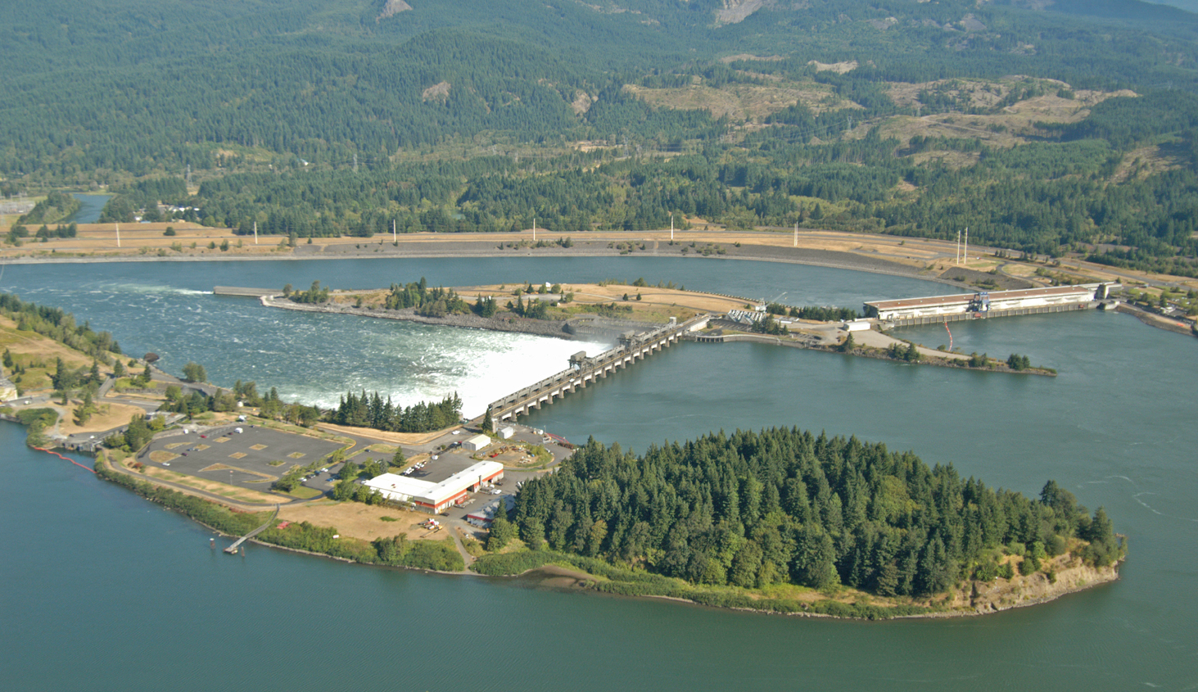
BPA markets power from 31 federally owned hydro projects, Columbia Generating Station, and several other non-federal projects
This system provides stability, flexibility, and reliability with limited fuel risk
Bonneville Dam

Slide 9
Virtually Emission-Free Assured Fuel Supply
97% of BPA’s firm power is carbon emission-free
Carbon Emission-Free
Federal Hydroelectric
Carbon Emission-Free Nuclear
Columbia Generating Station
Contract Purchases and Other Resources
6,298aMW
82%
1,116aMW
15%
242aMW
3%
Operating Year 2022 statistics from the 2019 Pacific Northwest Loads and Resources Study, October 2020
Investors should read the entire Preliminary Official Statement carefully before making an investment decision.
Notes:
Hydro Electric 6,298 82.3%
CGS 1,116 14.6%
Other 242 (29+48+165) 3.2%
Total 7,656
App A-16 (Table - Operating Federal System Projects for Operating Year 2022)

Slide 10
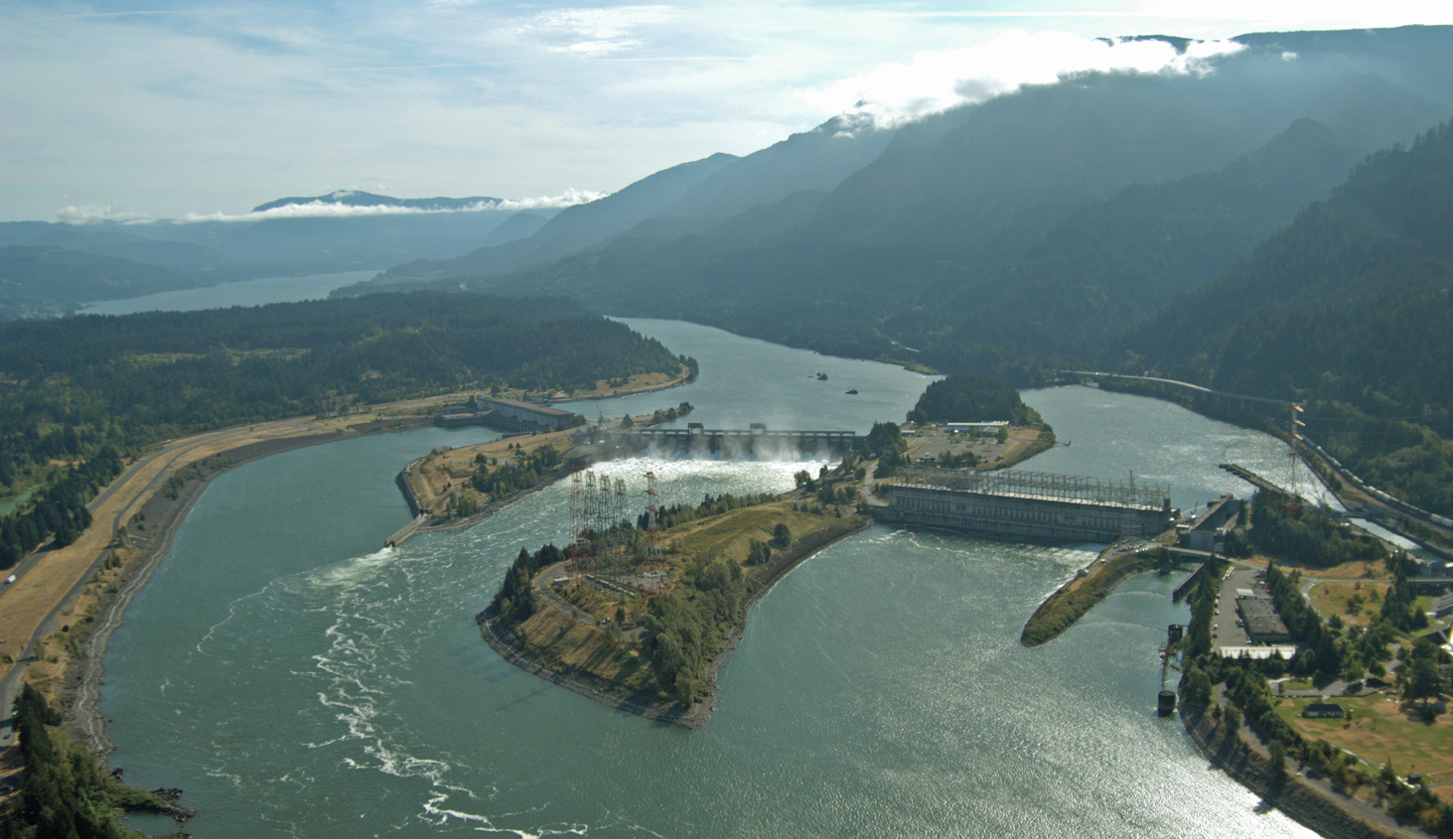
Power Business Unit
Markets about 28% of the electricity consumed in the region
Over 125 preference customers with long-term contracts
$2.7 billion in revenue in FY20
Bonneville Dam

Slide 11
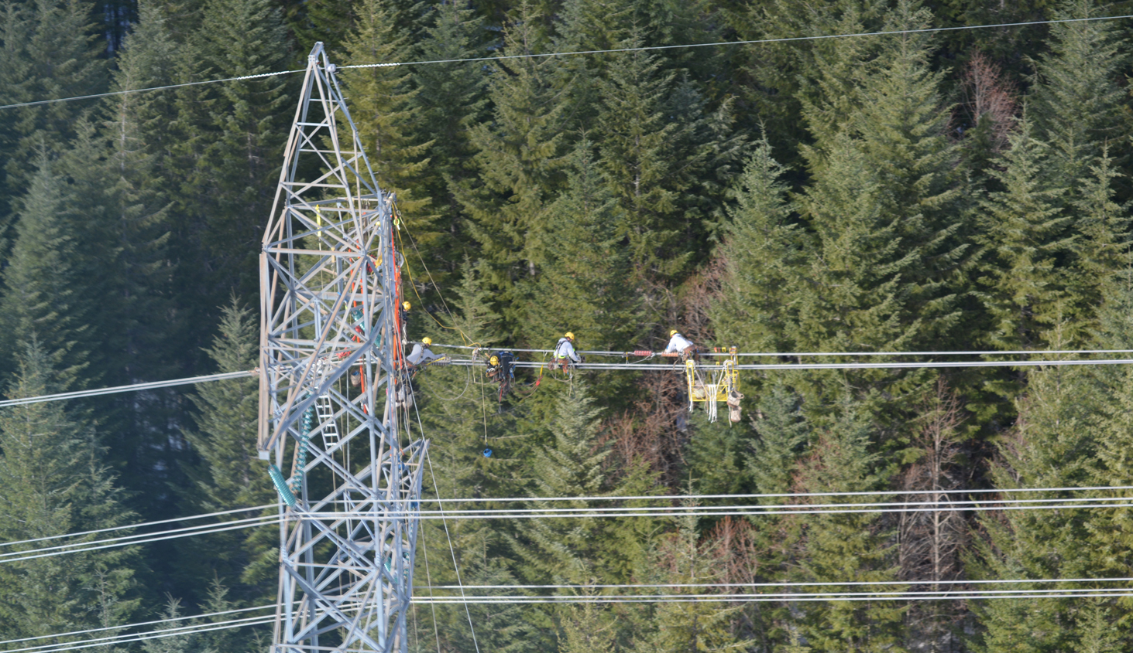
Transmission Business Unit
Approximately 75% of the bulk transmission capacity in the region
15k circuit miles of high voltage lines
$985m revenue in FY20
262 substations
High Voltage Transmission

Slide 12
Federal and Non-Federal Debt Outstanding
Total $14.5 billion
Non-Federal Debt
Borrowings from
U.S. Treasury
Federal Appropriation
Repayment Obligations
$7.3 billion
50%
$5.6 billion
39%
$1.5 billion
11%
Energy Northwest $4.8 billion
Lease-Purchase Program $2.1 billion
Prepaid Power Purchases $0.2 billion
Non-Federal Facilities $0.2 billion
BPA is authorized to have up to $7.7 billion in bonds outstanding at any one time with the U.S. Treasury
BPA repays amounts that have been appropriated by Congress to construct the Federal System
BPA evaluates current and forecasted leverage ratios to determine if any rate action needs to be taken to maintain the 75-85% leverage target through FY28 with a long-term target of 60-70%
As of 9/30/2020
Investors should read the entire Preliminary Official Statement carefully before making an investment decision.

Slide 13
Priority of Payments
By statute, payments and monetary credits to Non-Federal entities are always met prior to BPA’s payments to the U.S. Treasury
All BPA funds, including revenues generated from Power and Transmission, are available to meet Non-Federal costs
FIRST
Payments/Credits other than to the U.S. Treasury
Non-Federal debt (including BPA-supported bonds issued by the Idaho Energy Resources Authority, the Port of Morrow, and Energy Northwest)
BPA O&M expenses
Other
(No priority implied among Non-Federal payments)
SECOND
U.S. Treasury Payments
Principal and interest on bonds, as well as the line of credit, with the U.S. Treasury
Principal and interest to repay federal appropriations that funded capital investments in the Federal System
Other
Investors should read the entire Preliminary Official Statement carefully before making an investment decision.

Slide 14
Additional Assurance of Payment
Short-term Credit Facility
Overnight access to a $750 million line of credit with the U.S. Treasury
Two-year
Rate Case
Conduct a rate case every two years to ensure recovery of all costs, including Federal and non-Federal debt service
In 2020, BPA made its 37th consecutive U.S. Treasury payment on time and in full
Reserves Provisions
Provisions to increase rate levels, without undertaking a formal rate process, if Reserves Available for Risk (RAR) fall below established thresholds
Investors should read the entire Preliminary Official Statement carefully before making an investment decision.

Slide 15
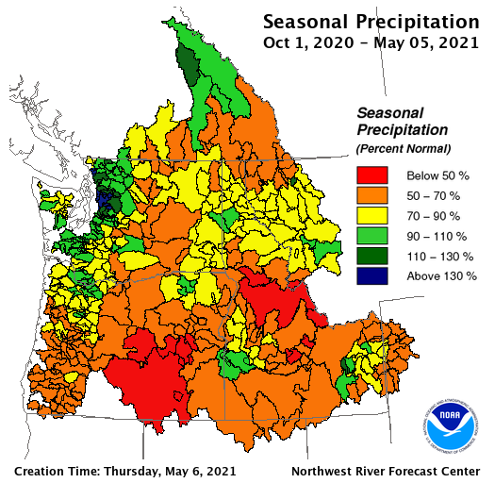
Seasonal Surplus (Secondary) Sales
The amount of energy produced by the hydroelectric system above firm energy
Under average water conditions this amount is estimated to be 1,405 aMW (Operating Year 2022)
Expected sales of seasonal surplus (secondary) energy is an important part of BPA’s ratemaking and risk mitigation
Revenue from seasonal surplus was approximately 12% of BPA’s total FY20 revenues of $3.7 billion. The prior five years have averaged 5% of total revenues.
Investors should read the entire Preliminary Official Statement carefully before making an investment decision.
Notes:
Seasonal Precipitation Map
https://www.nwrfc.noaa.gov/rfc/
Under the “Water Supply” heading, select “Precipitation/Temperature”
Click the “Current Month Summary Graphics” button and choose the “Seasonal Precipitation” chart
Make sure that the date chosen is consistent with the “Average Water Supply” number in the next bullet and with Appendix A
Average water conditions from page A-14 “For Operating Year 2022, the Federal System is forecast to generate seasonal surplus (secondary) energy of 1,405 annual average megawatts, assuming average water conditions (median water flows).” Source: A-13 OY22 secondary forecast e/m”

Slide 16
Revenues & Expenses More Stable than Streamflow
The relationship of operating revenues to operating expenses has been stable when compared to wide variances in stream-flows and hydro-generation
Sales of firm energy and transmission services contribute to the operating revenue stability
% of Average Streamflow
Streamflow data are based on the Operating Year (Aug 1 – July 31) and the financial information is based on the Fiscal Year (Oct 1 – Sept 30)
Investors should read the entire Preliminary Official Statement carefully before making an investment decision.

Slide 17
Financial Reserves
BPA’s total financial reserves fluctuate throughout the year, the balance is historically at the lowest point after the annual year-end U.S. Treasury payment
Cash, investments, and deferred borrowing (capital expenditures eligible to be funded with borrowing, but funds not yet borrowed)
Investors should read the entire Preliminary Official Statement carefully before making an investment decision.

Slide 18
Financial Reserves
BPA defers borrowing for capital construction until the cash is needed. BPA also maintains a $750 million line of credit with the U.S. Treasury
There was no outstanding balance at 9/30/2020
Year-End Reserves ($Millions)
Fiscal Year | Total Financial Reserves | Reserves Available for Risk (RAR) | U.S. Treasury Line of Credit | Days Liquidity on Hand
2016 | 724 | 602 | 750 | 281
2017 | 766 | 568 | 750 | 258
2018 | 840 | 551 | 750 | 254
2019 | 773 | 484 | 750 | 222
2020 | 889 | 708 | 750 | 295
Days Liquidity on Hand = (RAR + Available U.S. Treasury Line of Credit) / (Operating Expenses/360)
Investors should read the entire Preliminary Official Statement carefully before making an investment decision.

Slide 19
Non-Federal Debt Service Coverage¹
($millions excluding ratios) | FY20 | FY19 | FY18
Total Operating Revenues | 3,684 | 3,656 | 3,710
Total Operating Expenses² | 1,778 | 2,003 | 1,840
Funds Available to meet Non-Federal Debt Service | 1,906 | 1,653 | 1,870
Non-Federal Debt Service | 462 | 338 | 359
Non-Federal Debt Service Coverage Ratio | 4.1x | 4.9x | 5.2x
Non-Federal Debt management actions, such as the Regional Cooperation Debt program, have continued to result in higher than historical Non-Federal Debt Service Coverage results
¹This information is presented in Official Statements for BPA-backed, Non-Federal Debt bond issuances however, BPA’s audited financial statements do not include a similar table
²Operating Expenses include the following items from the Federal System Statement of Revenues and Expenses: BPA O&M, Purchased Power, Book-outs, Non-Federal entities O&M-net billed, Non-Federal entities O&M non-net-billed, and the Residential Exchange Program. Operating Expenses do not include certain payments to the Corps and Reclamation
Investors should read the entire Preliminary Official Statement carefully before making an investment decision.

Slide 20
Statutory Guidance
By Law
BPA must establish rates that recover all of its costs
BPA must defer its U.S. Treasury payments if required to meet Non-Federal obligations
Federal Rate Approval
The Federal Energy Regulatory Commission (FERC) reviews and approves BPA’s rates to ensure they are sufficient to recover all costs
Expedited
Rate Case
Option to initiate an expedited rate case to propose increased rates
Investors should read the entire Preliminary Official Statement carefully before making an investment decision.

Slide 21
Historical Average PF Preference Rates
Nominal (Actual) and Real (Inflation-Adjusted) Average PF Preference Rate Levels
$Dollars per Megawatt Hour
Power rates have remained relatively stable, especially on an inflation-adjusted basis
PF = Priority Firm Power
Investors should read the entire Preliminary Official Statement carefully before making an investment decision.

Slide 22
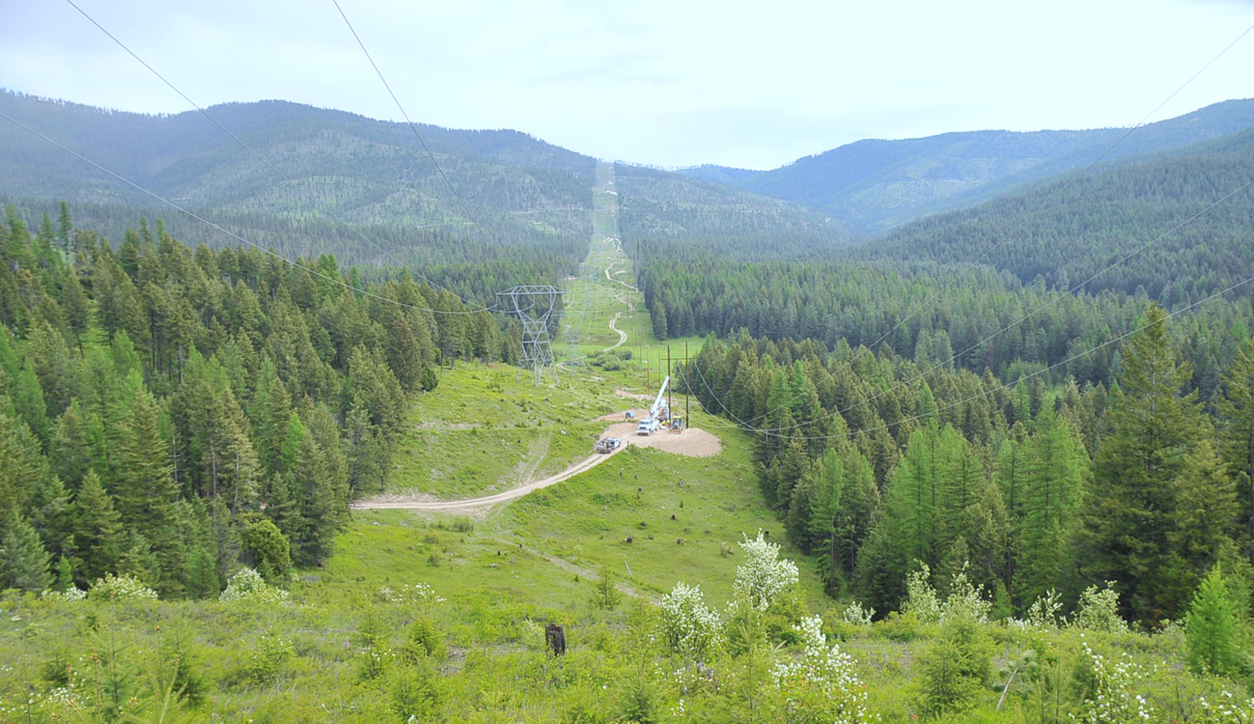
Vegetation Management and
Fire Prevention Program
Goals
System reliability
Wildfire risk mitigation
Methods
Annual ground patrols
Semi-annual air patrols
Results
Award winning program
Compliant with NERC rules
Successful WECC audits
High Voltage Transmission

Slide 23
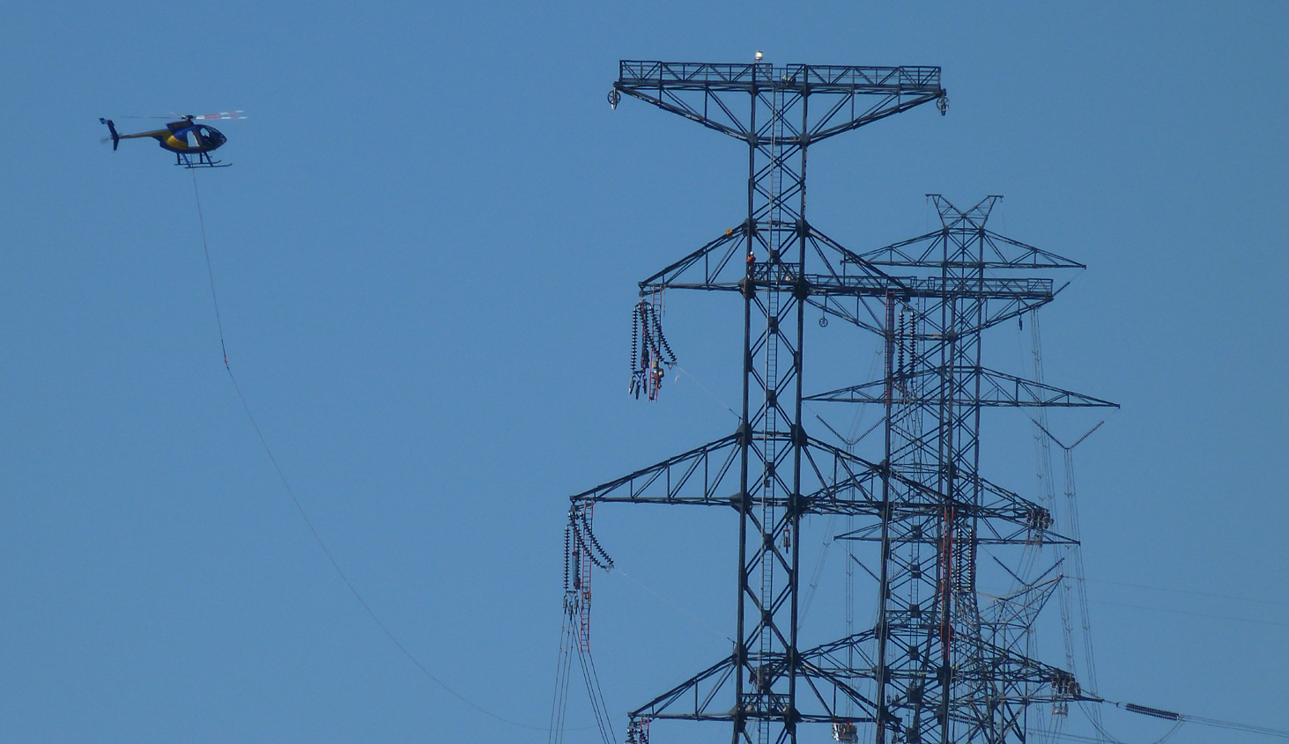
FY20 Wildfire Update
Hot, dry weather conditions in the Pacific Northwest combined with unprecedented high winds including gusts up to 70 mph led to wildfires across the region
BPA field crews assessed, monitored and worked with dispatch to de-energize and re-energize lines in response to the needs of customers and fire fighters
BPA estimates that the total cost to repair transmission assets, remove danger trees, and repair minor damage at one dam facility related to the FY20 fires will be between $10 million and $14 million
Cyber Security
BPA continues to enhance and expand its operational security through the implementation and monitoring of real time cyber security controls in addition to building alliances within the federal government
BPA was not significantly impacted by the 2020 cyber security attack on SolarWinds Orion Information Technology system management software
High Voltage Transmission

Slide 24
Non-Federal Debt – Transmission Issuers
Energy-related financing authority created by Idaho legislation
Authorized to finance transmission projects with publicly issued bonds and credit arrangements secured by BPA lease-purchase commitments
As of 9/30/20, $201 million in outstanding BPA-supported bonds and $181 million in outstanding lines of credit, $100 million of which will be refunded with the proceeds of the IERA 2021 bonds
Oregon port district
Authorized to finance transmission projects with publicly issued bonds and credit arrangements secured by BPA lease-purchase commitments
As of 9/30/20, $1.2 billion in outstanding BPA-supported bonds and $400 million in outstanding lines of credit, $200 million of which was refunded with the proceeds of the POM 2020-2 bonds. The remaining $200 million line of credit will be refunded with the proceeds of the IERA 2021 bonds
Investors should read the entire Preliminary Official Statement carefully before making an investment decision.

Slide 25
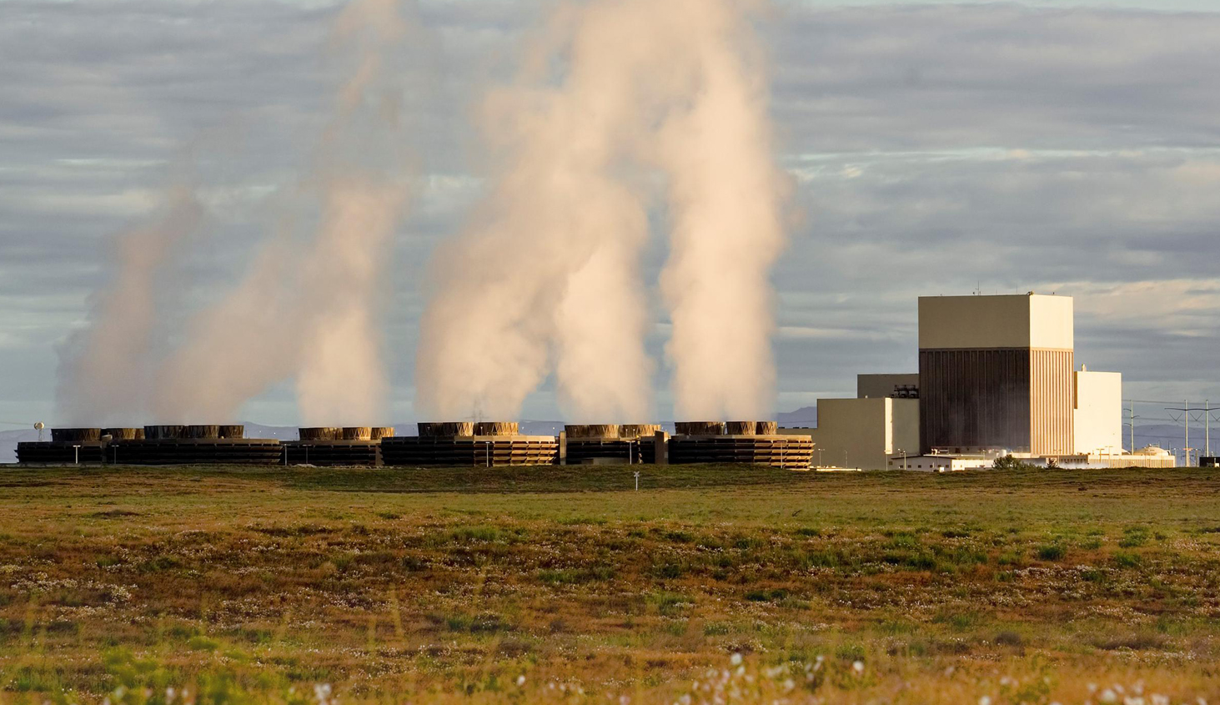
Non-Federal Debt
Washington State Joint Operating Agency
Owns and operates Columbia Generating Station (CGS)
$4.8 billion in BPA-supported obligations outstanding at 9/30/20
$4.1 billion in tax-exempt bonds
$634 million in taxable bonds
$151 million drawn on lines of credit
Subsequent to yearend, EN issued $712 million in bonds which are supported by BPA. The proceeds were used to refinance maturing bonds, fund new construction, lock in future fuel costs, and refinancings for interest savings
Continuing collaboration with Energy Northwest
Obligations are fully supported by BPA under existing net billing agreements
Columbia Generating Station

Slide 26
IERA Series 2021 Summary and Schedule
Bonneville Cooperation Project No. 2, Series 2021 (Federally Taxable)
Par Amount* | $309,315,000
Maturities* | Fixed Rate Term Bond due September 1, 2046 with Sinking Fund Payments in 2044 and 2045
Interest Payment Dates* | Beginning September 1, 2021 and semiannually on March 1 and September 1 thereafter
Pricing Date* | Tuesday, June 15, 2021
Settlement Date* | Wednesday, June 23, 2021
Optional Redemption** | Make Whole Call
Ratings | Moody's: Aa2 (Stable Outlook); Fitch: AA (Stable Outlook)
Syndicate | TD Securities, BofA Securities, Citigroup, and Wells Fargo Securities
* Preliminary, subject to change; when, as, and if issued
** To be determined at pricing. Additional call features exist; see The Series 2021 Bonds section in the Preliminary Official Statement
Investors should read the entire Preliminary Official Statement carefully before making an investment decision.

Slide 27
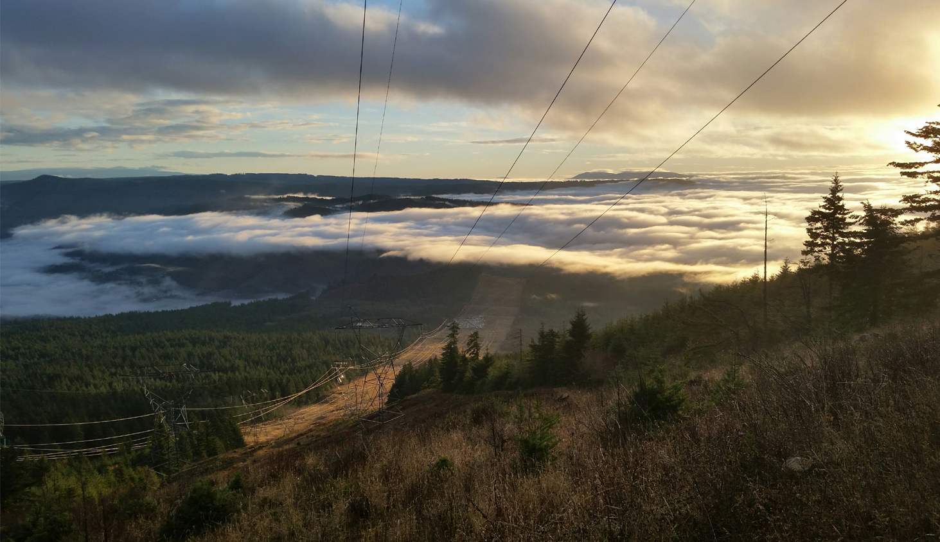
Contact Information
Nadine M. Coseo
Acting Treasury Manager,
Financial Strategy & Operations
(503) 230-3337
nmcoseo@bpa.gov
Alayne M. Switzer
Manager, Revenue Requirement,
Repayment & Investor Relations
(503) 230-4025
amswitzer@bpa.gov
Additional investor information:
http://www.bpa.gov/goto/investors
High Voltage Transmission

