Slide 1
QUARTERLY BUSINESS REVIEW
May 11, 2021

Slide 2
KEY PERFORMANCE INDICATORS
Joel Cook, CHIEF OPERATING OFFICER
BONNEVILLE POWER ADMINISTRATION | QBR MAY 2021 | JOEL COOK
SLIDE 2

Slide 3
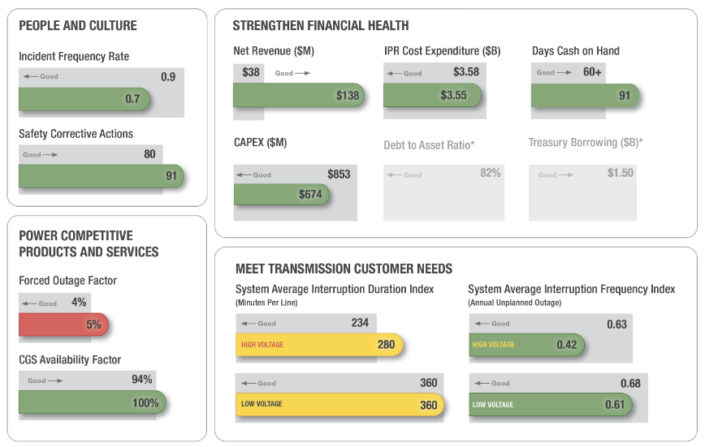
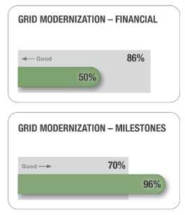
KPI & KSI DASHBOARD
Key Performance Indicators:
Key Strategic Initiatives:
* These measures are reported at the end of the fiscal year.
BONNEVILLE POWER ADMINISTRATION | QBR MAY 2021 | JOEL COOK
SLIDE 3

Slide 4
FINANCE
Michelle Manary, CHIEF FINANCIAL OFFICER
BONNEVILLE POWER ADMINISTRATION | QBR MAY 2021 | MICHELLE MANARY
SLIDE 4

Slide 5
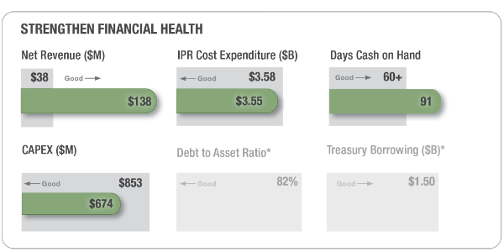
KPI DASHBOARD
* These measures are reported at the end of the fiscal year.
BONNEVILLE POWER ADMINISTRATION | QBR MAY 2021 | MICHELLE MANARY
SLIDE 5

Slide 6
AGENCY NET REVENUES
BONNEVILLE POWER ADMINISTRATION | QBR MAY 2021 | MICHELLE MANARY
SLIDE 6

Slide 7
AVERAGE BP-20 RATE PERIOD
BONNEVILLE POWER ADMINISTRATION | QBR MAY 2021 | MICHELLE MANARY
SLIDE 7

Slide 8
POWER FINANCIAL PERFORMANCE
Total $2,621
Total $2,660
BONNEVILLE POWER ADMINISTRATION | QBR MAY 2021 | MICHELLE MANARY
SLIDE 8

Slide 9
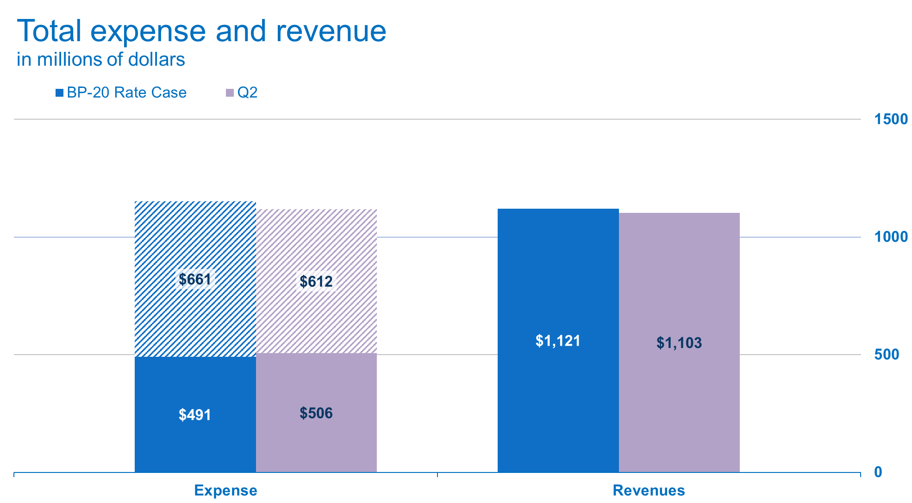
TRANSMISSION FINANCIAL PERFORMANCE
Total $1,152
Total $1,118
Non-IPR
IPR
BONNEVILLE POWER ADMINISTRATION | QBR MAY 2021 | MICHELLE MANARY
SLIDE 9

Slide 10
AGENCY CAPITAL EXPENDITURES
*Includes Fed Hydro, Power, IT and Facilities (Power portion)
BONNEVILLE POWER ADMINISTRATION | QBR MAY 2021 | MICHELLE MANARY
SLIDE 10

Slide 11
FINANCIAL RESERVES THRESHOLDS
x
Days Cash
93
91
96
BONNEVILLE POWER ADMINISTRATION | QBR MAY 2021 | MICHELLE MANARY
SLIDE 11

Slide 12
OTHER FINANCIAL UPDATES
Credit rating update
Michelle Manary’s Department of Energy detail in D.C.
May 18 Quarterly Business Review workshop will provide additional details about BPA’s financial performance, an update on Grid Modernization and the Strategic Cost Management initiative, and discussion on Transmission capital execution metrics.
BONNEVILLE POWER ADMINISTRATION | QBR MAY 2021 | MICHELLE MANARY
SLIDE 12

Slide 13
KEY PERFORMANCE INDICATORS
Joel Cook, CHIEF OPERATING OFFICER
BONNEVILLE POWER ADMINISTRATION | QBR MAY 2021 | JOEL COOK
SLIDE 13

Slide 14
STRATEGIC GOALS
BONNEVILLE POWER ADMINISTRATION | QBR MAY 2021 | JOEL COOK
SLIDE 14

Slide 15
QUESTION AND ANSWER
BONNEVILLE POWER ADMINISTRATION | QBR MAY 2021
SLIDE 15

Slide 16
THANK YOU
The QBR technical workshop is on
May 18 from 1 to 3 p.m.
The next QBR will be held in
August
Didn’t get your question answered?
Email Communications@bpa.gov. Answers will be provided at the QBR technical workshop if possible, or posted to www.bpa.gov/goto/QBR.
BONNEVILLE POWER ADMINISTRATION | QBR MAY 2021
SLIDE 16

Slide 17
FINANCIAL DISCLOSURE
This information was made publicly available on May 7, 2021, and contains information not sourced directly from BPA financial statements.
BONNEVILLE POWER ADMINISTRATION | QBR MAY 2021
SLIDE 17

