Slide 1


QUARTERLY
BUSINESS REVIEW
Aug. 10, 2021

Slide 2

QBR INTRODUCTION
Joel Scruggs, COMMUNICATIONS DIRECTOR
BONNEVILLE POWER ADMINISTRATION | QBR August 2021 | JOEL SCRUGGS
SLIDE 2

Slide 3
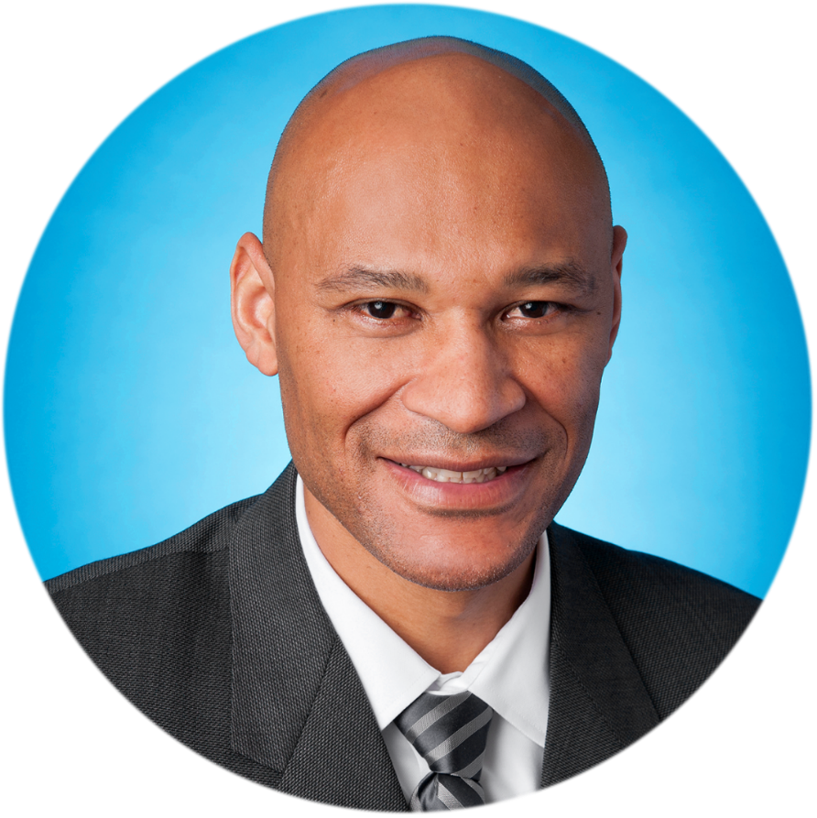
KEY PERFORMANCE INDICATORS
John Hairston, ADMINISTRATOR
BONNEVILLE POWER ADMINISTRATION | QBR August 2021 | JOHN HAIRSTON
SLIDE 3

Slide 4
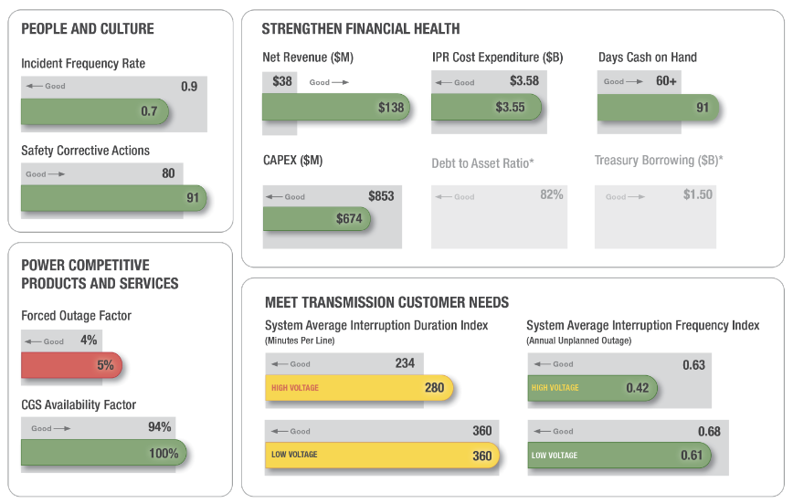
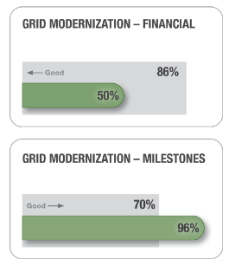
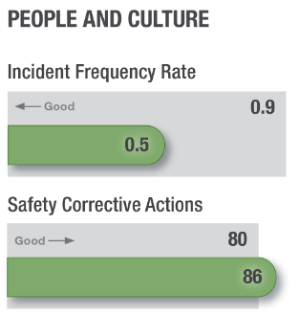
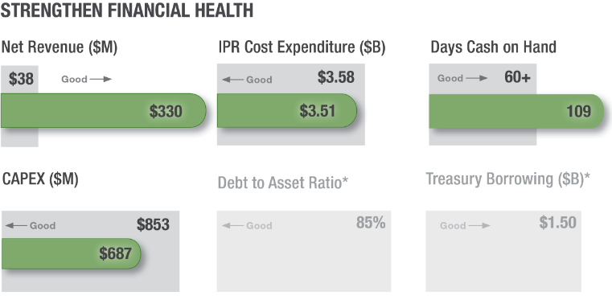
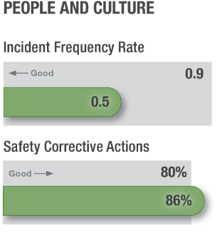
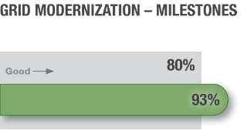
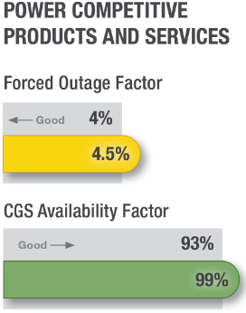

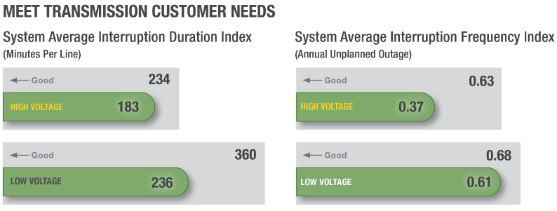
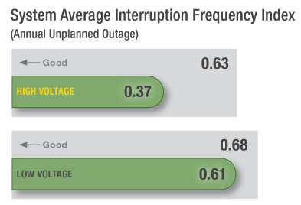
KPI & KSI DASHBOARD
Key Performance Indicators:
Key Strategic Initiatives:
* These measures are reported at the end of the fiscal year.
BONNEVILLE POWER ADMINISTRATION | QBR AUGUST 2021 | JOHN HAIRSTON
SLIDE 4

Slide 5

FINANCE
Marcus Harris, CHIEF FINANCIAL OFFICER
BONNEVILLE POWER ADMINISTRATION | QBR AUGUST 2021 | MARCUS HARRS
SLIDE 5

Slide 6
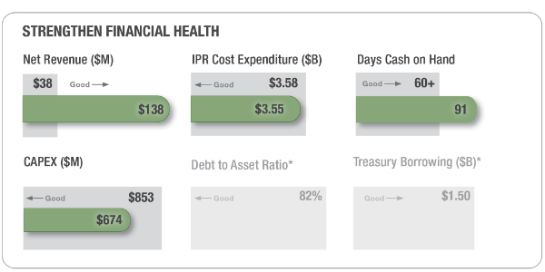
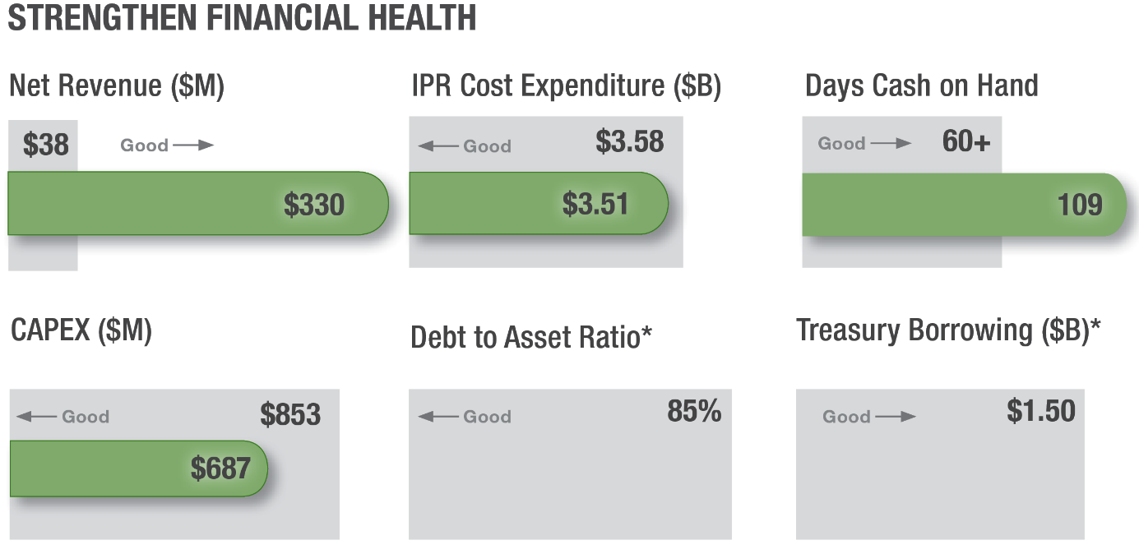
KPI DASHBOARD
* These measures are reported at the end of the fiscal year.
BONNEVILLE POWER ADMINISTRATION | QBR AUGUST 2021 | MARCUS HARRIS
SLIDE 6

Slide 7
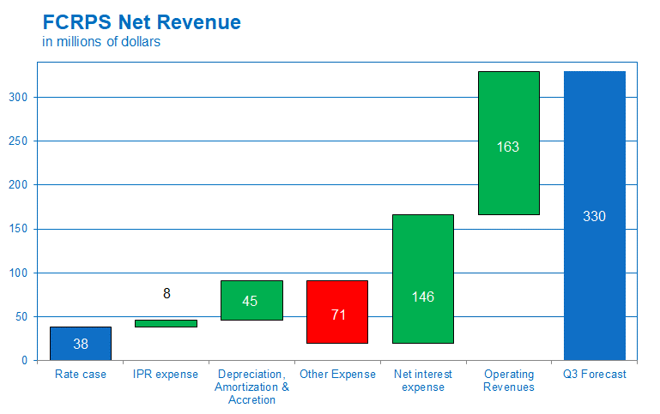
AGENCY NET REVENUES
BONNEVILLE POWER ADMINISTRATION | QBR AUGUST 2021 | MARCUS HARRIS
SLIDE 7

Slide 8
AVERAGE BP-20 RATE PERIOD
BONNEVILLE POWER ADMINISTRATION | QBR AUGUST 2021 | MARCUS HARRIS
SLIDE 8

Slide 9
POWER FINANCIAL PERFORMANCE
Total $2,621
Total $2,523
BONNEVILLE POWER ADMINISTRATION | QBR AUGUST 2021 | MARCUS HARRIS
SLIDE 9

Slide 10
TRANSMISSION FINANCIAL PERFORMANCE
Total $1,152
Total $1,103
Non-IPR
IPR
BONNEVILLE POWER ADMINISTRATION | QBR AUGUST 2021 | MARCUS HARRIS
SLIDE 10

Slide 11
AGENCY CAPITAL EXPENDITURES
*Includes Fed Hydro, Power, IT and Facilities (Power portion) ** $45 million of Transmission’s $113 million variance to rate case is due to customer driven Projects Funded in Advance (PFIA)
BONNEVILLE POWER ADMINISTRATION | QBR AUGUST 2021 | MARCUS HARRIS
SLIDE 11

Slide 12
FINANCIAL RESERVES THRESHOLDS
Days Cash
109 106 116
*Thresholds are triggered using the official end of year Reserves For Risk actuals. Please view the QBR Technical workshop materials for additional information
BONNEVILLE POWER ADMINISTRATION | QBR AUGUST 2021 | MARCUS HARRIS
SLIDE 12

Slide 13
OTHER FINANCIAL UPDATES
  Financial plan refresh
  Spring bond deals and rating agency reports
  QBR Technical Workshop
BONNEVILLE POWER ADMINISTRATION | QBR AUGUST 2021 | MARCUS HARRIS
SLIDE 13

Slide 14
STATE OF THE BUSINESS
John Hairston, ADMINISTRATOR
BONNEVILLE POWER ADMINISTRATION | QBR AUGUST 2021 | JOHN HAIRSTON
SLIDE 14

Slide 15





STRATEGIC GOALS
BONNEVILLE POWER ADMINISTRATION | QBR AUGUST 2021 | JOHN HAIRSTON
SLIDE 15

Slide 16
QUARTERLY BUSINESS REVIEW CLOSING
Joel Scruggs, COMMUNICATIONS DIRECTOR
BONNEVILLE POWER ADMINISTRATION | QBR AUGUST 2021 | JOEL SCRUGGS
SLIDE 16

Slide 17
BPA Public Engagement
QBR Technical Workshop,
Aug. 17, 1 p.m. to 3 p.m.
Commercial Business Process Improvement Customer Conference Call
Aug. 18, 10:30 a.m. to noon
ATC ID Customer Conference Call
Aug. 24, 10 a.m. to 11 a.m.
BPA and the NWPP Resource Adequacy Program
Aug. 25, 9 a.m. to noon
Financial Plan Refresh Kickoff Meeting
Sept. 15, 1 p.m. to 4 p.m.
BONNEVILLE POWER ADMINISTRATION | QBR AUGUST 2021 | JOEL SCRUGGS
SLIDE 17

Slide 18
Public Comment Periods
FY2022 Net Requirements Public Notice – Comment period closes Aug. 13
BPA issues Draft EIM Phase V Close-out letter – Comment period closes Aug. 23
BONNEVILLE POWER ADMINISTRATION | QBR AUGUST 2021 | JOEL SCRUGGS
SLIDE 18

Slide 19

QUESTION AND ANSWER
BONNEVILLE POWER ADMINISTRATION | QBR AUGUST 2021
SLIDE 19

Slide 20
THANK YOU
The next QBR will be held in
November, 2021
Didn’t get your question answered?
Email Communications@bpa.gov. Answers will be provided at the QBR technical workshop if possible, or posted to www.bpa.gov/goto/QBR.
BONNEVILLE POWER ADMINISTRATION | QBR AUGUST 2021
SLIDE 20

Slide 21
FINANCIAL DISCLOSURE
This information was made publicly
available on Aug. 9, 2021, and contains
information not sourced directly from
BPA financial statements.
BONNEVILLE POWER ADMINISTRATION | QBR AUGUST 2021
SLIDE 21

