Slide 1
BPA Climate Change Resiliency
Proposed Update to Long-Term Hydro Generation Forecast
Stakeholder Workshop
March 21, 2022

Slide 2
Agenda
Overview
Observed and Projected Changes in Climate
Proposed Update to Long-Term Hydro Generation Forecast
Break
Understanding Customer Impacts
Conclusion

Slide 3
Overview
BPA has been studying and assessing how to prepare for the impacts of climate change for over a decade.
Climate change is now being detected in both temperature and streamflow records across the region. These trends are nearly certain to continue.
The entire 90-year historical record likely includes temperature, precipitation, and run-off patterns that have a diminishing probability of recurrence in the future.
The recent 30-years of historical streamflows are consistent with climate change signals in the region and largely follow projected trends in future streamflows.

Slide 4
Overview
In light of emerging climate change trends, BPA is proposing to update streamflow assumptions for the long-term hydro generation forecasts used in routine planning (and reflected in rates) in order to provide a more accurate range of future generation:
  To use the most-recent 30-years of streamflows (1989 – 2018 Modified Flows), instead of streamflows dating back to 1929.
  To establish firm generation using the monthly 10th percentiles from the most recent 30-years of streamflows, instead of using 1937 water.
BPA is taking comments through April 8 and intends to make a a final decision in time to incorporate it into the RHWM Process and BP-24 Rate Case.

Slide 5
Observed and Projected Changes in Climate

Slide 6
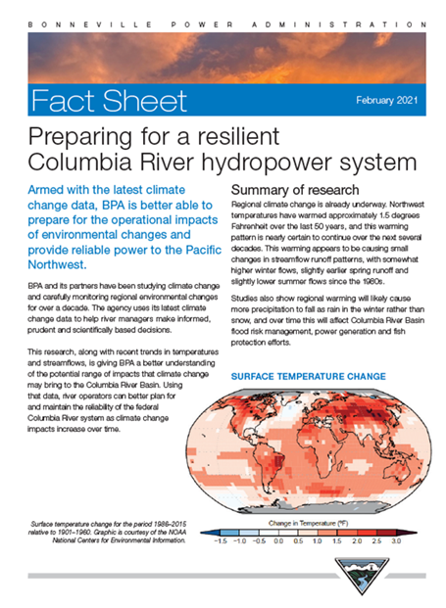
Background
BPA has been monitoring climate change science and trends for well over a decade.
We, and the rest of the region, had been anticipating climate change signals would probably start to appear by the 2020s as global warming continued.
  RMJOC-I Study in 2008-2011
  RMJOC-II Study in 2014-2019
  Department of Energy studies (as part of SECURE Water Act reporting to Congress)
  Dozens of other, regional academic studies
In the last couple of years, climate change signals have either begun to emerge and/or have become clearer, in actual, observed data.
  Temperatures
  Snowpack
  Streamflows
  Possibly precipitation (signal is stronger in other parts of the US)

Slide 7
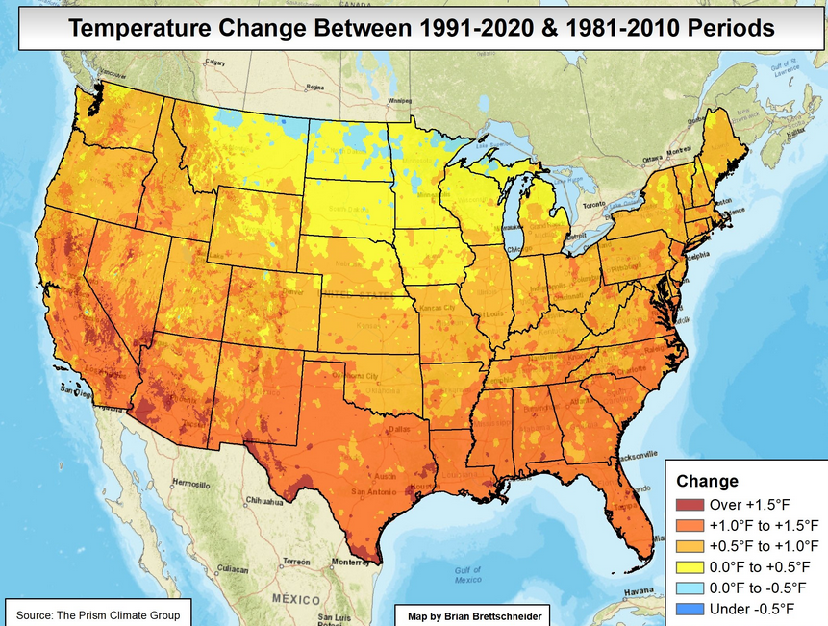
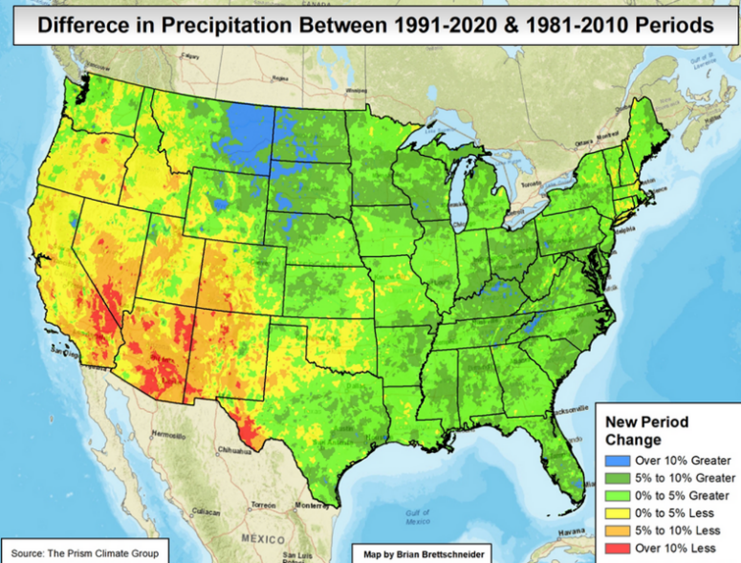
Temperature and Precipitation Signals
Source: PRISM Climate Group, Oregon State University
Almost the entire US warmed by 0.5-1.5°F or more in just the last 10 years.
There are hints that key snowpack areas in the northern Columbia Basin may have trended slightly wetter.
Unlike the Columbia Basin, California/SW US trended both hotter and drier in the past 10 years.

Slide 8
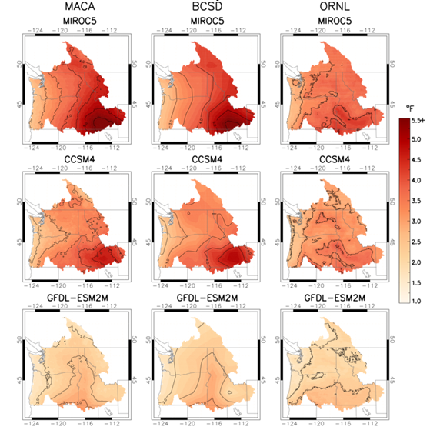
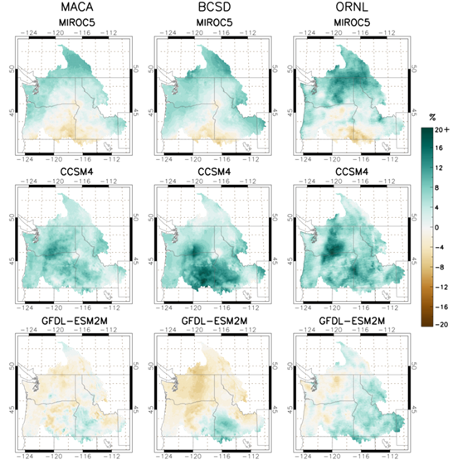
2030s Annual Temperature and Precipitation Projections
Recent data is matching climate change projections:
Temperature:
  Regional warming already underway and nearly certain to continue
  More warming likely in the interior than the coasts, particularly in the upper Snake Basin
Precipitation:
  Trends are less certain
  General upward trend is likely
  Most likely area to trend wetter is in BC
Temperature Change
Precipitation Change
Source: RMJOC-II Part 1 report, 2018

Slide 9
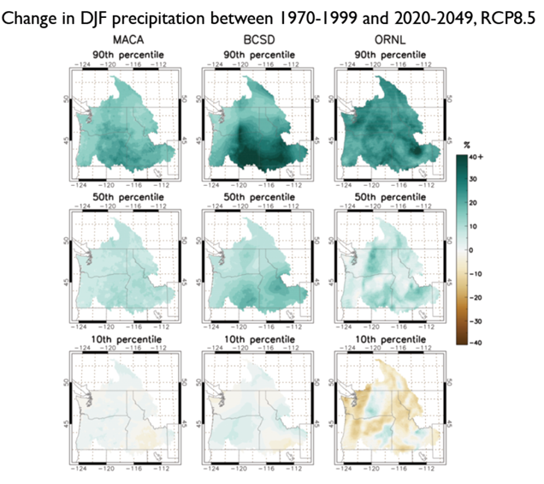
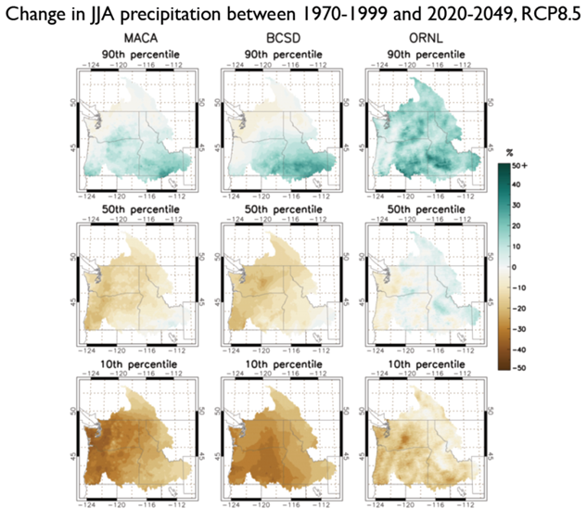
2030s Winter and Summer Precipitation Change in %
Winter
Summer
Source: RMJOC-II Part 1 report, 2018
Winters are likely to become wetter, possibly much wetter
Already dry summers could become drier (with some possible exceptions)

Slide 10
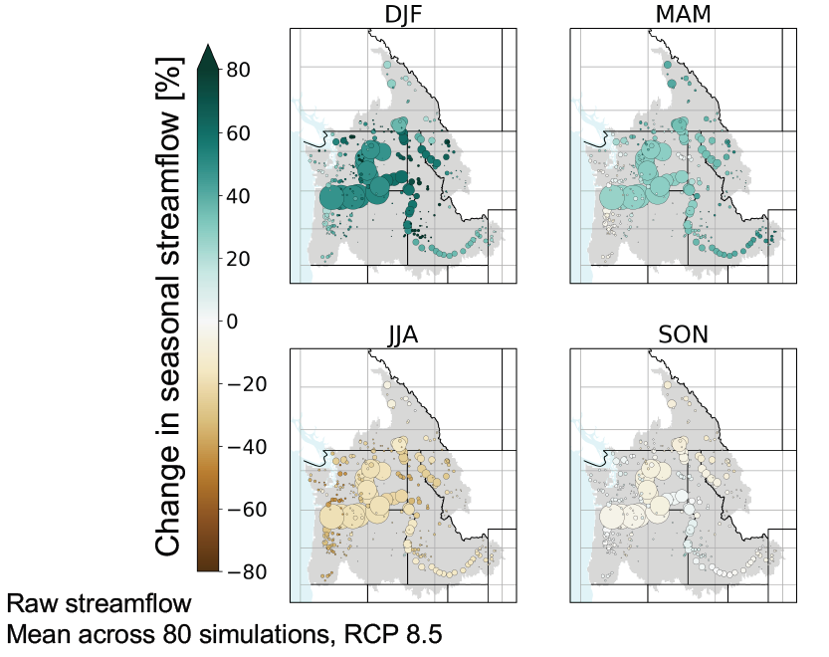
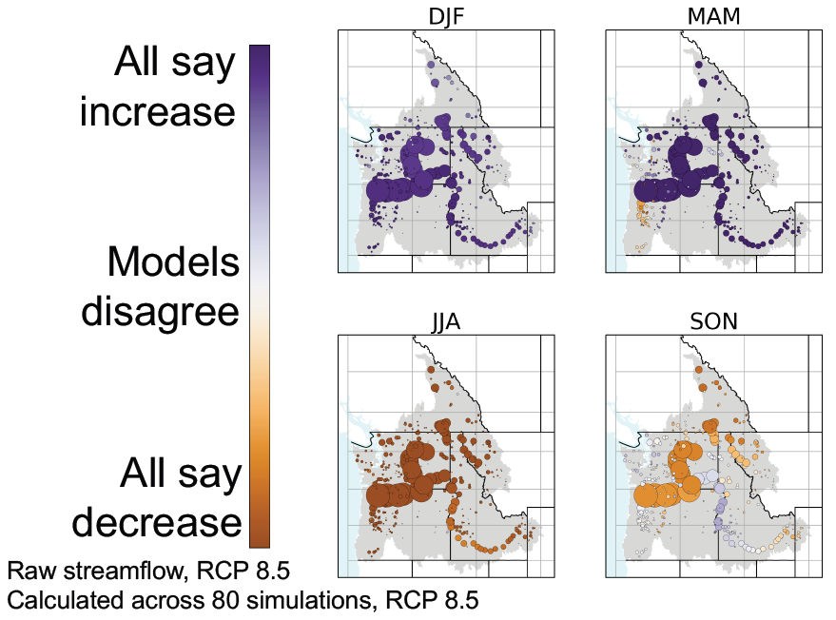
Seasonal Change in Streamflow Volumes and Relative Confidence: 2030s
Source: RMJOC-II Part 1 report, 2018

Slide 11
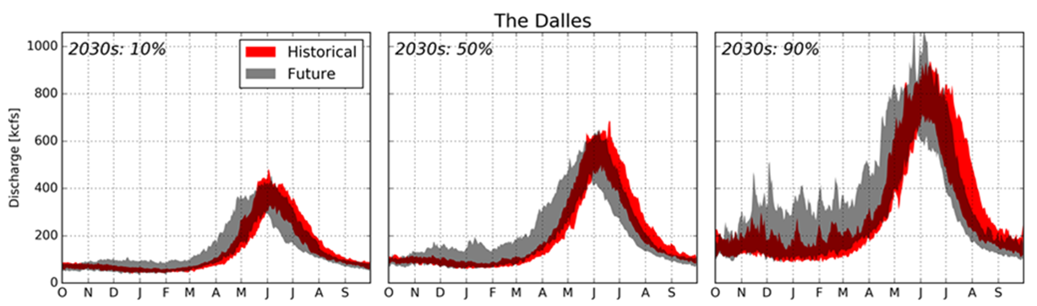
Simulated 10%, Median, and 90% Unregulated Streamflows: 2030s
Average The Dalles Inflows: 2030s and 2070s (All Hydro Models)
Source: RMJOC-II Part 1 report, 2018
Higher fall, winter and early spring flows
Earlier peak runoff timing
Lower June/July flows
More extreme flood events
Inconclusive drought trends (but longer periods of low natural flows are likely in the summer)

Slide 12
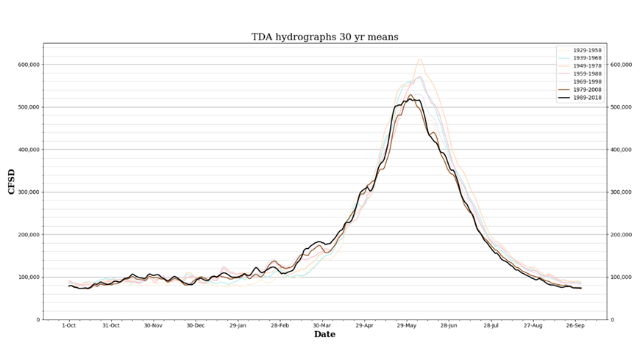
2020 Modified Flows
Source: 2020 Level Modified Streamflows
Included an assessment on whether climate change signals are emerging in the dataset used regional (and BPA) Long-Term Planning:
Higher February-April flows in last 30 years (especially in March). Statistically significant.
Lower June-September flows, especially in July-August. Not quite statistically significant, but close.
Peak of the spring runoff has shifted several days earlier since the 1980s. Statistically significant.
Weather and Streamflow conclusion:
A shorter and most recent streamflow period of record (1989-2018) is more representative of ongoing and developing climate change
Switching to a 30 year period-of-record is also more consistent with World Meteorological Organization (WMO) best-practices
The most recent 30 years still adequately captures the large range of natural, intraseasonal and interseasonal streamflows (e.g., high and low water years)

Slide 13
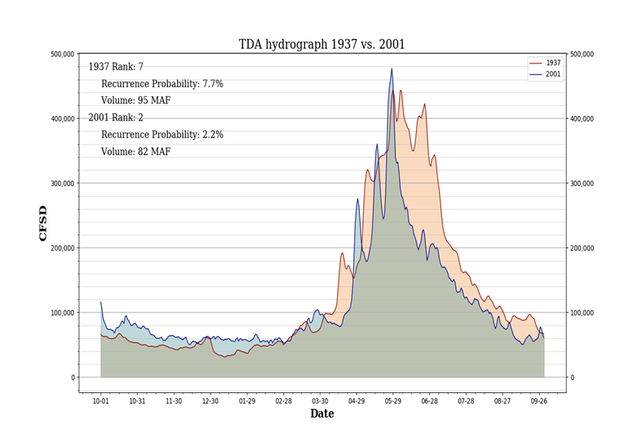
Critical Year Streamflow Assessment
WY1937 is no longer representative of ongoing and increasing climate change:
  All years in the long term record are no longer “equally probable” (referred to in the literature as non-stationarity)
  The chance of such low winter volume is now only 0.37% (~1/270 year event) with climate driven trends, and decreasing
  WY1937 was unusually cold, which led to the streamflow shape supporting lowest generation
  WY1937 volume was not the lowest on record (1977 was lowest; 2001 was second lowest)
  WY2001 is more representative of what future low water years will look like, especially in June-August

Slide 14
Other BPA actions
Switched to a shorter period-of-record for ESP streamflows (used for medium term planning)
  Switched from 1948-2015 to 1981-2018 (along with NOAA/NWS/NWRFC)
Updated long-term temperatures for loads
  Moved from 1970-2005 to 2005-2019, and will now update every 5 years
  So far, load changes have been small, but lower heating demand and increasing AC demand are expected to gradually become more pronounced
Collaborating with DOE on their latest national climate change assessment using IPCC-6 Data
  New Report to Congress expected later this year
Continuing to monitor climate science news and trends:
  IPCC-6
  National Climate Assessments
  Other, reputable regional studies

Slide 15
Proposed Update to Long-Term Hydro Generation Forecast

Slide 16
Proposed Planning Update
BPA proposes the following in order to ensure that planning decisions reflect emerging climate change trends and capture anticipated ranges of uncertainty
  For routine long-term planning, the base streamflow assumptions for the hydro generation forecast are updated to include only the recent 30 years from the 2020 Modified Flows (1989 to 2018);
  For longer-term planning (15+ years into the future, on a rolling basis), BPA would assess whether the base streamflow assumptions for a given study should be based on future climate change studies (such as RMJOC-II); and
  BPA annualizes the monthly tenth percentiles (P10) of generation from the recent 30 years of Modified Flows to determine firm generation.
Propose making this change for the upcoming RHWM Process and BP-24 Rate Case.

Slide 17
Streamflow Forecasts 101
2010 Modified Flows
“Historic- 80”
Standard update
(Stand alone study)
2020 Modified Flows
“Historic- 90”
Observed Climate Change
2020 Modified Flows
“Recent- 30”
*RMJOC-II Climate Change Scenarios
Near term Climate change flows
“2030s”
1929-2018
1989-2018
2020-2049 (x4 from CRSO)
The 90-year record may include temperature, precipitation, and run-off patterns that have diminishing probability of recurrence.
*River management joint operating committee second report on climate change

Slide 18
Box Plots 101
90th percentile
75th percentile
Average
Median
25th percentile
10th percentile
5th percentile

Slide 19
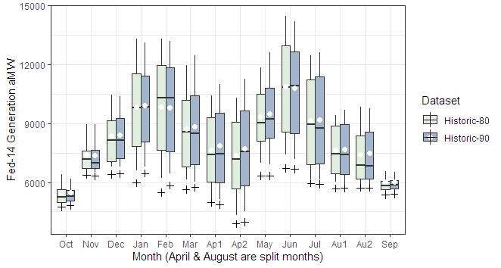
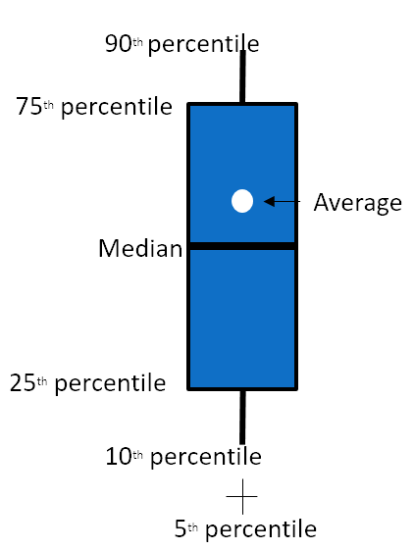
Generation with Historic 80 vs 90 streamflows

Slide 20
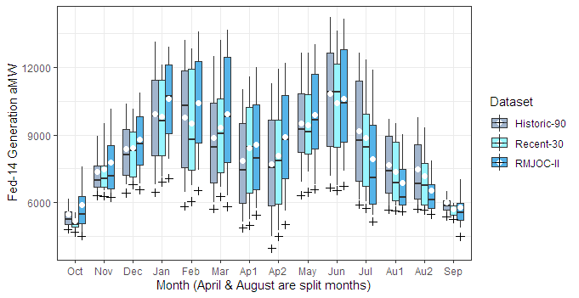
Generation with Historic 90 vs Recent 30 vs RMJOC-II streamflows
Observed and RMJOC-II climate change both show:
Earlier run off
Drier summers
Reduced generation in fall
RMJOC-II (2020-2049)
Increased Dec-Feb generation relative to observed stream flows.

Slide 21
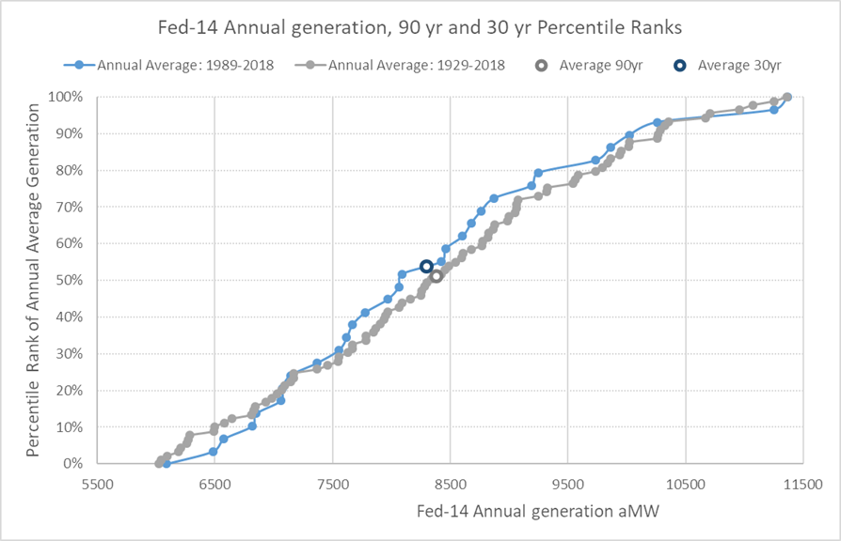
The distribution of annual generation has shifted. The lowest 10th percentile of years is characterized by larger generation, whereas the median is characterized by less generation. The resulting average from these distribution changes are close, with 30 WYs being about 86 aMW less than the 90yr distribution.

Slide 22
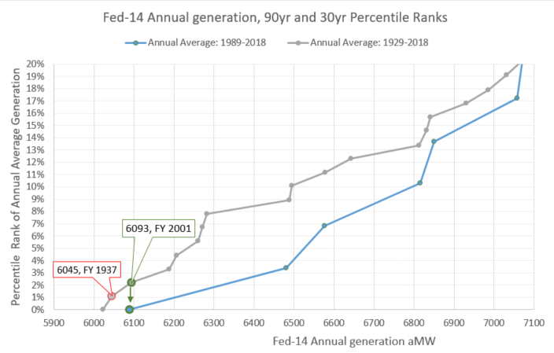
In the 30yr period of record, the analogous critical output to FY 1937 is FY 2001.
FY 2001 generation was the 2nd percentile in the full record, whereas it becomes the minimum in the 30yr record.

Slide 23
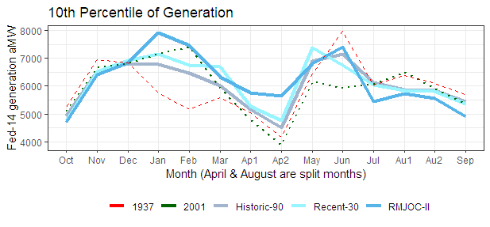
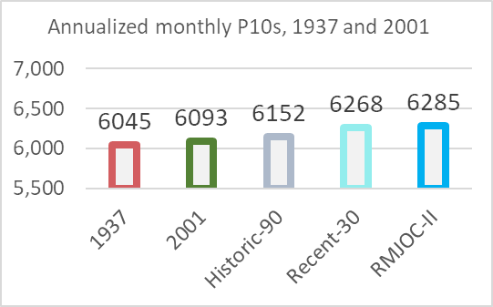
Monthly P10 generation vs Historic Years
This metric is similar to that used as a risk threshold in the Resource Program
30WY and RMJOC showing less risk in winter and spring, more risk summer.
Singular years are at times divergent from P10 generation statistics by month

Slide 24
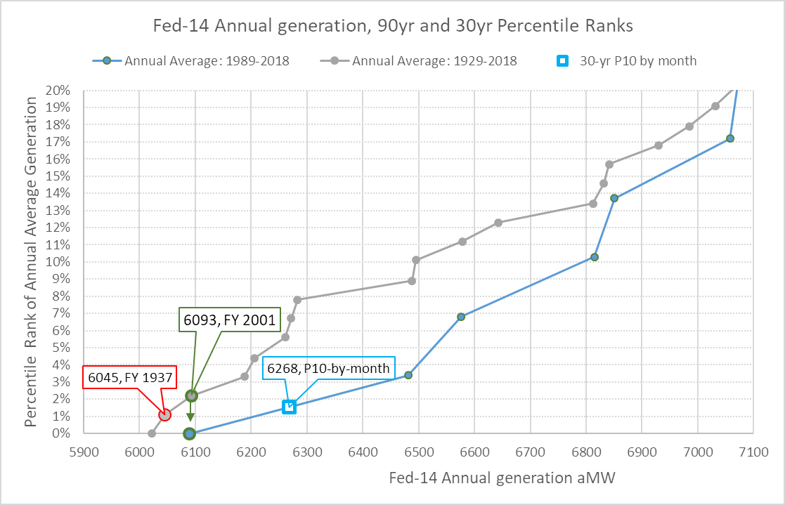
In the 90yr distribution FY 1937 generation is ranked at 1.1%, the monthly P10 is ranked at 1.6% in the 30yr distribution.

Slide 25
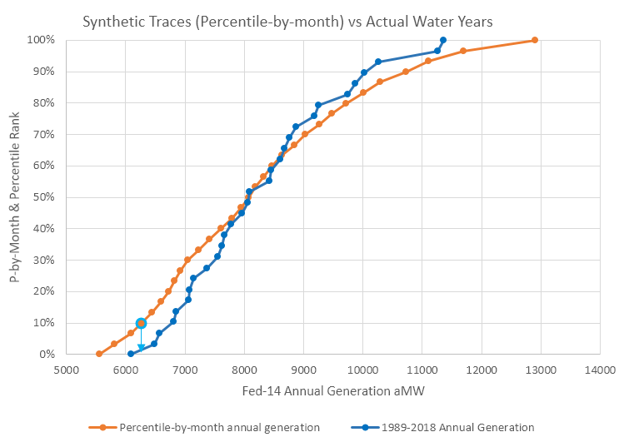

Slide 26
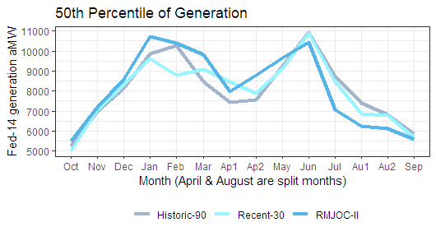
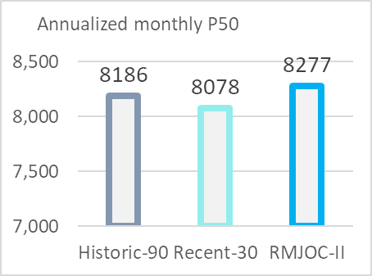

Slide 28
T1FSCO Change Over Time
Adjusted number for 2022 RHWM is reflective of adjustment if 30yr P10 methodology was applied.

Slide 29
Understanding Customer Impacts

Slide 30
Tiered Rate Methodology (TRM)
Question: Can BPA make these changes without revising the TRM?
Answer: Yes, TRM section 3.1.3.1 and section 3.1.3.2 (shown below) define and carve out this discretion for BPA.
3.1.3.2 Determination of Critical Period
For operational purposes, the Critical Period adopted by BPA as of the effective date of this TRM is September 1936 through April 1937. However, to be consistent with the corresponding Fiscal Years, BPA will use as the Critical Period for this TRM the historical streamflows from October 1936 through September 1937 in the determination of the Firm Critical Output of the Tier 1 System Resources. BPA may adopt a new Critical Period after a good faith analysis indicates that updates to power and/or nonpower requirements changed the length and/or water conditions of the then-current Critical Period such that the new Critical Period would, in BPA’s determination, be more reasonable than the then-current Critical Period. Examples of these requirements that may necessitate such revision include, but are not limited to, biological opinions, court orders, treaties, statutes, regulations, executive orders, changes in thermal resource operations, changes in forecast loads, extension of the historical streamflow record, and flood control. BPA may incorporate the new Critical Period that is used to forecast the available firm output of hydroelectric projects used in the determination of the Firm Critical Output of the Tier 1 System Resources. Any changes to the Critical Period will remain in effect until further revised pursuant to this section. Changes to the Critical Period are not considered to be changes to the TRM pursuant to sections 12 and 13.

Slide 31
Rate impact: 80/WY 1937 to 30 WY/P10 by month
All else equal, the net impact using FY24-25 information is an increase in revenue of $15 million – which translates to a rate decrease of 0.8%.
Tier 1 System Firm Critical Output (T1SFCO) increases by 218 aMW shifting from 80WY/1937 to 30WY/P10.
Tier 1 Loads increase 116 aMW, revenue increases $35.5 million.
Firm Surplus increases 98 aMW, revenue increases $21 million.
Secondary Revenue decreases $41.5 million.
  Secondary generation decreased slightly from 80WY to 30WY. Net Inventory decreased at a much greater rate reflecting the rise in Firm Loads.
Analysis was performed outside of RAM/REVSIM to approximate the impact.

Slide 32
System Shape Changes
System shape changes do not create “winners and losers” among customers.
All non-Slice customers receive a proportional share of the same system and therefore gain or lose System Shape Load at the same proportional size.

Slide 33
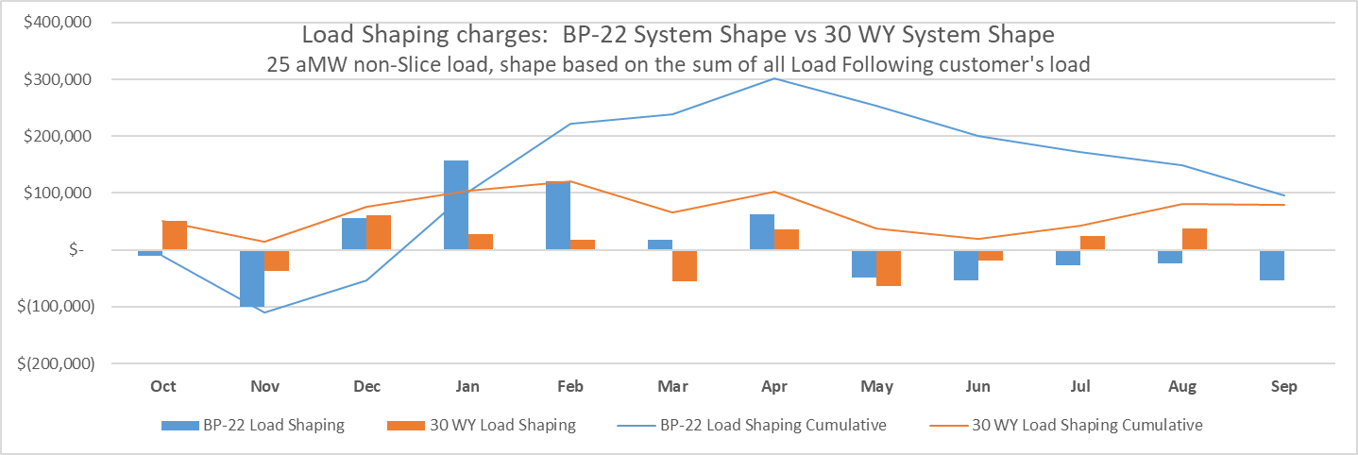
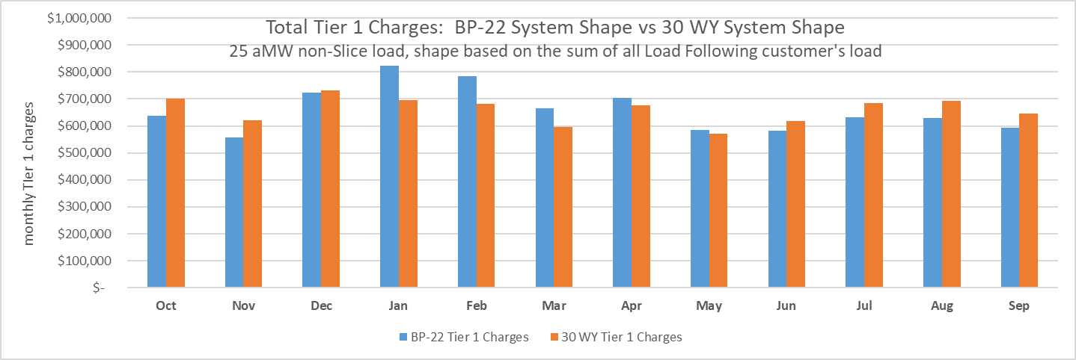
System Shape Impacts Cash Flow
System shape changes do impact cash flow.
The 30 WY system shape is lower in the early months of the fiscal year; relative to the BP-22 system shape, it is also flatter. This will result in higher Load Shaping charges in the first few months of the year for all customers and flatter Load Shaping charges across the year.

Slide 34
Slice/Block Customer Concern
A Slice/Block customer’s Block amount is equal to its Net Requirement minus the expected firm output of the Slice product.
Slice/Block customers are concerned that a more or less conservative measurement of firm capability will impact the size of the Block a Slice/Block customer receives from BPA.
While we do not disagree with this potential outcome, the objective of the 30WY/P10 measurement is to modernize and update the calculation of firm inventory based on the best information. Our intent is not to shift the measurement in the distribution. Thus, any potential impact is inadvertent.

Slide 35
Defining Firm Inventory
The calculated probability of 1937 generation changes over time – it is a product of the dataset used and not the determining function.
1937 is the historical water year on record with the least amount of generation in winter; combined with firm loads, this represents the most deficit water condition. It was not selected because of its annual generation P-value.
A key reason why we are proposing a change in the measurement of firm generation is because the most recent years are a better representation of the inventory BPA will receive. Therefore, trying to calculate the effective annual generation P-value of 1937 is difficult because all years do not have an equal chance of occurring.
The two methodologies are difficult to compare but the intent remains the same – to calculate an amount of generation that will show up the vast majority of the time.
Firm Inventory Methodology | 1937 | 30WY/P10
Annual Generation P-value | Undefined Dynamic | Defined Static
Basis | Single Year | Multiple Year Monthly
Attempts to Reflect Climate Change | No | Yes

Slide 36
Conclusion

Slide 37
Proposed Change
In order to ensure that planning decisions reflect emerging climate change trends and capture anticipated ranges of uncertainty, BPA proposes that:
  For routine long-term planning, the base streamflow assumptions for the hydro generation forecast are updated to include only the recent 30 years from the 2020 Modified Flows (1989 to 2018);
  For longer-term planning (15+ years into the future, on a rolling basis), BPA would assess whether the base streamflow assumptions for a given study should be based on future climate change studies (such as RMJOC-II); and
  BPA annualizes the monthly tenth percentiles (P10) of generation from the recent 30 years of Modified Flows to determine firm generation.
BPA intends to apply this standard consistently across agency planning processes, including determination of the critical period per the TRM. BPA has discretion to do this without changing the TRM.
BPA proposes this change be effective for the upcoming RHWM Process and BP-24 Rate Case.

Slide 38
Submit Comments
BPA is taking comments through April 8th.
Comments can be submitted at https://publiccomments.bpa.gov/

