Slide 1
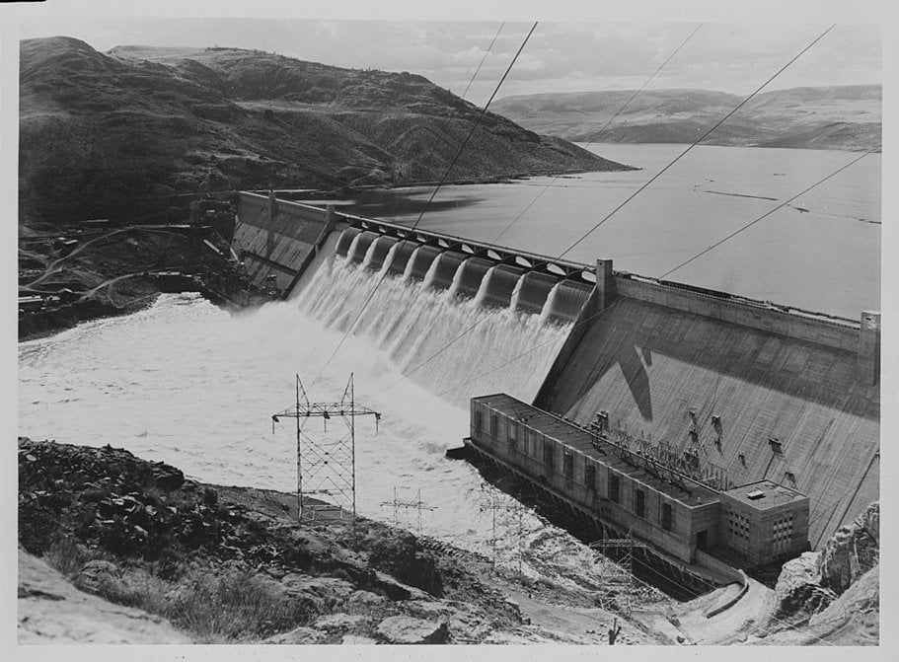
PNR Concept

Slide 2
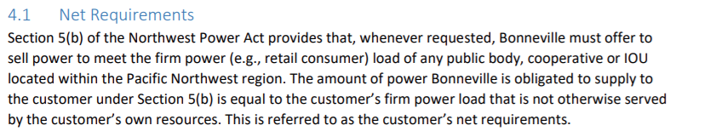
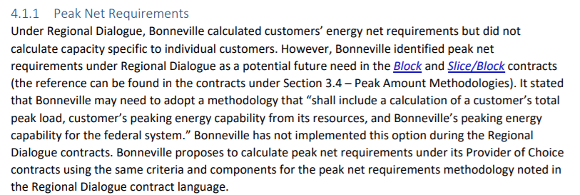
BPA provides for the “Net Requirements” of it’s customers.
BPA has proposed to calculate “Energy Net Requirements” and “Peak Net Requirements” through the Provider of Choice Contracts.
Provider of Choice – BPA Concept Paper July 2022

Slide 3
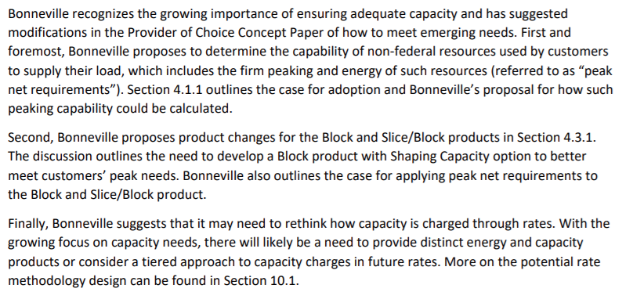
BPA has shared high level thoughts on how to address PNR.
Provider of Choice – BPA Concept Paper July 2022

Slide 4
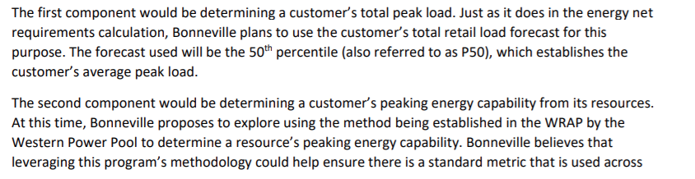
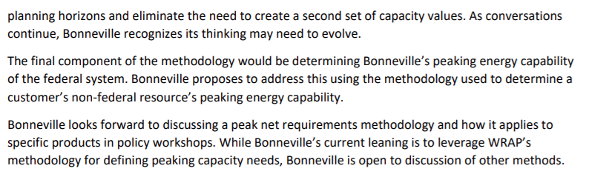
BPA has shared high level method for determining PNR.
Provider of Choice – BPA Concept Paper July 2022

Slide 5
PNR determination.
Customer Peak Load
Customer Resources Peaking Capabilities
Customer Peak Net Requirements (PNR)
BPA’s Peaking Capabilities
Customer Allocation (TOCA)
Customer Peak Allocation
Key Considerations
When calculating PNR and BPA’s system capabilities it is critical to use methods consistent with regional planning.
When allocating the system it is critical to consider the impacts to both energy and capacity delivery and how they impact each other.
When making rates and serving above high watermark PNR it is critical for BPA to meet it’s statutory obligations and consider cost transfers.

Slide 6
PNR Concept Proposal Overview
0
Level Setting
1
4
PNR Interests refresher
Concept
2
5
Refresher: Metrics and Utility Best Practice
Examples
3
6
Metrics
Additional Discussion Areas

Slide 7
0. Level Setting
This concept proposes a system for BPA to:
Implement PNR allowing all products to demonstrate resource adequacy
Maximize the ability of the federal system to meet preference customers net requirements
Provide transparent cost recovery between product groups
This concept does not:
Address tiered rates for capacity
Consider resource dedication impacts
Alter system operations

Slide 8
PNR Interests
Consistency with industry practice for utility planning
Consideration of forward planning and operations
BPA can address Peak Net Requirements deficits
Methodology is simple, practical, and achievable
Implementation charges for what is provided under all products

Slide 9
2. Utility Best Practices
  Demonstrated approaches in portfolio planning to account for low water conditions
  Demonstrated approaches in portfolio planning to account for high seasonal and within-month load conditions
  Evaluates the coincidence of peak needs to resource capability
  Measure seasonal and temporal periods reflective of core risks
  Use statistical techniques to inform appropriate and uniform risk thresholds that can be managed
  Measure portfolio capability and candidate resource capability
  Portfolio satisfies multiple standards & metrics (e.g. loss of load metrics for duration, magnitude, and frequency)
  Must pass the SAT (Simple, Accurate, and Transparent) test

Slide 10
3. Metrics
Planning metric(s) and implementation standards form a “system” when considered together. The system proposes to use the metrics as defined by the WRAP.
Uniform adoption of the WRAP metrics avoids planning gaps and possible inconsistencies between load following and planned products.
The Metrics:
            Qualified Capacity Contribution (QCC) as defined by the WRAP
            Planning Reserve Margin (PRM) as defined by the WRAP

Slide 11
4. Concept
Standardize load measurements using the WRAP methodology
Standardize resource QCCs for customer resources
Calculate the QCC amount for the FCRPS
Attribute FCRPS QCC between preference customers
Utilize the WRAP framework to identify Peak Net Requirements (PNR) deficits
Customers with PNR deficits and surplus are made whole through RA Transfer Product(s)
BPA continues to meet all Load Following customers needs on an hourly bases for both energy and peaking capacity
Planned product customers demonstrate resource adequacy on a forward basis.
All customers are made whole when transfers occur
Use of the FCRPS to serve energy and peak net requirements is maximized

Slide 12
5. Example – Setting the Stage
What it is
A forward showing product for demonstrating resource adequacy.
What it isn’t
An operational product.

Slide 13
5. Example - BPA is Short
BPA is 100 MW deficit July 2028
BPA demonstrates the deficit using the WRAP
BPA notices surplus customers of the intent to call for transfers
Transfers priced at a rate avoiding cross-subsidization
Transfers are applied proportionately to surplus customers
Customers respond to BPA’s notice
If the transfer causes an energy or capacity resource adequacy deficit (using best practices RA metrics) the customer is exempted from some/all of the transfer
*Prior to forward showing

Slide 14
5. Example - Customer is Short
*Prior to forward showing
Customer is deficit 100 MW July 2028
Customer demonstrates the deficit using the WRAP
Customer calls on BPA for transfers.
Transfers priced at a rate avoiding cross-subsidization
BPA agrees to sell 100 MW
If the transfer causes an energy or capacity RA deficit (using best practices RA metrics) BPA is exempted from some/all of the transfer

Slide 15

5. PNR Interests Checked
Consistent with industry practices
Consistent with forward planning and operations
BPA can balance surplus and deficit customers requirements
Simple, practical, and achievable
Transparent and accurate cost recovery
Flexibility for tiered rate methods
?

Slide 16
6. Net Requirement distinctions between products
For discussion
Planned Product Customer
Net Requirement Schema
Load Following Customer
Net Requirement Schema
Net Requirement calculated during planning period informs maximum and minimum of statutory eligibility for Priority Firm service
Planned Net Requirement
Consumption Standard for Net Requirements
Planned Net Requirement
Planned Product Offering
Contracted-for Planned Product
Criteria for whether BPA offers a planning product is whether the product provides certainty of service obligation
Common
Measurement
BPA’s obligations for planned products are limited to the service obligation contracted-for by customers
Net Requirement calculated during planning period informs rate treatment
BPA’s Net Requirements obligations for load following customers are met through load-consumption standard

Slide 17
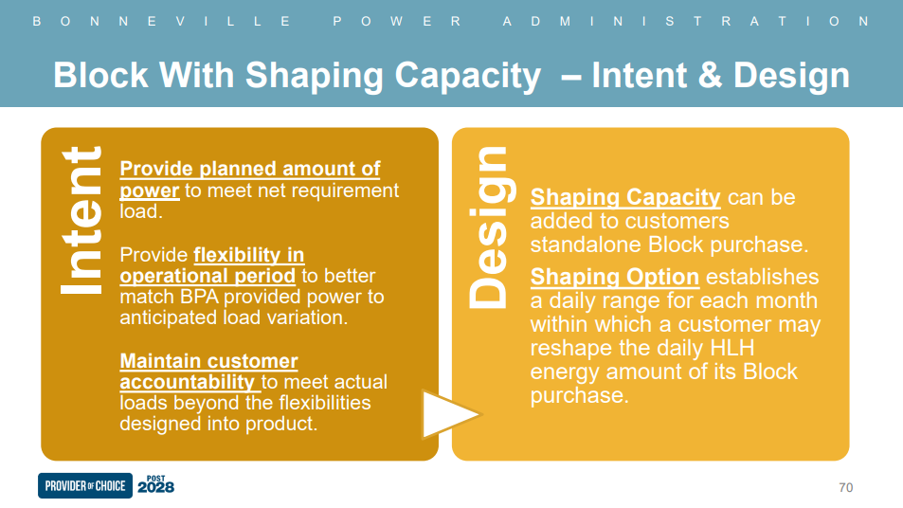
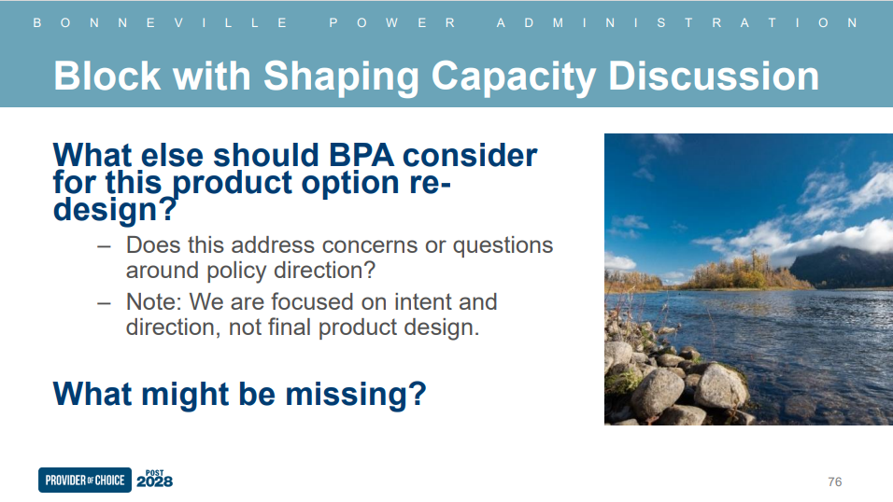
6. Block with Planning Reserve Margin product option for consideration
For discussion
Provide planned amount of power to meet net requirement load
Planning reserve margin added to customers standalone Block purchase
Intent
Design
Maintain certainty in demarcation of obligation between BPA and customers
Western Resource Adequacy Program’s RA Transfer instrument used to operationalize the product
Maintain customer accountability to meet actual loads
There is not additional flexibility or arbitrage opportunity for customers beyond energy net requirement product
Product offering that meets peak net requirements for planned product customers

Slide 18
BPA is guided by a diverse group of stakeholders and statutes which must be balanced by the Administrator.
Load Following customers have BPA meet both planning and hourly operational needs.
Planned Product customers have BPA meet only planning needs.

Slide 19
Key Takeaways
The Slice Customer proposal meets Planned Product customer needs and BPA’s stated goals, and has the support of Planned Product customers
Load Following Product provides for planning and operational needs; Planned Products provide for planning needs; and implementing a peak net requirement methodology requires the development of new planned products to meet planned resource adequacy needs.
The advent of the Western Resource Adequacy Program is an opportunity to define and implement Peak Net Requirements consistently across products and resources
Notes:
PNR can be designed to provide all products with equitable access to planned system peaking
PNR and the planned products as originally presented do not meet customer’s planning and demonstration needs.
Customer products satisfy BPA’s Energy Net Requirements methodology and meet customers planned energy needs.
Customer products require enhancement to work with BPA’s Peak Net Requirements methodology and customers planned peaking needs.
BPA products can be improved by utilizing the WRAP metrics during the Provider of Choice process.

