Slide 1
PLVS and Comment Deadlines
August 26, 2024
Slide 14 Updated 8/23/2026

Slide 2
Peak Load Variance Service for Block with Shaping Capacity

Slide 3
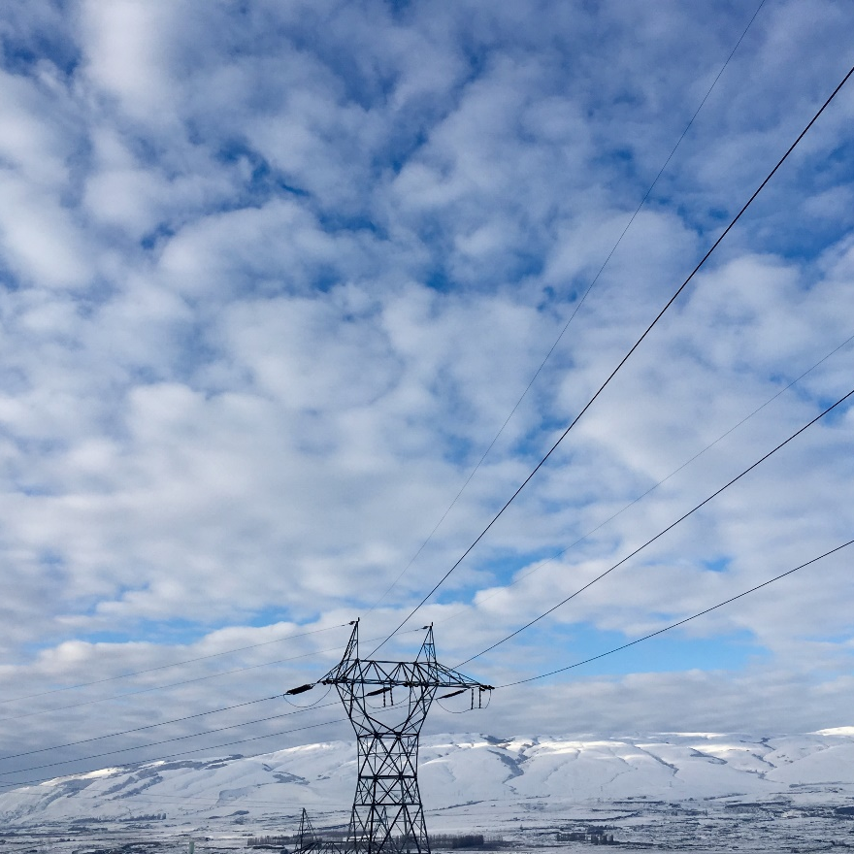
Workshop Objectives
Review BPA’s proposal for Peak Load Variance Service (PLVS) for Block with Shaping Capacity (BWSC) product.
Discuss additional PLVS design elements. New design elements are designated with a *.

Slide 4
PLVS for BWSC Overview
Bonneville intends to offer PLVS as an add-on service that will help cover some of the variation in load between the planned P50 peak load and planned P10 peak load for a customer.
PLVS would only be available to customers that take the BWSC product with the Shaping Capacity that is calculated using a customer’s Peak Net Requirements (PNR).
  PLVS would not be available to customers electing the 10% Shaping Capacity option.
Customers would make a one-time election to add PLVS to their BWSC product when electing the product or making a product change to BWSC.

Slide 5
PLVS - Additional Flexibility
Additional Capacity with an amount of Energy
Additional Capacity. PLVS would provide a customer additional capacity at a cost to help meet loads when they are in excess of their maximum shaping capacity amount in a month.
Limited Energy Amount. Bonneville would establish an amount of energy that a customer can use above its monthly BWSC Maximum Hourly Energy amount throughout the year, until that specific energy amount is exhausted.
Amount of Energy Available. Bonneville is proposing to base this energy amount on an expected average number of event hours a year and the greatest delta between a customer’s forecasted P10 monthly PNR and P50 monthly PNR.

Slide 6
Proposed PLVS Energy Pool Amount Calculation
Assumed Events = 3 events a year at 50 hours an event = 150 hours a year
Highest P10 to P50 monthly PNR delta
  December P10 PNR = 150 MW
  December P50 PNR = 100 MW
PVLS Energy Amount
  150 hours * (150 MW - 100 MW) = 7,500 MWhs

Slide 7
Activating PLVS Energy
  Activating PLVS
  Loads will need to be significantly higher than normal to activate PLVS.
  BPA recognizes that there is significant uncertainty around predicting load excursion events. BPA must balance this uncertainty with a need to have adequate information to make its own operational plans to meet potential load excursion events.
  Initial PLVS Notification. BPA is proposing that customers provide an Initial PLVS Notification that they may take PLVS energy 7 days prior to potential deployment. BPA is proposing that the product would include an annual limit of 6 Initial PLVS Notifications.
  The customer will have 3 days to cancel the Initial PLVS Notification or it will count as a PLVS Event. BPA is proposing that the product would include an annual limit of 3 PLVS Events.

Slide 8
*PLVS Event Energy Limit
PLVS Event Energy limit
Bonneville is proposing to implement an energy limit on the amount of energy taken during a single PLVS event.
  The limit would be equal to 50% of the total annual PLVS pool for the customer.
This limit gives BPA more certainty on how much energy might be used in any given event.

Slide 9
*Length of PLVS Event and Linking Events
Bonneville is proposing that PLVS events last no more than seven days.
Customers will be allowed to link events together, provided that the customer meets the seven day notification requirement for PLVS event activation, and customer still has a remaining event.

Slide 10
PLVS Design Elements
Feature | Details
Amount of Energy | A customer specific amount of energy that can be used above the monthly BWSC Maximum Hourly Energy amount throughout the year, until the amount is exhausted.
Size of Amount of Energy | Available amount of energy based on average number of event hours a year and greatest delta between a customer’s forecasted P10 monthly PNR and P50 monthly PNR.
Activating PLVS | Loads will need to be significantly higher than anticipated to activate PLVS. Initial Notification with chance to withdraw before it becomes a PLVS Event. BPA is proposing annual limits of 6 Initial Notifications and 3 PLVS Events.
*PLVS Event Length | BPA is proposing a 7 days event length. Events can go back-to-back, provided customer still has a remaining event and meets activation notification requirement.

Slide 11
PLVS Design Elements
Feature | Details
Additional Capacity | Provides additional capacity which increases hourly BWSC Maximum Energy Delivery limit during a PLVS Event. Total hourly amount would be limited to the P10 PNR.
Additional Energy | Within the rules for PLVS, gives the customer the option to take limited amounts of energy in excess of the established monthly block amount for an additional energy charge.
Timing | Locked in Day-Ahead along with any other Shaping Capacity.
*Per Event Energy Limit | BPA is proposing limiting the amount of energy available in any event to 50% of a customer annual energy pool.
BWSC Rules Continue | Use of a PLVS Event does not change the underlying rules around the BWSC product. For example, ramp rates would continue at 20% and first half of the month energy usage rules would continue.

Slide 12

Reactions to additional
PLVS design features.
Discussion

Slide 13
Upcoming Deadlines

Slide 14
Standards for Resource Declarations
Deadline for comments: October 1, 2024
Looking for comments that address:
  Values to use for peaking capability in the shoulder months (April, May, October) where the Western Resource Adequacy Program (WRAP) has no associated Qualified Capacity Contribution (QCC) values.
  General changes or approaches to Standards for Resource Declarations.
Customers inquired about re-evaluating peaking capability values for PNR calculation for storage hydro resources.
  Policy ROD addressed being open to discussing an alternative method for storage hydro resources, if necessary, until such a time WRAP addresses hydro energy constraints in its methodology.
  If customers have a request for an alternative methodology for storage hydro resources, they should submit a comment to this process that includes:
    The alternative value they want BPA to consider by hydro storage resource.
    Explanation of why the alternative should be used in lieu of WRAP QCC.

Slide 15
CHWM Calculation
By October 1, BPA is looking for:
  Requests for resource removal (to be considered for the CHWM calculation).
  Requests to consider loads for the economic adjustment.
  Requests to consider loads for the CF/CT subsequent adjustment.

Slide 16
August Letter
BPA is sending a letter to customers clarifying upcoming deadlines and data being requested.
The letter provides additional details on the data requested.

Slide 17
Where to Respond and Comment?
Please send all responses, comments, and questions on these implementation processes to post2028@bpa.gov and your Power AE.

