Slide 1
Provider of Choice
Weather Normalization
October 22nd, 2024
Version note: Weather station slides updated 10/23/24

Slide 2
Agenda
Purpose of the Weather Normalization process
Requirements and Objectives
Overview of the process to be followed
Weather Normalization of Non-irrigation Load
  Estimation of temperature sensitivity
  Load Adjustment for Abnormal Weather
Weather Normalization of Irrigation Load
Timeline
What to remember

Slide 3
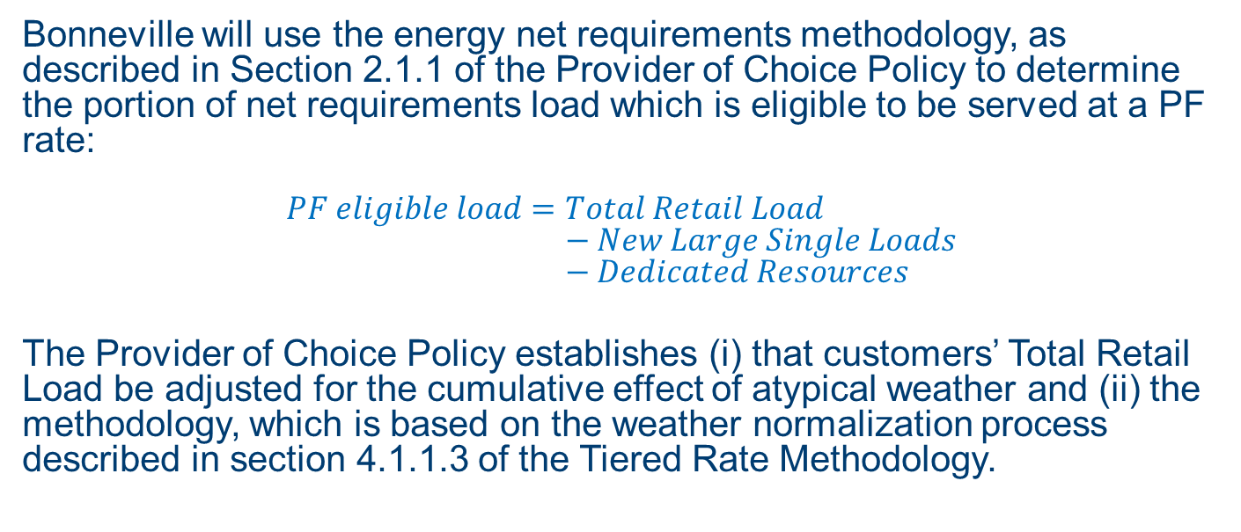
Purpose of this work
Bonneville will use the energy net requirements methodology, as described in Section 2.1.1 of the Provider of Choice Policy to determine the portion of net requirements load which is eligible to be served at a PF rate:
$$PF eligible load=Total Retail Load \\ − New Large Single Loads \\ − Dedicated Resources$$
The Provider of Choice Policy establishes (i) that customers’ Total Retail Load be adjusted for the cumulative effect of atypical weather and (ii) the methodology, which is based on the weather normalization process described in section 4.1.1.3 of the Tiered Rate Methodology.
Notes:
Weather Normalization is the process by which Measured Load in the index year (2023) is adjusted for the cumulative effect of atypical weather by BPA pursuant to section 4.1.1.3 of the Tiered Rate Methodology (TRM).
TRL generally means all of a customer’s retail electric power consumption, including electric system losses, with some exceptions based on a customer’s unique service territory

Slide 4
Requirements and Objectives
To use a method that is consistent, transparent, and verifiable
To use a software that is available to all customers (R & Excel)
To obtain statistically robust results:
  Following standard load forecasting methods, obtaining coefficients of temperature sensitivities that have the correct signs, are significant, and unbiased.
To make final calculations available to all stakeholders so results can be reproduced
To use resources effectively (methodology is not overly burdensome and time consuming)

Slide 5
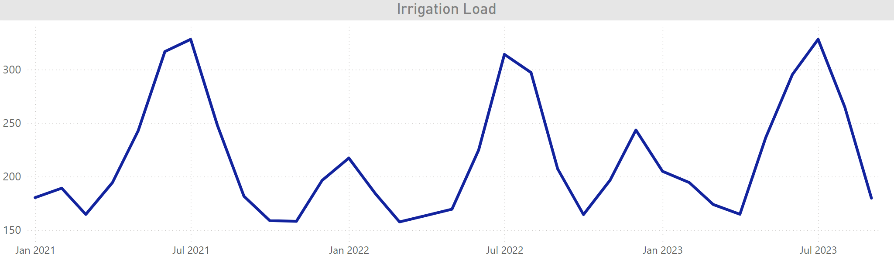
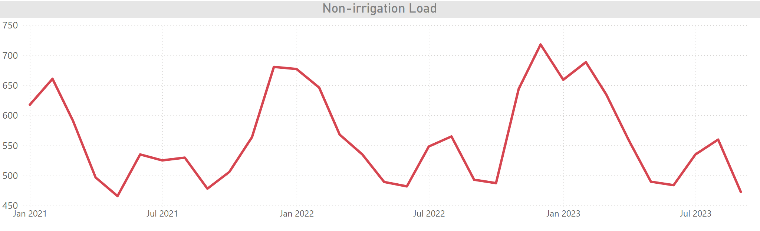
Overview of the Process
The Measured FY2023 Load will be
separated into 2 types:
non-irrigation and irrigation loads
Each type of load is weather normalized
separately:
  For irrigation load, the FY23 load is adjusted to meet the growth rate-adjusted historical load average
  For non-irrigation load, FY23 load is adjusted for any deviation of temperatures from typical levels
The resulting weather normalized loads are aggregated to determine the weather normalized FY2023 Total Retail Load

Slide 6
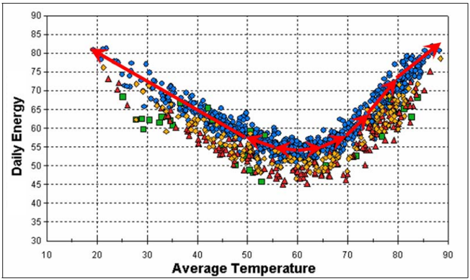
Weather Normalization (WN) of Non-irrigation Load
Estimation of Temperature Sensitivities
  The WN process for non-irrigation load uses
  daily data during the period of FY2018-2022
  to establish the impact of temperatures on
  load for each customer
Load Adjustment for Abnormal Weather
  Observed cooling and heating needs (measured in heating and cooling degree days) during FY2023 are compared to typical cooling and heating needs
  The load sensitivity to temperature is used to quantify the amount of monthly energy associated with any deviation of heating and cooling needs from normal levels, which is then added to/subtracted from recorded load. Temperature will be measured in Fahrenheit.

Slide 7
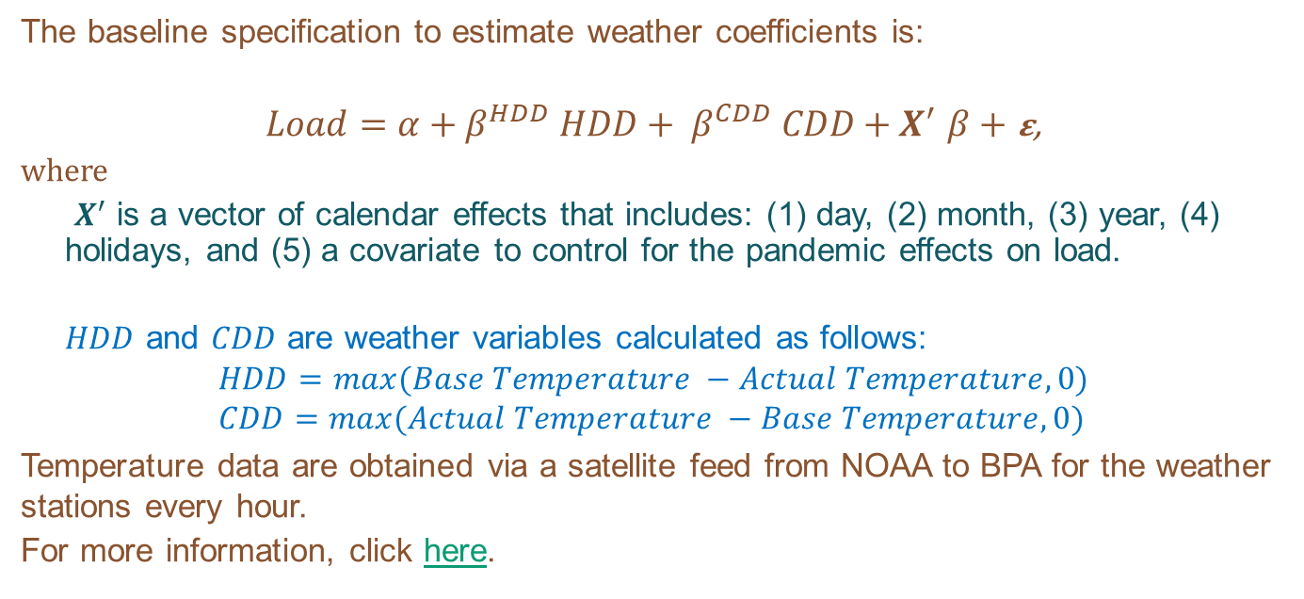
Estimation of Temperature Sensitivities
The baseline specification to estimate weather coefficients is:
$Load=α+β^{HDD} HDD+ β^{CDD} CDD+X^{′}$ $β$ $+$ 𝛆,
where
$X^{′}$ is a vector of calendar effects that includes: (1) day, (2) month, (3) year, (4) holidays, and (5) a covariate to control for the pandemic effects on load.
$HDD$ and $CDD$ are weather variables calculated as follows:
$$HDD=max⁡(Base Temperature −Actual Temperature,0) \\ CDD=max⁡(Actual Temperature −Base Temperature, 0)$$
Temperature data are obtained via a satellite feed from NOAA to BPA for the weather stations every hour.
For more information, click here.

Slide 8
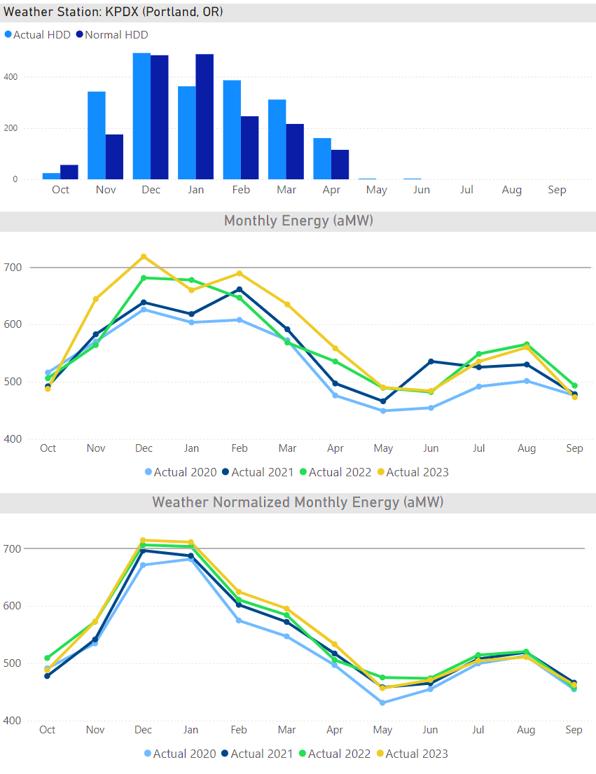
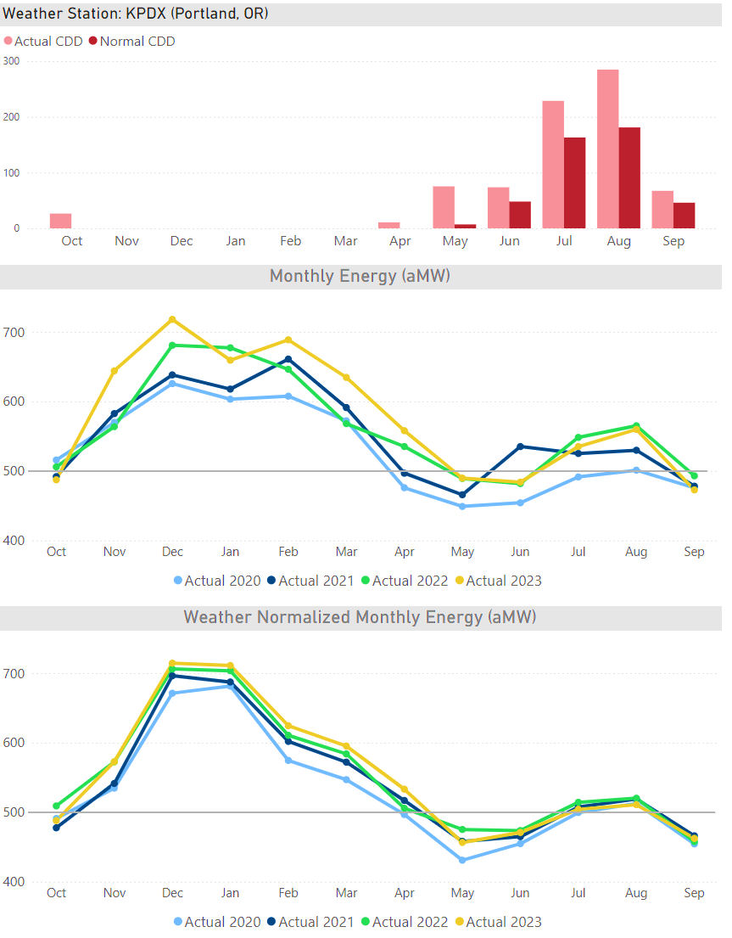
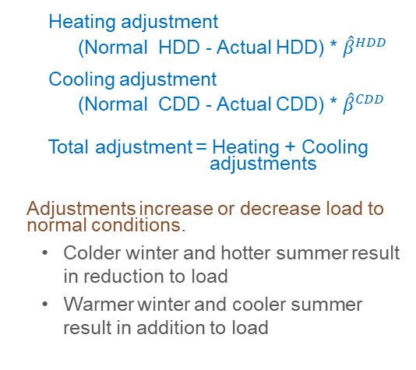
Load Adjustment for Abnormal Weather
Given the estimates of load responsiveness to winter and summer temperatures, a monthly load adjustment that increases/decreases load to normal conditions is calculated:
Heating adjustment
      (Normal HDD - Actual HDD) * ${\hat{β}}^{HDD}$
Cooling adjustment
      (Normal CDD - Actual CDD) * ${\hat{β}}^{CDD}$
Total adjustment = Heating + Cooling adjustments
Adjustments increase or decrease load to
normal conditions.
    Colder winter and hotter summer result in reduction to load
    Warmer winter and cooler summer result in addition to load

Slide 9
Normal Average Temperature
“Normal weather” is defined as the statistical expectation of the temperature for a location based on a sample that can be considered representative of the current climate.
The construction of normal weather indices follow standard practice (outlined in the appendix).
In 2020, BPA updated the period of record used for weather normal assumptions to better align with recent climate trends¹:
  BPA now uses daily temperatures from 2005-2019² instead of 1970-2004
  Daily average temperatures for this 15-year period are higher than during the prior 30 years at all weather stations, and over a third of locations are warmer by 1.0°F or more.
¹ https://www.bpa.gov/energy-and-services/power/climate-change-fcrps
² If time and resources allow, BPA will update the period of record to include more recent years prior to the estimation of temperature sensitivities

Slide 10
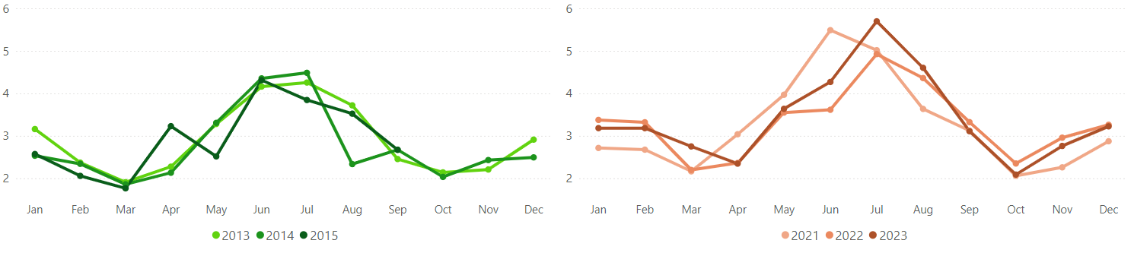
Weather Normalization of Irrigation Load
The WN process for irrigation load uses the highest annual irrigation load during the period of CY2013-2015 and CY2021-2023 to establish the annual average growth rate of irrigation load
This rate is then applied to the historical average irrigation load
observed during the period of FY2018-FY2022

Slide 11
PSS pull NLSL loads; AEs review with customers
October 1, 2024
Customer deadline to submit loads for economic adjustment
Returning publics value determinations- NLSLs, loads, resources, etc.
Oct 2024 - Feb 2025
Gather and validate data for weather normalization
Loads- Weather normalization and economic adjustment
Feb 2025 - May 2025
Estimation of weather adjustments to loads
Jun 2025 - Jul 2025
Potential recalculation of weather normalization, based on customer comments
BPA review historical and returned loads to determine values for economic adjustment
Oct 2024-Feb 2025:
Gather 5 years of historical daily loads and average temperature.
  Historical data that will match meter configuration used to produce the customers bill (with losses included).
  Historical temperature data will be average of daily hourly values.
    Weather stations
  Gather necessary data from customers

Slide 12
PSS pull NLSL loads; AEs review with customers
October 1, 2024
Customer deadline to submit loads for economic adjustment
Returning publics value determinations- NLSLs, loads, resources, etc.
Oct 2024 - Feb 2025
Gather and validate data for weather normalization
Loads- Weather normalization and economic adjustment
Feb 2025 - May 2025
Estimation of weather adjustments to loads
Jun 2025 - Jul 2025
Potential recalculation of weather normalization, based on customer comments
BPA review historical and returned loads to determine values for economic adjustment
Feb 2025 - May 2025:
Estimation of weather adjustments to loads
Deliver data for customer review –completed by end of February 2025
  Model the load temperature relationship for each customer separately
    Use Root MSE as the final criteria to measure model fit when other measures do not provide differentiation.
    Verify model acceptability through residual analysis.
    Maintain a history of the steps taken to find the optimal model conditions such as each base HDD and CDD, series interventions, etc.
Notes:
Actual data is obtain via a satellite feed from NOAA to BPA for the weather stations every hour.
Hourly reads are the temperature at a set time during the hour (i.e. approximately 5 minutes past the hour)
Will not likely match with the NOAA reported daily maximum or minimum temperature.
Max and Min are likely within an hour.
Arithmetic average of hourly points are used when sufficient observations are available.

Slide 13
PSS pull NLSL loads; AEs review with customers
October 1, 2024
Customer deadline to submit loads for economic adjustment
Returning publics value determinations- NLSLs, loads, resources, etc.
Oct 2024 - Feb 2025
Gather and validate data for weather normalization
Loads- Weather normalization and economic adjustment
Feb 2025 - May 2025
Estimation of weather adjustments to loads
Jun 2025 - Jul 2025
Potential recalculation of weather normalization, based on customer comments
BPA review historical and returned loads to determine values for economic adjustment
Jun 2025 - Jul 2025:
Potential recalculation of weather normalization, based on customer comments
  June 2025: BPA will share with each customer the specific calculation of the load-temperature relationship for their service territory and the resulting load adjustment to normal weather conditions.
  July 2025: Based on customer comments, BPA will evaluate alternative model specifications

Slide 14
What to remember
Requests to use a different weather station need to be sent by December 31st, 2024.
Provide monthly irrigation amounts and system distribution losses for the period of CY2013 to CY2023 by January 31st, 2025.
Provide hourly load data if required by notice from BPA as the contract requires by January 31st, 2025.
Review actual data to be used in the calculations by January 31st, 2025.
Send data electronically to the KSLF@bpa.gov mailbox. Please copy your AE.
6. Do you have questions or comments? Reach out to KSLF@bpa.gov

Slide 15
Weather Normalization Contacts
Adela Arguello,
Energy Economist,
adelamarguello@bpa.gov
Michael Redlinger,
Energy Economist,
mrredlinger@bpa.gov

Slide 16
Appendix

Slide 17
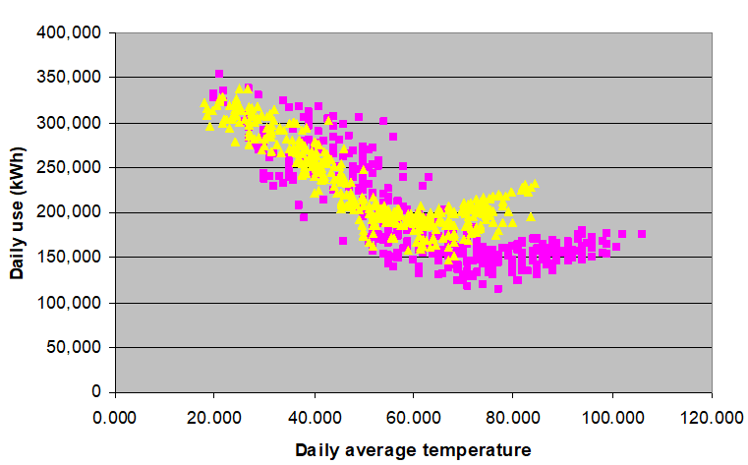
1) Analyze the data to find initial HDD and CDD bases
2) Run baseline specification model with HDD and CDD bases selected
3) Remove all insignificant variables.
4) Rerun model- record the model Root Mean Squared Error or MSE
(average distance between the predicted and observed values in a regression model),
T statistic and p values to measure significance of coefficients.
5) Increment weather variable bases looking for model improvement.
6) Repeat Step 5 until full improvement reached based on model Root MSE.
7) Evaluate regression output to identify if additional regressors (additional weather variables or customer-specific omitted variable) lead to model improvement
Return to slide
Estimation of load-temperature relationship

Slide 18
  The Rank and Average Method is used to develop a typical weather pattern that has normal extremes and normal average temperatures in each season or month (return to original slide)
  -Each year’s daily temperature values are ranked from coldest to hottest within each season.
  -Seasons are defined as follows- summer includes the months of Jun-Sep, fall includes the month of Oct, winter includes Nov-Feb, and spring includes Mar-May
  - Averages across temperature duration curves are calculated, and a monthly sorting is performed based on average temperature values
  - Seasonal high/low pairs are assigned to month and monthly high/low pairs are assigned to days in each month Average values are then assigned to representative year after representative year is ranked by season.
  -Daily heating and cooling degree days are calculated as well as their aggregate values for each month
  -For more information, click here
Defining Normal Weather for Energy Normalization

Slide 19
Weather Station List –Updated 10/23
An excel spreadsheet listing the weather station associated with each customer can be found here

Slide 20
Weather Station List –Updated 10/23
An excel spreadsheet listing the weather station associated with each customer can be found here

Slide 21
Weather Station List –Updated 10/23
An excel spreadsheet listing the weather station associated with each customer can be found here

Slide 22
Weather Station List –Updated 10/23
An excel spreadsheet listing the weather station associated with each customer can be found here

Slide 23
Weather Station List –Updated 10/23
An excel spreadsheet listing the weather station associated with each customer can be found here

Slide 24
Weather Station List –Updated 10/23
An excel spreadsheet listing the weather station associated with each customer can be found here

