Slide 1
Request for Partial Reduction of River Road’s 5(b)(1) Dedicated Amount
November 30, 2021

Slide 2
Objectives for this Presentation
Provide background regarding Clark Public Utilities’ (CPU) River Road Generating Plant (River Road)
Explain the conflict between CPU’s existing obligations regarding River Road under §5(b)(1) of the Northwest Power Act (NWPA) and its new obligations under Washington’s Clean Energy Transformation Act (CETA)
Describe CPU’s proposal and request to the Administrator for resolving the conflict and its underlying rationale
Identify CPU’s planned operations for River Road
Answer questions

Slide 3
§5(b)(1) of the Northwest Power Act
BPA is required under §5(b)(1) of the NWPA to serve a preference customer’s “Net Requirements”
A utility’s Net Requirements is the difference between the utility’s total retail load and its §5(b)(1) dedicated resources
A utility’s §5(b)(1) dedicated resources include:
  Resources used by the utility to serve its load in the year prior to December 5, 1980
  Resources the utility dedicated to serve its load in a BPA power sales agreement
Once a resource is dedicated it cannot be undedicated absent:
  A determination by BPA that it is lost, obsolete, or retired
  Administrator consent

Slide 4
River Road Generating Plant
CPU owns and operates the River Road Generating Plant (River Road)
  248 MW nameplate combined-cycle natural gas-fired combustion turbine
  Located west of downtown Vancouver, Washington
  Commercial operation began in December 1997
  Identified as a §5(b)(1) dedicated resource under CPU’s power sales agreement with BPA
  §5(b)(1) dedication of approximately 225 aMW on an energy basis
  §5(b)(1) dedication of approximately 248 MW on a capacity basis
  The energy dedication of 225 aMW represents approximately 45% of CPU’s current total retail load of 511 aMW

Slide 5
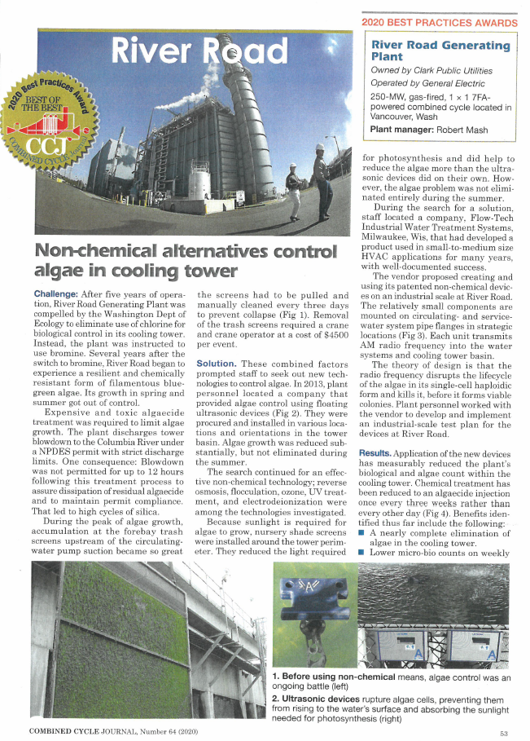
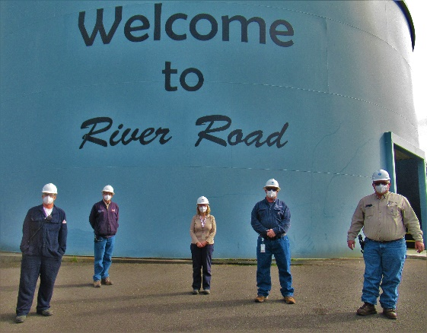
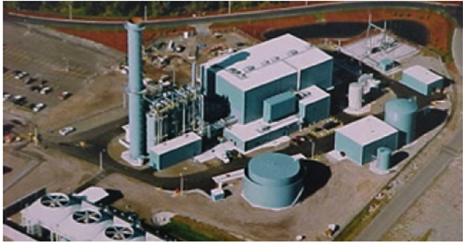

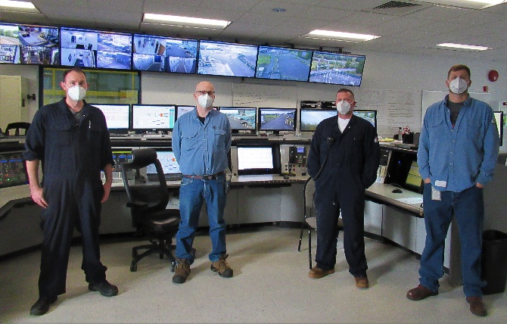
River Road Generating Plant 2020 Highlights
10-YEARS NO LOST TIME INJURIES
RRGP Winner of “Best of Best Practices” for Non-Chemical Cooling Tower Treatment
Best O&M Site Award by region
Five plant improvement projects published in Combined Cycle Journal
Installation of Auto-tune system on the combustion turbine
Replacement of the Carbon Monoxide Catalyst in the HRSG

Slide 6
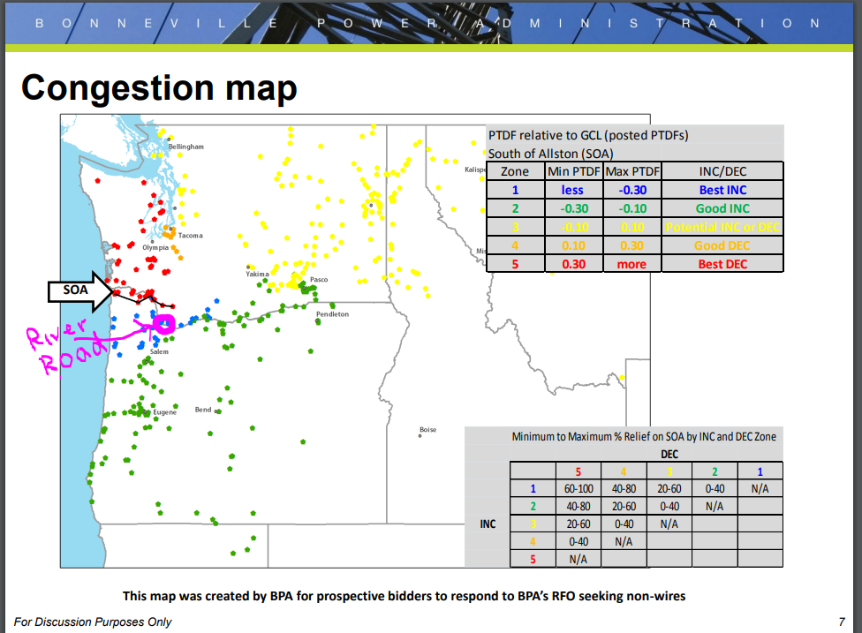
River Road’s Location
River Road interconnects with BPA and PacifiCorp on the south side of the Allston cut plane

Slide 7
Reliability and Transmission Benefits
Due to its size and dispatchable capacity, River Road can and does provide resource adequacy and reliability benefits to CPU, BPA, and the region
  E.g., CPU (and thus River Road) is participating in the non-binding phase of the Western Resource Adequacy Program (WRAP) using TEA as its Load Responsible Entity (LRE)
  River Road’s capacity could be used to meet the WRAP’s forward showing elements and, if called upon, could be deployed in the WRAP’s operational timeframe to ensure regional reliability
River Road’s size, dispatchability, and strategic location also provide valuable transmission benefits to the region
  Important component of BPA’s non-wires approach to managing congestion along the I-5 corridor
River Road provides critical voltage support to the region and specifically the Portland/Vancouver metro area

Slide 8
Clean Energy Transformation Act
CPU is subject to Washington’s Clean Energy Transformation Act (CETA)
  Including CETA’s greenhouse gas (GHG) neutral standard starting in 2030
    Will require CPU to serve 80% of its load with renewable/non-emitting resources
    Allows CPU to use River Road to serve up to 20% of its load so long as it uses one of CETA’s alternative compliance options
  CETA will require CPU to become GHG free beginning in 2045

Slide 9
Interplay Between CPU’s Obligations Under §5(b)(1) and CETA
In 2030, CPU’s obligations under §5(b)(1) will come into direct conflict with its GHG-neutral obligations under CETA
  Obligated under §5(b)(1) to use River Road to serve 45% of load
  Prohibited under CETA from using River Road to serve more than 20% of load
River Road would likely qualify for a partial reduction of its dedicated amount under BPA’s Revised 5(b)/9(c) Policy’s loss standard
Qualifying under the loss standard could restrict the ability to use River Road’s full capacity to provide the previously mentioned reliability and transmission benefits
  Because under the loss standard that portion of the plant determined to be lost could never be used to serve load again by CPU or a third party
CPU will meet its obligations under CETA but is seeking a way to do so that
  Resolves the conflict between §5(b)(1) and CETA
  Preserves the reliability and transmission benefits of River Road

Slide 10
CPU’s Proposal to BPA Administrator
CPU sent a letter to the Administrator requesting that he consent to a partial reduction of River Road’s §5(b)(1) dedication due to CETA as follows:
  For purposes of calculating CPU’s Net Requirements, River Road’s §5(b)(1) energy dedication would be permanently reduced to 102 aMW beginning in 2028 with the new BPA Power Sales Agreement
  Following expiration of the current BPA Power Sales Agreement, and if requested by CPU pursuant to §5(b)(1), BPA would serve CPU with firm power in replacement of River Road’s undedicated amount
  River Road’s §5(b)(1) capacity dedication would remain 248 MW under the Post-2028 contract
  After meeting its own needs, and to the extent permitted by law, CPU could sell surplus power from River Road (see next slide)
  Mutual acknowledgement that the new dedicated amount of 102 aMW will need to be revisited in the future to meet CETA’s GHG-free standard beginning in 2045 or if there is a change in the law or the plant otherwise becomes obsolete, lost, or retired

Slide 11
Benefits of Proposal
Reduces River Road’s §5(b)(1) dedication to the extent necessary to comply with CETA while ensuring that River Road can continue to contribute to system reliability and adequacy when BPA is most stressed
Under the proposal, River Road would be operated more as peaker-type resource used to meet heavy load periods including winter and summer peak conditions
Dispatching River Road’s peaking capabilities to meet peak conditions will:
  Alleviate congestion on east-to-west flows on the Cross Cascades South flowgate during, for example, winter peaks
  Alleviate congestion on the north-to-south flows on the Altson flowgate during heavy flow periods
Operating River Road as a peaker-type resource will also maintain 248 MW of resource adequacy capacity that is standing ready to help meet demand during moments of scarcity

Slide 12
River Road’s Post-2028 Operations
Washington new cap-and-trade law (Climate Commitment Act) will also impact RRGP
  Rules are not complete but program is supposed to start 2023
  CPU expects to receive free allowances but not for 100% capacity factor, that’s the cap part
  Free annual allowances will continue to be ramped down to a point potentially below the CETA generation limitation
  The unit can run above the capped amount but additional allowances will need to be purchased
What about the potential “leftover” energy production at RRGP come 2028?
  RRGP’s marginal cost of energy production in 2028 will depend upon gas prices, RRGP heat rate, and carbon adder costs
  The large renewables buildouts expected this decade will make it difficult for RRGP to compete in the secondary energy markets
  CPU’s reliance on RRGP’s full capacity every month to meet its peak loads means that RRGP will not be sold on a forward basis
  If RRGP produces more energy than the cap and trade or CETA limits allow, it will be mitigated by acquiring and retiring additional state issued carbon allowances and/or as otherwise required under the law
Bottom line expectation is that RRGP will operate more and more as a peaker-type resource
  CPU’s Board just approved a staff recommendation to spend $10 Million to add Hardware/Software that will result in:
    A significant increase in the load-following capability of the plant
    A significant reduction in annual carbon emissions due to reduced overall energy production
  Renewable energy buildout needs dispatchable resources, like peakers, to integrate to the grid
  The combination of zero variable cost resources and the increasing need to purchase cap and trade allowances will make the unit less attractive as a base loaded unit

Slide 13
Questions?

