Slide 1
FY 2026-2028 (BP-26) ASC Review
Kick-off Workshop
Updated
May 2, 2024; 9:00 am - Noon
Join the WebEx Meeting
https://mybpa.webex.com/mybpa/j.php?MTID=m00e40be2cf8156c8f90e3375408a9dc3
Join by Meeting Number: 1-415-527-5035; Access Code: 2823 051 8872#
Meeting Password: Sp3ZSDxx*87

Slide 2
Workshop Agenda
PART 1: General Workshop (9am – 10:30am)
  Welcome & Introductions
  ASC Basics
  General Information
    Schedule
    Procedures
    RPSA Website
  Appendix 1 and Forecast Model
    Updates and Reminders
    Best Practices for Appendix 1
    Running the Forecast Model
  FY 2026-2028 (BP-26) ASC Filings
    Visual Timeline
    Discovery, Errata and Issue List
    Generic Data Requests
    ASCM Highlights
BREAK – 15 minutes (10:30 – 10:45am)
PART 2: Discussion Topics (10:45am – Noon)
  NLSL Treatment
    NLSL Background
    NLSL Formula Rate (Historical approach)
    BP-24 Within Period Treatment
    Proposed BP-26 Treatment
  Next Steps & Closing
    NLSL Comment Period
    Upcoming Events

Slide 3
Who’s your BPA Analyst?
BPA Analyst | Utility
Paulina Cornejo REP Policy Lead | Avista Corporation
 | Clark Public Utilities
 | NorthWestern Energy
 | Portland General Electric
Michael Edwards REP Technical Lead | Idaho Power
 | PacifiCorp
 | Puget Sound Energy
 | Snohomish County PUD

Slide 4
REP Benefits Calculation
Section 5(c)(1) of NWPA
(2008 ASC Methodology)
Sections 3(18), 5(c)(1) of NWPA
(Average System Cost – PF Exchange Rate) x Res&Farm Load = REP Benefits $$$
Section 7(b)(2) of NWPA
(Legal Interpretation)
(7(b)(2) Methodology)

Slide 5

What is an ASC?
Section 5(c)(1) of the NWPA
  Whenever a Pacific Northwest electric utility offers to sell electric power to the Administrator at the average system cost (ASC) of that utility's resources in each year, the Administrator shall acquire by purchase such power and shall offer, in exchange, to sell an equivalent amount of electric power to such utility for resale to that utility's residential users within the region.
An ASC is:
  The sum of a utility’s resources costs, required to produce and deliver energy,
  expressed as a $/MWh rate, and
  ASC Methodology guides determination:
    Section 5(c)(7) of the NWPA directs BPA to determine an ASC methodology in consultation with the regional stakeholders.
    Subject to FERC review and approval.

Slide 6
Composition of ASCs
Contract System Cost (CSC)
Rate of Return portion of Production & Transmission Rate Base
Production & Transmission System Expenses
Administrative and General Expenses
Labor and State Property Taxes
LESS:
  Sales for Resale
  Other Revenues and Other Offsets
  Resource Costs to serve NLSLs, and Above-RHWM Loads (COUs only)
ASC ꓿ ($/MWh)
Contract System Costs (CSC)
________________________________
Contract System Load (CSL)
Contract System Load (CSL)
Total “regional” retail load (not exchange load)
Distribution Losses
LESS:
  NLSLs, and Above-RHWM Load (COUs only)

Slide 7
2008 ASC Methodology
BPA has had three ASC methodologies.
  1981 and 1984 ASC Methodologies were cumbersome, requiring 50+ staff to implement.
  2008 ASC Methodology streamlined the ASC process.
NWPA only stipulates the methodology must exclude the following costs:
  the cost of additional resources in an amount sufficient to serve any new large single load (NLSL) of the utility,
  the cost of additional resources in an amount sufficient to meet any additional load outside the region occurring after December 5, 1980, and
  any costs of any generating facility which is terminated prior to initial commercial operation.

Slide 8
Overview of ASC Calculation Procedures
Participating utilities submit to BPA documentation – referred to as an “Appendix 1” – which characterizes relevant financial information as prescribed by 2008 ASCM and other key documents to produce a base ASC for each utility.
BPA staff review as-filed Appendix 1 to ensure filing is accurate and consistent with statutory and legal determinations. Requests for data to clarify/explain components of Appendix 1 sent to utilities by BPA staff; issues compiled in issue list.
Base ASC from Appendix 1 feeds into Forecast Model which determines exchange period ASCs used to determine REP benefits.

Slide 9
Getting Started
Updated
Mid-May, BPA will formally announce on its REP public website the start of the FY 2026-2028 (BP-26) ASC Reviews.
  All interested parties requiring access to the REP Secure website shall send their request to BPAAverageSystemCost@BPA.gov.
  Once BPA grants access, the Petitions to Intervene, and Consent to be Bound (only if reviewing confidential information) forms shall be uploaded to the “Interventions” folder on the RPSA website.
ASC Review Process Schedule (Revised)
Rules of Procedures
ASC Confidentiality Rules

Slide 10
RPSA (REP Secure Website)
Navigating the site: rpsa.bpa.gov
  Event calendar.
  BP-26 ASC Review e-folders.
  Uploading files and communicating with BPA.
Initial Participation forms (available on RPSA).
  Petition to Intervene form
  Consent-to-be-Bound form
  Senior Financial Office Attestation
  Major Resources Attestation (if applicable)

Slide 11
Appendix 1 & Forecast Model Updates
Appendix 1 Updates:
  Appendix 1 template and a Utility Checklist, were emailed in April and are available on the RPSA.
  Three-year rate period modifications:
    Added a year to the following tabs: Load Forecast and Tiered Rates.
    New Resources tab: Rate period mid-point updated from 12 to 18 months from start of Exchange Period.
ASC Forecast Model Updates:
  The Forecast Model will be available on the REP Secure site by mid-May with the following updates:
    Natural Gas price forecast (sourced from the BP-26 Rate Case).
    Market price forecast (sourced from the BP-26 Rate Case).
    Escalation factors.
  For COUs only, upon completion of the RHWM process in late spring, BPA will email an updated Forecast Model with the following:
    Tiered Rates information - RHWM data.
    Initial Proposal Tiered Rates.
As needed, the forecasts will be updated prior to the publication of the initial and final Rate Case proposals.

Slide 12
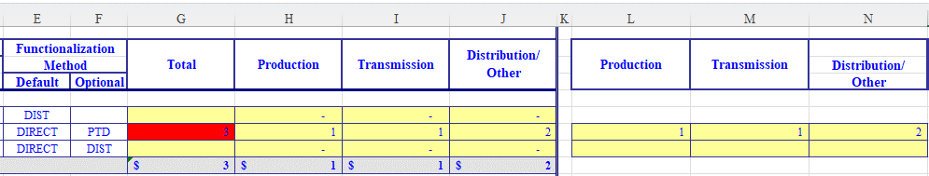
Appendix 1 Conditional Formatting Reminder
On DIRECT analysis accounts – When the sum total of Columns H:J does not match the reported total in Column G – The column fills red.
This is a quality assurance feature to highlight mismatches and ultimately prevent, or limit, unnecessary errata or discovery inquiries.
In the event the conditional formatting triggers when populating the Appendix 1 – please reconcile the inconsistency prior to submitting your utility filing.

Slide 13

Appendix 1 Best Practices
A Utility Checklist accompanied the Appendix 1 and is also available on the RPSA site. Please reference this guide in populating your utility’s Appendix 1 and contact your analyst if you have technical issues.
Please do not make edits to formulae in the models. Doing so could jeopardize the integrity of the models and lead to a determination of “Patiently Deficient”.
Please assist us in making this document more useful or robust with questions, clarification, or suggestions.

Slide 14
Forecast Model Updates
Updated
The BP-26 Forecast Model will run a three-year period, which will run from October 1, 2025 – September 30, 2028 (FY 2026-2028).
Model dates through FY 2028:
  Load Forecast
  PF Rates
  Tiered Rates
The Forecast Model will be updated with the most recent escalation factors, natural gas prices, and market prices and updated to function with rate period assumptions for FY 2026-2028.

Slide 15
Running the Forecast Model
Open both Appendix 1 and ASC Forecast Model together.
Confirm the Appendix 1 title in the Forecast Model “Base Data” tab (cell L10), including file type.
  The Forecast Model will automatically populate the data from the Appendix 1.
Running the model:
  Go to the Forecast Model “New Resource” tab and click on “Process Study Dates” (cell B1); this will take a few moments.
  The Forecast Model will then automatically calculate the utility’s Exchange Period ASC(s) in the “ASCs” tab cell M97.
  For utilities with Major Resources projected to come online/offline prior to the start of the Exchange period, the ASC displayed in cell M97 will reflect these costs.
    If a utility has more than one resource, or resource group, the tables between rows 112:184 will display varying ASCs based on online date.
    Reminder, only COUs are permitted to include resources that come online/offline through the Exchange Period.
Market Price forecasts, Gas Price forecasts, and Escalation values will be updated prior to publishing Draft ASC Reports (BPA’s BP-26 Initial Proposal) and Final ASC Reports (BPA’s BP-26 Final Proposal).

Slide 16
BP-26 ASC Review Process Timeline
July Kick-off
Updated
ASC Filings Kick-off
Draft ASC Reports Published
Jul 1
Nov 19
2024
Jun
Jul
Aug
Sep
Oct
Nov
Dec
2024
Filings Submittals
July 1 - July 12
Discovery Period
July 15 - Sep 4
Issues List
Sep 18 – Oct 2
Exchange Loads
Sep 24 - Oct 4
Draft Report Comment Period
Nov 20 - Dec 31

Slide 17
BP-26 ASC Review Process Timeline Con’t
Final ASC Reports Published
Jul 22
2025
Jan
Feb
Mar
Apr
May
Jun
Jul
2025
Draft Report Comment
Period Con't
Jan 1 - Apr 16
Exchange Loads Updated
Apr 21 - May 2
NLSLs Process
Feb 3 - May 16
Prep Final ASC Reports
Jun 2 - Jul 11

Slide 18
Working Templates
Discovery (Data Requests)
  Staff may request clarification on specific Appendix 1 accounts, subaccounts and/or other data provided.
    Intervening utilities may do the same of each other’s filings.
  Responding utility has 10 calendar days from time of receipt.
Errata
  Simplified approach to correct inadvertent errors made in populating the Appendix 1.
Issue Lists
  After Discovery Period, any issues unresolved or beyond a simple correction are compiled on Issue Lists.
    Any party may submit an Issue List.
  Each utility must respond to their respective Issue Lists, even if none exist.
Errata and Issues are recorded in Section 4 of the ASC Reports.

Slide 19
Common Data Requests
Suggested documentation to imbed within the Appendix 1:
  Supporting detailed documentation for all “Direct Analysis” accounts.
  Most recent PUC approved Rate Order information, where applicable
    For sub-accounts of Regulatory Accounts (182.3, 186, 254, 253, 407.4, 407.3) provide Rate Order and page reference of the verbiage approving recovery in retail rates, corresponding ROR or carrying charge
    Schedule 2 – Rate of Return
  “Load Forecast” tab details for: FY 2024-2028
  NLSL data:
    Aggregated NLSL MWh load for CY 2023 on Schedule 4
    Resource information on the “NLSL_Base_New-Calc” tab
  RECs sales and purchases for CY 2023

Slide 20
Common Data Requests Con’t
Updated
Conservation costs
  Apply the DIRECT functionalization to Conservation costs and provide supporting documentation.
  The ‘Customer Service and Informational’ account values reported in the ‘Salaries’ tab cell D20 feed into the ‘Ratios’ tab cell D17. If there are conservation related costs imbedded in the Customer Service and Informational account, you may assign these costs to PROD on the ‘Ratios’ tab by manually switching the functionalization to DIRECT in cell C17 and entering the adjusted values in cells I17:K17.
New resources and materiality
  COUs are permitted to include in their ASCs major resource additions/removals through the Exchange Period.
  Under the REP-12 Settlement the IOUs agreed to limiting inclusion in their ASCs major resource additions/removals that come online/offline prior to the start of the Exchange Period.
  ‘New Resources – Individual’ & ‘New Resources – Group’ tabs
    Provide all needed detail in the New Resource tab, including natural gas plant data
    Must meet resource criteria for consideration defined in the ASCM section 18 CFR § 301.4(c)(3)
  ‘Materiality – Individual’ & ‘Materiality – Group’ tabs
    Individual resources must meet the 2.5% materiality threshold or meet the 0.5% materiality threshold to group with other resources. See ASCM section 18 CFR § 301.4, (c)(4)
    All resources within a “Group” must come online/offline for the group to be included in the utility’s ASC.
COUs only
  ‘3-Year PP & OSS Worksheet’ tab: only COUs need to report purchases from BPA cells D82:E86.
  ‘Tiered Rates’ tab: populate the Pre-slice surplus cells H7:I7.

Slide 21
ASCM Highlights – Generic Issues
ASC Filing Review Period | Generic Issues Addressed
FY 2010-2011 | 6.1.1 Common Functionalization Framework 6.1.2 Common functionalization for similar types of Regulatory Assets and Regulatory Liabilities 6.1.3 Common functionalization for asset accounts that have corresponding liability accounts 6.1.4 Functionalization of other Regulatory Assets and Liabilities (Balance Sheet and Income Statement) 6.1.5 Treatment of Book-outs and Trading Floor Adjustments in purchased power expense and sales-for-resale revenues 6.1.6 Natural Gas Price forecast for new Plant Additions 6.1.7 Capacity Factors for New Plant Additions
FY 2012-2013 | 5.2.1 Rebuttable Presumption for Potential NLSLs 5.2.2 ASC Adjustments for NLSLs that Become Commercially operational after the Base Period 5.2.3 Request for a Practical NLSL Determination Process 5.2.4 Treatment of (Unbundled) RECs in NLSL and Above-RHWM Cost Calculation 5.3.1 Above-RHWM Obligation to Consult with Customers 5.3.2 COU Conservation Cost Treatment on Rate Period HWM ASCs 5.4 Rebundling of Disaggregated New Resource Projects 5.5.1 Allow utilities to directly assign Property Taxes or in-lieu taxes 5.5.2 Inclusion of Additional Taxes in ASC
FY 2014-2015 | 5.2.1 Cash Working Capital and Account 557 5.3.1 Tier 1 Power purchases in RHWM ASCs (Slice Surplus) 5.3.2 Calculation of ASC delta for New Resource Additions (NLSL Formula Rate)

Slide 22
ASCM Highlights – Generic Issues
ASC Filing Review Period | Generic Issues Addressed
FY 2016-2017 | None
FY 2018-2019 | 5.1 Rate of Return
FY 2020-2021; FY 2022-2023; FY 2024-2025 | None

Slide 23
BREAK – 15 minutes

Slide 24
NLSL Background
What is an NLSL?
  A load that grows to or exceeds 10 aMW over a consecutive 12-month period.
Section 5(c)(7) disallows NLSL load and associated resource costs from inclusion in utilities’ ASCs.
  BPA actively removes load and costs.
Monitoring of IOUs’ large loads
  IOUs report load data to BPA following closing of a calendar year; around late-winter early spring of next year.
  BPA staff makes NLSL determination and recognizes any new NLSLs.
  Adjustments to ASCs and REP benefits, as necessary.

Slide 25
NLSL Formula Rate
What is the 2014 NLSL Formula Rate?
  The NLSL Formula Rate was introduced during the FY14-15 ASC Review process to streamline ASC adjustments for NLSLs, and address timing issues of when a post-Base Period NLSL triggered vs its prospective NLSL start date.
  The Formula Rate allows within period adjustments to a utility’s ASCs when a new NLSL triggers post-Base Period.
  It locks-in certain inputs for the duration of an Exchange Period to easily drop in the NLSL value when it triggers and produce a new ASC.
Last implementation was in 2014, during the FY14-15 Exchange Period.
  Administratively burdensome.
ASC ($/MWh) = | Contract System Cost – (Cost of Serving NLSL * Actual New NLSL MWh)
 | Contract System Load – Actual New NLSL MWh

Slide 26
BP-24 Settlement & NLSLs
BPA and REP-participating utilities settled REP inputs (ASCs, PFx rates, and exchange loads) as part of BPA’s BP-24 Rate Case Settlement.
  ASC Review process was condensed.
  BP-24 Rate Case Settlement Proposal including PFx rates, ASCs and Exchange Loads were published in September 2022.
    No utility contested the REP-related rates and loads, during the comment period.
    BP-24 Final ASC Reports were published in October 2022.
    Final rates and loads were published in July of 2023.

Slide 27
Alternate NLSL Treatment within BP-24 Cont.
Some REP-participating utilities anticipated NLSLs to trigger after publication of BP-24 Final ASCs.
BPA implemented alternate NLSL treatment for BP-24.
  Utilities’ NLSLs were, and will be, recognized when triggered but not picked up in rates until the BP-26 ASC Filing Review process.
  As such, no within period adjustments will be made to effective ASCs.

Slide 28
Proposed NLSL Treatment for BP-26
Updated
New NLSLs that trigger post-Base Period (CY 2023) will be picked up in the Final BP-26 ASCs.
  BPA staff will collect large load data for CY 2024 between February-May 2025 and determine NLSL status.
NLSLs that trigger during CY 2025-2028 will be picked up in BP-29.
No within Exchange (Rate) Period adjustments will be made to ASCs.

Slide 29
PROs and CONs of BP-26 Proposal
PROs
  Complies with NWPA to exclude NLSLs and associated resources costs from utilities ASCs.
  Streamlines administrative process and prevents a within-period burdensome process for BPA and utilities.
  The 2008 ASCM is absent of true-up provisions due to bi-annual ASCs recalculation.
CONs
  Deviates from established process

Slide 30
NLSL Treatment Comment Period
BPA is soliciting comments on both the BP-24 NLSL treatment and proposed BP-26 treatment.
Please provide comments by COB May 17th to: BPAAveragesystemcost@bpa.gov

Slide 31
Upcoming Events: Filing Schedule Updated
Updated
Now | ASC Appendix 1 workbook is available on the RPSA site; the ASC Forecast Model will be available by mid-May.
Mid-May | Comments on NLSL Treatment due by COB Friday May 17th.
 | External announcement of invitation to participate in the BP-26 ASC Review Process will be posted on BPA’s external website.
July 1st | BP-26 ASC Filings Review Process kicks-off. Each utility’s completed Appendix 1 and Forecast Model are due by COB.
July 8th | Petitions to Intervene and Consent to be Bound (w/Qualified Persons) forms due.
July 12th | BPA grants or denies Petitions to Intervene status.
July 15th | Discovery Period commences and runs through August 7th.

Slide 32
Thank you!

Slide 33
What is the Residential Exchange Program?
Enacted by Congress under Section 5(c) of the 1980 Northwest Power Act to address wholesale rate disparity between Investor Owned Utilities (IOUs) and PF customers (COUs) in the Pacific Northwest:
  In simple terms: the REP is a federal program that provides economic benefits of federal system to residential and farm customers of participating utilities.

Slide 34
Preceding the 1980 NWPA
Load forecasts in the 1970s predicted energy requirements would triple over the next two decades.
Federal, private and public utilities collaborated to build generation and transmission.
The Hydro-Thermal Power Program proposed investing $17.9 billion ($141B today) in plants builds.
  HTPP faced a slew of issues, including; costs overruns, construction delays, community and environmental opposition, and reduced power forecasts.
  Such costs in retail rates sharply increased costs to serve regional customers of IOUs and COUs.
IOUs’ consumers were hit 3x harder than those of public utilities.
As rates between private and public utilities diverge, political pressure built to provide consumers of IOUs with a share of low-cost federal power.

Slide 35

The 1980 NWPA and REP
To avert conflict, Congress passed the NWPA in 1980.
One aspect of the NWPA was the REP, which was
designed to help address the wholesale rate disparity
between residential and farm customers in IOU vs. COU
territories.
NWPA created an “exchange” between IOUs and BPA to
residential and farm customers access to low-cost
federal power.
Preference battle avoided.
  IOUs’ consumers received some economic value from Federal projects. COUs received no diminishment in the amount of power sold to them, and “rate protection” through section 7(b)(2) of the NWPA.
The first 5 years of REP implementation was paid exclusively by DSIs. 7(b)(2) rate protection did not kick in until 1985.

Slide 36

Calculating the REP Payment
Average System Cost (ASC)
($70.00/MWh)
Exchanging Utility
100 MWh
Priority Firm (PF) Exchange Rate
($50.00/MWh)
100 MWh
(ASC – PF Exchange Rate) x Residential and Farm Load = REP $$$
($70 MWh - $50 MWh) x 100 MWh = $2000 (“REP benefit”)
No actual power exchanged. Just a “paper transaction” (except for in lieu under section 5(c)(5)).
Benefits are entirely passed-through to “eligible” residential and farm load, otherwise known as exchange load. No commercial load.

Slide 37
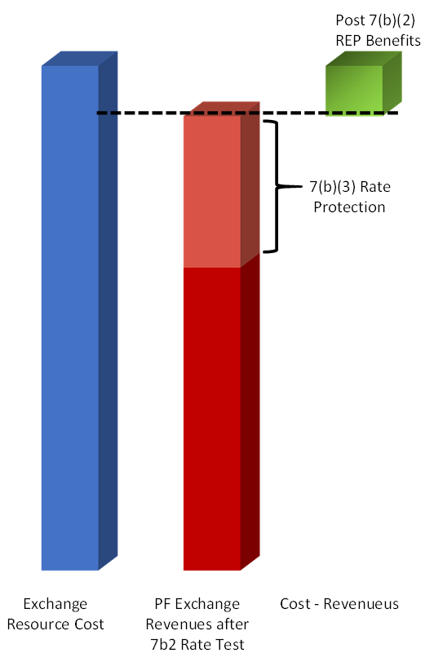
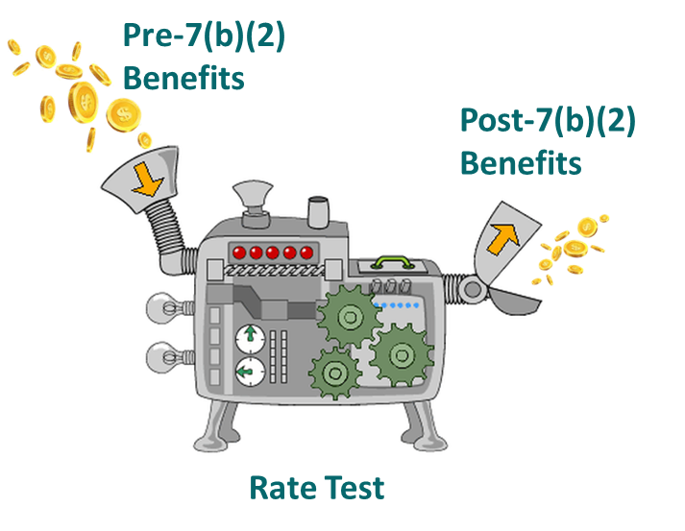
PF Exchange Rate and 7(b)(2)
The PF Exchange Rate reflects BPA’s resources costs after performing the 7(b)(2) Rate Test.
The Rate Test is a rate protection mechanism to ensure BPA’s preference customers are not negatively impacted as a result of the REP.
Rate protection is allocated away from preference loads and assigned to all other loads including Exchange Loads.
The Rate Test calculates the amount of rate protection and is affected by methodological choices which can change the level of REP Benefits.
Pre 7(b)(2) REP benefits represent the level of benefits that would be in place if there were no 7(b)(2) Rate Test or Rate Protection.
Post 7(b)(2) benefits represent the REP benefits that remain after performing the 7(b)(2) rate test.
Pre 7(b)(2)
7(b)(2) Rate Test
Post 7(b)(2)
(Average System Cost – PF Exchange Rate) x Res&Farm Load = Post 7(b)(2) REP Benefits

Slide 38
Exchange Load
Section 5(c)(3) states
  The cost benefits, as specified in contracts with the Administrator, of any purchase and exchange sale referred to in paragraph (1) of this subsection which are attributable to any electric utility's residential load within a State shall be passed through directly to such utility's residential loads within such State, except that a State which lies partially within and partially without the region may require that such cost benefits be distributed among all of the utility's residential loads in that State.
Section 3(18) defines “Residential Load” as
  Residential use or residential load means all usual residential, apartment seasonal dwelling and farm electrical loads or uses, but only the first four hundred horsepower during any monthly billing period of farm irrigation and pumping for any farm.
Simply put, the Residential and Farm load, also know as Exchange Load, is utilities’ load eligible to receive REP benefits.
Detailed descriptions of eligible loads are found in the Customer Load Eligibility Guidelines (CLEG), available on the REP’s external site.

