Slide 1
Post 2028 Residential Exchange Program
January 24, 2023
9:30am-12:00pm
Join the WebEx Meeting
https://bpa.webex.com/bpa/j.php?MTID=mad135af0761edcd52124ddf90f05d78b
Join by Meeting Number: 1-415-527-5035, 2764 769 2111#

Slide 2
Agenda for January 24, 2023
Time | Topic | Presenter(s)
9:30-9:40 | Introduction | Scott Winner
9:40-10:00 | Quick Recap of What We’ve Learned | Jonathan Ramse
10:00-10:15 | Process Plan Review and Expectations for Sub-phase 2 (Summer 2023) | Paulina Cornejo
10:15-10:30 | Discussion and Confirmation of Scenario Short-list for Phase 2 | Stephanie Adams
10:30-10:45 | Break
10:45-11:15 | ASC Methodology Revision Timeline and Process | Paulina Cornejo
11:15-11:45 | Proposed ASC Forecast Methodology for Sub-phase 2 (Summer 2023) | Paulina Cornejo and Michael Edwards
11:45-11:55 | Rate Protection Allocation to Secondary | Stephanie Adams
11:55 - Noon | Next Steps, Feedback and Questions | Michael Edwards

Slide 3
Introduction

Slide 4
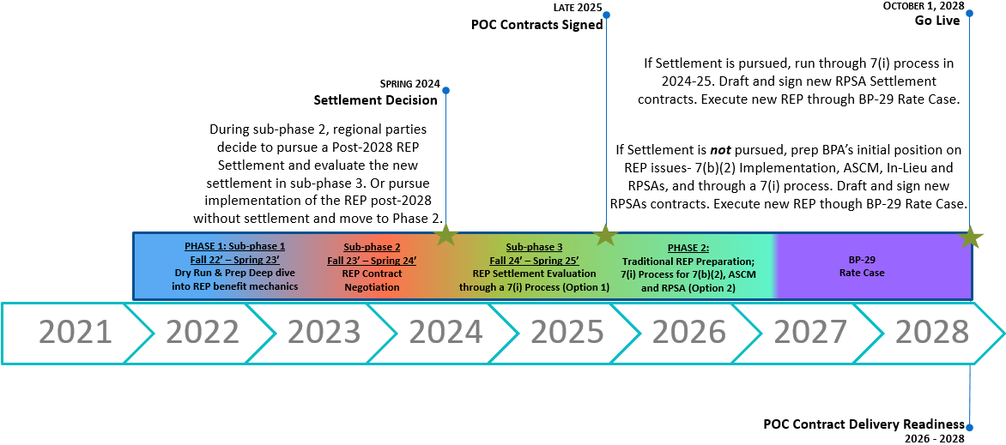
Post 2028 Two-Phase Approach Timeline

Slide 5
Public Process Plan – Two-Phase Approach
Phase 1 is comprised of three sub-phases designed to support and facilitate regional efforts towards a new REP settlement. If successful, implementation of the REP under new settlement agreements will commence BP-29 (October 1, 2028).
Phase 2 focuses on positioning on REP issues and policies to implement the program traditionally, for the BP-29 rate case.
Sub-Phase 1:
REP Dry Run and Preparation
(Fall 2022 – Spring 2023)
Sub-Phase 2: REP Contract Negotiation
(Fall 2023 – Spring/Summer 2024)
Sub-Phase 3: REP Settlement Evaluation Process and Decision (7i)
(Fall 2024 – Spring 2025)
Phase 1 – Settlement (2022-2025)
Phase 2 –
Traditional REP
Preparation Phase
(2026-2029)
The settlement phase builds on the foundation established by the 2012 REP Settlement– BPA’s focus and efforts are to facilitate and encourage regional discussions towards a structured settlement of the REP.
If no settlement is reached in 2025, BPA must shift its focus from facilitating and supporting settlement discussions to preparing its positions and policies for the BP-29 rate. proceeding.

Slide 6
Informational Resources and Contact
We encourage participants to access educational and background information on REP, which can be found on the Post-2028 REP external webpage.
  If parties are seeking additional information not posted here, please email us directly with your inquiry.
The Post-2028 REP team can be contacted directly via email to: REP2028@bpa.gov.

Slide 7
Recap

Slide 8
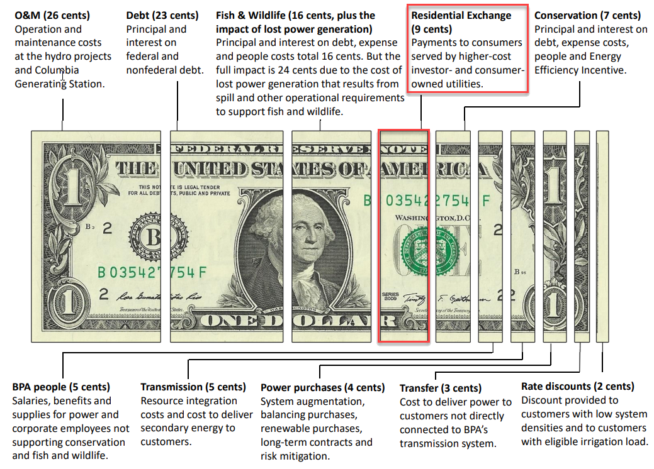
September workshop: What is the REP Program?
How BPA spends a Dollar of it’s Revenue based on BP-22
What is the REP Program?
The REP is a federal program that provides economic benefits of the federal system to residential and farm customers of participating utilities.
Why are we discussing the REP program now?
The current REP settlement expires in 2028 adjacent to long-term power contracts. Given the contentious history of the REP program we need to get an early jump on understanding the program and its issues before arriving at a position before 2025.
What is the basis of determining the Net amount of REP benefits?
The amount is determined by [(ASC’s–PFx rate) * Exchange Loads].

Slide 9
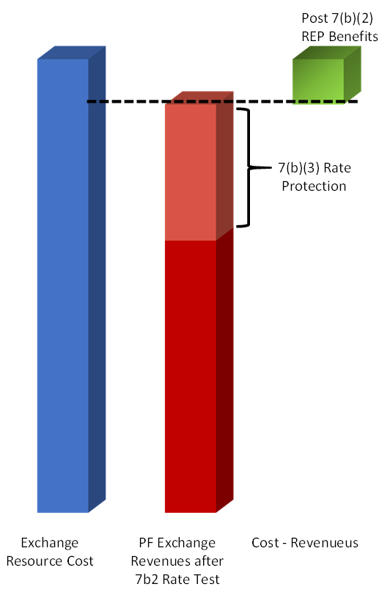
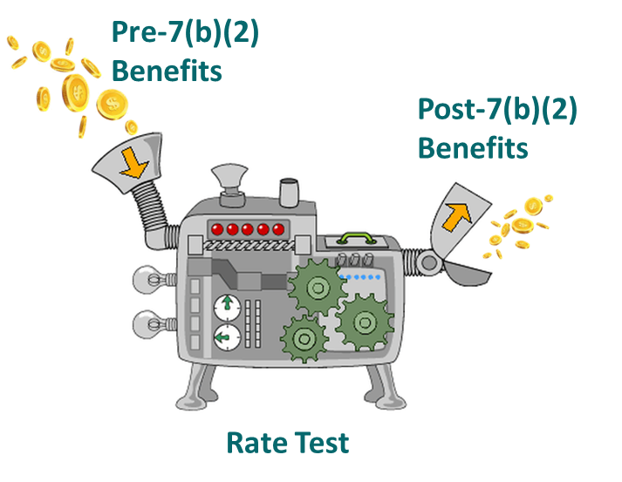
Recap: Calculating REP Benefits
Pre 7(b)(2) REP benefits represent the level of benefits that would be in place if there were no 7(b)(2) Rate Test or Rate Protection.
Post 7(b)(2) benefits represent the REP benefits that remain after performing the 7(b)(2) rate test.
The rate test calculates the amount of rate protection.
The Rate Test is affected by methodological choices which can change the level of REP Benefits.
Rate protection is allocated away from preference loads and assigned to all other loads including Exchange Loads.
Pre 7(b)(2)
7(b)(2) Rate Test
Post 7(b)(2)
(Average System Cost – PF Exchange Rate) x Res&Farm Load = Post 7(b)(2) REP Benefits

Slide 10
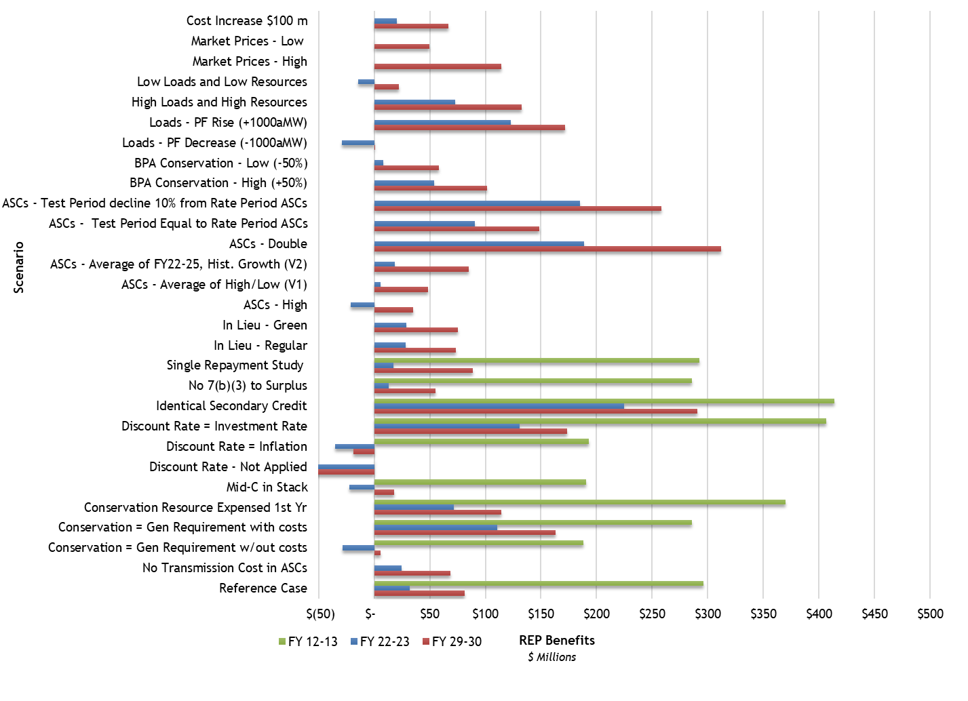
Recap: Sub-Phase 1 Scenario Results Presented 9/27
The “dry run” analysis shared at the 9/27 REP workshop provides an educational model for participants to become familiar with, and to get a sense of scale for, the various assumptions and factors that affect the REP benefit levels.
Understanding each scenario and how the results were derived is complex and will require time to fully understand.
Participants are encouraged to ask questions and/or submit agenda topics for future workshops.
Results do not represent what REP benefits will be in the future. The analysis will continue to be updated.

Slide 11
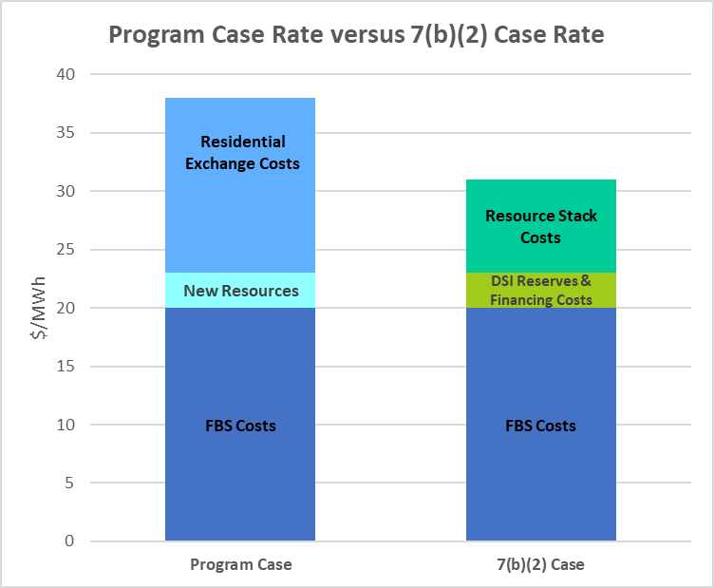
October workshop: Calculating Post-7(b)(2) Benefits
The Rate Test can be considered an ongoing cost/ benefit analysis.
  It compares projected rates set to recover certain power costs included in the NWPA (Program Case) to a hypothetical rate set to recover power costs assuming certain features of the NWPA were not in place (7b2 Case).
  The Rate Test is intended “to assure that the financial benefits
  of the preference clause in the Bonneville Act will continue to
  accrue to BPA preference customers.” Sen. Rep., Appendix B
Functionally, the Rate Test limits the amount of REP
costs that may be recovered in the PF rate.
  If the Program Case rate is higher than the 7(b)(2) Case rate,
  then the Rate Test is said to “trigger” and the difference
  between the $/MWh is multiplied by PF public load to
  establish a rate protection amount.
  The rate protection amount is then allocated away from
  PF customer loads to all other power sold as a supplemental
  rate charge.
Trigger

Slide 12
Determining the 7(b)(2) Case Rate requires multiple adjustments
The 7(b)(2) Case uses the Program Case rate as a base prior to making adjustments set forth by Section 7(b)(2) of the Northwest Power Act.*
  No REP purchases and sales. (7(b)(2)(C))
  DSIs are served by their local utility instead of BPA. (7(b)(2)(A))
  Power reserve benefits and reduced financing costs available under the Act are not achieved. (7(b)(2)(E))
  The Federal Base System (FBS) resources are used to serve 7(b)(2) Case loads first and all costs associated with the FBS are included in the 7(b)(2) Case. (7(b)(2)(B))
  5) After the FBS is exhausted, other resources owned by publics are called upon in least cost order. (7(b)(2)(D))
    (5.1) Treatment of Conservation*
  6) Final 7(b)(2) Case loads are decreased to the extent that conservation is selected from the Resource Stack and the associated resource cost is added.
  *This is based on 2008 7(b)(2) Implementation Methodology and Legal Interpretation.
Program Case Rate = $44.82
Program Case Costs ÷ Program Case Loads
7(b)(2) Case Rate $/MWh = $26.71
7(b)(2) Case Costs ÷7(b)(2) Case Loads
Program Case Loads
Program Case Net Costs
7(b)(2) Case Loads
7(b)(2) Case Net Costs
Notes:
The Northwest Power Act specifically defines conservation as a resource: “Resource” means – electric power, including the actual or planned electric power capability of generating facilities, or actual or planned load reduction resulting from direct application of a renewable energy resource by a consumer, or from a conservation measure.

Slide 13
Allocation of Rate Protection to all other Power Sold per 7(b)(3)
Graphics For Illustration Purposes Only

Slide 14
Process Plan Review and Expectations for Sub-phase 2

Slide 15
Survey Feedback on Post-2028 REP Workshops
In November of 2022 the REP Post-2028 team requested of its AEs to aid in conducting a survey soliciting participant feedback regarding the Post-2028 REP workshops.
Feedback provided:
  Customers with prior knowledge of the REP have understood the material presented at the workshops and felt they were well presented and executed.
  Those less familiar with REP are relying on their trade organizations to provide input and engage on their behalf.
  Participants are inundated with the various Bonneville work streams (i.e. Provider of Choice, BP-24, EIM, REP, etc.) and have limited bandwidth and resources to be fully engaged.
  Some utilities, both from the Publics and IOUs, are ready to move the discussion forward from educational (sub-phase 1) to negotiations (sub-phase 2).

Slide 16
2023 Public Process Plan
Sub-phase 1 has focused efforts on aiding participants’ foundational understanding of the REP, calculating benefits and the impact of the 7(b)(2) Rate Test in preparation for Sub-phase 2.
  Initial workshops covered background and mechanics of the REP and 7(b)(2).
  BPA shared a “dry-run” analysis of REP benefits under 29 scenarios using BP-22 rate case inputs.
  Winter and Spring of 2023 will shift efforts from educational (sub-phase 1) to negotiations (sub-phase 2).
Sub-phase 2 will focus on supporting regional discussions towards negotiating a new REP settlement.
  BPA will share updated REP benefits analysis, with BP-24 inputs, under a paired-down list of scenarios which will kick-off discussions for structuring a new settlement agreement.
  If there’s regional alignment on a new settlement, terms will be negotiated fall of 2023 through summer 2024 and the new agreements will undergo a 7(i) process Fall of 2024 through Spring of 2025 (sub-phase 3).
Sub-Phase 1: REP Dry Run and Preparation
(Fall 2022 – Spring 2023)
Sub-Phase 2: REP Contract Negotiation
(Fall 2023 – Spring/Summer 2024)
Sub-Phase 3: REP Settlement Evaluation Process and Decision (7i)
(Fall 2024 – Spring 2025)
Phase 1 – Settlement (2022-2025)

Slide 17
Sub-Phase 2 Public Process Plan
During the Sub-Phase 2 Process:
Bonneville will provide the book-ends of REP benefits using data from the BP-24 rate proceeding.
  Similar to the “dry run” production, REP benefit results will be modeled for FY 2024-25 and FY 2029-30 from a shortened list of scenarios.
  The RAM2024 REP Model will be provided externally which includes detailed inputs and modeling assumptions.
Sub-phase 1 focused efforts on aiding participants’ foundational understanding on calculating REP benefits and the impacts of the 7(b)(2) Rate Test in preparation for Sub-Phase 2.
  Initial workshops covered background and mechanics of the REP and 7(b)(2).
  BPA shared a “dry-run” analysis of REP benefits under 29 scenarios using BP-22 rate case inputs.
  Winter and Spring of 2023 will shift efforts from educational (sub-phase 1) to negotiations (sub-phase 2).
Sub-phase 2 will focus on supporting regional discussions towards negotiating a new REP settlement.
  BPA will share updated REP benefits analysis, with BP-24 inputs, under a paired-down list of scenarios which will kick-off potential settlement discussions that’ll feed contract negotiations this coming Fall of 2023.

Slide 18
Discussion and Confirmation of Scenario Short-list for Phase 2

Slide 19
Proposed Sub-Phase 2 Scenario List
REP analysis will be refreshed with BP-24 data and long-term projections for Sub-Phase 2.
BPA proposes focusing Sub-Phase 2 Scenarios on methodology based scenarios.
  As a result, the number of scenarios is reduced to 13 total. Analysis will be completed for the 2024-25 and 2029-30 rate periods.
  Participants have until January 31st to provide comment on the proposed list.
The Reference Case will shift from using an ASC
forecast based on a historical growth rate of 2% to
one informed by the long-term ASC forecast model
using IOU Integrated Resource Plans (IRPs).
The no Transmission in ASCs scenario will be part
of the ASC methodology review and public process.
The In Lieu analysis was removed but discussions are
expected to continue during the Post-2028 REP
process.
Sub-Phase 2 Proposed Scenario list
1 | Reference Case
2 | Conservation = Gen Requirement with out costs
3 | Conservation = Gen Requirement with costs
4 | Conservation Resource Expensed 1st Year vs 5 Years
5 | Mid-C Resources in 7(b)(2) Resource Stack
6 | Discount Rate - Not Applied
7 | Discount Rate uses Inflation Rate
8 | Discount Rate uses Investment Rate
9 | Identical Secondary Credit in 7(b)(2) Case
10 | No 7(b)(3) allocation to Surplus Sales
11 | Single Repayment Study Used
12 | ASCs – High (both loads and ASCs)
13 | ASCs - Low (both loads and ASCs)
Notes:
Consider still calling out the desire to shift to LT ASC but note timing issue, verbalize implications to REP benefits.

Slide 20
BREAK

Slide 21
ASC Methodology Revision Process and Timeline

Slide 22
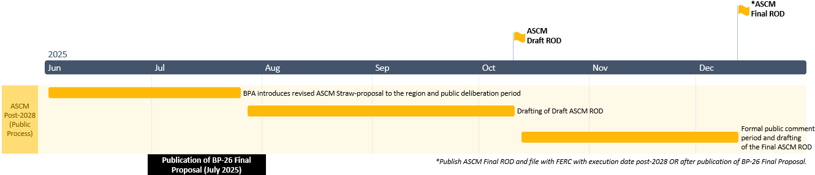
ASCM Revision Timeline

Slide 23
ASC Methodology Revision Process
The ASC Methodology (ASCM) revision process will run parallel to post-2028 REP efforts, but be an independent formal process.
  The NWPA requires regional collaboration to devise an ASC methodology.
Initial step – Present a Straw Proposal of a revised ASCM.
  Bonneville’s Administrator approves and puts forth a proposed revised methodology and will engage regional parties (Pacific NW utilities, PUCs, the Council) in workshops to deliberate revisions.
Second step – Publication of the Draft Record of Decision.
  BPA publishes a Draft ASCM ROD and opens up a formal comment period.
Third step – Publication of the Final Record of Decision and file with FERC post publication of the BP-26 Final Proposal.

Slide 24
Potential Areas for Consideration
With each ASCM iteration utility system costs and revenues are reassessed for reasonableness in determining an REP-participating utility’s ASC. BPA identifies the following sections of the 2008 ASCM as potential areas for evaluation.
  Transmission investments and expenses.
  Treatment of Carbon Policy implications.
  Implementation of the In Lieu provision of the NWPA.
  Timing of inclusion of New Major Resource additions/removals.
  Coordination with new contracts – implications of new TRM and CHWM contracts.

Slide 25
Proposed Long Term ASC Forecast Methodology for Sub-phase 2

Slide 26
Context and Background
The Long-Term (LT) ASC Forecast Model mirrors the 2-year ASC Forecast Model.
  The 2-year ASC Forecast Model escalates historical costs and loads to determine REP Utilities’ Exchange Period or Rate Period ASCs, which are inputs to BPA’s rate case proceedings
  During an ASC Review Filing, which run parallel to BPA’s rate case proceedings, REP Utilities report historical resource costs and additional data to BPA in an excel-based model (Appendix 1). The 2-year ASC Forecast Model escalates these costs and loads forward to the mid-point of the applicable rate period in order to determine REP-participating utilities’ individual ASCs for calculation of REP benefits to be paid during this period.
  Primary inputs into the 2-year Forecast Model are: escalation factors, natural gas prices and market prices.
The LT ASC Forecast Model is a long range version of the 2-year ASC Forecast Model.
  As with the 2-year ASC Forecast Model, the LT ASC Forecast Model escalates historical costs and loads from a utility’s Appendix 1.

Slide 27
REP-12 Forecast Model & Methodology
The LT ASC Forecast Model was first introduced and utilized during the 2012 REP Settlement negotiations to project long-range ASCs for REP benefits calculations.
Similar to the 2-year ASC Forecast Model, the REP-12 LT ASC Forecast Model escalates historical resources costs and loads from a utility’s Appendix 1, but additionally considers the below inputs:
  Utility resource builds and retirements from most the most recently published integrated resource plans (IRPs), including conservation investments.
  Utility average load growth rate with conservation from, also derived from IRPs.
  Long-term forecast of natural gas prices, market prices and escalators.
The LT ASCs were an input to the Long-Term Rate Model (equivalent to RAM2024) to calculate REP benefits under various scenarios.
  See the 2012 REP Settlement Evaluation Study and Documentation

Slide 28
Long-Term ASCs for REP Post-2028 Analysis
Presently, the LT ASC Forecast Model is undergoing modernization to calculate LT ASCs that’ll feed the Reference Case, High and Low Scenarios of the REP benefits analysis that’ll be shared during Sub-Phase 2 this coming Fall.
BPA intends on retaining the LT forecasting methodology from REP-12, but requesting feedback by January 31st on:
  Are IRPs the most reliable source for utilities’ most current resource plan to meet industry requirements and changes (e.g. carbon policy, electrification, gas prices, regional demand).
    The LT ASC Forecast Model relies on resource builds and retirement schedules to inform costs in LT ASCs. Therefore accuracy of plant online and offline dates is important.
    Pros to IRPs:
      Publicly available and transparent on utilities’ long-term resource planning.
      Filed with and approved utilities’ state commissions.
    Cons to IRPs:
      Data lag when resource plans are published and when they are utilized to inform the LT ASC Forecast Model.
  Modeling the high and low scenarios.
    Price forecasts
    Assumption on resource builds and retirements

Slide 29
Rate Protection Allocation to the FPS/Secondary Loads

Slide 30
Allocation of Rate Protection to FPS/Secondary
Section 7(b)(3) of the Northwest Power Act directs the allocation of rate protection to
all other non-PF power sold as a supplemental rate charge.
Rate Protection is allocated to PF Exchange Loads, Industrial Firm Loads, New Resource Loads and Surplus Firm/Secondary Loads (see slide 32 for data table example).
  Initially, the Program Case and 7(b)(2) Case include an equal Net Secondary Revenue Credit.
  Once the first iteration is complete a level of rate protection is determined and a portion
  is allocated to Surplus/Secondary Loads. This reduces the Secondary Revenue Credit
  included in the unbifurcated PF rate (see slide 33 for data table example).
    All else being equal, the Unbifurcated PF Rate increases, leading to a higher
    Program Case Rate used in the Rate Test causing higher Rate Protection.
    The Secondary Revenue Credit in the 7(b)(2) Case remains unchanged.
  Allocating Rate Protection to Surplus Firm/Secondary Loads creates an
  iteration loop within RAM because the PF rate changes.
    RAM will run the 7(b)(2) Rate Test continuously until the
    amount of rate protection allocated to the FPS/Secondary
    Loads no longer changes between iterations and the PF rate
    remains the same.
Initial Unbifurcated PF Rate *
Initial 7(b)(2) Rate Test Run
Determine Unbifurcated PF Rate
Run 7(b)(2) Rate Test
Allocate Rate Protection
Rate Protection to FPS/SP Loads Changed?
Adjust Secondary Revenue Credit
RAM Iteration Loop
No
Final Rate Protection Level and REP Benefits Established
Yes
*NSR Credit included in the initial Unbifurcated rate is set equal in the initial 7(b)(2) Rate Test for the Program Case & 7(b)(2) Case

Slide 31
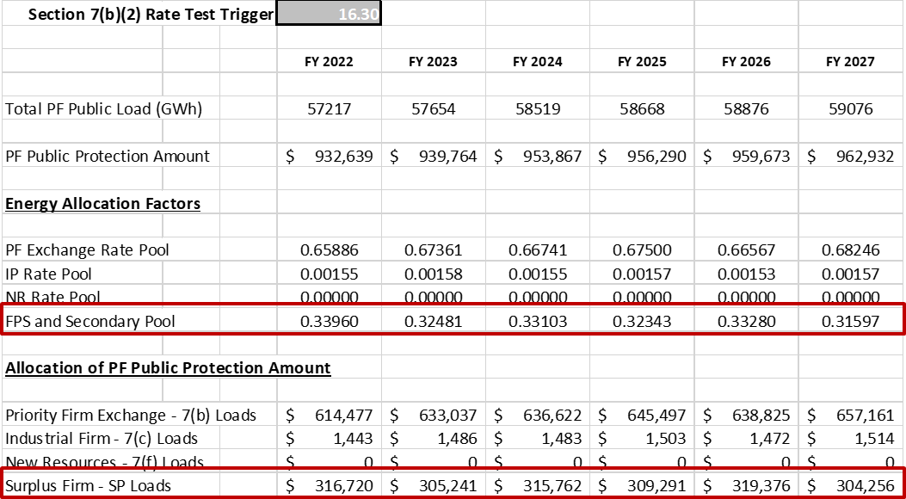
Allocation of Rate Protection to FPS/Secondary
Secondary Loads are included in the Surplus Firm (SP) load pool when allocating rate protection. This results in a larger portion of
Rate Protection being allocated to SP Loads.
  In the Phase 1 Analysis released September 25th, Secondary loads average 2,258 aMW annually, whereas, Firm Surplus loads average 261 aMW annually in the Reference Case.

Slide 32
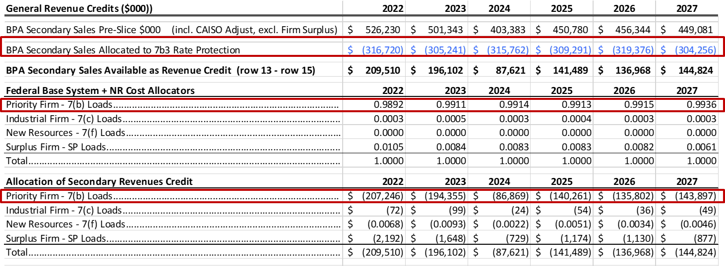
Allocation of Rate Protection to FPS/Secondary
Rate protection allocated to Firm Surplus and Secondary Loads reduces the Secondary Revenue used in the unbifurcated PF Rate. As a result, the Program Case Rate rises in the 7(b)(2) Rate Test. All else equal, this leads to higher Rate Protection.
  See the 10/25/2022 workshop material for a detailed explanation of the relationship between the Unbifurcated PF Rate and the Program Case Rate used in the 7(b)(2) Rate Test.
  The Secondary Revenue Credit reflected in the 7(b)(2) Case does not change; no reduction is made for rate protection.

Slide 33
Next Steps

Slide 34
Thank You!
Post 2028 REP Lead Sponsor:
Kim Thompson, Vice President, Northwest Requirements Marketing
Post 2028 REP Team:
Stephanie Adams, Paulina Cornejo, Michael Edwards, Daniel Fisher,
Rich Greene, Neil Gschwend, Kelly Olive, Jonathan Ramse, Scott Winner

