Slide 1
Post-2028 Residential Exchange Program
7(b)(2) Legal Interpretation and
Implementation Methodology Process
Technical Workshop
October 22 & 23, 2026
1:15pm – 3:00pm / 9:30am – 12:00pm
RHR and Webex / RHR and Webex

Slide 2
Day 1 Agenda
 | Workshop Topics | Presenter(s)
9:00 – 9:20 | Agenda and Introductions, Process Overview | Sarah Burczak
9:20 – 10:00 | History and Background | Richard Greene
10:00 – 10:30 | The REP in Practice | Richard Greene
10:30 – 10:45 | Origins of LI & IM | Richard Greene
10:45 – 11:00 | Break | ~
11:00 – 11:45 | Updated Assumptions and Scenarios | Stephanie Adams
11:45 – 12:15 | Settlement Concepts and Opportunities | Richard Greene & Daniel Fisher
12:15 – 1:15 | Lunch | ~
1:15 – 2:50 | Technical Workshop: 7(b)(2) Deep-dive & Historical Interpretation | Jonathan Ramse & Richard Greene
2:50 – 3:00 | Next Steps / Close Out | Daniel Fisher

Slide 3
Day 2 Agenda – Technical Workshop
 | Workshop Topics | Presenter(s)
9:30 – 9:40 | Agenda & Objectives Overview | Sarah Burczak
9:40 – 10:00 | Technical Workshop: Continue 7(b)(2) Deep-dive & Historical Interpretation | Jonathan Ramse & Richard Greene
10:00 – 11:30 | RAM Modeling including Scenarios and How to Operate the Model | Stephanie Adams
11:30 – 11:50 | Technical Questions | REP Team
11:50 – 12:00 | Next Steps / Close Out | Sarah Burczak

Slide 4
Objectives
Walk through the Ratemaking Steps and Assumptions of Section 7(b)(2).
Discuss historical interpretation issues with different sections.
Show how the impacts of various assumptions and positions tie into the Scenarios and RAM.
Discuss RAM and how to operate the model.
Answer any technical questions.

Slide 5
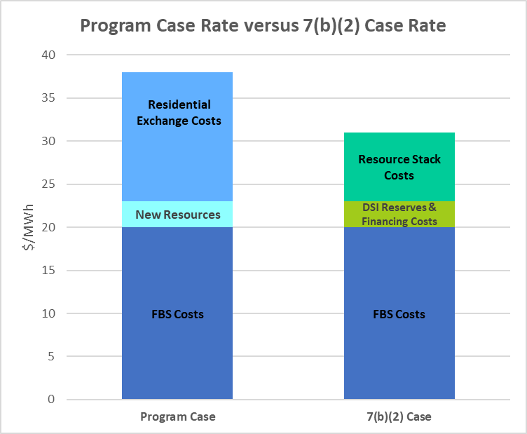
Components of the Section 7(b)(2) Test
Step 1 | Exclude specific Section 7(g) Costs from Program Case | Conservation costs, experimental resource costs, billing credits costs, and “uncontrollable events” costs
Step 2 | Run the five assumptions of the 7(b)(2) rate test (Alternative Test Case as directed by Congress) | (A) DSIs are served by their local utility instead of BPA (B) Federal Base System (FBS) resources are used for publics first (C) no REP purchases and sales (D) after the FBS is exhausted, other resources owned by publics are applied in least cost order (E) power reserve benefits and reduced financing costs available under the Act are not achieved
Step 3 | Compare the rates produced by Program Case with the 7(b)(2) Case | - Produce five-year projection of Program Case Rate and 7(b)(2) Case Rate. Historically, discount both. - If Program Case rate is lower, do nothing; if 7(b)(2) Case rate is lower, rate test triggers. The $/MWh difference between the two rates is multiplied by the PF customer load to determine a rate protection amount.
Step 4 | Allocate difference from Step 3 to other rates | The rate protection amount from Step 3 must be allocated to other non-PF power sold per 7(b)(3).
Trigger

Slide 6
7(b)(2) LI & IM Process
Rates Analysis Model
(RAM)
Stephanie Adams
Rates and 7(b)(2) Lead

Slide 7
What is RAM?
RAM is a Rates Analysis Model, sometimes called RAM Core, it is a macro enabled Excel model with upwards of 150 tabs.
RAM performs the calculations necessary to develop BPA’s wholesale power rates: Cost of Service Analysis (COSA), Rate Directives, and Rate Design.
  Cost of Service (COSA): Determines and allocates BPA’s resource and program costs to the appropriate rate pools consistent with statutory requirements.
  Rate Directives: Applies statutory rate adjustments, such as Section 7(b)(2) and 7(b)(3) to establish appropriate cost and rate relationships among rate pools.
  Rate Design: Allocates PF Preference costs and revenue credits to Tier 1 composite, Non-Slice, Slice and Tier 2 cost pools consistent with TRM (going forward PRDM), while demonstrating alignment with COSA and Rate Directives.
Presented analysis uses RAM2029 REP Model October 2026 available here: RAM2029 REP Model October 2026.

Slide 8
Step 1 - Section 7(b)(2) Prime
Unbifurcated PF Rate to Program Case Rate
REP Team

Slide 9
Creating the Program Case Rate
Section 7(b)(2) Prime states:
  After July 1, 1985, the projected amounts to be charged for firm power for the combined general requirements of public body, cooperative and Federal agency customers, exclusive of amounts charged such customers under subsection (g) of this section for the costs of conservation, resource and conservation credits, experimental resources and uncontrollable events may not exceed in total, as determined by the Administrator, during any year after July 1, 1985, plus the ensuing four years, an amount equal to the power costs for general requirements of such customers if, the Administrator assumes that—

Slide 10
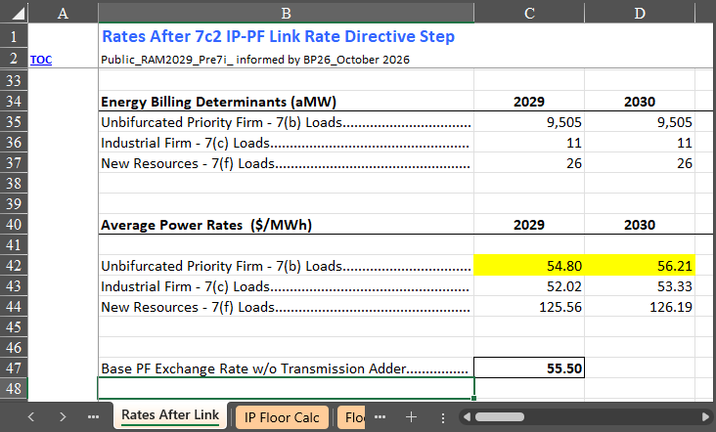
“projected amounts to be charged…”
Code for the Unbifurcated PF Rate:

Slide 11
“exclusive of amounts charged …”
Start with the Unbifurcated PF Rate, then subtract from it “exclusive of” amounts charged
to that rate for…
  the costs of conservation,
  resource and conservation credits,
  experimental resources, and
  uncontrollable events.
These costs are called “Applicable 7(g) costs.” Comes from Section 7(g).
The resulting rate is called the “Program Case Rate”.
  The Program Case rate is NOT designed to recover all of BPA’s costs. It is a rate built on a subset of BPA’s costs.
  It’s called “Program Case” because BPA used a FORTRAN “program” to run the rate test during the legislation’s development.

Slide 12
“during any year… plus the ensuing four years”
The rate test looks at a projection of rates for the current year’s rate PLUS the “ensuing four years..”
To do this BPA uses the current projected rates and then adds four additional years to the end of the rate period, using projections of future loads, resources costs, etc… to create these “out-year” projections.
Objective of these out years (we think) was to smooth out the impacts over the rate test.
  If looking at a single year, may have large trigger one year, then no trigger the next. Incorporating multiple years allows for a smoother, less volatile outcome of the rate test.
Later in the rate test BPA will discount results.

Slide 13
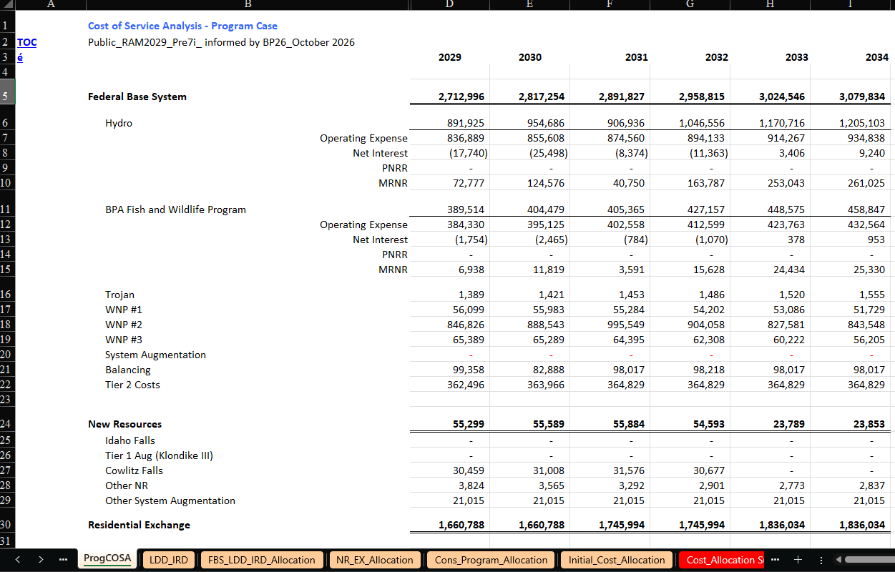
RAM Connection:
ProgCOSA tab in RAM provides the cost aggregation used to calculate the Unbifurcated PF rate.

Slide 14
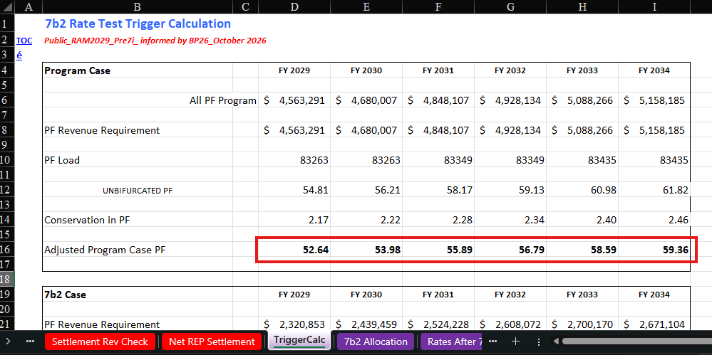
The “…exclusive of…” adjustment is made in the TriggerCalc tab where conservation costs are removed from Unbifurcated PF rate to arrive at the Program Case Rate.
Loads can be found on the PF Public and PF Exchange tabs.

Slide 15
“general requirements…”
The NWPA is clear that the “load” that receives the protections of the rate test are “general requirements.”
This is defined by Section 7(b)(4) to mean the electric power purchased by COUs from BPA under Section 5(b), excluding New Large Single Loads.
Sales at the NR and IP rates are NOT entitled to protections of Section 7(b)(2).

Slide 16
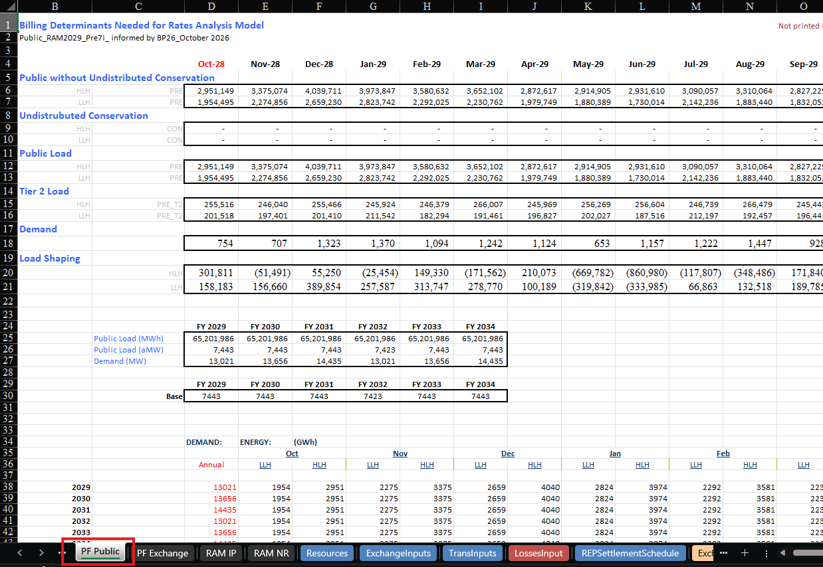
RAM Connection:
Public Loads / General requirements used in the Program Case rate

Slide 17
Step 2.0 - Section 7(b)(2) Rate Test
Section 7(b)(2) Case Rate (Setup)
REP Team

Slide 18
Section 7(b)(2) Case Rate Setup
[The rate] “may not exceed in total… an amount equal to the power costs for general requirements of such customers if, the Administrator assumes that –”
Remainder of the rate test is determining the “amount equal to the power costs for general requirements of such customers. . .”
Before we begin applying the rate test assumptions, we need to establish WHERE we start for purposes of the Section 7(b)(2) Case Rate costs and loads.

Slide 19
What costs do we start with in the 7(b)(2) Case Rate?
Exclusive of applicable 7(g)
Unbifurcated PF Rate
$55.85/MWh
Program Case Rate
$53.28/MWh
1984 LI / IM*
2008 LI / IM*
Did Congress intend BPA to start with the Unbifurcated PF Rate or the Program Case rate?
BPA has adopted different interpretations of whether Congress intended the “exclusive of” language to apply to only the Program Case or whether Congress intended to also apply it to the 7(b)(2) Case
  1984 LI/IM BPA started with the Unbifurcated PF Rate (did not remove applicable 7(g) costs from 7(b)(2) Case rate). (*But see Conservation.)
  2008 LI/IM BPA started with the Program Case Rate (BPA removed applicable 7(g) costs from the 7(b)(2) Case rate). (*But see Conservation.)

Slide 20
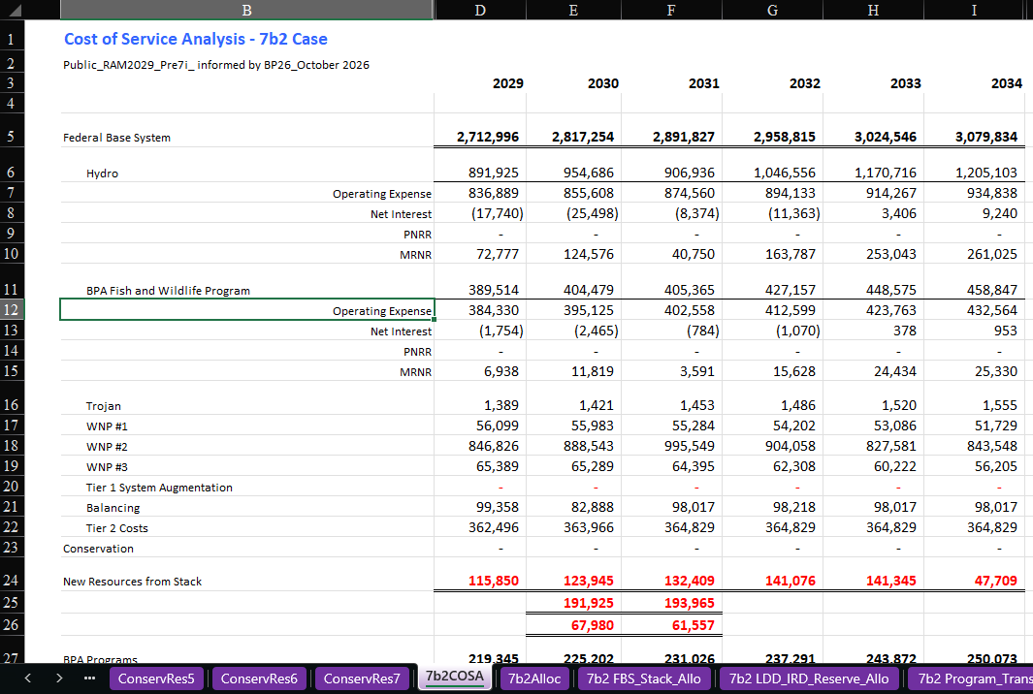
RAM
Connection:
Base Case
The Base Case scenario uses the 2008 LI/IM approach.

Slide 21
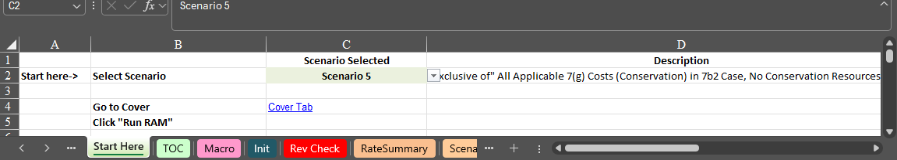
RAM Connection – Scenario 5
Scenario 5 – “exclusive of” Conservation Cost in 7(b)(2) case
  An argument that all “applicable” 7(g) costs are to be included in the 7(b)(2) Case Rate, but excluded from the Program Case rate. Practically speaking, this means all conservation costs are in the 7(b)(2) Case Rate, but excluded from the Program Case Rate.

Slide 22
What loads do we start with in the 7(b)(2) Case Rate?
Section 7(b)(2) repeats multiple times that the load in the rate test is for “general requirements” (aka power purchased by COUs under Section 5(b), with no NLSL).
What about conservation?
  See later slides about Section 7(b)(2)(D)(i) and the “resource stack.”
  If conservation is in the resource stack, then we must presume that conservation was not acquired at the time the rate test is performed.
  Ergo, the loads that we have at the beginning of the rate test must be adjusted to remove the effects of conservation included in the resource stack from the rate test.
So 7(b)(2) case load is not just the “general requirements” of COUs; “general requirements” + conservation. (1984 LI/IM and 2008 LI/IM adopted this position.)

Slide 23
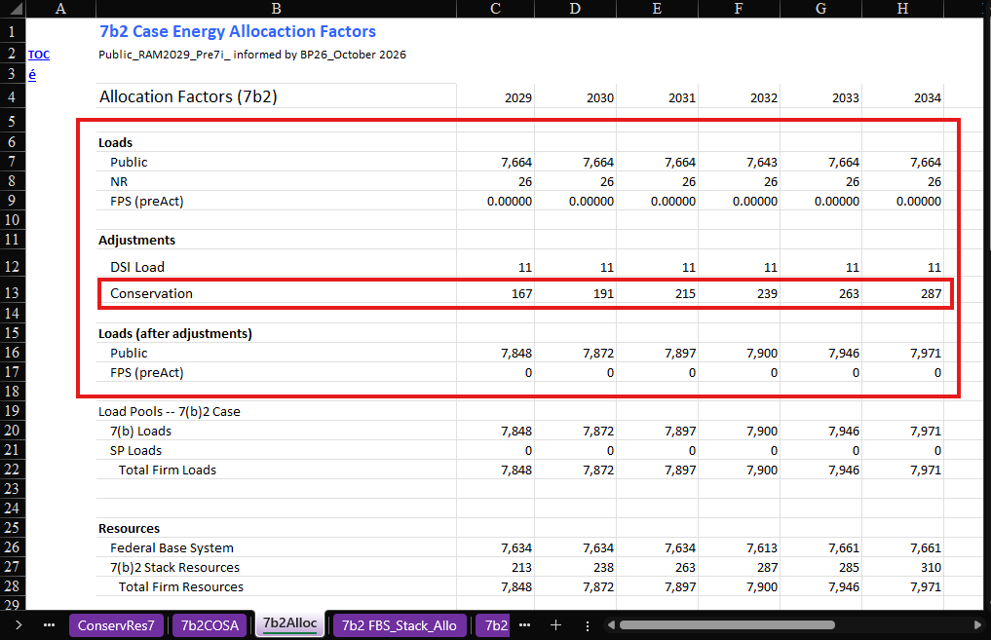
RAM
Connection: Base Case
Base Case assumes Conservation is a resource and adjusts the loads per the 1984/2008 LI and IM.

Slide 24
Step 2.1 - Section 7(b)(2) Rate Test
First Assumption - Section 7(b)(2)(A)
(DSI Load)
REP Team

Slide 25
Section 7(b)(2)(A) – DSI Loads Added
Section 7(b)(2)(A) requires that the COUs’ “general requirements” include DSI loads that are “served by the Administrator” and “located within or adjacent to” the COUs’ territory.
Why?
  Recall, that in the absence of the legislation, the DSIs were threatening to simply take federal power through their local COUs. This would have exacerbated the power shortage facing the COUs, requiring that they acquire more non-federal power to serve their total load.
  This assumption assumes the DSIs made good on that threat because they were not being directly served by BPA.
  Not all DSIs had the option of connecting to a local COU; some were not located “within or adjacent” to a COU.
Impact of this assumption: DSI load added.
  Historically, this was a major factor in the rate test because this assumption added around 3,300 aMW to 7(b)(2) Case Loads.
  Currently very small impact – around 11 aMW.

Slide 26
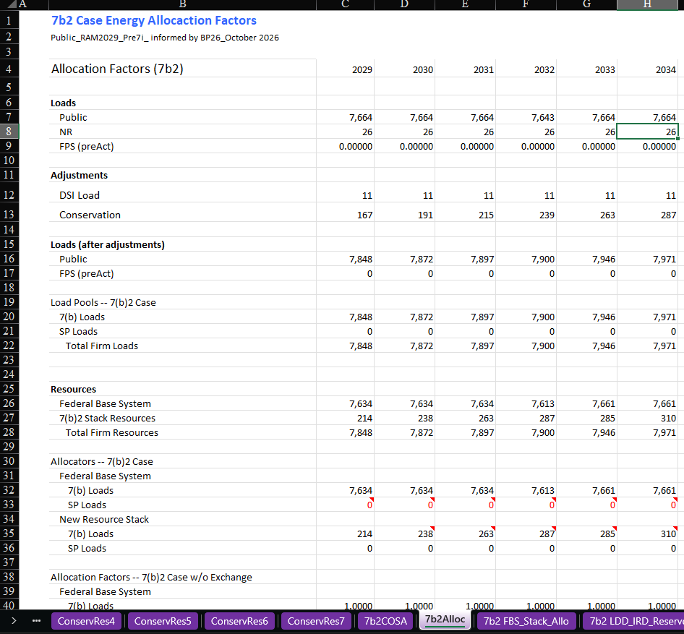
RAM
Connection:
Base Case

Slide 27
Step 2.2 - Section 7(b)(2) Rate Test
Second Assumption - Section 7(b)(2)(B)
(FBS Only)
REP Team

Slide 28
Section 7(b)(2)(B) – BPA only has the FBS
BPA must assume that the only BPA power available to serve the COUs loads for the six-year period are the Federal Base System resources (FBS).
Why?
  Without the Act, BPA would not have had Section 6 acquisition authority and would be limited to the size of the FBS.
  COUs would have been entitled, exclusively, to the FBS.
Impact of this assumption: New Resources costs and MWs excluded.

Slide 29
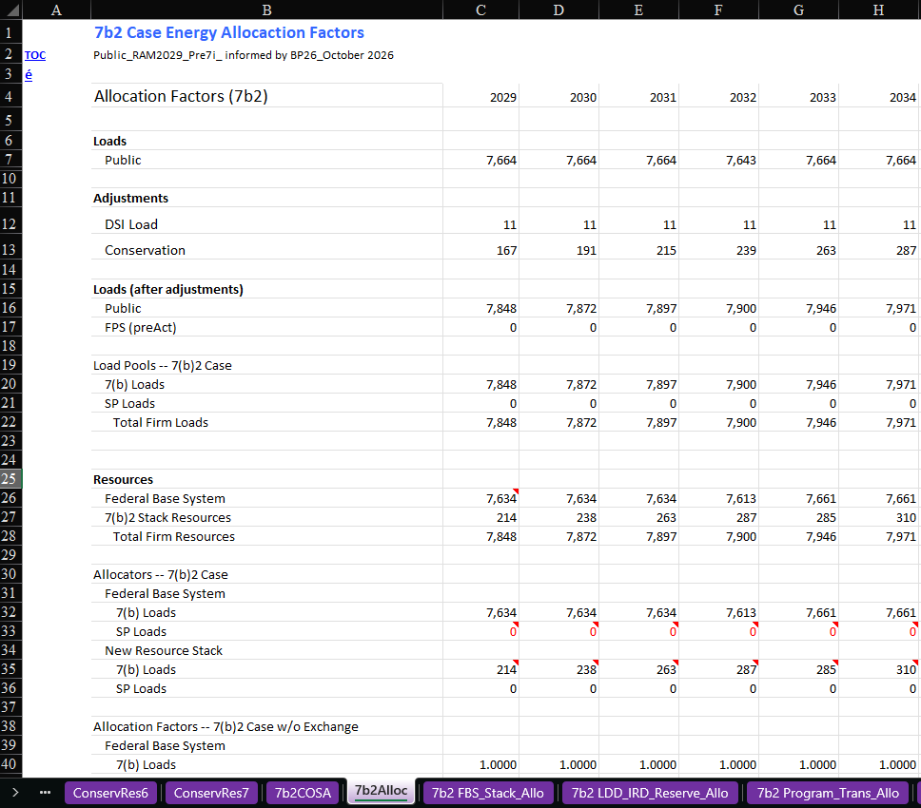
RAM
Connection: Base Case

Slide 30
Step 2.3 - Section 7(b)(2) Rate Test
Third Assumption - Section 7(b)(2)(C)
(No REP)
REP Team

Slide 31
Section 7(b)(2)(C) – No REP
“no purchases or sales by the Administrator as provided in section [5](c) of this section were made during such five-year period;”
Effectively, unwinds the cost melding required by Section 7(b)(1).
Why?
  In the “no act” world, the COUs would not have paid for the REP in their rates because no REP existed.
Impact of this assumption: this assumption removes the costs associated with the REP from the 7(b)(2) Case Rate.

Slide 32
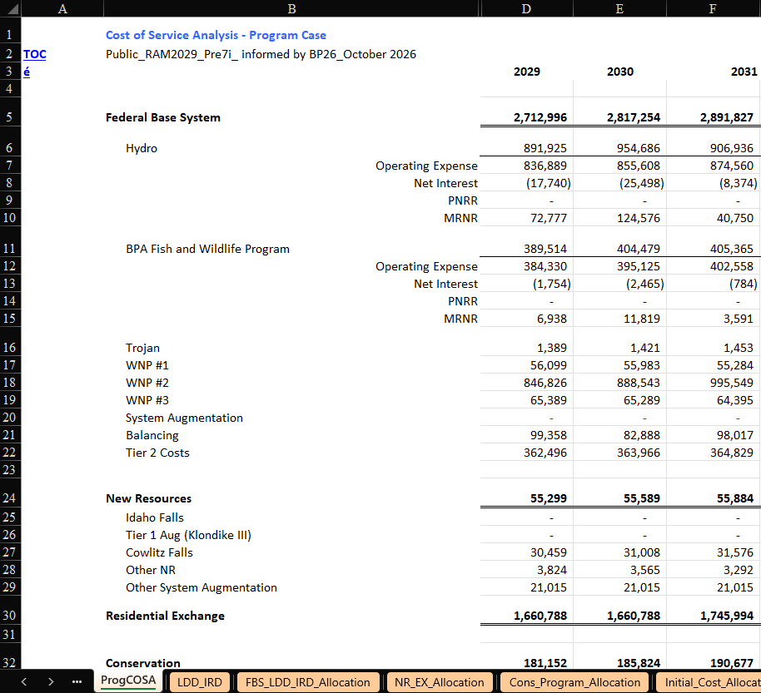
RAM Connection – Base Case

Slide 33
Step 2.4 - Section 7(b)(2) Rate Test
Fourth Assumption - Section 7(b)(2)(D)
(Resource Stack)
REP Team

Slide 34
Resource Stack: Threshold and Purpose
Section 7(b)(2)(D) builds what BPA colloquially calls the “resource stack.”
Threshold question: Do we need to use the resource stack?
  Section 7(b)(2)(D) only applies to meet “remaining general requirements” of COUs not met by the FBS.
  If FBS is sufficient to serve all COUs’ general requirements (inclusive of DSI load), then the rate test selects no resources under Section 7(b)(2)(D), and can proceed to Section 7(b)(2)(E).
Purpose of Section 7(b)(2)(D): COUs serve their own load with other non-federal resources.
  Reflects what resources/cost the COUs would have incurred to serve their remaining general requirements (after FBS).

Slide 35
RAM Connection: Base Case
We have unmet General Requirements, thereby, needing to go into the resource stack.

Slide 36
Resource Stack: Categories and Criteria
Three categories of resources are included in the resource stack:
  First, resources acquired by the Administrator from COUs under Section 6 (Section 7(b)(2)(D)(i)).
    Theory: if BPA did not have acquisition authority under Section 6, this resource would have been retained by the COUs and used to serve their own loads. Hence the MWs and costs would have been incurred directly by the utility.
  Second, COU resources “not committed to load pursuant to section [5](b)” (Section 7(b)(2)(D)(ii).
    Theory: resources owned or purchased by COUs that have NOT been dedicated to a regional Section 5(b) load would be available to serve the COUs’ collective general requirements. Those MWs and costs are assumed to be available in the resource stack.
  Third, (if there are remaining general requirements), then hypothetical resources at the “average cost of all other new resources acquired by the Administrator.”
Criteria for resources in the resource stack:
  The resources were “owned or purchased” by a COU.
  The resources are ordered in “least cost” order.

Slide 37
Sourcing the 7(b)(2) Resource Stack
No
Does the Utility have a 5b Contract with BPA?
Yes
None of the Utility’s resources will be included in the 7b2 Resource Stack
Does the Utility have any resources not committed to load?
No
Yes
Yes
Is the not committed to load resource 100% committed to load in any other 5b contract?
No
The resource or portion of the resource that is not committed to load in any 5b contract is included in the 7b2 Resource Stack. These resources can be found in Exhibit A, Section 6 of the Provider of Choice Contract.

Slide 38
Pricing the 7(b)(2) Resource Stack
Owned
What type of resource is it?
Purchased
Is the purchase price publicly available information?
Yes
Is the resource’s cost basis publicly available information?
No
Is the cost of the source resource publicly available information?
No
Yes
Yes
Cost set equal to the average publicly available benchmark for a similar resource type for the test period.
Cost set equal to the average publicly available price for the test period.
Cost set equal to the average of: 1) the known cost of source resource, and 2) the average market price forecast over test period.
Cost set equal to the average of: 1) a benchmark for a similar resource type, and 2) the average market price forecast over the test period

Slide 39
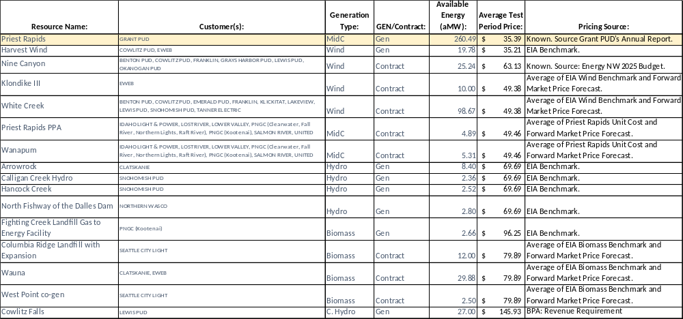
Current Resource Stack (Excl. Conservation)

Slide 40
What changed with the resource stack?
 | Eligibility | Resources Overview | Pricing | Impact on Benefits
Historically | Two criteria: 1. Resources owned by regional Public Utilities. 2. Not dedicated to loads. | Primary resources included in the stack were Mid-C hydro resources owned by public utilities without a 5(b) contract. Wind resources, both owned and purchased by public customers, made up a sizable quantity of resources. | Each resource is priced based on that specific resource cost. Significant effort is taken to calculate each resource cost. Lack of data resulted in hybrid pricing by mixing benchmarking and direct cost calculations. | The lower cost resource stack increased rate protection and restricted the amount of REP benefits.
Current Analysis | Three criteria: 1. Resources owned or purchased by 5(b) preference customers. 2. Not dedicated to loads. 3. Must be larger than 1MW nameplate. | Resources are included in Regional Dialogue and Provider of Choice contracts in Exhibit A, under Section 6. Includes a larger variety of smaller resources from a broader set of customers. Wind tends to be the cheapest resources when Conservation is excluded. | Resources are priced differently based on if they are owned or purchased. 1. Owned – use resource cost defined by utility or EIA benchmark. 2. Purchased (PPAs) – use the average of forward market price forecast and known resource cost (if not available use benchmark). | Relatively higher cost resources in the stack decreases the rate protection which increases the amount of REP benefits.

Slide 41
What about Conservation?
Recall, Section 7(b)(2)(D)(i) says that BPA includes in the “resource stack” resources that were “purchased from such customers by the Administrator pursuant to section [6][.]”
Conservation is generally considered a resource under the NWPA.
§ 3(19)(B).
BPA acquires Conservation from COUs under Section 6(a)(1).
Ergo, conservation acquisitions are in the Section 7(b)(2)(D) resource stack.
  If Conservation is in the 7(b)(2) resource stack, conservation costs cannot already be in the 7(b)(2) Case Rate.
  If Conservation is in the 7(b)(2) resource stack, conservation load reduction cannot be in the 7(b)(2) Case Rate load.
Under both 1984 LI/IM, and 2008 LI/IM, 7(b)(2) Case Rate treated Conservation as a resource in the resource stack.

Slide 42
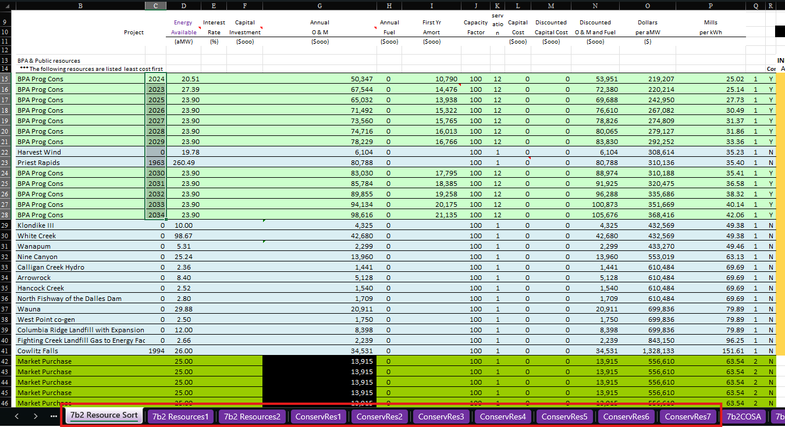
RAM Connection – Base Case – Resource Stack

Slide 43
RAM Connection – Base Case – Resource Stack
Tab | Description
7b2 Resource Sort | Available resources for inclusion in the Resource Stack are input into this tab. When RAM is “RUN” VBA code orders resources into least cost order (Column P). This tab is the primary representation of the “resource stack”.
7b2 Resources1 | Resources are reported in least cost order based on information from the 7b2 Resource Sort tab, a resource number is assigned, available energy, costs and applicable in-service dates are reported.
7b2 Resources2 | This tab identifies the number of resources needed to meet 7(b)(2) Case loads after FBS resources are exhausted; it identifies the last resource brought on from the Resource Stack to meet the remaining load obligation. Any residual energy after meeting the 7(b)(2) loads is valued at the last resources $/MWh cost.
ConservRes1 | Resources are reported in least cost order by resource number followed by resource name, available energy, costs and applicable in-service dates are reported.
ConservRes2 | Conservation Resources are listed; any selected conservation resources have the associated aMW value listed for the year in which it is called upon.
ConservRes3 | The real dollar cost of each resource selected is reported.
ConservRes4 | The nominal amortized cost of expensed conservation resources selected from the resource stack are reported.
ConservRes5 | The nominal annual cost of capitalized conservation resources selected from the resource stack are reported. BPA no longer capitalizes conservation resources.
ConservRes6 | The nominal annual cost of non-conservation resources selected from the resource stack are reported.
ConservRes7 | All nominal annual costs for selected resources from the resource stack are reported and totaled for inclusion in the 7(b)(2) COSA. This represents the total cost of the resources selected from the stack on an annual basis prior to crediting the annual residual value of excess energy.
7b2COSA | Costs included in the 7(b)(2) Case are reported including the costs of new resources called from the Resource Stack (ConservRes7).

Slide 44
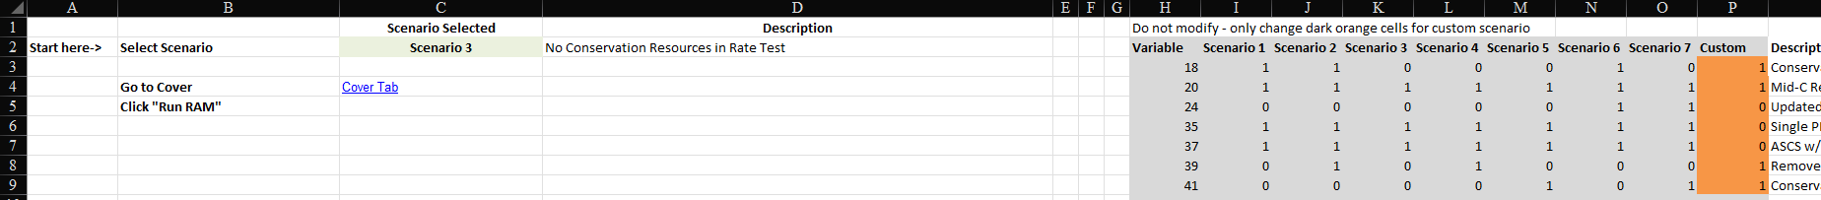
RAM Connection: Scenario 3 No Conservation
COUs have historically argued that Conservation should not be included in the resource stack, and no load adjustment should be made.
Scenario 3 – No Conservation resources in the Resource Stack

Slide 45
Step 2.5 - Section 7(b)(2) Rate Test
Fifth Assumption - Section 7(b)(2)(E)
(Remove Reserve and Financing Benefits)
REP Team

Slide 46
Section 7(b)(2)(E) – Remove Reserve / Financing Benefits
Section 7(b)(2)(E) removes certain “quantifiable monetary savings” achieved under the NWPA.
  First, are the “financing costs” savings the COUs received from the resources included in the resource stack.
    Theory: When BPA is an anchor tenant for the output for a COU-built resource, the financing costs for building the resource is lower.
    Simple example: bank loans COU $100 Million at 9.95% interest rate to build resource for COU’s load because BPA is anchor buyer. If BPA had not been the offtaker, bank loan would have been 10%. In this example, “quantifiable monetary savings” would be the interest rate delta (.05%).
  Second, are “reserve benefits as a result of the Administrator's actions under this chapter.”
    Under DSI contracts provided by Act, BPA had a right to curtail the DSI’s load as a “reserve” to support firm load service. See Section 5(d)(1)(A). DSIs received a rate credit for providing this reserve. See Section 7(c)(3).
    Theory: If DSIs are no longer directly buying power from BPA, but are now part of the COU’s load (see 7(b)(2)(A)), then BPA/COUs would lose this “reserve” benefit and BPA would have to incur other “reserve” costs to maintain firm power service to COUs.
Impact of this assumption: Costs are added to the Section 7(b)(2) Case Rate.

Slide 47
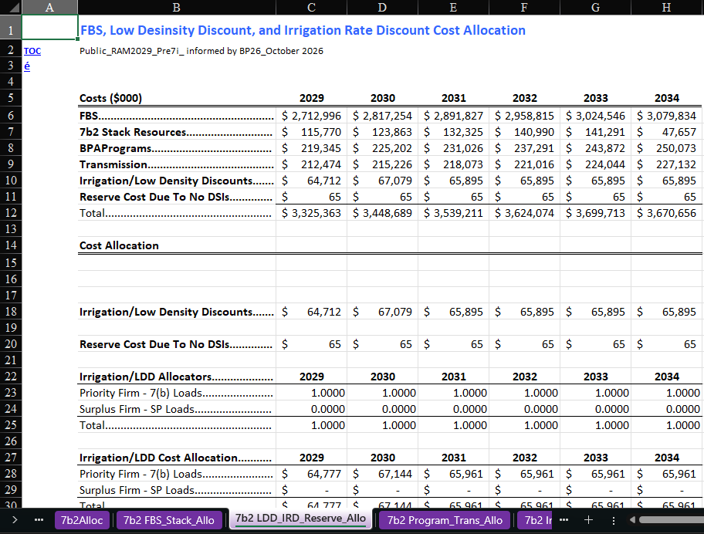
RAM Connection: Base Case

Slide 48
Step 3 - Section 7(b)(2) Rate Test
Five-Year Projections and Compare Rates
REP Team

Slide 49
Rate Period Program Case & 7(b)(2) Case Rate
Begin by calculating rates for the rate period.
 | FY 2029 | FY 2030
Program Case Revenue Requirement ($ 000s) | $4,524,843 | $4,641,449
Program Case Loads (GWh) | 83263 | 83263
Unbifurcated PF Rate ($/MWh) | $54.34 | $55.74
Exclusive of Costs (Conservation costs) ($/MWh) | $2.17 | $2.22
Program Case Rate* ($/MWh) | $52.18 | $53.52
7(b)(2) Case Revenue Requirement ($ 000s) | $2,322,412 | $2,441,030
7(b)(2) Case Loads (GWh) | 65,299 | 65508
7(b)(2) Case Rate ($/MWh) | $35.57 | $37.26
Trigger ($/MWh): (Prog. Case Rate – 7(b)(2) Case Rate) | $16.61/MWh | $16.26
* Program Case Rate is determined by subtracting conservation costs ($/MWh) from the unbifurcated PF rate.
Values represented in the table above reflect an interim RAM run prior to the removal of IOUs with negative REP benefit values after running the 7(b)(2) Rate Test.

Slide 50
Out-Year Projections and Compare Rates
Section 7(b)(2) states that the rate test covers the current rates “projected amounts to be charged” plus a number of future years, the “ensuing four years”.
For a two-year rate period, BPA goes out four years from the end of the rate period. The rate test includes six years in total.

Slide 51
Out-Year Projections
Input Data: | Forecast Type: | Source: | Included in Program Case or 7(b)(2) Case?
FBS costs | Inflation and targeted known costs | Rate Case Revenue Requirement Study and Documentation | Both
ASCs and Exchange Loads | ASCs inflated at GDP growth forecast. | ASCs outyear forecast applied in PSRF Load forecasts provided by IOUs through filings. | Only Program Case
New Resource Costs | Inflation and targeted known costs | Rate Case Revenue Requirement Study and Documentation | Only Program Case
Conservation Quantity and Costs | Internal forecasts – see source materials | Quantities: Energy efficiency Action Plan Costs: Rate Case Revenue Requirement Study and Documentation | Dependent upon scenario
BPA Program Costs | Inflation and targeted known costs | Rate Case Revenue Requirement Study and Documentation | Both
Power Transfer Costs / Surplus Power Transmission | Inflation and targeted known costs | Rate Case Revenue Requirement Study and Documentation | Both
Financing Benefit Removal |  | 7(b)(2) Study and Documentation | 7(b)(2)
Resource Stack costs | Inflation and targeted known costs | 7(b)(2) Study and Documentation | 7(b)(2)
Load Forecasts: COUs, DSIs | Internal forecasts – see source materials | Rate Case Loads and Resource Study and Documentation | Both – but different quantities

Slide 52
Out-Year Rate Projections
Rate Period
Four Years (out-year projections)
 | FY 2029 | FY 2030 | FY 2031 | FY 2032 | FY 2033 | FY 2034
Program Case Revenue Requirement | $4,524,843 | $4,641,449 | $4,809,399 | $4,889,369 | $5,049,656 | $5,119,575
Program Case Loads | 83263 | 83263 | 83349 | 83349 | 83435 | 83435
Program Case Rate* ($/MWh) | $52.18 | $53.52 | $55.42 | $56.32 | $58.12 | $58.90
7(b)(2) Case Revenue Requirement | $2,322,412 | $2,441,030 | $2,525,793 | $2,609,637 | $2,701,734 | $2,672,669
7(b)(2) Case Loads | 65299 | 65508 | 65717 | 65929 | 66136 | 66346
7(b)(2) Case Rate ($/MWh) | $35.57 | $37.26 | $38.43 | $39.58 | $40.85 | $40.28
Trigger ($/MWh): (Prog. Case Rate – 7(b)(2) Case Rate) | $16.61 | $16.26 | $16.99 | $16.74 | $17.27 | $18.61

Slide 53
Discounting
1984 IM brought in the concept of discounting to account for the “time value of money” in the rate test.
Reaffirmed discounting in 2008 IM.

Slide 54
Discounting Projections and Comparing Rates
The technical process:
  Define the discount rate: BPA has used its internal 30yr borrowing rate.
  Create deflator based on BPA 30yr borrowing rates.
  Apply deflator to projected rate period and test period rates and apply simple average over the six years:
 | Borrowing Rate | Deflator
2028 |  | 1.0000
2029 | 3.09 | 0.9700
2030 | 3.10 | 0.9408
2031 | 3.10 | 0.9125
2032 | 3.10 | 0.8851
2033 | 3.10 | 0.8585
2034 | 3.11 | 0.8326
 | FY 2029 | FY 2030 | FY 2031 | FY 2032 | FY 2033 | FY 2034 | Average:
Program Case Rate ($/MWh) | $52.18 | $53.52 | $55.42 | $56.32 | $58.12 | $58.90 | $55.74
7(b)(2) Case Rate ($/MWh) | $35.57 | $37.26 | $38.43 | $39.58 | $40.85 | $40.28 | $38.66
Deflator | 0.9700 | 0.9408 | 0.9125 | 0.8851 | 0.8585 | 0.8326
Discounted Program Case ($/MWh) | $50.61 | $50.35 | $50.57 | $49.85 | $49.90 | $49.04 | $50.05
Discounted 7(b)(2) Case PF ($/MWh) | $34.50 | $35.06 | $35.07 | $35.03 | $35.07 | $33.54 | $34.71
Trigger ($/MWh) | $16.11 | $ 15.30 | $15.50 | $14.82 | $14.83 | $15.50 | $15.34

Slide 55
Discounting Outcome
Larger assumed discount rate decreases 7(b)(2) trigger value.
The use of a deflator calculated using the discount rate creates a proportionally larger impact on the Program Case compared to the 7(b)(2) Case.
The method uses a simple average over the six years and therefore the rates at the end of the test period that are discounted to the greatest extent tend to drive the trigger value significantly.
$17.08/MWh Trigger w/ No Discounting
$15.34/MWh Trigger @ 3.1%
$14.49/MWh Trigger @ 4.8%

Slide 56
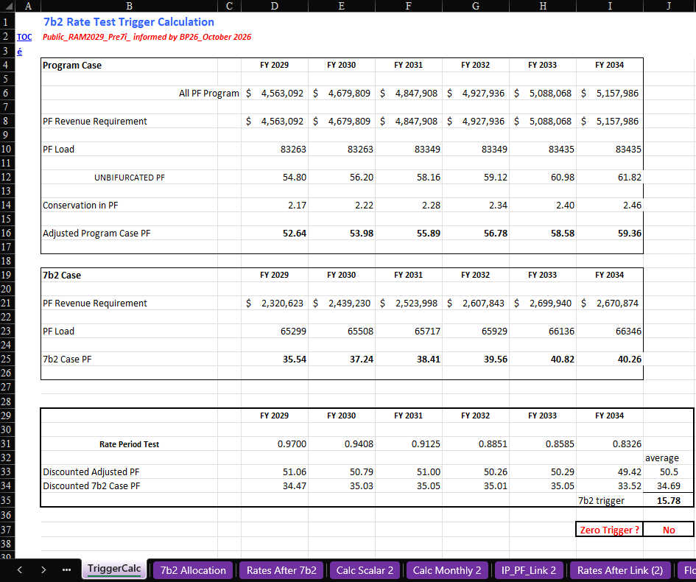
RAM Connection: Base Case

Slide 57
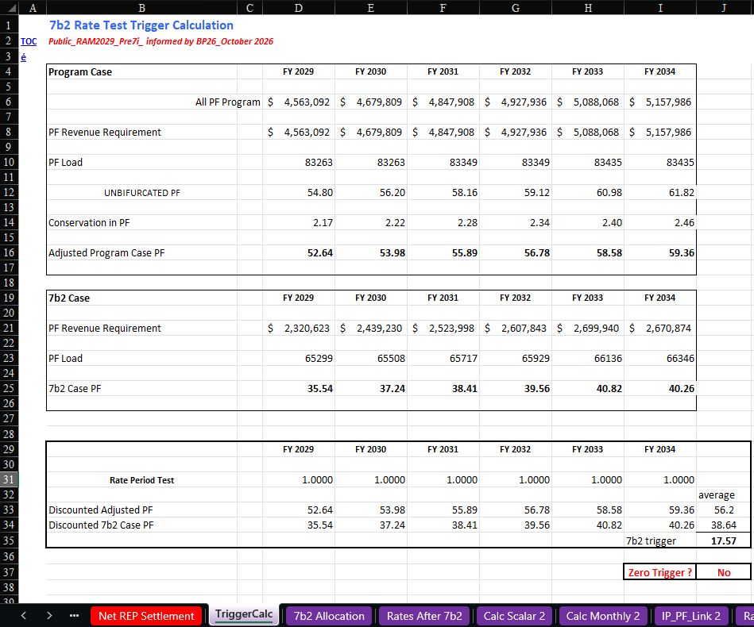
RAM Connection: Scenario 2 (Remove Discounting)
Scenario 2 assumes no discounting occurs.

Slide 58
Step 4 - Section 7(b)(2) Rate Test
Section 7(b)(3) Surcharge applied to “all other power sold”
REP Team

Slide 59
Section 7(b)(2) Rate Protection → 7(b)(3) Surcharge
Section 7(b)(3) requires that any amounts “not charged” to COUs because of the 7(b)(2) rate, must be recovered through supplemental rate charges for all other power sold by the Administrator.
Rates impacted by this provision:
  PF Exchange rate
  NR rate
  IP rate (DSI rate)
  FPS/Surplus cost pool*
*Historically, COUs opposed allocation to FPS/Surplus rates. The 1985 LI/IM and 2008 LI/IM both allocated to FPS/Surplus cost pool.

Slide 60
7(b)(2) LI & IM Process
Rates Analysis Model
(RAM)
Stephanie Adams
Rates and 7(b)(2) Lead

Slide 61











How the 7(b)(2) Rate Test Works within the Rates Analysis Model (RAM)
What the Rate Test Does
Key Terms
The 7(b)(2) Rate Test is a cost/benefit comparison. It compares the Program Case rate with a hypothetical 7(b)(2) Case rate.
The test limits how much REP cost can be recovered by public customers (PFp rate)
Unbifurcated Rate
Initial rate with costs shared by PF public & exchange loads
Program Case
Actual Rates under the NWPA, excluding certain 7(g) costs
7(b)(2) Case
Hypothetical rate with certain NWPA provisions removed
Trigger
Occurs if Program Case exceeds the 7(b)(2) Case
Rate Protection
The delta from the trigger is multiplied by PF public load.
Resource Stack
A hypothetical set of resources to serve 7(b)(2) Case loads
1. Start with COSA
2. Build Program Case
3. Build 7(b)(2) Case
4. Add Resource Stack
5. Trigger Calculation
6. Protection
Cost of Service analysis allocates cost to rate pools. This creates the starting “unbifurcated PF rate” shared by PF public and exchange loads.
Start with unbifurcated PF rate, remove specific Section 7(g) Costs i.e., Conservation costs, experimental resource costs, “uncontrollable events”
Use Program Case rate then make adjustments set forth by Section 7(b)(2) in the Northwest Power Act.
After the FBS is exhausted, if loads remain, other public resources are called in least cost order. Cost added to the 7(b)(2) Case. Conservation resources impact costs & loads.
Each rate for the test period
is discounted back to year one and averaged for comparison.
If the test Triggers, rate protection is allocated to all other rate pools while the PF public rate is credited
Rate Protection =
Trigger $/MWh x
PF Public Loads GWh
Program Case $56.20
7(b)(2) Case $38.64
Discount
  No REP purchases & Sales
  DSIs served by their local utility
  No power reserve/ financing benefits
  FBS resources serve loads first
Program Case $50.50
7(b)(2) Case $34.69
Unbifurcated PF Rate
$55.50/MWh
FY29-30
Program Case Rate
$56.20/MWh
FY29-34
7(b)(2) Case Rate
$38.64/MWh
FY29-34
Program Case > 7(b)(2) Case $15.78/MWh Trigger
$15.78 x 65,202 = $1,029 million
7. Final Rates
Rate Pool Rate Period Rates (FY29-30) | Before Rate Test ($/MWh) | After Rate Test ($/MWh) | $/MWh ∆
PF Public (PFp) | $55.50 | $39.72 | -15.78
PF Exchange (PFx) | $55.50 | $84.95 | +29.45
Industrial / DSIs (IP) | $52.67 | $66.84 | +14.17
New Resource / NLSL (NR) | $125.87 | $155.32 | +29.44
8. Calculate Final REP Benefits
Rate protection determined by 7(b)(2) is allocated to all other
rates as a
7(b)(3) surcharge
Final REP benefits are determined by comparing an active IOU’s ASC to the final PF Exchange rate (PFx) after the 7(b)(3) surcharge.
REP Benefit Formula
(ASC - PFx) x Residential & Farm Loads
Pre Rate Test (active IOUs)
(91.85 – 55.50) x 18,061 = $657,984
Post Rate Test / REP Benefits
(91.85 – 84.95) x 18,061 = $126,146
Values reflect the Base Case scenario in RAM2029_REP.

