Slide 1
End-Use Load Forecasting Workshop
June 15, 2017

Slide 2
Time | Mins | Agenda Item
9:00 – 9:10 | 10 mins | Introductions and Agenda Review
9:10 – 9:20 | 10 mins | Program Background and Overview
9:20 – 9:50 | 30 mins | End-Use Forecasting At BPA Overview
9:50 – 10:00 | 10 min | Wellness Break
10:00-11:00 | 60 min | End-Use Forecasting Framework
11:00 – 11:10 | 10 mins | Wellness Break
11:10 – 11:25 | 15 min | End-Use Data Sources being Considered
11:25 – 11:40 | 15 mins | Scope of Work
11:40 – 11:50 | 10 min | What’s Next
11:50 – 12:00 | 10 mins | Q&A

Slide 3
Background
BPA began doing its Resource Program after the Act was passed in 1980
The purpose of the RP is to assess BPA’s need for power and reserves and then develop a resource strategy for meeting those needs
BPA did the RP until 1992 after which it relied on its 1995 business plan
In 2008, after BPA signed 20 year contracts, it restarted the RP process
Over the past couple of years, BPA has been reviewing its methods for planning and has identified some areas of change which will be discussed today
The proposed changes should enhance many of its long-term planning activities through augmented information and analysis

Slide 4
Project Scope
  The Resource Program Enhancement Project includes the following efforts:
    Change to end use based load forecasting
      Selected the ITRON Statistically Adjusted End-Use (SAE) Approach
    Conducting a BPA conservation potential assessment and distributed energy resources potential assessment
    Reviewing the Needs Assessment
    Determining the economic evaluation methodology and tool for resource optimization

Slide 5
Resource Program Planning Process
Needs Assessment Metrics*
* Indicates a new process

Slide 6
End Use Forecasting Project Status
Currently working on scoping with vendor. Software project completion scheduled for February 2018.
Currently reviewing and moving ahead with hiring activity and starting internal processes. Expect completion end of calendar year 2018.
Reviewing detailed data from available surveys to get market specifics as close to customer level as possible.
Started internal training.

Slide 7
End Use Forecasting at BPA

Slide 8
BPA Load Forecast – Current State
Load Forecasting and Analysis (KSL) is responsible for producing agency load forecasts and associated analysis.
  Providing over 1000 energy/peak forecasts (annually)
  Providing a single set of forecasts that are the backbone for consistent transmission and power infrastructure planning and rate cases.
  Forecasts lack transparency to effectively communicate energy efficiency (EE) impacts included in the forecasts. Models use historical meter reads (already including EE impacts) as an input.

Slide 9
End Use Load Forecast – Future State
Goal:
An update to the load forecasting process and systems to allow BPA to be transparent and identify the amount of EE and other DSM activities that are in the load forecast
This would then allow BPA to determine how much additional EE could be used to meet the BPA needs identified in the Needs Assessment
This process update is consistent with an Action Plan item for the 7th Power Plan

Slide 10
Why Statistically Adjusted End-Use
SAE provides the end-use framework for thinking about how electricity is used.
It integrates with BPAs existing forecasting suite providing efficiency and maintains flexibility.
Leverages current modeling process integrating end-use long-term structural change processes with econometrics.
Reduces training time for staff on tool.
It allows statistics to help compensate for missing or imperfect data.
Retains flexibility to use an econometric or SAE option with the BPA tool suite.

Slide 11
SAE Primer – Modeling Concepts
Weather
Economy
Appliance efficiencies
EE &DSM programs
Current concepts modeled
Appliance Market Shares
Demographics
Utility use
Federal
Legislation
Building Stock

Slide 12
SAE modeling additions
Provides means to incorporate many end uses explicitly into process (greater transparency)
Uses regional data when utility specific data isn’t available while calibrating to each utility
Uses indices of end-uses as independent model driver
Allows us to expand for future technologies and other impacts on electric consumption
Easily scalable allowing for full integration into process from transmission POD level to total customer level.

Slide 13
SAE End-Use Method at BPA
Because BPA does not deal with class level data, there are some slight nuances to the standard SAE method being applied.
  All classes must be included in the modeling process. We cannot model a single class only.
  We calibrate to total customer energy, no individual class level calibration.
  Slight differences in process.
  Slight differences in data views.
Fundamental concepts and overall methods gives same results.

Slide 14
BPA SAE Forecasting Method
Residential Cooling Equipment Stock
Saturation & Efficiency
Thermal Efficiency
Square Footage Trends
Usage Trends
Commercial Cooling Equipment Stock
Fuel Share & Intensity
Floor Space Trends
Usage Trends
Residential Heating Equipment Stock
Saturation & Efficiency
Thermal Efficiency
Square Footage Trends
Usage Trends
Commercial Heating Equipment Stock
Fuel Share & Intensity
Floor Space Trends
Usage Trends
Residential Other Equipment Stock
Saturation & Efficiency
Usage Trends
Commercial Other Equipment Stock
Fuel Share & Intensity
Usage Trends
Industrial
Economic Trends
Energy Intensities
Cooling Degree Days
Heating Degree Days
Res XOther +
Com XOther + Ind XOther
Res Cool + Com Cool
Res XHeat +
Com XHeat
Energym=a+ bc x XCoolm + bh x XHeatm + bo x XOtherm +em

Slide 15
End Use Load Forecast Framework

Slide 16
SAE End-Use Framework
The framework involves five fundamental steps to create independent index types
  Combine the end-use detail (sets) for the residential, commercial, industrial sectors into three modeling types as independent variables; Heating, Cooling and other.
  Create monthly representations of indexes.
  Use utility specific drivers to create expected changes into the future.
  Scale the data to each specific utility footprint by class of service.
  Weight monthly indexes by weather
Shown as steps for discussion purposes they are not really unique steps

Slide 17
Creating Independent Variable Sets
For the various end-uses create indexes for heating, cooling, and other equipment.
Calculate annual intensity (EI) indexes by end use, using formula.
      UEC_{baseyear (by)} x Sat _{y}/Sat _{by}
          EFF _{y}/ EFF _{by}
UEC is annual kWh use for appliance (ie. Clothes Dryer 800 kWh).
Percent of homes with appliance in base year 38%.
Efficiency in base year .75
As saturations increase annual intensity increases offset by increases in annual efficiencies.

Slide 18
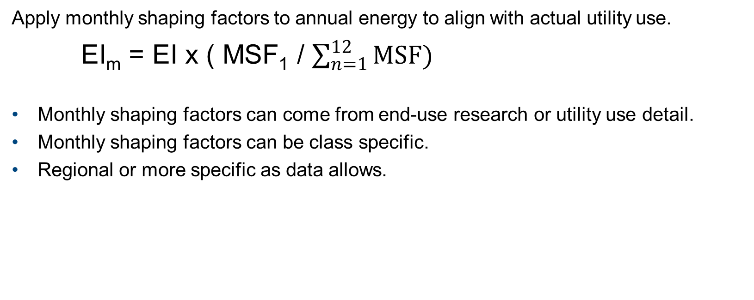
Shape indexes to months
Apply monthly shaping factors to annual energy to align with actual utility use.
EI_{m} = EI x ( MSF₁ / $\sum_{n=1}^{12}{MSF})$
Monthly shaping factors can come from end-use research or utility use detail.
Monthly shaping factors can be class specific.
Regional or more specific as data allows.

Slide 19
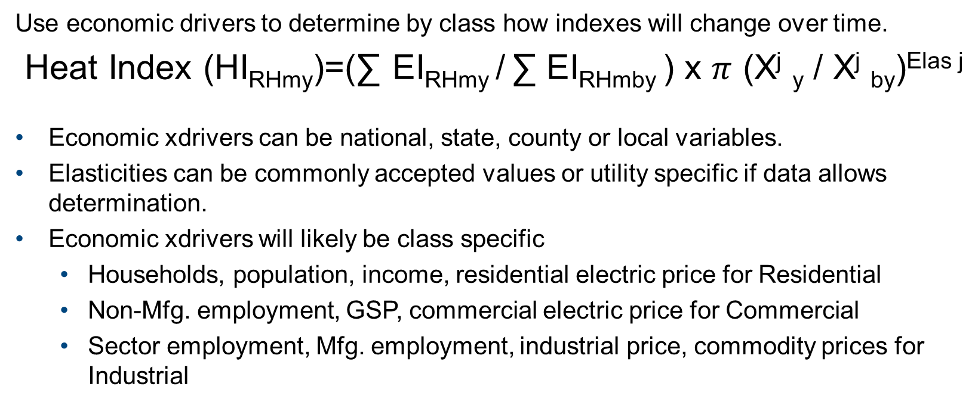
Economics Determine the future
Use economic drivers to determine by class how indexes will change over time.
Heat Index (HI_{RHmy})=(∑ EI_{RHmy} / ∑ EI_{RHmby} ) x $π$ (X^{j} _{y} / X^{j} _{by})^{Elas j}
Economic xdrivers can be national, state, county or local variables.
Elasticities can be commonly accepted values or utility specific if data allows determination.
Economic xdrivers will likely be class specific
  Households, population, income, residential electric price for Residential
  Non-Mfg. employment, GSP, commercial electric price for Commercial
  Sector employment, Mfg. employment, industrial price, commodity prices for Industrial

Slide 20
Weighting Independent Variables by class
Combine the various end-uses types into class weighted indexes.
Create the class weighted independent variables types by.
HI =(ResHeatWgt x HI_{RHmy}) + (ComHeatWgt x HI_{CHmy} ) +
(IndHeatWgt x HI_{IHmy})
Each utilities footprint creates a unique index that aligns with their usage.

Slide 21
Apply Weather Variables to Index
Combine the class weighted type indexes with weather variables to align with historical usage.
Create the class weighted independent variables types by.
Heat Index =(Heat Index x HDD)
Cool Index =(Cool Index x CDD)
Each utilities footprint creates a unique index that aligns with their usage.

Slide 22
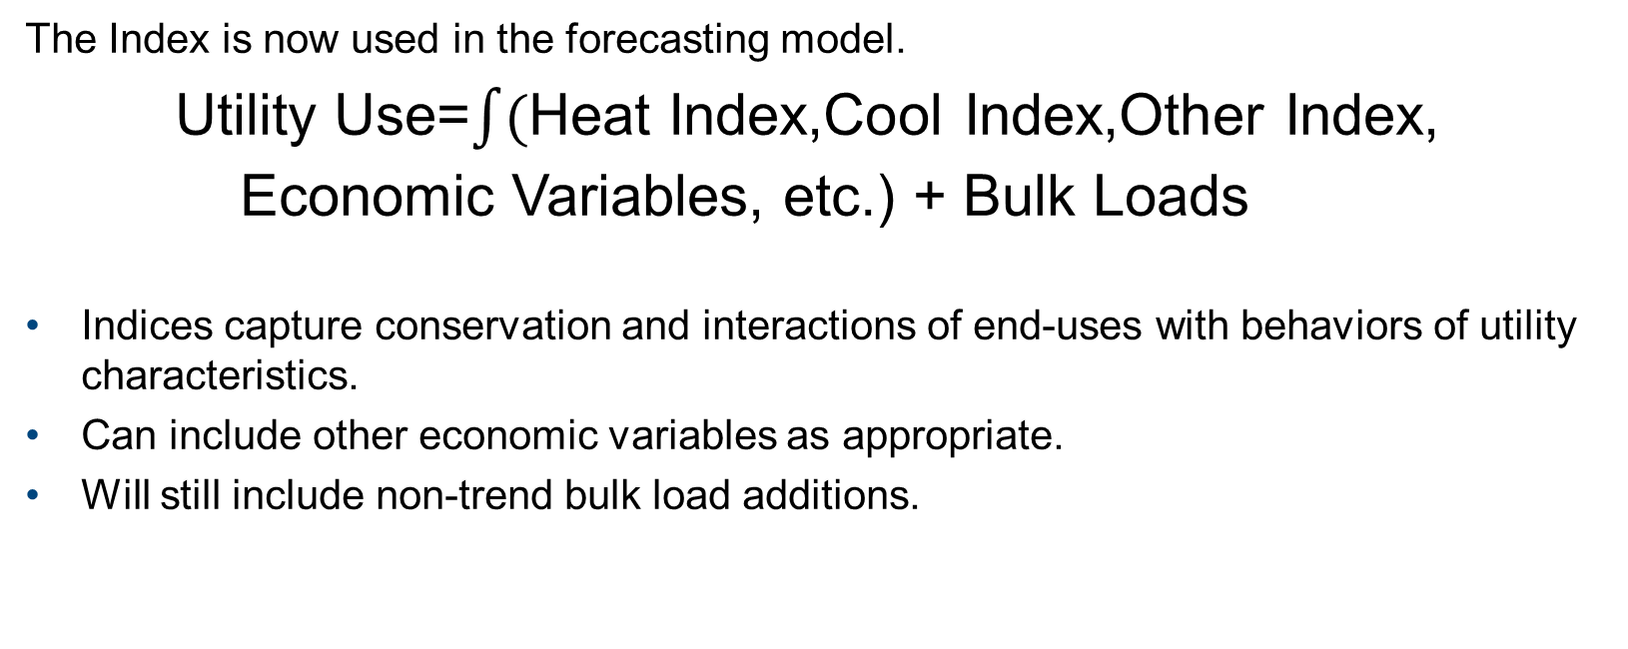
Index used in Econometric Specification
The Index is now used in the forecasting model.
Utility Use=$\int{(}$Heat Index,Cool Index,Other Index, Economic Variables, etc.) + Bulk Loads
Indices capture conservation and interactions of end-uses with behaviors of utility characteristics.
Can include other economic variables as appropriate.
Will still include non-trend bulk load additions.

Slide 23
Benefits of this framework
Better transparency of modeling assumptions
Detail on EE & DSM assumptions & explicitly how they drive model results
Retains ability to independently collaborate on assumptions with each utility
Retains scalability ease
Sets up framework to easily incorporate distributed generation in the future

Slide 24
Data Sources Being Considered

Slide 25
Saturations
What is needed; Historical and future values by end-use (Years 2000-2035)
Best choice is utility specific data.
  Using RBSA phone survey for Residential
  Where available will use utility data
Next option
  Regional survey data with utility judgement applied
Additional option
  Northwest Power & Conservation Council model results

Slide 26
End-Use Efficiencies
What is needed; Historical and future values by end-use (Years 2000-2035)
Best choice is utility specific data.
  Northwest Power & Conservation Council model results
  ITRON Data Developed from DOE NEMS Model for the Region
Next option
  Regional survey data with utility judgement applied
Additional option
  Where available will use utility data

Slide 27
Unit Energy Consumption (UEC)
What is needed; Base year consumption by end-use (annual kWh)
Best choice is utility specific data.
  Northwest Power & Conservation Council model results
  ITRON Data Developed from DOE NEMS Model for the Region
Next option
  Regional survey data with utility judgement applied
Additional option
  Where available will use utility data

Slide 28
Utility Scalers, HDD, and CDD Data
What is needed; Base year Scalers and Normal HDD & CDD Data
Best choice is utility specific data.
  Scalers- Utility Data for 2014, EIA Data or Utility records
  HDD & CDD Data- Existing BPA Values
Next option
  Scalers- Similar Utility EID data
Additional option
  Scalers- Northwest Power & Conservation Council model results

Slide 29
Monthly Shaping Factors
What is needed; Base Year values
Best choice is utility specific data.
  Northwest Power & Conservation Council model results
  ITRON Data Developed from DOE NEMS Model for the Region
Next option
  Regional survey data with utility judgement applied
Additional option
  Where available will use utility data

Slide 30
Economic Drivers
What is needed; Historical and future values by end-use (Years 2000-2035)
Best choice
  IHS Markit metropolitan economic data.
  IHS Markit county level economic data.
  IHS Markit state sector level economic data.
Next option
  ITRON Data Developed from DOE NEMS Model for the state with utility judgement applied.
  Where available Utility data.
Additional option
  Northwest Power & Conservation Council state level model data.

Slide 31
End Use Load Forecast Scope of Work

Slide 32
Scope Adjustment
Scope of implementing end-use forecasting is being set to meet this criteria
We need to have the entire Resource Program completed for IPR in 2018 and delivery date was established as June 2018. This is several months earlier than previously expected.
Delivery of the software will be later than expected resulting in a need to do much of this work manually.
Hiring will take longer than originally scheduled.
Scope- Use SAE end-use forecasting technique to provide forecasts without conservation for customers who account for 60% of cumulative conservation achieved. Ratio this method to the remaining customers by strata to provide forecasts without conservation for others.

Slide 33
Scope Specifics
Between 12-20 customers will be forecast using SAE by the end of September this year. With the completion of the software and hiring we will expand the list in the coming year.
Create strata of customers based on historical conservation reported and ratio SAE approach to remaining strata, looking for commonalities between strata.
We are open to other thoughts on how to do remaining strata.

Slide 34
What’s next

Slide 35
Original Timeline

Slide 36
Current Timeline
 | Jan-17 | Feb-17 | Mar-17 | Apr-17 | May-17 | Jun-17 | Jul-17 | Aug-17 | Sep-17 | Oct-17 | Nov-17 | Dec-17 | Jan-18 | Feb-18 | Mar-18
Gather IT project requirements
Executive approval
IT project structure set up
Arrange for work with Itron
Contracting Process
Gather end-use data by class of service
Gather customer sales by service class
Training forecasting staff on end use method
Work with customers on end-use forecast
Review forecasts
Distribute forecasts for use within Agency

Slide 37
Remaining Steps
June: continue data gathering for targeted utilities.
June-July: begin discussion with targeted utilities on SAE inputs.
Mid-late July: research approaches to apply SAE to other customers.
July-August: complete and review SAE results with targeted utilities.
Mid-late August: complete and review non-SAE forecasts without conservation.
September: Review overall results.
Late September: Deliver forecasts without conservation to Needs Assessment for use.

Slide 38
SAE Targeted Utility Engagement
Participate in discussions on SAE inputs (efficiencies, saturations, economic drivers).
  Compare against utility specific data where available.
  Research differences.
Review forecast results.
  Understand drivers and impacts.
  Review for thoroughness.

Slide 39
Questions

