Slide 1
EIM-S Informational Meeting
11.17.2022

Slide 2
Agenda
Opening Remarks
EIM-S Schedule
Tag values: Base and ATF
Outages and Settlements Impact
Closing remarks
Notes:
The agenda is as follows.

Slide 3
Opening Remarks

Slide 4
EIM-S Schedule

Slide 5
EIM-S Schedule
BPA and PCI published EIM Detailed Data Files (DDFs) and EIM Services Bills for September earlier this week
Additional time is needed between invoices to receive PCI software upgrades
More schedule information planned for next customer informational meeting

Slide 6
Tag values:
Base and ATF Refresh

Slide 7
Base vs. ATF – Persistent Deviation
Base
This is the snapshot at T-57 (57 minutes before the Trade hour)
ATF = After the Fact
This is the final value of the tag
Includes any adjustments made after T-57
Persistent Deviation compares Imbalance against ATF values
Previously PD was based solely on After the Fact values
Imbalance = Metered minus Base (T-57 snapshot)*
For each tier, comparing
Imbalance against ATF tag value*Percentage Threshold
AND Imbalance against MW threshold
*This is new

Slide 8
Outages and Settlements Impact

Slide 9
Outages and Settlement Impacts
What is an electrically disconnected event?
California Independent System Operator considers a generating resource to be unavailable or electrically disconnected from the Transmission network
Electrically disconnected events can happen for multiple reasons:
Transmission Outage
Generation Outage
Modeling Issue (settlements impact similar to Transmission Outage)
Telemetry Issue (settlements impact similar to Transmission Outage)
Notes:
Telemetry – tell CAISO incorrectly re: breaker is open

Slide 10
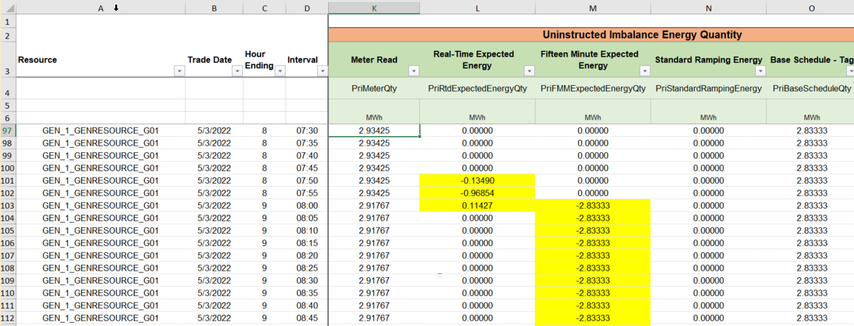
Transmission Outage
If there is a Transmission Outage, the CAISO will negate the Base Schedule in the market run by setting the Fifteen Minute Market schedule/award to zero – this creates a Fifteen Minute Expected Energy value of equal and opposite to the Base Schedule
Telemetry and modeling issues will appear in the detailed data files in a similar manner as Transmission outages
Notes:
Ramping will occur when the base schedule value changes from hour to hour.
Ramping is not unique to electrically disconnected events, but ramping will show up at the beginning of the electrically disconnected event, even if the base schedule has not been changed.
Ramping occurs in the ten minutes before the next hour starts, so in this example, the two negative values in RT Expected Energy are CAISO forcing ramping towards a base schedule of zero; the third value (positive) is the adjustment to the RT Expected Energy after the FMM value has been modified by CAISO.

Slide 11
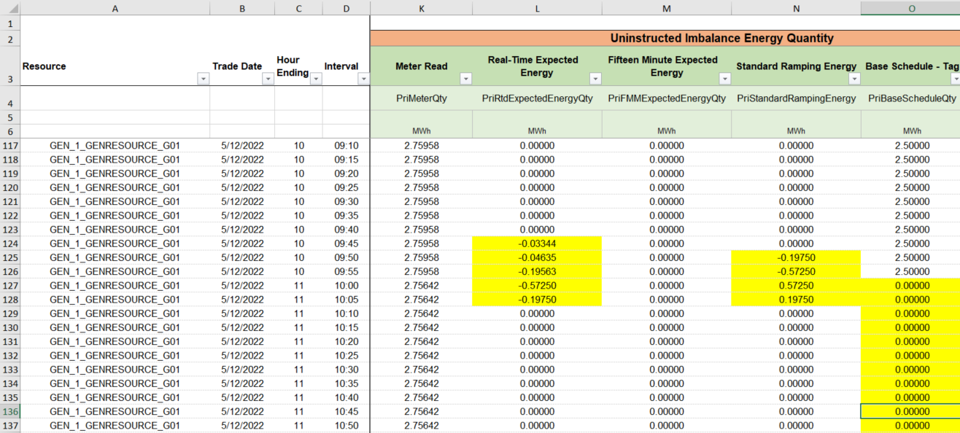
Generation Outage
If there is a generation outage, BPA software will set the base schedule to zero and CAISO will ramp the values as applicable.

Slide 12
BPA Correction of Tx/Gen Outages
Electrically disconnected events affect the following charge codes for Generating Resources: 64750, 64600, 64700
If the electrically disconnected event is deemed due to factors beyond the customer’s control, BPA may modify the sub-allocated charges/credits
For Transmission outages, BPA will zero out the affected Real-Time and Fifteen Minute Market Expected Energy values where applicable.
For Generation outages, BPA will substitute the appropriate Base Schedule value in for the zeroes and zero out the affected Real-Time Expected Energy and Standard Ramping Energy values where applicable.

Slide 13
Questions?
or
Proposals for future agenda items?

Slide 14
BPA Contacts for EIM
Topic / Question Area | Email and Phone | Email (cc)
EIM Services Bill (EESC) | EESCSettlements@bpa.gov or 503-230-EIM1 | gridmod@bpa.gov and Power or Transmission Account Executive
Customer Billing
Metering | mdm@bpa.gov
Customer Portal | customerportal@bpa.gov
BPA Outage Office | Planned outages: bpaoutage@bpa.gov Unplanned: Contact BPA’s Generation Dispatcher
After-hours Outage | Contact BPA’s Generation Dispatcher | N/A

Slide 15
Closing Remarks

