Slide 1
RHWM Process Workshop
BP-22 Rate Period – Draft Final Outputs
August 4, 2020
WebEx: https://bpa.webex.com/bpa/j.php?MTID=m2874782735fecd09b30ef10c4afd9ee2
Meeting Number: 199 280 9647
Meeting Password: 2FQvpr8YuQ3

Slide 2
RHWM Process Workshop Agenda
Topic | Presenter
Introductions and Purpose of the Workshop | Kathryn Patton
Load Forecast Update | Reed Davis
Tier 1 System Firm Critical Output (T1SFCO):
Hydro Study Results and Related RHWM Questions | Peggy Racht
T1SFCO Study Results | Steve Bellcoff
RHWM Augmentation | Kathryn Patton
Other Topics | All
Next Steps | Kathryn Patton

Slide 3
Load Forecast Update for
BP-22 RHWM Process

Slide 4
Load Forecast Updates
Six customers have submitted comments for updates to their load forecasts.
  All six submittals met the update guidelines and have been accepted.
  All six load forecasts will be updated as requested.
  Aggregate results are an increase of ~11 aMW in 2022 and a decrease of ~2 aMW in 2023.

Slide 5
Guidelines for Load Forecast
Principles Guiding changes
  Communicate with us as soon as possible so your forecaster can review your additional information.
  This year we are a bit more flexible due to uncertainties around COVID-19.
    More likely to accept reasonable changes with identifiable COVID-19 links.
    Amounts of change are likely vary based on local economies.
    Amounts of change will likely vary up the maximum reduction we have seen identified worldwide.
    Only impacts customers with a non-zero AHWM .
  Continue to want to avoid subjective bias in results
    Make changes with a clearly identifiable cause and effect.
  Temporarily suspending some of the change criteria, those tied to modeling statistics and prior model performance.
  Incorporate highly probable information on new load and project additions.
    Include new loads/projects that have higher than 70% probability of occurring.

Slide 6
Load Forecast Next Steps
Customers provide notice of additional changes - ASAP, please.
  Submit forecast change request (including cause and amount) on BPA’s public comment page: https://publiccomments.bpa.gov/OpenCommentListing.aspx

Slide 7
Hydro and T1SFCO
Study Results

Slide 8
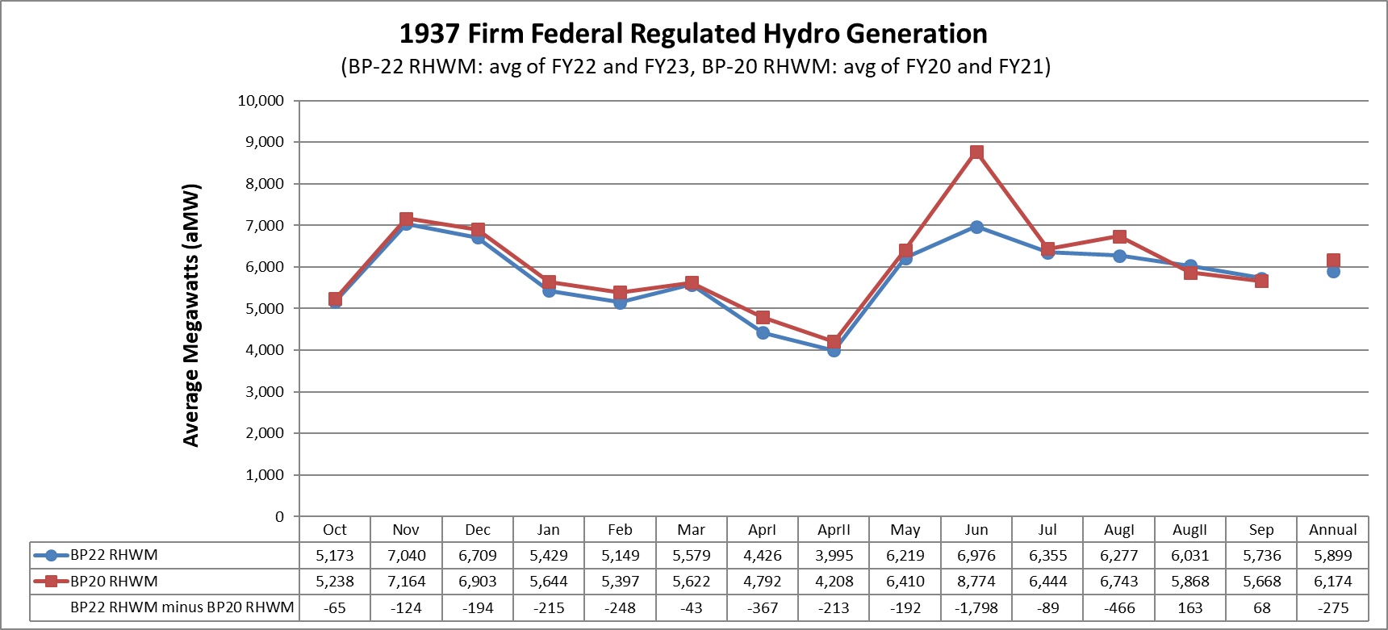
Firm Hydro Comparison to BP-20 RHWM
The -275 aMW decrease in annual 1937 generation compared to BP20 RHWM is attributable to a change from Block Spill Pattern to 125% flex ( -160 aMW); the net CRSO EIS Preferred Alternative measures Implemented in FY22 & FY23 ( -110 aMW); and typical updates including water supply forecast and PNCA data updates ( -5 aMW)
  ( -275 aMW = -160 aMW - 110 aMW - 5 aMW )

Slide 9
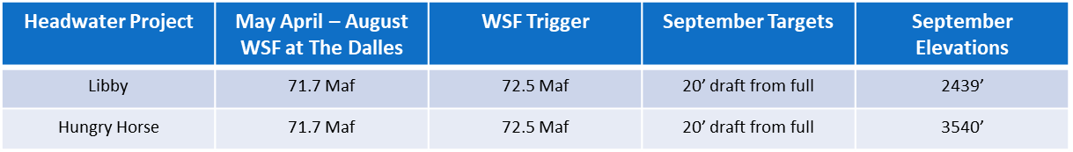
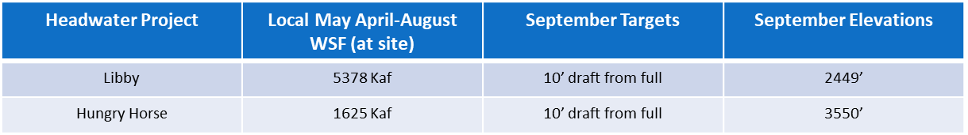
Examining the FCRPS drop of 110 aMW
Most FCRPS changes cause the T1SFCO to change about 2 aMW, up or down
Summer Sliding Scale at Libby and Hungry Horse causes about 100 aMW drop in T1SFCO
Libby and Hungry Horse 1937 drafts in BP-20 RHWM
Libby and Hungry Horse 1937 drafts in BP-22 RHWM

Slide 10
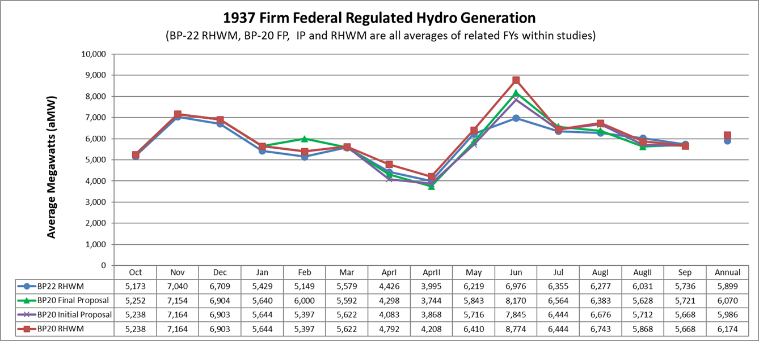
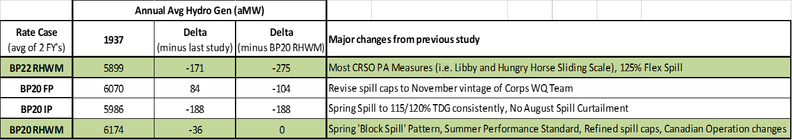
Firm Hydro Comparison to Recent Rate Case

Slide 11
Historical T1SFCO Crosswalk
Rate Case (Avg of two FYs) | Spring Spill Operational Basis | Summer Spill Operational Basis | 1937 Fed Hydro (aMW) | Sequential Delta | Approx Fish Ops Change (aMW) | 80 Yr Avg Fed Hydro (aMW) | Sequential Delta | Approx Fish Ops Change (aMW)
BP16 RHWM^{1/} | 2014 BiOp | 2014 BiOp | 6302 | --- | --- | 8459 | --- | ---
BP16 Final Proposal^{2/} | 2014 BiOp | 2014 BiOp | 6302 | 0 | 0 | 8410 | - 49 | 0
BP18 RHWM^{3/} | 2014 BiOp | 2014 BiOp | 6201 | - 102 | - 40 | 8425 | 15 | -10
BP18 Final Proposal^{4/} | 2014 BiOp | 2014 BiOp | 6210 | 9 | 0 | 8481 | 56 | 0
BP20 RHWM^{5/} | Block Spill Design | Performance Standard | 6174 | - 36 | - 110 | 8343 | - 138 | - 110
BP20 Initial Proposal^{6/} | Spill to 120% TDG | Performance Standard | 5986 | - 188 | - 190 | 8166 | - 177 | - 170
BP20 Final Proposal^{7/} | Revise spill caps | Revise spill caps | 6070 | 84 | 80 | 8278 | 112 | 110
BP22 RHWM^{8/} | 125% Flex Spill | Performance Standard | 5899 | - 171 | - 50 | 8172 | - 106 | - 100
Footnotes can be found in the Appendix, slide 25.

Slide 12
Federal Tier 1 System Firm Critical Output Summary

Slide 13
HLH/LLH Modeling Change
BPA identified an issue in the HOSS modeling process, due to the lack of a Light Load Hours purchase limit, as a result the model was over shaping energy into Heavy Load Hours
  What was found
    Model outputs included in the May workshop materials did not include a LLH market limit,
    As a result, the model unrealistically pushed more hydro generation into Heavy Load Hours.
  What was done
    Implemented a market depth limit of 1,000 aMW on Light Load Hours
  What does this change?
    Annual Average Energy = Zero change
    Monthly Average Energy = Zero change
    Heavy Load Hour Energy = 175 annual aMW reduction
    Light Load Hour Energy = 175 annual aMW increase
    Table represents Monthly reduction in HLH energy, increase in LLH energy in each month is equal
    Change has no effect on the annual RHWM, but it does effect monthly/diurnal RT1SC values.
HLH aMW | Oct | Nov | Dec | Jan | Feb | Mar | Apr 1 | Apr 16 | May | Jun | Jul | Aug 1 | Aug 16 | Sep | Annual
FY2022 | -60 | -162 | -535 | -524 | -452 | -241 | -30 | -54 | 0 | 0 | -42 | -54 | -37 | -18 | -175
FY2023 | -28 | -140 | -492 | -548 | -463 | -218 | -20 | -53 | -2 | -2 | -107 | -60 | -45 | -50 | -175

Slide 14
RHWM Augmentation

Slide 15
Extension of Tribal Augmentation
BPA received comments from NRU, PPC, and WPAG that BPA should follow the procedures outlined in Section 13 and 14 of the Tiered Rate Methodology (TRM) to implement such a change.
BPA concurs with this assessment on process and appreciates that the commenters did not express concern about the substance of the proposal.
Making formal changes through the voting procedures of the TRM is a process hurdle that the Region has undertaken only once. Recognizing that this process is time-intensive, BPA is not proposing a formal change be evaluated during the current RHWM process.
In the event that a written request is submitted to BPA, we remain open to proposing an extension of the expiration date for the load growth exception for New Tribal Utilities in section 4.1.6.4 of the TRM and exploring alternative approaches, consistent with the current TRM to best meet the needs of Tribal Utilities during the term of the Regional Dialogue Contracts.

Slide 16
Next Steps
Public comment period August 5 – August 19, 2020. Please submit comments (including load forecast change requests) on BPA’s public comment page: https://publiccomments.bpa.gov/OpenCommentListing.aspx
RHWM draft final outputs are posted on the RHWM website: https://www.bpa.gov/Finance/RateCases/RHWM/Pages/Current%20RHWM%20Process.aspx
Deadline for written preservation of right to dispute is August 7, 2020.
Republish RHWM process outputs (if any changes made due to public comments) by September 8, 2020.
Publish final RHWM process outputs by September 30, 2020.

Slide 17
Questions?

Slide 18
Appendix

Slide 19
BP-22 RHWM Timeline
Action | FY 20 Timing
Public Workshop – Present preliminary RHWM process outputs | May 19 (Tuesday)
Public comment period | May 20 (Wednesday) – June 3 (Wednesday)
Second Public Workshop (if necessary) | June 23 (Tuesday)
Calculate draft final RHWM outputs | July
FORMAL PROCESS BEGINS
Public Workshop – Present draft final RWHM outputs | August 4 (Tuesday)
Draft final RHWM outputs published | August 5 (Wednesday)
Public comment period | August 5 (Wednesday) – August 19 (Wednesday)
Deadline for written preservation of right to dispute | August 7 (Friday)
Republish RHWM Outputs (if changes made due to public comments) | September 8 (Tuesday)
Deadline for dispute notice | September 18 (Friday)
Publish final RWHM process outputs | September 30 (Wednesday)

Slide 20
Hydro Study Typical Updates
Pacific Northwest Coordination Agreement (PNCA) Project Data
Update based on 2019 PNCA data, with latest Coulee pumping data from 2020 PNCA submittal
Canadian Operations
Update based on the 2022 Assured Operating Plan (AOP22) completed under the Columbia River Treaty. AOP22 provides the same Canadian Operation for FY20 – FY24.
Project Outages
Update based on the latest long term maintenance and capital program forecasts from PGAF. This will use the same methodology as the last rate case.
Reserves
Update FCRPS reserve assumptions consistent with Generation Inputs forecasts.
Loads
Update based on latest forecasts produced by KSL and aggregated by PGPR in LORA.

Slide 21
Updates from CRSO EIS Preferred Alternative
Water Supply Forecast
Include the Corps’ Water Supply Forecast, uses consistent forecasting methodology
Project Operations
Update Flood Risk Management inputs based on new Water Supply Forecast
Minimum Operating Pool at John Day raised April-May to disrupt salmonid predators
Implement sliding scale summer draft at Libby and Hungry Horse
Allow Dworshak to draft slightly deeper for hydropower (winter/early-spring)
Set lower Grand Coulee September and October targets to maintain power flexibility
Updates affecting Hydro availabilities obtained from PGAF
Contingency reserves can include unused turbine capacity (Lower Snake, Lower Columbia projects)
Allow turbine operation within and above 1% of peak efficiency
Allow each Lower Snake project to carry up to 5% reserves during fish passage season
Updates Affecting H/K values of plant data input
Installation of “fish-friendly” turbines at IHR (slightly increases H/K)

Slide 22
Spill Updated with 2020 125% Flex Spill
Spring Spill Season
Begins - Lower Snake Projects: April 3, Lower Columbia Projects: April 10
125% Flex Spill: LWG, LGS, LMN, IHR, MCN, BON (with 150 kcfs max spill) - applies 125% TDG spill caps (16 hrs), Performance Standard Spill (8 hrs)
120% Flex Spill: JDA - applies 120% TDG spill caps (16 hrs), Performance Standard Spill (8 hrs)
TDA – 40% Performance Standard Spill (24 hrs)
Summer Spill Season
Begins – Lower Snake Projects: June 21, Lower Columbia Projects: June 16
Performance Standard Spill at all eight projects
Ends – August 14, and transitions into reduced spill amounts through August 31

Slide 23
Examining the FCRPS drop of 110 aMW
Most FCRPS changes cause the T1SFCO to change about 2 aMW, up or down
  Fish friendly turbines at Ice Harbor
  Deeper draft and changing flexibility at Dworshak
  Relaxing Minimum Operating Pool on four Lower Snake projects
  Adjusting Minimum Operating Pool at John Day
Summer Sliding Scale at Libby and Hungry Horse causes about 100 aMW drop in T1SFCO

Slide 24
Sliding Scale Changes Summer Draft Targets
Libby and Hungry Horse continue to be drafted deeper in the summer during dry years, providing more water for downstream uses
Sliding Scale changes September draft targets
  Previous September draft targets based on the system-wide volume water forecasts at The Dalles
  Current Sliding Scale draft targets based on
    Linear interpolation between draft points
    Volume water forecast triggers based on 30 year record of NOAA April-August water volumes from 1981 - 2010
    The May forecast of the local volume water forecasts (local water supply forecasts can be quite different than the system-wide forecasts)
  These refinements cause substantially less summer drafts at both Libby and Hungry Horse during dry years (like 1937)

Slide 25
Footnotes on T1SFCO Crosswalk

Slide 26
T1SFCO Difference Between BP-22 RHWM Process and BP-20 Final RHWM

Slide 27
T1SFCO Change Over Time

Slide 28
Federal System Hydro Generation
Used in T1SFCO Calculation

Slide 29
Federal System Hydro Generation
Used in T1SFCO Calculation (cont.)

Slide 30
Designated Non-Federally Owned Resources
Used in T1SFCO Calculation

Slide 31
Designated BPA Contract Purchases
Used in T1SFCO Calculation

Slide 32
Designated BPA System Obligations
Used in T1SFCO Calculation

Slide 33
Designated BPA System Obligations
Used in T1SFCO Calculation (cont.)

