Slide 1
RHWM Process Workshop
BP-22 Rate Period – Preliminary Outputs
May 19, 2020
WebEx: Join Meeting
Meeting Number: 900 313 690
Meeting Password: tpTdJZVk274

Slide 2
RHWM Process Workshop Agenda
Topic | Presenter
Introductions and Purpose of the Workshop | Kathryn Patton
Load Forecast Update | Reed Davis
Tier 1 System Firm Critical Output (T1SFCO):
Hydro Study Results | Peggy Racht
T1SFCO Study Results | Steve Bellcoff
RWHM Augmentation | Kathryn Patton
Other Topics | All
Next Steps | Kathryn Patton

Slide 3
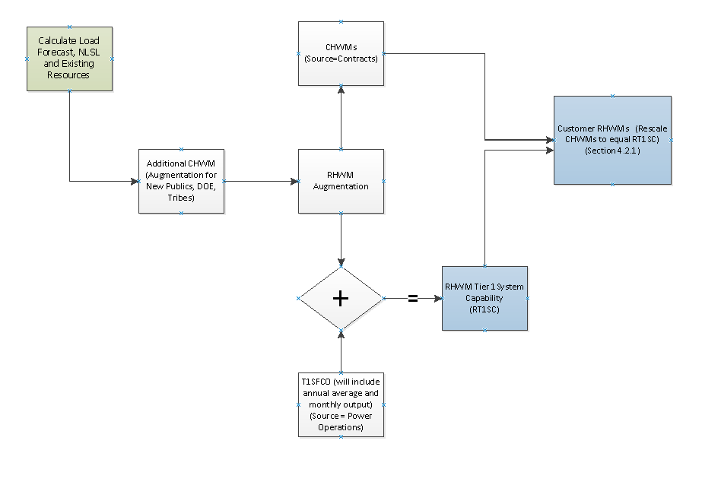
RHWM Process*
*For more details about the Rate Period High Water Mark (RHWM) process and calculations, please refer to section 4.2.1 of the Tiered Rate Methodology (TRM)

Slide 4
Load Forecast Update for
BP-22 RHWM Process

Slide 5
Load Forecast Agenda
Review economic conditions
Review current model performance
New forecast quantities
Changes suggested
  Principles guiding changes
  Changes by subject
Next steps

Slide 6
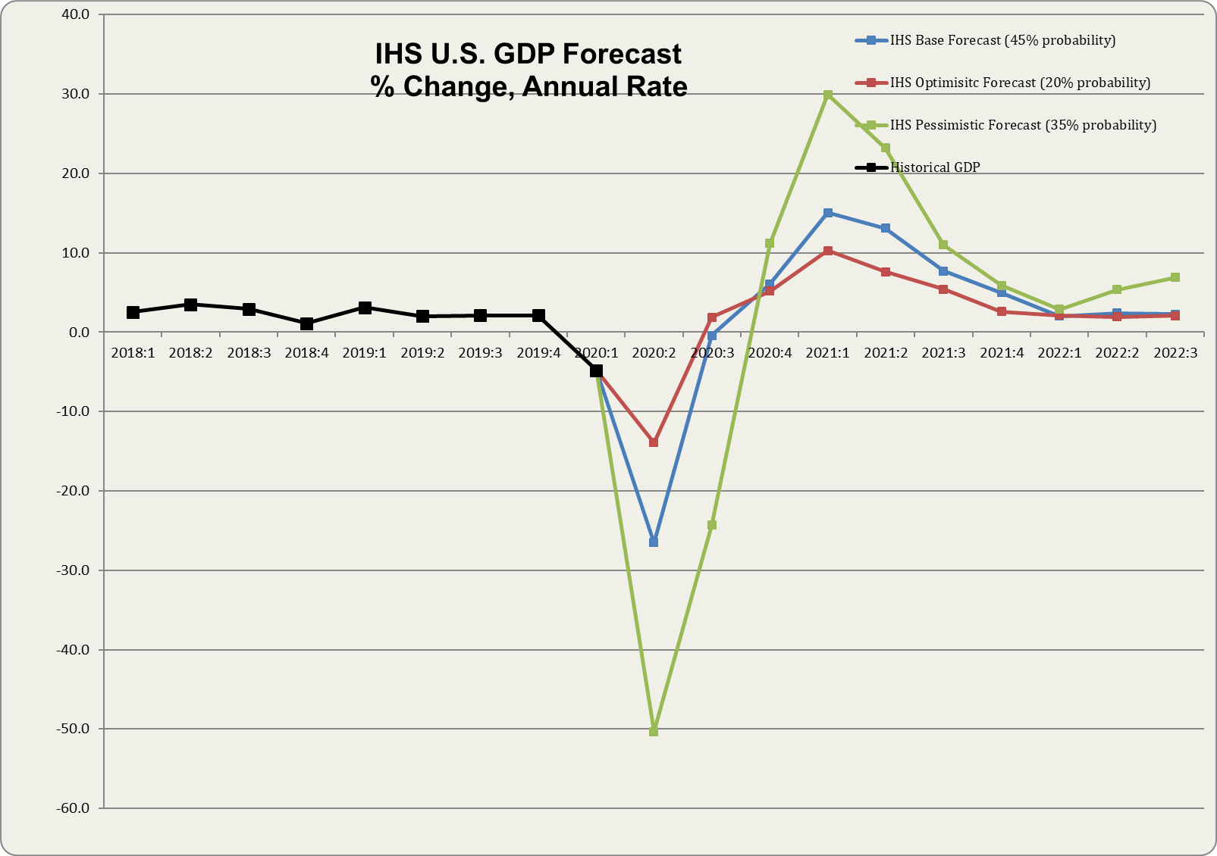
Current Economic Forecast
Negative GDP growth is expected for the nation
Regional unemployment has increased significantly
Load continues to remain flat
World economic concerns continue
Notes:
US GDP – 2020Q1 – -4.8% (Preliminary Estimate), Expected to decline -37% in 2020Q2, CARES Act, though large, will have a small offset to GDP decline.
Unemployment March 2020/Change from March 2019: Idaho – 2.6%/-0.3%, Oregon – 3.3%/-0.8%, Washington – 5.1%/0.6% - Unemployment Rates expected to Increase in April 2020
World Economic Concerns – COVID-19, Global Growth Slowdown, Trade Tariffs, International Sanctions, Volatile Stock Market, Geopolitical Unrest

Slide 7
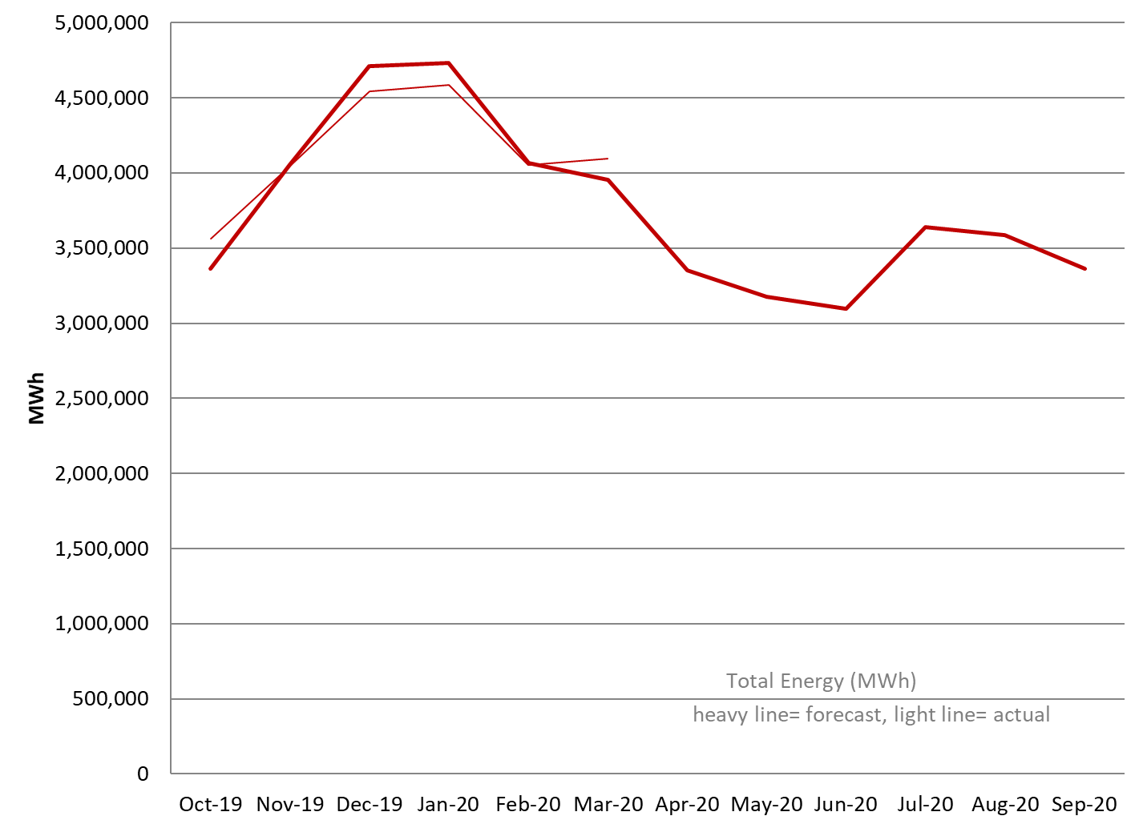
Current Models - Energy
Forecasted energy is performing well
Fiscal Year to date Actuals are nearly equal to Forecast

Slide 8
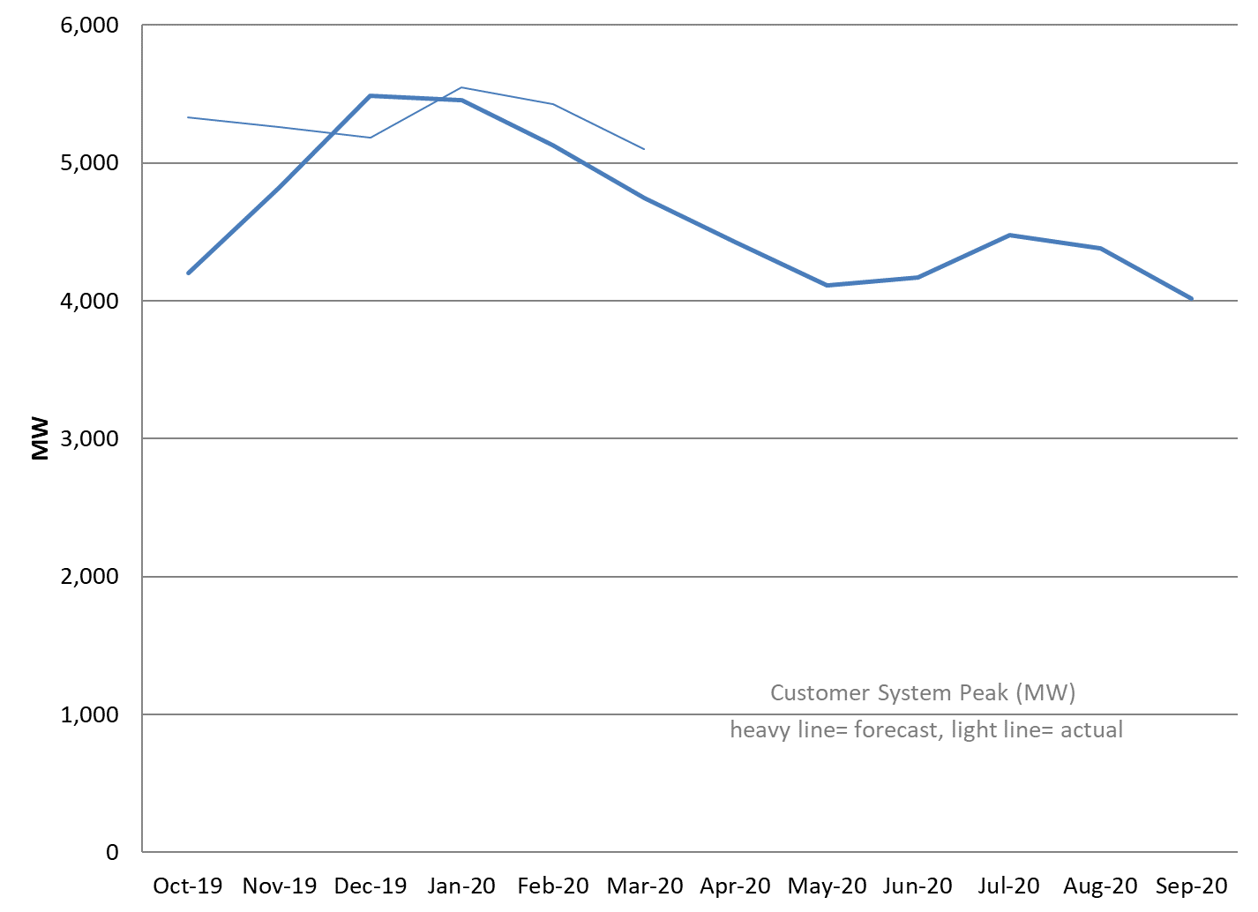
Current Models - Peaks
Demand models are performing well after compensating for the ups and downs of the weather.

Slide 9
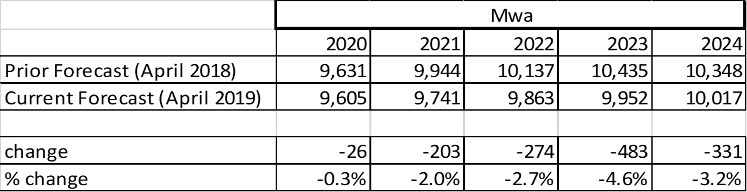
Forecasted Agency Loads
  ~30% of the customers increased forecast over last year levels, ~ 40% reduced forecast, ~ 30% no change
  Average change about 2 aMW per customer
Bulk of changes are the results of anticipated specific large customer adjustments with most of the change coming from a few customers.
Notes:
Forecast for Mills reduced. Forecast for Data Warehouses tempered.

Slide 10
Guidelines for Load Forecast
Principles Guiding changes
  Communicate with us as soon as possible so your forecaster can review your additional information.
  This year we are a bit more flexible due to uncertainties around COVID-19.
    More likely to accept reasonable changes with identifiable COVID-19 links.
    Amounts of change are likely vary based on local economies.
    Amounts of change will likely vary up the maximum reduction we have seen identified worldwide.
    Only impacts customers with a non-zero AHWM .
  Continue to want to avoid subjective bias in results
    Make changes with a clearly identifiable cause and effect.
  Temporarily suspending some of the change criteria, those tied to modeling statistics and prior model performance.
  Incorporate highly probably information on new load additions.
    Include new loads/projects that have higher than 70% probability of occurring.
  Incorporate highly probably information on new load additions.
    Include new loads/projects that have higher than 70% probability of occurring.

Slide 11
Load Forecast Next Steps
Customers provide notice of additional changes - ASAP, please.
  Submit forecast change request (including cause and amount) on BPA.gov comment page.
Forecaster to review and include necessary changes by June 10, 2020
Communicate changes to be incorporated by June 20, 2020
Deliver updated data for continued processing by July 1, 2020

Slide 12
Hydro and T1SFCO
Study Results

Slide 13
Hydro Study Typical Updates
Pacific Northwest Coordination Agreement (PNCA) Project Data
Update based on 2019 PNCA data, with latest Coulee pumping data from upcoming 2020 PNCA submittal
Canadian Operations
Update based on the 2022 Assured Operating Plan (AOP22) completed under the Columbia River Treaty. AOP22 provides the same Canadian Operation for FY20 – FY24.
Project Outages
Update based on the latest long term maintenance and capital program forecasts from PGAF. This will use the same methodology as the last rate case.
Reserves
Update FCRPS reserve assumptions consistent with Generation Inputs forecasts.
Loads
Update based on latest forecasts produced by KSL and aggregated by PGPR in LORA.

Slide 14
Updates from CRSO EIS Preferred Alternative
Water Supply Forecast
Include the Corps’ Water Supply Forecast, uses consistent forecasting methodology
Project Operations
Update URCs based on the new Water Supply Forecast
Adjust MIP and MOP at John Day
Implement sliding scale summer draft at Libby and Hungry Horse
Allow Dworshak to draft slightly deeper for hydropower (winter/ early-spring)
Set lower Grand Coulee September and October targets to maintain power flexibility
Updates affecting Hydro availabilities obtained from PGAF
Contingency reserves can include unused turbine capacity (Lower Snake, Lower Columbia projects)
Allow turbine operation within and above 1% of peak efficiency
Allow each Lower Snake project to carry up to 5% reserves during fish passage season
Updates Affecting H/K values of plant data input
Installation of “fish-friendly” turbines at IHR (slightly increases H/K)

Slide 15
Spill Updated with 2020 125% Flex Spill
Spring Spill Season
Begins - Lower Snake Projects: April 3, Lower Columbia Projects: April 10
125% Flex Spill: LWG, LGS, LMN, IHR, MCN, BON (with 150 kcfs max spill) - applies 125% TDG spill caps (16 hrs), Performance Standard Spill (8 hrs)
120% Flex Spill: JDA - applies 120% TDG spill caps (16 hrs), Performance Standard Spill (8 hrs)
TDA – 40% Performance Standard Spill (24 hrs)
Summer Spill Season
Begins – Lower Snake Projects: June 21, Lower Columbia Projects: June 16
Performance Standard Spill at all eight projects
Ends – August 14, and transitions into reduced spill amounts through August 31

Slide 16
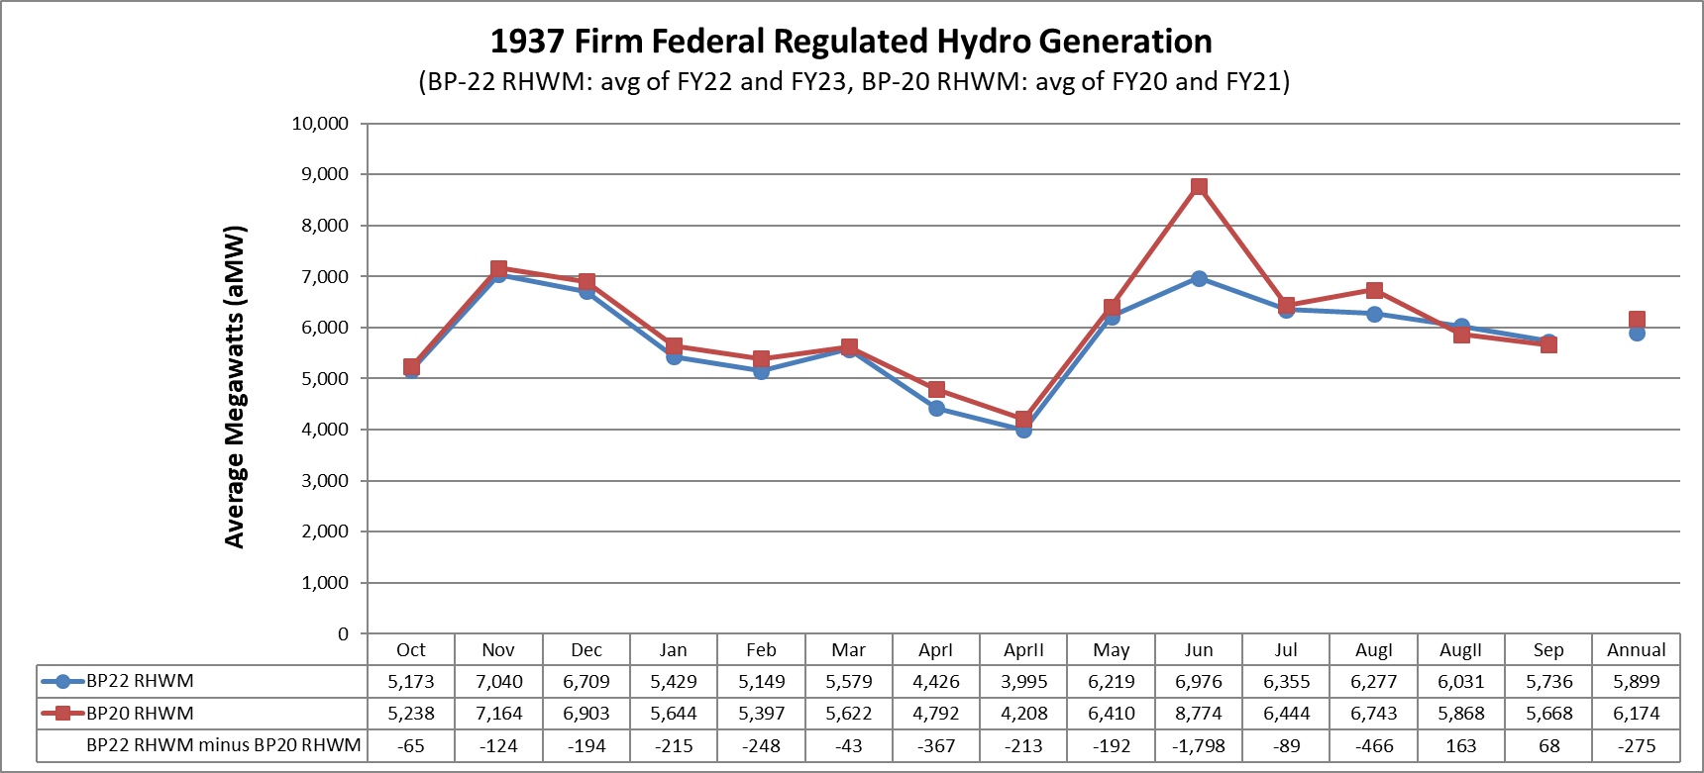
Firm Hydro Comparison to BP-20 RHWM
The -275 aMW decrease in annual 1937 generation compared to BP20 RHWM is attributable to a change from Block Spill Pattern to 125% flex ( -160 aMW), the net CRSO EIS Preferred Alternative measures Implemented in FY22 & FY23 ( -110 aMW), and typical updates including water supply forecast and PNCA data updates ( -5 aMW)
  ( -275 aMW = -160 aMW - 110 aMW - 5 aMW )

Slide 17
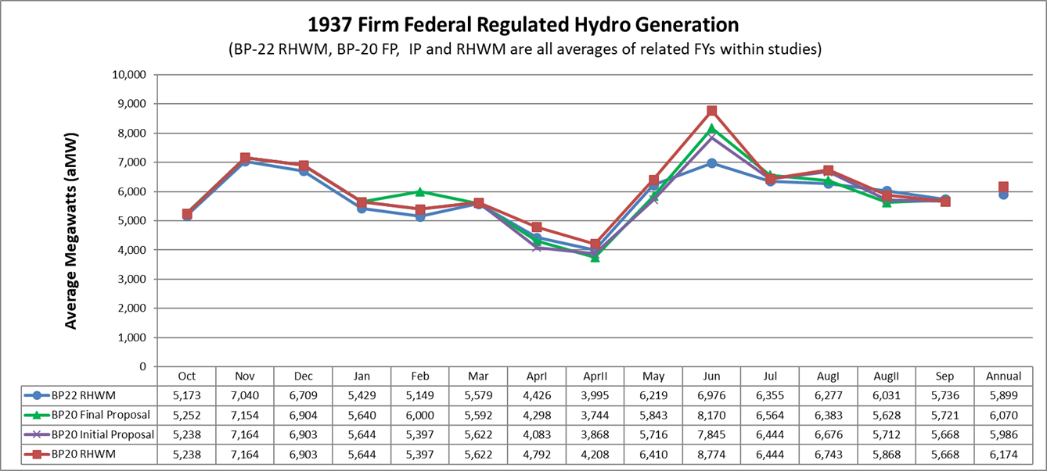
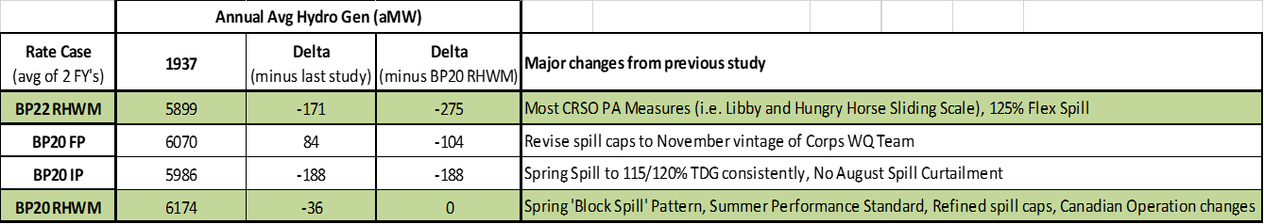
Firm Hydro Comparison to Recent Rate Case

Slide 18
Federal Tier 1 System Firm Critical Output Summary

Slide 19
T1SFCO Difference Between BP-22 RHWM Process and BP-20 Final RHWM

Slide 20
T1SFCO Change Over Time

Slide 21
RHWM Augmentation

Slide 22
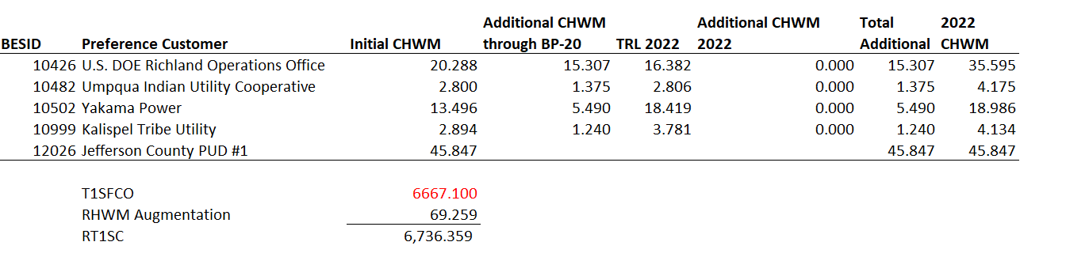
RHWM Augmentation

Slide 23
Extension of Tribal Augmentation
In May of 2017, the Affiliated Tribes of Northwest Indians requested that BPA extend the time period for augmenting CHWMs for New Tribal Utility Load Growth, from 9/30/2021 to 9/30/2028.
BPA has issued a letter to region opening a comment period, to run concurrent with the BP-22 RHWM process, on the proposed extension.
Please submit comments about this extension on BPA’s public comment page: https://publiccomments.bpa.gov/OpenCommentListing.aspx.

Slide 24
Next Steps
Public comment period May 20 – June 3, 2020. Please submit comments (including load forecast change requests) on BPA’s public comment page: https://publiccomments.bpa.gov/OpenCommentListing.aspx
RHWM preliminary outputs are posted on the RHWM website: https://www.bpa.gov/Finance/RateCases/RHWM/Pages/Current%20RHWM%20Process.aspx
June 23, 2020 public workshop tentatively scheduled to address customer concerns raised in the public comment period.
August 4, 2020 public workshop to present draft final RHWM outputs

Slide 25
Questions?

Slide 26
Appendix

Slide 27
BP-22 RHWM Timeline
Action | FY 20 Timing
Public Workshop – Present preliminary RHWM process outputs | May 19 (Tuesday)
Public comment period | May 20 (Wednesday) – June 3 (Wednesday)
Second Public Workshop (if necessary) | June 23 (Tuesday)
Calculate draft final RHWM outputs | July
FORMAL PROCESS BEGINS
Public Workshop – Present draft final RWHM outputs | August 4 (Tuesday)
Draft final RHWM outputs published | August 5 (Wednesday)
Public comment period | August 5 (Wednesday) – August 19 (Wednesday)
Deadline for written preservation of right to dispute | August 7 (Friday)
Republish RHWM Outputs (if changes made due to public comments) | September 8 (Tuesday)
Deadline for dispute notice | September 18 (Friday)
Publish final RWHM process outputs | September 30 (Wednesday)

Slide 28
Federal System Hydro Generation
Used in T1SFCO Calculation

Slide 29
Federal System Hydro Generation
Used in T1SFCO Calculation (cont.)

Slide 30
Designated Non-Federally Owned Resources
Used in T1SFCO Calculation

Slide 31
Designated BPA Contract Purchases
Used in T1SFCO Calculation

Slide 32
Designated BPA System Obligations
Used in T1SFCO Calculation

Slide 33
Designated BPA System Obligations
Used in T1SFCO Calculation (cont.)

