Slide 1
RHWM Process Workshop
BP-26 Rate Period – Preliminary Outputs
June 4, 2024 (Corrected)
WebEx: Join Meeting
Meeting Number: 2827 077 7222
Meeting Password: WPxDgmX*86

Slide 2
RHWM Process Workshop Agenda
Topic | Presenter
Introductions and Purpose of the Workshop | Liz Oberhausen
Load Forecast Update | Max St. Brown
Tier 1 System Firm Critical Output (T1SFCO): | Milli Chennell
Hydro Study Results
T1SFCO Study Results
RHWM Augmentation | Garth Beavon
Next Steps | Liz Oberhausen

Slide 3
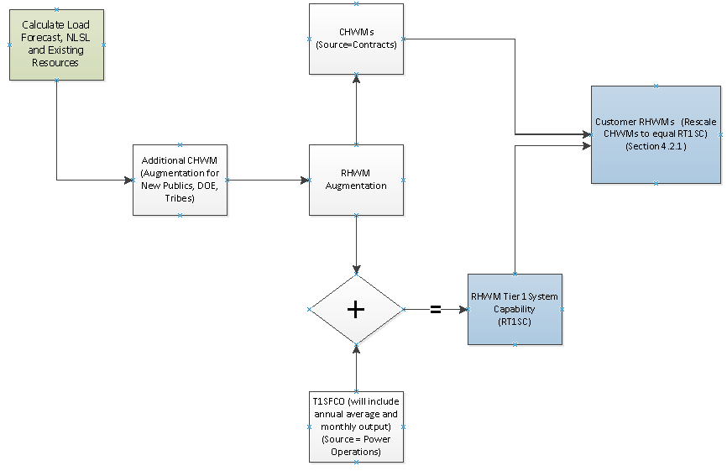
RHWM Process*
*For more details about the Rate Period High Water Mark (RHWM) process and calculations, please refer to section 4.2.1 of the Tiered Rate Methodology (TRM)

Slide 4
Load Forecast Update for
BP-26 RHWM Process

Slide 5
Load Forecast Agenda
Review economic conditions
Review current model performance
Forecasted Agency Loads (Preference)
Guidelines for Load Forecast
Next steps

Slide 6
Current Economic Forecast
Positive GDP growth is expected for the nation
World economic and geopolitical concerns continue

Slide 7
Current Economic Forecast
All Pacific Northwest states are forecasted to grow faster than the U.S.

Slide 8
Current Models - Energy
Forecasted energy is performing well against Fiscal Year to date Actuals

Slide 9
Current Models - Peaks
Demand models are performing well after compensating for weather

Slide 10
Forecasted Agency Loads
  Increase in Preference Forecast between FY2025 & FY2026
  Increase in Preference Forecast between FY2026 & FY2028
  Increase in Tier 2 Load
  Three customers switched products between BP-24 and BP-26
Notes:
Some of the specific large changes include: Data Centers, Mining

Slide 11
Load Forecast Next Steps
Customers provide notice of additional changes - ASAP, please.
Submit forecast change request (including cause and amount) on BPA.gov comment page by June 18, 2024.
Forecaster to review and include necessary changes.

Slide 12
Guidelines for Load Forecast
Guiding Principles for Revising Load Forecasts
  Avoid subjective bias in results
    Make changes with a clearly identifiable cause and effect
    Avoid making changes within the tolerance of model errors, i.e., changes less than 5%
    Rely on models and results put together when consequences are not immediately pending
  Avoid forcing the models to give specific answers
    Rely on statistics of models
    Rely on accuracy of models and improve when results are not within accuracy tolerance levels
    Avoid updating without sufficient new data
  Incorporate highly probably information
    Include new loads/projects that have higher than 70% probability of occurring

Slide 13
Hydro and T1SFCO
Study Results

Slide 14
Hydro Study Typical Updates
Pacific Northwest Coordination Agreement (PNCA) Project Data
Updated based on 2023 Coulee pumping data from 2023 PNCA submittal, no other PNCA data changes since 2022
Canadian Operations
Updated based on the 2024 Assured Operating Plan (AOP24) and Detailed Operating Plan (DOP24) completed under the Columbia River Treaty
AOP24 provides the same Canadian Operation for FYs20 – 24, while DOP24 includes minor updates
An updated AOP will be available at some point, but current timing is unknown. Bonneville expects changes to be minimal and would evaluate impacts to the RHWM process based on timing of the updated AOP and magnitude of change.
Project Outages
Updated based on 2023 vintage long term maintenance and capital program forecasts from the BPA Federal Hydro group. This will use the same methodology as the last rate case
Flood Control
Updated with Corps produced FRM for the 2020 Level Modified Flows Dataset, not reflective of CRT Article IV
Reserves
Updated FCRPS reserve assumptions consistent with Generation Inputs forecasts
Loads
Updated based on the latest forecasts produced by Load Forecasting and aggregated by Long Term Power Planning in LORA-LT

Slide 15
Spill Updated with 12/14 agreement (aka RCBA)
Spring Spill Season
125% TDG spill at six projects
40% of outflow daytime spill and 125% TDG spill nighttime spill at John Day
40% outflow spill at The Dalles 24 hours a day
Little Goose spill transitions from 125% TDG 24 hours a day to 16 hours a day, eight hours 30% outflow after adult criteria is met
Summer Spill Season
Like BP-24 RHWM, except transition to late summer spill shifted to August 1st
Assumptions for surface weir flow slightly adjusted
Fall/Winter Spill Season
Increased to four hours a day for seven days a week September 1st through November 15th and March 1st through March 20th and 24 hours a day from March 21st through the beginning of spring spill

Slide 16
Firm Hydro Comparison to BP-24 RHWM
The 78 aMW decrease in firm generation compared to BP-24 RHWM is attributable to:
Net loss of 49 aMW of generation due to the 12.14 Agreement spill operations
Net loss of approximately 28 aMW due to other modeling changes including:
  Changes to Canadian outflows
  Changes to Brownlee operations
  Updates to FRM
  Differences in the monthly p10 years

Slide 17
Firm Hydro Comparison to Recent Rate Case
 | Annual Avg. Hydro Gen (aMW)
Study Vintage | Firm Hydro | Delta from BP26 RHWM | Major changes from previous study
BP-26 RHWM | 6219 | - | New Spill Operations/DOP/Brownlee Operation/FRM
BP-24 Initial Proposal | 6339 | +120 | Updates to FRM/Flex spill modeling
BP-24 RHWM | 6297 | +78 | First 2020 Level Modified Flows/30-year subset study

Slide 18
Federal Tier 1 System Firm Critical Output Summary

Slide 19
T1SFCO Difference Between BP-26 RHWM Process and BP-24 Final RHWM

Slide 20
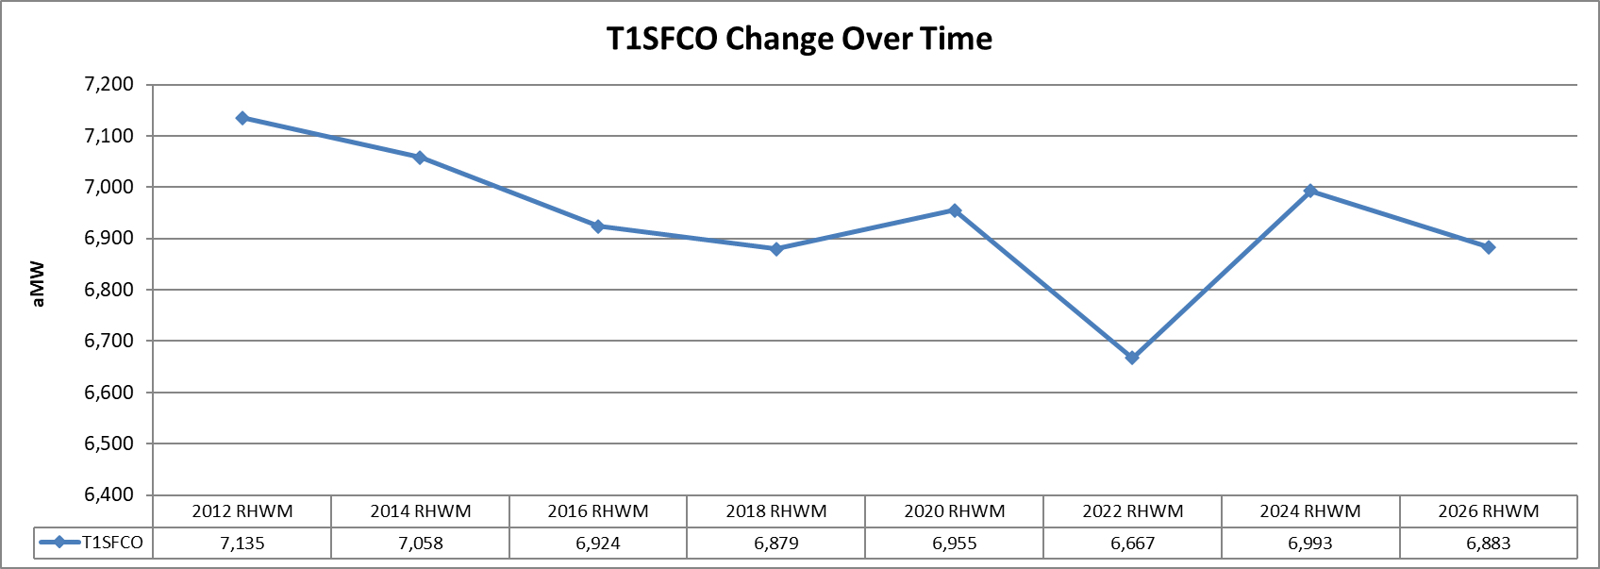
T1SFCO Change Over Time

Slide 21
RHWM Augmentation

Slide 22
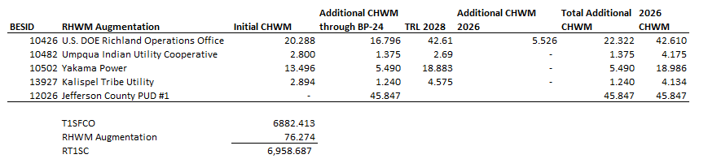
RHWM Augmentation

Slide 23
Next Steps and BP-26
RHWM Timeline

Slide 24
Next Steps
RHWM preliminary outputs will be posted on the RHWM website following today’s meeting:
  https://www.bpa.gov/energy-and-services/rate-and-tariff-proceedings/rate-period-high-water-mark-process
Public comment period June 5th – June 18th, 2024
  Please submit comments (including load forecast change requests) on BPA’s public comment page:
  https://publiccomments.bpa.gov/OpenCommentListing.aspx
July 31st public workshop to present draft final RHWM outputs

Slide 25
BP-26 RHWM Timeline
Action | FY 24 Timing
Public workshop – Present preliminary RHWM process forecast, augmentation and system size | June 4th (Tuesday)
Publish preliminary RHWM process outputs | June 4th (Tuesday)
Public comment period | June 5th – 18th
Calculate draft final RHWM outputs | Late July
FORMAL PROCESS BEGINS
Public workshop – Present draft final forecast, augmentation and system size | July 31st (Wednesday)
Publish draft final RHWM process outputs | July 31st (Wednesday)
Public comment period | August 1st-14th
Deadline for written preservation of right to dispute | August 5th (Monday)
Republish RHWM Outputs (if changes made due to public comments) | August 30th (Friday)
Deadline for dispute notice | September 10th (Tuesday)
Publish final RWHM process outputs | September 30th (Monday)

Slide 26
Questions?

Slide 27
Appendix

Slide 28
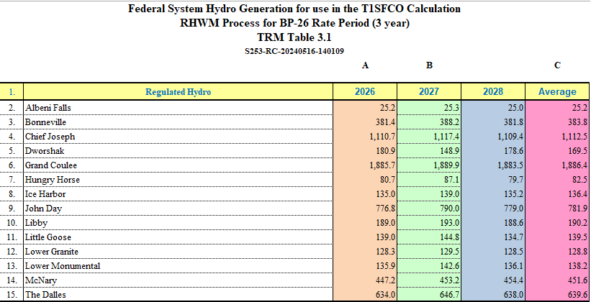
Federal System Hydro Generation
Used in T1SFCO Calculation

Slide 29
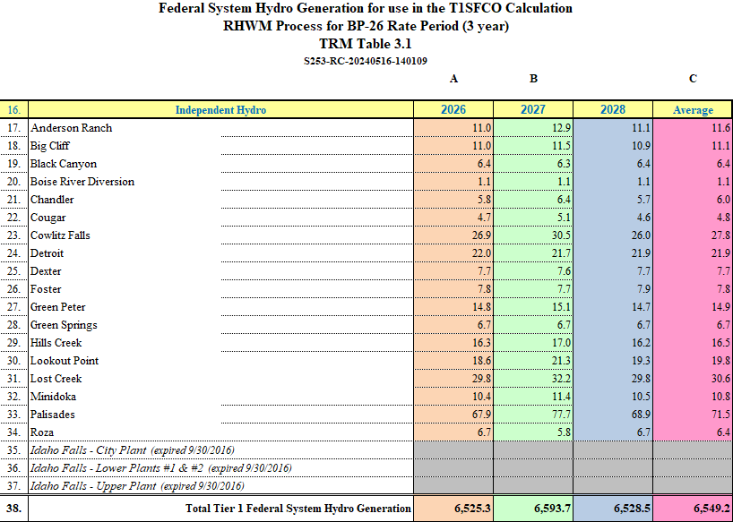
Federal System Hydro Generation
Used in T1SFCO Calculation (cont.)

Slide 30
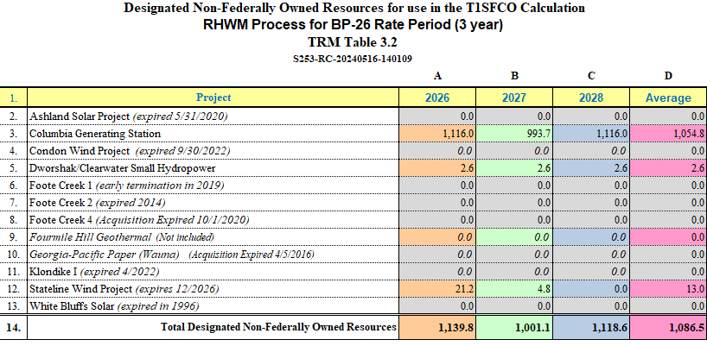
Designated Non-Federally Owned Resources
Used in T1SFCO Calculation

Slide 31
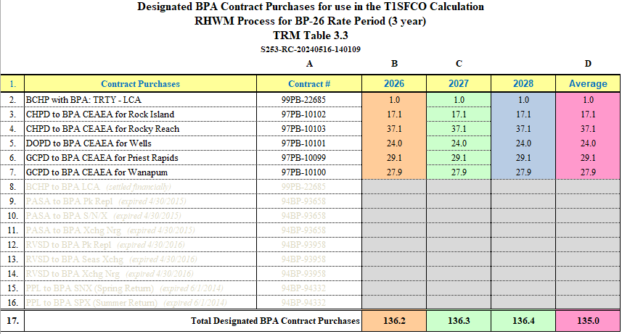
Designated BPA Contract Purchases
Used in T1SFCO Calculation

Slide 32
Designated BPA System Obligations
Used in T1SFCO Calculation - Corrected
NO Changes to original June 4, 2024 Workshop numbers

