Slide 1
FERC Order 676-K OASIS Changes
Status
August 26, 2026
BPA

Slide 2
FERC Final Order 676-K
On 04/25/24, FERC issued final Order 676-K adopting the NAESB v004 standards.
Order 676-K was published in the Federal Register on 02/27/25 with an effective date of 04/28/25.
Compliance dates for implementation are:
  Cybersecurity changes: 02/27/26 (already met)
  Everything else: 08/27/26 (tomorrow!)

Slide 3
OASIS changes from NAESB v004
Topic | Sub | Description and Status
OASIS |  | Some transsell and transstatus template response variables that were previously optional are now mandatory.
OASIS | OS | Add the ability to see additional information for child reservations from a given reservation on OASIS. Changes to the reduction OASIS template. (API 3c). Voted out of the OASIS Subcommittee 06/22/21. Voted out of the Executive Committee on 10/05/21. Ratified by NAESB Membership on 11/04/21.
NITS | OS | Define some new customer query variables for NITS (API 3e). Voted out of the OASIS subcommittee on 03/24/20. Formal Comment period closed 04/24/20 with no industry comments filed. Voted out of the Executive Committee on 10/27/20. Ratified by NAESB Membership on 11/30/20.
Rollover | OS | Change how Rollover Rights work for Redirects to end-of-term. Customer will need to specify on OASIS if Rollover Rights go with the parent or the Redirect. (API 3b.i) Voted out of the OASIS subcommittee on 02/15/22. Voted out of the WEQ Executive Committee on 03/29/22. Ratified by NAESB Membership on 04/28/22.
NITS | OS | Define posting of Rollover Rights for NITS on OASIS (API 3a). Voted out of the OASIS subcommittee on 03/24/20. Formal Comment period closed 04/24/20 with comments from SoC, MISO, SRS. Voted out of the Executive Committee on 10/27/20. Ratified by NAESB Membership on 11/30/20.

Slide 4
OATI Implementation
OATI is turning on the OASIS changes adopted in 676-K for all customers, including BPA, on 08/27/26.
This presentation is a summary of these OASIS changes.
This includes the following:
  All programmatic template queries will now use version 4.0.
  Modification of transsell and transstatus Templates
  OASIS Reduction Details Changes
  NITS Display/Template Changes
  Redirect Rollover Rights Change
  NITS Rollover Rights Changes

Slide 5
Modification of transsell and transstatus Templates for PCM

Slide 6
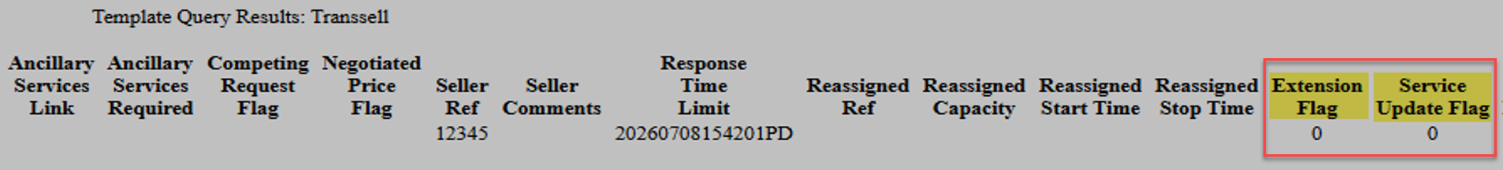
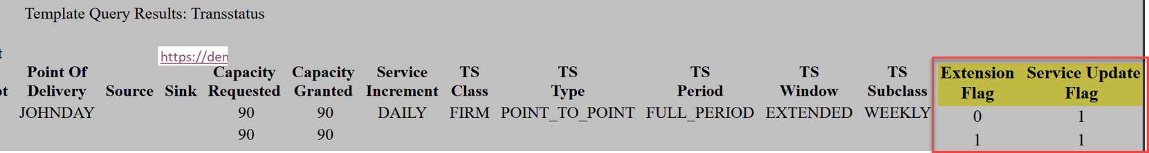
Template Modifications
With PCM, whenever a Reservation is challenged and matches via ROFR:
  The Extension Flag field is incremented.
  The Service Update Flag field is incremented if the Defender’s service has changed (e.g. Daily to Weekly).
Two webSmartOASIS query templates reference these fields:
  Transsell – Used by a Seller to act upon a Request.
  Transstatus – Used by a Customer to view the status of a Request.
These two fields previously were optionally returned. Now they are mandatory.

Slide 7
OASIS Reduction Details

Slide 8
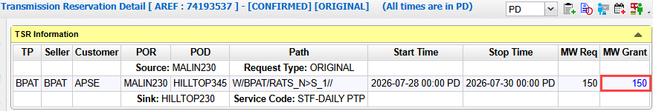
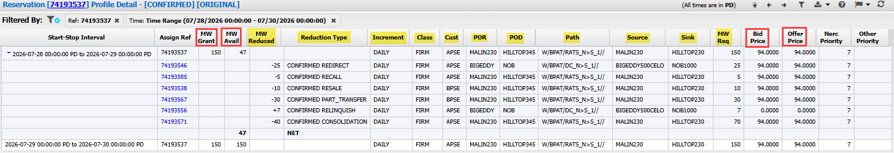
OASIS Reduction Details Display Changes
Reduction Details display has 2 purposes:
  Shows the impact of child TSRs (e.g. Resales, Redirects) on a parent ARef.
  Shows Conditional Firm Priority changes from 7-F to 6-CF.
OASIS screen name: Reservation Profile Detail
Navigation: OASIS > Transmission Reservation Detail > MW Grant hyperlink.
Changes:
  11 new columns added (labels highlighted in yellow below).
  4 existing column labels renamed (marked with red rectangles below).

Slide 9
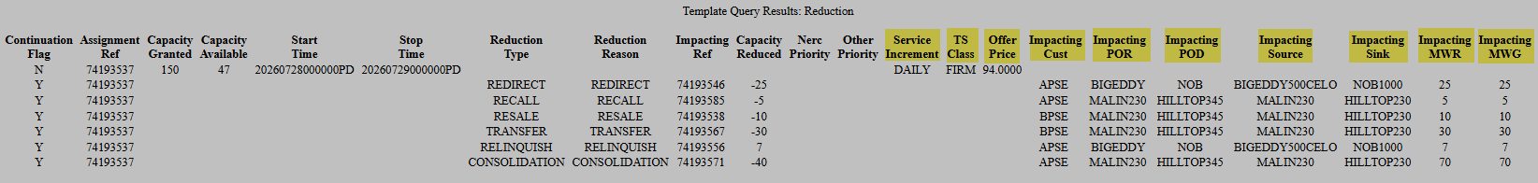
OASIS Reduction Template Changes
Reduction template is used to programmatically query data from OASIS.
Reduction template returns data shown in the Reservation Profile Detail display.
Changes:
  Version = 4.0 (Updated from 3.3)
  10 new output columns. Previously required running the Reduction template and the Transstatus template to get the same data.
Example Reduction template query:
Example output (new columns highlighted in yellow):

Slide 10
NITS Display/Template

Slide 11
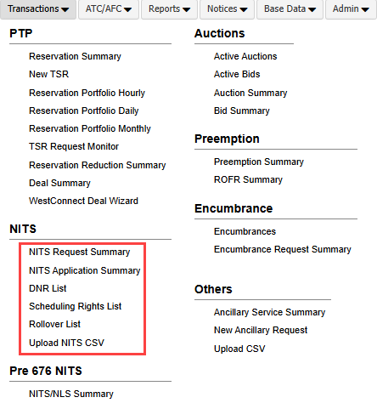
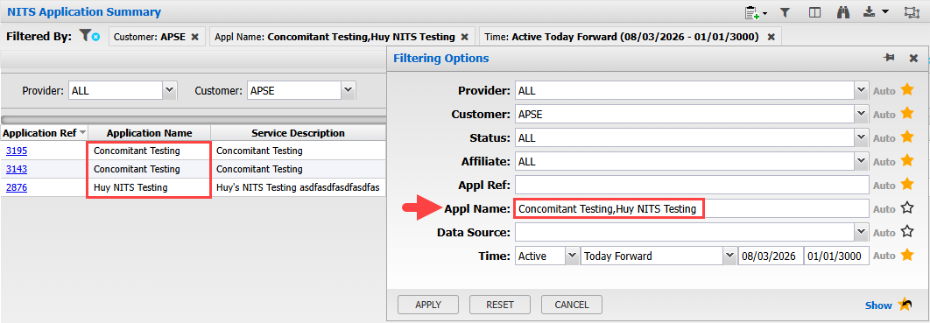
OASIS NITS Display Changes
NITS (Network Integration Transmission Service on OASIS) is a method for requesting and managing NT service.
NITS screens are available from the OASIS Transactions menu. Navigation: OASIS > Transactions > NITS
Changes:
  New “Appl Name” filter added to 3 NITS displays:
    NITS Application Summary
    DNR List
    Scheduling Rights List
Example filter input/result:

Slide 12
OASIS NITS Template Changes
NITS templates are used to programmatically query data from OASIS.
Changes:
  Version = 4.0 (Updated from 3.3).
  Query variables added to 4 templates:
Query Template | New Query Variable(s) | Max Length
QueryNITSRequestDetails | APPLICATION_NAME_LIST RESOURCE_NAME_LIST POR_LIST POD_LIST SOURCE_LIST SINK_LIST | 1000 characters
QueryNITSApplication | APPLICATION_NAME_LIST | 1000 characters
QueryNITSDNR | APPLICATION_NAME_LIST | 1000 characters
QueryNITSSchedulingRights | APPLICATION_NAME_LIST | 1000 characters

Slide 13
Redirect Rollover Rights

Slide 14
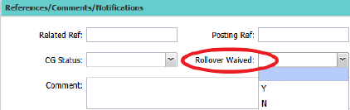
Redirect Rollover Rights Change
Rollover rights are granted to TSRs with a duration of 5 years or more.
Customers exercise their rollover rights within a year of their renewal period.
On the OASIS Transmission Reservation Detail display, a new value of ‘N’ has been added to the ROLLOVER WAIVED field.
This field indicates to the Transmission Provider that the Transmission Customer is requesting conveyance of any potential rollover (renewal) rights that is available in association with the requested service.
Customers who forgot to populate the Rollover Waived field would have their ROVER rights moved to the Redirect, perhaps inadvertently.
Customers are now required to choose where the ROVER should go if they are doing a redirect to end of term from a parent with ROVER rights.
A value of ‘N’ means to convey ROVER rights to the Redirect TSR.
New validation prevents submission with an incorrect rollover waived value based on the parent TSRs rollover rights.

Slide 15
NITS Rollover Rights

Slide 16
Summary
OATI will turn on NITS Rollover Rights functionalities on August 27th in webSmartOASIS.
The process of evaluating, granting, posting Rollover Rights for NT Customers on OASIS does not change.
Currently, Rollover Rights are posted on OASIS using the PTP functionalities on NT Reservations. New functionalities are coming where Rollover Rights are posted for NITS. BPAT will inform customers if/when we implement these new functionalities for NITS.
Here are the fields/displays that Customers will see. However, these fields/displays will not be used by BPAT at this time.

Slide 17
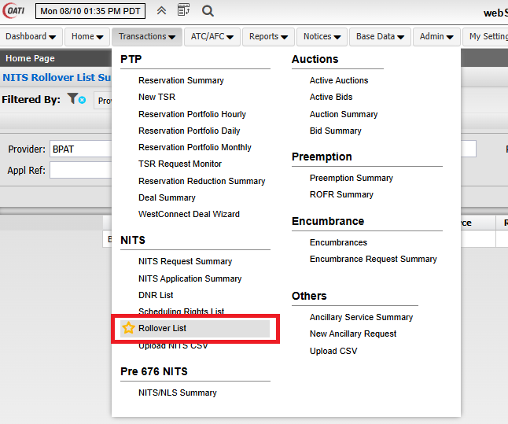
New Display: Rollover List
1) NITS Rollover List Display: OASIS > Transactions > NITS > Rollover List
  This screen will provide a summary of all NITS Rollover Rights granted and remaining.

Slide 18
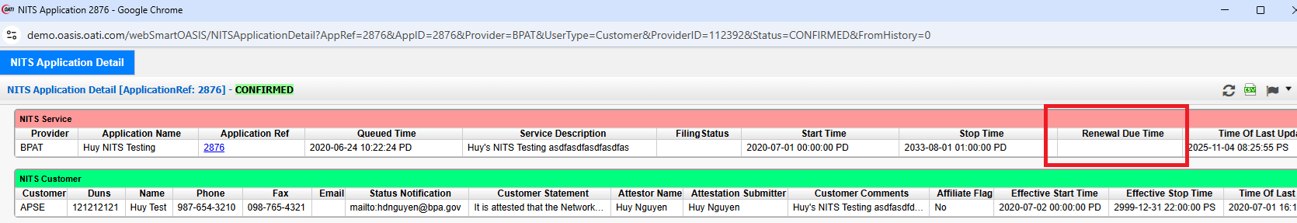
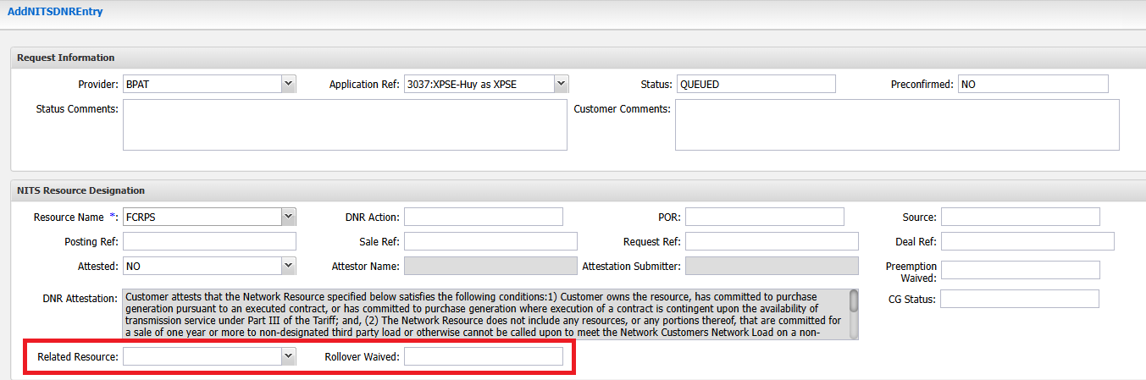
New Fields
2) New Field on NITS Application Detail: Renewal Time Due
3) New Fields on AddNITSDNR Request: Related Resource & Rollover Waived

Slide 19
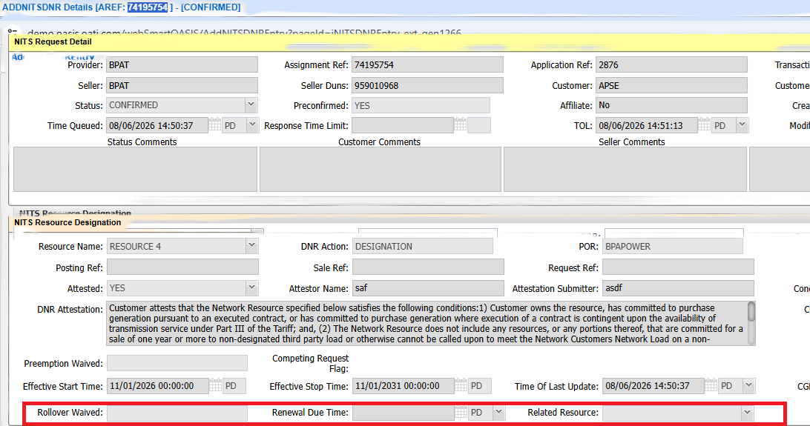
New Fields
4) New Fields on AddNITSDNR Detail: Rollover Waived, Renewal Due Time &
Related Resource

