Slide 1
Preemption ARef Tag Validation
CBPI
October 16, 2024
Mike Anderson

Slide 2
Summary
Preemption Aref tag validation implements NAESB WEQ standard.
WEQ-001-25.4.4.2.3 says: "While a reservation is flagged, the Transmission Provider may deny an RFI that references that reservation until the competition flag is cleared."
Error message on eTag: “AREF is involved in a Preemption”
This means that the AREF is involved in a Preemption as either a Defender or a Dependent.
Note: An e-Tag that uses a Blanket contract in the OASIS field can still be approved against a conditional reservation even if the Competing Request Flag has already been set for that reservation.
This tag validation will be included in the next release of the Scheduling Transmission Service Business Practice.
Scheduled to be turned on in Production on 10/22/2024 at 11:00 am.

Slide 3
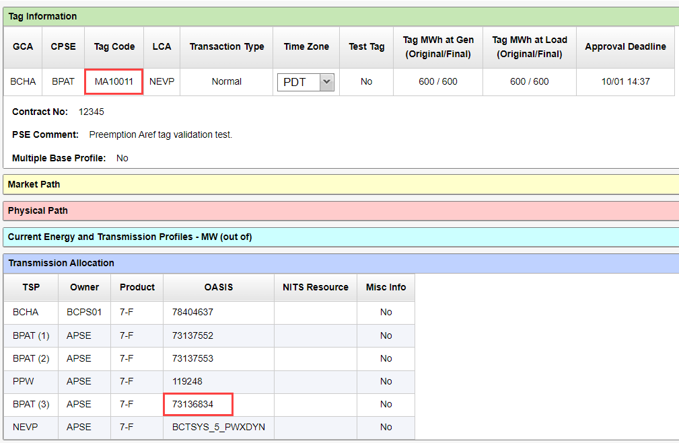
Example (1 of 2)
TSR 73136834 is Defender with Competing Request Flag = 3885.
Tag MA10011 is then created with TSR 73136834 as its OASIS number.

Slide 4
Example (2 of 2)
Tag MA10011 fails the Preemption Aref tag validation for TSR 73136834.
Error message appears in Reason/Comment field of Approval Status History for tag.

