Slide 1
Redispatch and Curtailment
BP v14
CBPI
May 15, 2024
Mike Steigerwald

Slide 2
Objectives
Describe the changes to the Redispatch and Curtailment BP that was posted for customer comment on May 3, 2024.
The change is to curtailments on 1:1 paths.

Slide 3
Key Takeaways
Most of the redlines represent curtailment functionality that has been in place for 15 years. These BP changes are being made for transparency of the process.
The substantive change is to address a concern about how some NITS tags are handled by curtailments on 1:1 paths.
BPA is retaining a reservation-based approach on 1:1 paths rather than adopting a strictly schedules-based procedure.
The actual logic involved in calculating the curtailment has not changed. The change is to an input for certain NITS tags.
The changes are a result of extensive engagement with customers and represent a compromise that addresses the NITS concerns while retaining the reservation-based approach advocated by some PTP customers.

Slide 4
History
04/29/22: BP v14 posted for comment to make transparent how curtailments are handled on 1:1 paths.
  NITS customers raise concerns that they may be disadvantaged.
07/21/22: BP v14 withdrawn. Evaluation of options begins.
01/18/23: BPA proposes adopting a schedules-based approach. Strong customer pushback from some PTP customers.
05/17/23: After much deliberation, BPA proposes retaining the reservation-based approach, but adjust the input for certain NITS tags to recognize the actual NITS “reserved rights” (next slide).
06/22/23: BPA decision is made to adopt the proposal.
10/02/23: Contract change is executed with OATI.
05/07/24: Functionality is deployed to Production. The new curtailment logic is disabled pending BP effective date.

Slide 5
NITS Reserved Rights for Curtailments
The primary input to curtailment logic on 1:1 paths is a customer’s “reserved rights”.
However, the NT reservation is not always an accurate representation of a NITS customer’s “reserved rights”.
The Scheduling Transmission Service BP allows certain NITS tags to be scheduled above the underlying NT reservation (e.g., schedule to their load forecast).
Under the current curtailment procedures on 1:1 paths, these tags could be disproportionately cut.
As part of this BP update, BPA is not revisiting the policy of allowing NITS customers to schedule above the NT reservation.
The BP change is to recognize that the “reserved rights” for NITS is the higher of the NT reservation or the NT schedule.

Slide 6
Example – Current Curtailments on 1:1 Paths
NT Customer 1 has scheduled 25MW more than their underlying reservation. This is allowed.
As a result, NT Customer 1 is curtailed disproportionately.

Slide 7
Example – New Curtailments on 1:1 Paths
The starting Reserved amount for Customer 1 is adjusted to 125MW.
The rest of the logic is unchanged.
The result is that the NT Customer 1 is curtailed proportionally with PTP Customer 1.

Slide 8
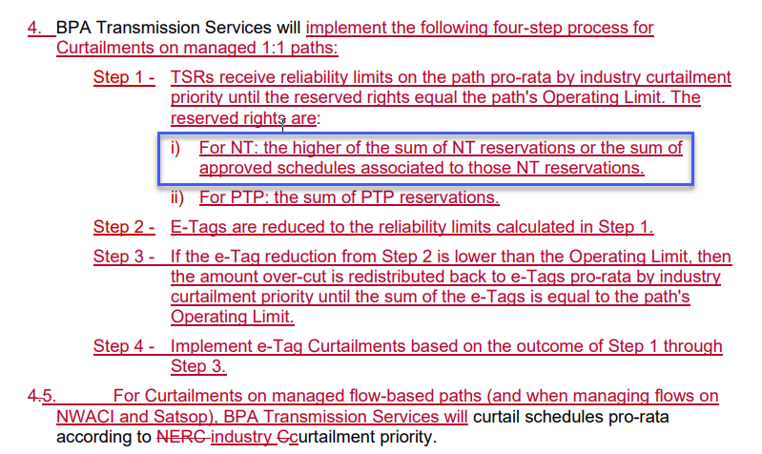
Proposed BP Redlines
Only the part in blue represent a change from what BPA has been doing for 15 years.
The rest of the redlines are to be transparent about the procedure that has been in place for years.

Slide 9
Next Steps
Follow the normal process for BPs.
The customer comment period closes June 11, 2024.
The date for BPA response to comments is July 11, 2024.
If there are no comments, the functionality will be enabled on June 12.
If there are comments, the functionality will be enabled no sooner than July 16.

